Slide 1
BITS Pilani Digital Design
Prof. GSS Chalapathi, Prof. Saurabh Gandhi (EEE department)

Slide 2

Attendance!
Will be opened only during the attendance window.
Enable location on your device.
Grant any location permissions requested by the website.
Refresh the page.
Try submitting again.

Slide 3
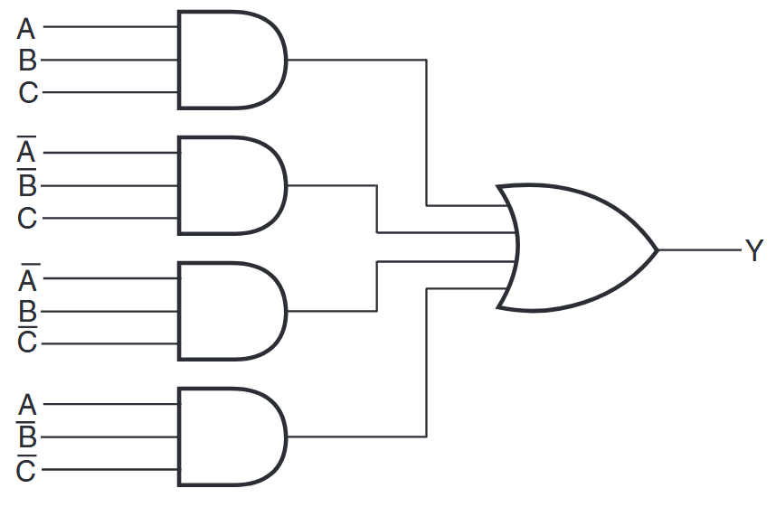
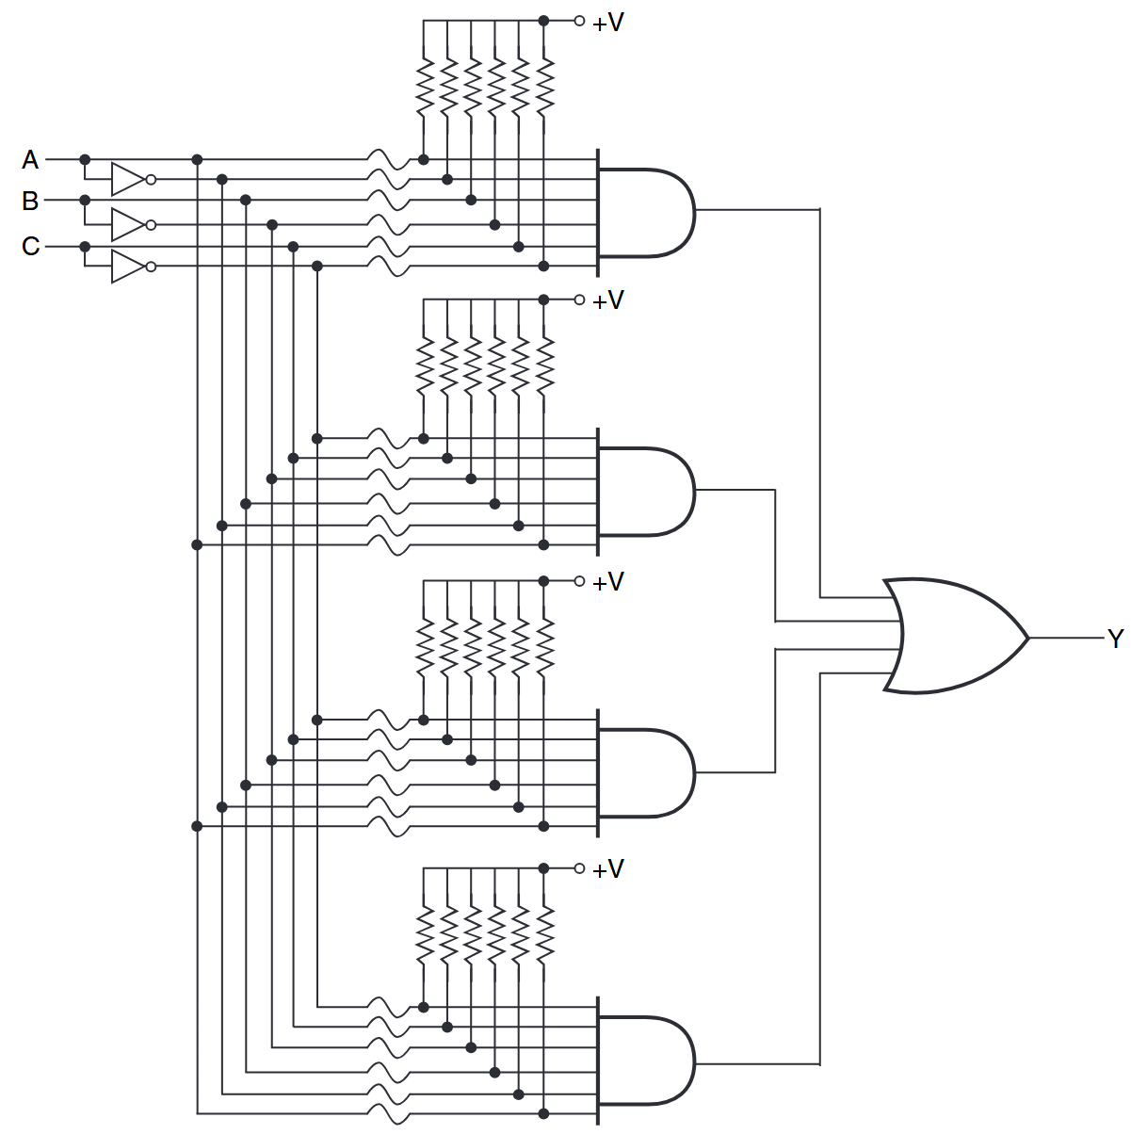
Programmable logic devices
Fixed logic circuit
Simple programmable logic device built using antifuses that can be burned in

Slide 4
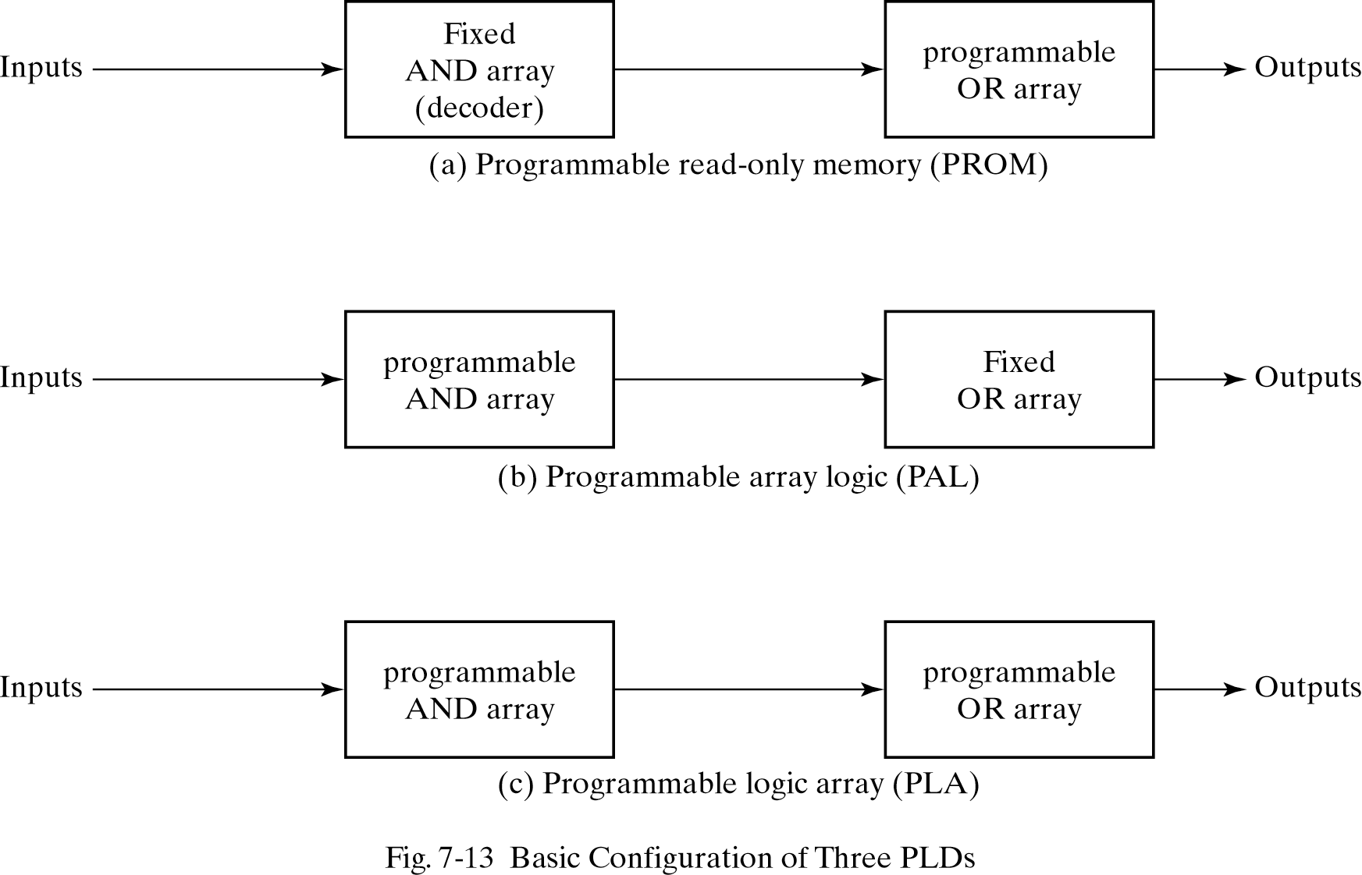
Programmable logic devices

Slide 5
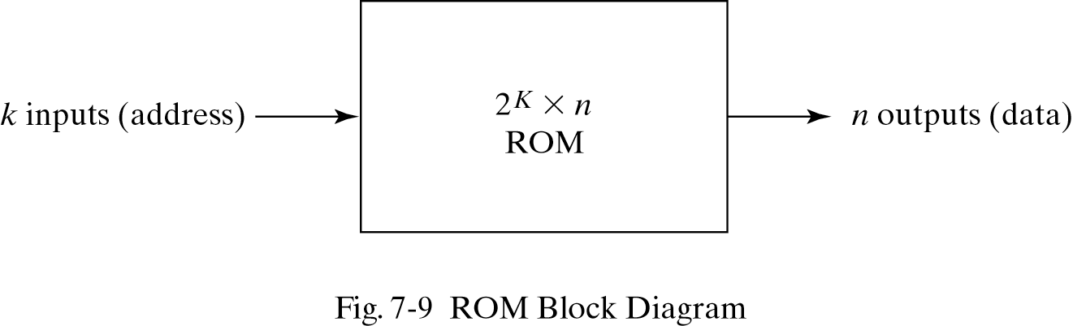
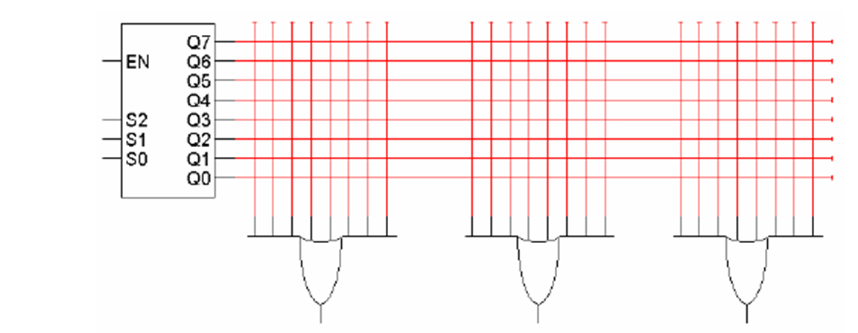
Read Only Memory (ROM)
Memory in which permanent binary information / combinational circuit is stored
Remember: “decoders are minterm generators”
Also “any combinational logic can be represented as sum of minterms”
ROM includes decoders and OR gates within a single IC → decoder outputs may be sent to several OR gates
Connections between decoder outputs and OR gates is ‘programmable’ to implement different functions

Slide 6
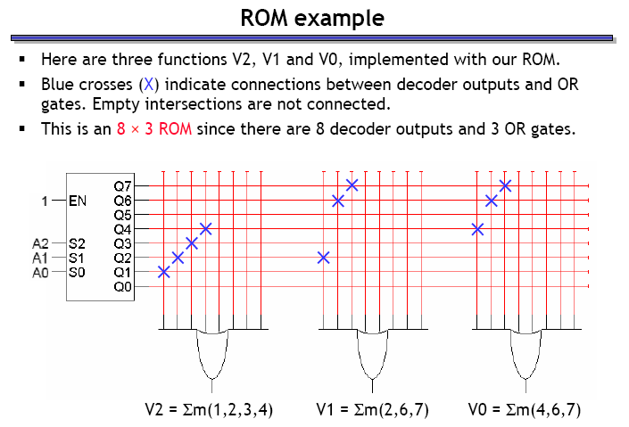
Implementing a Boolean function with a ROM
Implement: V0 = m( 4, 6, 7); V1 = m( 2, 6, 7); V2 = m( 1,2,3,4)

Slide 7
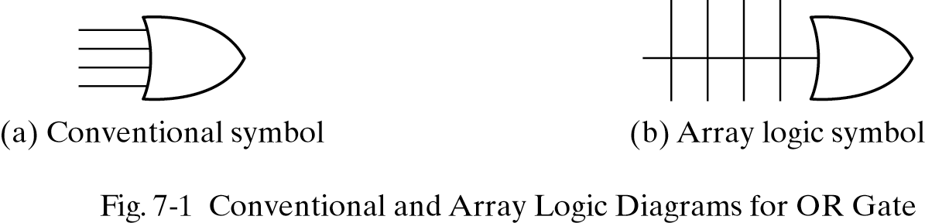
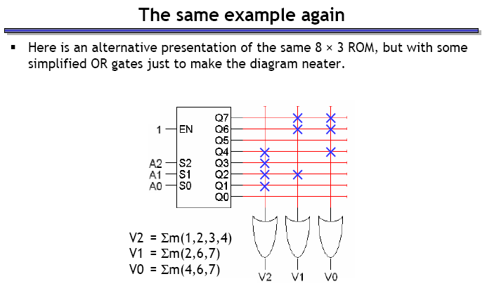
New symbols

Slide 8
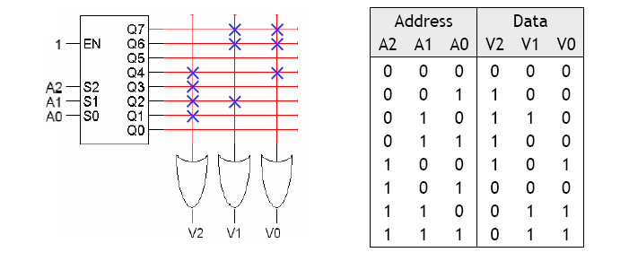
Why do we call this a ‘memory’?
Circuit is performing a computation on inputs A2A1A0 to produce output V2V1V0
The same input will generate the same output every time
Circuit “remembers” the output for each possible input
Effectively: circuit stores 8 values of data, each value 3 bits long
A2A1A0 forms an address that refers to one of the 8 stored values
Read Only because once the OR gate inputs are fused, they cannot be changed.

Slide 9
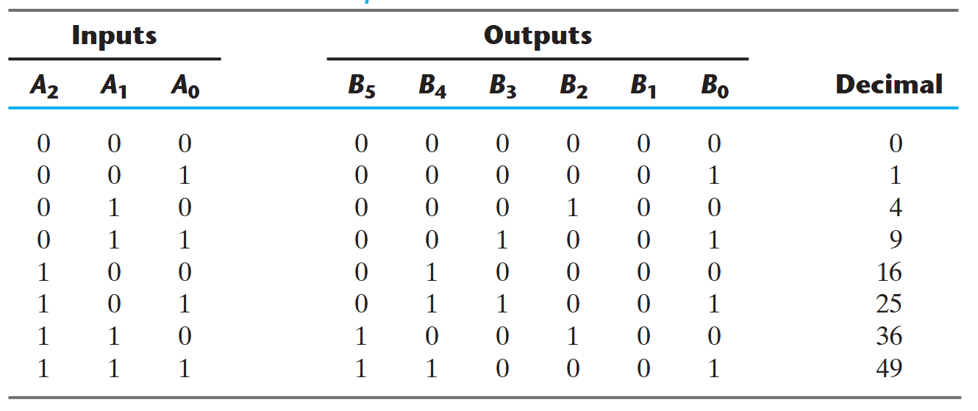
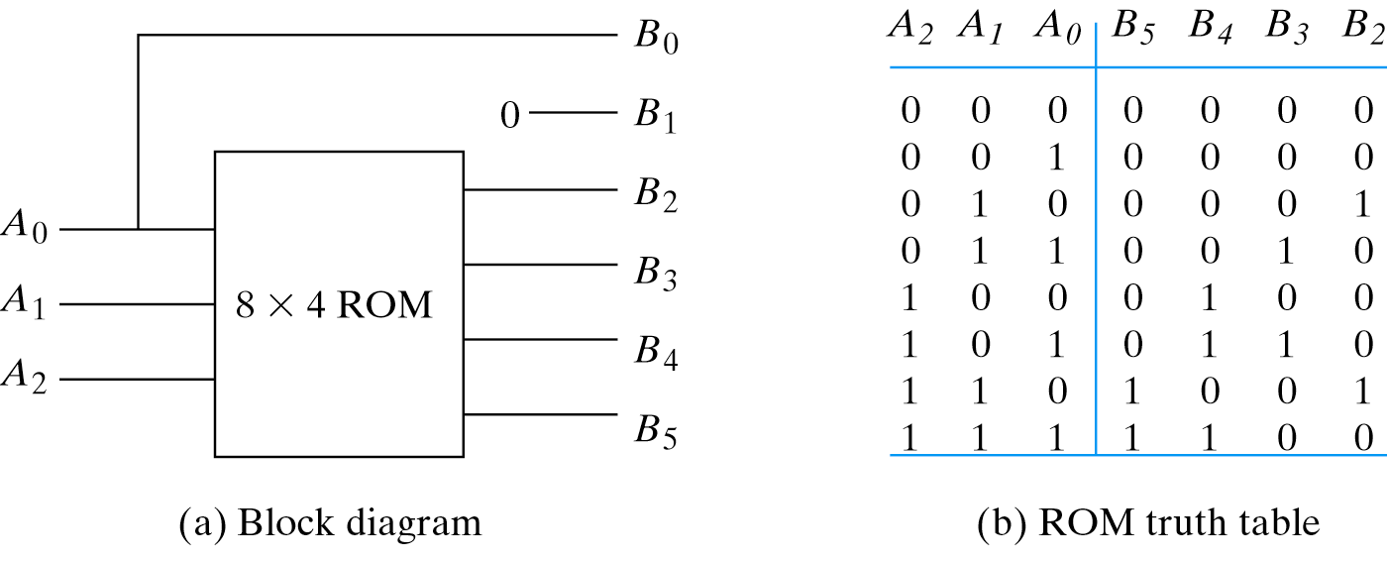
Example: output is square of input
ROM implementation is not efficient for inputs with many don’t care condition

Slide 10
Programmable Logic Arrays (PLAs)
A ROM uses a decoder to generate all possible minterms, with no circuit minimization
ROM implementation of an n-input function uses many gates:
n-to-2^{n} decoder (which has n inverters and 2^{n} n-input AND gates)
OR gate with 2^{n} inputs
Number of gates roughly doubles for each additional ROM input
A PLA makes the decoder part of the ROM also programmable
You can choose what products (not necessarily minterms) to generate

Slide 11
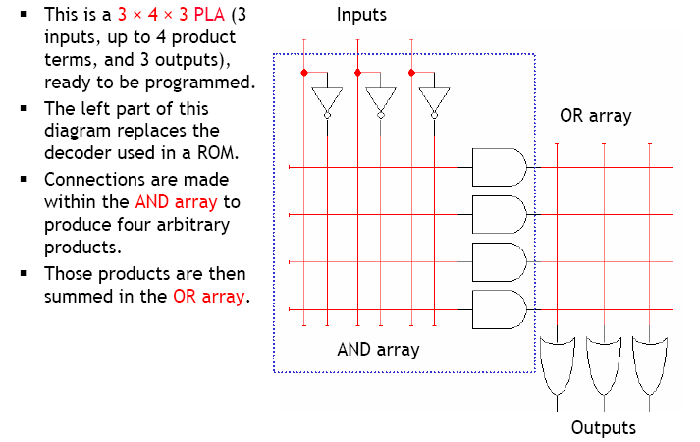
A 3 x 4 x 3 PLA

Slide 12
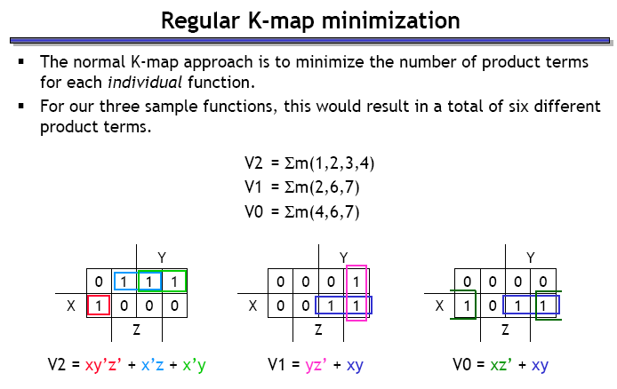
Optimizing expressions for PLA implementation

Slide 13
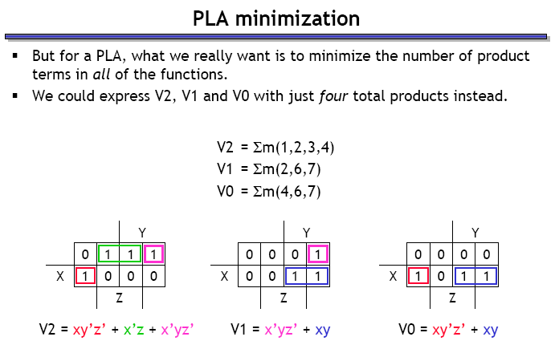
Optimizing expressions for PLA implementation

Slide 14
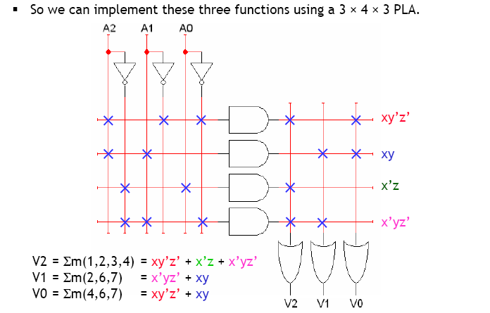
Implementing out example with PLA

