Slide 1
BITS Pilani Digital Design
Prof. GSS Chalapathi, Prof. Saurabh Gandhi (EEE department)

Slide 2
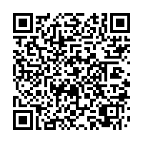
Attendance!
Will be opened only during the attendance window.
Enable location on your device.
Grant any location permissions requested by the website.
Refresh the page.
Try submitting again.

Slide 3
Digital Logic Families
ICs are classified based on their specific circuit technology, known as digital logic family.
Each family has its own basic electronic components (NAND, NOR, and NOT gates), used to build complex digital circuits.
Various digital logic families have been introduced and used over the years.

Slide 4
Digital logic families (timeline)
RTL: Resistor-Transistor Logic
DTL: Diode-Transistor Logic
TTL: Transistor-Transistor Logic
ECL: Emitter-coupled Logic
MOS: Metal-Oxide Semiconductor
CMOS: Complementary MOS
Low power dissipation, currently the MOST DOMINANT
BiCMOS: Bipolar CMOS
CMOS and TTL for additional current/speed
GaAs: Gallium-Arsenide
earliest, now obsolete
widely used
high-speed operation
compact
very high-speed operation

Slide 5
Defining characteristics of logic families
Fan-in: # of gate inputs.
Fan-out: # of standard loads a gate’s output can drive.
Noise margin: max external noise tolerated.
Power dissipation: power consumed by the gate (dissipated as heat).
Propagation delay: time required for an input signal change to be observed at an output line.

Slide 6
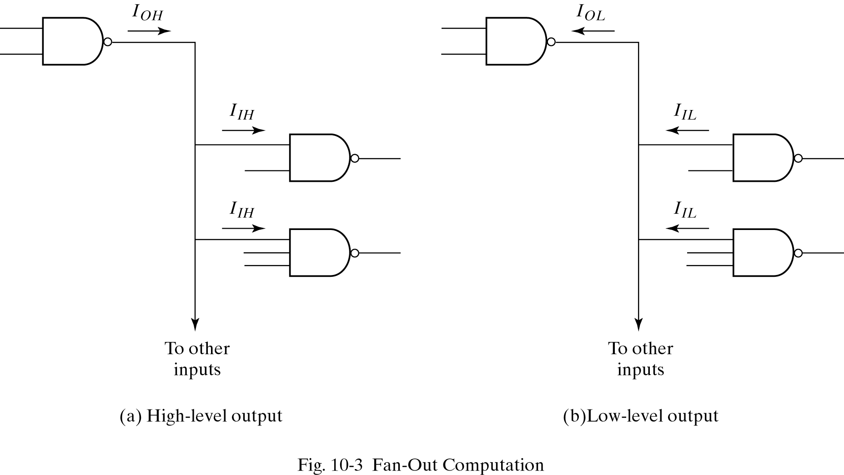
Fan in and fan out

Slide 7
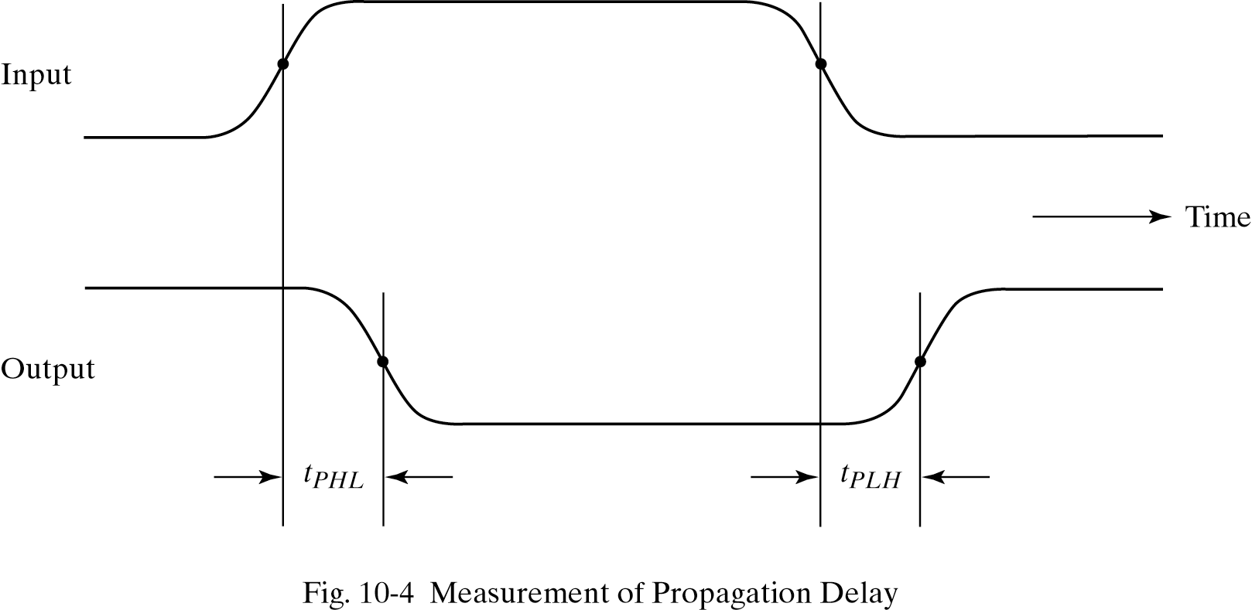
Propagation delay

Slide 8
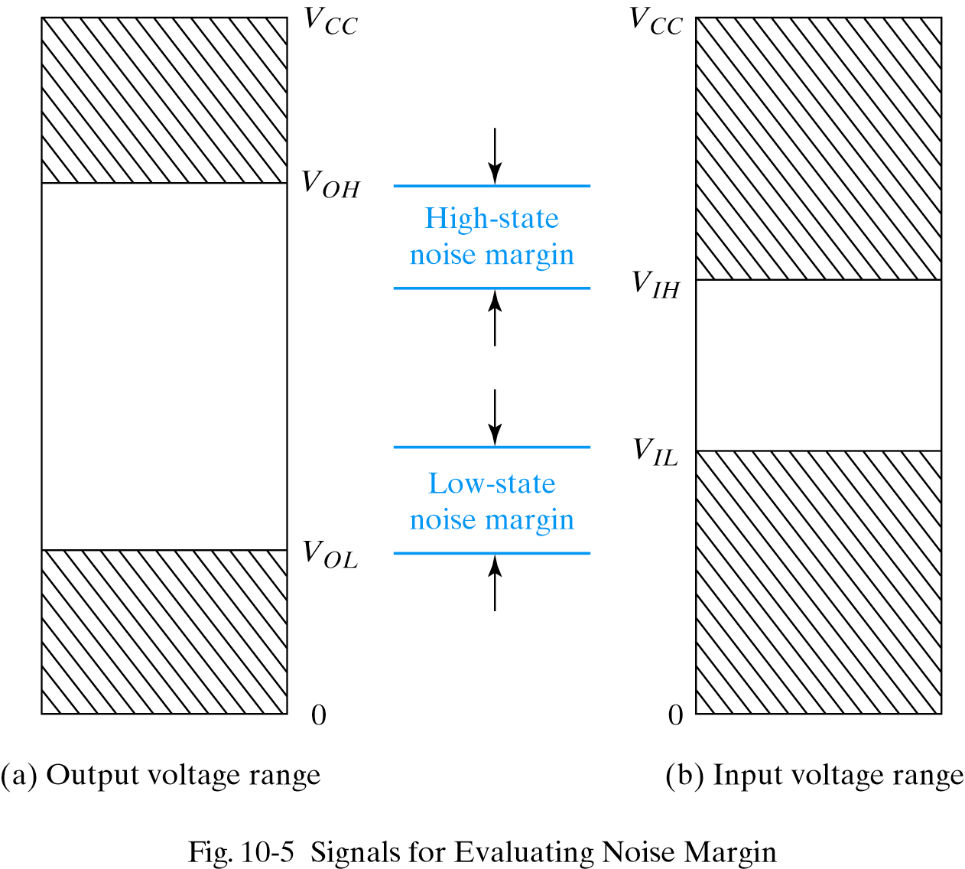
Noise margin

Slide 9
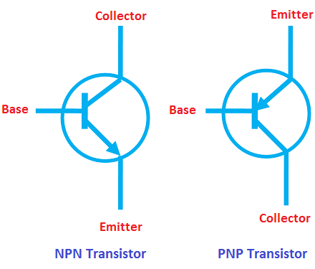
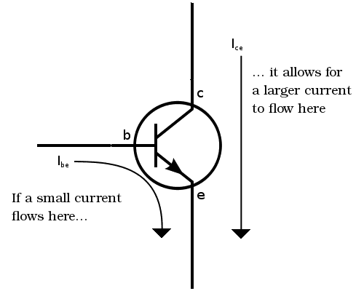
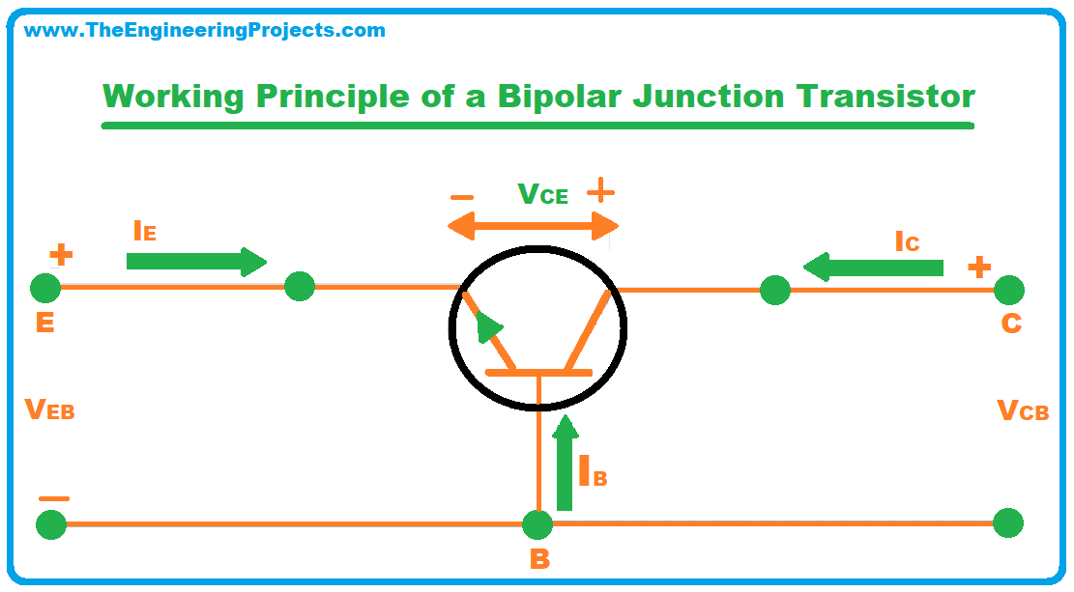
The Bipolar Junction Transistor:
current-controlled current source
Base–Emitter junction (BE) is forward-biased so that the emitter injects carriers (electrons)
Only a small fraction of electrons recombine with holes in the base → this small recombination current forms the base current IBI_BIB​
Majority of electrons that enter the base diffuse across it and reach the collector-base junction,
Base–Collector junction (BC) is reverse-biased
The electric field in the reverse-biased junction sweeps these electrons into the collector.

Slide 10
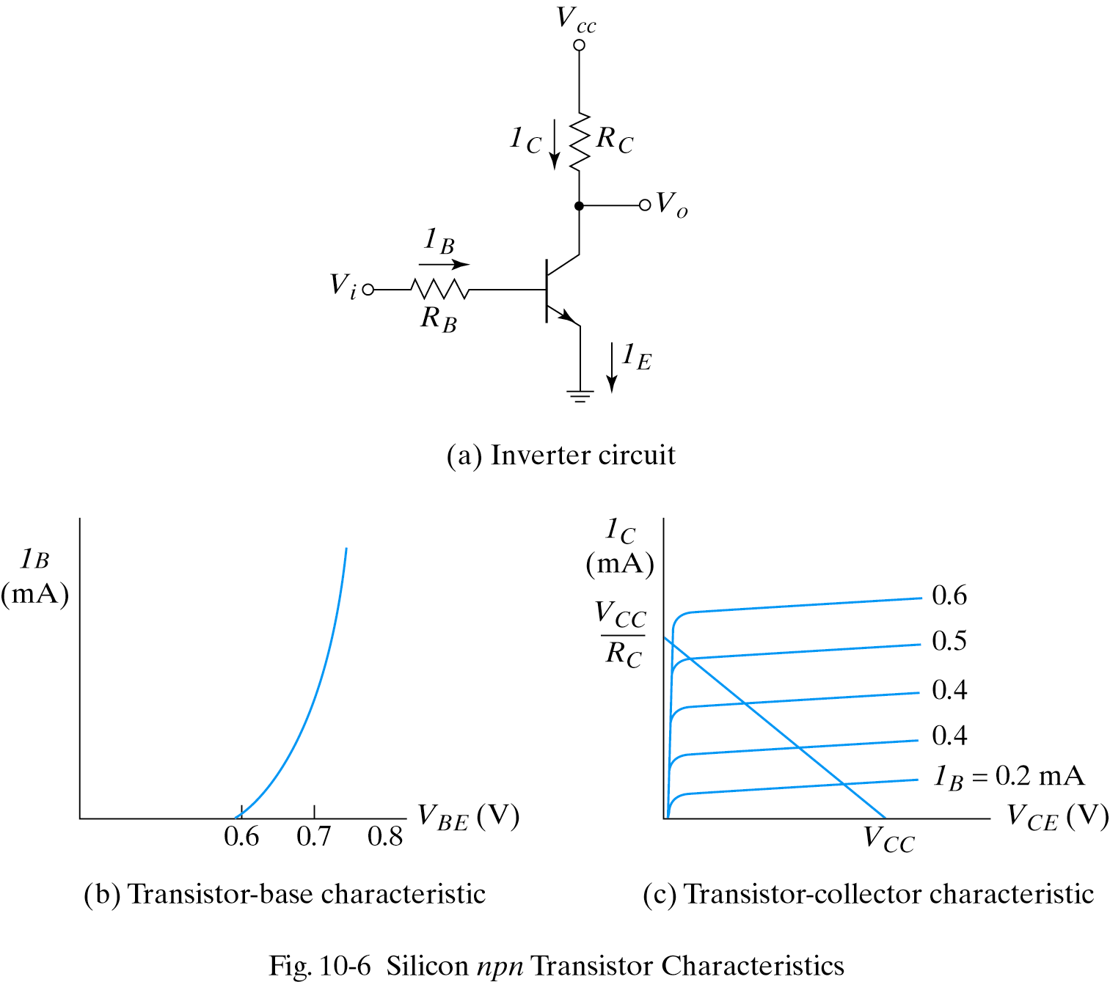
BJT characteristics
Base-Emitter voltage less than 0.6V ; I_{B} = 0
Cut-Off region
Base-Emitter voltage more than 0.6V, transistor starts conducting
Active region I_{C} = β I_{B}
Maximum collector current I_{C} = V_{CC}/R_{C}
R_{C} = 1kΩ, R_{B} = 22kΩ, β= 50
V_{CC} = 5V, find V_{o} for
V_{i} = 0.2V and V_{i} = 5V

