Slide 1
BITS Pilani Digital Design
Prof. GSS Chalapathi, Prof. Saurabh Gandhi (EEE department)

Slide 2
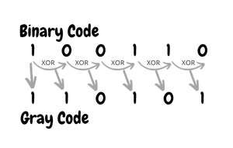
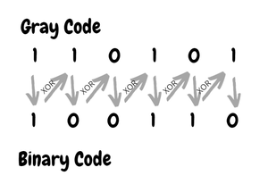
Binary to Gray conversion

Slide 3
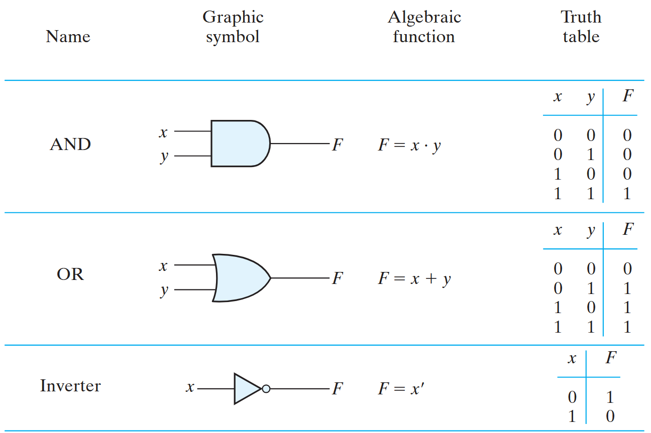
Operations with binary numbers

Slide 4
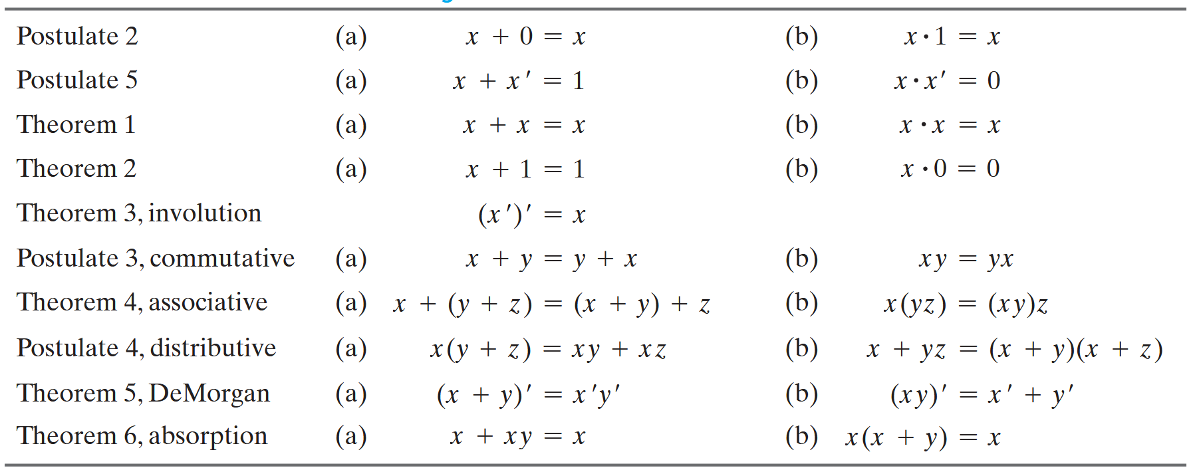
Boolean algebra: postulates and theorems
Principle of duality: Interchanging operators and the identity elements result in a valid expression!

Slide 5
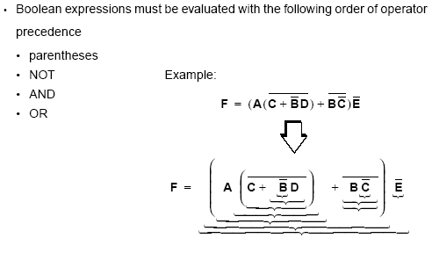
Operator precedence in Boolean expressions

Slide 6
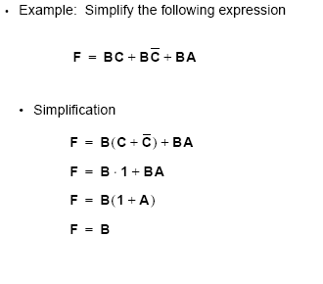
Examples of Boolean functions
Expressing the function as a truth table
Implementing with gates

Slide 7

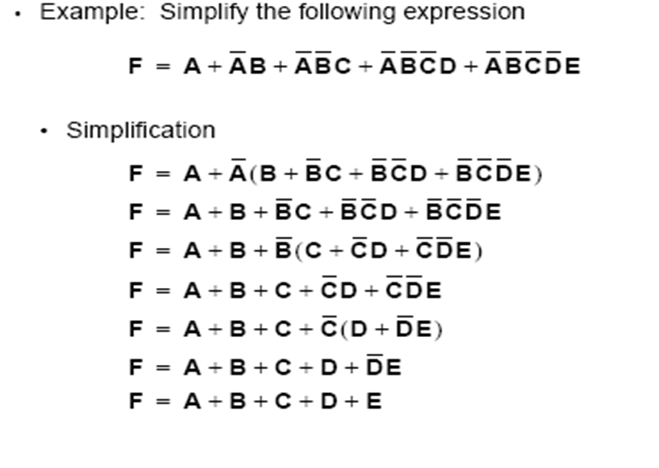
Examples of Boolean functions
Expressing the function as a truth table
Implementing with gates

Slide 8
Complement of functions
F’ is a function that takes the value 0 whenever F takes 1 and vice versa
Procedure:
Use de Morgan’s laws
Alternately (equivalently):
Take the dual
Complement each literal
Example:
F = x’yz’ + x’y’z
Dual of F is (x’+y+z’)(x’+y’+z)
Complement each literal gives (x+y’+z)(x+y+z’) = F’
Verify with truth tables!

Slide 9
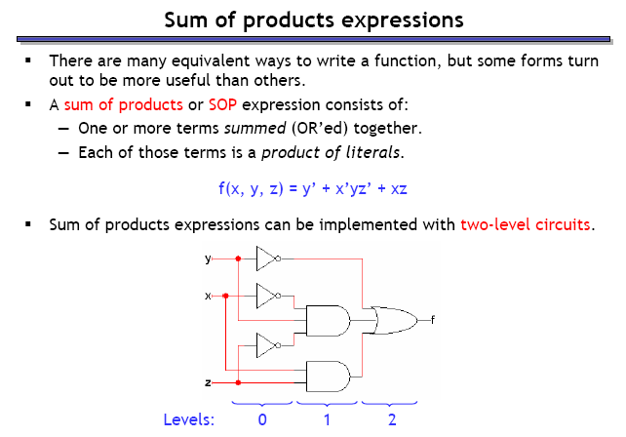
Simplifying expressions for implementation: sum of products

Slide 10
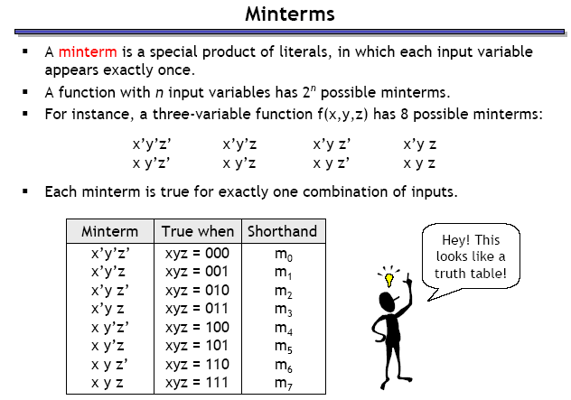
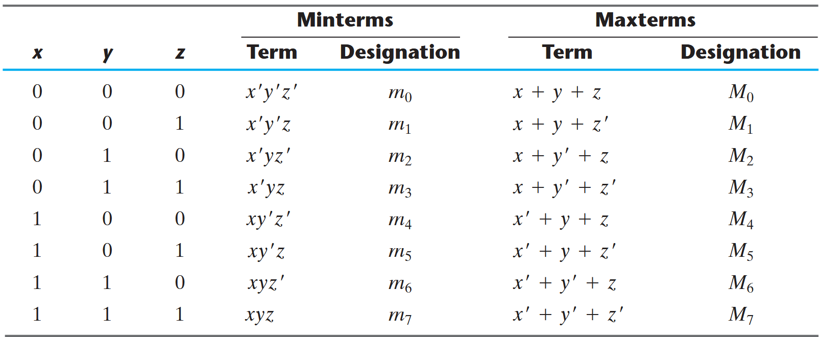
minterms

Slide 11
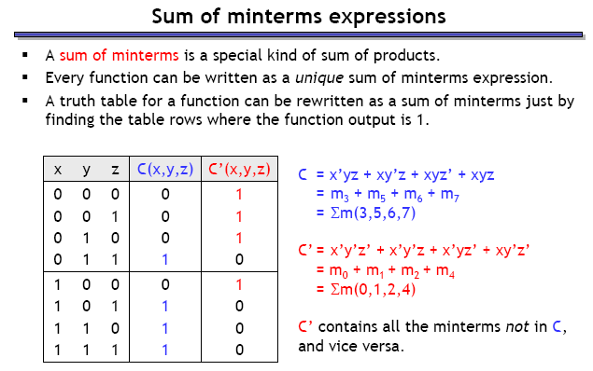
Sum of minterms

Slide 12
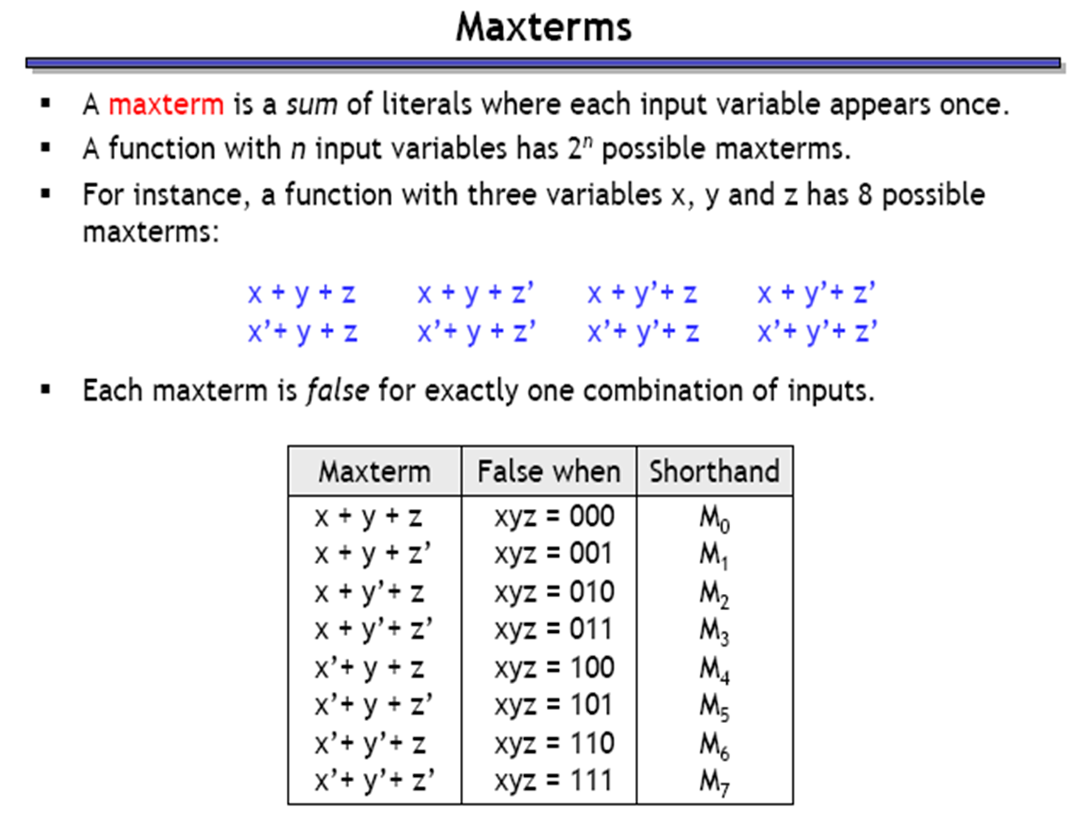
maxterms – the dual version of minterms

Slide 13
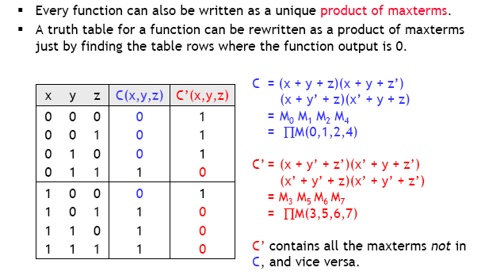
Product of maxterms

Slide 14
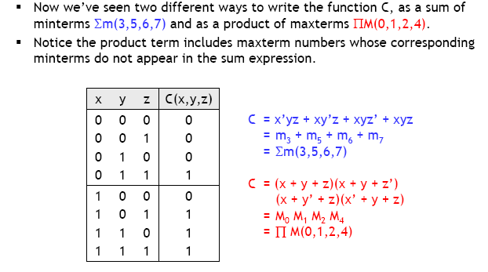
Relationship between minterms and maxterms

Slide 15
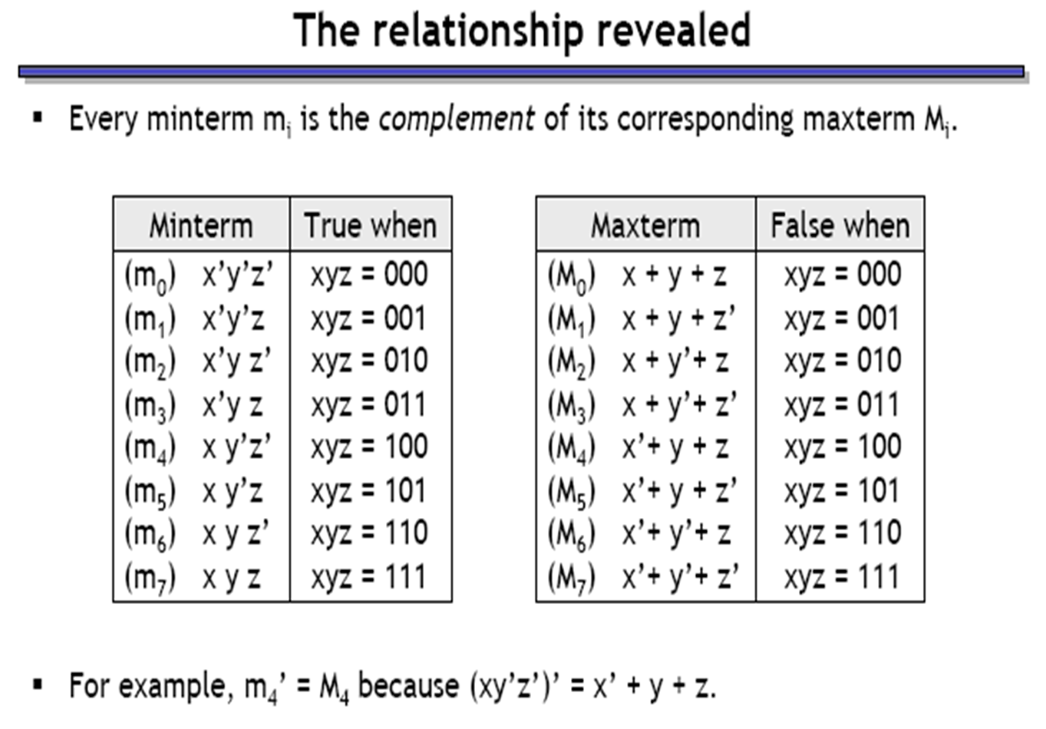
Relationship between minterms and maxterms

Slide 16
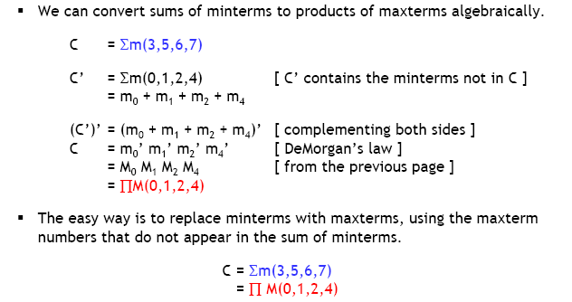
Converting between minterms and maxterms

