Slide 1
BITS Pilani Digital Design
Prof. GSS Chalapathi, Prof. Saurabh Gandhi (EEE department)

Slide 2
Karnaugh Maps
Graphical Device used to Simplify Boolean expressions
Relates inputs to Outputs
Useful for up to six variables

Slide 3
Minimal sum of products
Reduce expressions to a minimal sum of products (MSP) form
Minimum number of product terms
Each product has a minimal number of literals
Circuit-wise leads to minimal two-level implementation

Slide 4
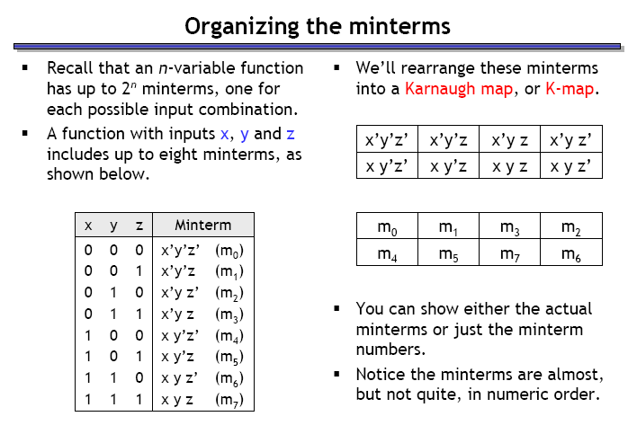
Building K-maps
Row of a Truth Table corresponds to a square in K-map
Adjacent square differ in only one variable
Combine squares with 1’s
y z = 0 0 0 1 1 1 1 0
x = 0
x = 1

Slide 5
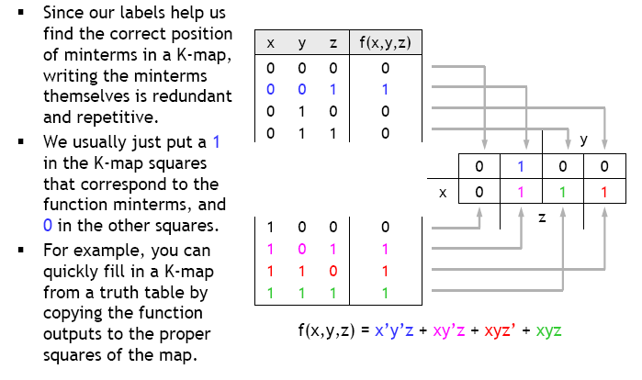
Filling in the k-map

Slide 6
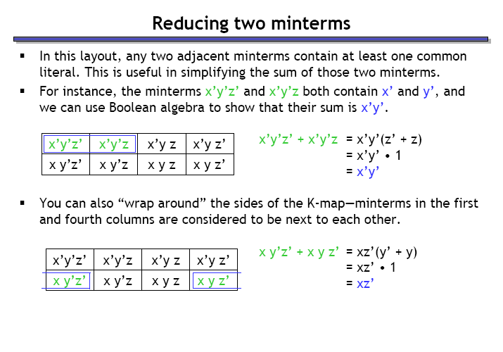
Reducing two minterms in k-maps

Slide 7
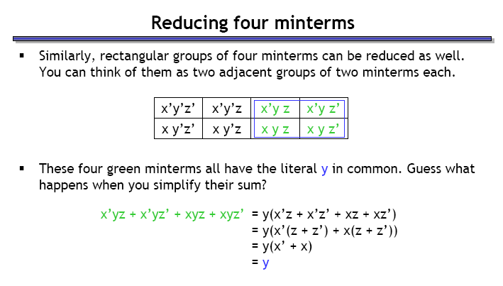
Reducing four minterms in k-maps

Slide 8
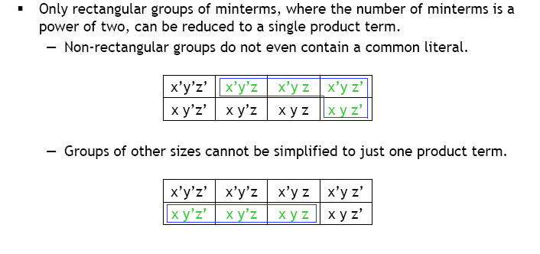
Reducible groups

Slide 9
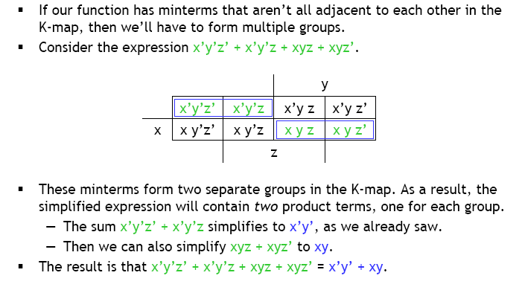
Reducing multiple groups

Slide 10
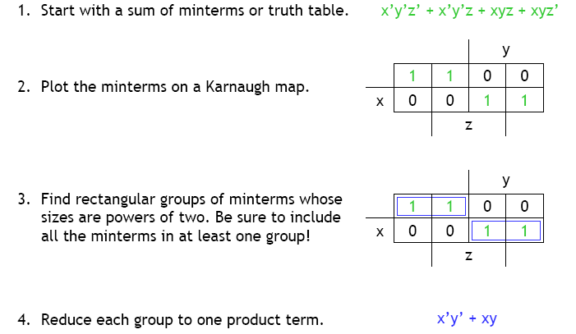
Summary: simplification using k-maps

Slide 11
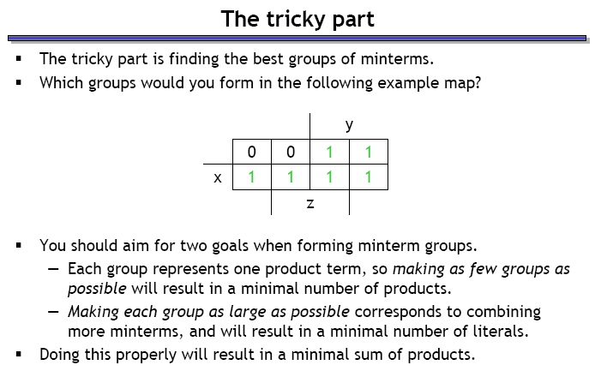
How to decide the best group of minterms?

Slide 12
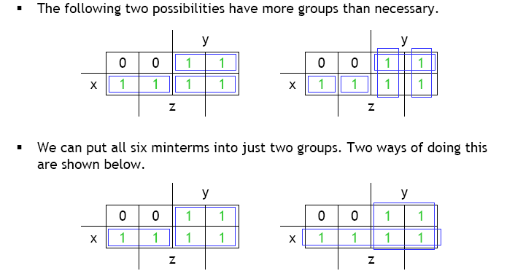
Minimizing groups

Slide 13
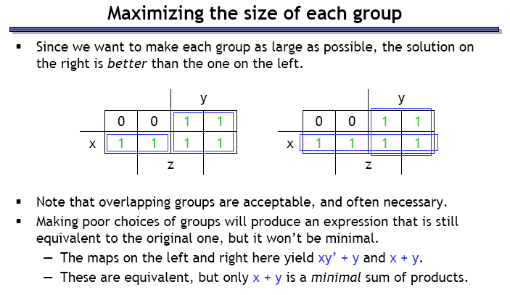
Maximizing group size

Slide 14
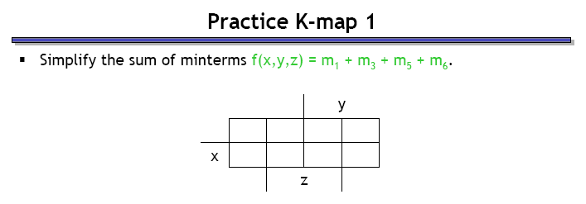
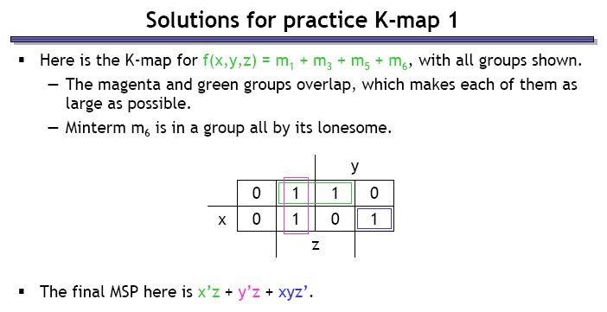
Example

Slide 15
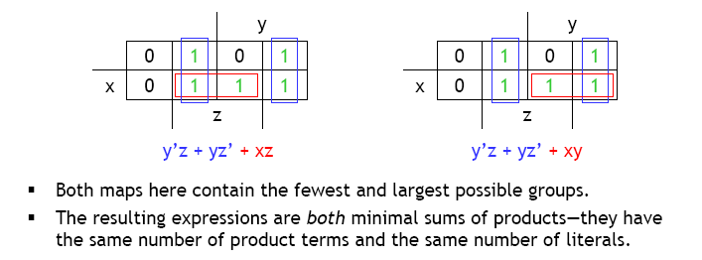
Multiple solutions can exist

Slide 16

Slides
https://github.com/csndl-iitd/f2152025

Slide 17
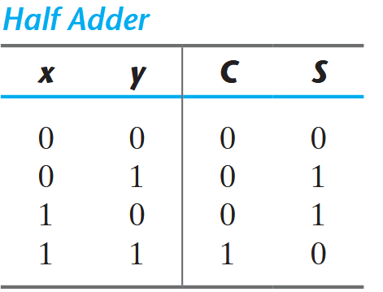
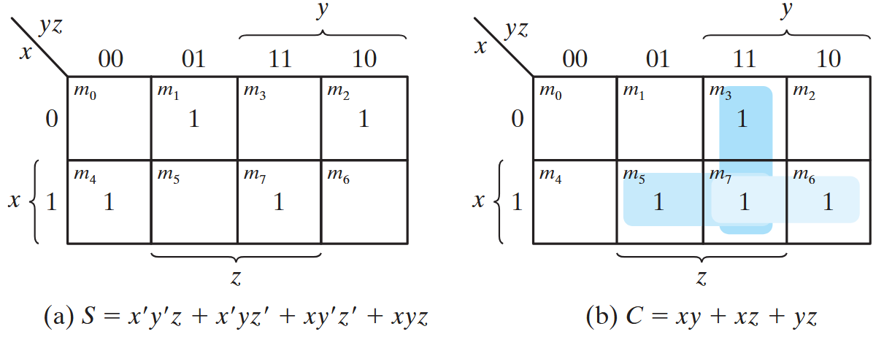
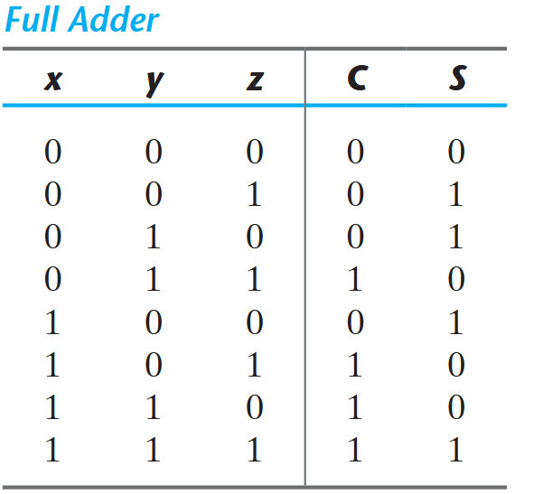
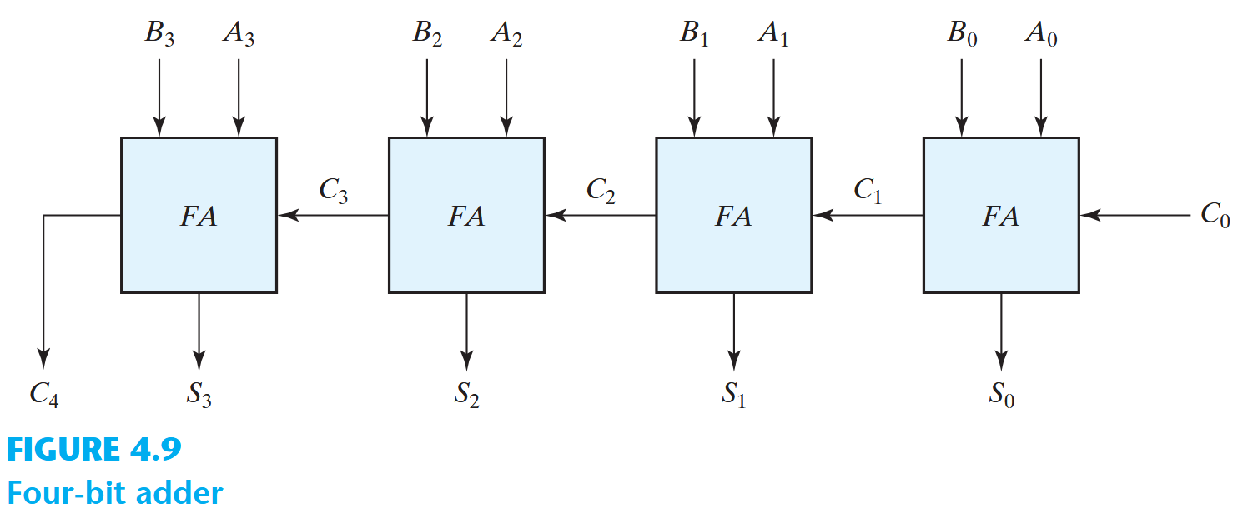
Using K-maps to build binary adders
K-map for S
K-map for C

Slide 18
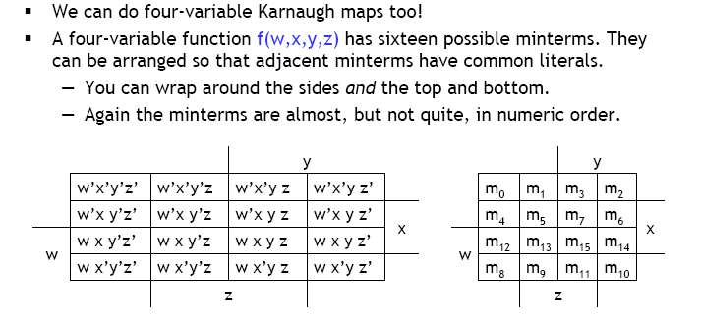
Four variable K-maps

Slide 19
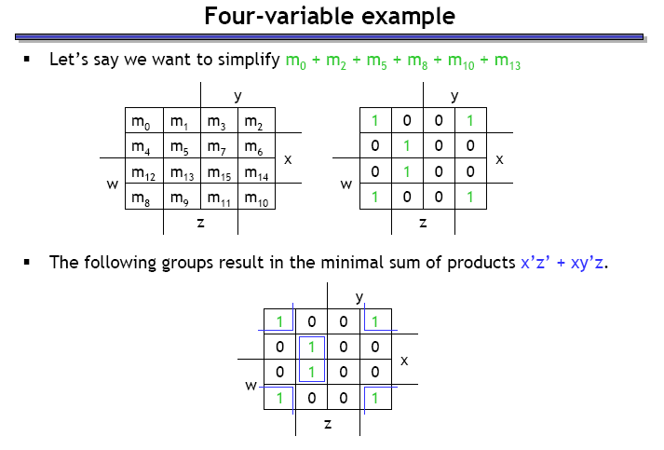
Four variable example

Slide 20
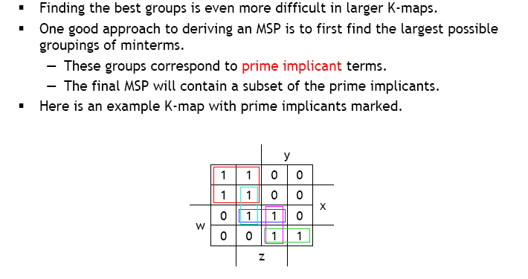
Prime implicants

Slide 21
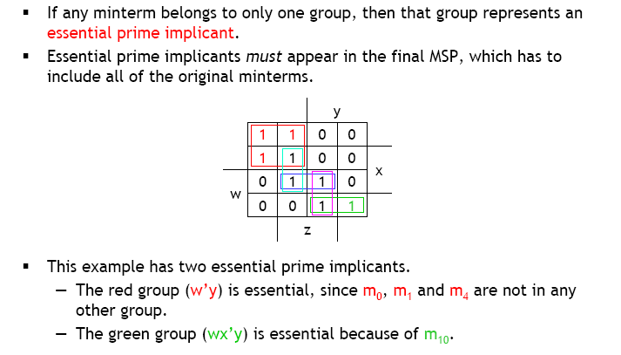
Essential prime implicants

Slide 22
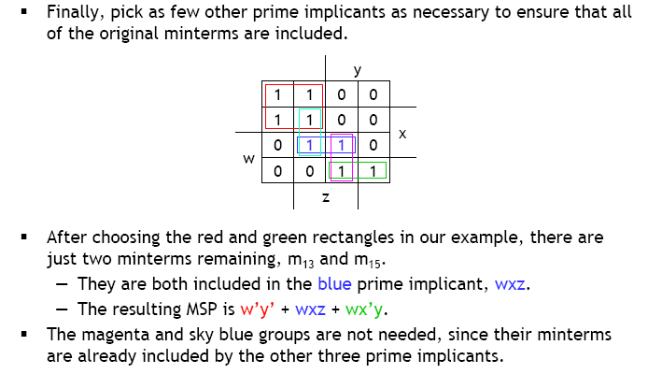
Covering the remaining minterms

Slide 23
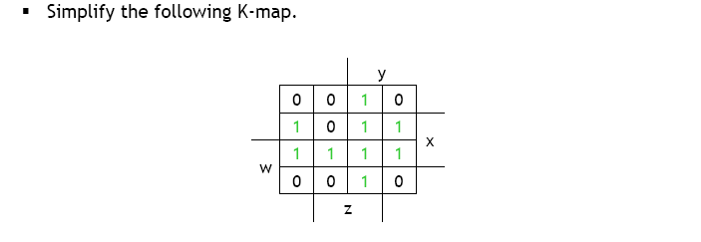
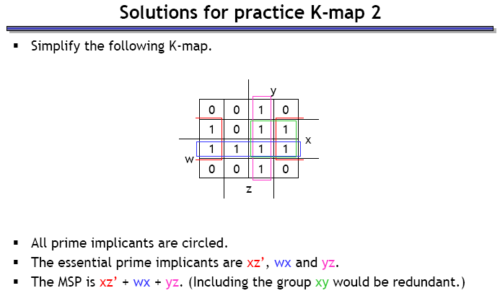
Example 2

Slide 24
Don’t Care Conditions
Unspecified outputs for certain inputs
Used in Map to provide further simplification
X is marked inside the square for don’t care input
Choose to include each don’t care minterm as either 1 or 0

Slide 25
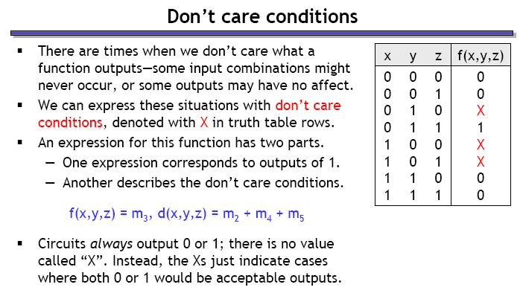
Don’t care conditions

Slide 26
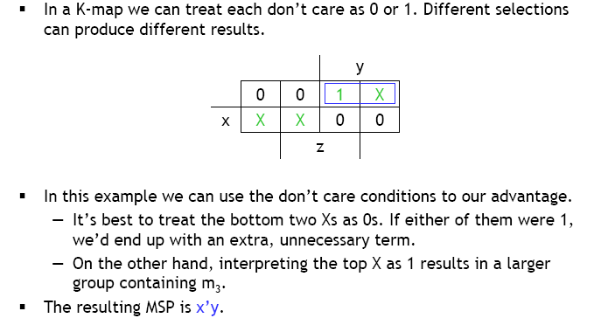
Don’t care simplifications

Slide 27
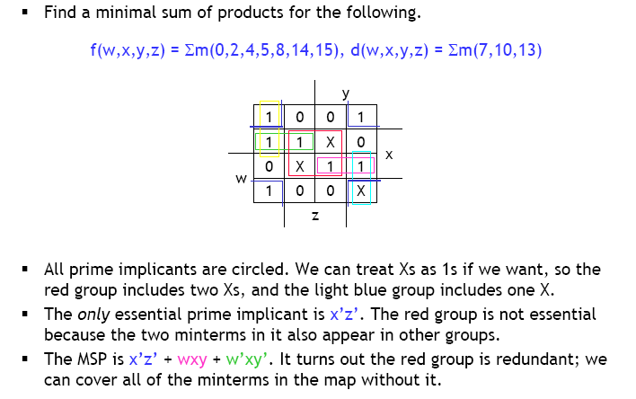
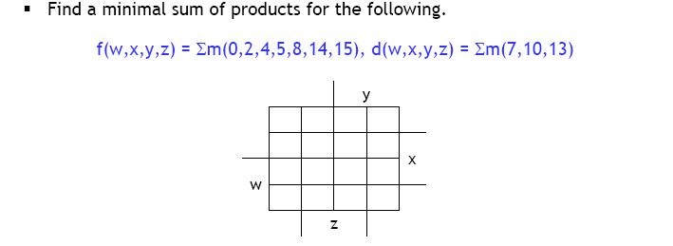
Example 3

Slide 28
POS Simplification
Combine valid adjacent squares containing 0’s
Obtain simplified expression of the complement in SOP form
Compliment further to get function in POS form
F(A,B,C,D) = Σ(0,1,2,5,8,9,10)
1 | 1 | 0 | 1
0 | 1 | 0 | 0
0 | 0 | 0 | 0
1 | 1 | 0 | 1
F’ = AB + CD + BD’
By De Morgan’s:
F = (A’+B’) (C’+D’)(B’+D)

Slide 29
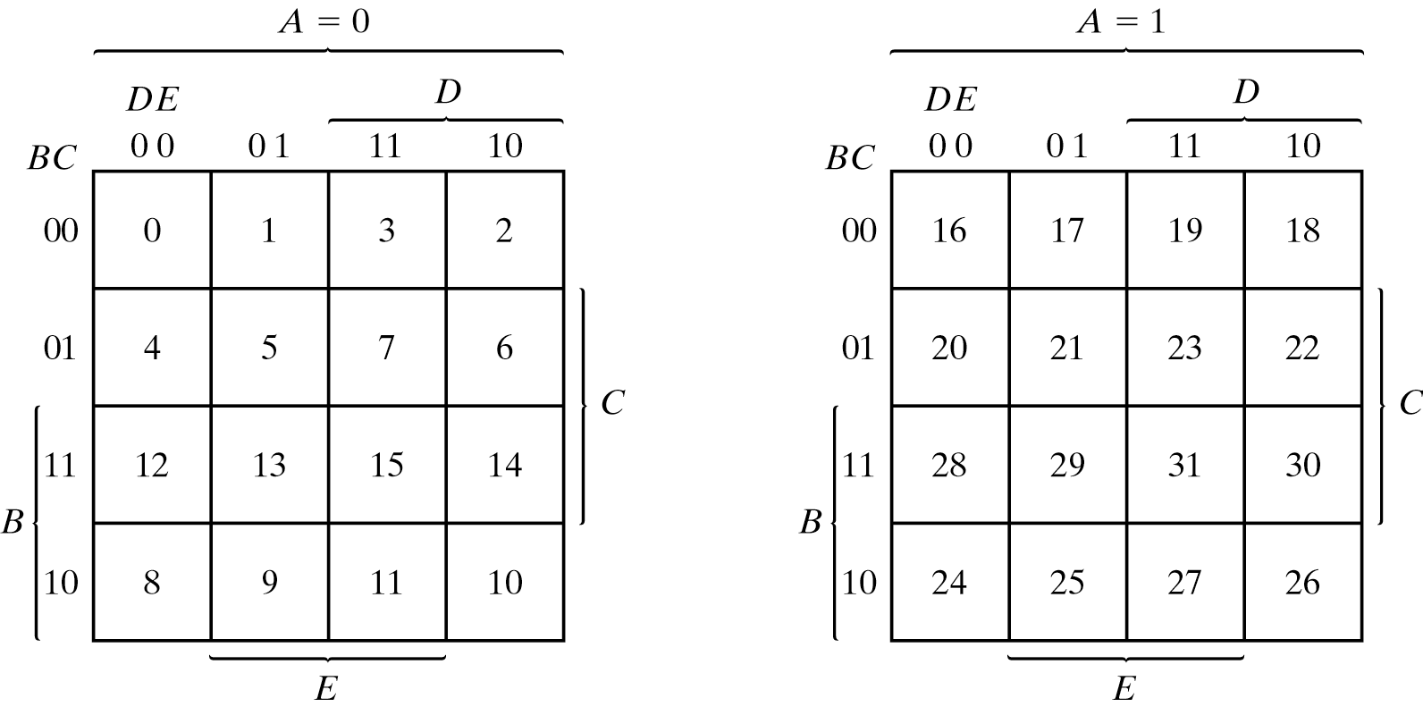
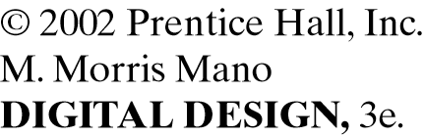
Five variable K-map

