Slide 1
BITS Pilani Digital Design
Prof. GSS Chalapathi, Prof. Saurabh Gandhi (EEE department)

Slide 2

Attendance!
Will be opened only during the attendance window.
Enable location on your device.
Grant any location permissions requested by the website.
Refresh the page.
Try submitting again.

Slide 3
Revisiting multiplication
Some general observations
Multiplication involves the generation of partial products – one for each digit in the multiplier.
Partial products are summed to produce the final product.
Partial products are very simple to define for binary multiplication. If the digit is a ‘one’ the partial product is the multiplicand, otherwise the partial product is zero.
The total product is the sum of the partial products. Each successive partial product is shifted one position to the left.
The multiplication of two n-bit binary numbers results in a product of up to 2n bits in length.
1011
X 1101
1011
0000
1011
1011
10001111

Slide 4
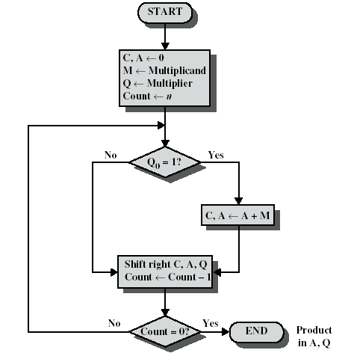
Simplifying multiplication using our new tools!
The processor can keep a running product rather than summing at the end.
For each ‘1’ in the multiplier we can apply an add and a shift.
For each ‘0’ only a shift is needed.

Slide 5
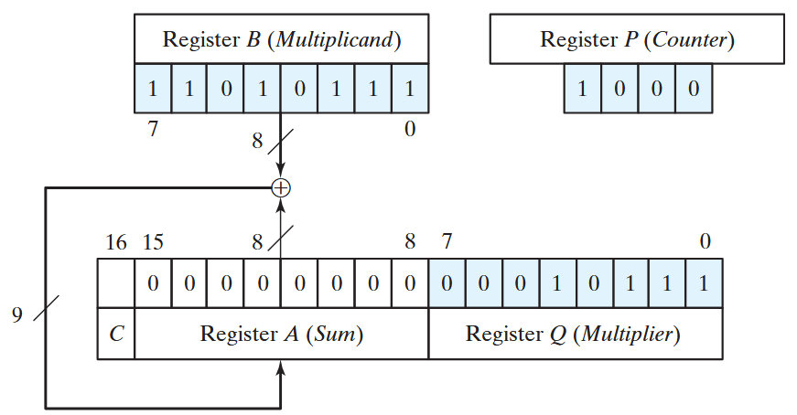
Simplifying multiplication using our new tools!
Multiplier and multiplicand are loaded into registers Q and M.
A third register (A) is initially set to zero.
A one-bit C register (initialised to zero) holds carry bits.

Slide 6
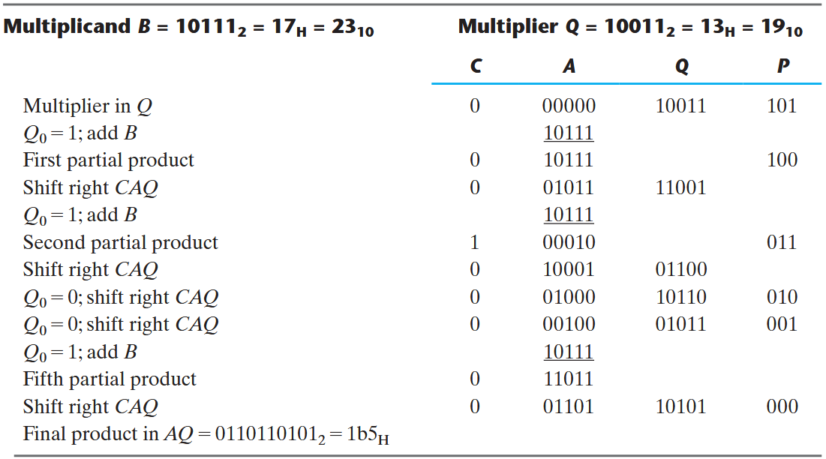
Simplifying multiplication…

Slide 7
A problem with our multiplier
Will not work if both or any one of the Multiplicand & Multiplier are negative.
Solution: Booth’s algorithm

Slide 8
Prereqs for Booth’s algorithm
Multiplicand M unchanged
Recode the multiplier Q to a recoded value R
Each digit can assume a negative as well as positive and zero values
Signed Digit (SD) encoding
Recoding (Skipping over ones):
String of 1s replaced by 0s
For ex: 30 = 0011110
= 32 – 2 = 0100000 – 0000010
In the coded form = 0100010
Booth recoding Procedure:
Working from LSB to MSB retain each 0 until a 1 is reached
When a 1 is encountered insert 1̅ at that position and complement all the succeeding 1’s until a 0 is encountered
Replace that 0 with 1 and continue
While multiplying with 1̅ 2’s compliment is taken

Slide 9
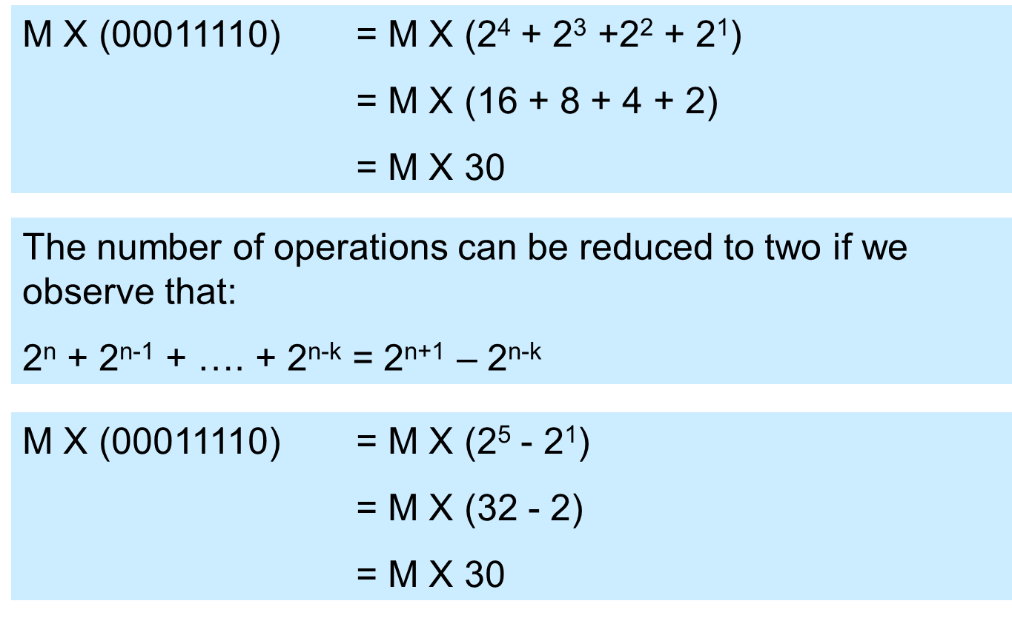
How it works

Slide 10
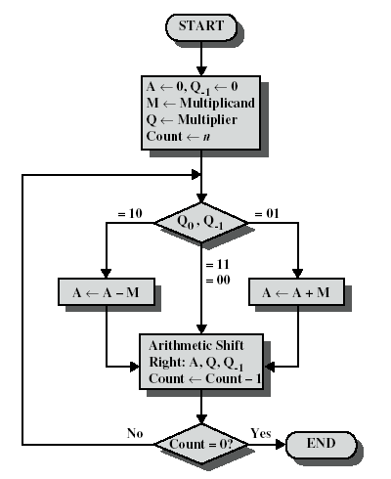
Booth’s algorithm
Multiplier and multiplicand are placed in Q and M registers.
A 1-bit register is placed to the right of the least significant bit (Q₀) and designated Q₋₁
Control logic scans the bits of the multiplier one at a time – the LSB AND its bit to the right are examined.
If the bits are the same (1-1 or 0-0) then all bits of the A, Q and Q - 1 registers are shifted to the right 1 bit.
If the two bits differ, then the multiplicand is added/subtracted depending on whether the bits are 0-1 or 1-0.
Addition is followed by a right arithmetic shift.

Slide 11
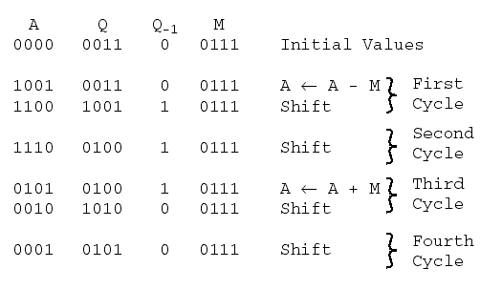
Example

Slide 12
Example 2
Verify the operation of:
(+7) x (-3)
Multiplicand M = 0111
Multiplier Q = 1101
A Q Q₋₁ M = 0111
0000 1101 0 initial
1001 1101 0 A ⟵ A-M
1100 1110 1 shift
0011 1110 1 A ⟵ A+M
0001 1111 0 shift
1010 1111 0 A ⟵ A-M
1101 0111 1 shift
1110 1011 1 shift
Now:
Verify the operation of
(-7) x (+3)
Multiplicand M = 1001
Multiplier Q = 0011

