Slide 1
BITS Pilani Digital Design
Prof. GSS Chalapathi, Prof. Saurabh Gandhi (EEE department)

Slide 2
Revisiting multiplication
Some general observations
Multiplication involves the generation of partial products – one for each digit in the multiplier.
Partial products are summed to produce the final product.
Partial products are very simple to define for binary multiplication. If the digit is a ‘one’ the partial product is the multiplicand, otherwise the partial product is zero.
The total product is the sum of the partial products. Each successive partial product is shifted one position to the left.
The multiplication of two n-bit binary numbers results in a product of up to 2n bits in length.
1011
X 1101
1011
0000
1011
1011
10001111

Slide 3
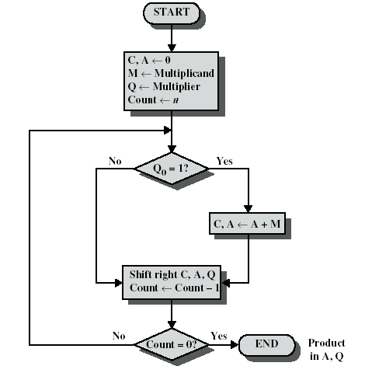
Simplifying multiplication using our new tools!
The processor can keep a running product rather than summing at the end.
For each ‘1’ in the multiplier we can apply an add and a shift.
For each ‘0’ only a shift is needed.

Slide 4
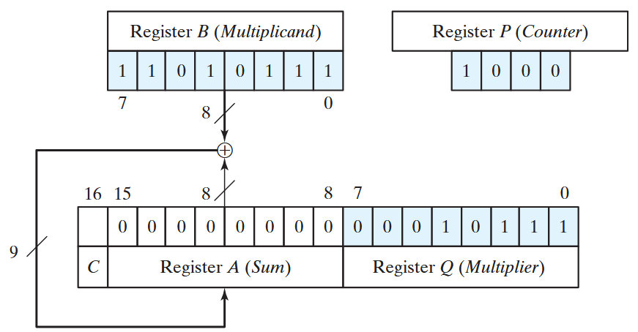
Simplifying multiplication using our new tools!
Multiplier and multiplicand are loaded into registers Q and M.
A third register (A) is initially set to zero.
A one-bit C register (initialised to zero) holds carry bits.

Slide 5
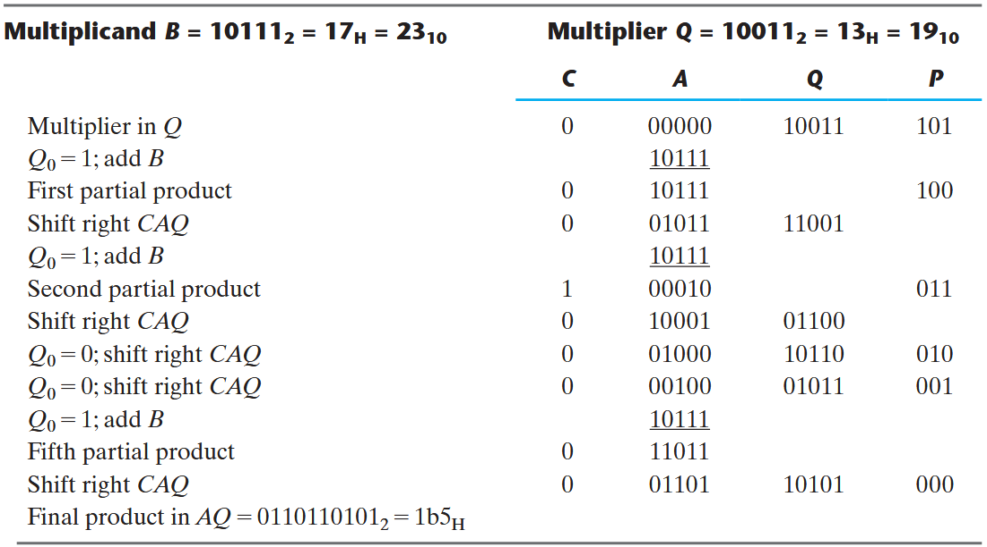
Simplifying multiplication…

Slide 6
A problem with our multiplier
Will not work if both or any one of the Multiplicand & Multiplier are negative.
Solution: Booth’s algorithm

Slide 7
Prereqs for Booth’s algorithm
Multiplicand M unchanged
Recode the multiplier Q to a recoded value R
Each digit can assume a negative as well as positive and zero values
Signed Digit (SD) encoding
Recoding (Skipping over ones):
String of 1s replaced by 0s
For ex: 30 = 0011110
= 32 – 2 = 0100000 – 0000010
In the coded form = 0100010
Booth recoding Procedure:
Working from LSB to MSB retain each 0 until a 1 is reached
When a 1 is encountered insert 1̅ at that position and complement all the succeeding 1’s until a 0 is encountered
Replace that 0 with 1 and continue
While multiplying with 1̅ 2’s compliment is taken

Slide 8
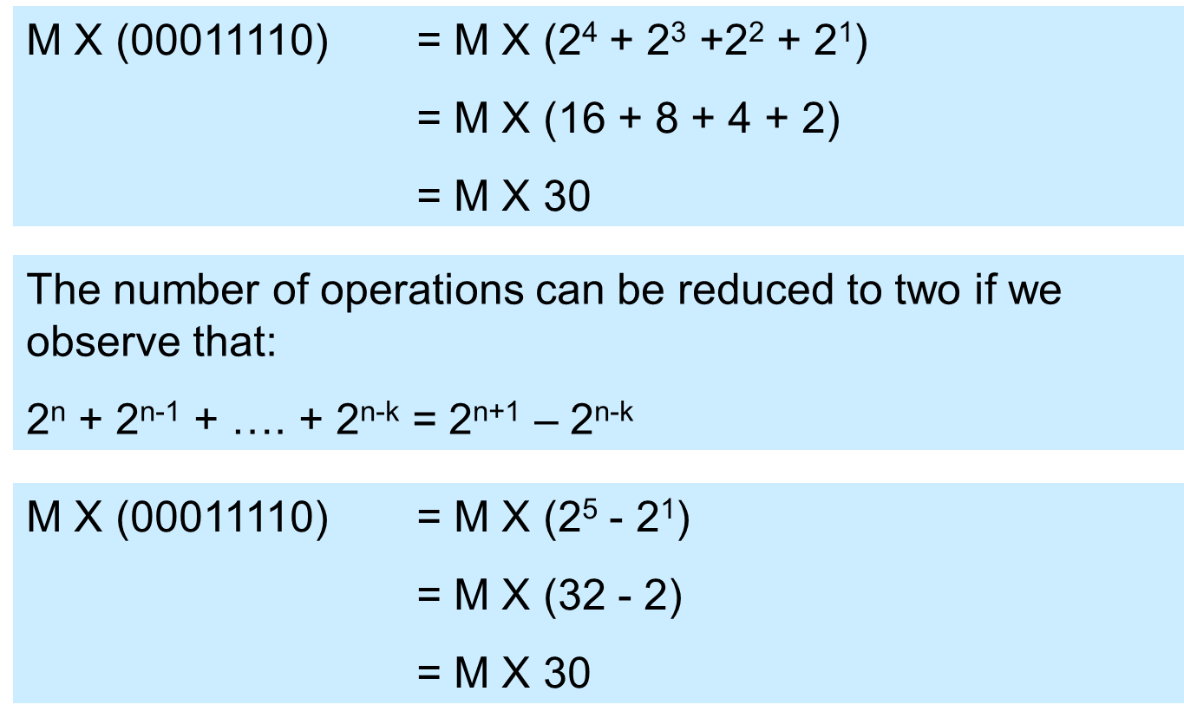
An observation with binary numbers

Slide 9
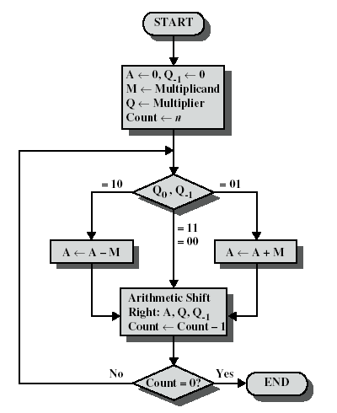
Booth’s algorithm
Multiplier and multiplicand are placed in Q and M registers.
A 1-bit register is placed to the right of the least significant bit (Q₀) and designated Q₋₁
Control logic scans the bits of the multiplier one at a time – the LSB and the bit to its right are examined.
If the bits are the same (1-1 or 0-0) then all bits of the A, Q and Q - 1 registers are shifted to the right 1 bit.
If the two bits differ, then the multiplicand is added/subtracted depending on whether the bits are 0-1 or 1-0.
Addition is followed by a right arithmetic shift.

Slide 10
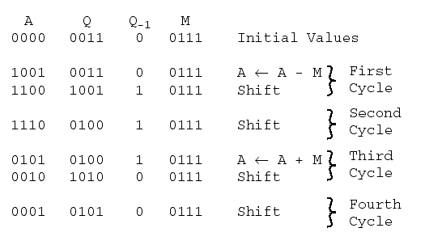
Example

Slide 11
Example 2
Verify the operation of:
(+7) x (-3)
Multiplicand M = 0111
Multiplier Q = 1101
A Q Q₋₁ M = 0111
0000 1101 0 initial
1001 1101 0 A ⟵ A-M
1100 1110 1 shift
0011 1110 1 A ⟵ A+M
0001 1111 0 shift
1010 1111 0 A ⟵ A-M
1101 0111 1 shift
1110 1011 1 shift
Now:
Verify the operation of
(-7) x (+3)
Multiplicand M = 1001
Multiplier Q = 0011

Slide 12

Attendance!
Will be opened only during the attendance window.
Enable location on your device.
Grant any location permissions requested by the website.
Refresh the page.
Try submitting again.

Slide 13
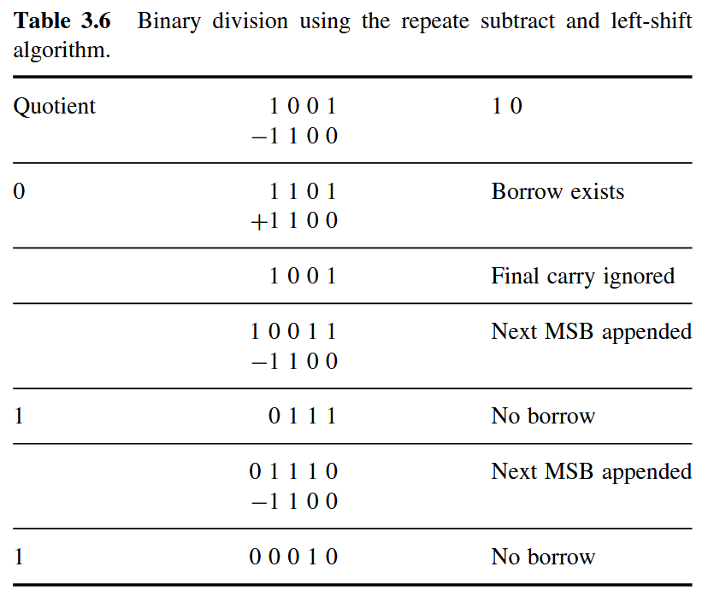
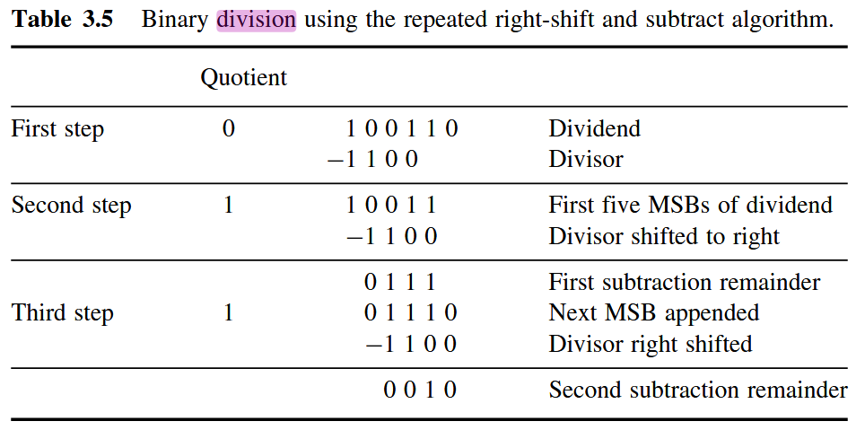
Binary division
Dividend (numerator) and divisor (denominator)
Bits of dividend are examined from left to right until set of bits examined represents a number greater than or equal to the divisor
Till then place 0s in the quotient from left to right
When dividend exceeds divisor (like step 2 above), place 1 in quotient and subtract divisor from dividend (called the partial remainder)
Repeat

Slide 14
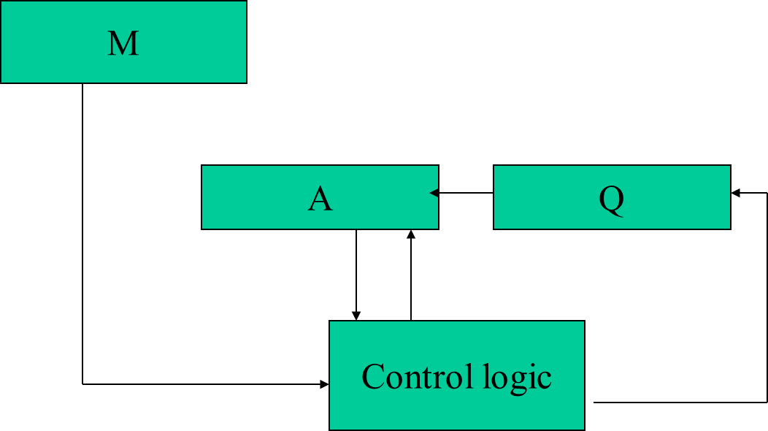
Division by restoration algorithm
The divisor placed in register M
Dividend placed in register Q
Register A initially cleared
Each step A and Q are shifted to left 1 bit
A ← A – M
If MSB of A is 0 (ie subtraction result is positive), Q₀ ← 1
If MSB of A is 1 (ie subtraction result is negative), Q₀ ← 0 AND A ← A + M (restore A by undoing subtraction)
Repeat n times (n is the number of bits in the dividend)
At the end Quotient in Q and remainder in A

Slide 15
Example: divide 7 by 3
Dividend : 0111 Divisor : 0011 M : 0011
A Q
0000 0111 Initial value
0000 1110 Shift left
1101 1110 A←A-M (MSB is 1, Q₀←0)
0000 1110 Add M to restore A
0001 1100 Shift left
1101 1100 A←A-M (MSB is 1, Q₀←0)
0001 1100 Add M to restore A
0011 1000 Shift left
0000 1001 A←A-M (MSB is 0, Q₀←1)
0001 0010 Shift left
1110 0010 A←A-M (MSB is 1, Q₀←0)
0001 0010 Add M to restore A
Result: Q = 0010; remainder = 0001

Slide 16
Non-restoration method
Eliminates the need for restoring A after result of subtraction is negative
Divisor loaded in M, dividend loaded in Q, A cleared
If sign(A) positive, shift A, Q left by 1 bit and subtract M from A
If sign(A) negative, shift A, Q left by 1 bit and add M to A
If MSB is 1, Q₀ set to 0; else 1
Repeat n times
At the end, if sign(A) is negative, add M to A to get correct remainder

Slide 17
Example: divide 7 by 3
A Q
0000 0111 Initial values
0000 1110 Shift left; MSB is 0
1101 1110 Subtract M; since MSB = 1, Q₀ = 0
1011 1100 Shift left; MSB is 1
1110 1100 Add M
1101 1000 Shift left; MSB is 1
0000 1001 Add M; since MSB = 0, Q₀ = 1
0001 0010 Shift left; MSB is 0
1110 0010 Subtract M; MAB is 1
0001 0010 Add M to adjust remainder

