Slide 1
BITS Pilani Digital Design
Prof. GSS Chalapathi, Prof. Saurabh Gandhi (EEE department)

Slide 2
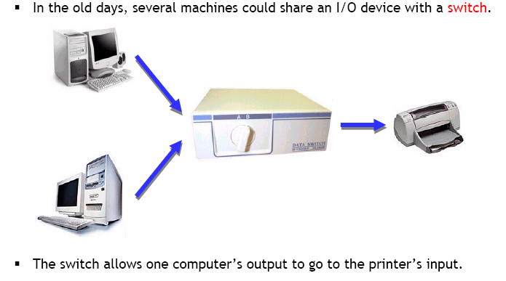
Multiplexers – digital traffic lights

Slide 3
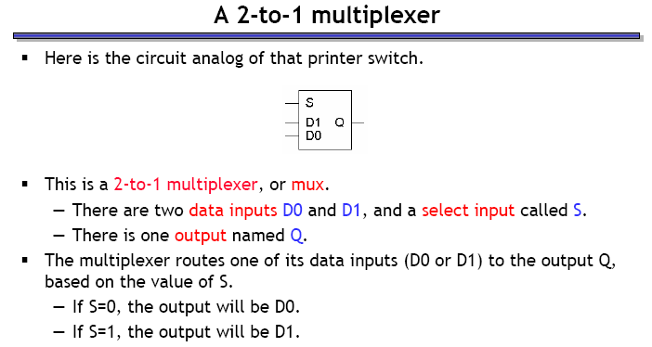
2–to–1 multiplexer

Slide 4
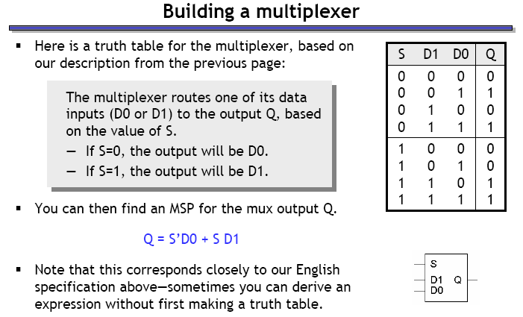
Building a multiplexer

Slide 5
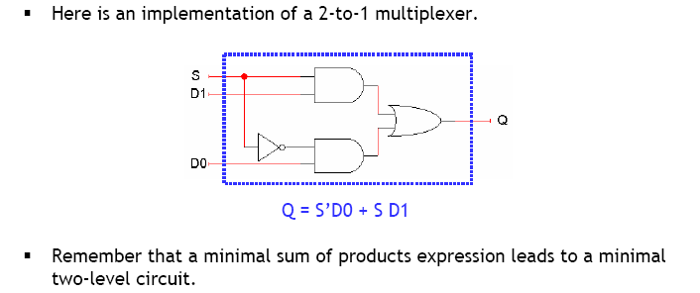
Building a multiplexer – the circuit

Slide 6
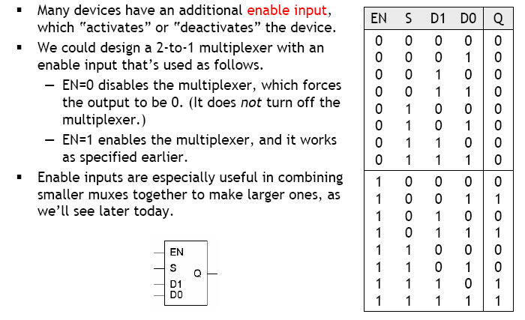
Multiplexers with Enable input

Slide 7
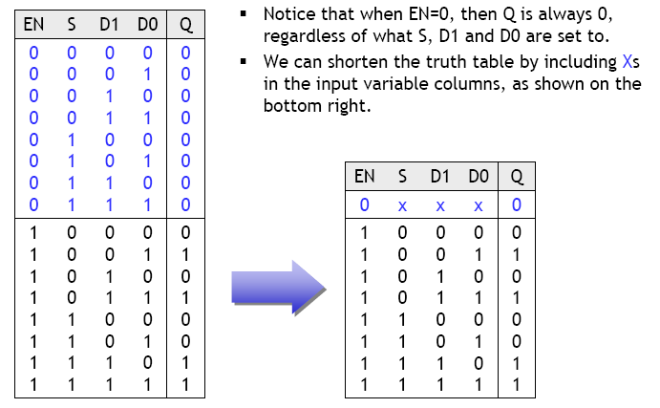
Truth table abbreviations

Slide 8
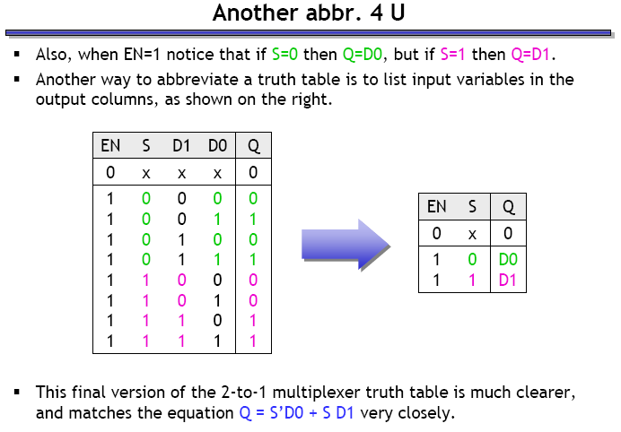
More abbreviations

Slide 9
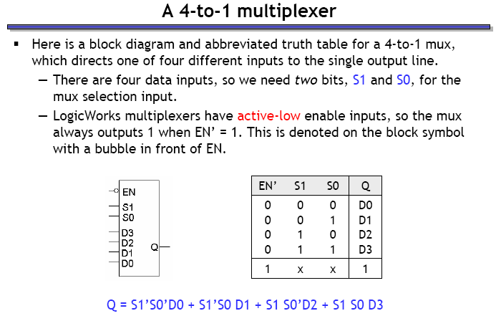
4–to–1 mux
Block diagram and truth table
What is that bubble at the input of EN?
This is an active-low enable input multiplexer, i.e. when EN pin is made 0, output will select some input; when EN pin is 1, the multiplexer outputs 1 (independent of the input)
Useful for hierarchical designs (we will see later)!

Slide 10
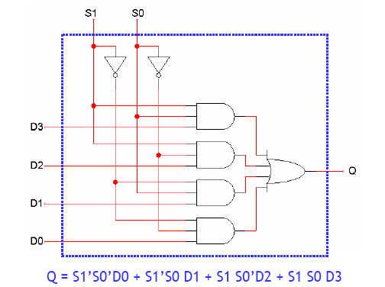
4-to-1 mux implementation

Slide 11
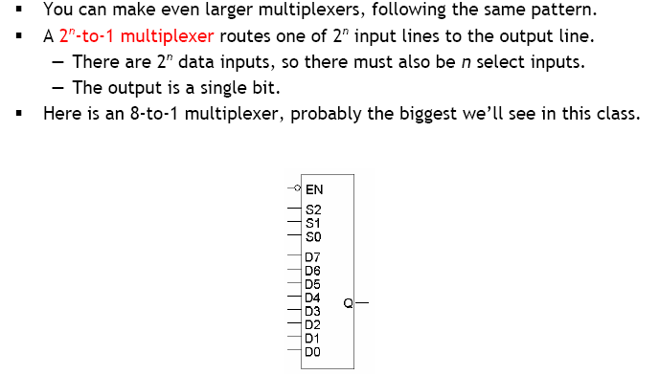
2^{n}-to-1 multiplexers

Slide 12
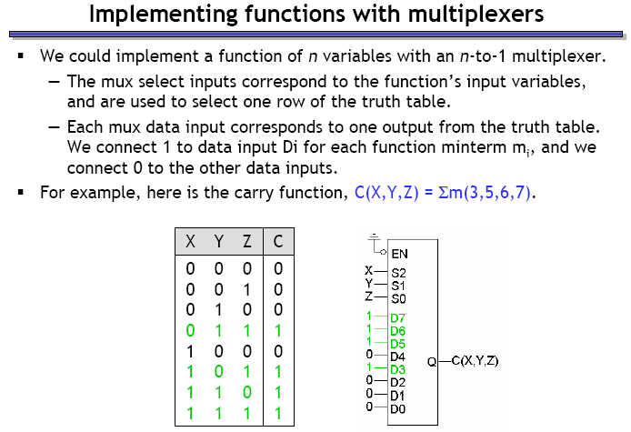
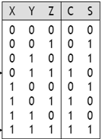
Implementing Boolean functions with muxes – addition
n variable functions use an n-input multiplexer (n-to-1)
The n variables connect to the select input pins of the mux, thereby selecting on row of the truth table
data inputs are chosen intelligently to get the correct output
For each minterm to be included in the SOP, we connect the corresponding data input of the mux to 1; rest to 0

Slide 13
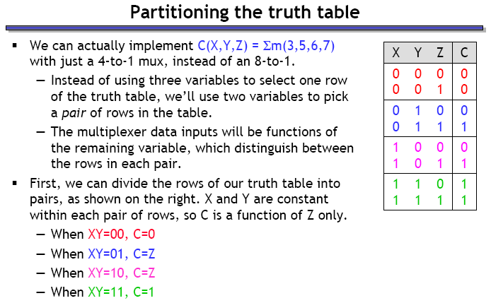
An adder with a smaller mux

Slide 14
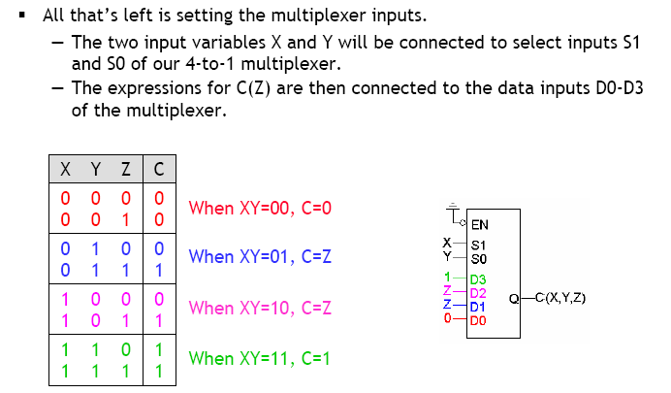
An adder with a smaller mux

Slide 15
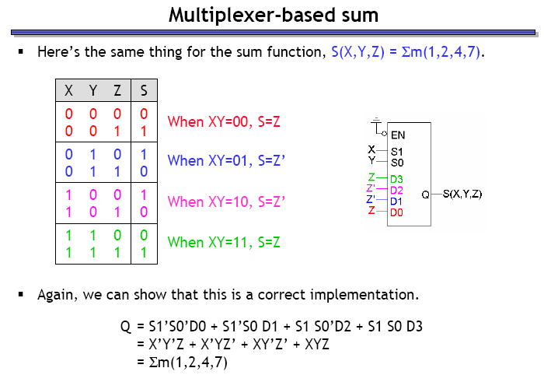
Adder with smaller mux – implement the sum

Slide 16
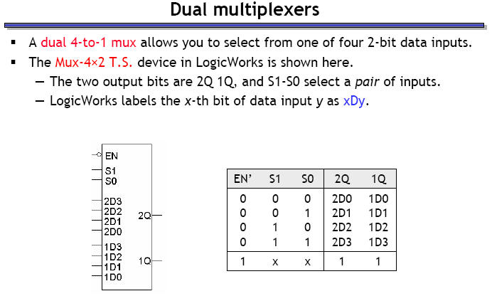
Dual multiplexers
Dual 4-to-1 mux: Instead of selecting 1 out of 4 input bits, selects 1 2-bit input out of 4 2-bit inputs

Slide 17
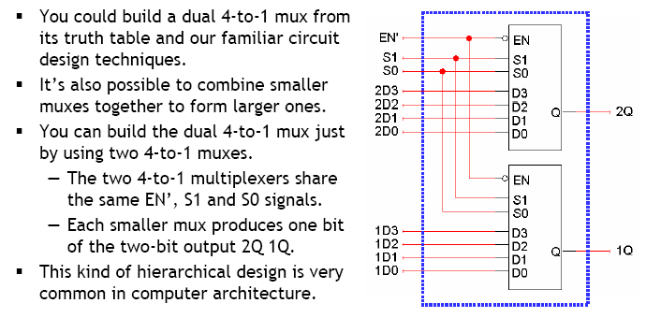
Building dual multiplexers

Slide 18
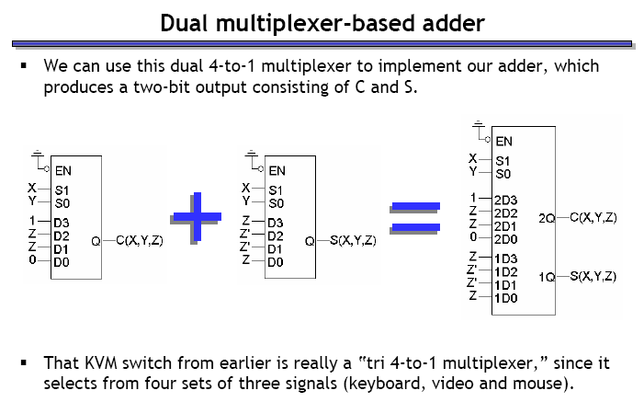
Adder with dual mux – combining sum and carry in a single device

Slide 19
Example
Implement the Boolean function F(A,B,C,D) = Σ (0,1,3,4,8,9,15)

Slide 20
De-multiplexers
Transmit information from a single line on to one of 2^{n} lines
Selection of output line determined by n select lines
A decoder with enable input can function as a demux

Slide 21
Finishing up combinational circuits!

Slide 22
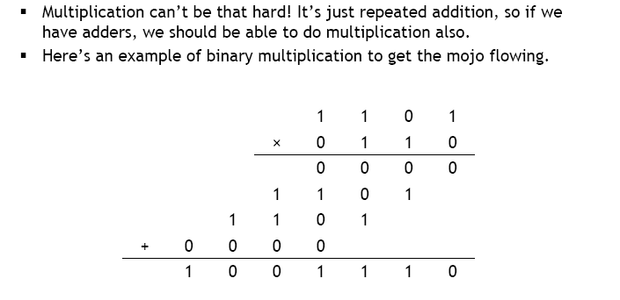
Multipliers

Slide 23
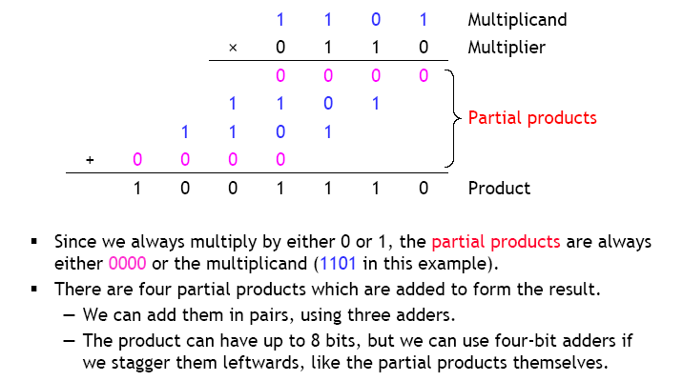
Binary multiplication

Slide 24
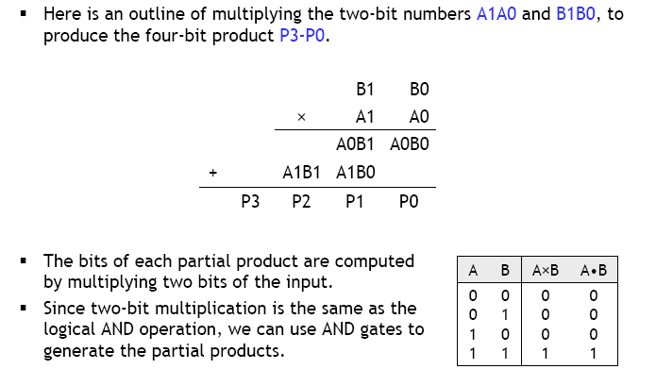
2 x 2 multiplication

Slide 25
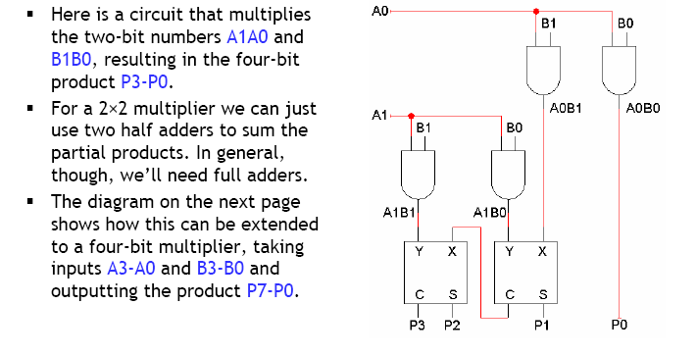
2 x 2 multiplication

Slide 26
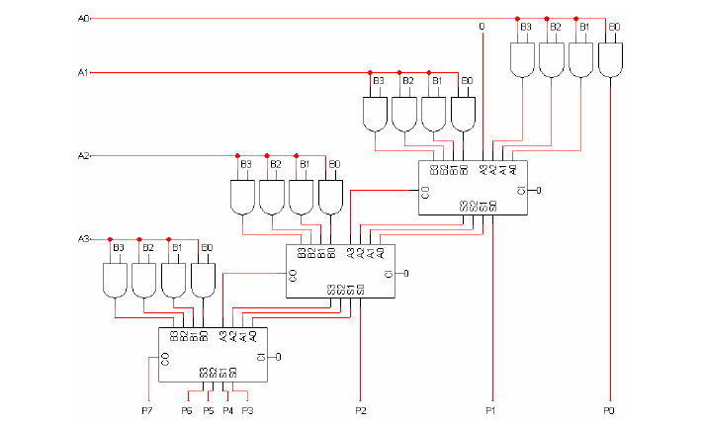
4 x 4 multiplication

