Slide 1
BITS Pilani Digital Design
Prof. GSS Chalapathi, Prof. Saurabh Gandhi (EEE department)

Slide 2
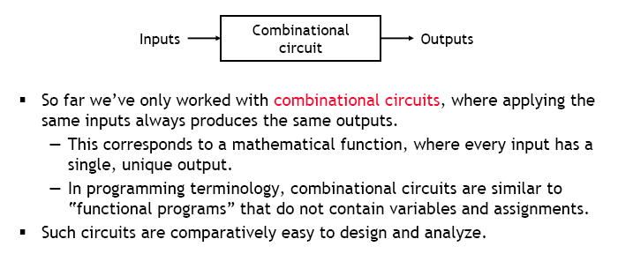
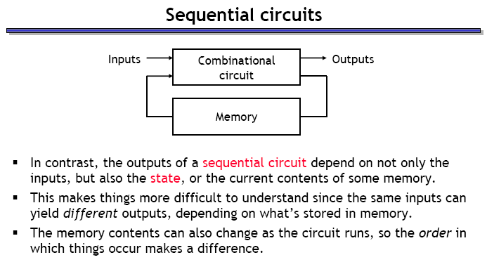
Sequential circuits

Slide 3
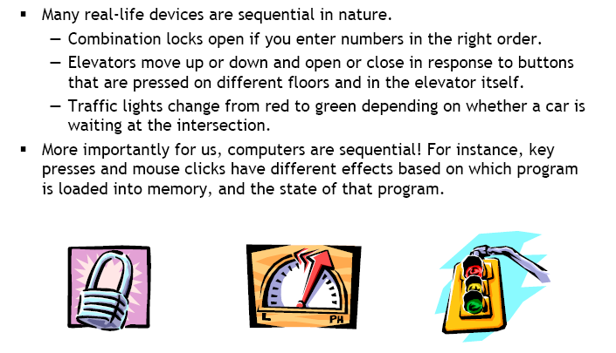
Examples of sequential devices

Slide 4
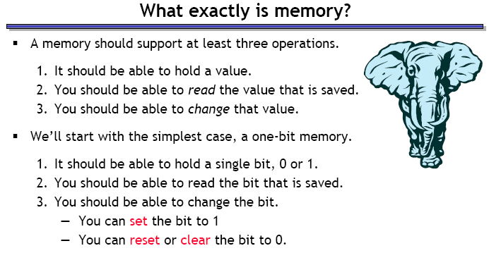
What is memory?

Slide 5
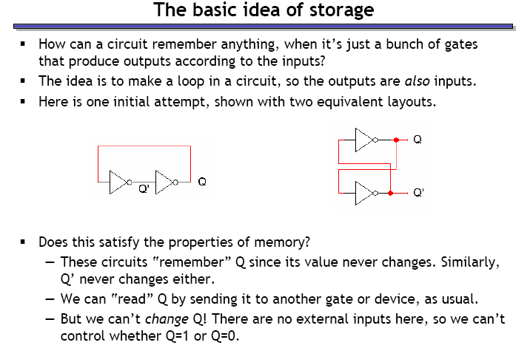
Storing a bit in a digital device

Slide 6
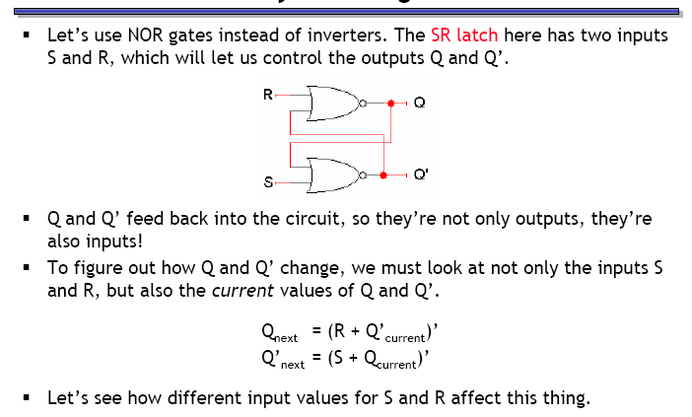
Storing a changeable bit in a device

Slide 7
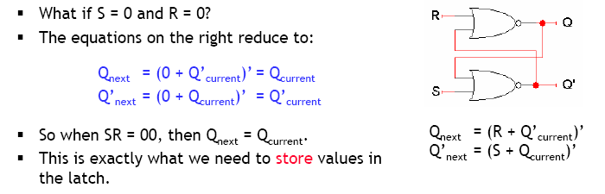
Storing a value (SR = 00)

Slide 8
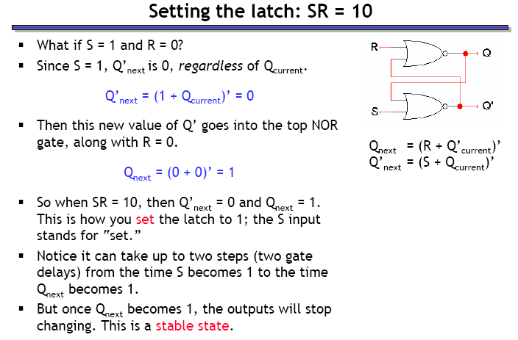
Setting the latch (SR = 10)

Slide 9
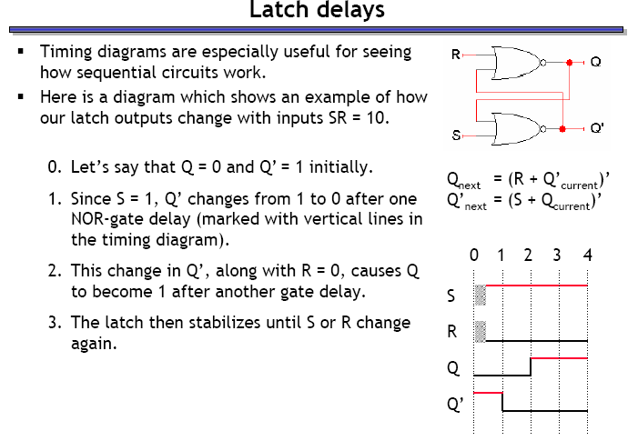
Latch delays

Slide 10
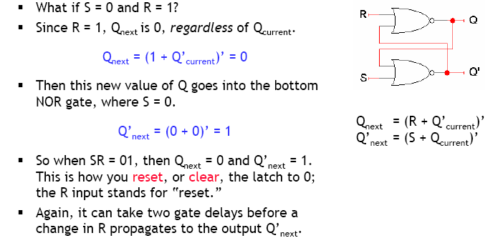
Resetting the latch (SR = 01)

Slide 11
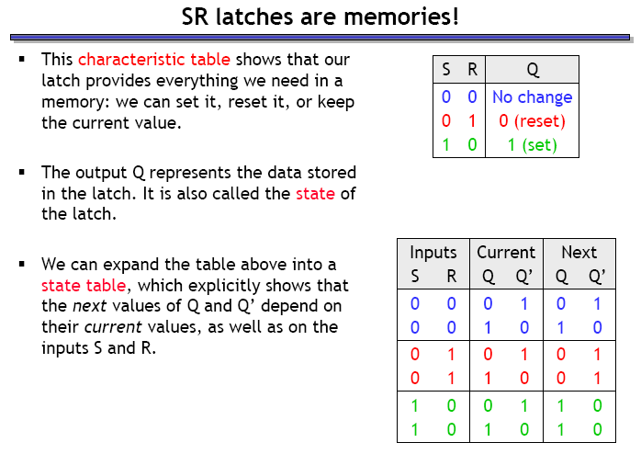
SR latch forms a memory unit

Slide 12
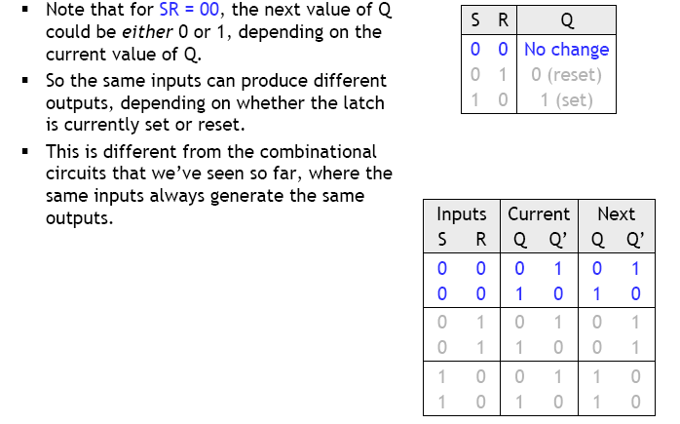
SR latches are sequential

Slide 13
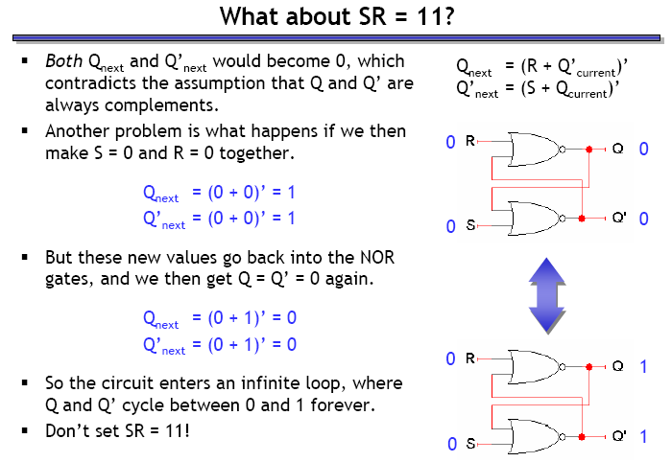
What happens when SR = 11?
The
Really?
This is the real purpose of your lab, go try it out!

Slide 14
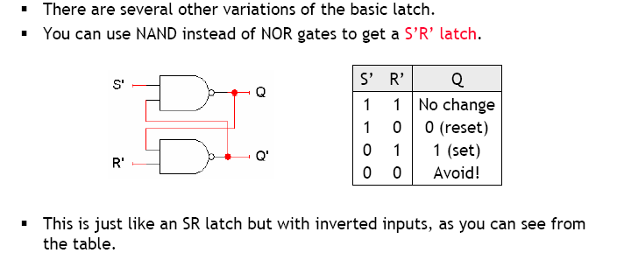
S’R’ latch

Slide 15
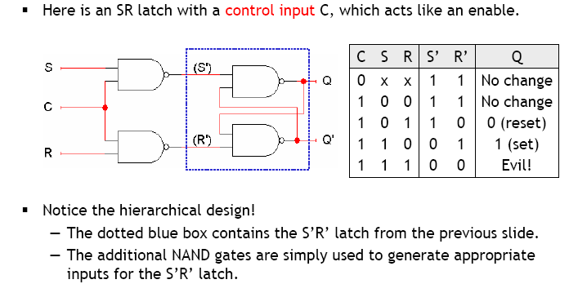
SR latch with control input

Slide 16
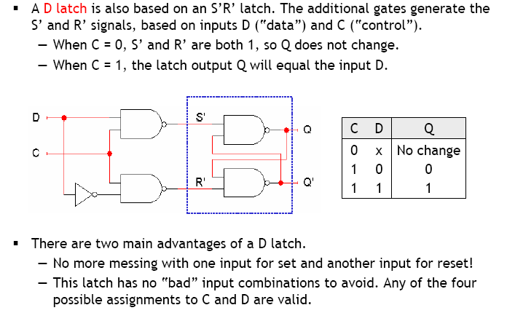
The D latch (D = Data)

Slide 17
Flip-flops
Latches are transparent i.e. any change on inputs is immediately reflected in the output
When control signal is high, data continuously flows from input to output
Terminology: Latches are ‘level sensitive’
Synchronization across multiple memory units might become difficult and unpredictable
Solution: ‘edge sensitive’ memory units, called flip-flops, that respond only at specific times

Slide 18
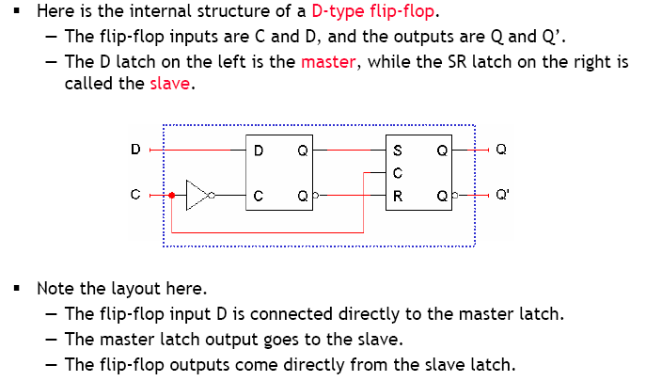
D flip-flop (D = Data or Delay…)

Slide 19
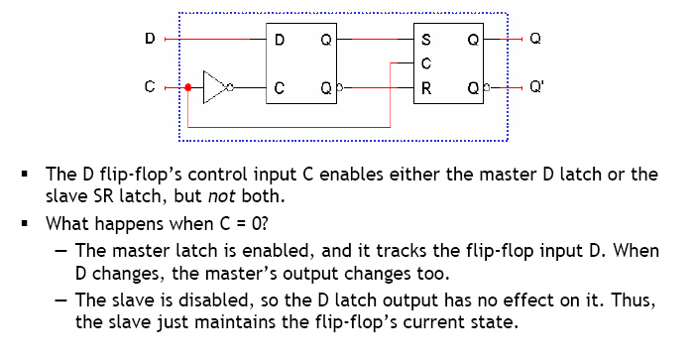
Working of D the flip-flop: C = 0

Slide 20
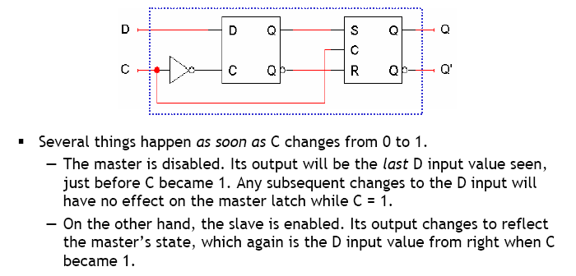
Working of D the flip-flop: C = 1

Slide 21
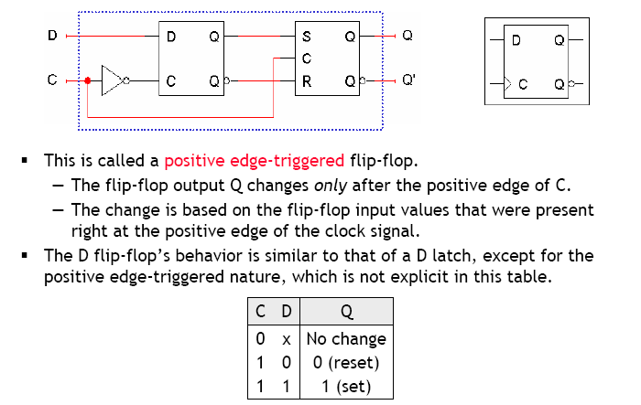
Positive edge triggering

Slide 22
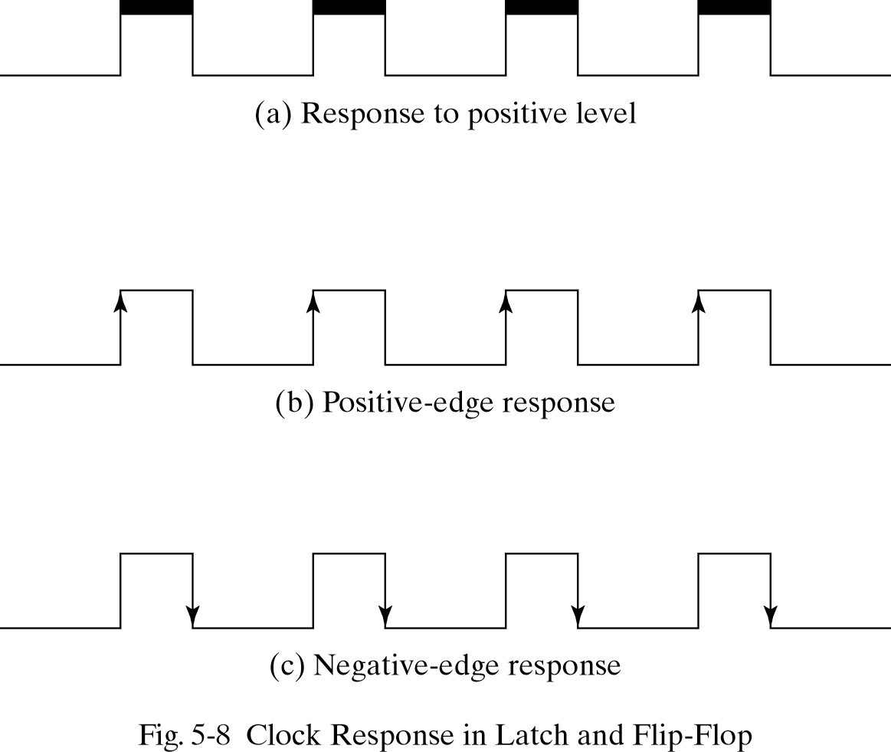
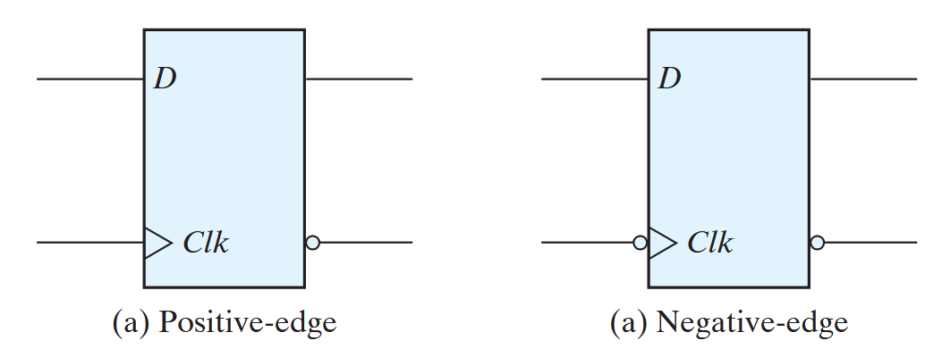
Level vs edge triggering summary

Slide 23
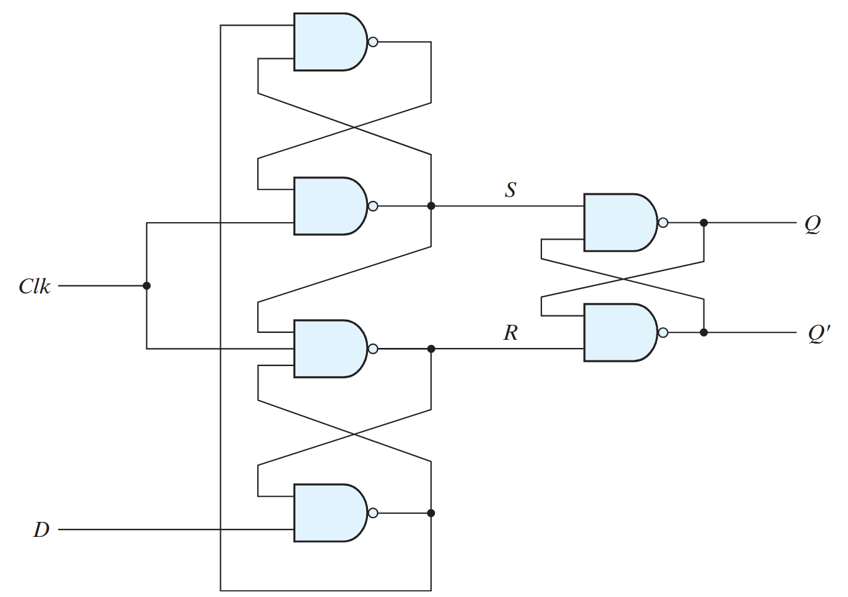
Another design of the D flip-flop

Slide 24
Working of the 3-latch design
Case I:
D = 0, CLK = 0
D = 0 => B = 1
CLK = 0 => R = 1, S = 1
B = 1, S = 1 => A = 0
ASRB = 0111
SR = 11 => No change in Q
A
B

Slide 25
Working of the 3-latch design
In case I (i.e., ASRB=0111) make CLK=1
D = 0 => B = 1
B = 1, S = 1 => A = 0
A = 0 => S = 1
S = 1, B = 1, CLK = 1 => R = 0
SR = 10 => RESET
ASRB = 0101
Only R has changed here after one gate delay.
What happens if D changes now:
If D changes after R has stabilized there will be no effect on output.
This is Hold Time.
A
B

Slide 26
Working of the 3-latch design
A
Case II:
D = 1, CLK = 0
CLK = 0 => R = 1, S = 1
D = 1, R = 1 => B = 0
B = 0, S = 1 => A = 1
ASRB = 1110
SR = 11 => No change
B

Slide 27
Working of the 3-latch design
A
In case II make CLK = 1
ASRB = 1110
R = 1, D = 1 => B = 0
B = 0, => A = 1
A = 1, CLK = 1 => S = 0 => R = 1
SR = 01 => SET
ASRB = 1010
B

Slide 28
Working of the 3-latch design
From D = 1, CLK = 0 what if we suddenly changed to D = 0, CLK = 1?
ASRB = 1110
D = 0 => B = 1
CLK = 1, A = 1 => S = 0
S = 0, B = 1 => A = 1
S = 0, B = 1, CLK = 1 => R = 1
SR = 01 => SET
ASRB = 1011
Wrong result
Correct sequence will be:
Go from case II to case I, i.e., let ASRB change from 1110 to 0111. Here A takes two gate delays to change. This is Setup time.
Now go from case I to D = 0, CLK = 1.
A
B

Slide 29
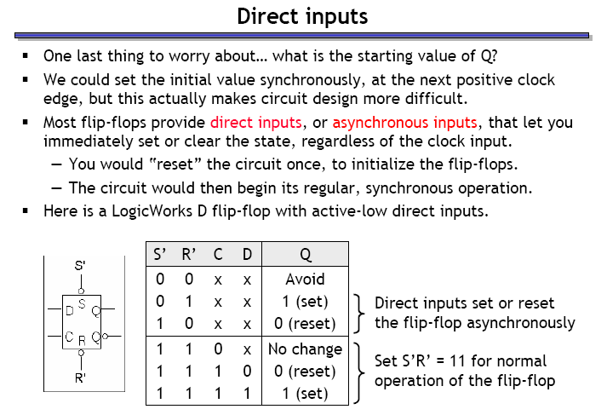
Flip-flops with direct inputs

Slide 30
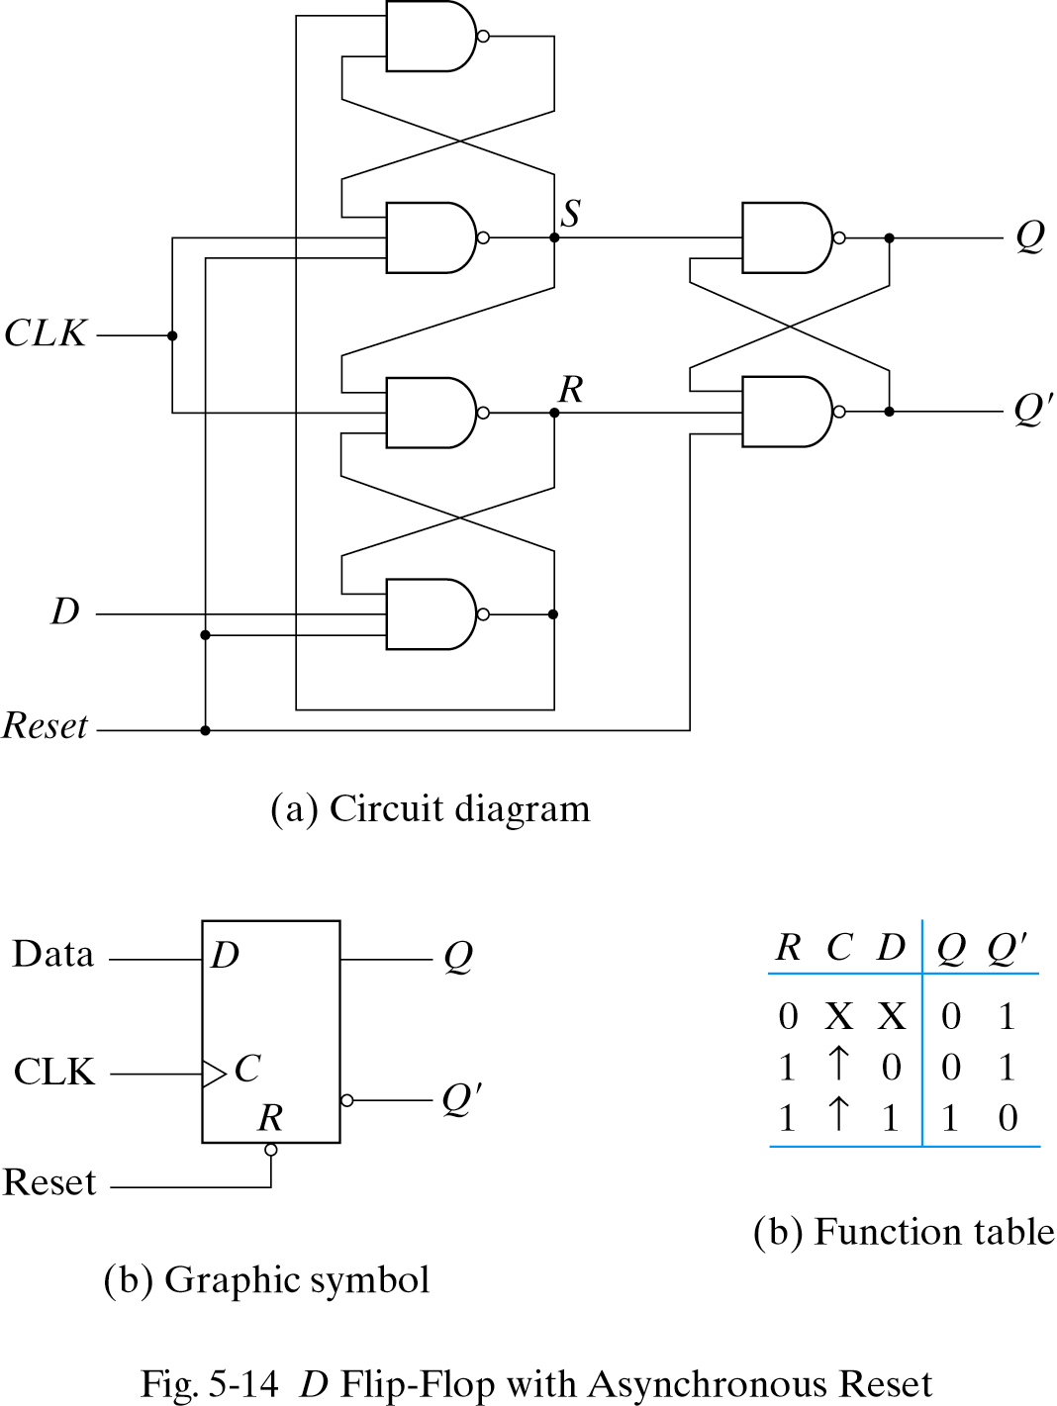
D flip-flop with asynchronous reset

Slide 31
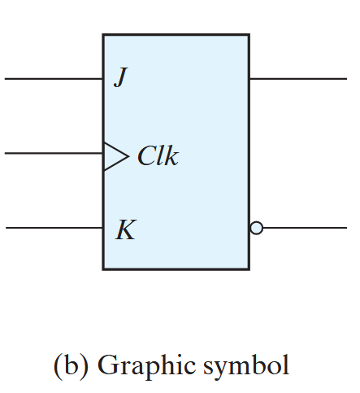
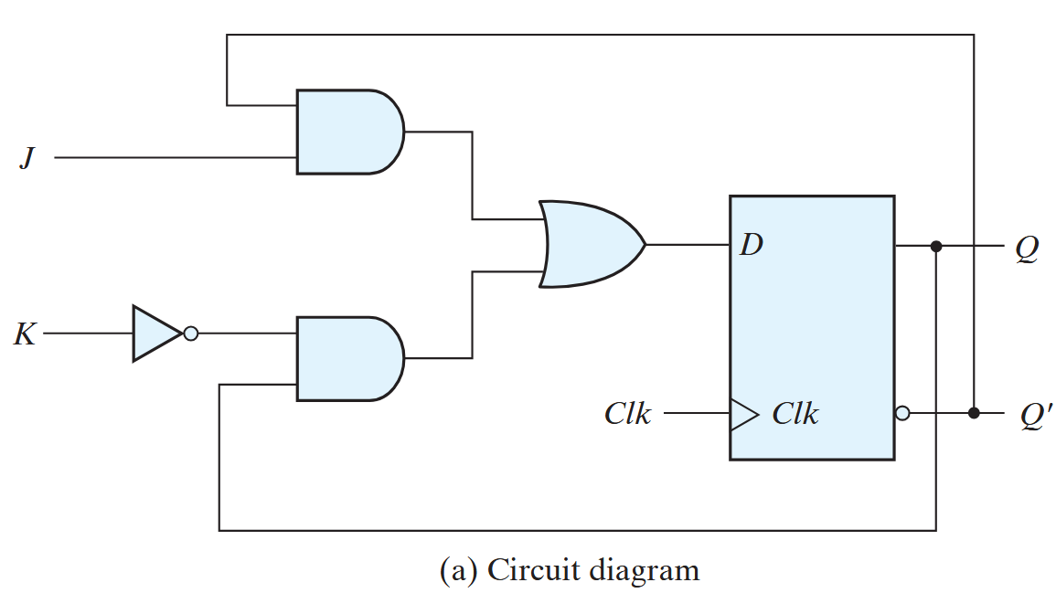

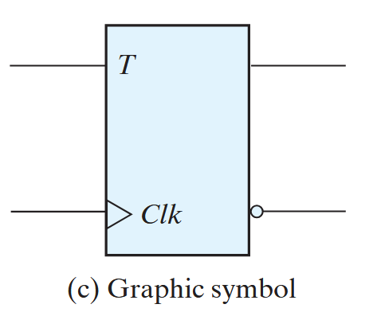
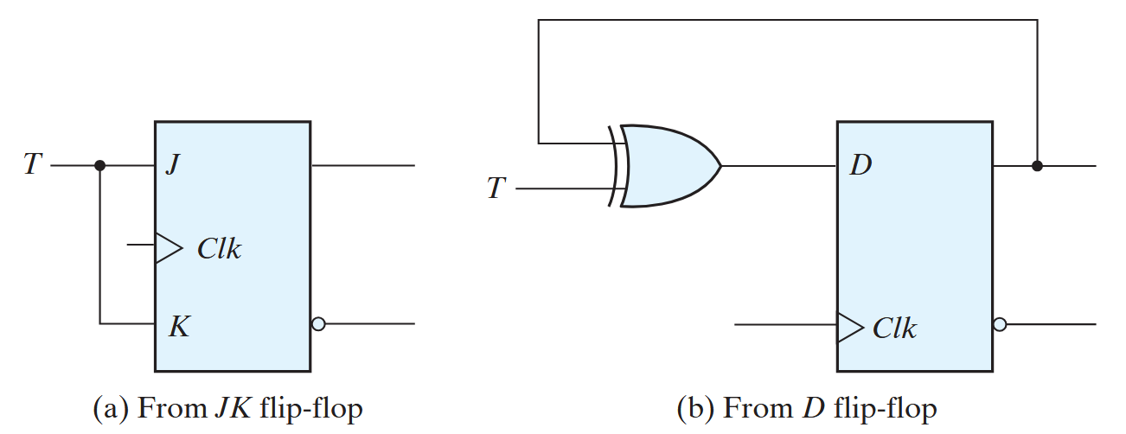
Other types of flip-flops
There are three operations that can be performed with a flip-flop:
Set it to 1
Reset it to 0
Complement its output
D flip-flop can set or reset the output, no toggle
JK flip-flop has two inputs and performs all three operations
The J input sets the flip-flop to 1
The K input resets it to 0
When both inputs are enabled, the output is complemented
T (toggle) flip-flop

Slide 32
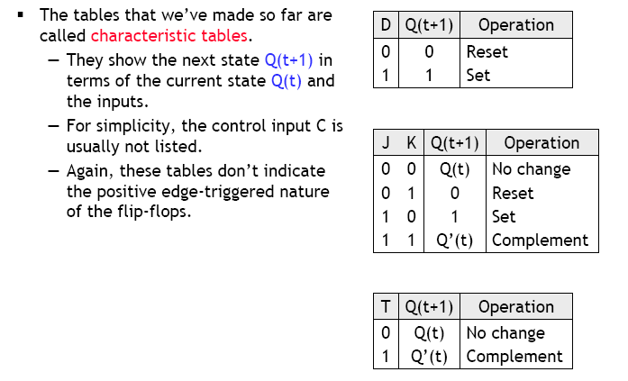
Characteristic tables

Slide 33
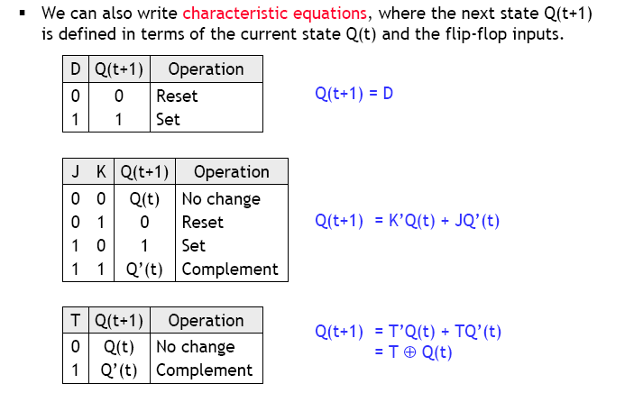
Characteristic equations

Slide 34
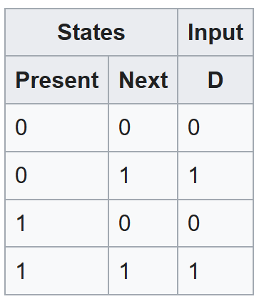
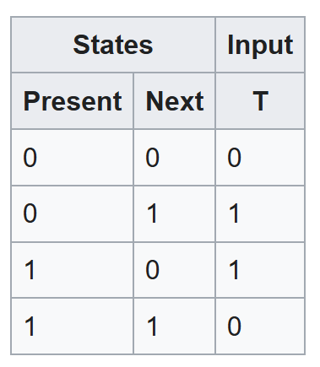
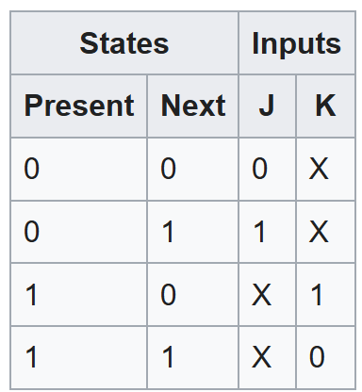
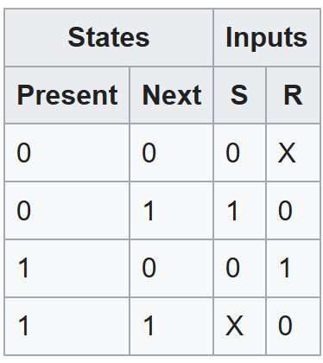
Excitation tables
Shows the minimum inputs that are necessary to generate a particular next state (in other words, to "excite" it to the next state) when the current state is known
Rearrange the data so that the current state and next state are next to each other on the left-hand side
Inputs needed to make that state change happen are shown on the right side of the table

Slide 35

Attendance!
Will be opened only during the attendance window.
Enable location on your device.
Grant any location permissions requested by the website.
Refresh the page.
Try submitting again.

Slide 36
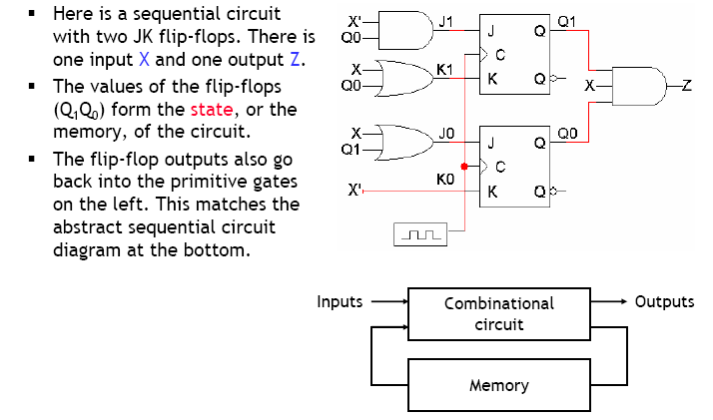
Analyzing sequential circuits

Slide 37
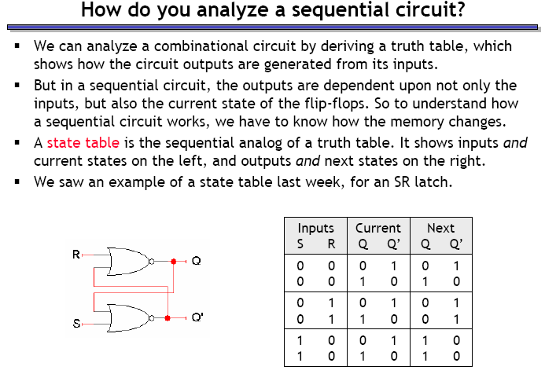
How do we begin analyzing the circuit?

Slide 38
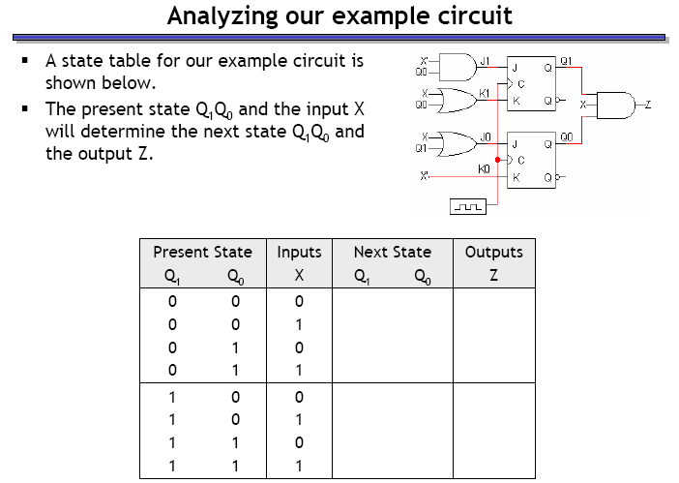
Analyzing our example circuit

Slide 39
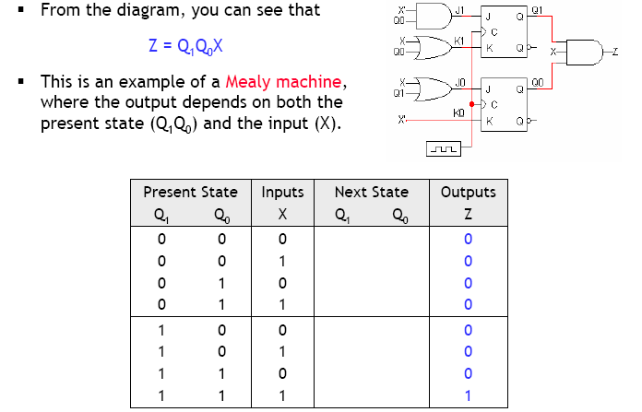
Finding the outputs

Slide 40
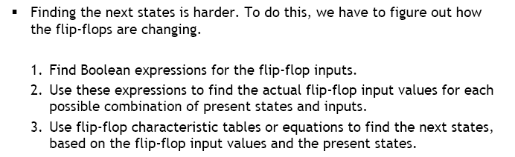
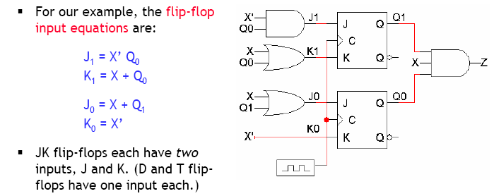
Finding next states

Slide 41
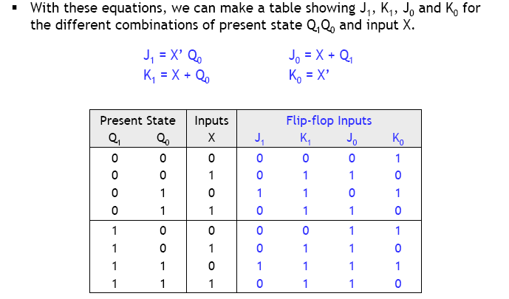
Flip flop input values

Slide 42
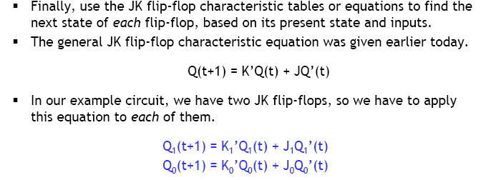
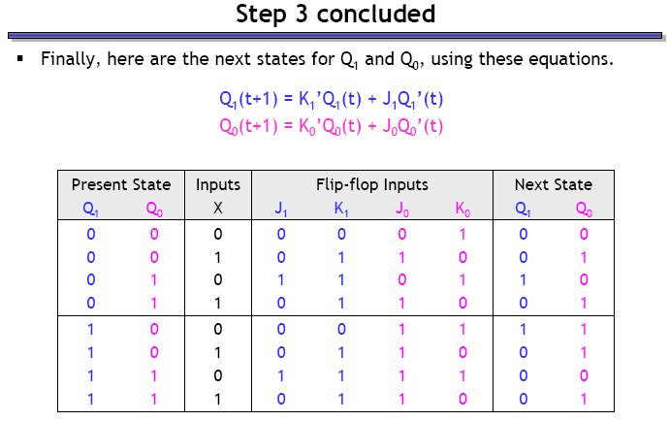
Finding the next states

Slide 43
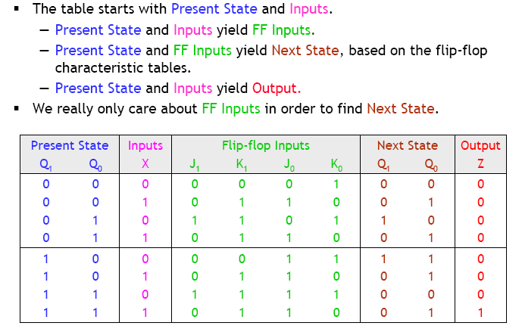
State table

Slide 44
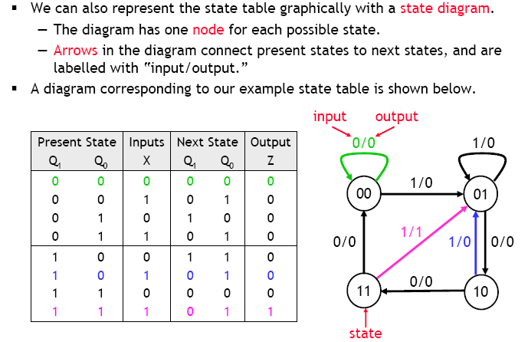
State diagrams

Slide 45
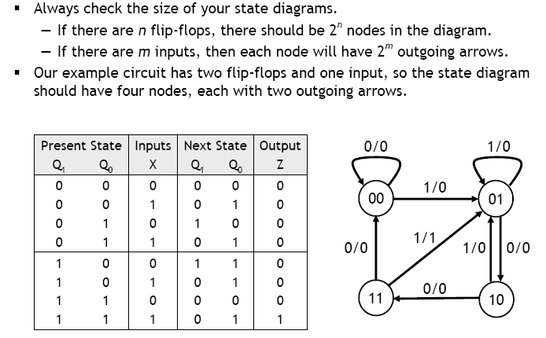
Size of the state diagram

Slide 46
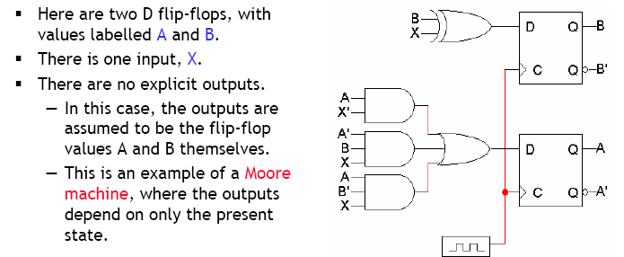
Example

Slide 47
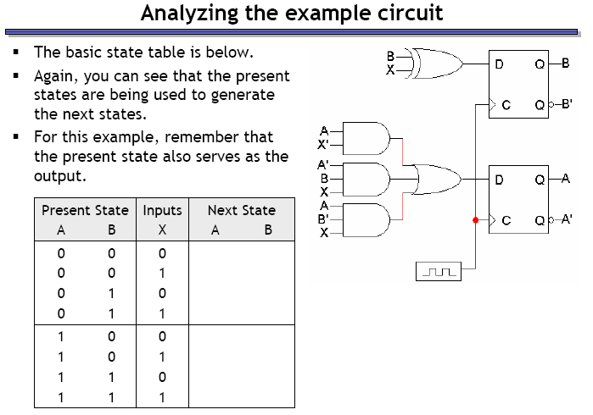
Example – circuit analysis

Slide 48
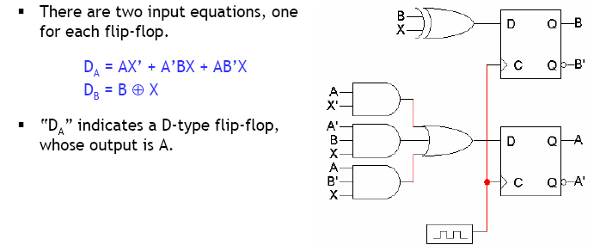
Step 1: Flip flop input equations

Slide 49

Step 2: Flip flop input values

Slide 50

Step 3: finding next states

Slide 51

What does this circuit do?

Slide 52

Summary

