Slide 1
BITS Pilani Digital Design
Prof. GSS Chalapathi, Prof. Saurabh Gandhi (EEE department)

Slide 2
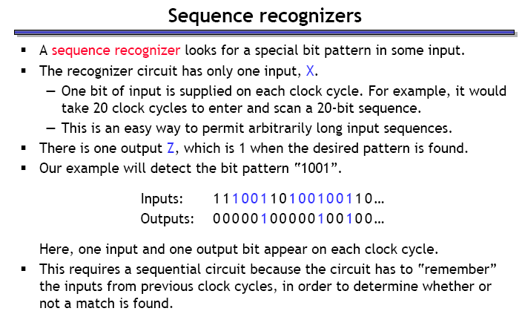
Design of sequential circuits

Slide 3
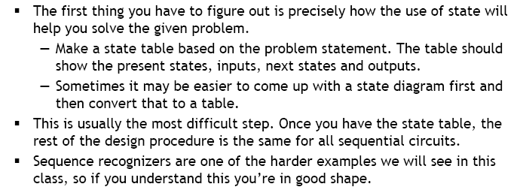
Step 1.1: Make the state diagram

Slide 4
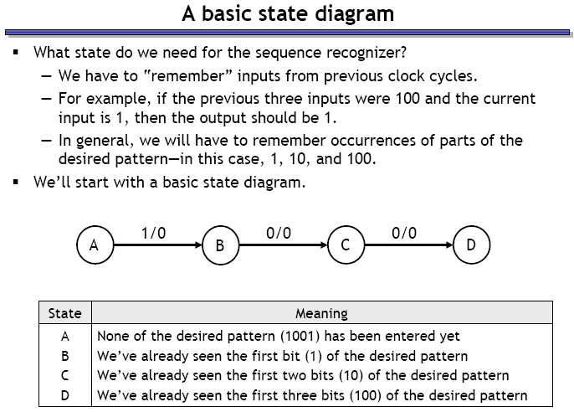
Sequence recognizer state diagram

Slide 5
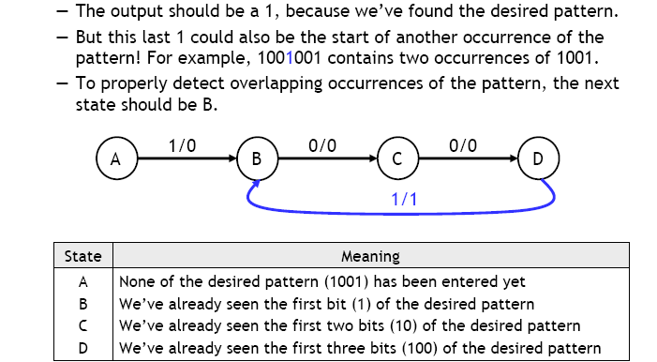
Where should the system go from D?

Slide 6
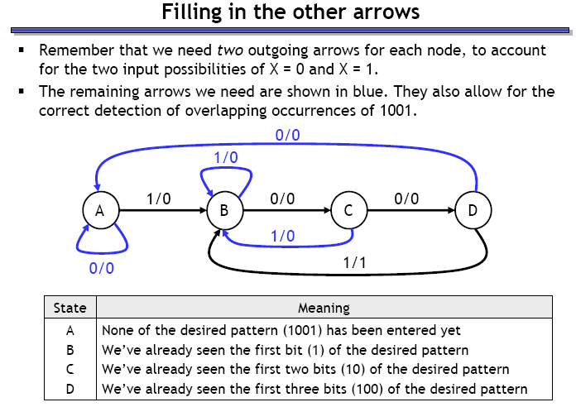
What about other state transitions?

Slide 7
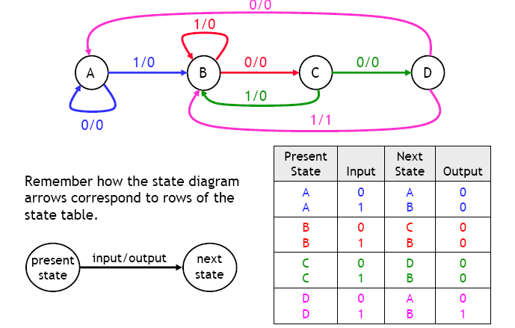
Step 1.2: make the state table

Slide 8
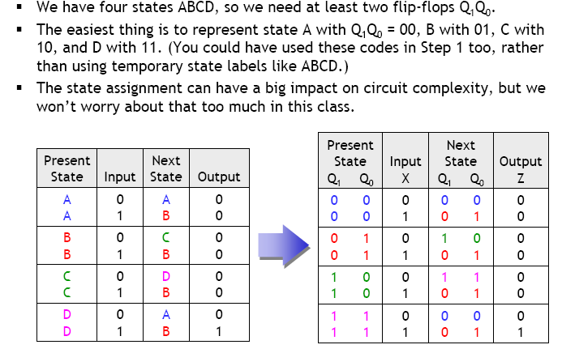
Step 2: Assign binary codes to states (to store them in flip-flops)

Slide 9
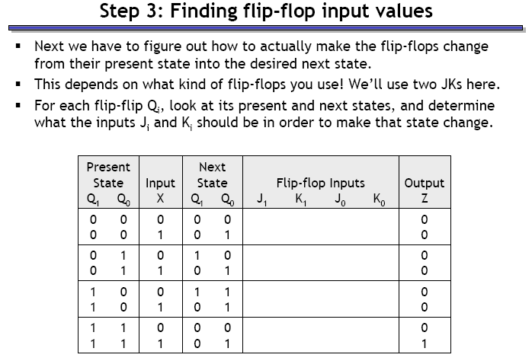
Step 3: Find flip-flop input values

Slide 10
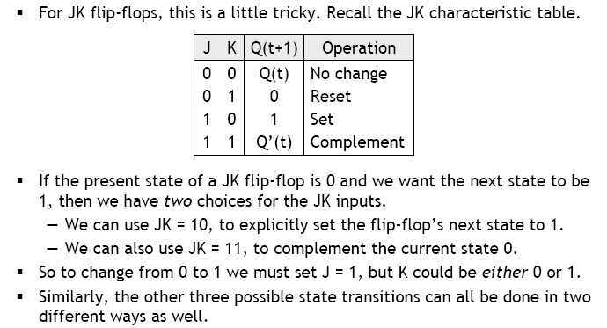
JK flip-flop input values

Slide 11
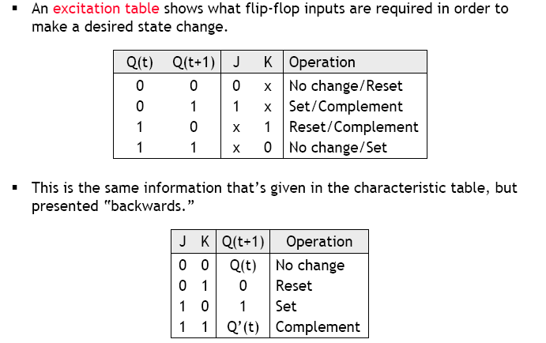
JK flip-flop excitation table

Slide 12
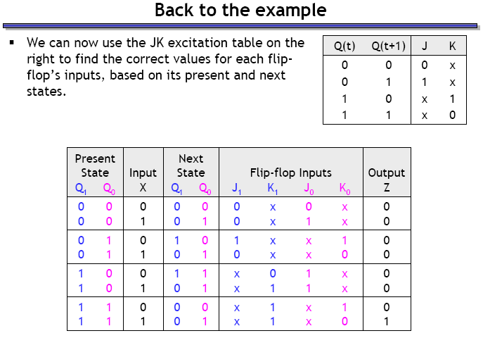
Use excitation table to complete the expanded state table

Slide 13
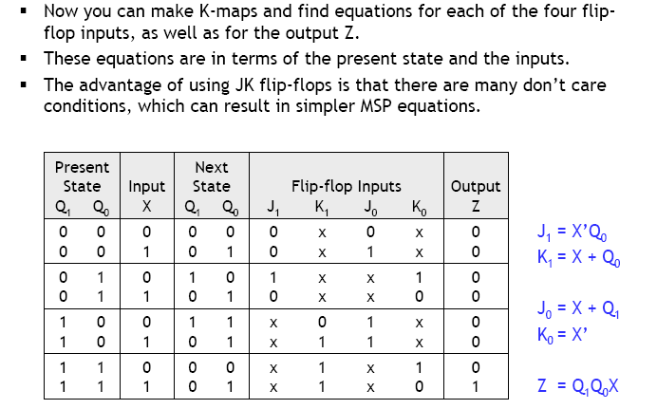
Step 4: Find equations for flip-flop input and output

Slide 14
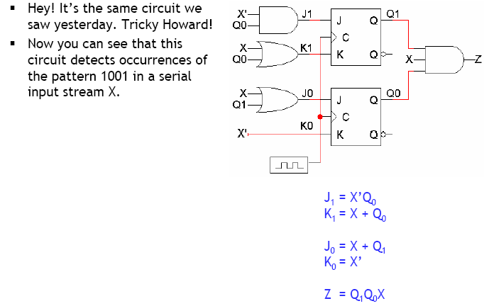
Step 5: Build the circuit!

Slide 15
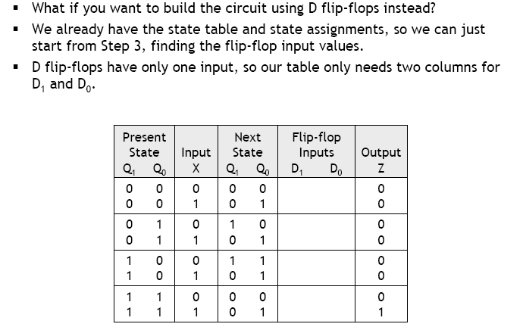
Example: same circuit with D FFs

Slide 16
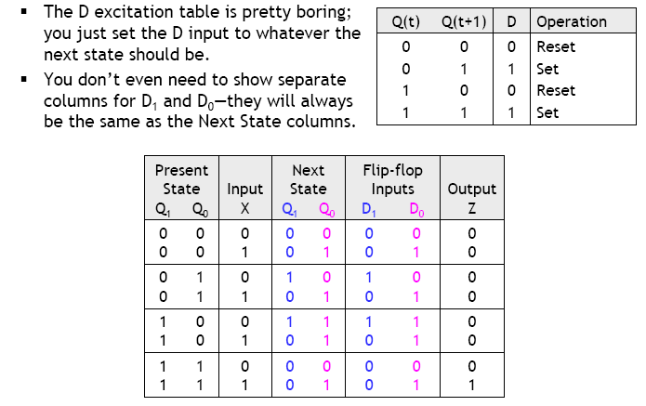
Back to step 3 with D FFs

Slide 17
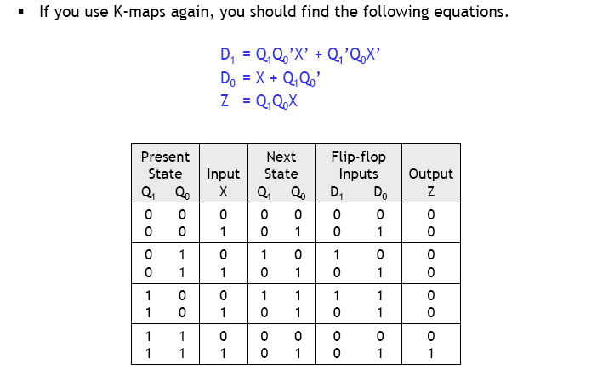
Step 4: Finding equations

Slide 18
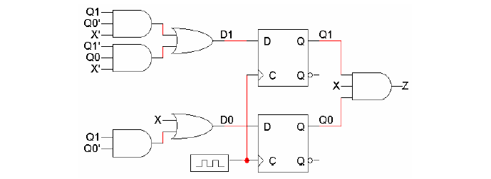
Step 5: Building the circuit

Slide 19
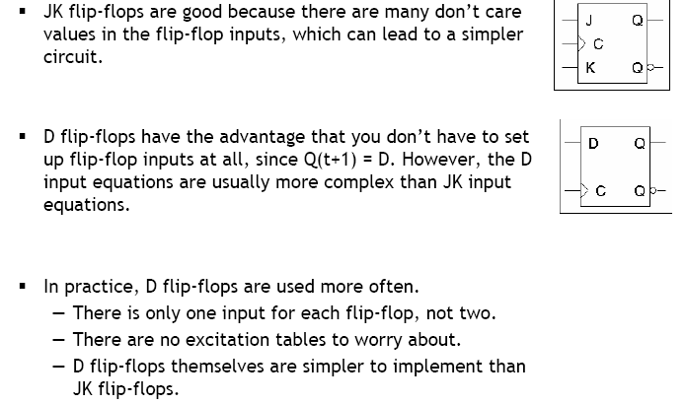
D vs JK flip flops

Slide 20
Counters
A counter is a register that goes through a predetermined sequence of states upon the application of clock pulses.
Categorized as:
Ripple counters The FF output transition serves as a source for triggering other FFs. NO COMMON CLOCK.
Synchronous counters All FFs receive the common clock pulse, and the change of state is determined based on the present state

Slide 21
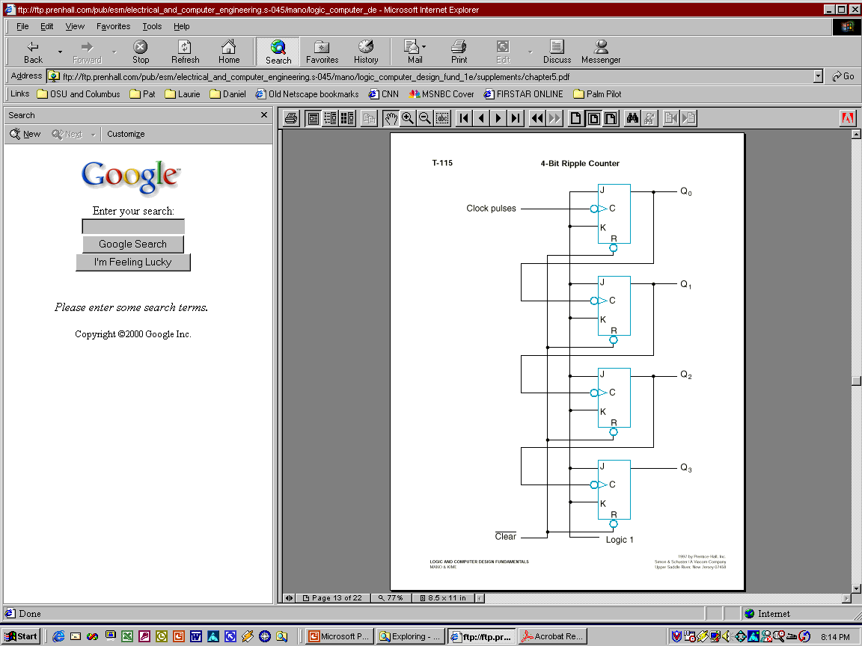
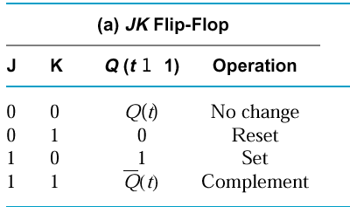
4-bit binary up counter
Less significant bit serves as the clock for the next significant bit (negative edge clock)

Slide 22
4-bit binary up counter
The output of each FF is connected to the C input of the next FF in sequence.
The FF holding the least significant bit receives the incoming clock pulses.
The J and K inputs of all FFs are connected to a permanent logic 1.
The bubble next to the C label indicates that the FFs respond to the negative-going transition of the input.

Slide 23
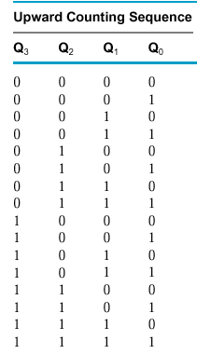
4-bit binary up counter

Slide 24
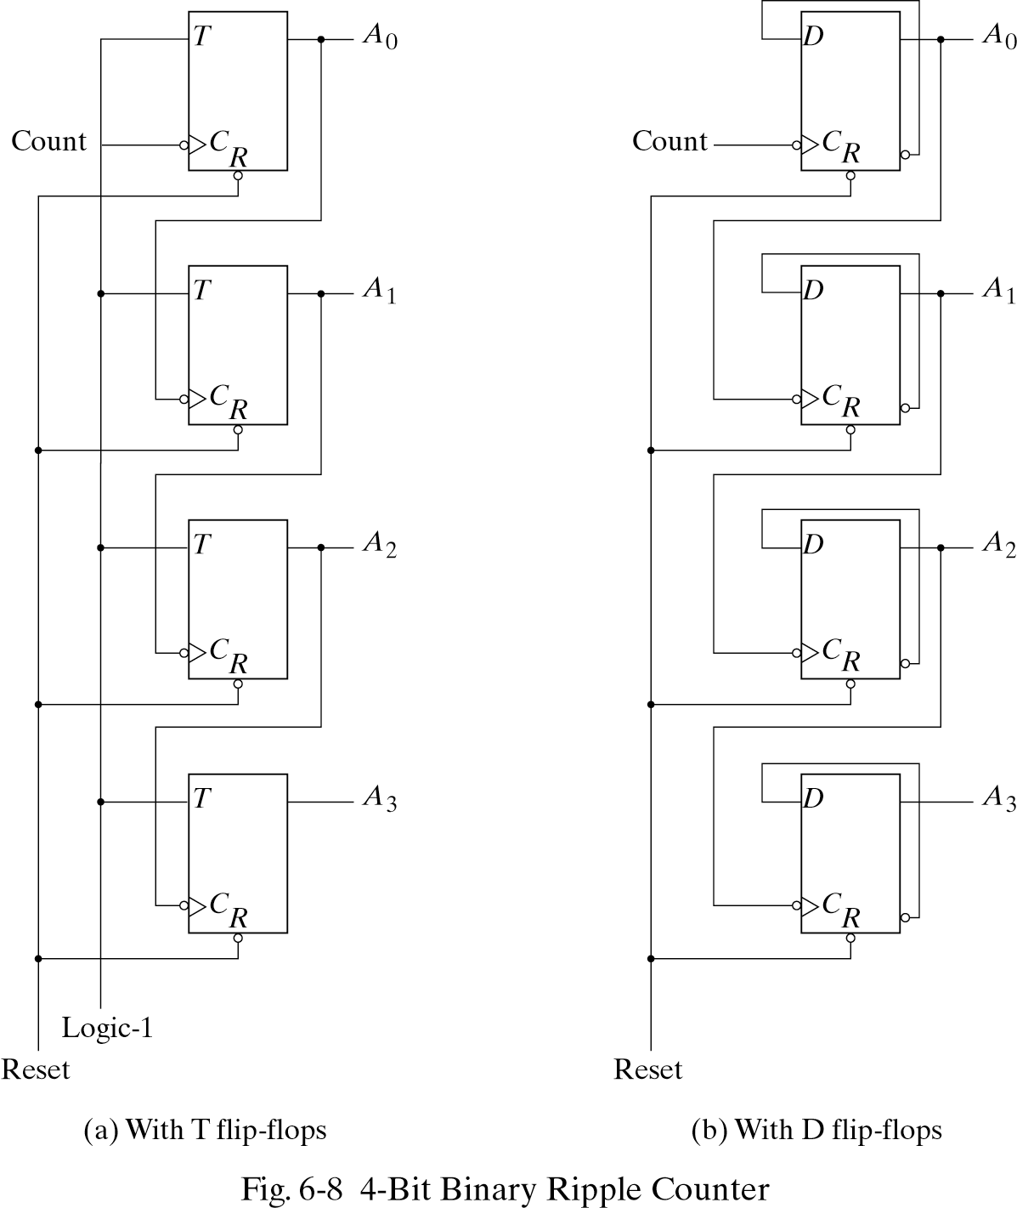
4-bit ripple counters (other designs)

Slide 25
4-bit binary down counter
Use direct set (S) instead of direct reset (R) to start at 1111 instead of 0000
Design the rest on your own…

Slide 26
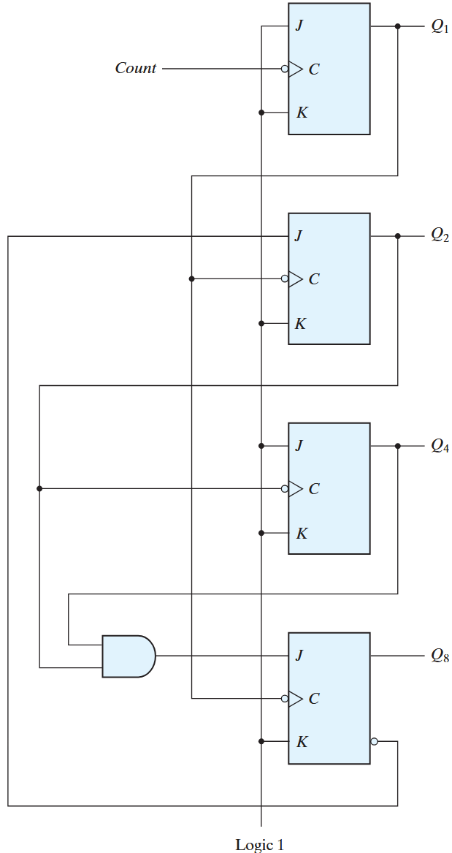
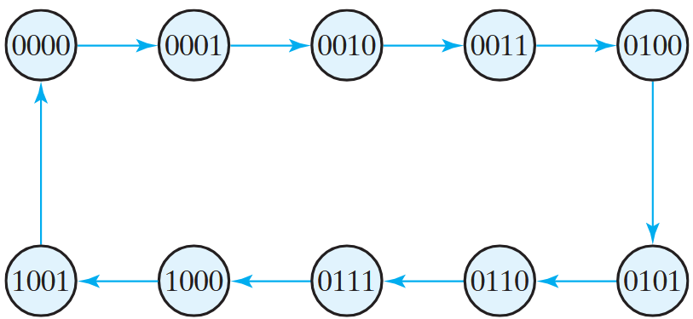
BCD ripple counter
Q1 complemented on every clock edge
Q2 complemented if Q8 = 0, Q1 goes from 1 to 0.
Q2 cleared if Q8 = 1 and Q1 goes from 1 to 0
Q4 complemented when Q2 goes from 1 to 0
Q8 complemented when Q4Q2 = 11, Q1 goes from 1 to 0.
Q8 cleared if either Q4 or Q2 is 0 and Q1 goes from 1 to 0

Slide 27
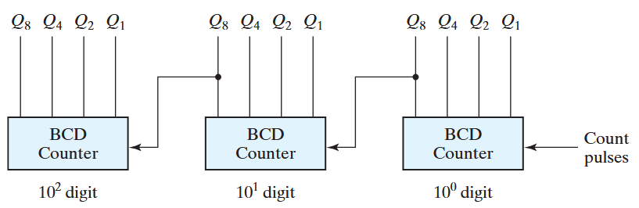
The ‘ripple’ in BCD ripple counters

Slide 28

Attendance!
Will be opened only during the attendance window.
Enable location on your device.
Grant any location permissions requested by the website.
Refresh the page.
Try submitting again.

Slide 29
Synchronous binary counters
Same design procedure as other sequential circuits
Inputs: clock and control signals (EN, Load etc)
Outputs: FF states
Most efficient implementations use T or JK FFs

Slide 30
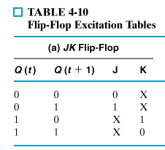
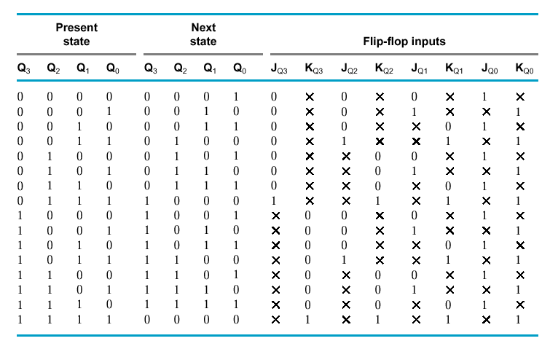

JK synchronous binary counter

Slide 31
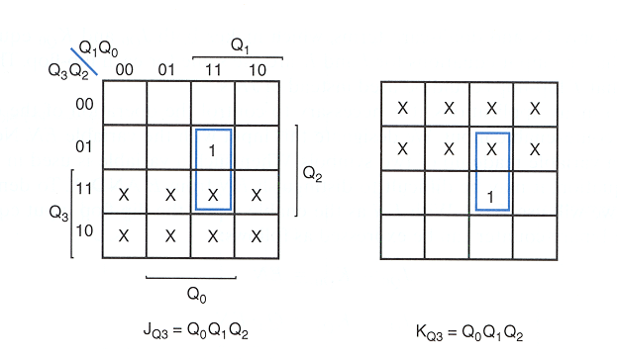
JK synchronous binary counter

Slide 32
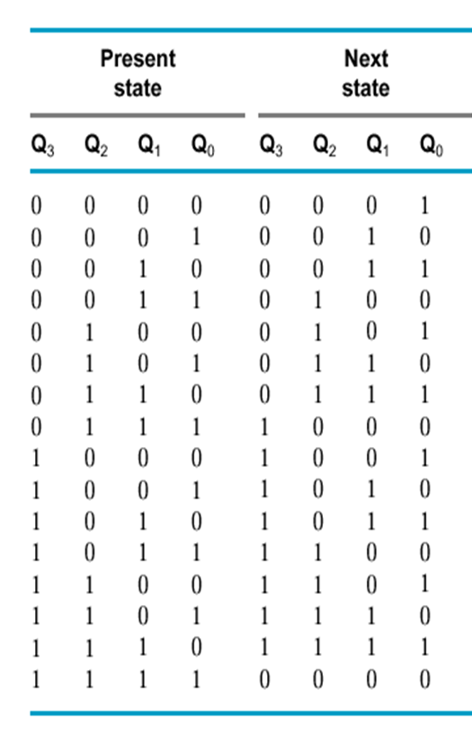
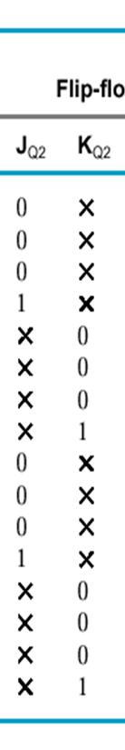
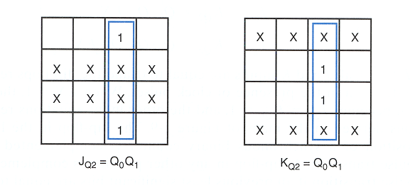
JK synchronous binary counter

Slide 33
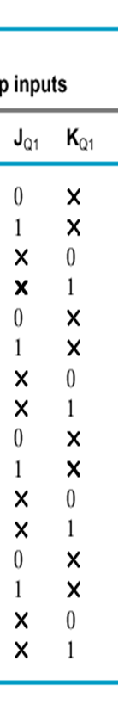
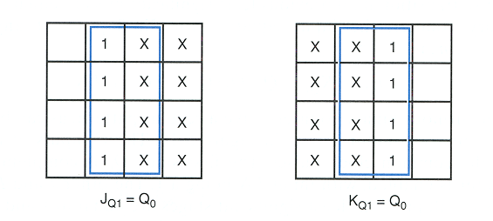
JK synchronous binary counter

Slide 34
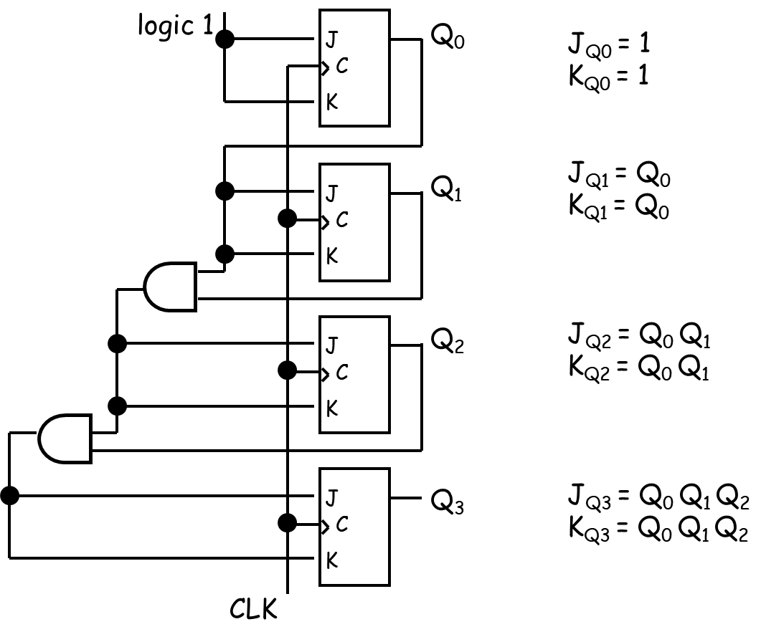
JK synchronous binary counter

Slide 35
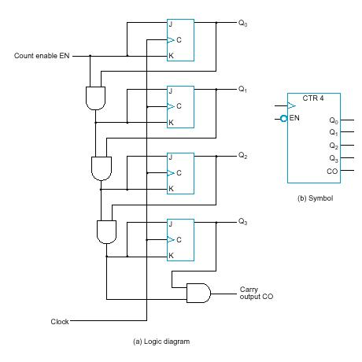
JK synchronous binary counter with EN and CO
EN = enable control signal, when 0 counter remains in the same state, when 1 it counts
J_{Q0} = 1 · EN
K_{Q0} = 1 · EN
J_{Q1} = Q₀ · EN
K_{Q1} = Q₀ · EN
J_{Q2} = Q₀ Q₁ · EN
K_{Q2} = Q₀ Q₁ · EN
J_{Q3} = Q₀ Q₁ Q₂ · EN
K_{Q3} = Q₀ Q₁ Q₂ · EN
C0 = Q₀ Q₁ Q₂ Q₃ · EN
CO = carry output signal:
used to extend the counter to more stages
…how?

Slide 36
Serial vs parallel counters
If serial gating (chain of gates, info ripples through) is used → serial counter
If serial gating is replaced with parallel gating (this is analogous with ripple-logic replaced with carry-lookeahead logic in our adder designs) → parallel counter
Advantage of parallel over serial counter: faster in certain occasions (1111 → 0000)

Slide 37
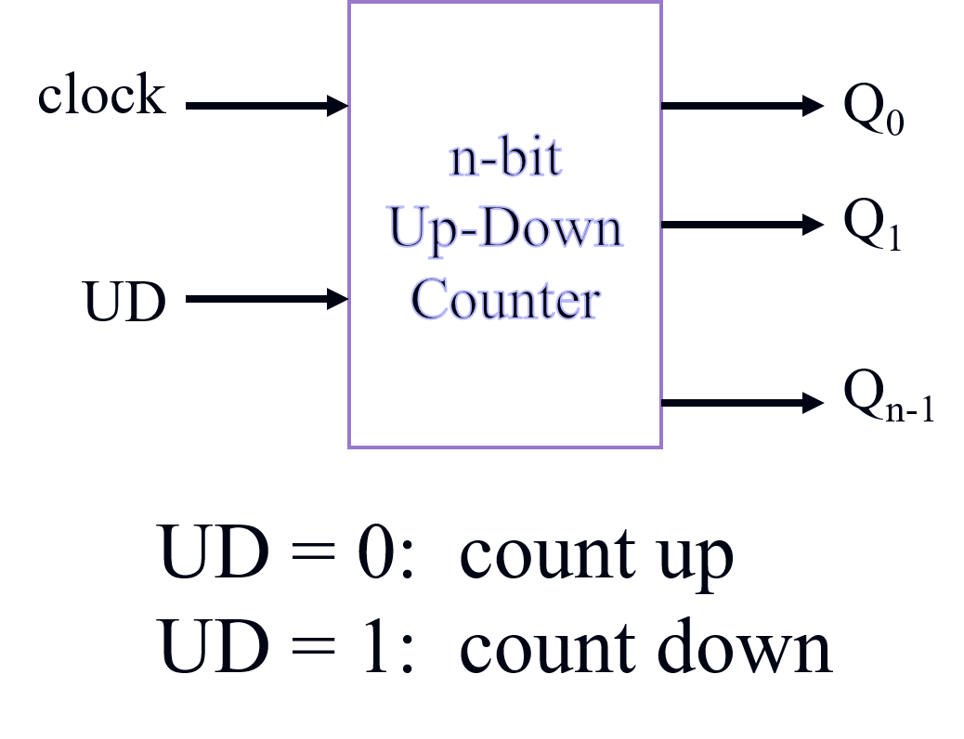
Up – Down binary counters

Slide 38
Up – Down binary counters
UD Q2 Q1 Q0 Q2.D Q1.D Q0.D
UD Q2 Q1 Q0 Q2.D Q1.D Q0.D
0 0 0 0 0 0 1
0 0 0 1 0 1 0
0 0 1 0 0 1 1
0 0 1 1 1 0 0
0 1 0 0 1 0 1
0 1 0 1 1 1 0
0 1 1 0 1 1 1
0 1 1 1 0 0 0
1 0 0 0 1 1 1
1 0 0 1 0 0 0
1 0 1 0 0 0 1
1 0 1 1 0 1 0
1 1 0 0 0 1 1
1 1 0 1 1 0 0
1 1 1 0 1 0 1
1 1 1 1 1 1 0
Up-Counter
Down-Counter

Slide 39
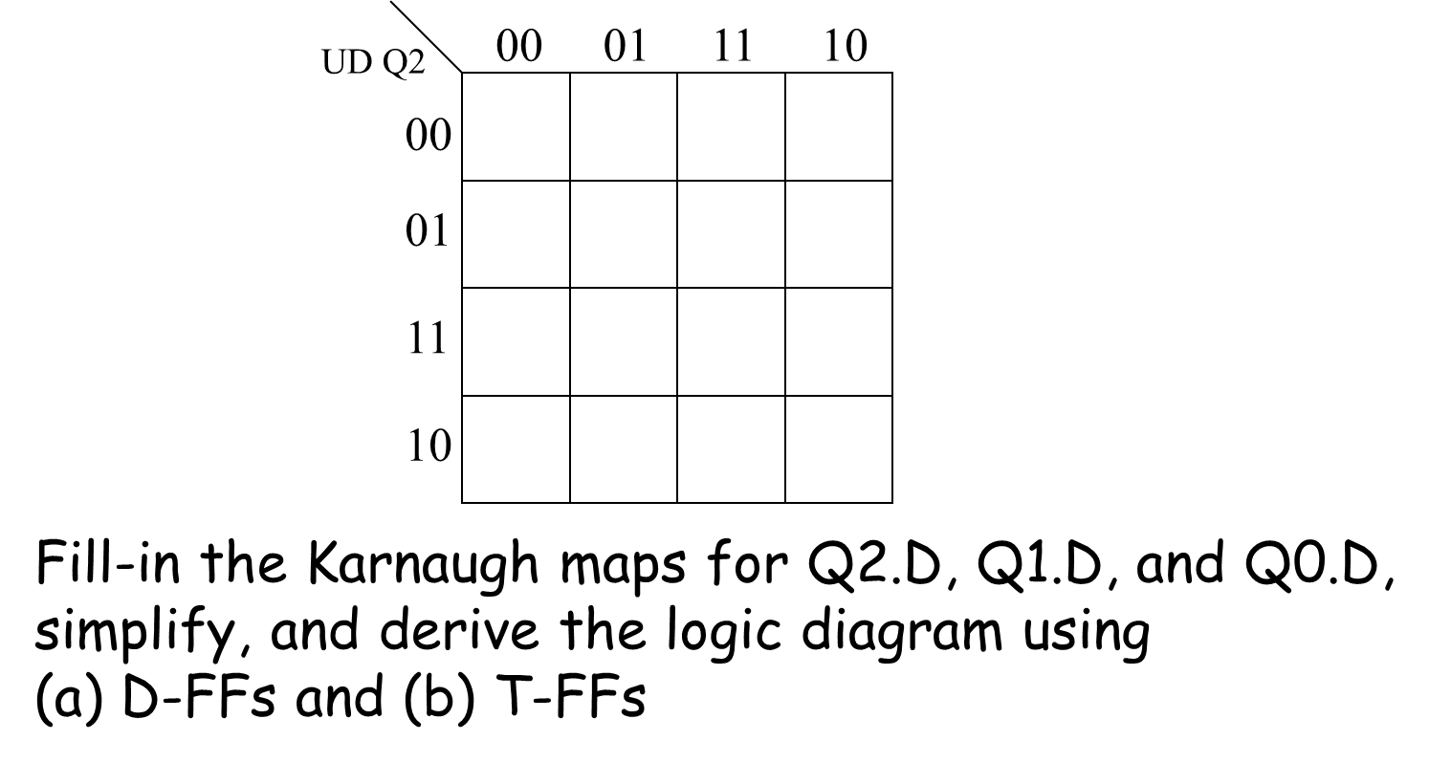
Up – Down binary counters

Slide 40
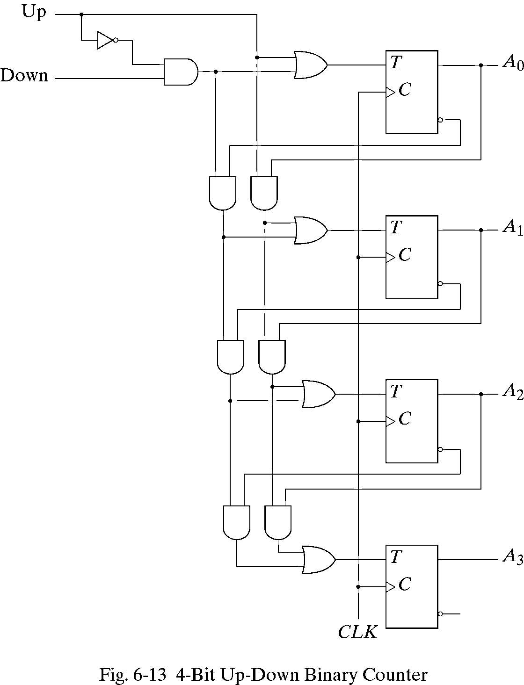
Up – Down binary counters

Slide 41
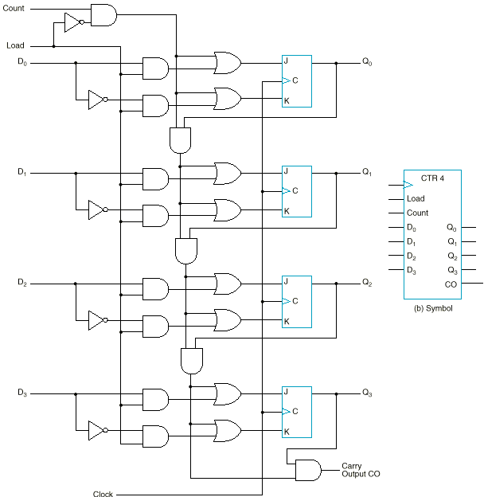
Binary counter with parallel load
Ability to set the counter to an arbitrary value to begin counting
Load | Count | Operation
0 | 0 | Nothing
0 | 1 | Count
1 | x | Load

Slide 42
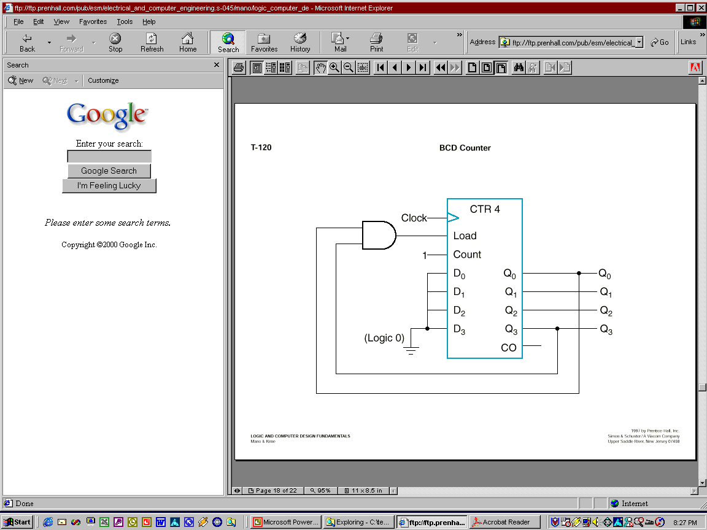
BCD counter using parallel load counter
The counter starts with an all-zero output.
As long as the output of the AND gate is 0, each positive clock pulse transition increments the counter by one.
When the output reaches the count of 1001, both Q₀ and Q₃ become 1, making the output of the AND gate equal to 1. This condition makes Load active, so on the next clock transition, the counter does not count, but is loaded from its four inputs.
The value loaded then is 0000.

Slide 43
Arbitrary sequence counter
Given an arbitrary sequence, design a counter that will generate the sequence
Procedure:
Derive state table / diagram based on the sequence
Simplify
Build the circuit
Example: Use D-FFs to design a sequence generator for the sequence: 0 → 7 → 6 → 1 → 0 (000 → 111 → 110 → 001 → 000)

Slide 44
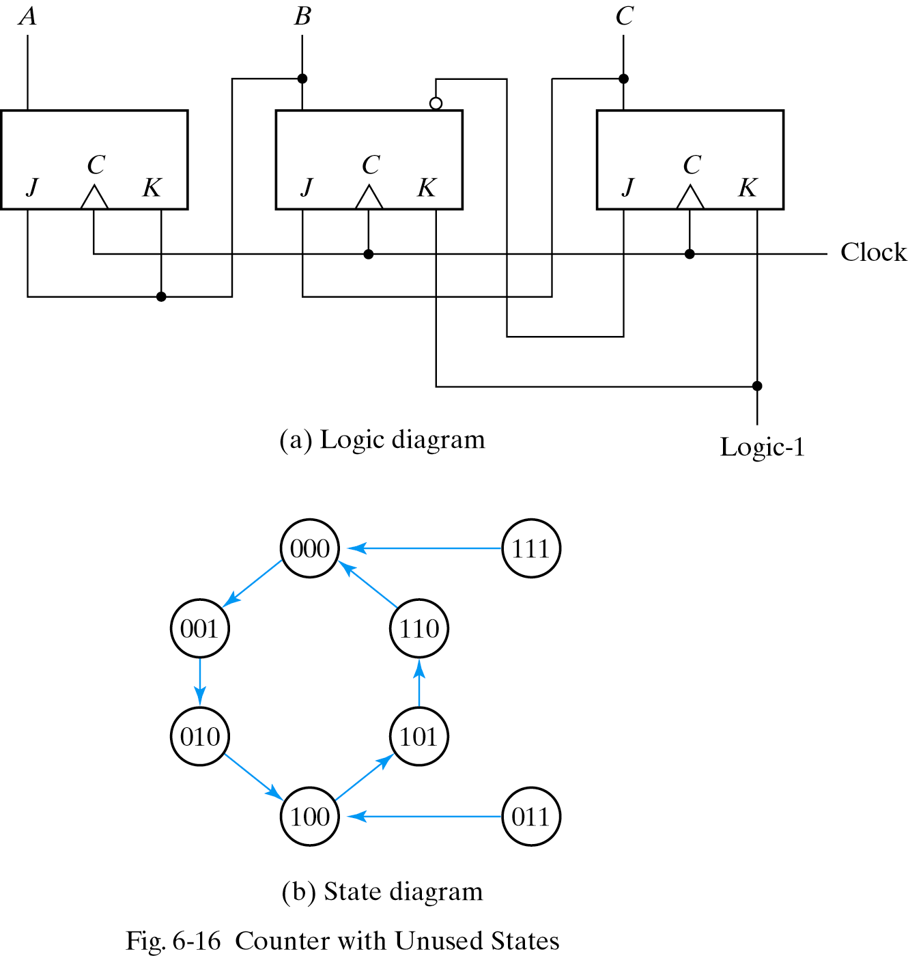
Counters with unused states

Slide 45
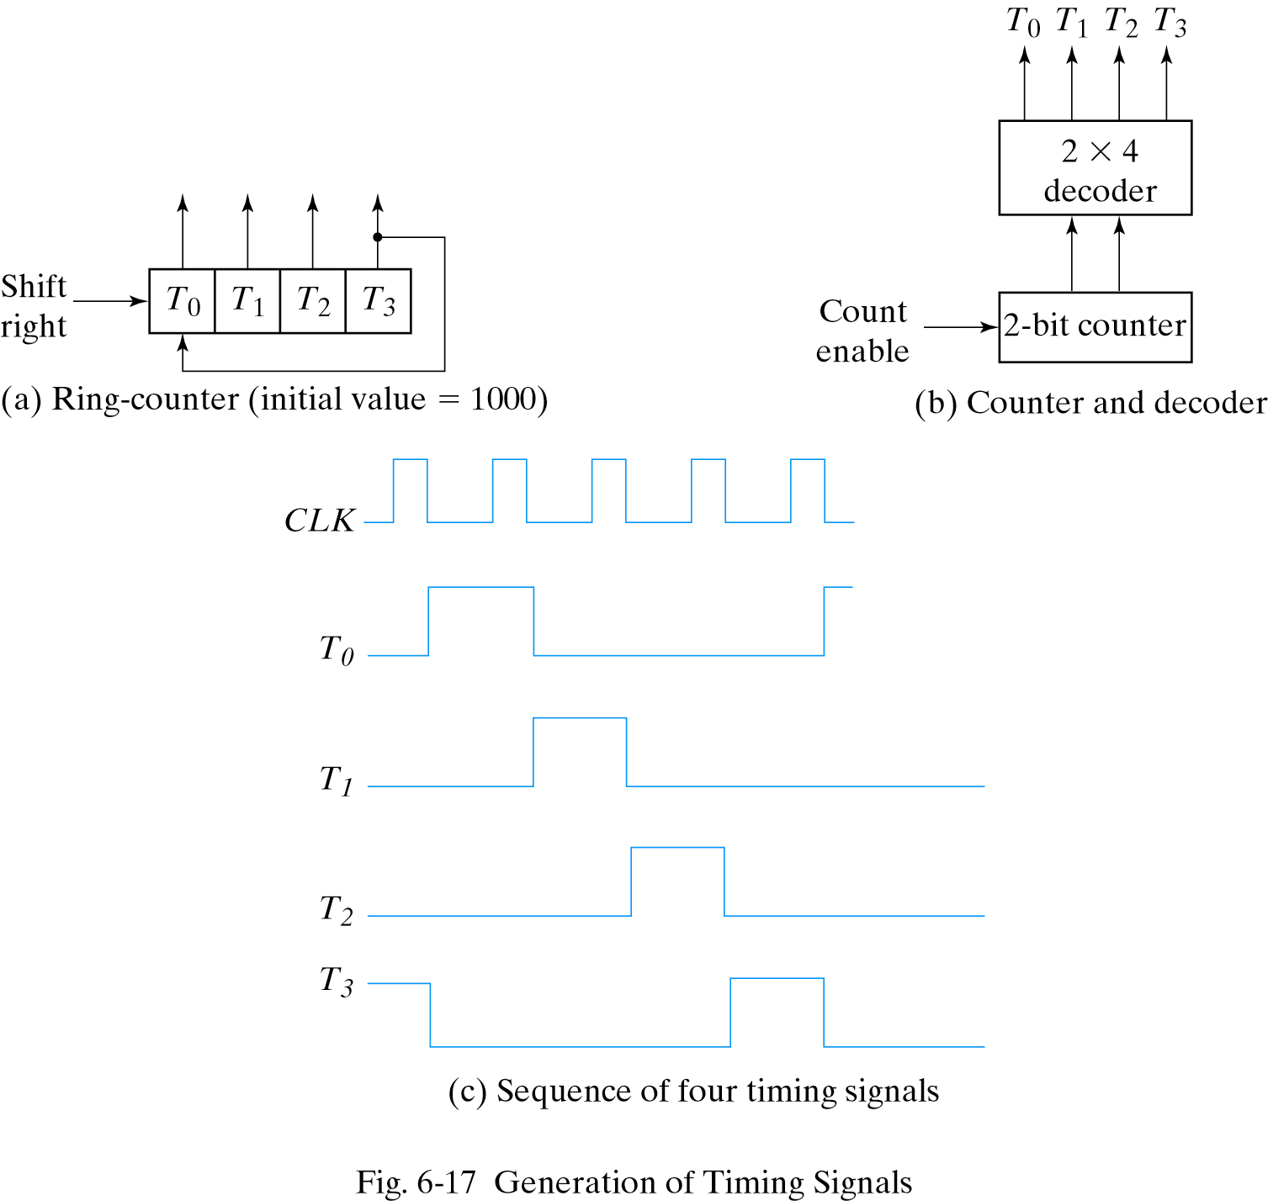
Ring counter

Slide 46
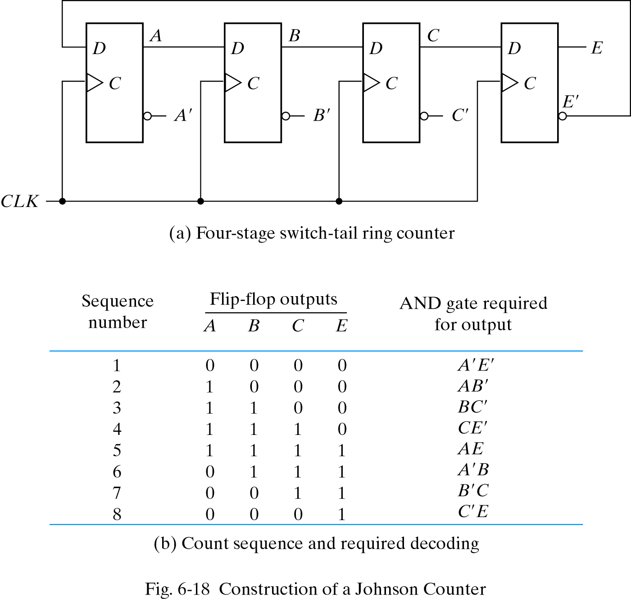
Johnson counter

