Slide 1
BITS Pilani Digital Design
Prof. GSS Chalapathi, Prof. Saurabh Gandhi (EEE department)

Slide 2
Synchronous binary counters
Same design procedure as other sequential circuits
Inputs: clock and control signals (EN, Load etc)
Outputs: FF states
Most efficient implementations use T or JK FFs

Slide 3
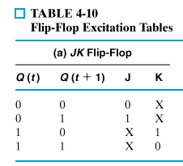
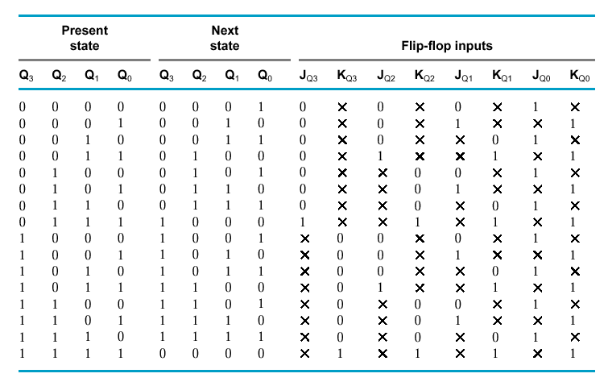

JK synchronous binary counter

Slide 4
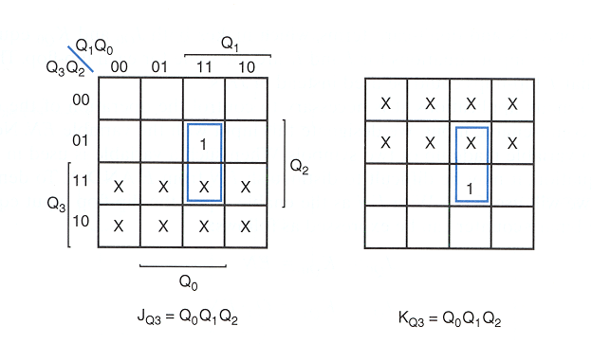
JK synchronous binary counter

Slide 5
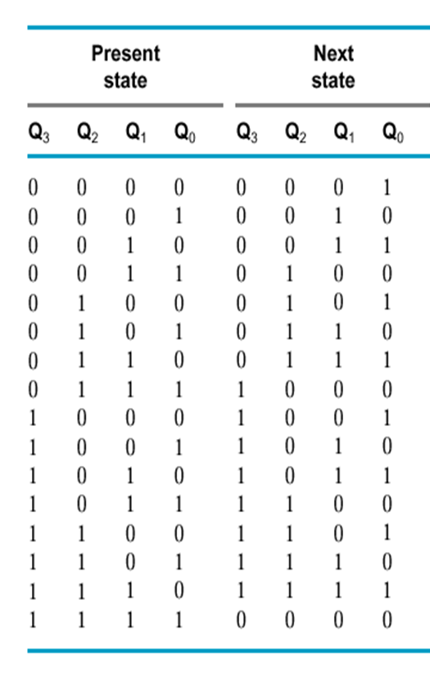
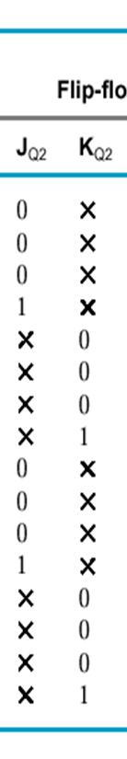
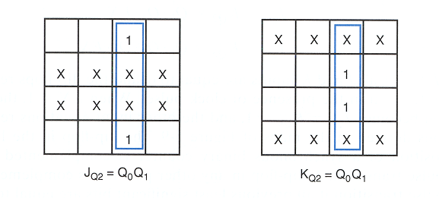
JK synchronous binary counter

Slide 6
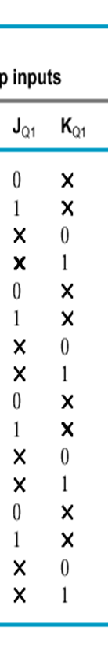
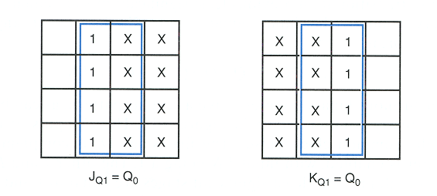
JK synchronous binary counter

Slide 7
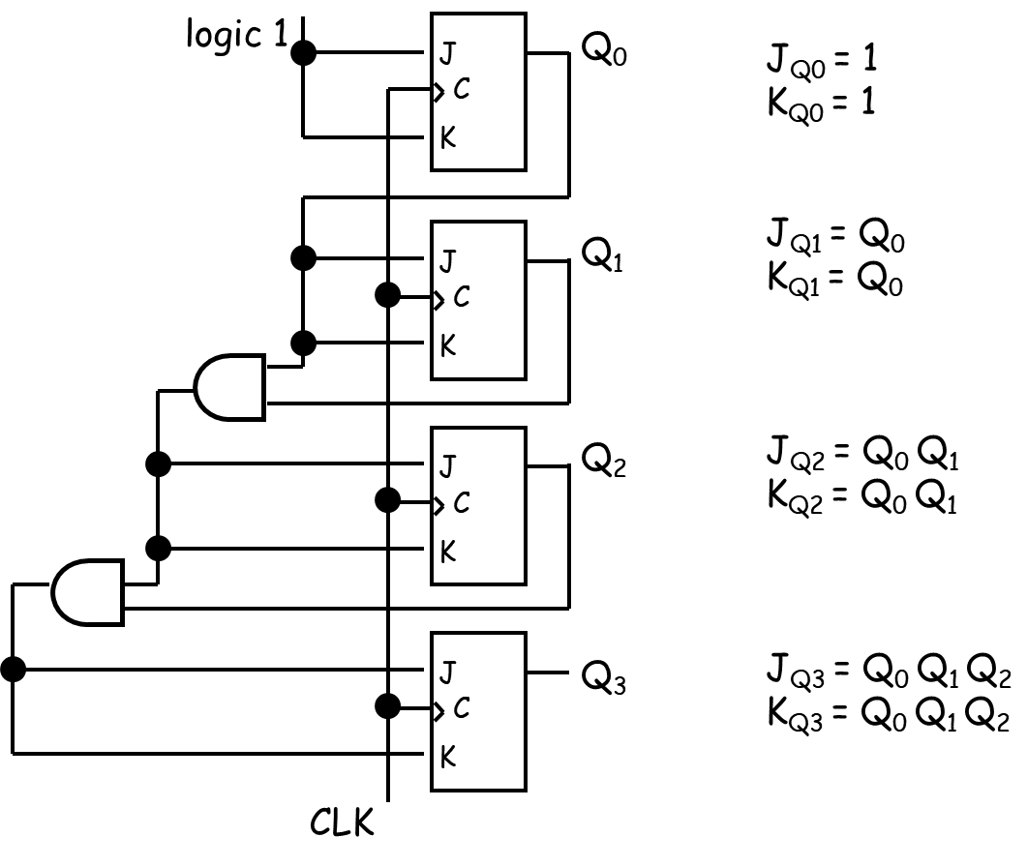
JK synchronous binary counter

Slide 8
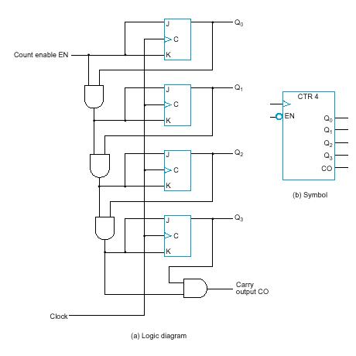
JK synchronous binary counter with EN and CO
EN = enable control signal, when 0 counter remains in the same state, when 1 it counts
J_{Q0} = 1 · EN
K_{Q0} = 1 · EN
J_{Q1} = Q₀ · EN
K_{Q1} = Q₀ · EN
J_{Q2} = Q₀ Q₁ · EN
K_{Q2} = Q₀ Q₁ · EN
J_{Q3} = Q₀ Q₁ Q₂ · EN
K_{Q3} = Q₀ Q₁ Q₂ · EN
C0 = Q₀ Q₁ Q₂ Q₃ · EN
CO = carry output signal:
used to extend the counter to more stages
…how?

Slide 9
Serial vs parallel counters
If serial gating (chain of gates, info ripples through) is used → serial counter
If serial gating is replaced with parallel gating (this is analogous with ripple-logic replaced with carry-lookeahead logic in our adder designs) → parallel counter
Advantage of parallel over serial counter: faster in certain occasions (1111 → 0000)

Slide 10
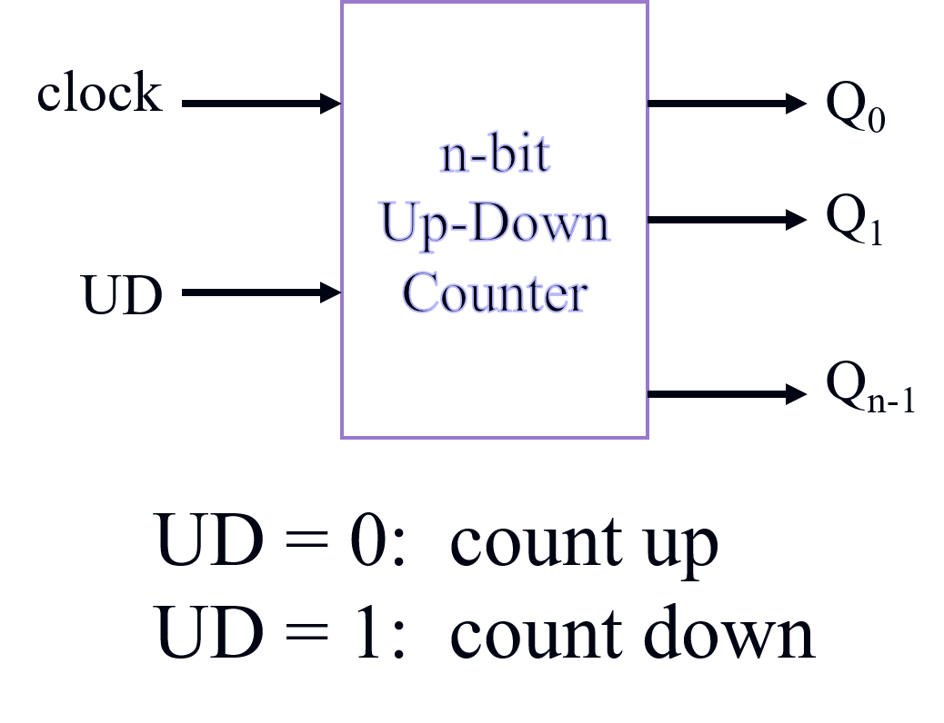
Up – Down binary counters

Slide 11
Up – Down binary counters
UD Q2 Q1 Q0 Q2.D Q1.D Q0.D
UD Q2 Q1 Q0 Q2.D Q1.D Q0.D
0 0 0 0 0 0 1
0 0 0 1 0 1 0
0 0 1 0 0 1 1
0 0 1 1 1 0 0
0 1 0 0 1 0 1
0 1 0 1 1 1 0
0 1 1 0 1 1 1
0 1 1 1 0 0 0
1 0 0 0 1 1 1
1 0 0 1 0 0 0
1 0 1 0 0 0 1
1 0 1 1 0 1 0
1 1 0 0 0 1 1
1 1 0 1 1 0 0
1 1 1 0 1 0 1
1 1 1 1 1 1 0
Up-Counter
Down-Counter

Slide 12
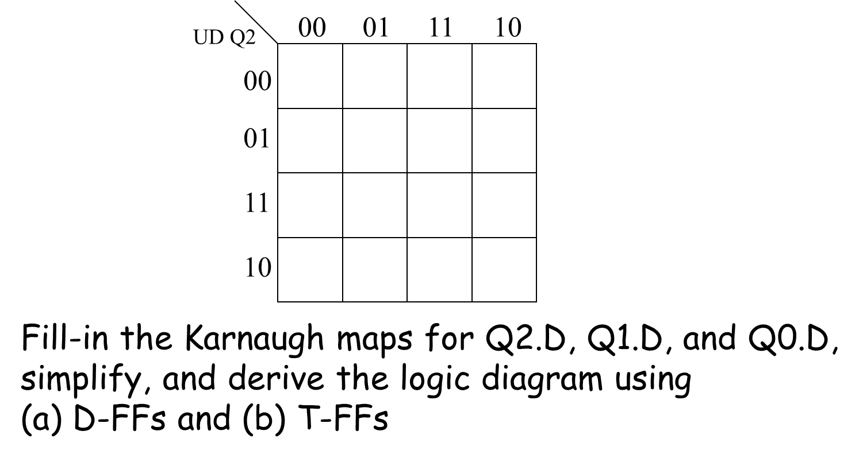
Up – Down binary counters

Slide 13
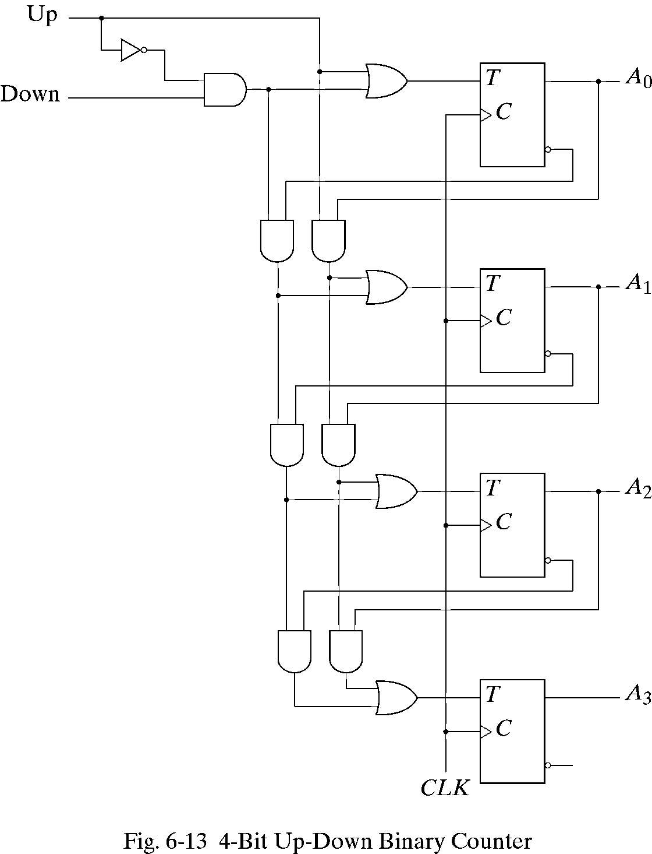
Up – Down binary counters

Slide 14
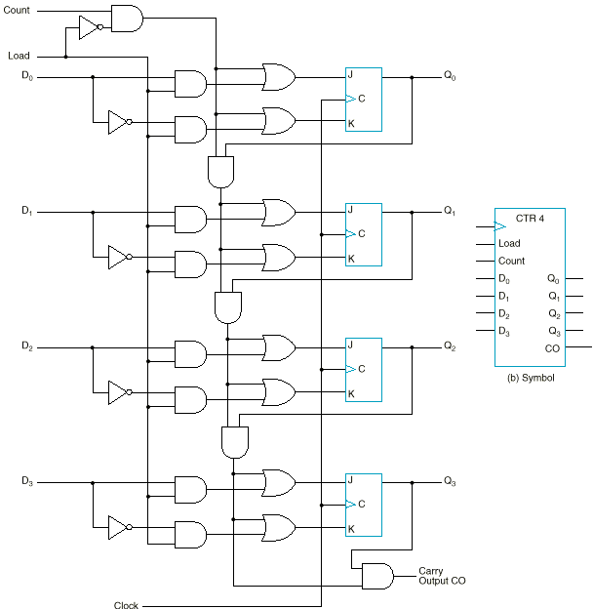
Binary counter with parallel load
Ability to set the counter to an arbitrary value to begin counting
Load | Count | Operation
0 | 0 | Nothing
0 | 1 | Count
1 | x | Load

Slide 15
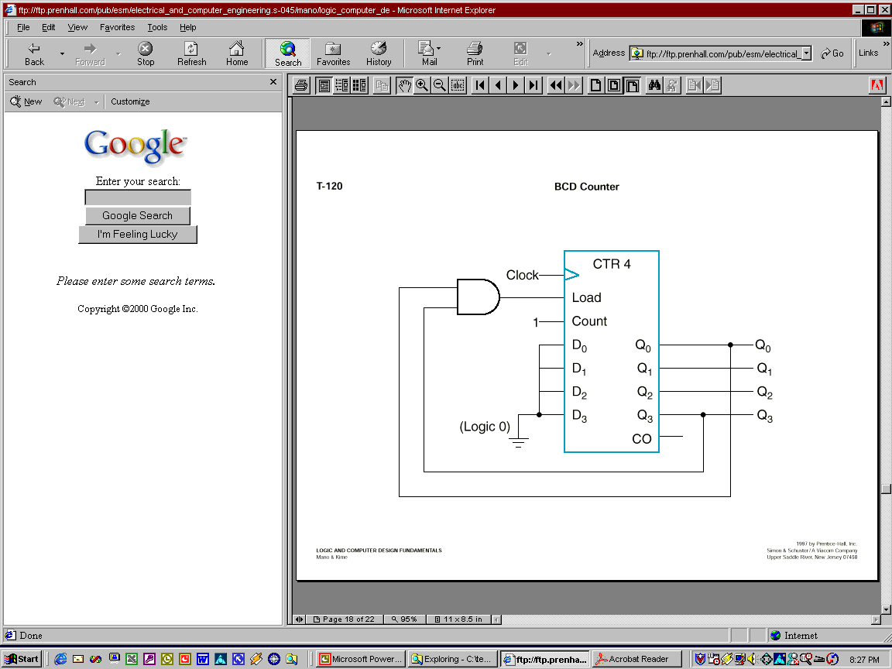
BCD counter using parallel load counter
The counter starts with an all-zero output.
As long as the output of the AND gate is 0, each positive clock pulse transition increments the counter by one.
When the output reaches the count of 1001, both Q₀ and Q₃ become 1, making the output of the AND gate equal to 1. This condition makes Load active, so on the next clock transition, the counter does not count, but is loaded from its four inputs.
The value loaded then is 0000.

Slide 16
Arbitrary sequence counter
Given an arbitrary sequence, design a counter that will generate the sequence
Procedure:
Derive state table / diagram based on the sequence
Simplify
Build the circuit
Example: Use D-FFs to design a sequence generator for the sequence: 0 → 7 → 6 → 1 → 0 (000 → 111 → 110 → 001 → 000)

Slide 17
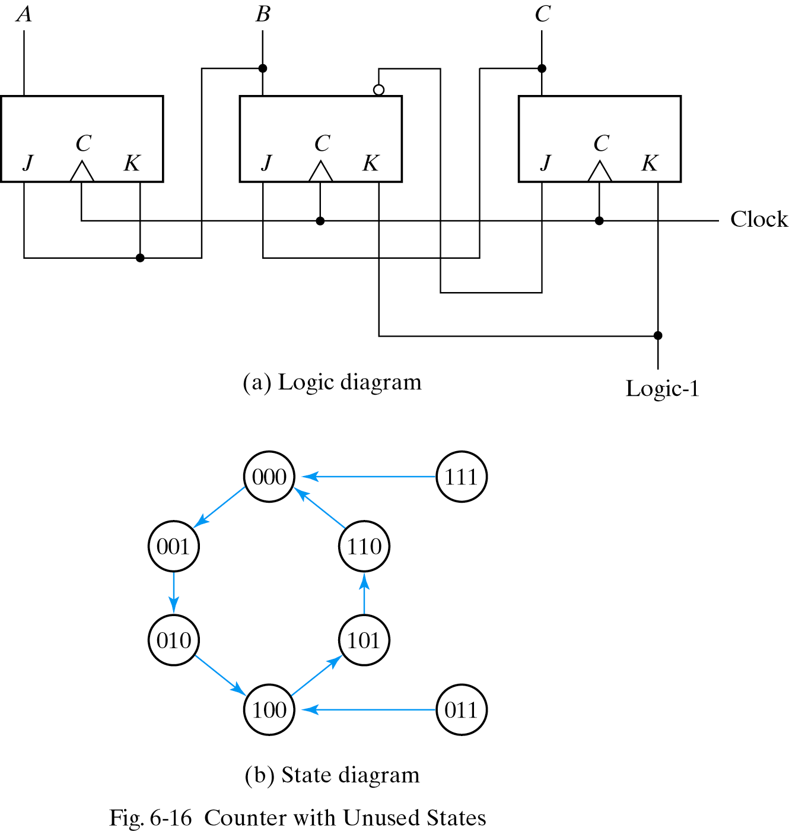
Counters with unused states

Slide 18
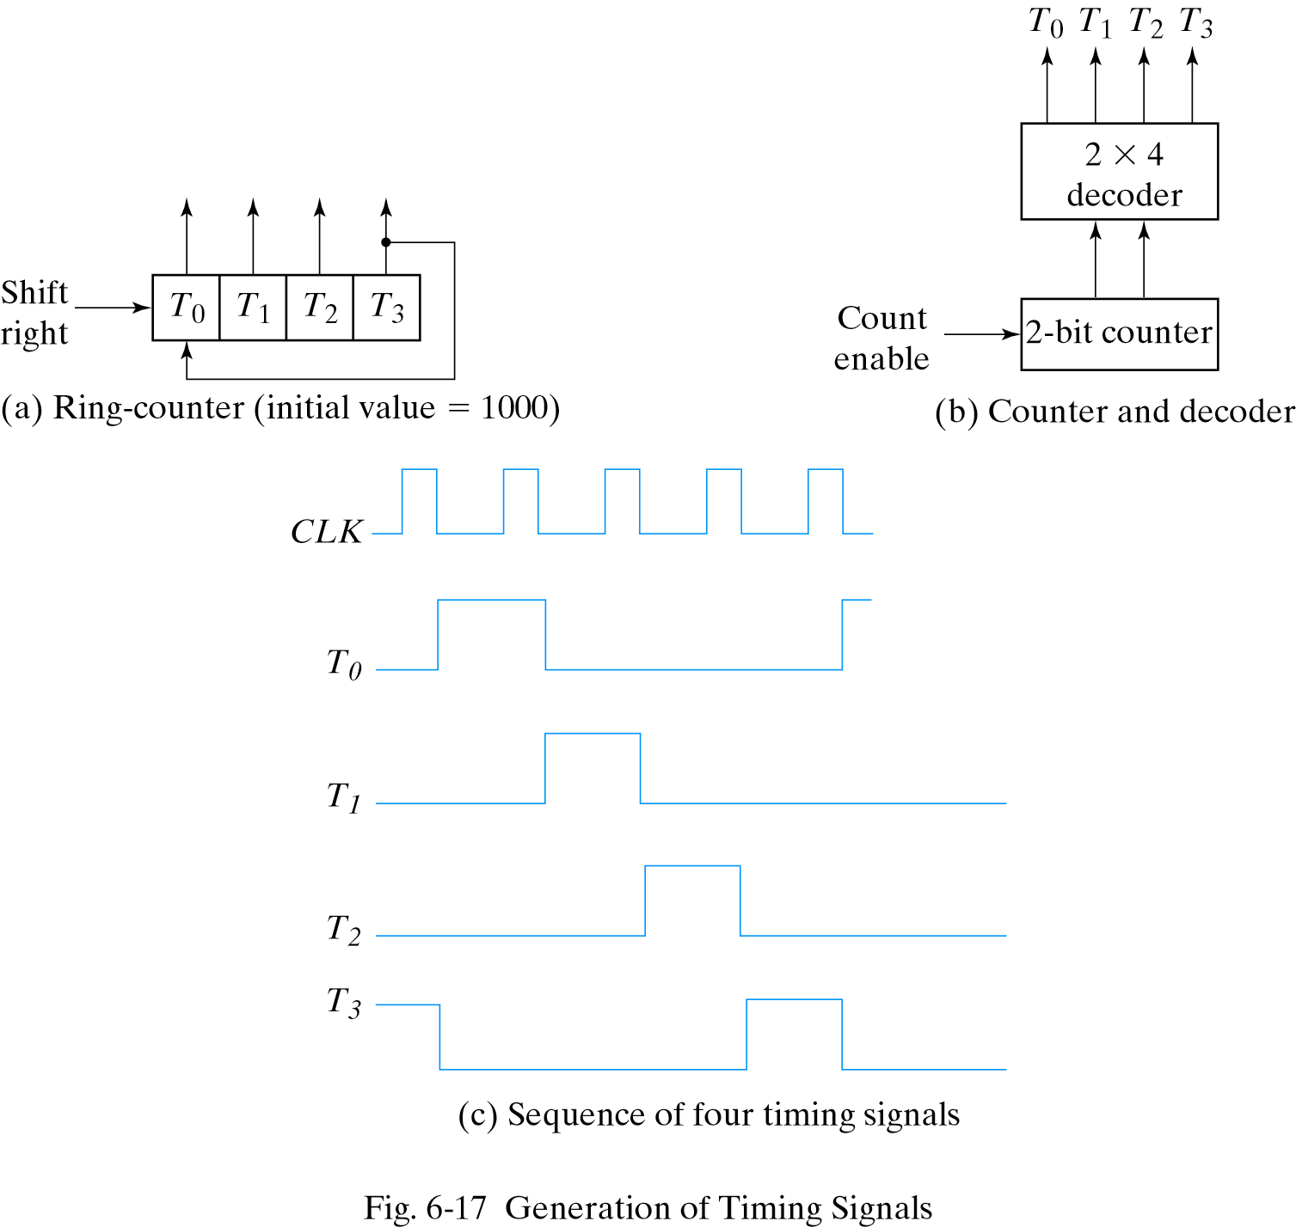
Ring counter

Slide 19
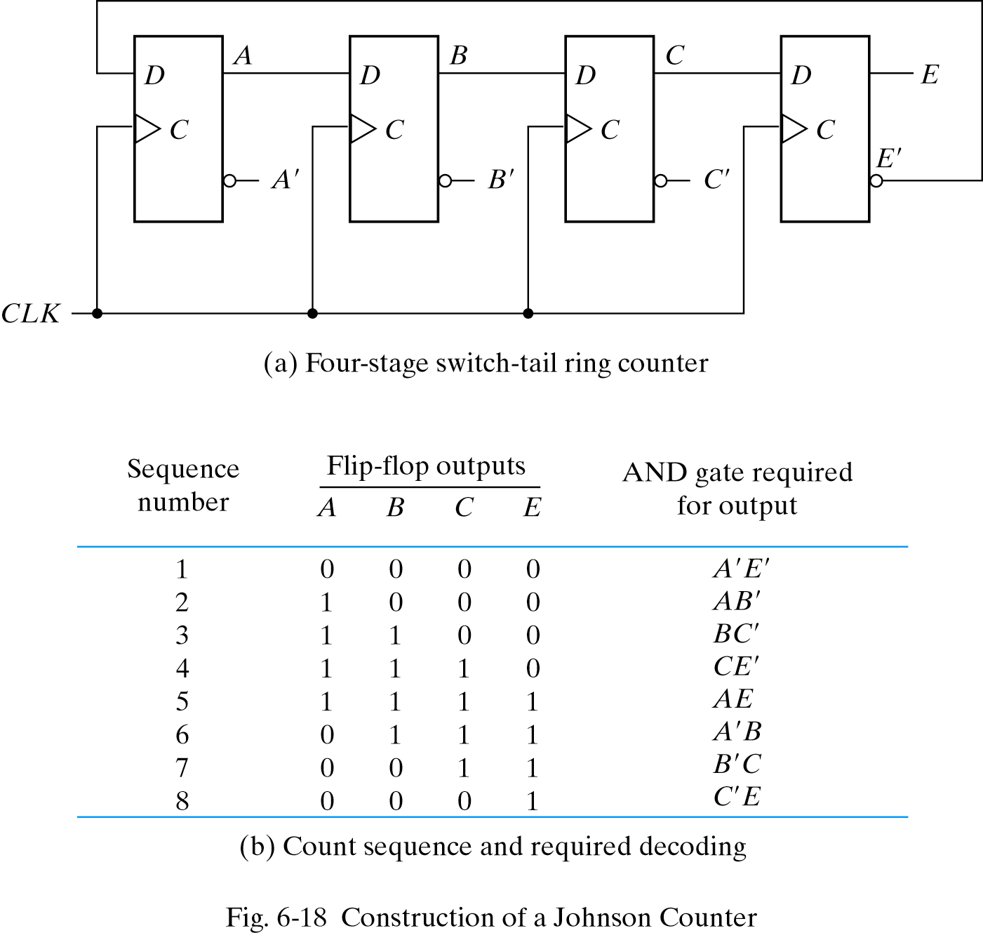
Johnson counter

Slide 20

Attendance!
Will be opened only during the attendance window.
Enable location on your device.
Grant any location permissions requested by the website.
Refresh the page.
Try submitting again.

Slide 21
Registers
Flip-flops store only one bit
We surely need larger units of storage, for example 32 bit integers or floating point numbers
A register is an extension of a flip flop that can store multiple bits
Registers are commonly used as temporary storage in a processors
Faster and more convenient than main memory
More registers can help speed up complex calculations

Slide 22
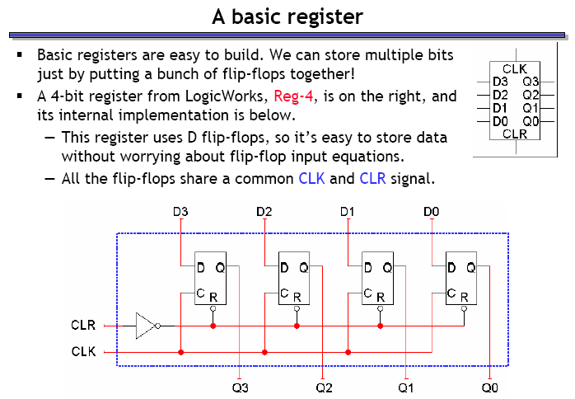
A basic register
Basic registers are easy to build – just put a bunch of flip flops together!

Slide 23
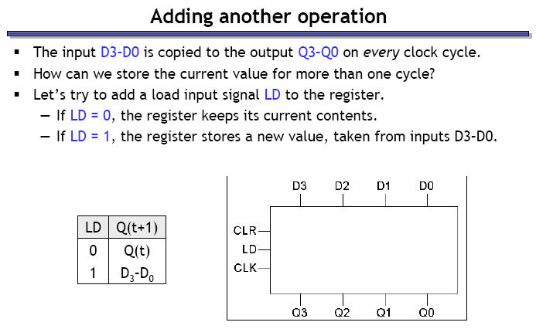
Register with LOAD

Slide 24
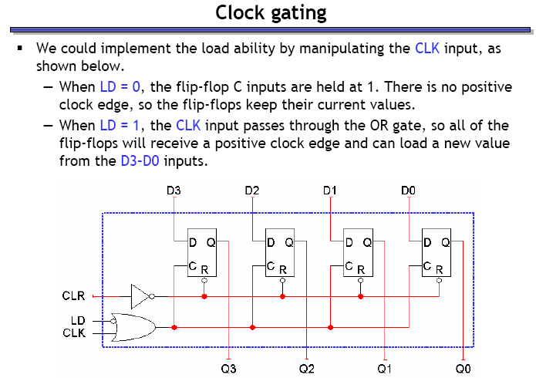
LOAD with ‘clock gating’

Slide 25
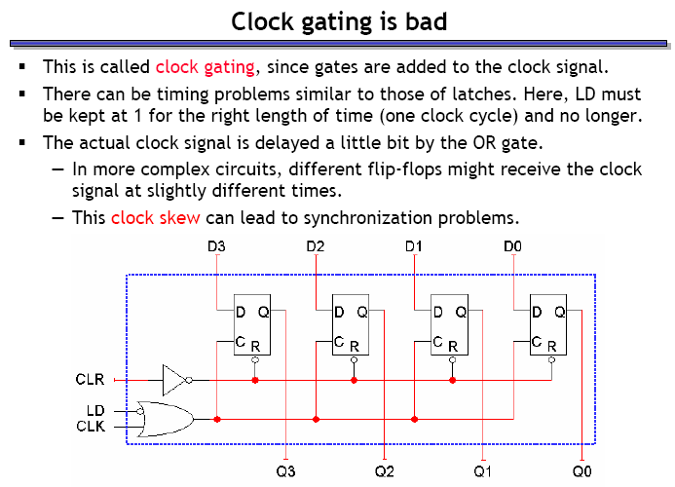
The problems with clock gating

Slide 26
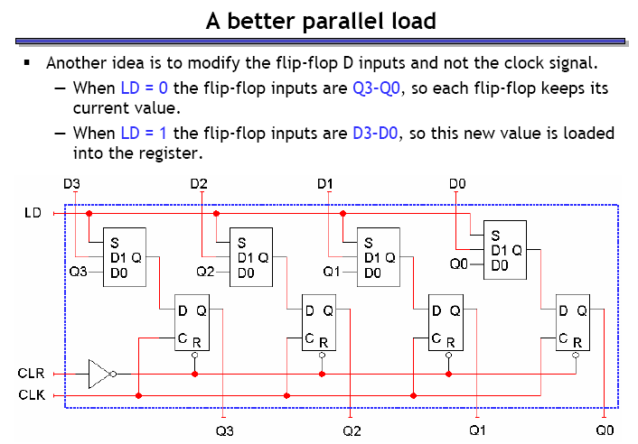
A better implementation of LOAD

Slide 27
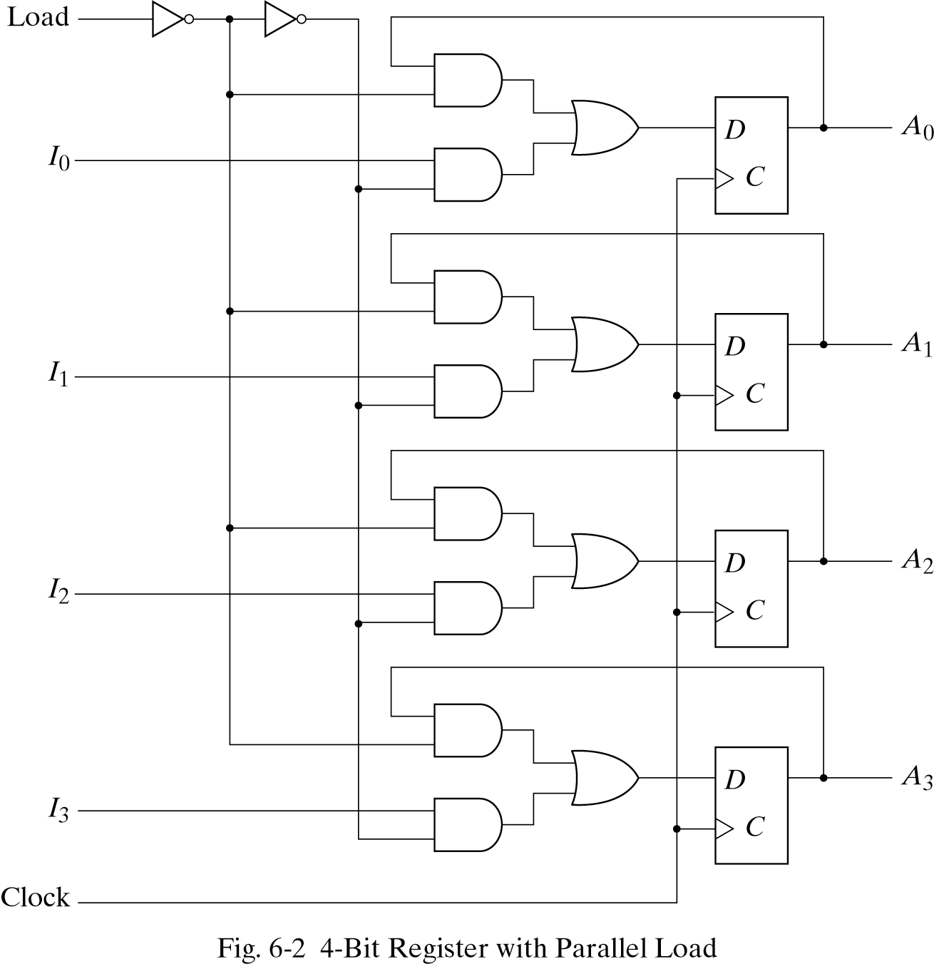
Parallel load without Muxes

Slide 28
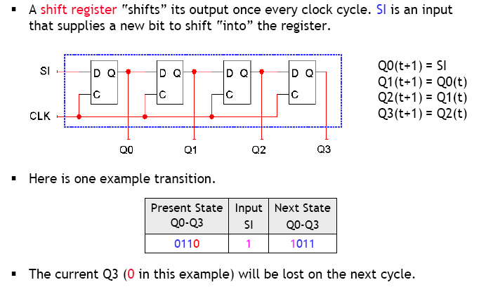
Shift registers

Slide 29
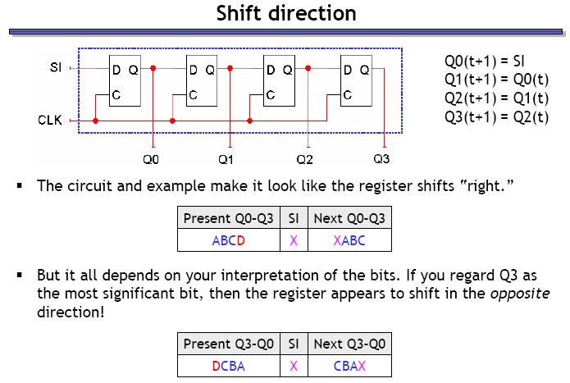
Shift direction

Slide 30
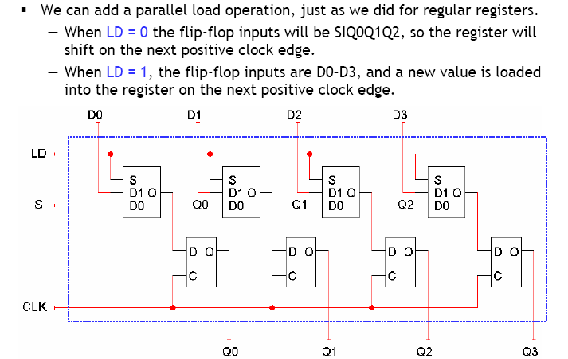
Shift registers with parallel load

Slide 31
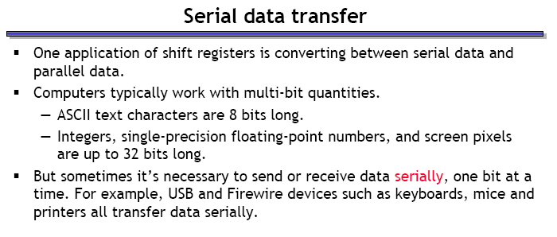
The use of shift registers

Slide 32
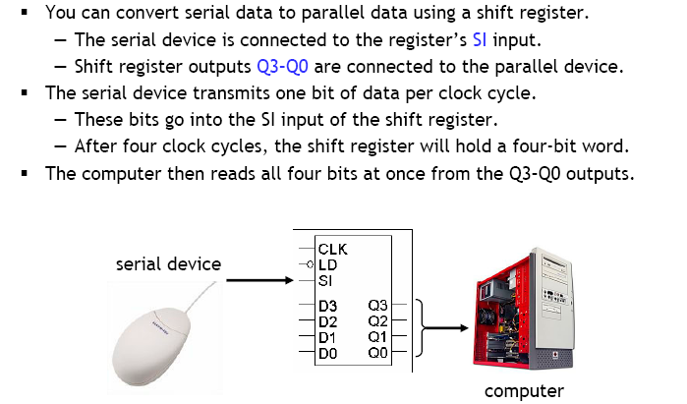
Receiving serial data

Slide 33
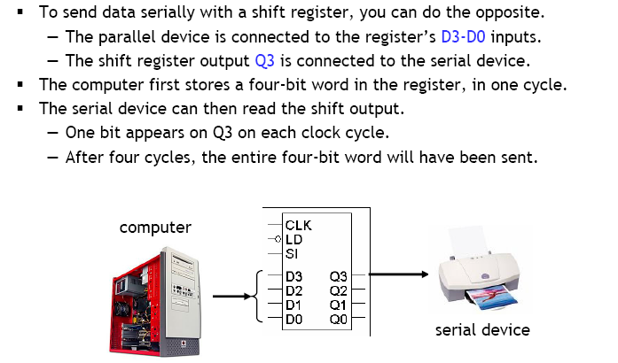
Sending serial data

Slide 34
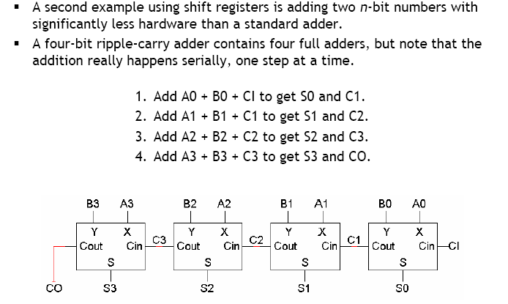
Serial addition

Slide 35
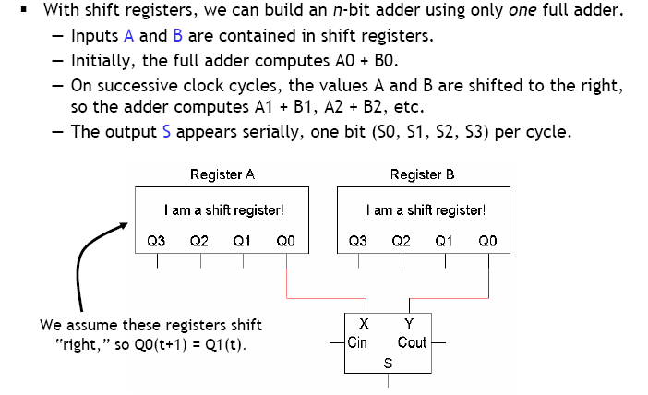
Serial addition – implementation

Slide 36
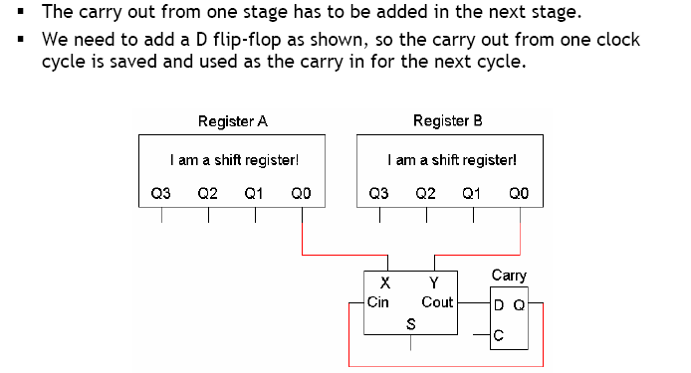
How to deal with the carry?

Slide 37
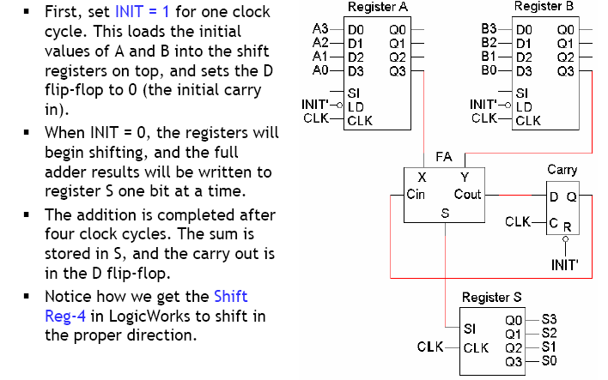
Putting together the serial adder

Slide 38
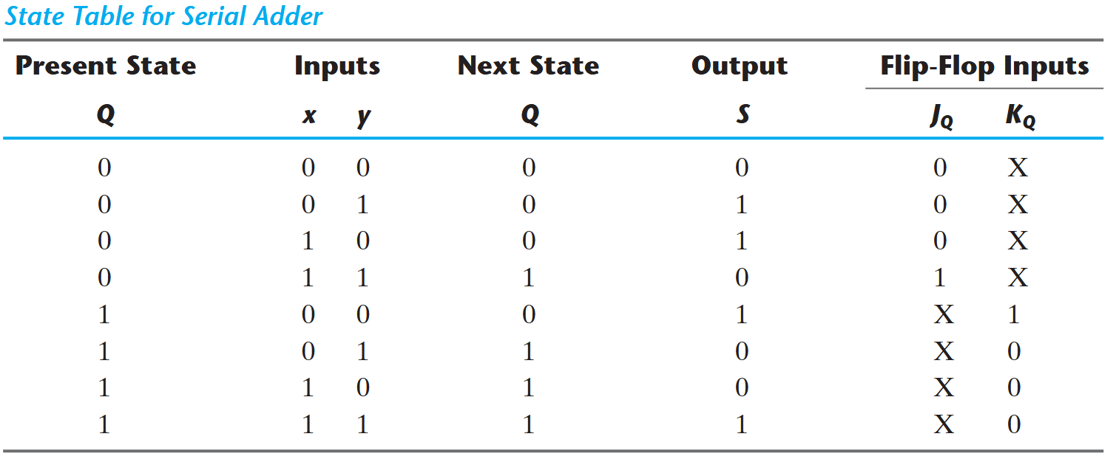
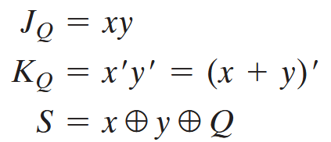
Designing a serial adder from scratch

Slide 39
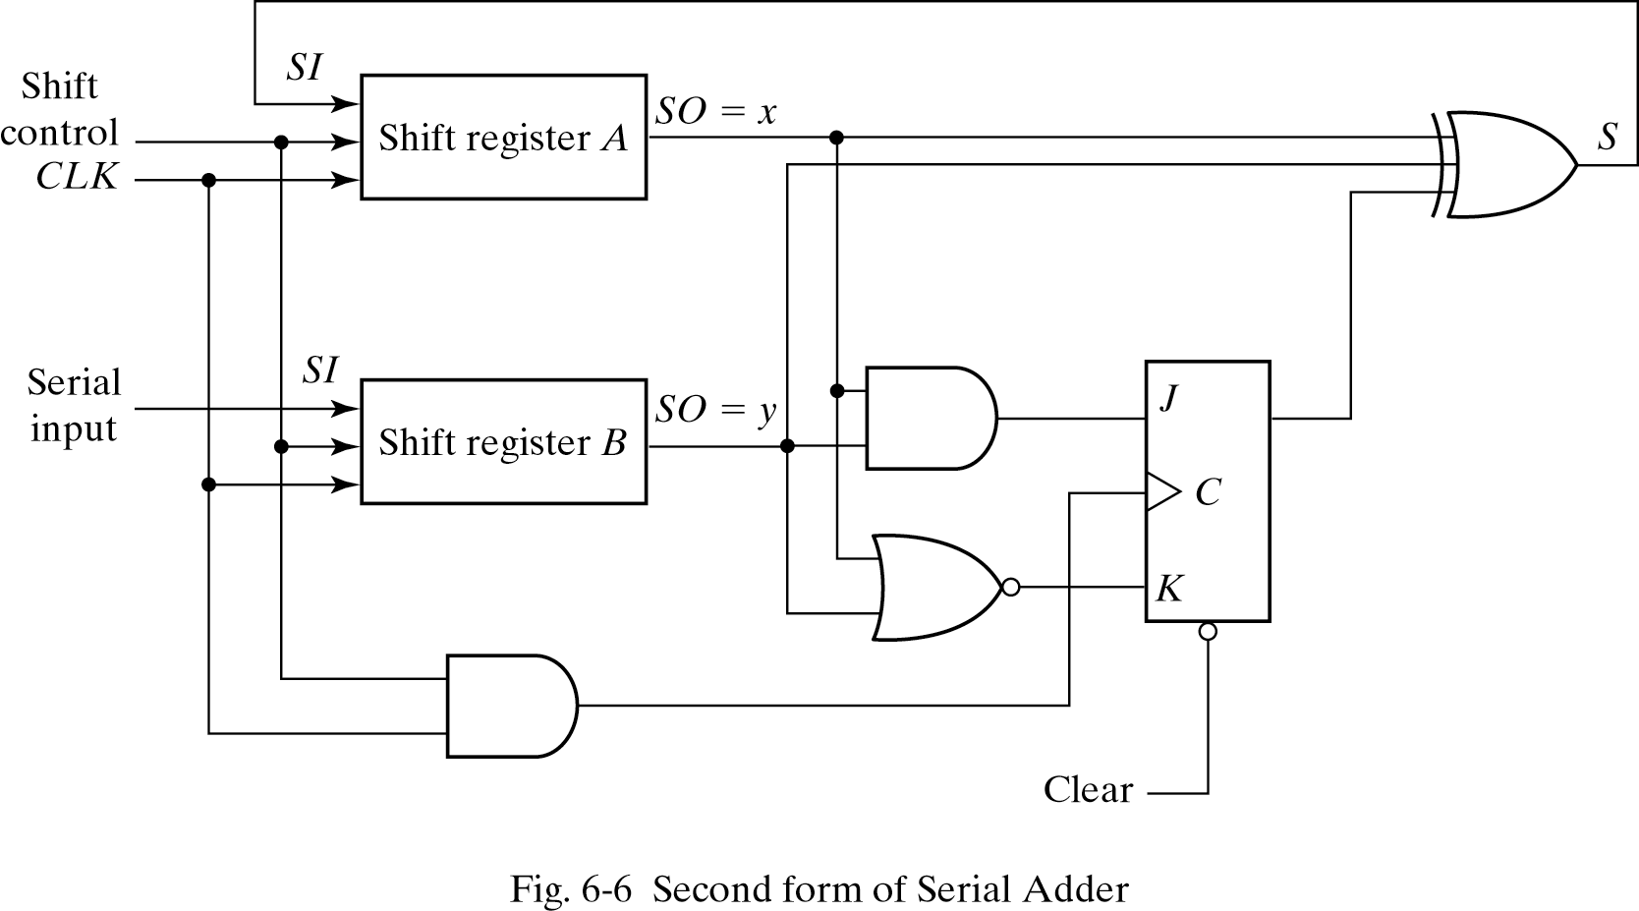
Serial adder from scratch implemented with shift registers

Slide 40
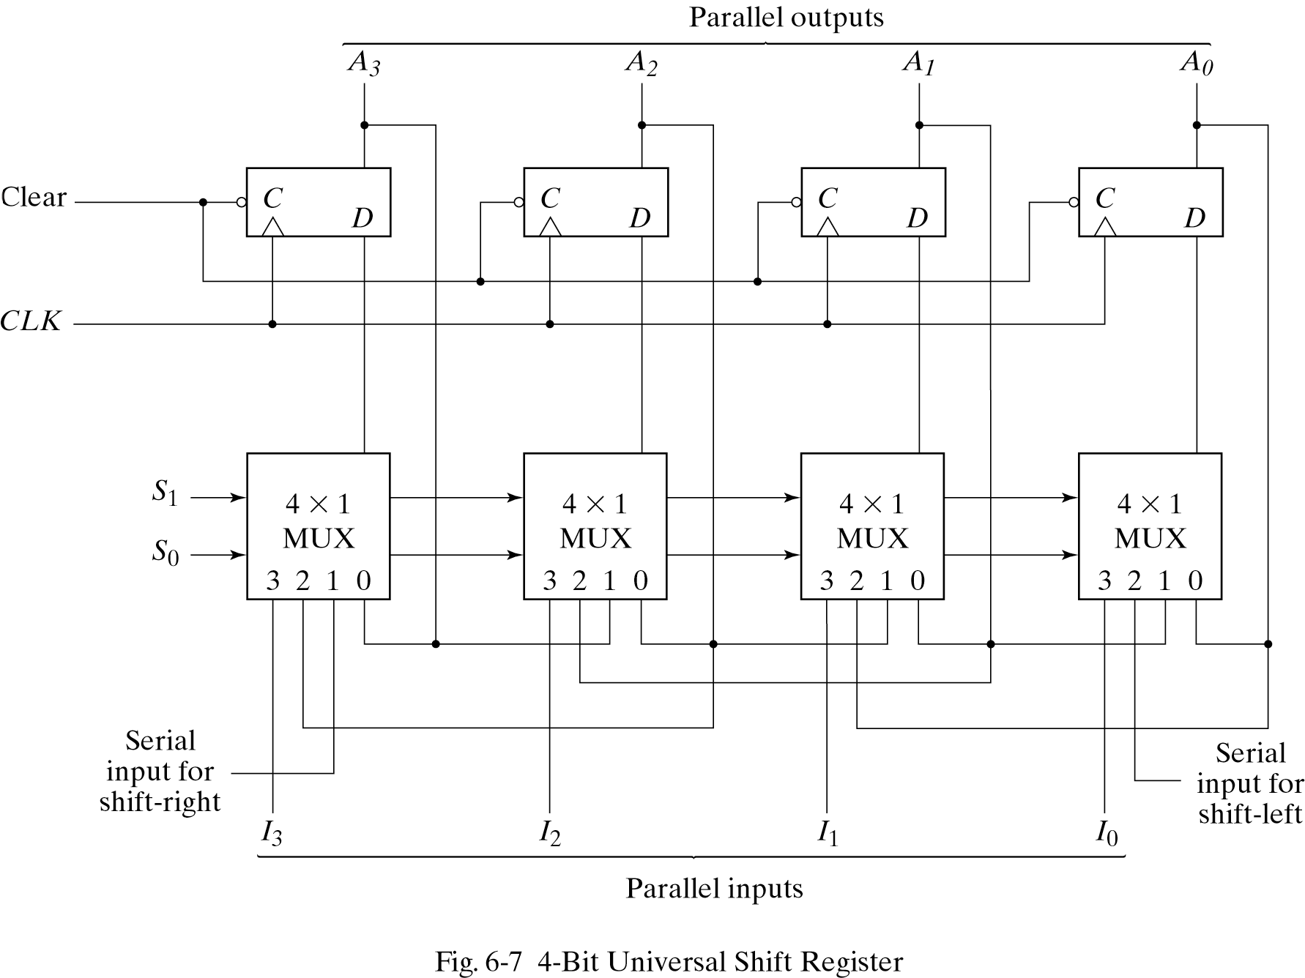
Universal shift register

