Slide 1
BITS Pilani Digital Design
Prof. GSS Chalapathi, Prof. Saurabh Gandhi (EEE department)

Slide 2
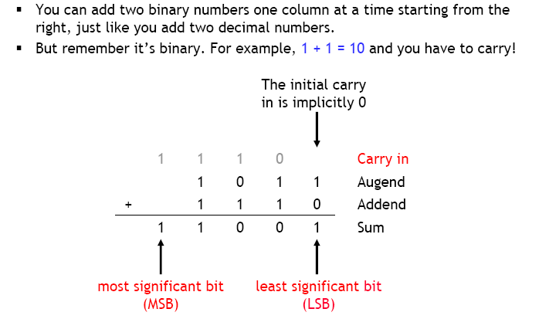
Binary addition – terminology

Slide 3
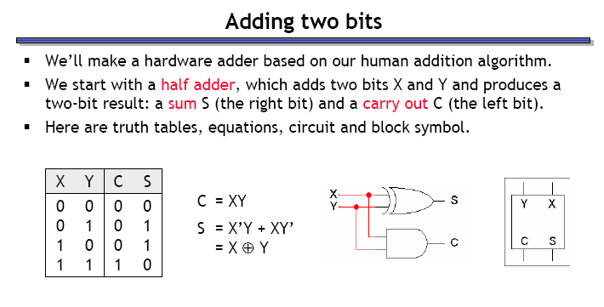
Adding two bits: half adder

Slide 4
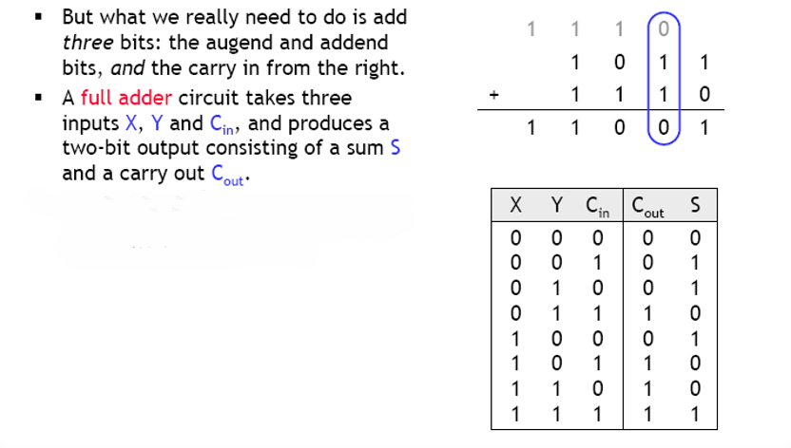
Adding three bits: full adder

Slide 5
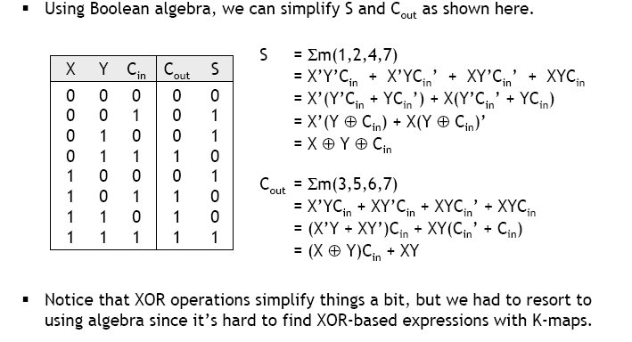
Full adder equations

Slide 6
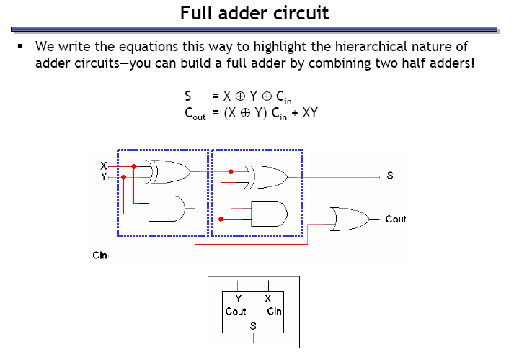
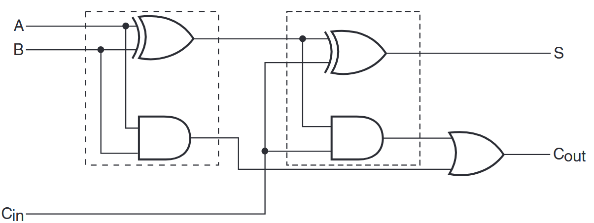
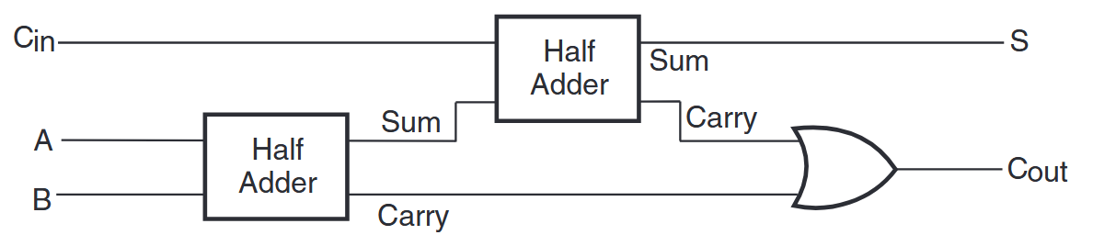
Full adder circuit

Slide 7
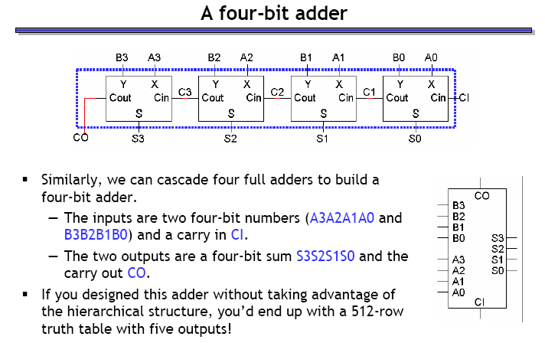
A four-bit adder

Slide 8
Binary subtraction
Remember the complement method for subtraction?
The subtraction A-B can be performed by taking the 2’s complement of B and adding to A.
The 2's complement of B can be obtained by complementing B and adding one to the result.
A-B = A + 2C(B) = A + 1C(B) + 1 = A + B’ + 1

Slide 9
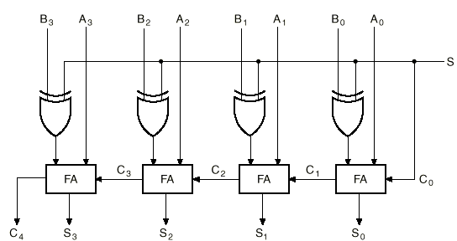
A 4-bit binary adder / subtractor
How does this circuit work?
When S = 0:
Inputs are A and B
Result is A + B
When S = 1:
Inputs become A and B’
C₀ = 1, so 1 is added to A + B’
Result is A - B
XOR gate acts as a programmable inverter!
Is the subtraction result correct as is?
When A > B?
When B > A?

Slide 10
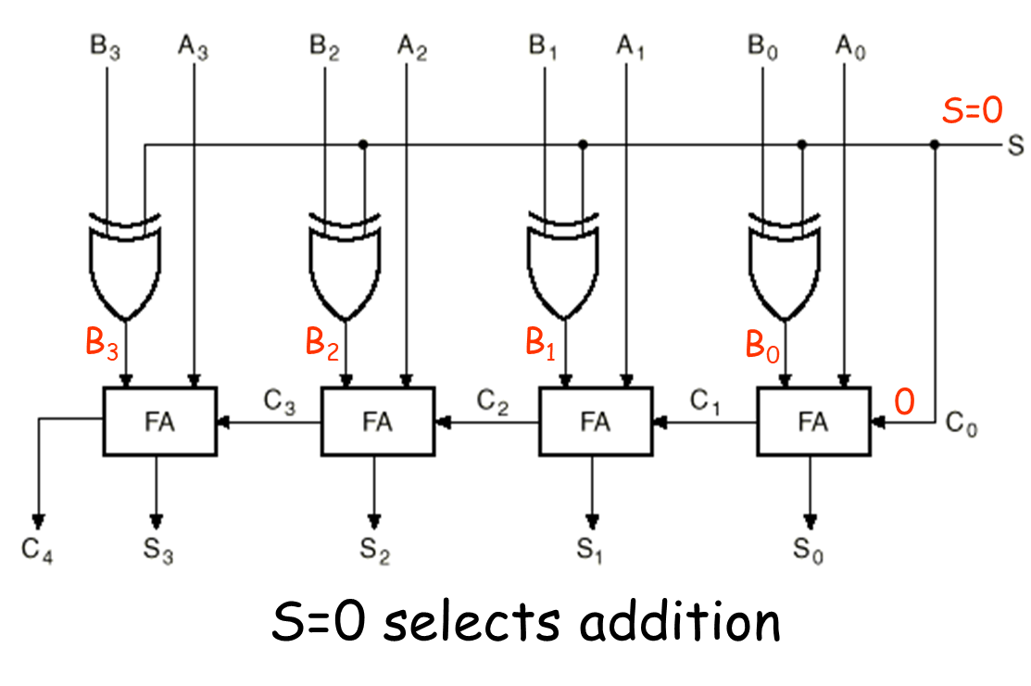
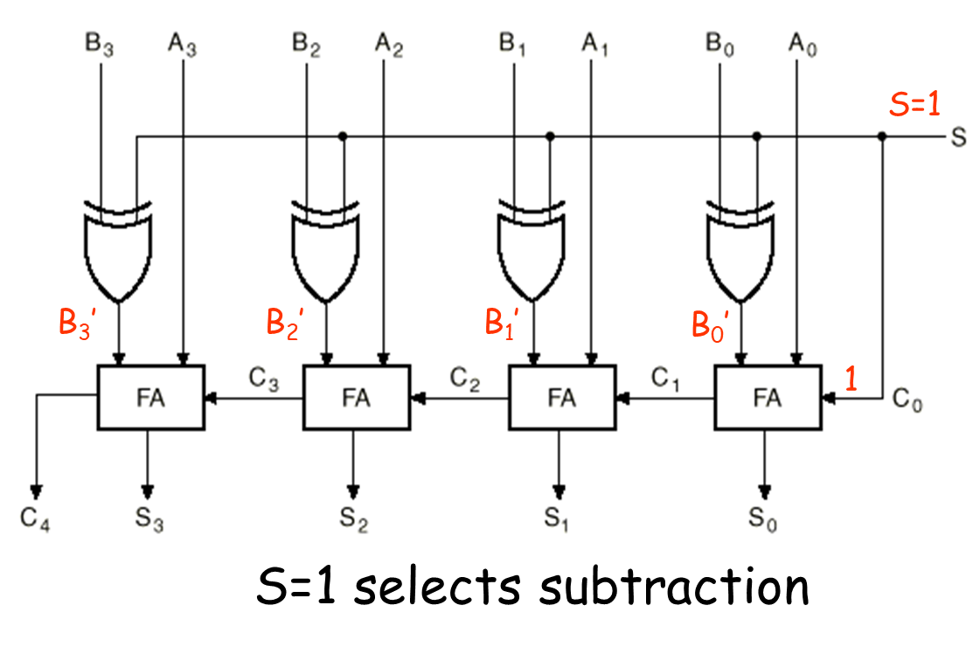
Addition and subtraction modes

Slide 11
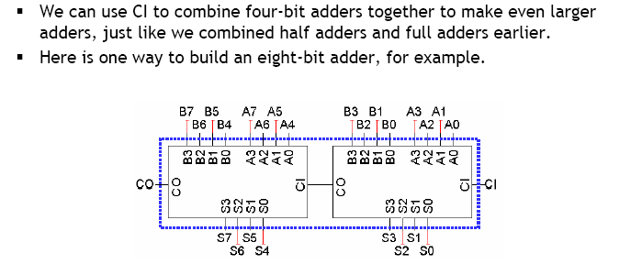
Extending the 4-bit adder: ripple carry adders
How long does the addition take?

Slide 12
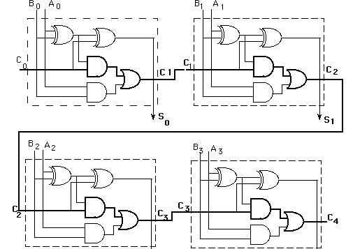
Ripple carry delays
S₃
S₄
How long does a 4-bit adder take to perform addition?
How many gates does the input signal have to flow through?
For an n-bit adder, how many gates does the signal have to flow through?
2n + 1 (for a 64-bit adder, 129 gates!)
Assuming ~1 ns propagation delay per gate, how many 64-bit additions can you perform per second?
How many do modern processors carry out?

Slide 13
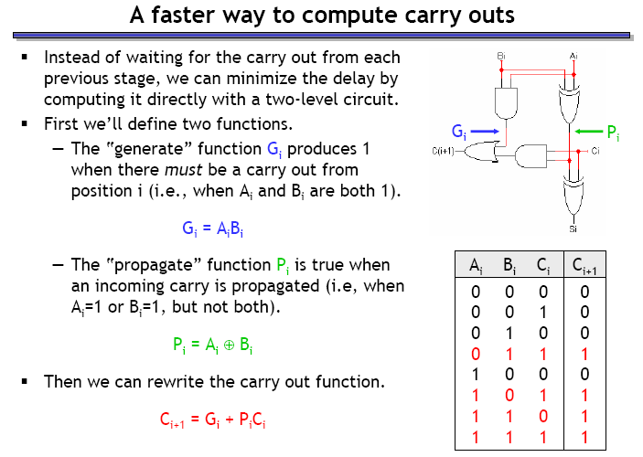
Can we have faster adders?

Slide 14
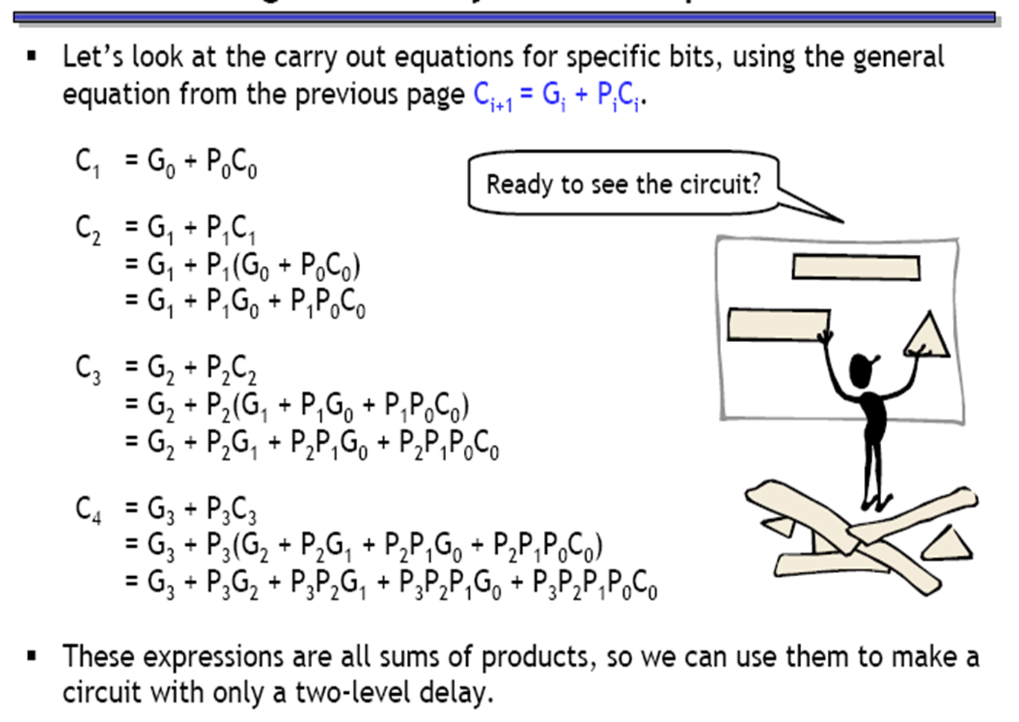
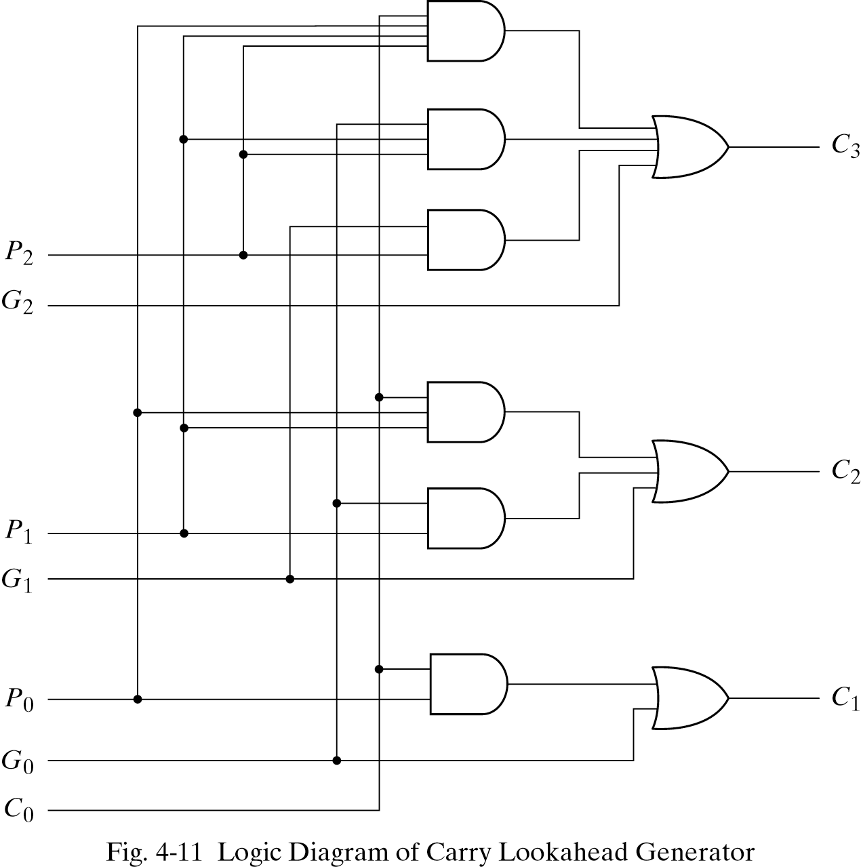
Can we have faster adders?

Slide 15
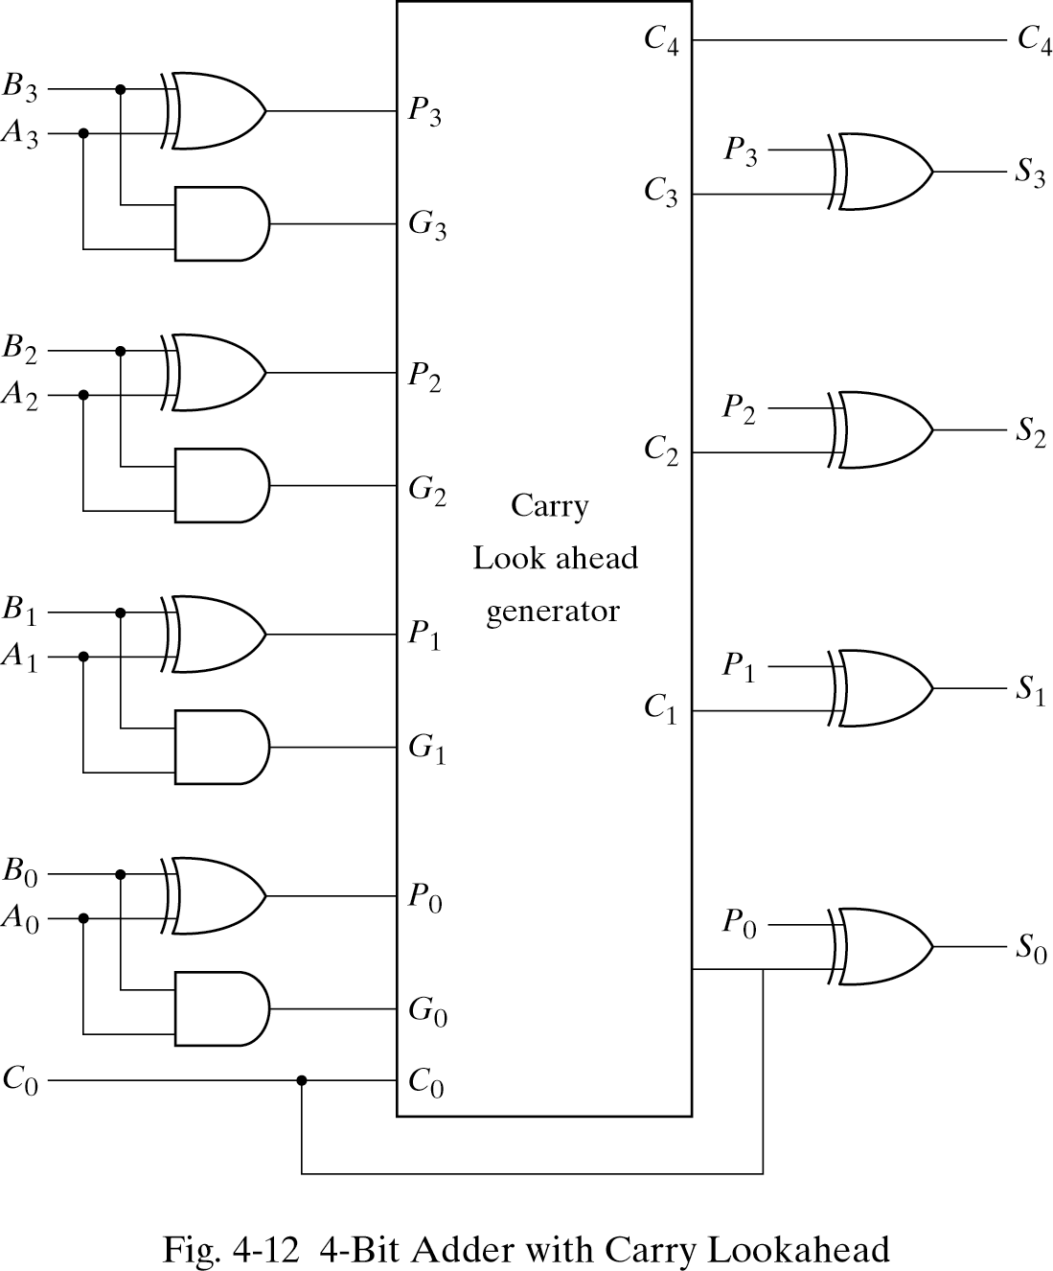
4-bit adder with carry lookahead

Slide 16
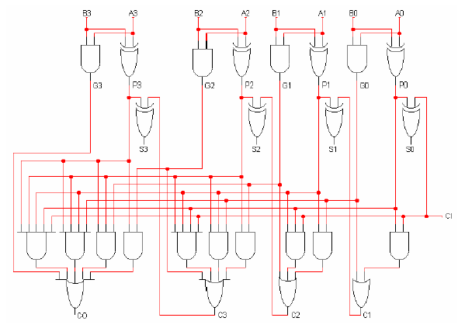
A faster 4-bit adder
How many 64-bit additions can this circuit perform per second?

Slide 17
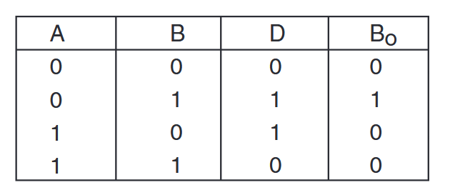
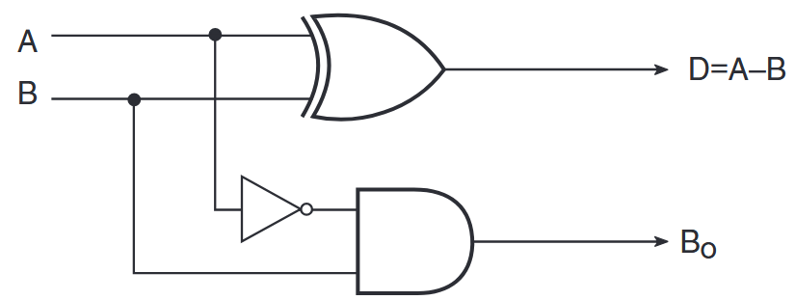
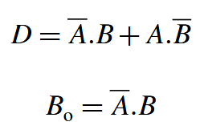
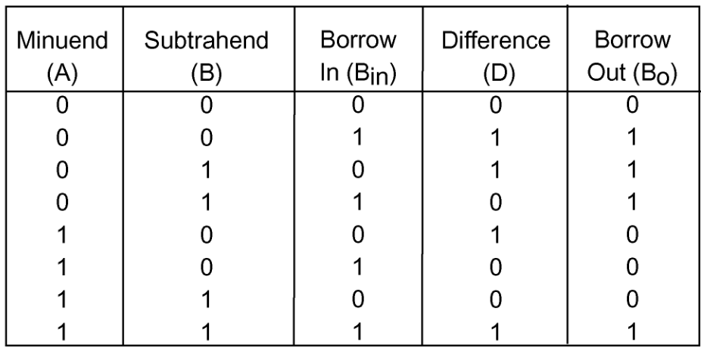


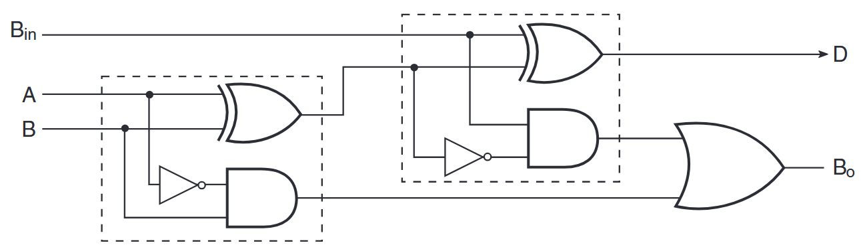
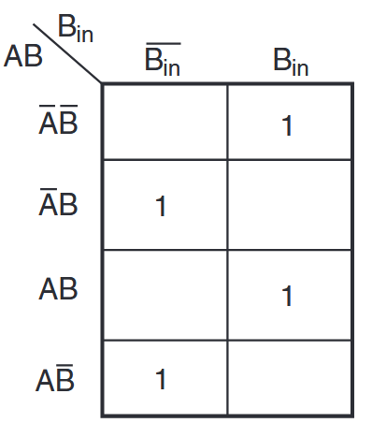
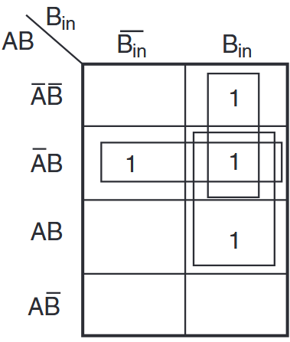
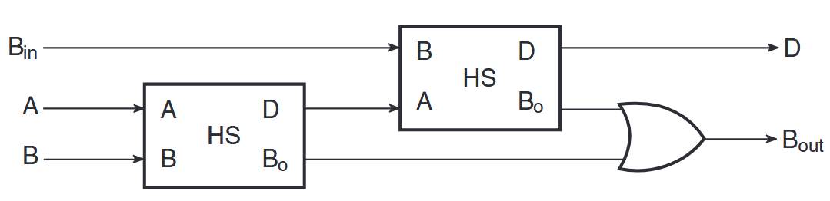
Building an exclusive subtractor
Half subtractor
sum → difference
carry → borrow
Full subtractor

Slide 18
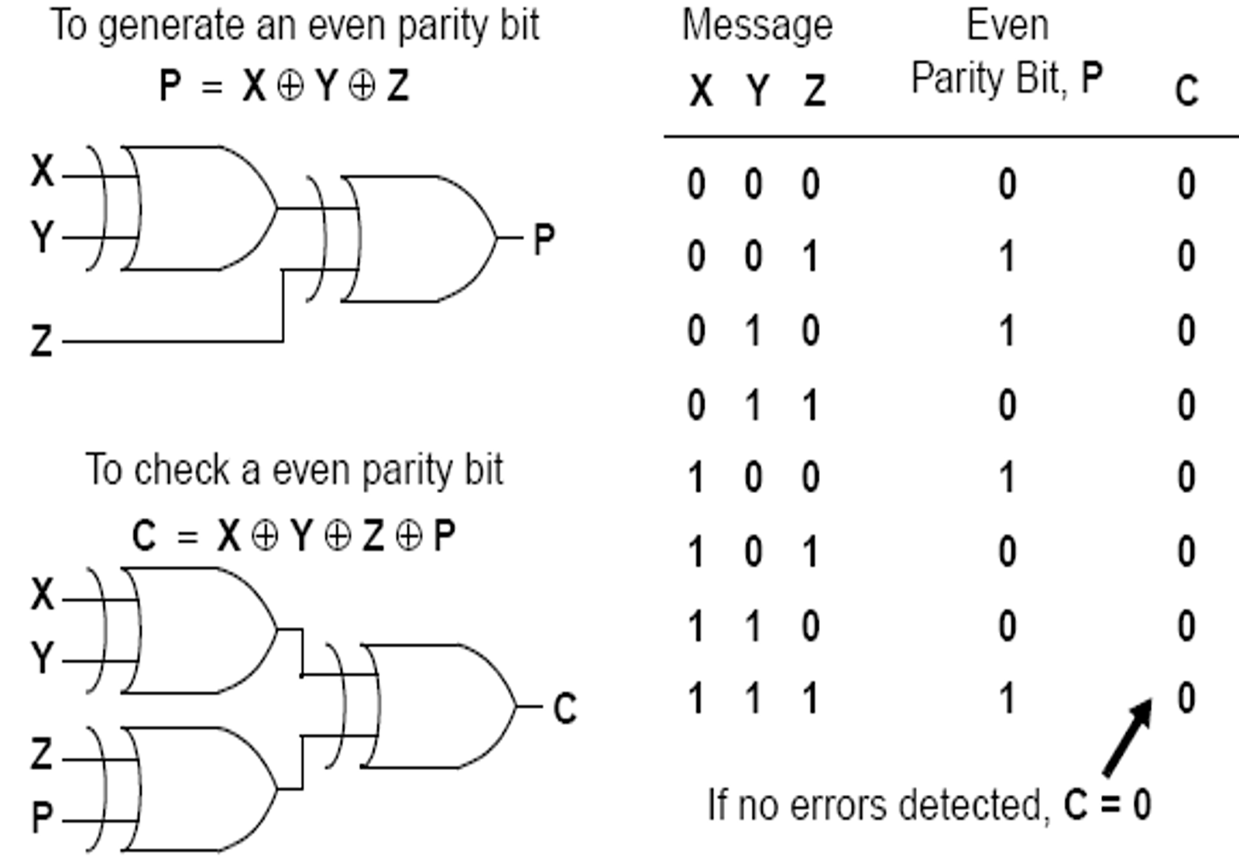
Parity generation and checking
Useful in error detection and correction
Parity bit: extra bit included with binary message
Parity generator
Parity checker

Slide 19
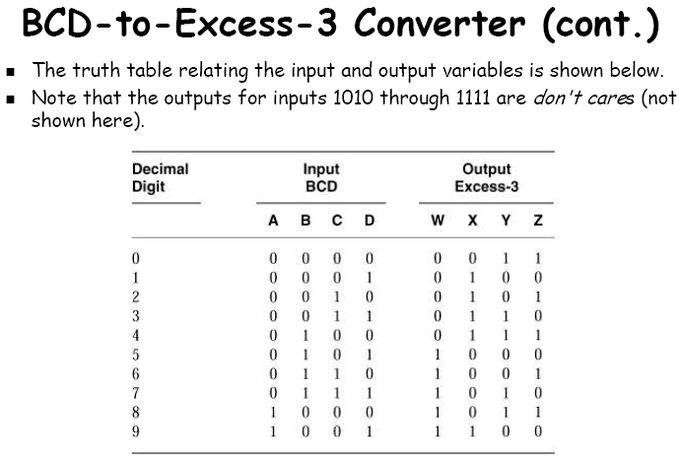
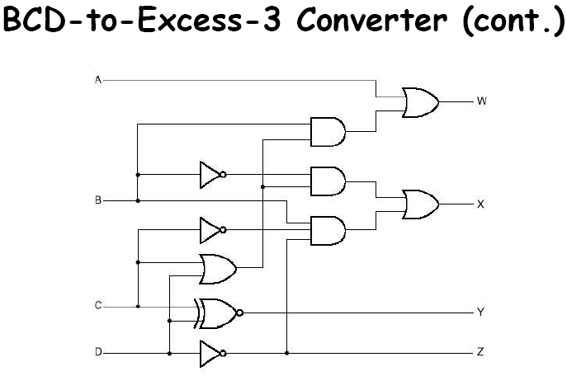
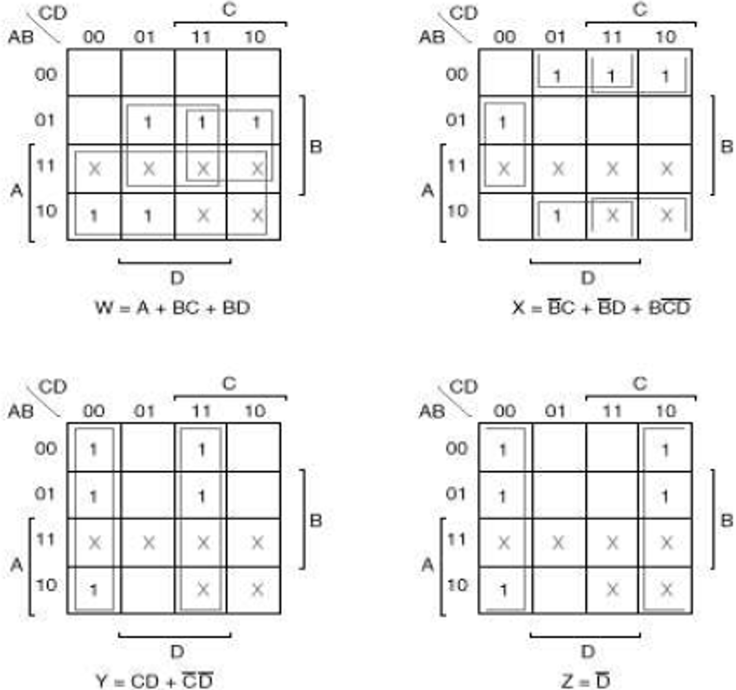
Working with decimal numbers
BCD to Excess 3 code converter
A circuit that converts a BCD codeword to the corresponding excess-3 codeword
Exces-3 code: Given a decimal digit n, it is encoded in excess-3 as (n+3)₂
Example: n = 5: 1000; n = 0: 0011
How many input and output variables?

Slide 20
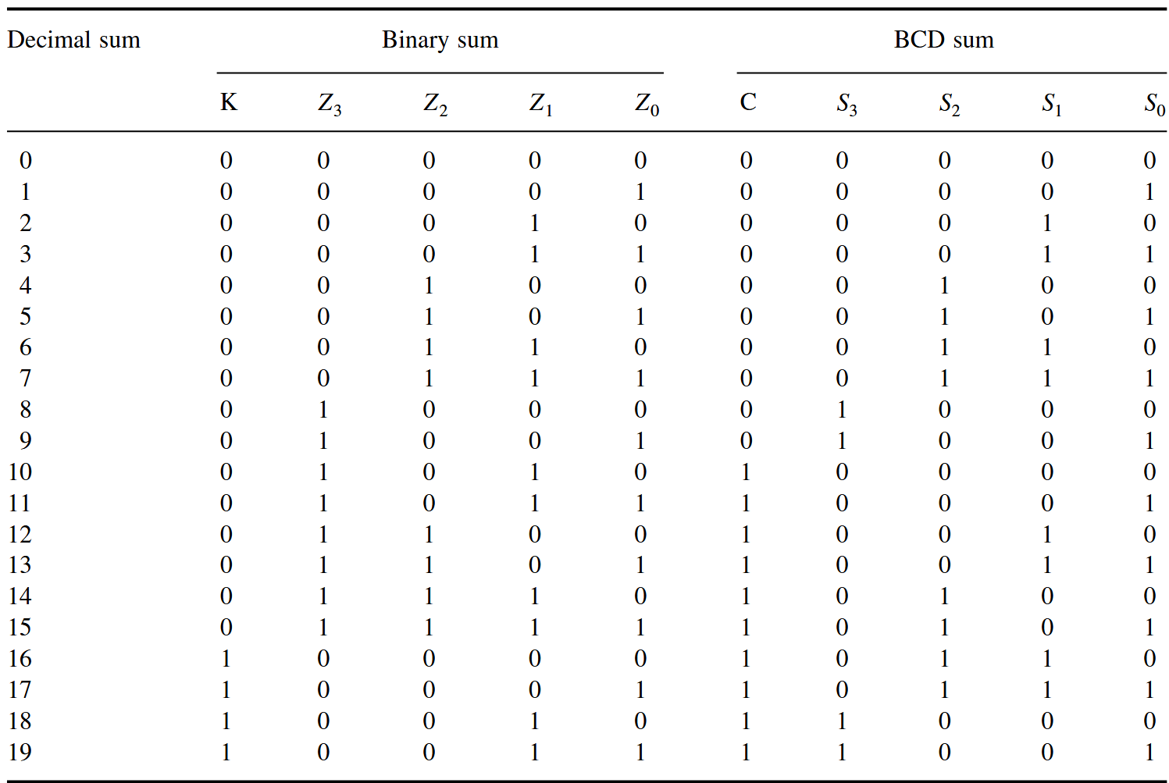
Decimal adders (adding BCD numbers)
Is binary sum less than or equal to 1001?
Yes: answer
No: add 0110 to get the answer (and a carry)

Slide 21
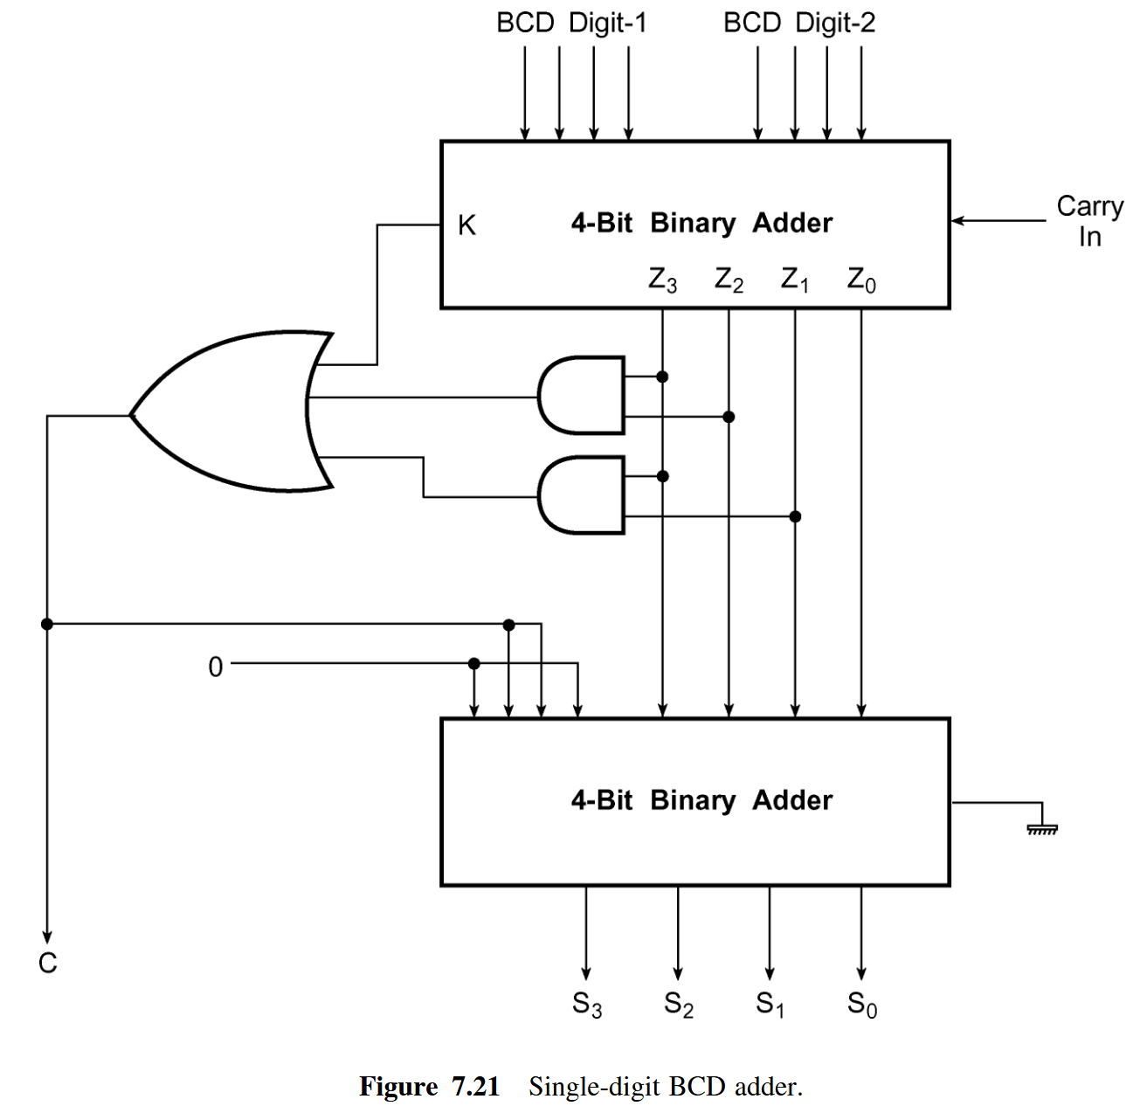
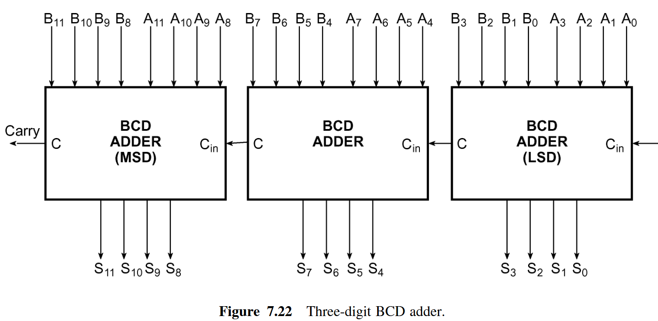
BCD adder

