Slide 1
BITS Pilani Digital Design
Prof. GSS Chalapathi, Prof. Saurabh Gandhi (EEE department)

Slide 2
Introduction

Slide 3
Why study Digital Design?
Industry relevance:
Basis for chip design, FPGA development, ASIC/SoC development and validation, hardware systems, embedded system design
Automotive, consumer electronics, aerospace, IoT
Understanding computer hardware will help design better software: performance optimization, hardware acceleration, cloud infrastructure, security
Foundation for better AI: Google’s TPU, Apple’s Neural Engine, NVIDIA’s DL cores, building domain-specific AI enabled hardware
Research opportunities:
Computer architecture, VLSI design, neuromorphic computing (e.g., IBM TrueNorth, Intel Loihi), security
Hardware-aware ML, real time AI, bio-inspired computing, quantum computing, fault tolerant systems

Slide 4
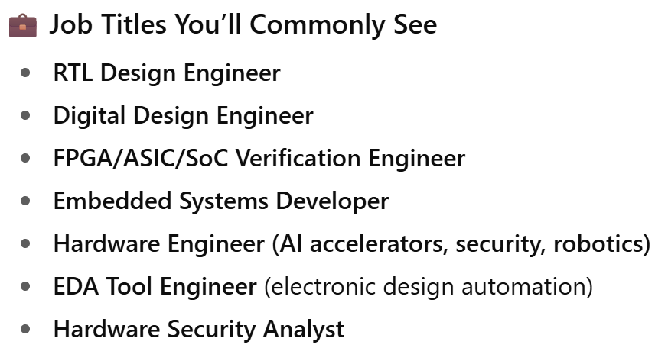
(since we are all using it) GPT says…
Overall Market Demand Summary
Sector | Digital Design Demand | Notes
Semiconductors & Chip Design | 🔥 Very High | Core skill for VLSI, ASIC, FPGA, SoC. Growth fueled by AI, 5G, custom silicon.
Embedded Systems & IoT | 🔥 High | Used in consumer electronics, automotive, defense, and medical devices.
AI/ML Hardware (Edge & Cloud) | 🔥 High | Digital design is needed for accelerators like GPUs, TPUs, NPUs.
FPGA-based Systems | 🔥 High | Especially in telecom, finance, defense, and AI prototyping.
Automotive (ADAS, EV) | 🔥 High | Key to hardware in electric vehicles, autonomous driving, etc.
Cloud Infrastructure | ⚡ Moderate to High | Digital hardware design is essential for optimizing data center hardware.
Startups in Deep Tech | ⚡ Moderate to High | Especially in AI hardware, robotics, edge computing.
Top Hiring Companies:
Chip Makers: Intel, AMD, Nvidia, Qualcomm, ARM, Broadcom, Apple, Samsung.
AI Hardware: Google (TPU), Amazon (Inferentia), Tesla, Cerebras, Graphcore.
Startups: SiFive (RISC-V), Tenstorrent, Mythic, Edge Impulse, etc.
Defense/Avionics: Boeing, Lockheed Martin, DRDO (India), HAL.
Automotive: Tesla, Bosch, NXP, Renesas, Mobileye.
Most of these have core design roles in India now!
Several Indian startups getting into this field as well!

Slide 5
What the heck is ‘digital’ about our age?
Signals
Continuous
Discrete
Systems
Analog
Digital

Slide 6
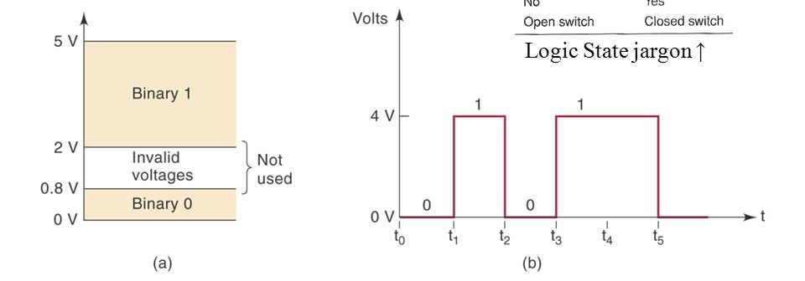
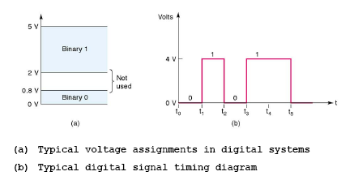
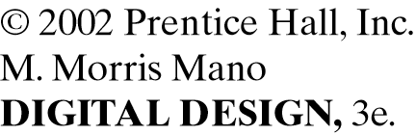
A typical binary digital system

Slide 7
Advantages of digital systems
Reproducibility of results
Ease of design
Programmability
Speed
Cost
Integrated Circuits

Slide 8
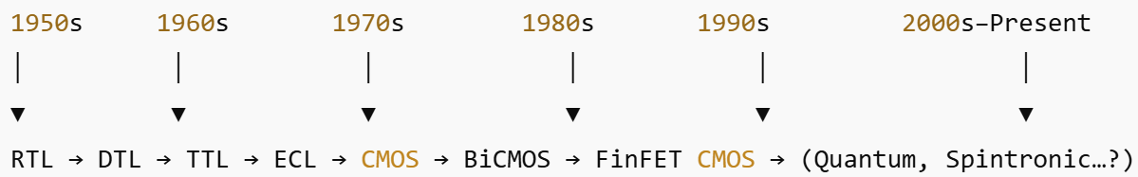
What are integrated circuits?
Linear
Digital
Levels of integration
SSI
MSI
LSI
VLSI
IC logic families
RTL, DTL
TTL
ECL
NMOS, PMOS
CMOS

Slide 9
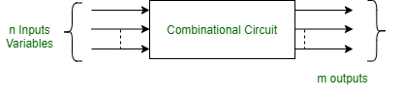
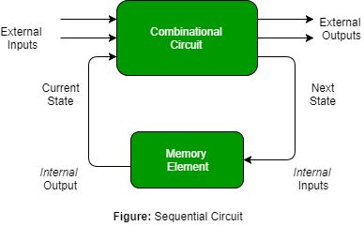
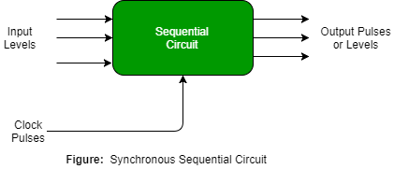
Broad categories of digital circuits
Combinational
Sequential

Slide 10
In this course
Binary codes (representation of information) and binary logic
Digital ICs and their characteristics
Combinational circuit design
Sequential circuit design
Basics of HDL

Slide 11
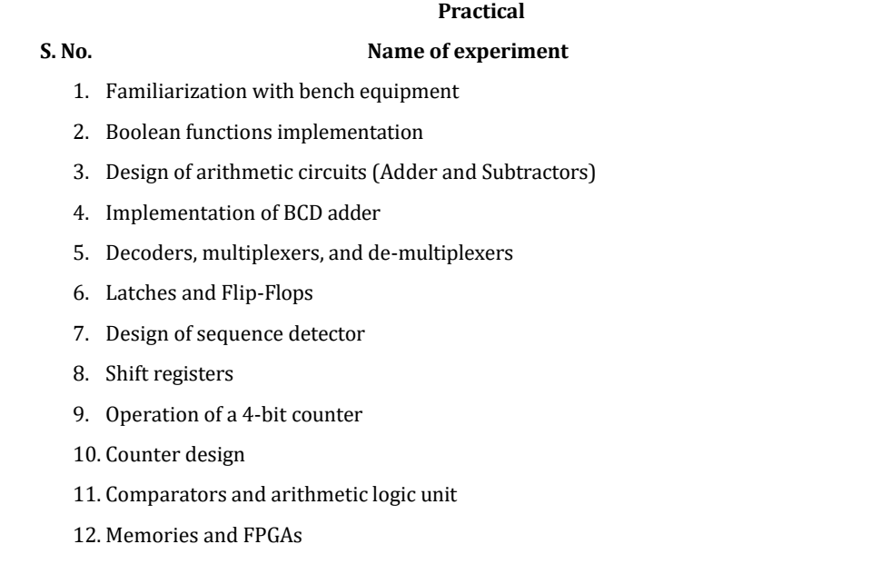
Lab Experiments

Slide 12
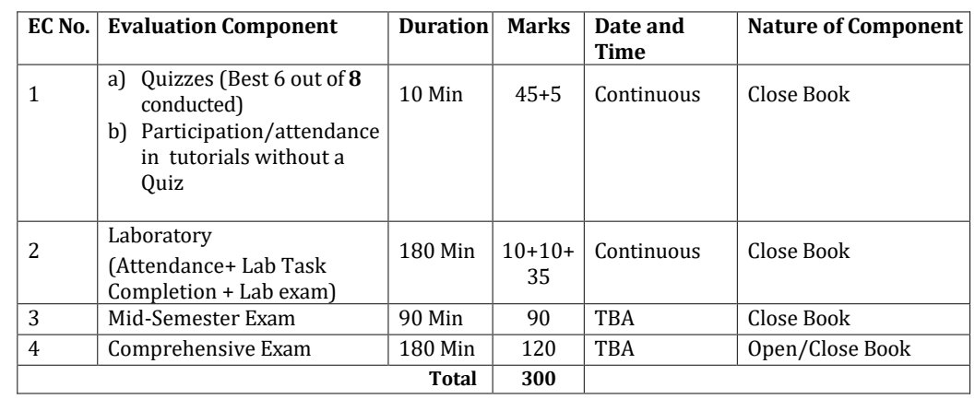
Evaluation Scheme
Open book exam: only hand-written notes will be allowed.
Printouts of digital notes (on your tablets etc.) will not be allowed.
Please take notes accordingly.

Slide 13
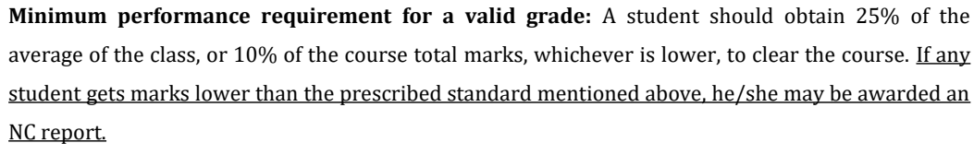
Regarding obtaining a valid grade

Slide 14
IC Characteristics
Fan Out
Propagation Delay
Noise Margin
Power Dissipation

Slide 15
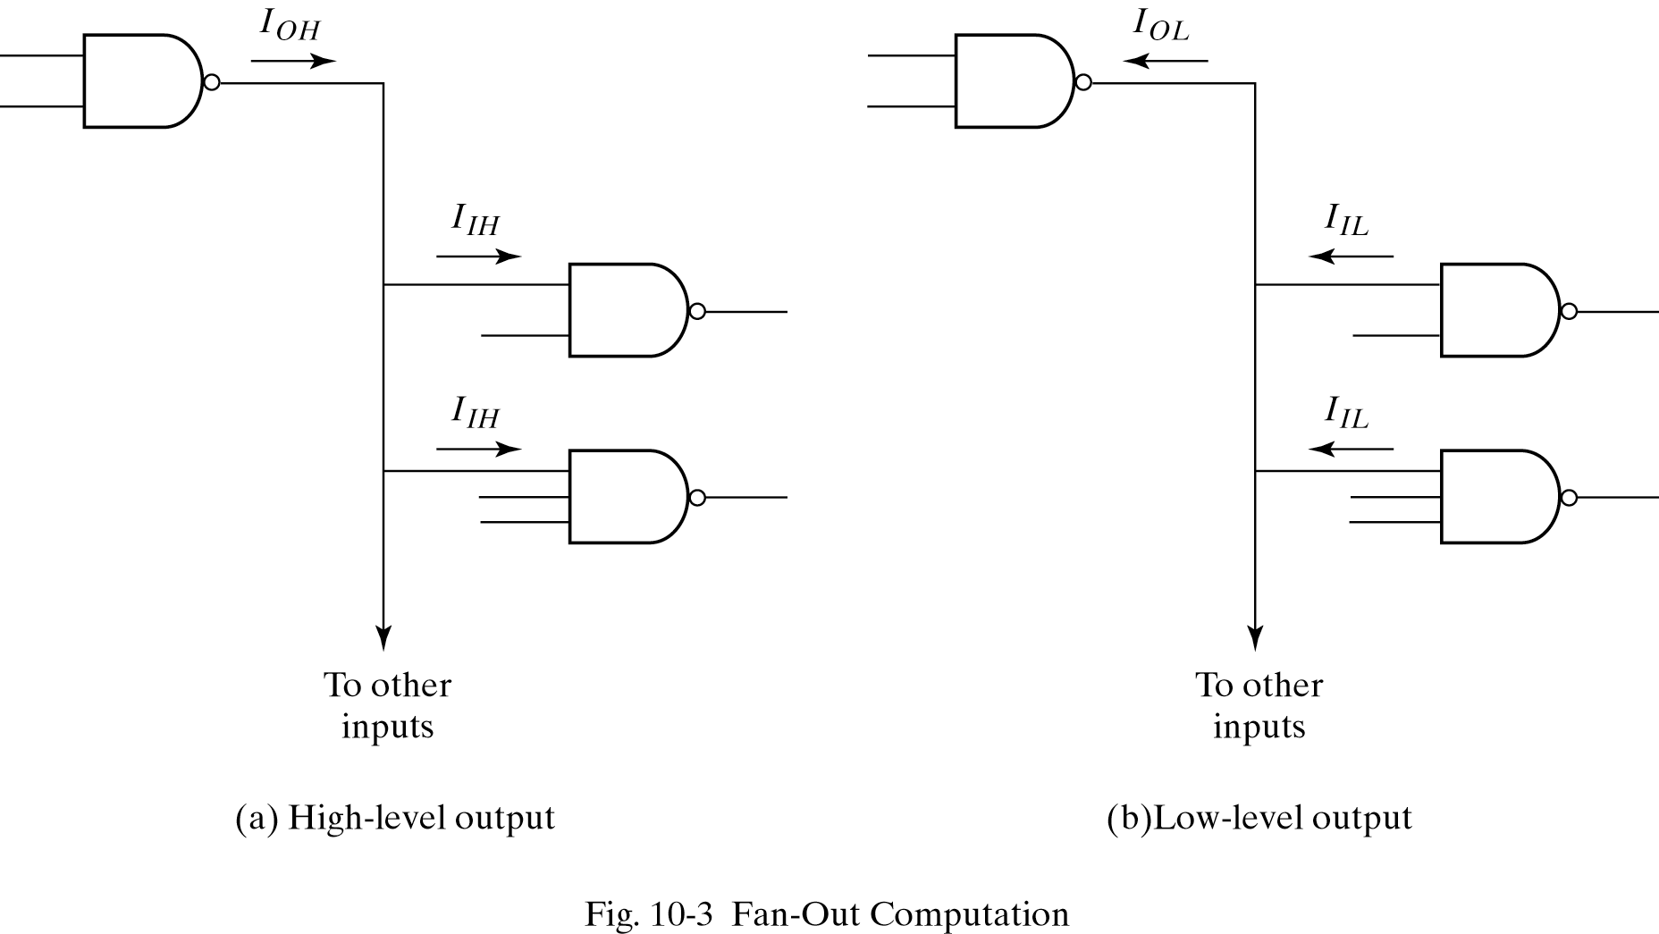
Fan Out

Slide 16
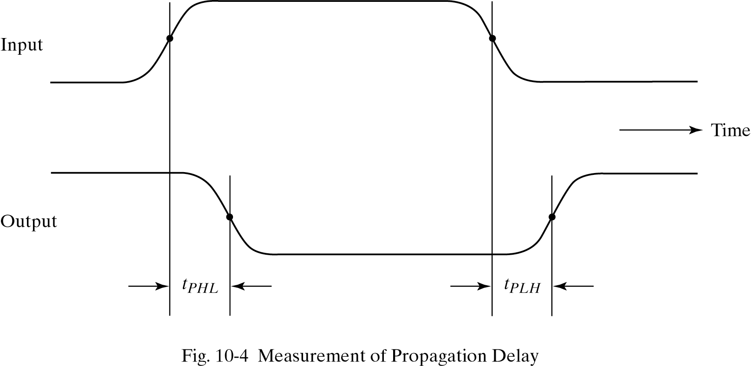
Propagation Delay

Slide 17
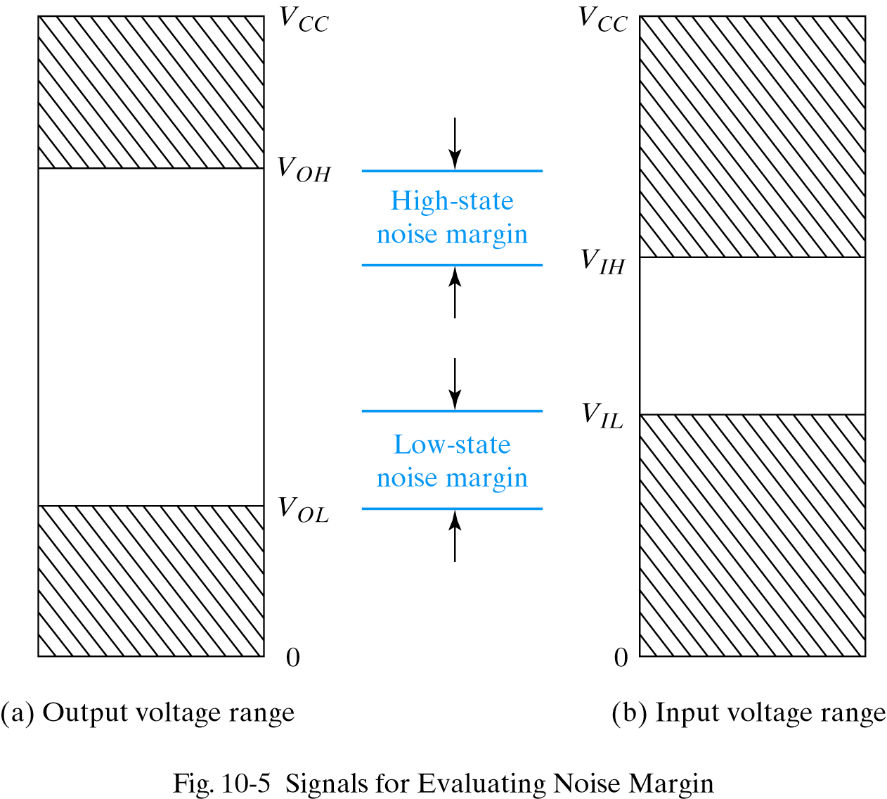
Noise Margin

Slide 18
Power Dissipation (PD)
Expressed in milliwatts
PD = V_{CC} * I_{CC}
I_{CC}(avg)=(I_{CCH}+I_{CCL})/2

