Slide 1
BITS Pilani Digital Design
Prof. GSS Chalapathi, Prof. Saurabh Gandhi (EEE department)

Slide 2
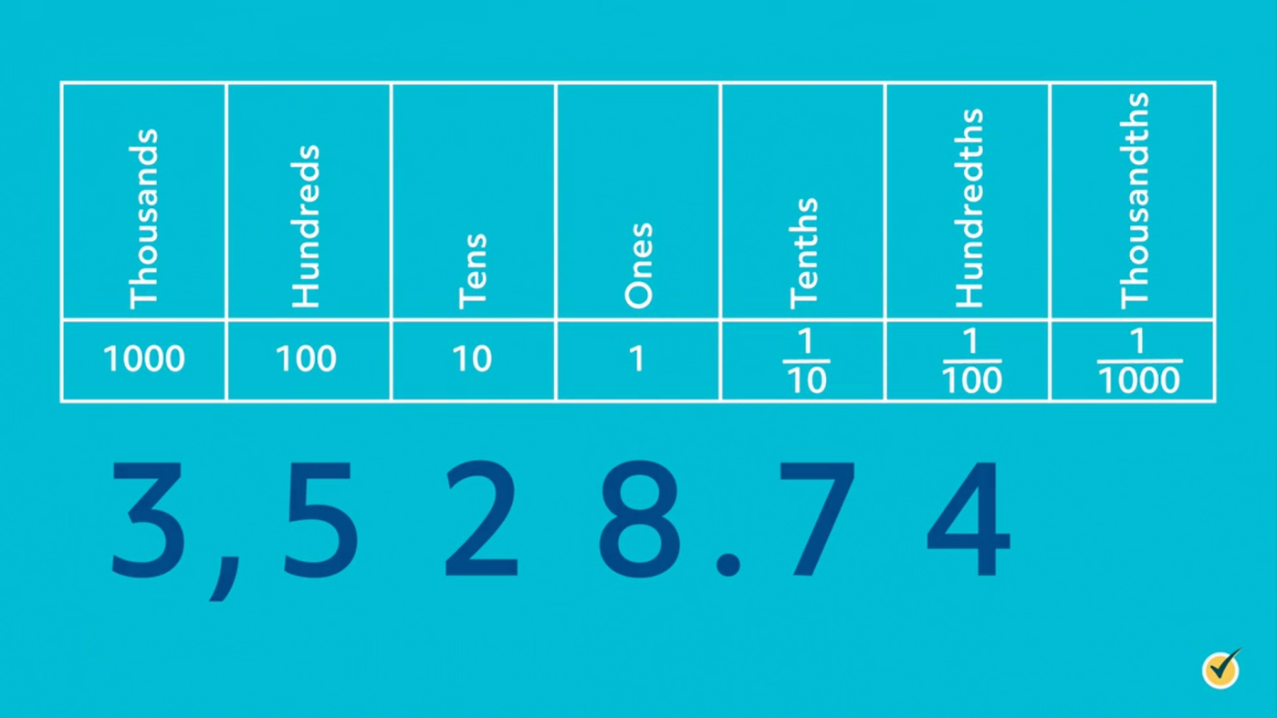
The decimal positional system
(base 10 or radix 10)

Slide 3
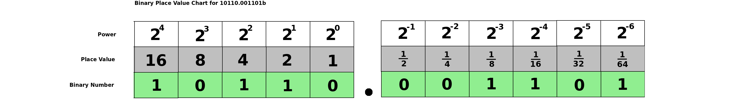
The binary positional system
(base 2 or radix 2)

Slide 4
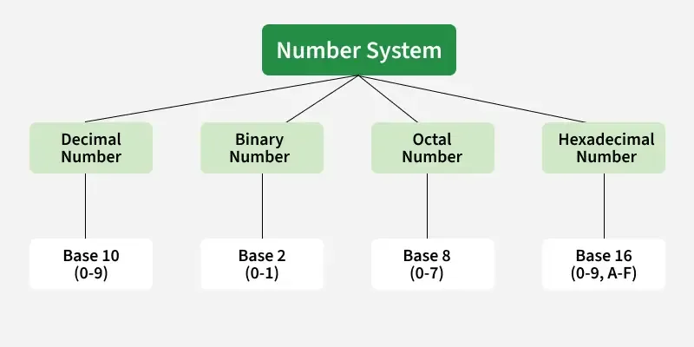
Other common systems you will see

Slide 5
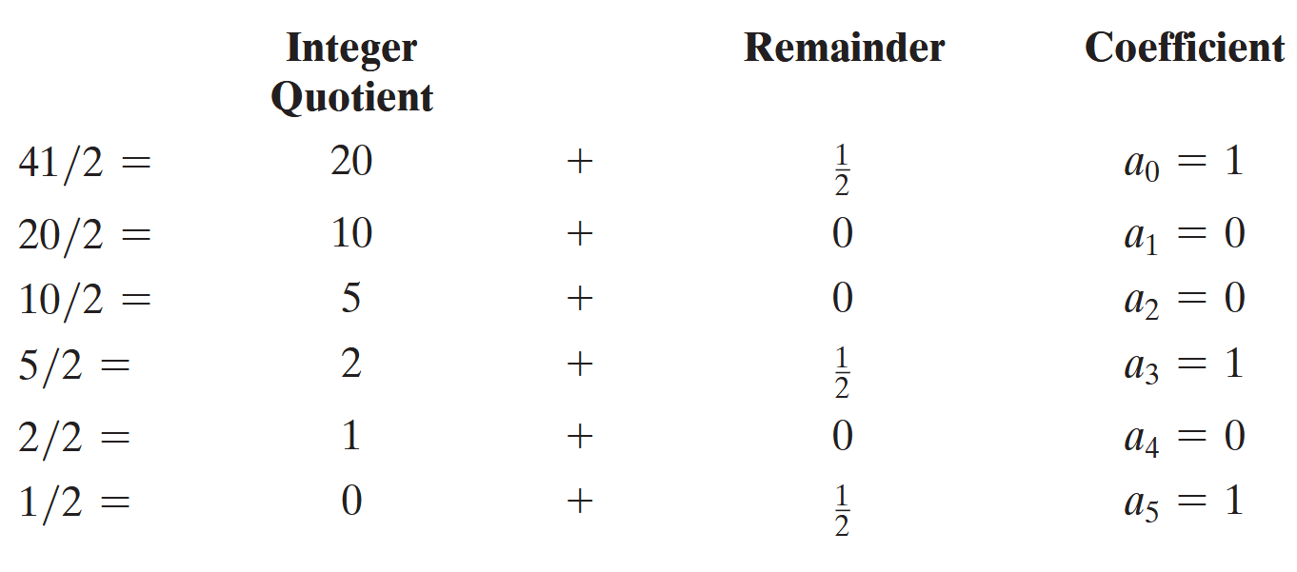
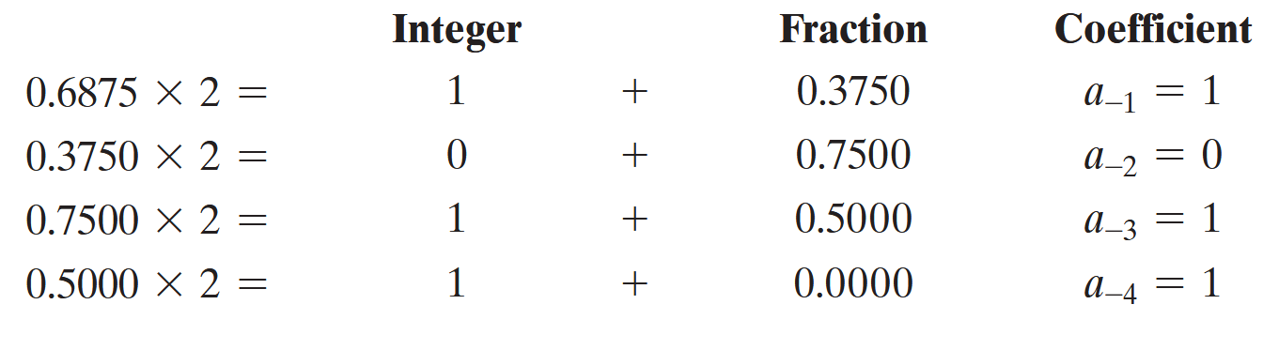
Converting between systems

Slide 6
Radix complements
Diminished Radix Complement Number N in base r having n digits: (r-1)’s complement = (r^{n} -1) – N
Obtained by subtracting each digit from (r - 1)
Radix Complement Number N in base r having n digits (r)’s complement = (r^{n} – N )
Examples:
What is 1’s complement of a binary number, 1011000
“The 1’s complement of a binary number is formed by changing 1’s to 0’s and 0’s to 1’s”
What is the 2’s complement of 1101100?
“The 2’s complement is obtained by leaving the least significant 1 unchanged and complementing all other digits”
Notes:
For binary numbers, r = 2 and r - 1 = 1, so the 1’s complement of N is (2n - 1) - N. Again, 2n is represented by a binary number that consists of a 1 followed by n 0’s. 2n - 1 is a binary number represented by n 1’s. For example, if n = 4, we have 24 = (10000)2 and 24 - 1 = (1111)2. Thus, the 1’s complement of a binary number is obtained by subtracting each digit from 1. However, when subtracting binary digits from 1, we can have either 1 - 0 = 1 or 1 - 1 = 0, which causes the bit to change from 0 to 1 or from 1 to 0, respectively. Therefore, the 1’s complement of a binary number is formed by changing 1’s to 0’s and 0’s to 1’s.

Slide 7
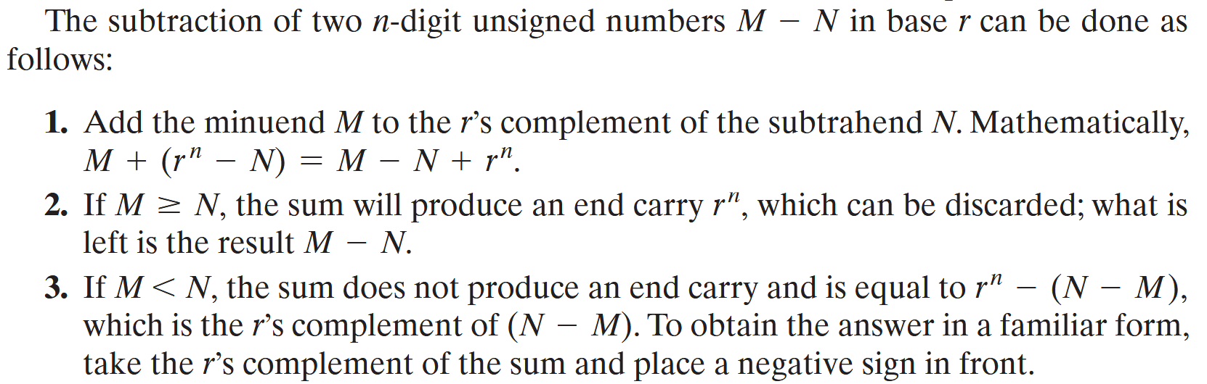
Subtracting numbers with complements

Slide 8
Representing negative numbers
Can we put a minus sign in a computer?
Both signed and unsigned binary numbers consist of a string of bits when represented in a computer!
The user determines whether the number is signed or unsigned
The signed magnitude system: leftmost symbol indicates the sign
The signed complement system: negative number is indicated by its complement (ie a negative number is stored as its complement)
2’s complement most common
Why do all of this?
It makes addition and subtraction easy!
Notes:
there are three different ways to represent -9 with eight bits:
signed‐magnitude representation: 10001001
signed‐1’s‐complement representation: 11110110
signed‐2’s‐complement representation: 11110111

Slide 9
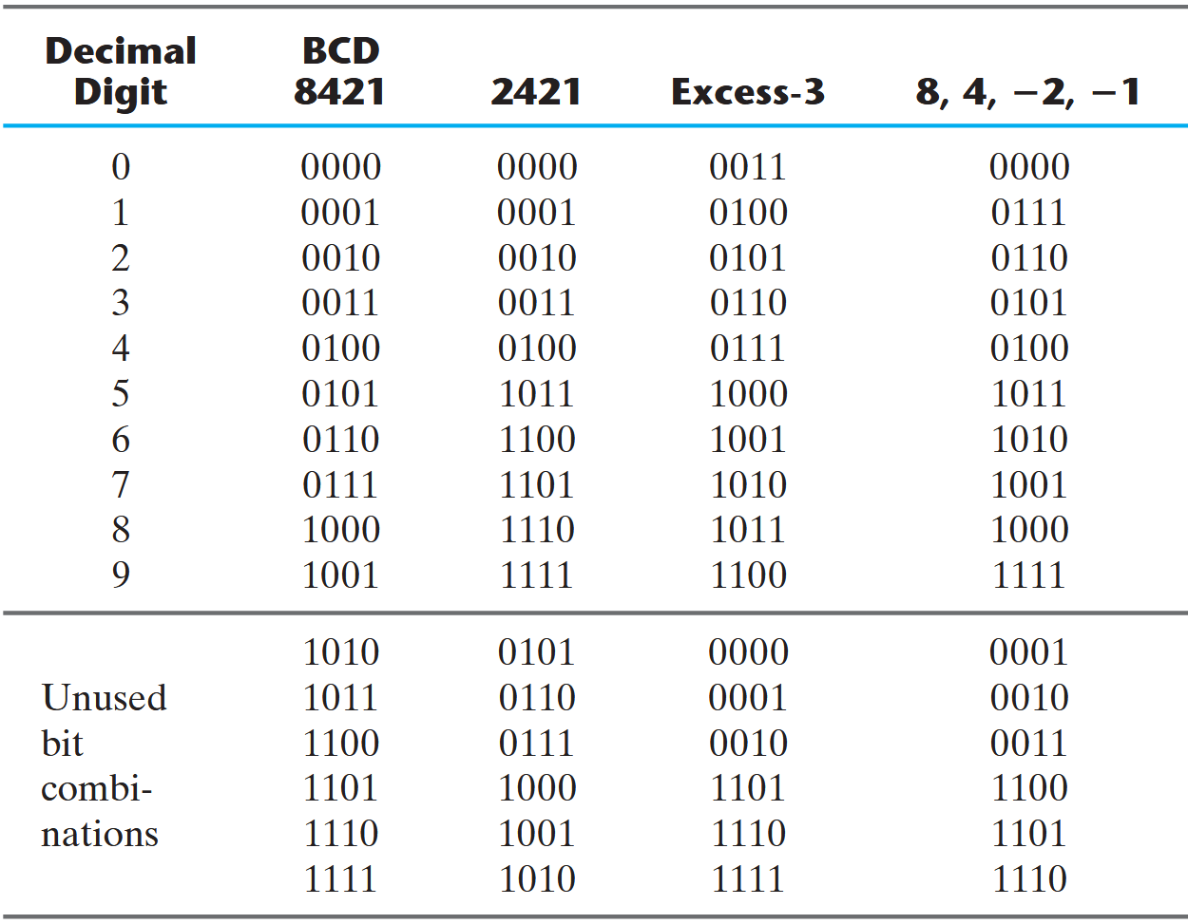
Representing digits in binary
Notes:
Excess‐3 is an unweighted code in which each coded combination is obtained from the corresponding binary value plus 3

Slide 10
Review
Converting between hex / octal / binary
Representing with radix 2 vs binary coded numbers
2’s complement representation of binary numbers

Slide 11
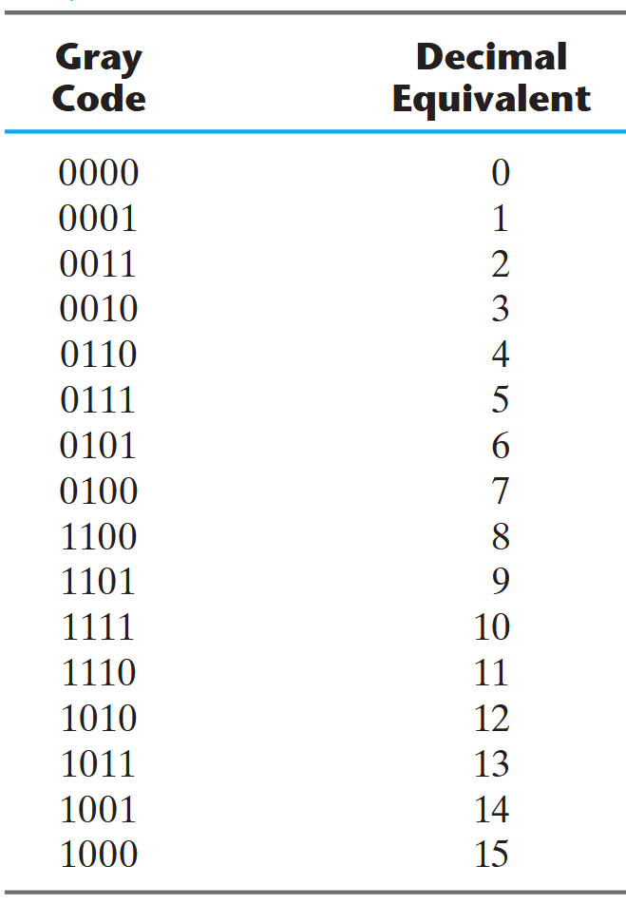
Why all the different codes?
BCD requires adding 6 to the result if it is greater than 9
The 2421 and the excess‐3 codes are self‐complementing
9’s complement of a decimal number is obtained directly by changing 1’s to 0’s and 0’s to 1’s
Making a robust (error-tolerant) code
Purpose? Transmitting a discretized version of a continuous signal
What can go wrong?

Slide 12
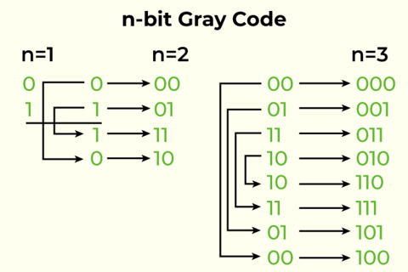
How to generate the Gray code?

Slide 13
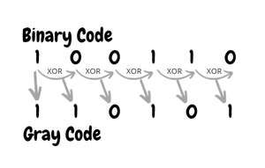
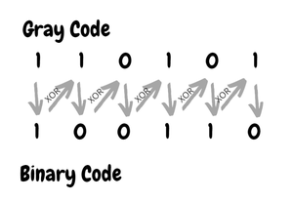
Binary to Gray conversion

