Slide 1
BITS Pilani Digital Design
Prof. GSS Chalapathi, Prof. Saurabh Gandhi (EEE department)

Slide 2
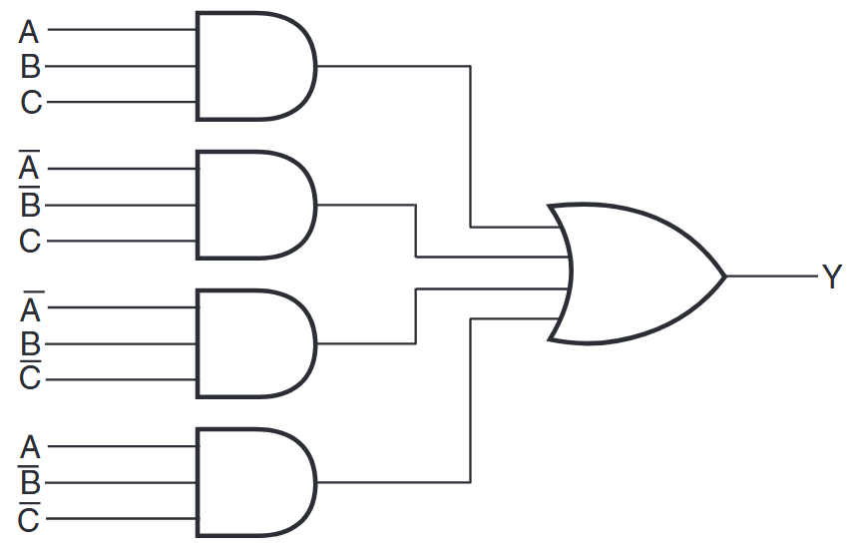
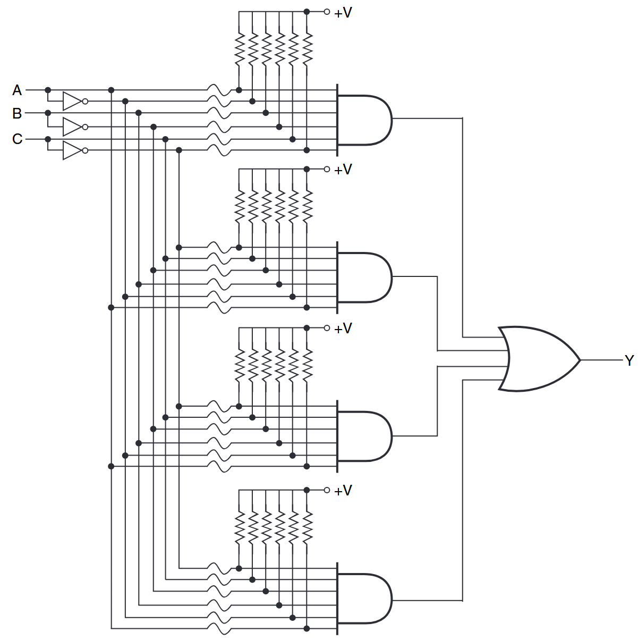
Programmable logic devices
Fixed logic circuit
Simple programmable logic device built using antifuses that can be burned in

Slide 3
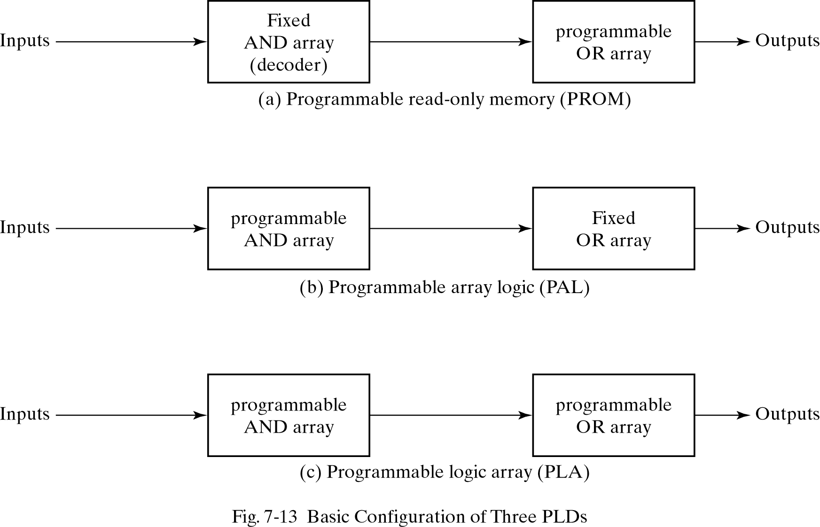
Programmable logic devices

Slide 4
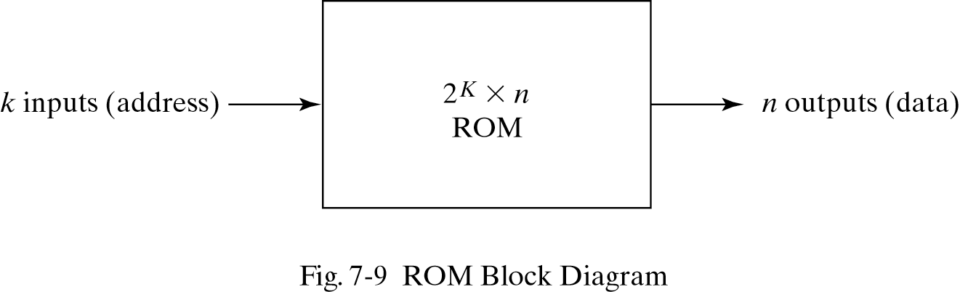
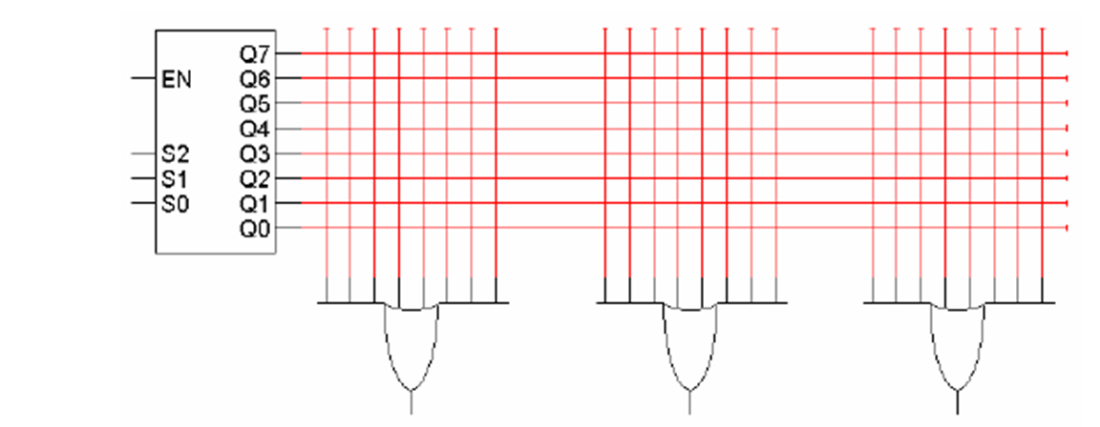
Read Only Memory (ROM)
Memory in which permanent binary information / combinational circuit is stored
Remember: “decoders are minterm generators”
Also “any combinational logic can be represented as sum of minterms”
ROM includes decoders and OR gates within a single IC → decoder outputs may be sent to several OR gates
Connections between decoder outputs and OR gates is ‘programmable’ to implement different functions

Slide 5
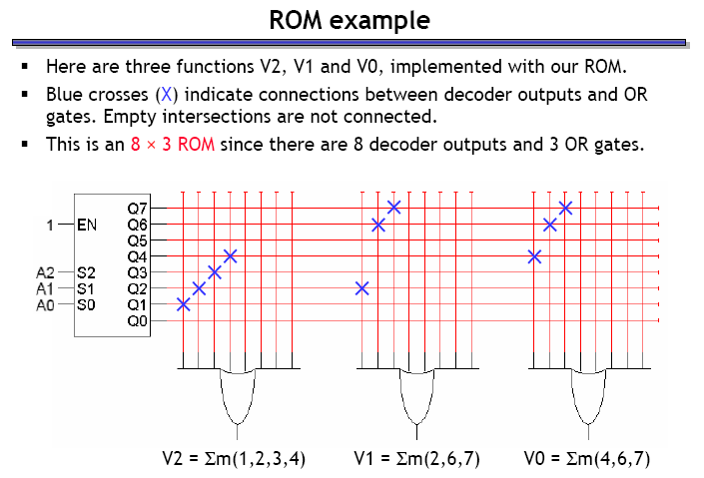
Implementing a Boolean function with a ROM
Implement: V0 = m( 4, 6, 7); V1 = m( 2, 6, 7); V2 = m( 1,2,3,4)

Slide 6
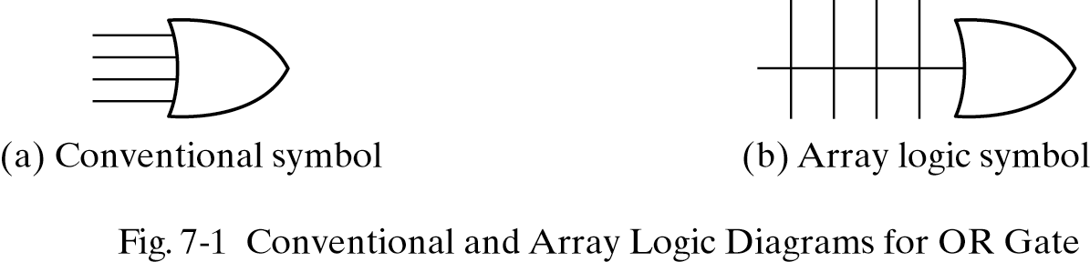
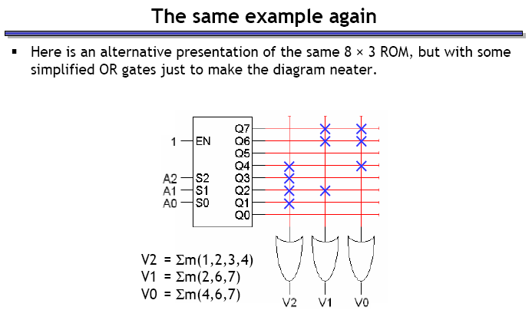
New symbols

Slide 7
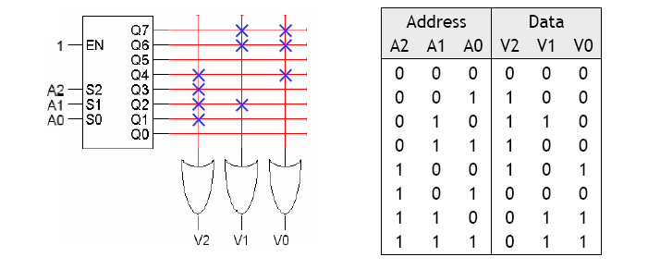
Why do we call this a ‘memory’?
Circuit is performing a computation on inputs A2A1A0 to produce output V2V1V0
The same input will generate the same output every time
Circuit “remembers” the output for each possible input
Effectively: circuit stores 8 values of data, each value 3 bits long
A2A1A0 forms an address that refers to one of the 8 stored values
Read Only because once the OR gate inputs are fused, they cannot be changed.

Slide 8
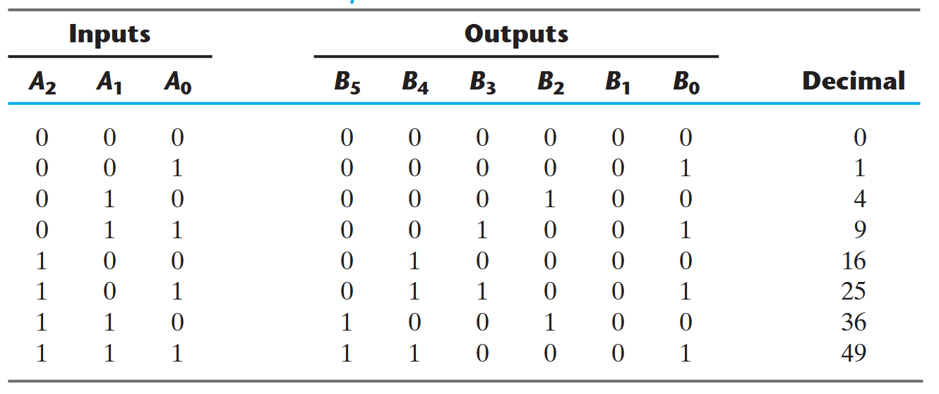
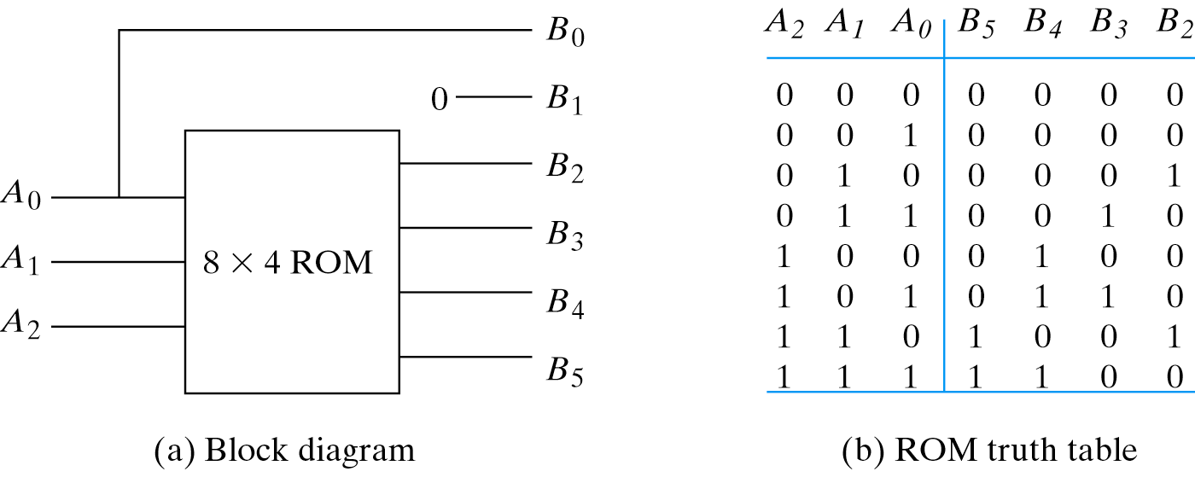
Example: output is square of input
ROM implementation is not efficient for inputs with many don’t care condition

Slide 9
Programmable Logic Arrays (PLAs)
A ROM uses a decoder to generate all possible minterms, with no circuit minimization
ROM implementation of an n-input function uses many gates:
n-to-2^{n} decoder (which has n inverters and 2^{n} n-input AND gates)
OR gate with 2^{n} inputs
Number of gates roughly doubles for each additional ROM input
A PLA makes the decoder part of the ROM also programmable
You can choose what products (not necessarily minterms) to generate

Slide 10
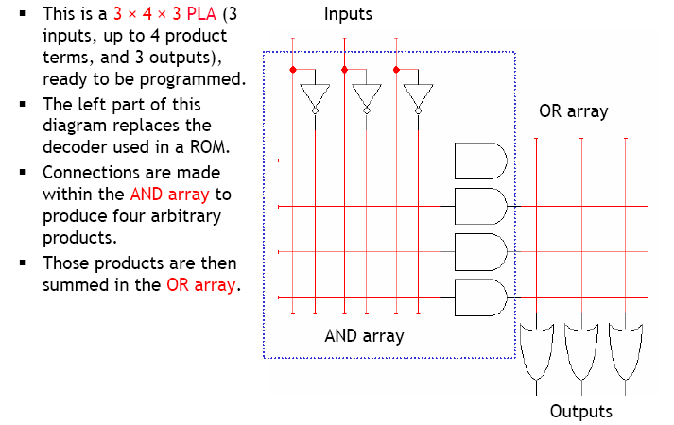
A 3 x 4 x 3 PLA

Slide 11
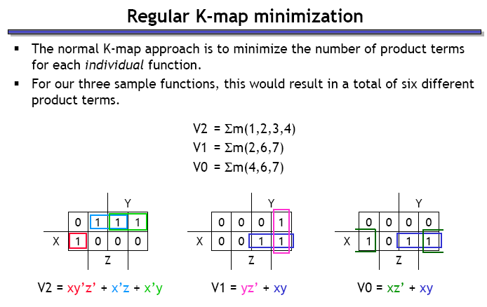
Optimizing expressions for PLA implementation

Slide 12
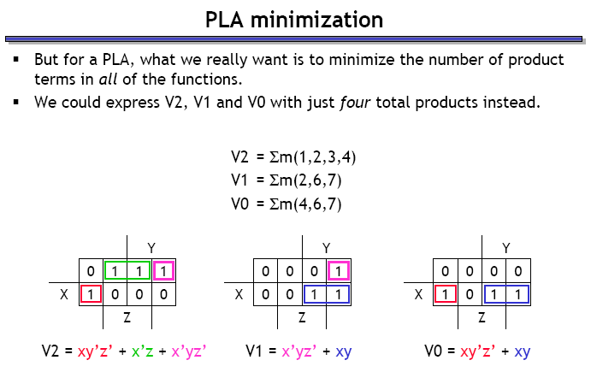
Optimizing expressions for PLA implementation

Slide 13
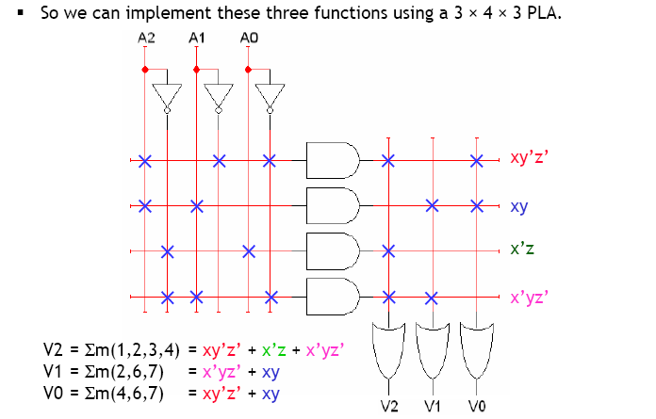
Implementing our example with PLA

Slide 14
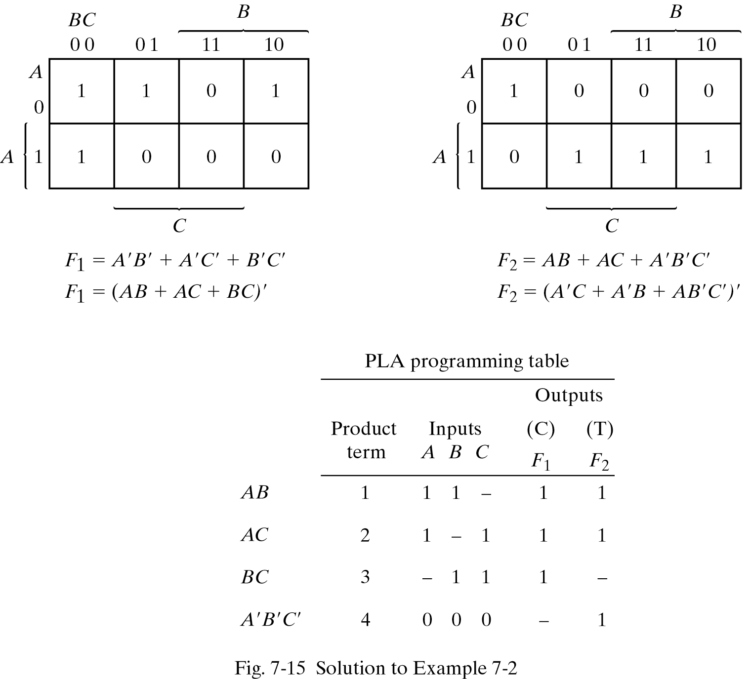
Example 2
Implement the two functions given below using a 3x4x2 PLA:
F1=Σ(0,1,2,4)
F2= Σ(0,5,6,7)

Slide 15
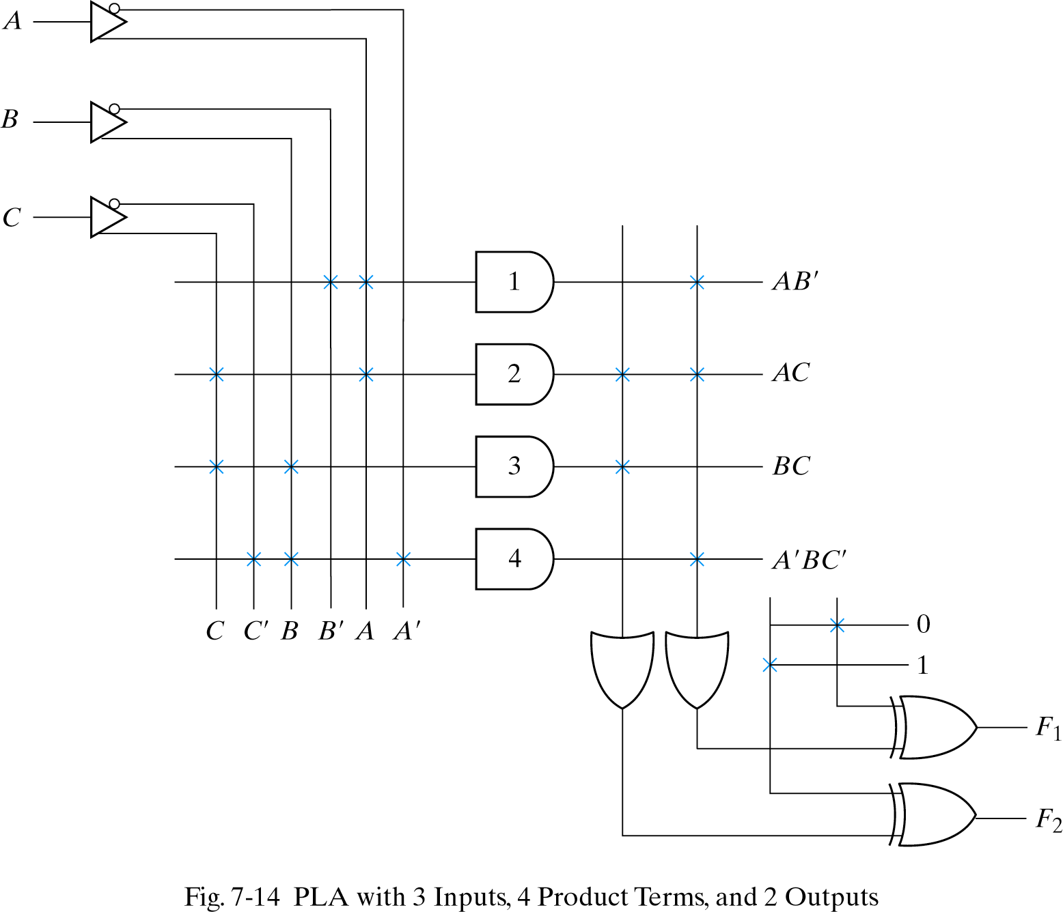
Example 2 – circuit implementation

Slide 16
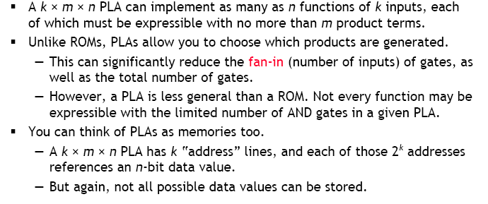
PLA summary

Slide 17

Attendance!
Will be opened only during the attendance window.
Enable location on your device.
Grant any location permissions requested by the website.
Refresh the page.
Try submitting again.

Slide 18
Programmable logic devices

Slide 19
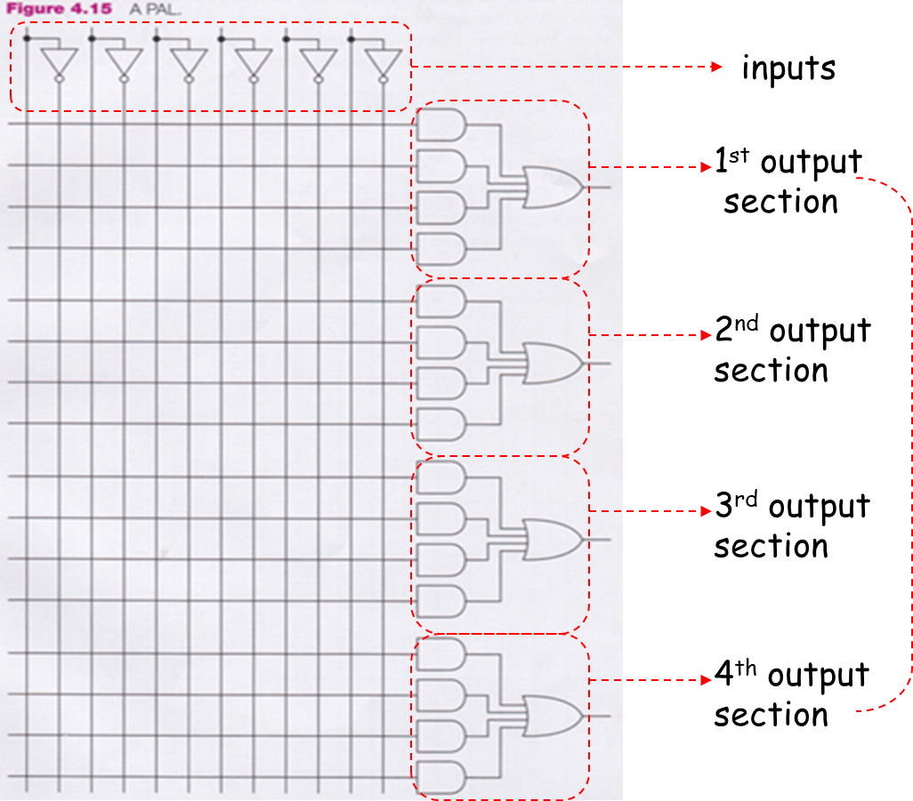
Programmable Array Logic (PAL)
OR array is fixed, AND array can be programmed
Less flexible than PLA
Number of product terms available per function is fixed
Only functions with at most four products can be implemented

Slide 20
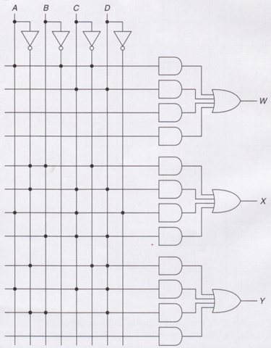
Example
W = AB′C′ + CD
X = A′BC′ + A′CD + ACD′ + BCD
Y = A′C′D′ + ACD + A′BD

Slide 21
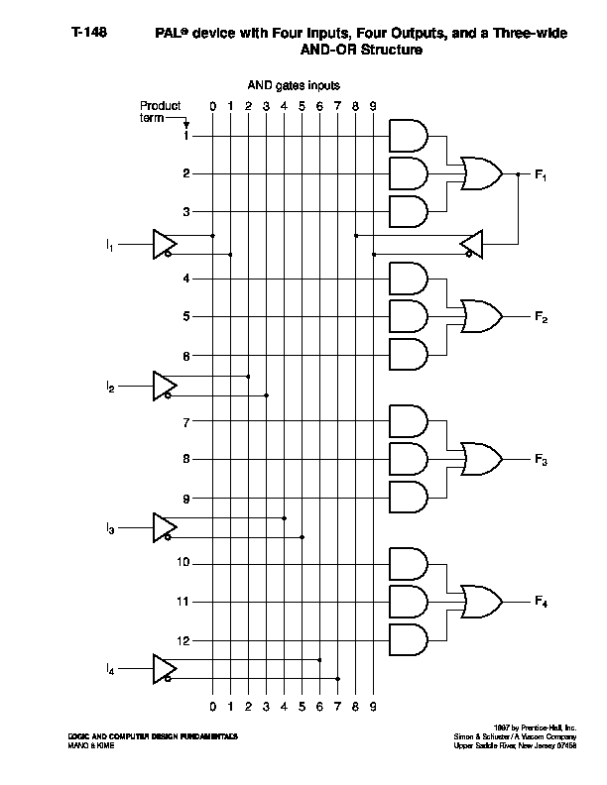
More complex functions using PALs
What if you allowed outputs to be connected back as inputs?

Slide 22
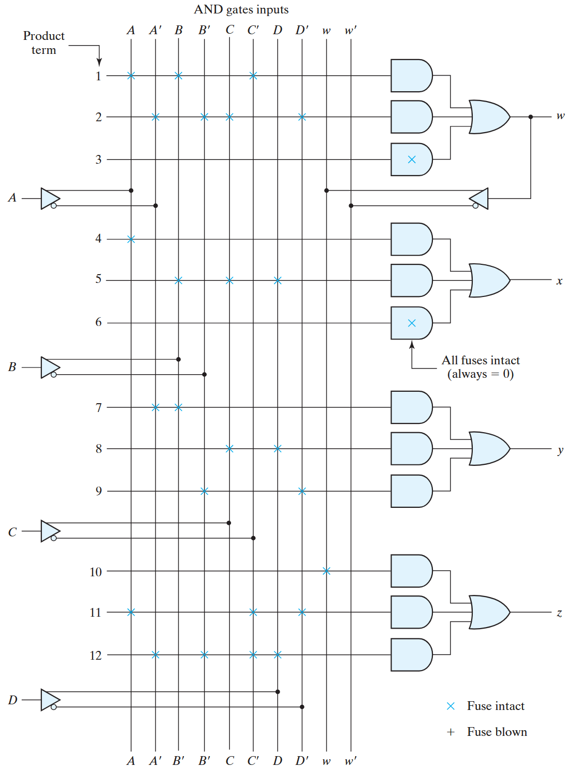
Example 2
Implement the following equations using a PAL with 4 inputs, 4 outputs, and 3-wide AND-OR structure.
W(A, B, C, D) = ∑m(2, 12, 13)
X(A, B, C, D) = ∑m(7, 8, 9, 10, 11, 12, 13, 14, 15)
Y(A, B, C, D) = ∑m(0, 2, 3, 4, 5, 6, 7, 8, 10, 11, 15)
Z(A, B, C, D) = ∑m(1, 2, 8, 12, 13)
Simplification:
W = ABC’ + A’B’CD’
X = A + BCD
Y = A’B + CD + B’D’
Z = ABC’ + A’B’CD’ + AC’D’ + A’B’C’D
= W + AC’D’+A’B’C’D

Slide 23
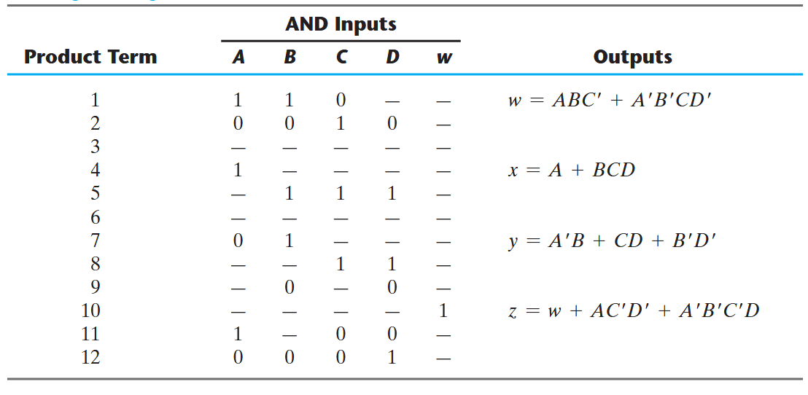
Example 2 – tabular specification

Slide 24
Implement using PLA
F1 (a, b, c) = ∑ (6, 7)
F2 (a, b, c) = ∑ (4, 5, 7)
F3 (a, b, c) = ∑ (3, 5)
F4 (a, b, c) = ∑ (2, 6)

