Slide 1
BITS Pilani Digital Design
Prof. GSS Chalapathi, Prof. Saurabh Gandhi (EEE department)

Slide 2
NAND and NOR implementation
Circuits are more often implemented with NAND and NOR gates rather than AND, OR and NOT gates
Easier to fabricate
Basics gates, used in all IC digital logic families
Universal gates: all other gates can be constructed using just NAND (or just NOR) gates

Slide 3
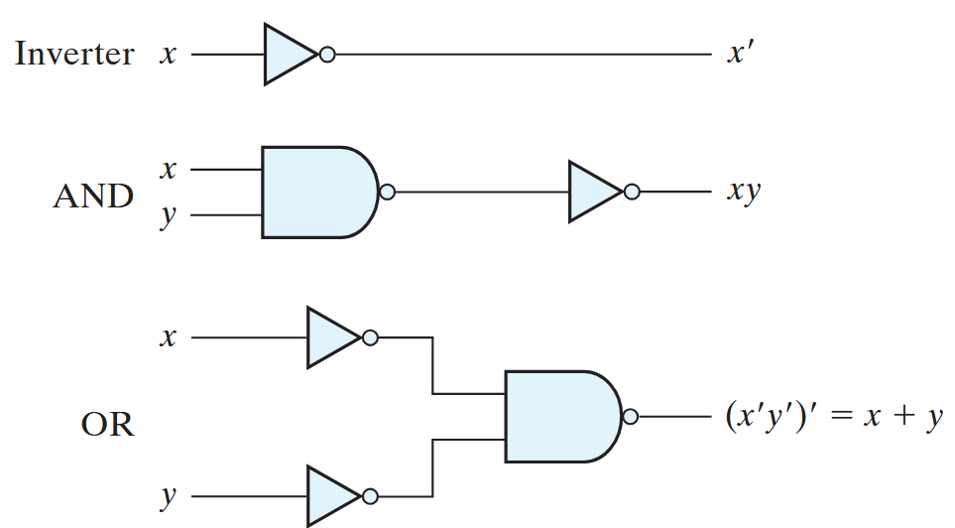
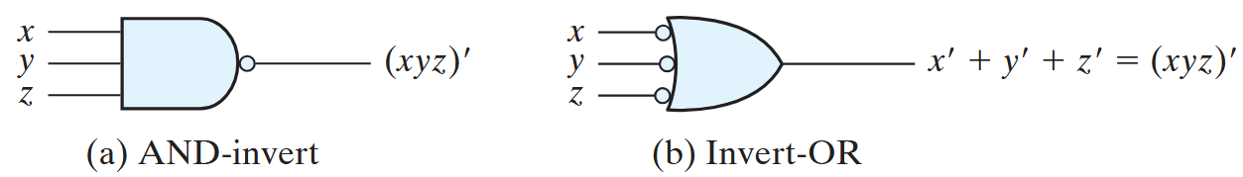
NAND circuits
NOT, AND and OR can be implemented with NAND gates
Two representations of the NAND gate

Slide 4
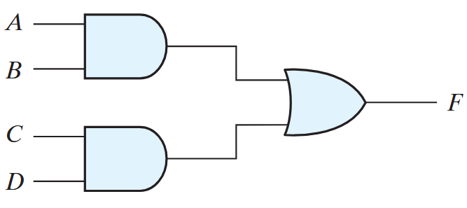
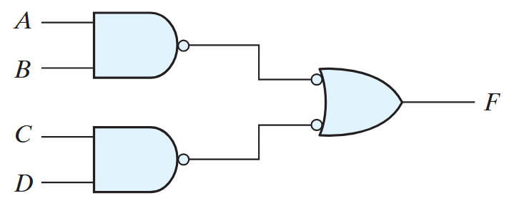
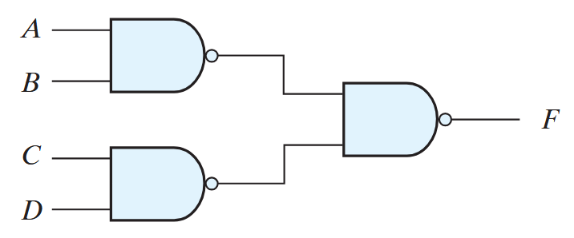
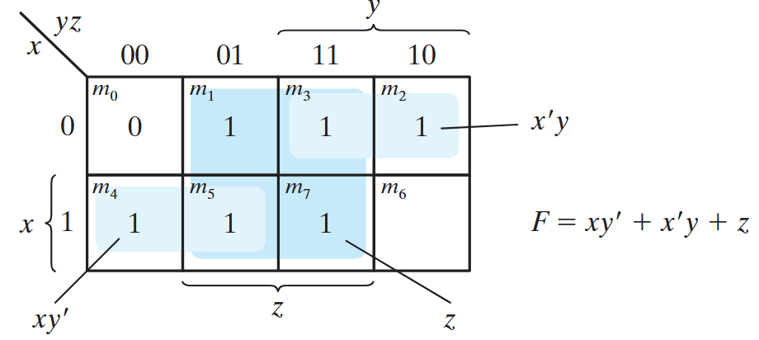
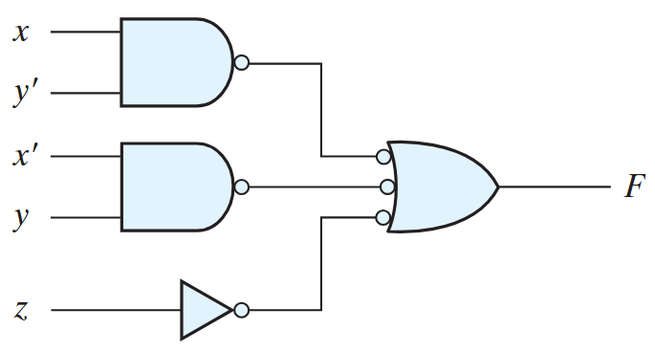
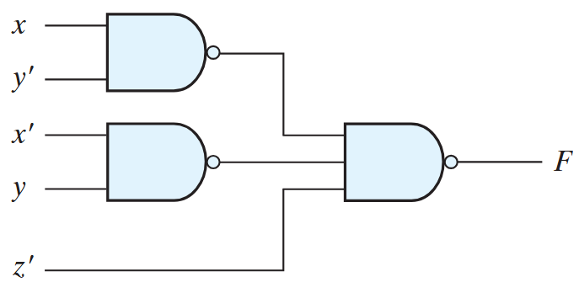
SOP implementation with NAND
The implementation of Boolean functions with NAND gates requires that the functions be in sum-of-products form
Consider the gate level implementation of: F = AB + CD
Example:
Implement with NAND gates: F (x, y, z) = sum(m(1, 2, 3, 4, 5, 7))

Slide 5
General procedure for NAND implementation
Simplify the function and express it in sum-of-products form.
Draw a NAND gate for each product term of the expression that has at least two literals. The inputs to each NAND gate are the literals of the term. This procedure produces a group of first-level gates.
Draw a single gate using the AND-invert or the invert-OR graphic symbol in the second level, with inputs coming from outputs of first-level gates.
A term with a single literal requires an inverter in the first level. However, if the single literal is complemented, it can be connected directly to an input of the second level NAND gate.
Generates 2-level implementations of expressions

Slide 6
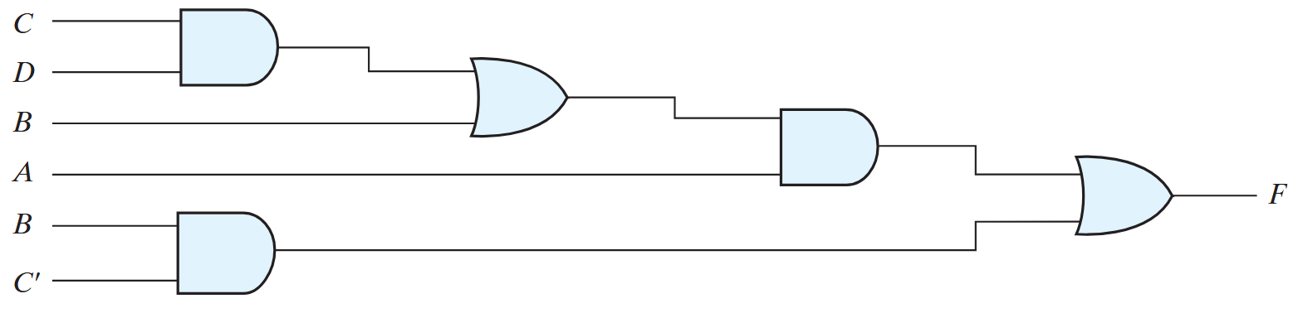
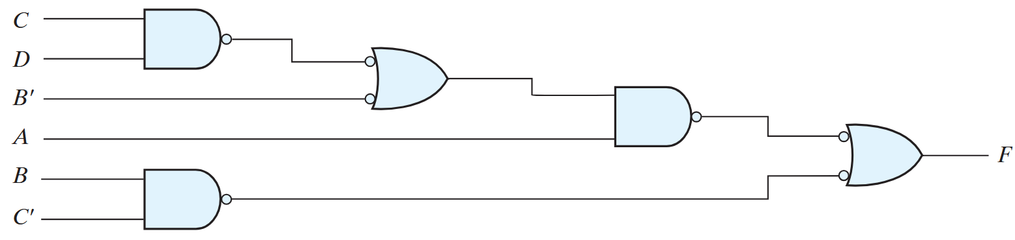
Multilevel NAND circuits
Example: Implement the function F = A (CD + B) + BC’
Convert all AND gates to NAND gates with AND-invert graphic symbols
Convert all OR gates to NAND gates with invert-OR graphic symbols
Check all the bubbles in the diagram. For every bubble that is not compensated by another small circle along the same line, insert an inverter (a one-input NAND gate) or complement the input literal

Slide 7
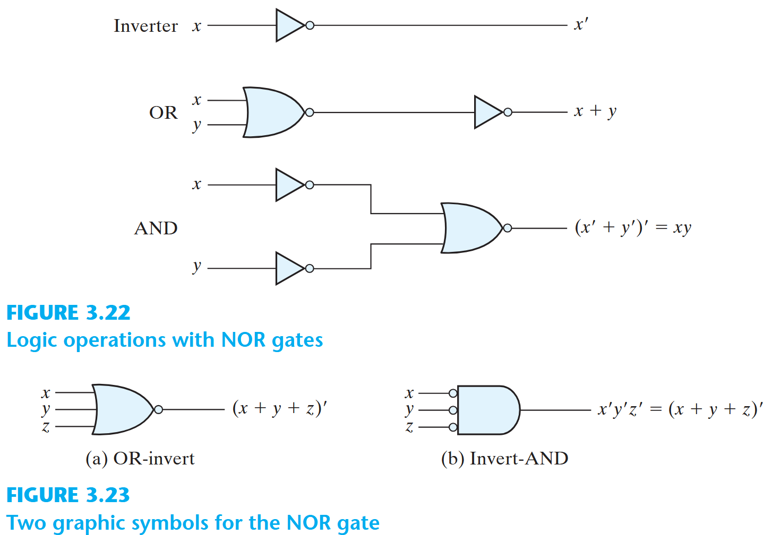
NOR implementation
Dual of NAND implementation
Requires function to be in POS form
Rest of the procedure remains analogous to NAND implementation
Example: Implement (A+B)(C+D)E using NORs

