Slide 1
BITS Pilani
Digital Design
Prof. GSS Chalapathi, Prof. Saurabh Gandhi (EEE department)

Slide 2
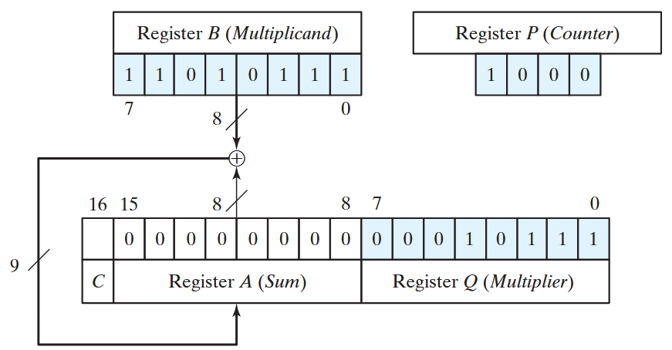
Remember our sequential multiplier?
Want to build a digital system that does this
What all does the system need to do?
  Arithmetic operations
  Decision regarding what operations to perform
Arithmetic operations (data processing): data path (data unit)
Inputs: data, control signals
Decision making with proper timing: control path (control unit)
Inputs: external conditions + internal ‘status’

Slide 3
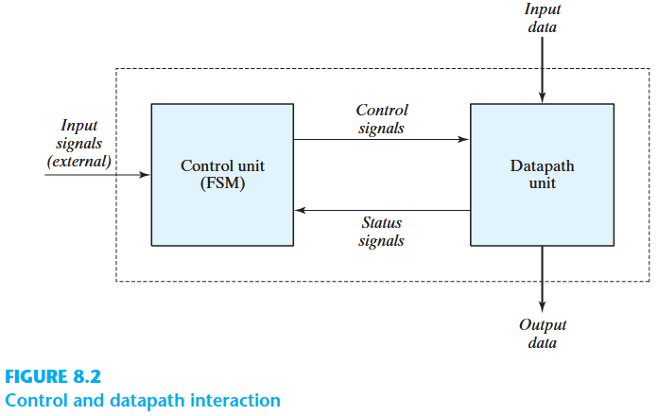
Control and data path interaction
Combinational or sequential?
Data path?
Combinational!
Control path?
Sequential!
Arithmetic operations (data processing): data path (data unit)
Inputs: data, control signals
Decision making with proper timing: control path (control unit)
Inputs: external conditions + internal ‘status’

Slide 4
Algorithmic State Machine (ASM)
Control sequence and data processing tasks are specified by means of Hardware Algorithm.
  Algorithm: algorithm consists of a finite number of procedural steps that specify how to obtain a solution to a problem
  Hardware algorithm: procedure for solving the problem with a given piece of equipment
Flowchart: sequence of procedural steps
  Not concerned with the time relationship between steps (states)
A special flowchart developed to design digital hardware algorithms is called Algorithmic State Machines (ASM)
  Sequence of steps
  + relationships between states of the controller

Slide 5
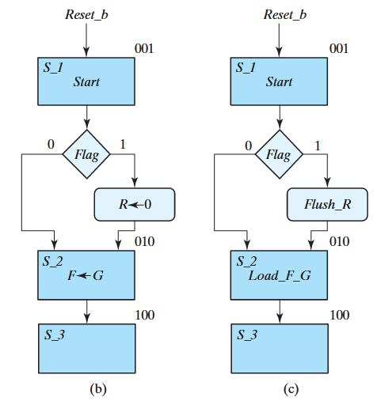
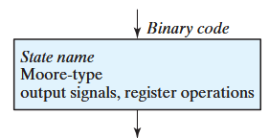
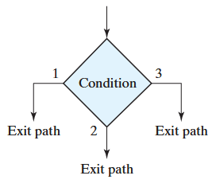
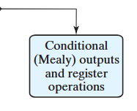
Components of an ASM chart
State box
Indicates a state (top left description and top right code)
Register operations (b)
OR
o/p control signal (c)
Decision box
Condition to be tested
Possible exit paths (typically 2 for binary conditions)
Conditional box
Input always from the exit path of a condition box
Register operations OR o/p control signals
These are generated during the state if conditions are met

Slide 6
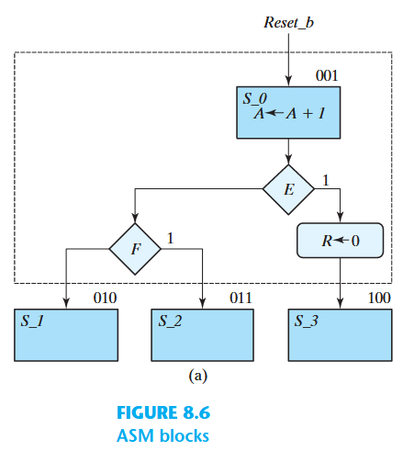
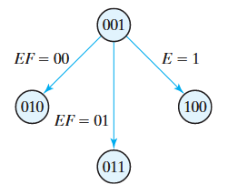
ASM Block
Structure containing one state box and all decision and conditional boxes connected to the state box exit path
ASM block has 1 input (entrance), and any number of exit paths
Describes the state of the system during 1 clock cycle
All operations inside the block are initiated simultaneously when the system transitions out of the state into the next state
Similar to a state diagram:
  State box → state
  Decision box → edge connecting states
Similar design process for control path as you did for sequential circuits!

Slide 7
Comparison to conventional flowcharts
Conventional flowcharts: the listed operations follow one after another
ASM chart: everything within a block happens simultaneously, synchronized to the clock pulse!

Slide 8

Projects (next 1 - 2 semesters)
Development of teaching / learning tools
  Easy to create / deploy pop quiz addons for PPT / Google Slides
    → Web stack, general coding
  LLM based adaptive unit testing platform
    → Web stack, LLM integration
*Find an interested senior who has taken Comp Arch and was good at it.
*Add their name in the ‘Other’ question in the form
*They should also fill the form separately, and mention your name + their comp arch grade in the ‘Other’ question (Senior can be taken as TA for CS F342)
*Fill by: Saturday night; Start: Next week!
Neuroscience
  Cognitive neuroscience experiments
  → Long term research interest only (2-3 semester commitment)

Slide 9
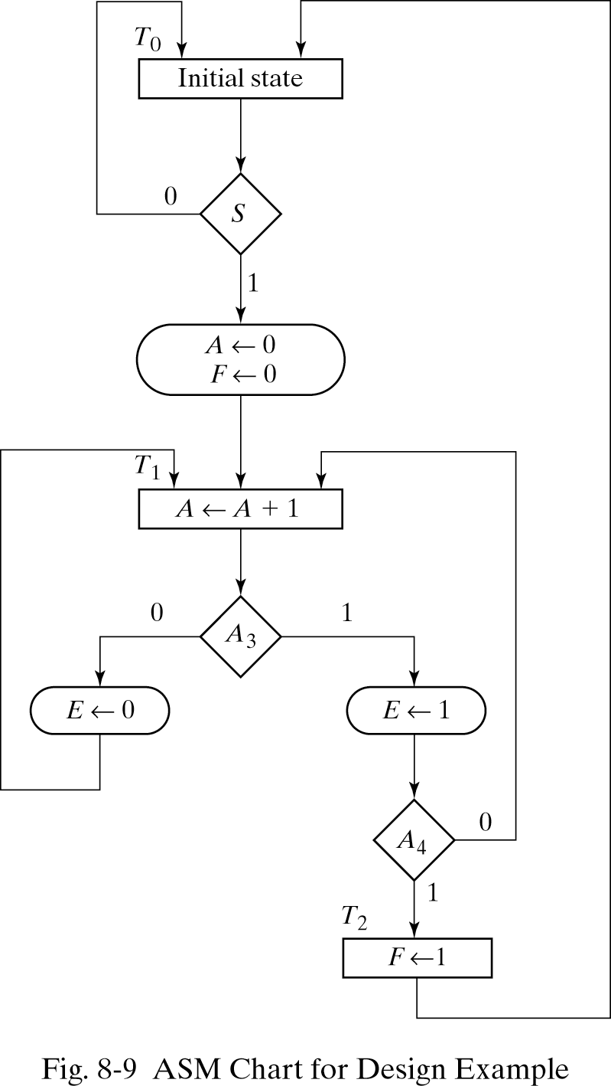
Design example
Parts:
2 FFs (named E and F), 4-bit binary counter (A₄A₃A₂A₁)
Working:
start signal (S) initiates the operation by clearing the counter and F
Counter increments at each clock pulse until stopped
If A₃ = 0: E cleared and count continues
If A₃ = 1: E set to 1 and
  If A₄ = 0: count continues
  If A₄ = 1: F set to 1 and counting stops
If S = 0: system retains state
If S = 1: operation cycle repeats from the beginning

Slide 10
Design example
How many states do we have?
How many ASM blocks do we have?
3!
Remember:
  Every block in the ASM chart specifies the operations performed during one common clock pulse.
  Operations specified within the state and conditional boxes in the block are performed in the datapath section.
  The change from one state to next is performed in the control section.

Slide 11
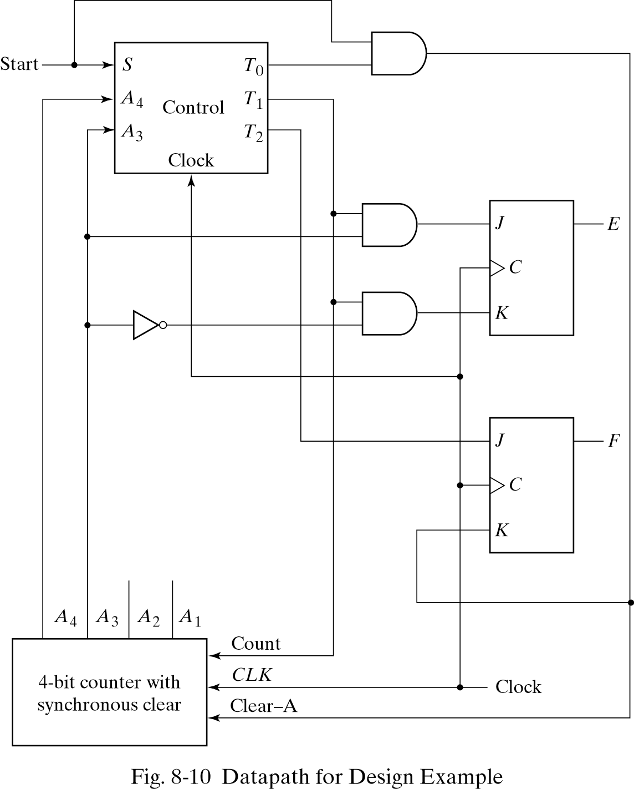
Designing the data path
Components:
4-bit binary counter
FFs E and F
Gates
Inputs:
State (T₀, T₁, T₂)
Start signal, S
Clock, C

Slide 12
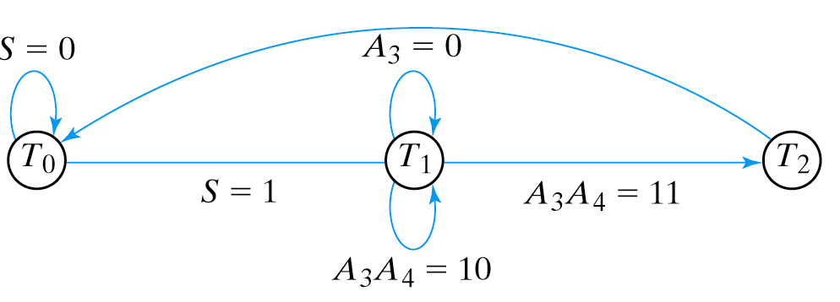
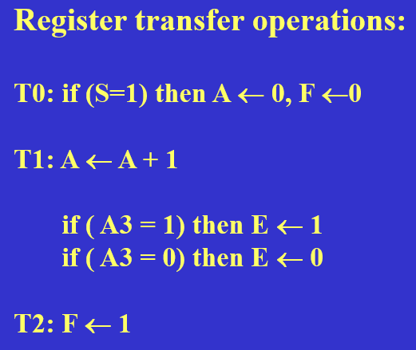
Designing the control path
How many FFs for control circuit (CC)?
3 states => 2 FFs! G₁ and G₀
What are the outputs of CC?
T₀, T₁, T₂
What are the inputs to the control circuit?
S, A₃, A₄

Slide 13
Building the state table
Present state |  |  | Inputs |  |  | Next state |  | Outputs
Name | G₁ | G₀ | S | A₃ | A₄ | G₁ | G₀ | T₀ | T₁ | T₂
T₀ | 0 | 0 | 0 | X | X | 0 | 0 | 1 | 0 | 0
T₀ | 0 | 0 | 1 | X | X | 0 | 1 | 1 | 0 | 0
T₁ | 0 | 1 | X | 0 | X | 0 | 1 | 0 | 1 | 0
T₁ | 0 | 1 | X | 1 | 0 | 0 | 1 | 0 | 1 | 0
T₁ | 0 | 1 | X | 1 | 1 | 1 | 1 | 0 | 1 | 0
T₂ | 1 | 1 | X | X | X | 0 | 0 | 0 | 0 | 1
Design using D FFs:
DG₀: T₀S+T₁
DG₁: T₁A₃A₄
Outputs:
T₀: G₀’
T₁: G₁’G₀
T₂: G₁

Slide 14
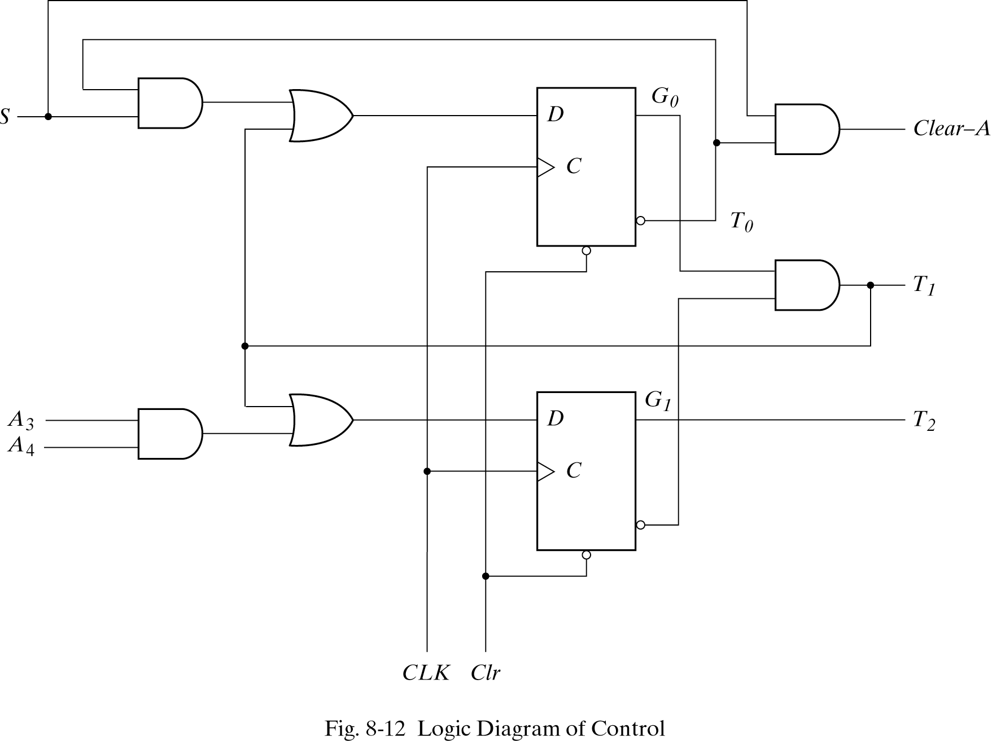
Control circuit

Slide 15
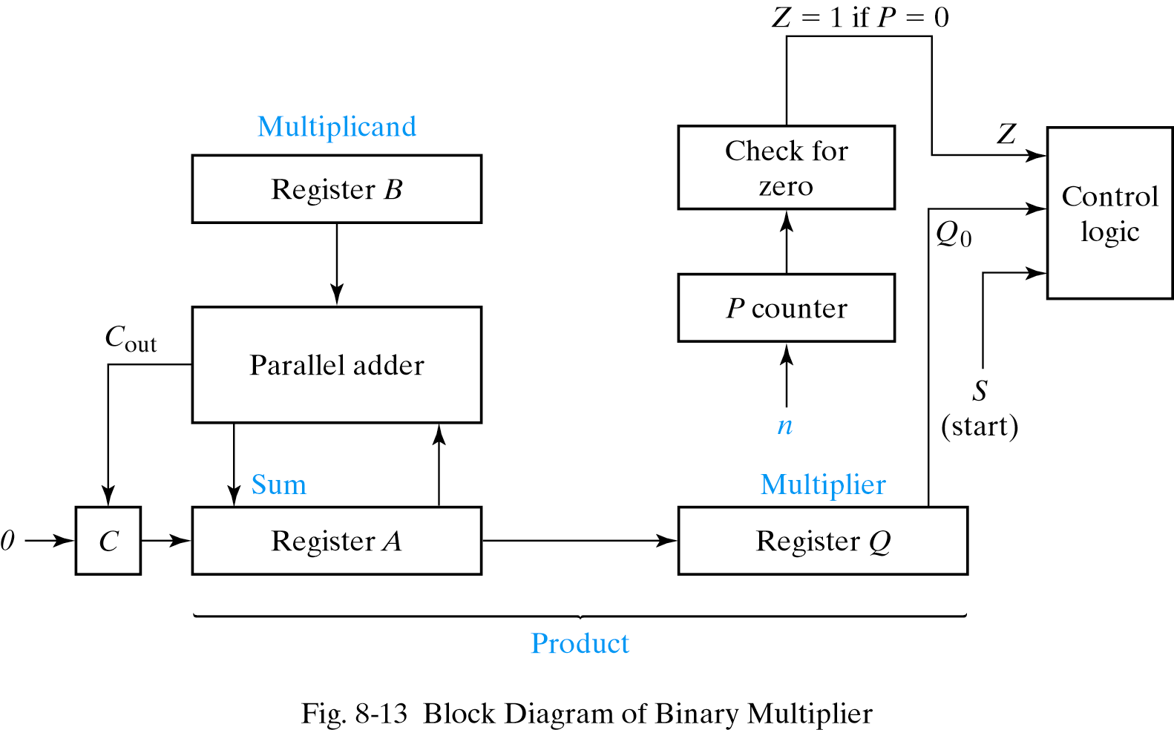
Now let’s do the binary multiplier!

Slide 16
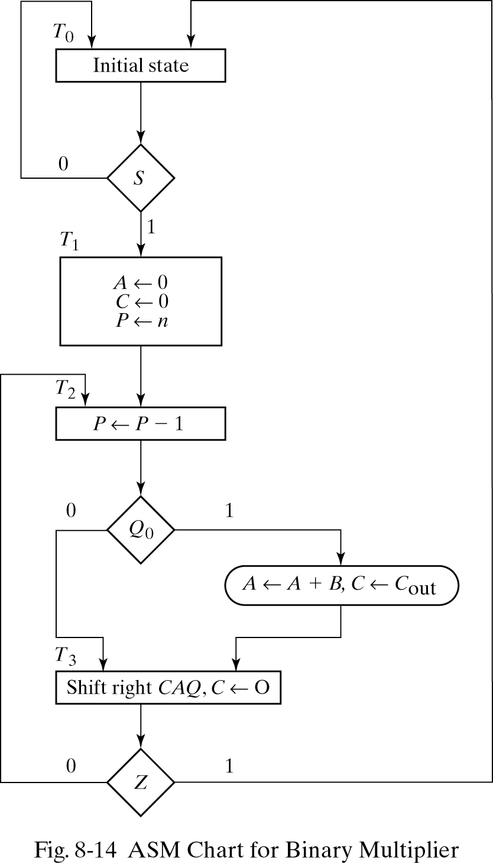
Multiplier ASM chart
Wait for ‘start’
Set up registers and counters
Count down and perform appropriate operation
Shift and repeat
When countdown completes, go back to the ‘waiting’ state.

Slide 17
Design of control logic

Slide 18
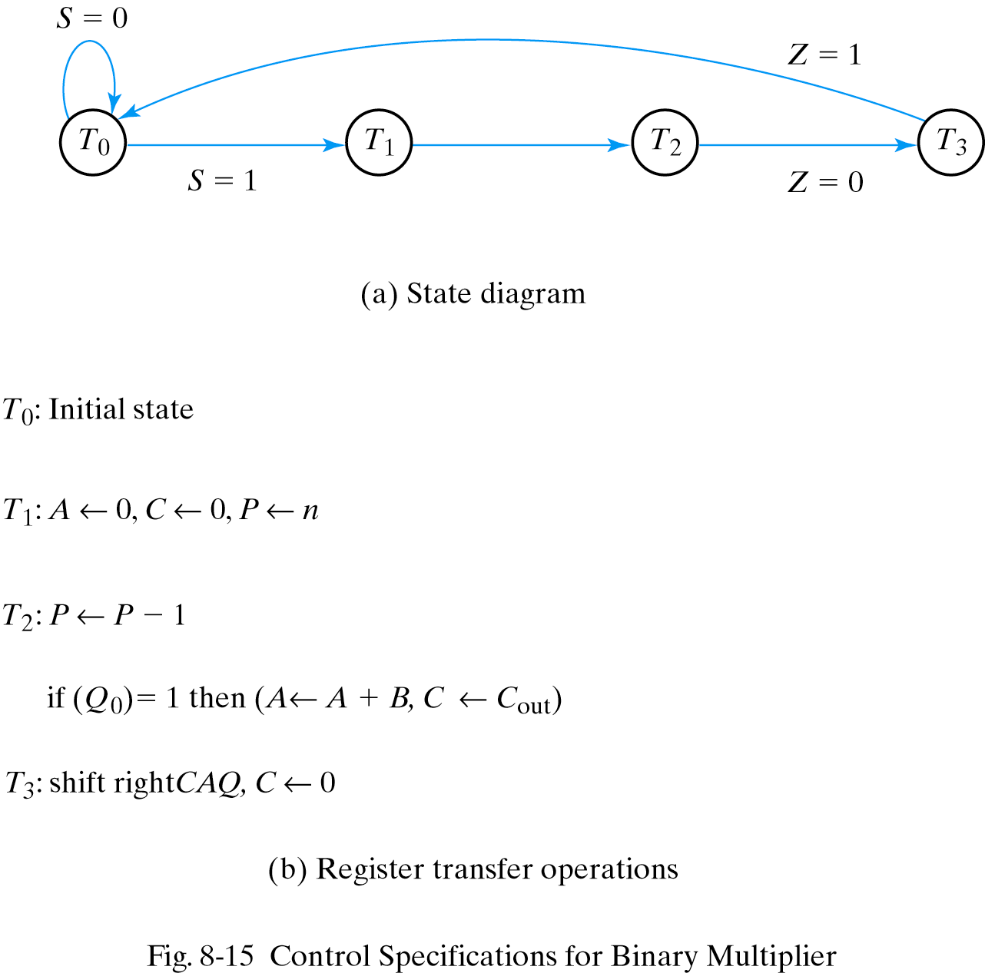
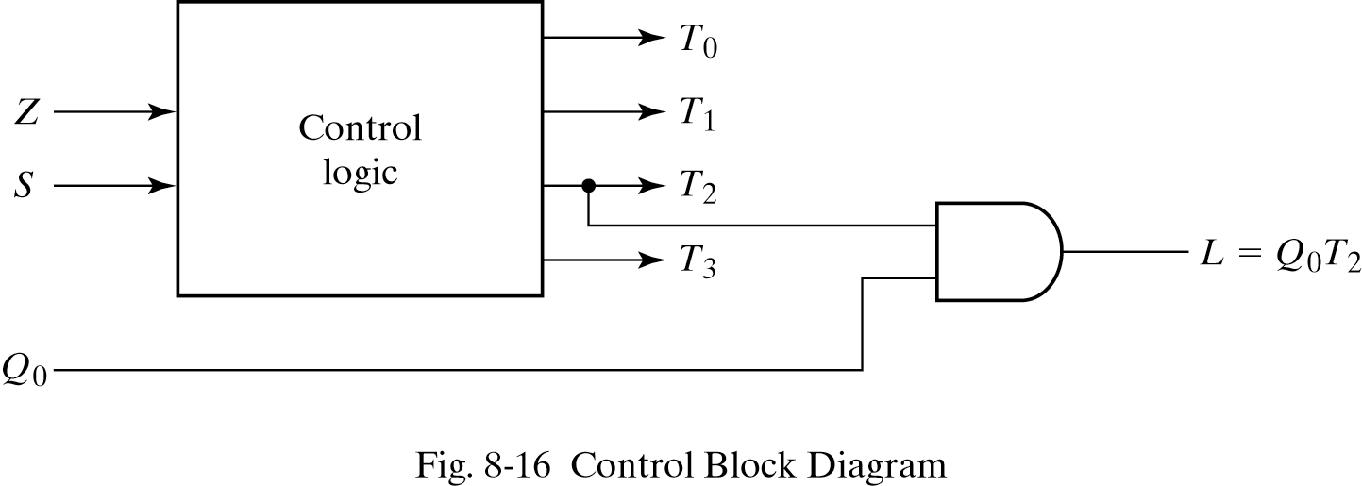
Design of control logic
Signals for controlling register operations:
T1 ( for clearing A and C)
T2 ( for decrementing P)
T3( for shifting CAQ), Q0 to decide whether to add B or not

Slide 19
Design of control logic – state assignment and state table
State | Binary | Gray code | One-hot
T0 | 00 | 00 | 0001
T1 | 01 | 01 | 0010
T2 | 10 | 11 | 0100
T3 | 11 | 10 | 1000
Present state |  | Inputs |  | Next state |  | Outputs
G1 | G0 | S | Z | G1 | G0 | T0 | T1 | T2 | T3
0 | 0 | 0 | X | 0 | 0 | 1 | 0 | 0 | 0
0 | 0 | 1 | X | 0 | 1 | 1 | 0 | 0 | 0
0 | 1 | X | X | 1 | 0 | 0 | 1 | 0 | 0
1 | 0 | X | X | 1 | 1 | 0 | 0 | 1 | 0
1 | 1 | X | 0 | 1 | 0 | 0 | 0 | 0 | 1
1 | 1 | X | 1 | 0 | 0 | 0 | 0 | 0 | 1

Slide 20
Design of control logic – state assignment and state table
Using binary encoding of states
Input columns have X whenever the variable is not used to determine next state
Outputs can be generated from inputs using a 2-to-4 decoder
Present state |  | Inputs |  | Next state |  | Outputs
G1 | G0 | S | Z | G1 | G0 | T0 | T1 | T2 | T3
0 | 0 | 0 | X | 0 | 0 | 1 | 0 | 0 | 0
0 | 0 | 1 | X | 0 | 1 | 1 | 0 | 0 | 0
0 | 1 | X | X | 1 | 0 | 0 | 1 | 0 | 0
1 | 0 | X | X | 1 | 1 | 0 | 0 | 1 | 0
1 | 1 | X | 0 | 1 | 0 | 0 | 0 | 0 | 1
1 | 1 | X | 1 | 0 | 0 | 0 | 0 | 0 | 1

Slide 21
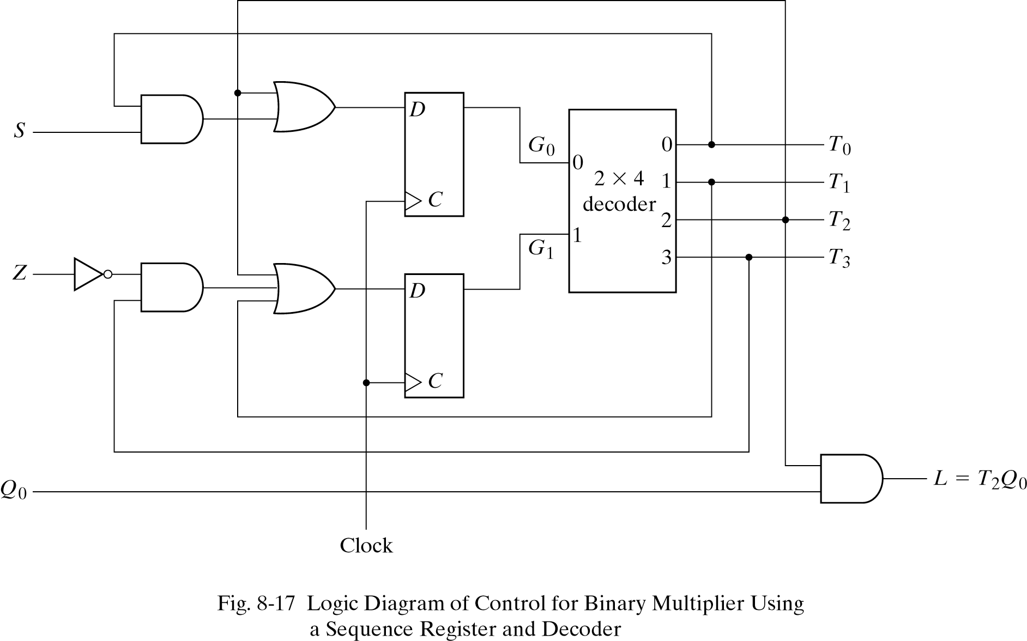
Control circuit using D flip flops

Slide 22
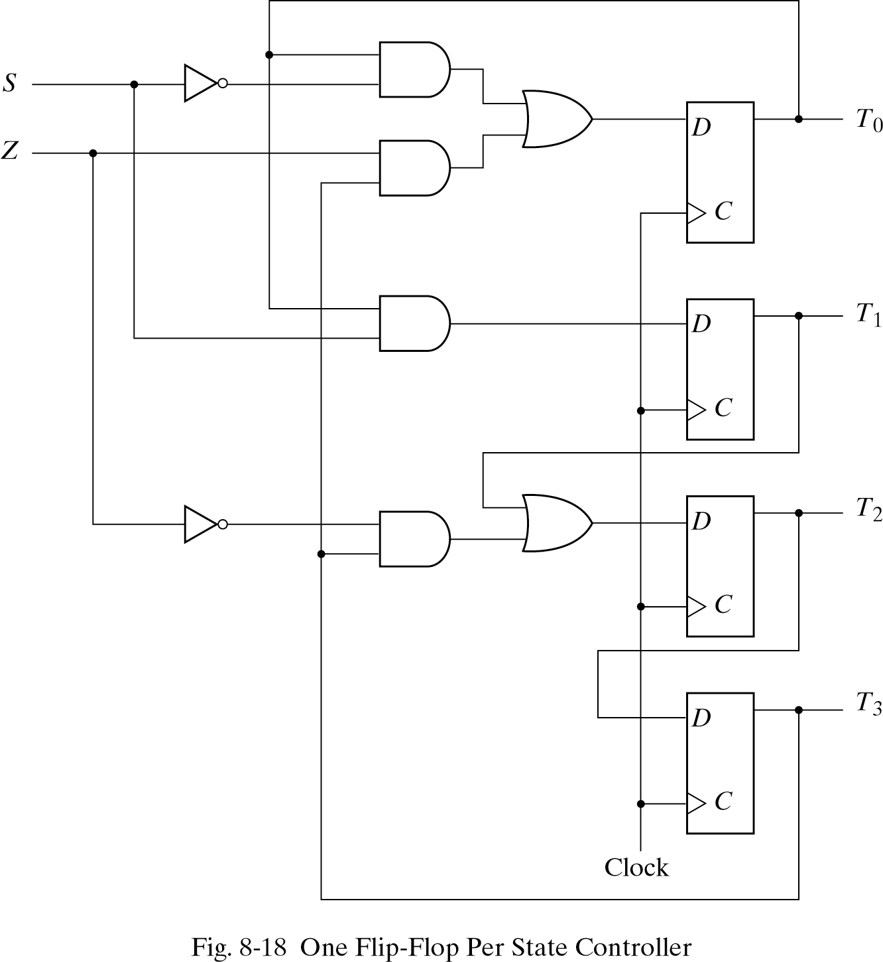
Use of one hot encoding
1 FF per state
Single 1 that propagates from one FF to the next under control logic
DT0 = T0S’ + T3Z
DT1 = T0S
DT2 = T1 + T3Z’
DT3 = T2

Slide 23

Attendance!
Will be opened only during the attendance window.
Enable location on your device.
Grant any location permissions requested by the website.
Refresh the page.
Try submitting again.

Slide 24
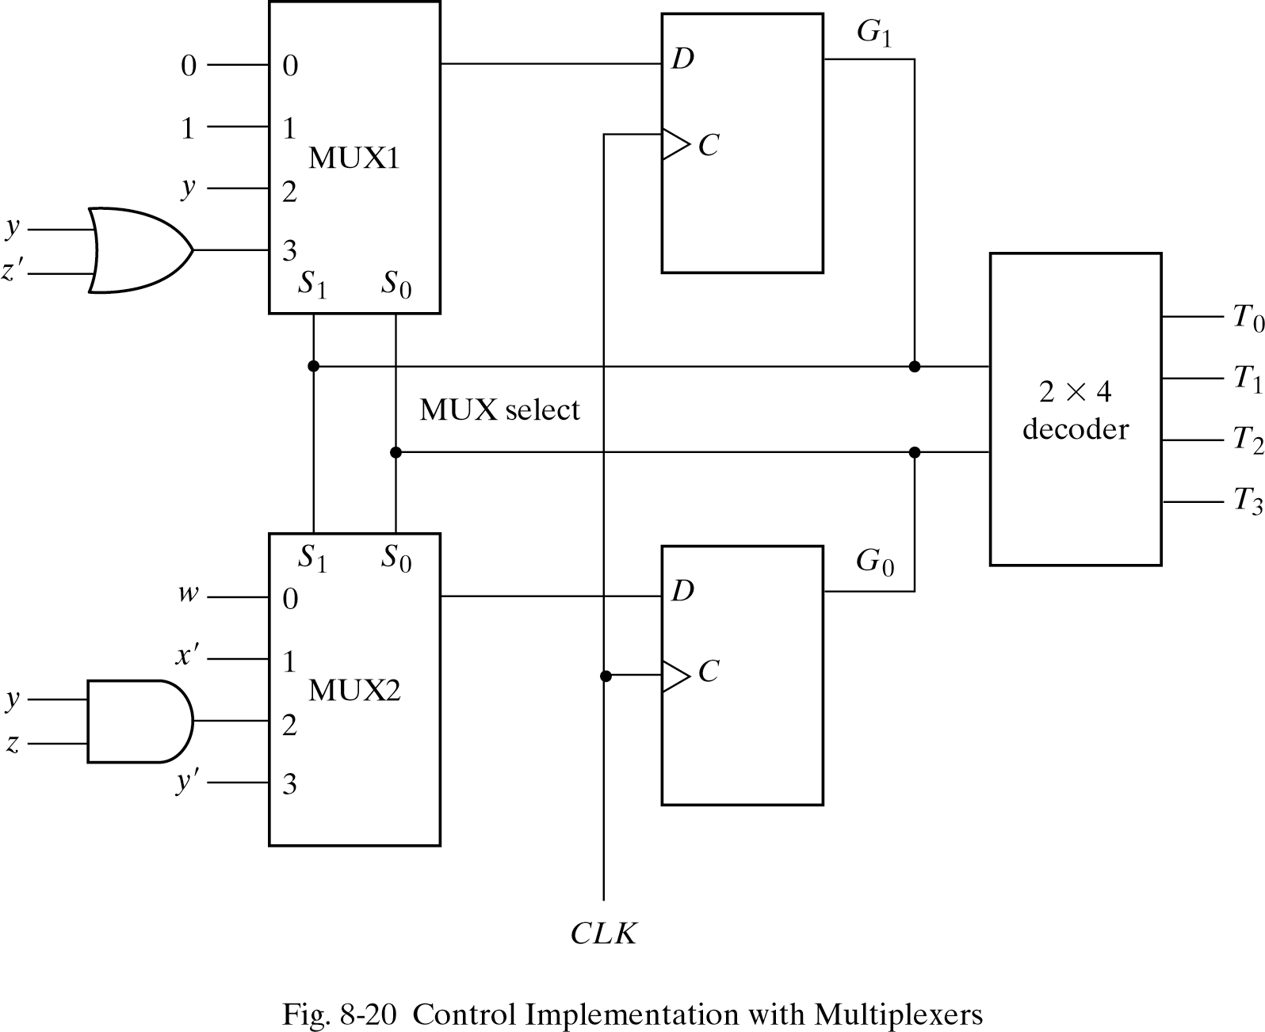
Design with multiplexers
General pattern:
Multiplexers determine the next state of registers
Registers hold the present state
Decoders provide separate output for control state
Predefined standard cells in many ICs

Slide 25
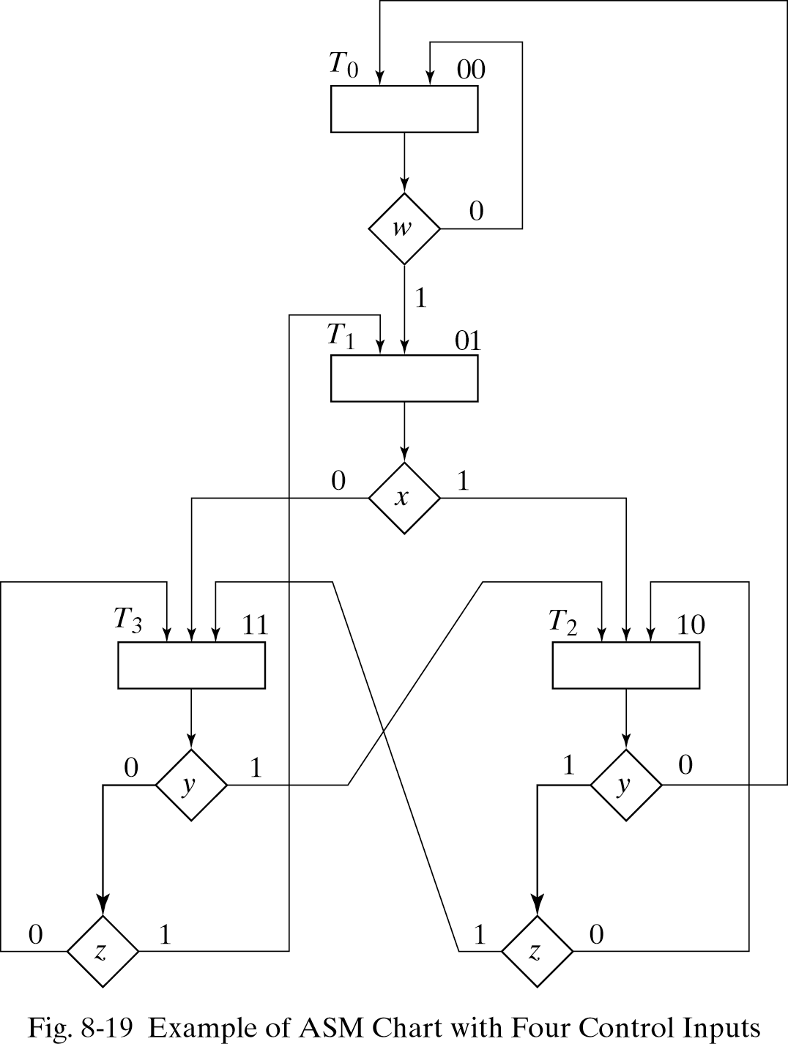
Example – design with muxes
Focus on control part (state boxes left empty)
Binary state assignment
How many control inputs?
4!
3-level implementation

Slide 26
3-level controller
What should the inputs to the muxes be, to get the correct state transitions?

Slide 27
3-level controller
Present state |  | Input Conditions | Next state |  | Mux Inputs
G1 | G0 |  | G1 | G0 | mux0 | mux1
0 | 0 | W’ | 0 | 0
0 | 0 | W | 0 | 1
0 | 1 | X | 1 | 0
0 | 1 | X’ | 1 | 1
1 | 0 | Y’ | 0 | 0
1 | 0 | YZ’ | 1 | 0
1 | 0 | YZ | 1 | 1
1 | 1 | Y’Z | 0 | 1
1 | 1 | Y | 1 | 0
1 | 1 | Y’Z’ | 1 | 1

Slide 28
3-level controller
What should the inputs to the muxes be, to get the correct state transitions?

Slide 29
Example
Design Example:
Count number of 1’s in a register
Two registers R1 and R2 and Flip-flop E
System count number of 1’s in R1 and sets R2
to that number. Done by shifting each bit in R1 one at a time into E, E checked by control and if 1 R2 is incremented.
Control uses external input S to start and uses status input E and Z from datapath. Z = 1 when R1 = 0

Slide 30
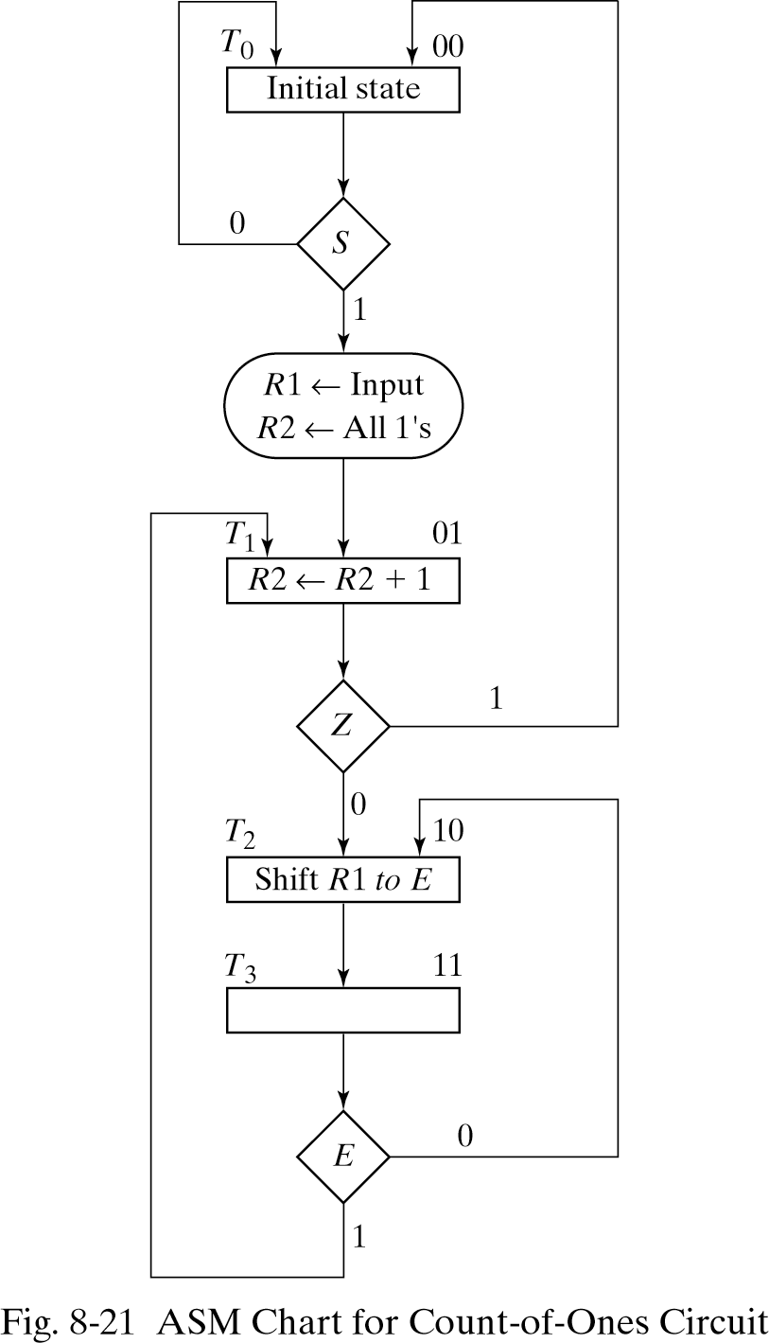
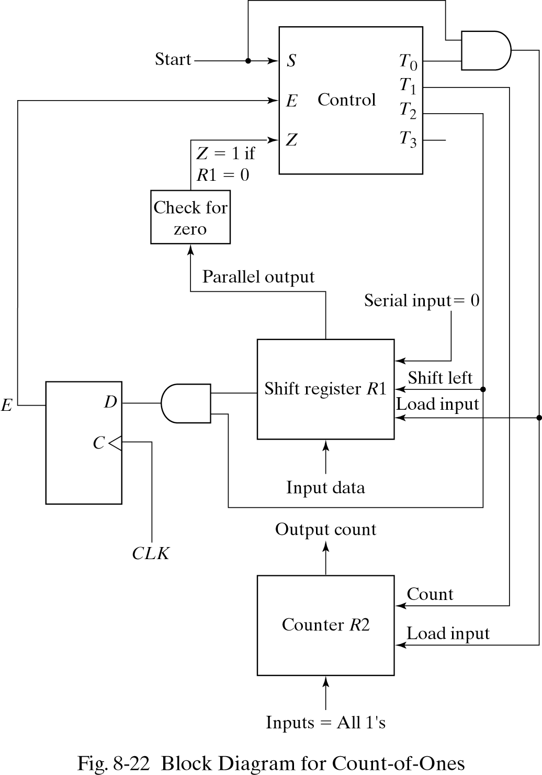
Example

Slide 31
Mux inputs
Multiplexer input conditions for control
Present Next
state state Input Inputs
G1 G0 G1 G0 conditions MUX1 MUX2
0 0 0 0 S’
0 0 0 1 S 0 S
0 1 1 0 Z’
0 1 0 0 Z Z’ 0
1 0 1 1 None 1 1
1 1 1 0 E’
1 1 0 1 E E’ E

Slide 32
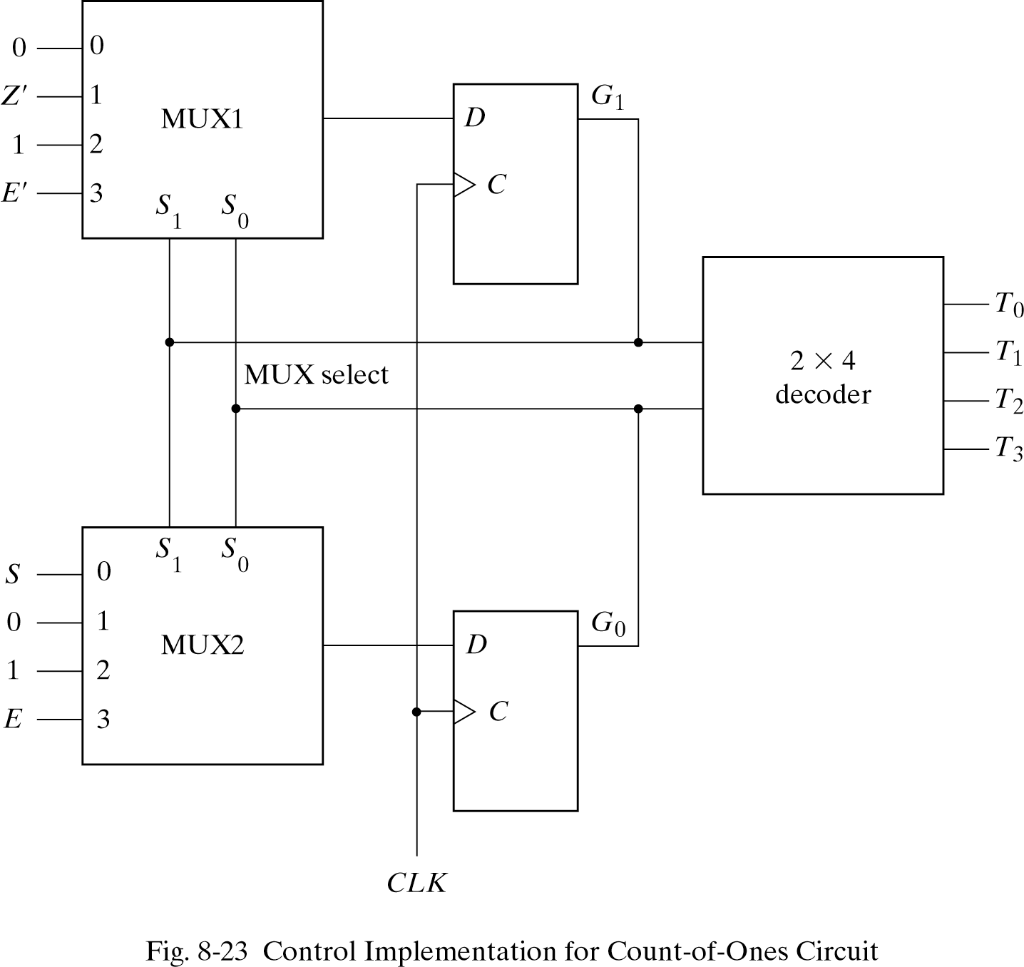
Mux inputs

Slide 33
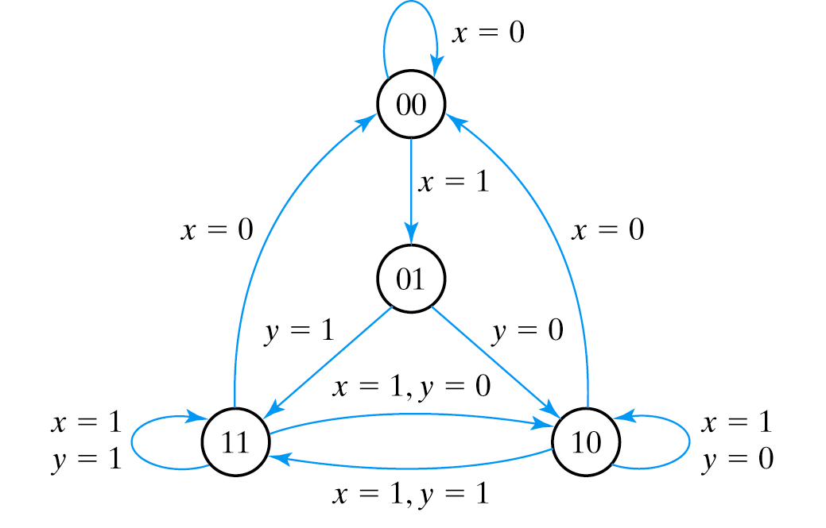
Example: draw the ASM chart

