Slide 1
BITS Pilani Digital Design
Prof. GSS Chalapathi, Prof. Saurabh Gandhi (EEE department)

Slide 2
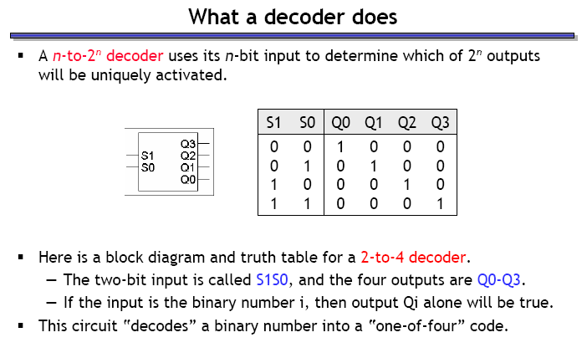
Decoders

Slide 3
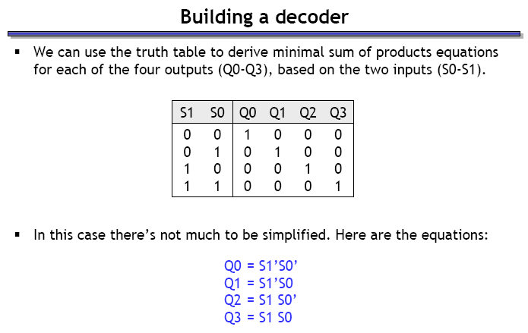
Building a decoder

Slide 4
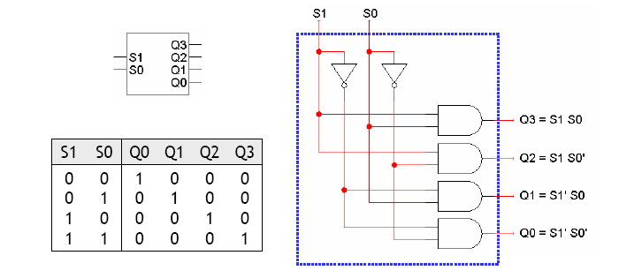
Building a decoder – the circuit

Slide 5
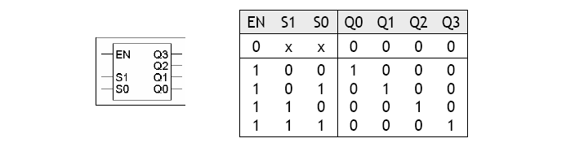
Decoders with ‘enable’ inputs
Decoders can include an enable input (EN)
EN = 0 disables the decoder (all outputs are 0)
EN = 1 enables the decoder (exactly 1 output is 1 depending on the input)

Slide 6
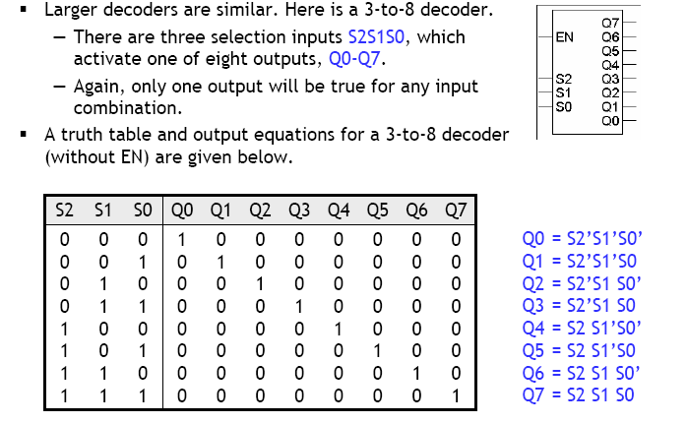
3 – to – 8 decoder

Slide 7
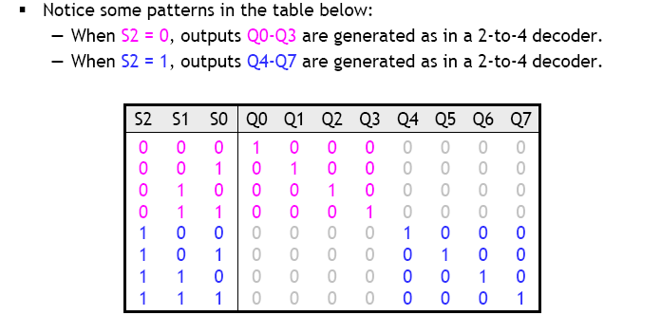
Building a 3 - to - 8 decoder
Can you think of a ‘hierarchical’ design for this decoder, like we did with half and full adders?

Slide 8
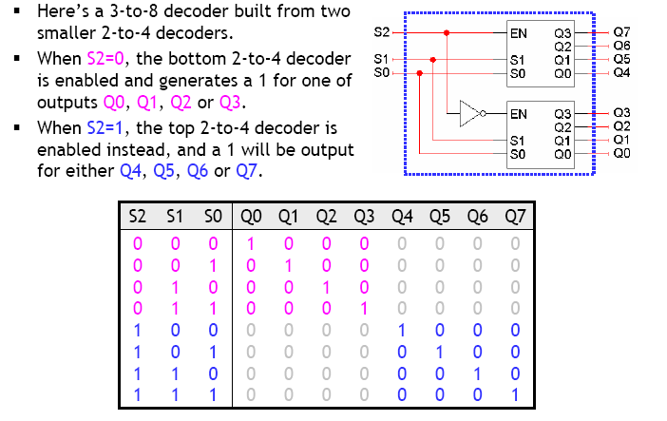
Hierarchical decoder design
Verify this circuit: use equations for the 2-to-4 decoder to derive equations for 3-to-8 decoder!

Slide 9
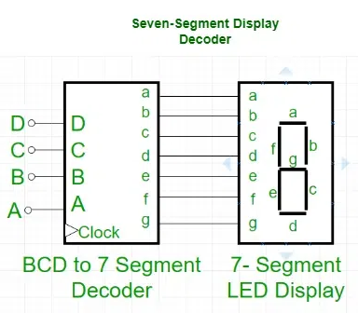
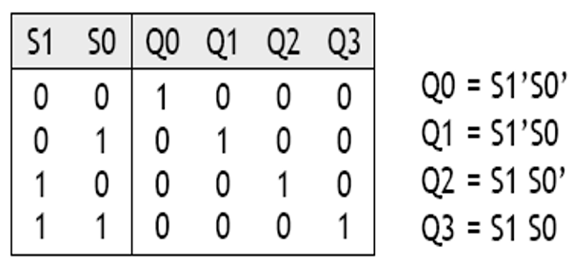
What is a decoder used for?
Address decoding
Data routing
7-segment displays
Implementing other digital circuits!
Do the truth table and equations look familiar?
Decoders are minterm generators!
Used to generate any Boolean expression

Slide 10
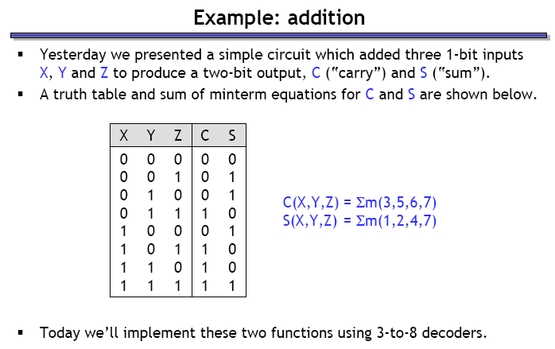
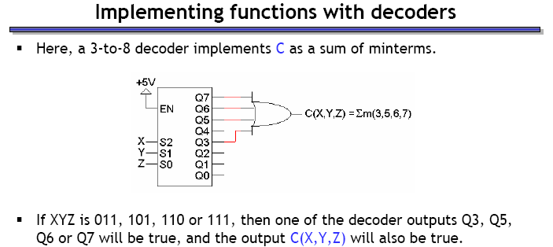
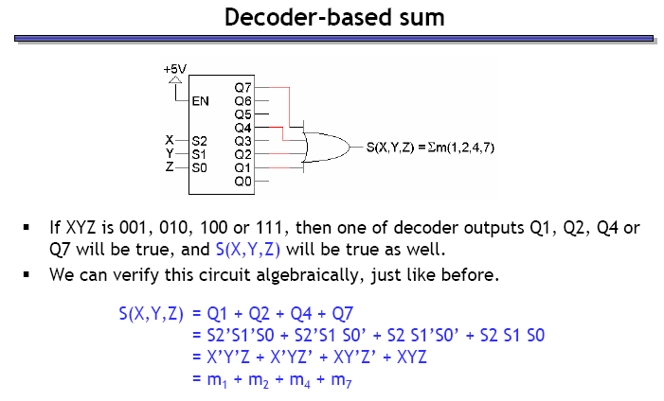
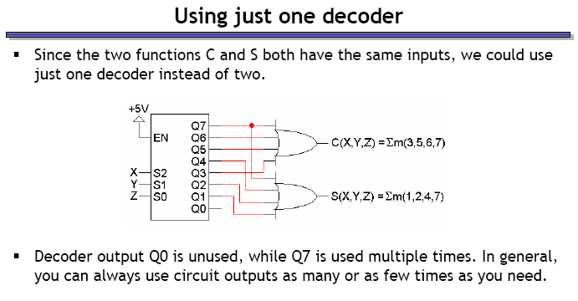
Example: building an adder with decoder(s)
Verify:
Reuse the same decoder for both outputs:
(Dis)advantages of this approach?

Slide 11
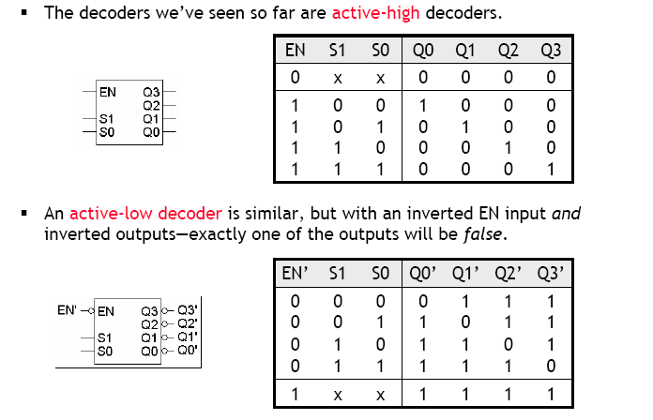
Active-high and active-low decoders

Slide 12
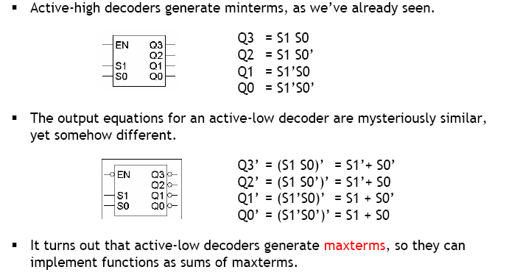
Active-low decoders are maxterm generators!

Slide 13
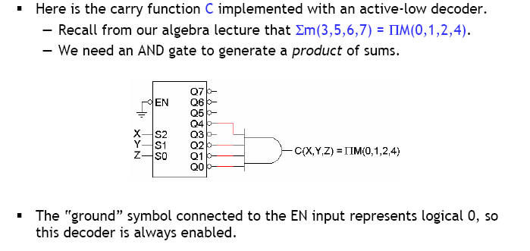
Active-low decoder example

Slide 14
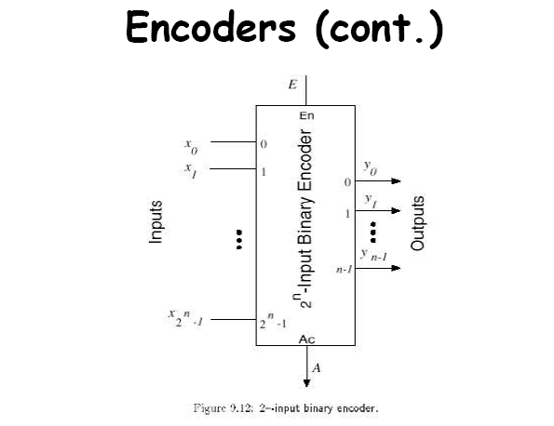
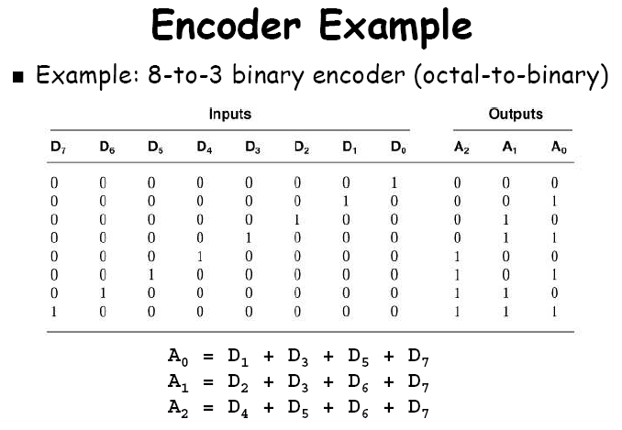
Encoders
Opposite function as that of a decoder
Takes 2^{n} inputs, and generates the binary equivalent of the input rank as output

Slide 15
Encoder design issues
Two ambiguities associated with the design of the simple encoder shown previously:
It assumes only one input to be active. If two inputs are simultaneously active, output becomes invalid.
D₀ = 1 or all Ds = 0 will both generate an output of 0
Solution: Priority encoders
Multiple asserted inputs allowed; one has priority over others
Separate indication of no-asserted-inputs

Slide 16
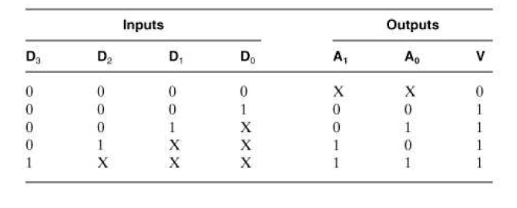
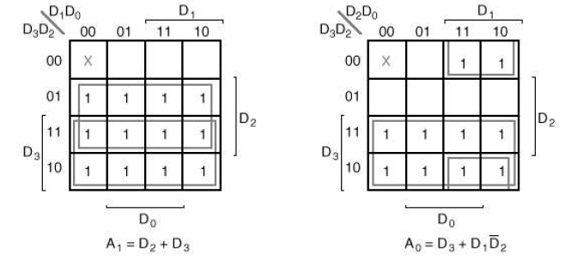
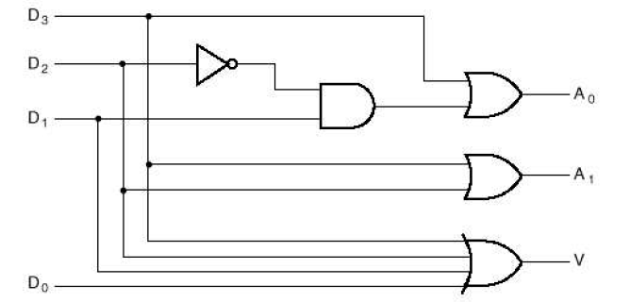
Example: 4-to-2 priority encoder
If two or more inputs are simultaneously 1, output will correspond to the rank of the highest priority input
‘Valid’ output indicator, set to 1 only if at least one of the inputs is 1

Slide 17
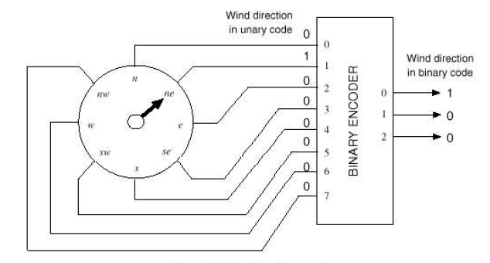
Use of binary encoder (example)

Slide 18
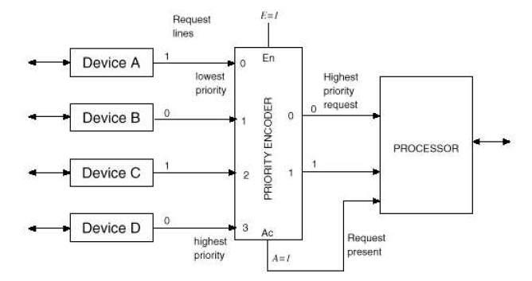
Uses of priority encoders (example)

