Slide 1
BITS Pilani Digital Design
Prof. GSS Chalapathi, Prof. Saurabh Gandhi (EEE department)

Slide 2
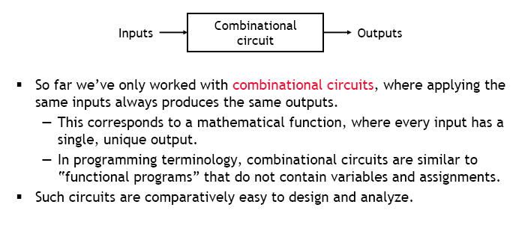
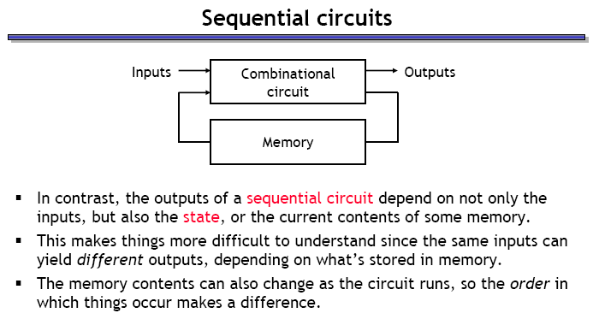
Sequential circuits

Slide 3
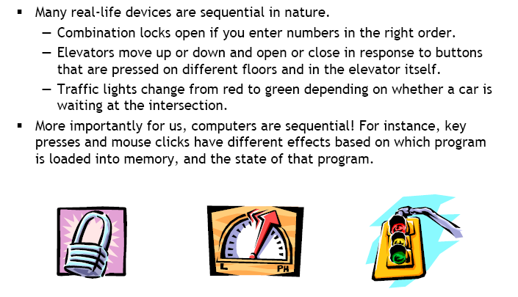
Examples of sequential devices

Slide 4

Attendance!
Will be opened only during the attendance window.
Enable location on your device.
Grant any location permissions requested by the website.
Refresh the page.
Try submitting again.

Slide 5
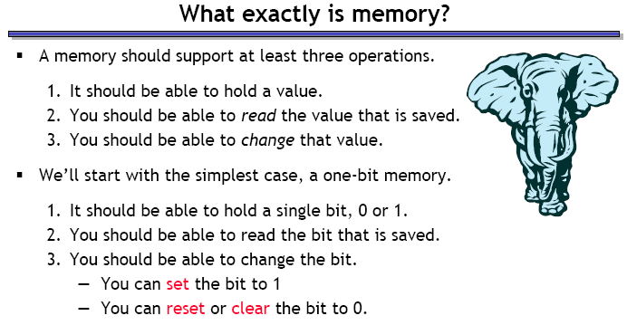
What is memory?

Slide 6
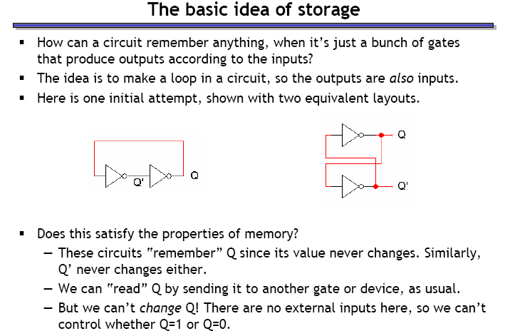
Storing a bit in a digital device

Slide 7
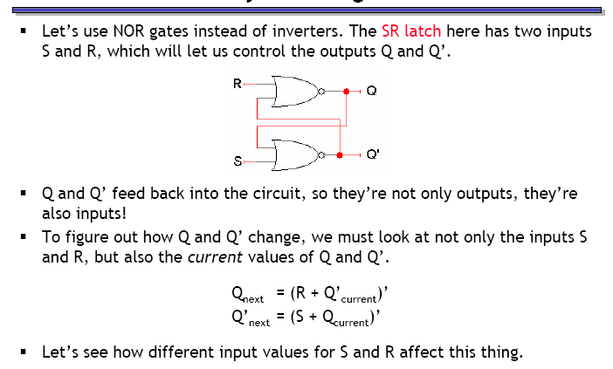
Storing a changeable bit in a device

Slide 8
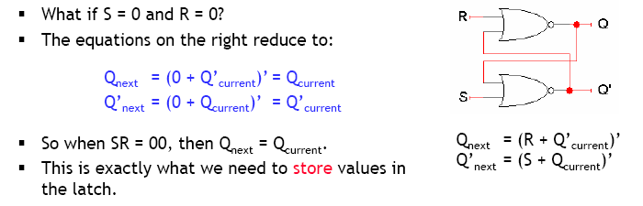
Storing a value (SR = 00)

Slide 9
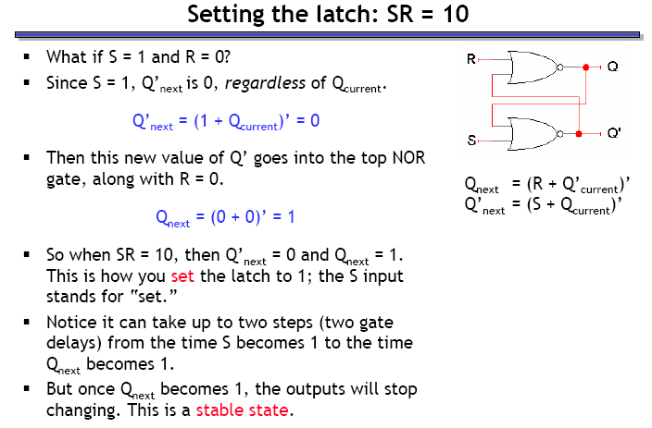
Setting the latch (SR = 10)

Slide 10
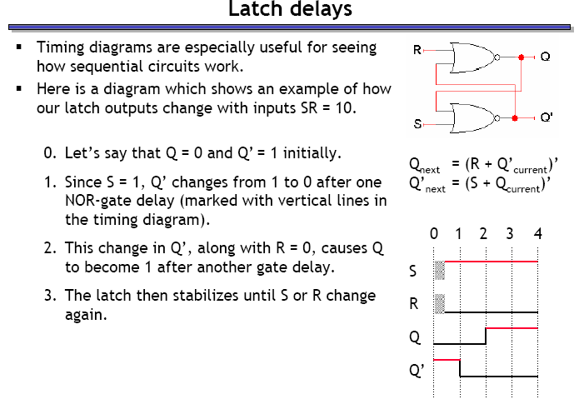
Latch delays

Slide 11
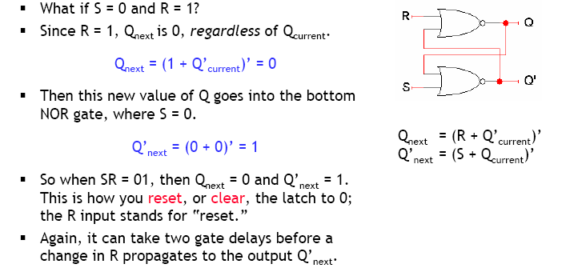
Resetting the latch (SR = 01)

Slide 12
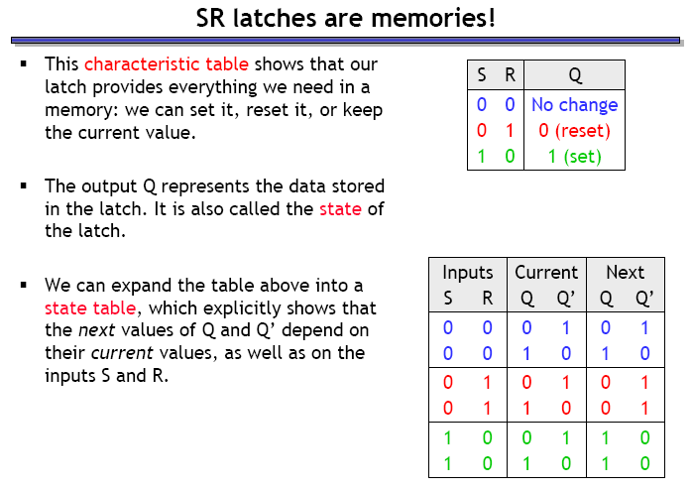
SR latch forms a memory unit

Slide 13
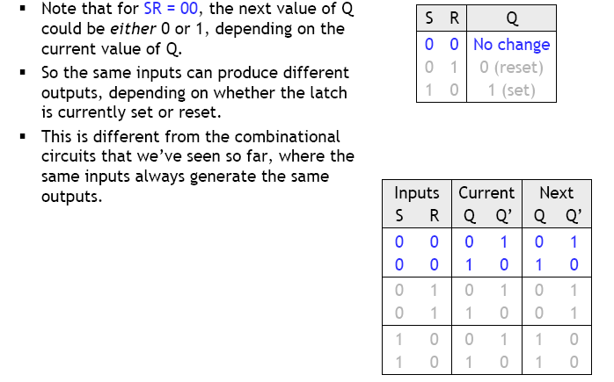
SR latches are sequential

Slide 14
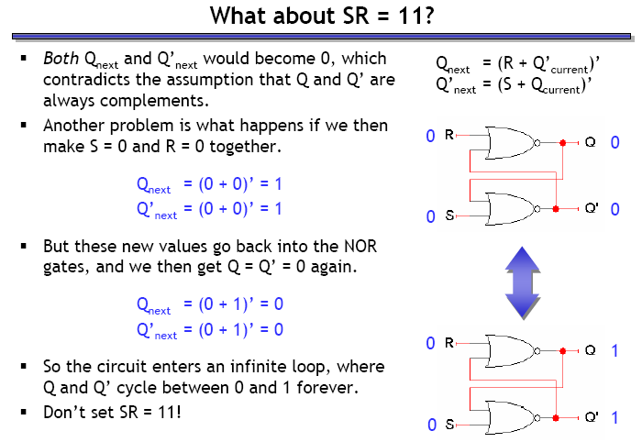
What happens when SR = 11?
The
Really?
This is the real purpose of your lab, go try it out!

Slide 15
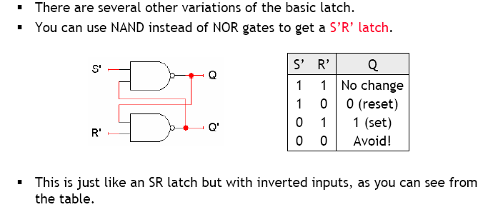
S’R’ latch

Slide 16
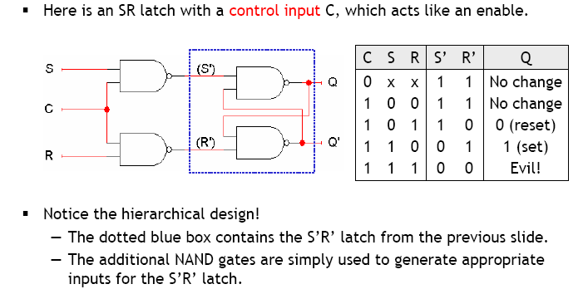
SR latch with control input

Slide 17
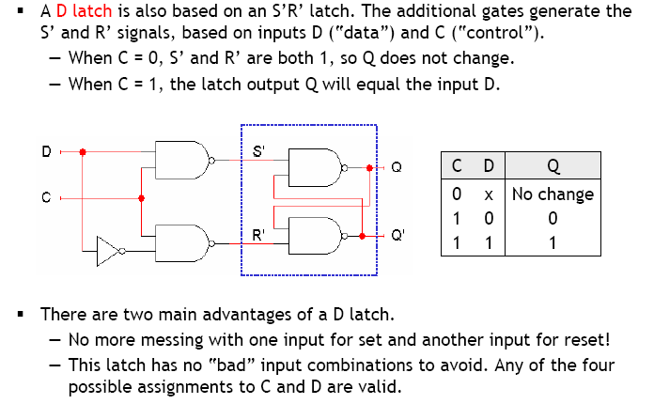
The D latch

