Slide 1
BITS Pilani Digital Design
Prof. GSS Chalapathi, Prof. Saurabh Gandhi (EEE department)

Slide 2
Digital Logic Families
ICs are classified based on their specific circuit technology, known as digital logic family.
Each family has its own basic electronic components (NAND, NOR, and NOT gates), used to build complex digital circuits.
Various digital logic families have been introduced and used over the years.

Slide 3
Digital logic families (timeline)
RTL: Resistor-Transistor Logic
DTL: Diode-Transistor Logic
TTL: Transistor-Transistor Logic
ECL: Emitter-coupled Logic
MOS: Metal-Oxide Semiconductor
CMOS: Complementary MOS
Low power dissipation, currently the MOST DOMINANT
BiCMOS: Bipolar CMOS
CMOS and TTL for additional current/speed
GaAs: Gallium-Arsenide
earliest, now obsolete
widely used
high-speed operation
compact
very high-speed operation

Slide 4
Defining characteristics of logic families
Fan-in: # of gate inputs.
Fan-out: # of standard loads a gate’s output can drive.
Noise margin: max external noise tolerated.
Power dissipation: power consumed by the gate (dissipated as heat).
Propagation delay: time required for an input signal change to be observed at an output line.

Slide 5
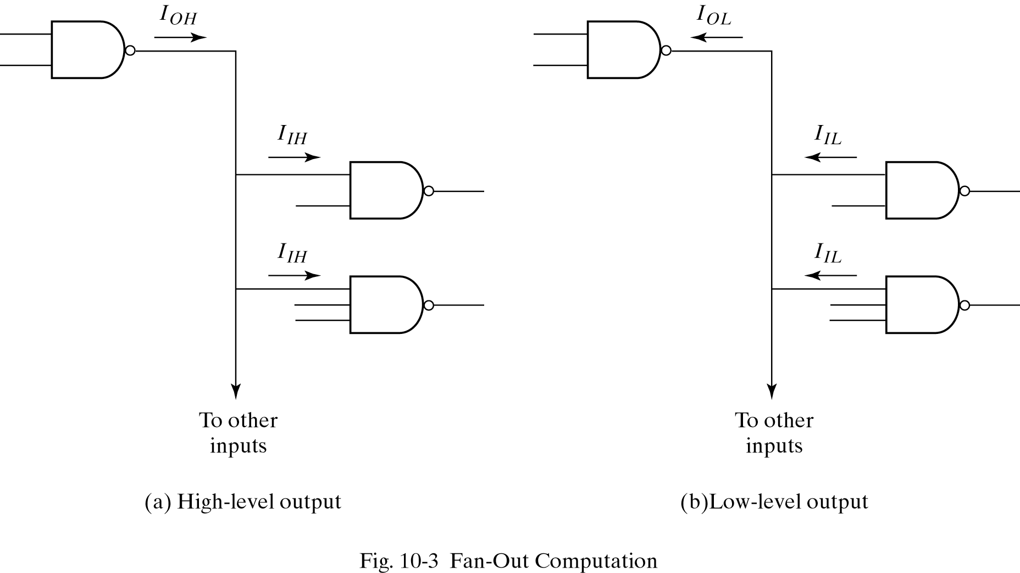
Fan in and fan out

Slide 6
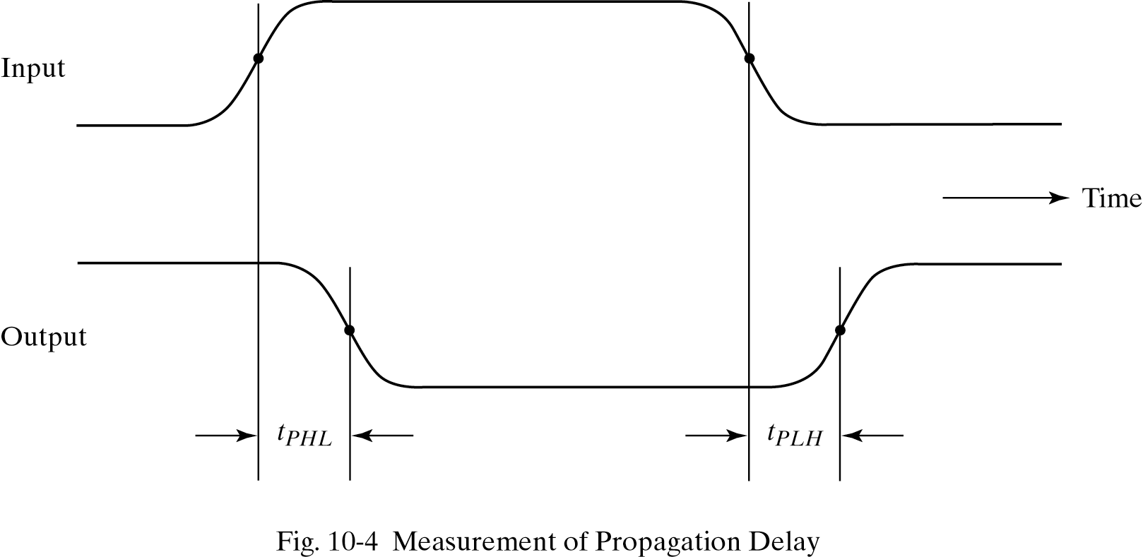
Propagation delay

Slide 7
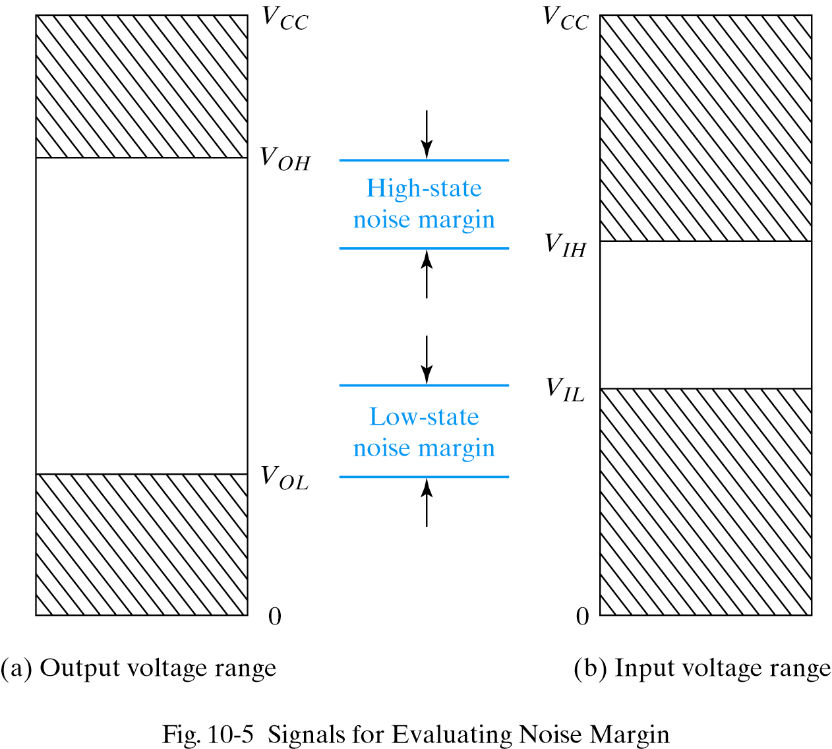
Noise margin

Slide 8
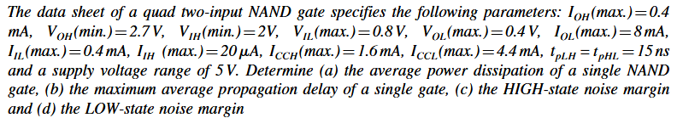
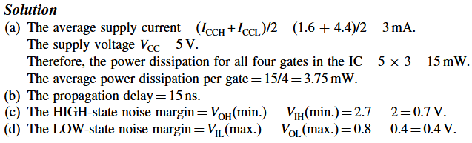

Example

Slide 9
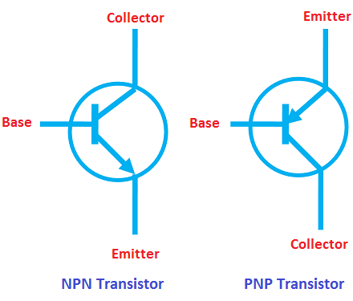
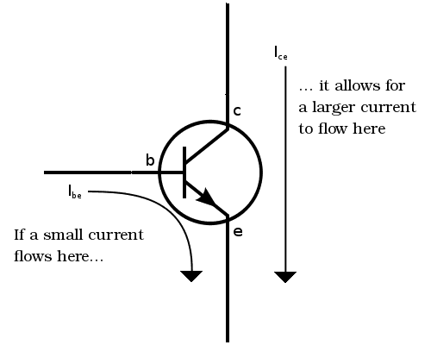
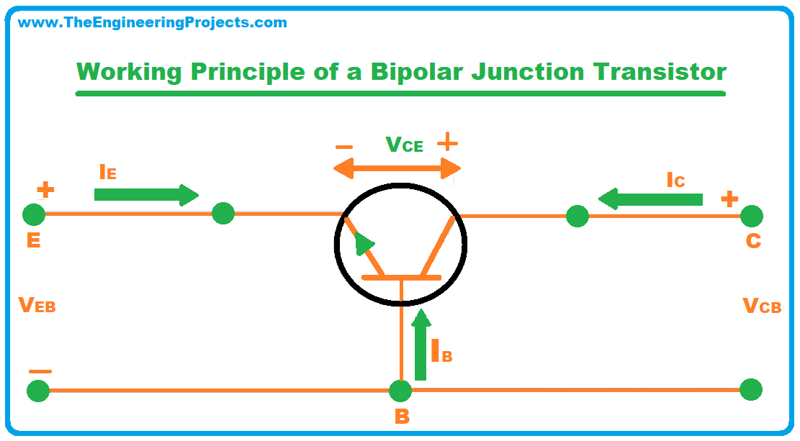
The Bipolar Junction Transistor:
current-controlled current source
Base–Emitter junction (BE) is forward-biased so that the emitter injects carriers (electrons)
Only a small fraction of electrons recombine with holes in the base → this small recombination current forms the base current IBI_BIB​
Majority of electrons that enter the base diffuse across it and reach the collector-base junction,
Base–Collector junction (BC) is reverse-biased
The electric field in the reverse-biased junction sweeps these electrons into the collector.

Slide 10
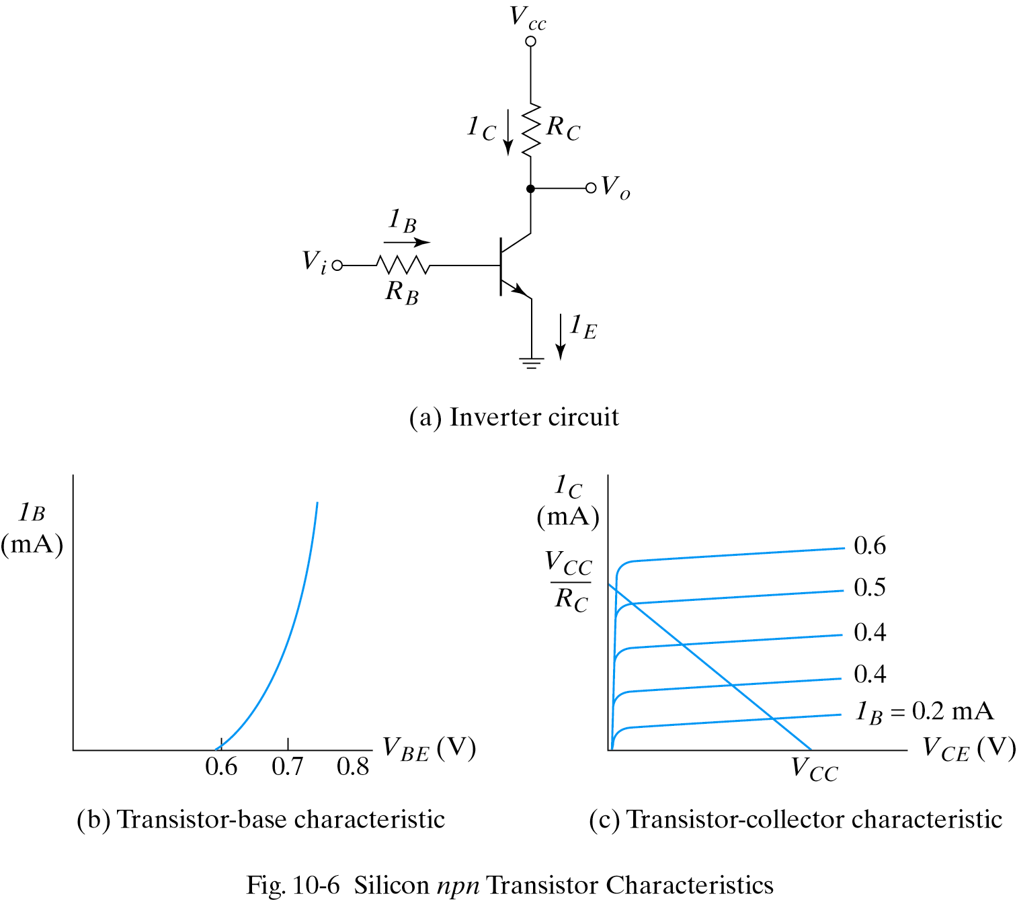
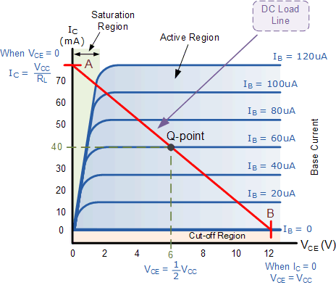
BJT characteristics
Base-Emitter voltage less than 0.6V ; I_{B} = 0
Cut-Off region
Base-Emitter voltage more than 0.6V, transistor starts conducting
Active region I_{C} = β I_{B}
Maximum collector current I_{C} = V_{CC}/R_{C}
R_{C} = 1kΩ, R_{B} = 22kΩ, β= 50
V_{CC} = 5V, find V_{o} for
V_{i} = 0.2V and V_{i} = 5V

Slide 11
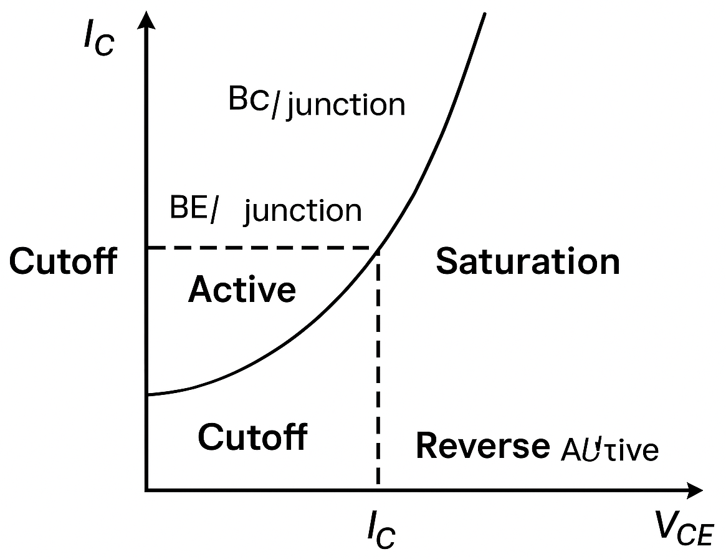
BJT operating regimes
Region | BE junction | BC junction | V_{BE} | V_{CE} (approx) | Behavior / Use
Cutoff | Reverse-biased | Reverse-biased | < 0.5 V | ≈ V_{CC} | No current flows (I_{C} ≈ 0, transistor OFF). Used in digital logic / switching circuits.
Active (Forward Active) | Forward-biased | Reverse-biased | ≈ 0.7 V (Si) | > 0.2 V | Transistor amplifies — collector current ≈ β × IB. Used in analog amplification.
Saturation | Forward-biased | Forward-biased | ≈ 0.7 V | 0.1–0.3 V | Both junctions conducting. Transistor fully ON (acts like closed switch). Used in digital logic, switching circuits.
Reverse Active (Inverse Active) | Reverse-biased | Forward-biased | < 0 V | — | Roles of emitter and collector reversed. Low β (~1/10 of forward). Rarely used.
Breakdown | Reverse-biased beyond limits | — | — | V_{CE} > V_{(BR)CEO} | Junction breakdown occurs — destructive unless avalanche mode is designed for (e.g., Zener, avalanche transistor).

Slide 12
TTL ICs
TTL Series name Prefix
Standard 74
Low-power 74L
High-speed 74H
Schottky 74S
Low-power Schottky 74LS
Advanced Schottky 74AS
Advanced Low power- Schottky 74ALS
Fast 74F

Slide 13
Three types of TTL gates
Open - collector output
Totem-pole output
Three-state output

Slide 14
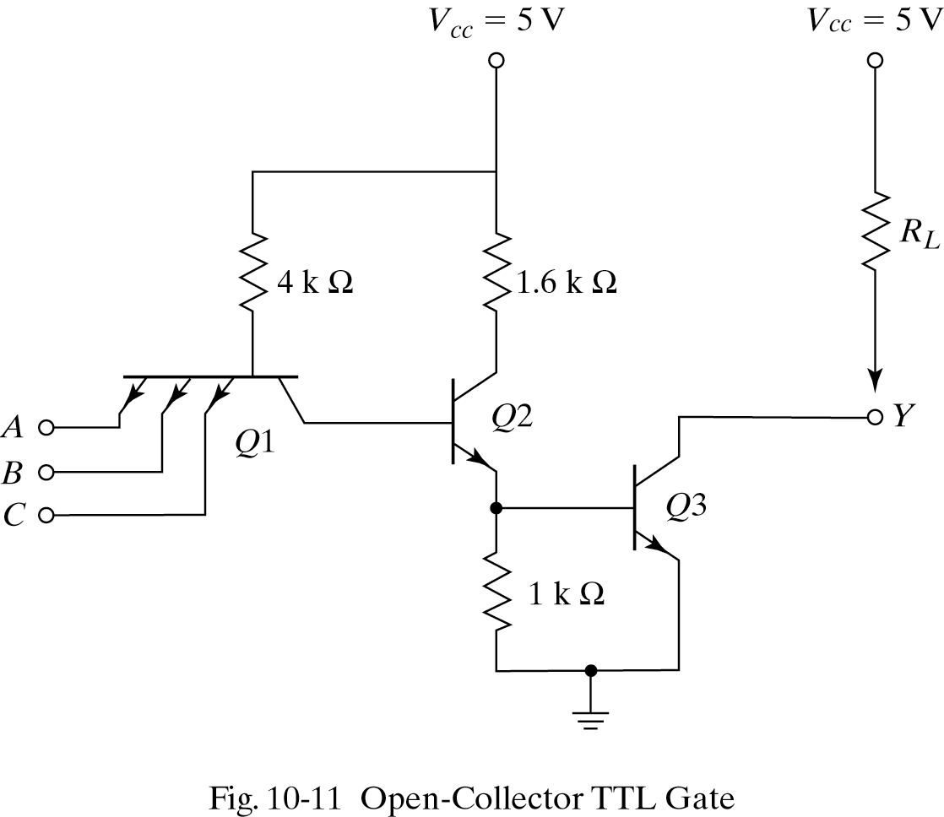
Open collector TTL NAND gate
Advantage:
Outputs of different gates can be wired together, resulting in ANDing of their outputs
Used for:
Driving relays and lamps
Wire ANDing
Construction of common bus system

Slide 15
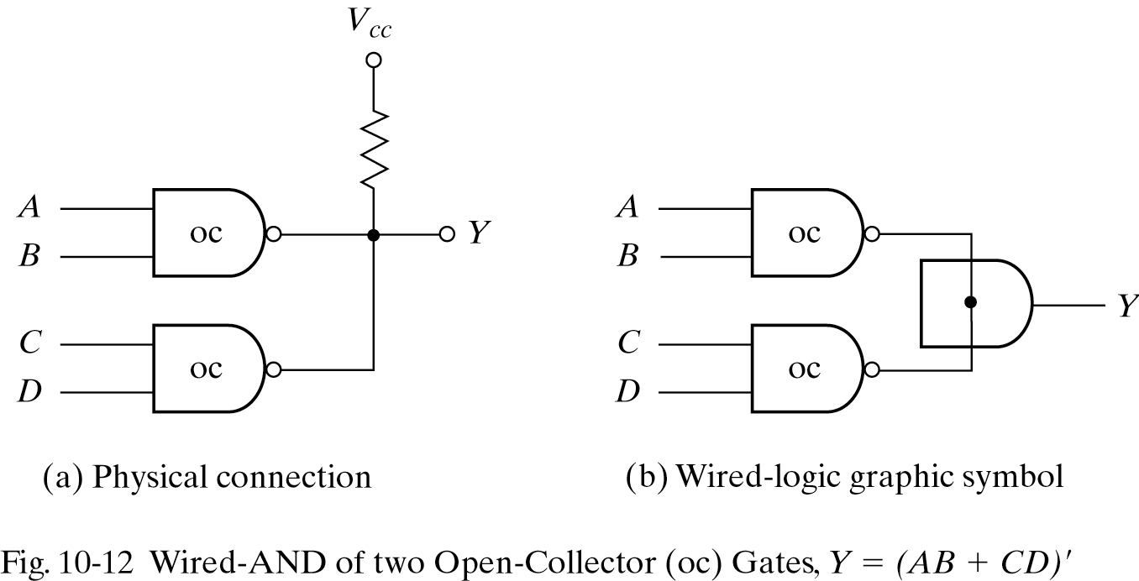
Wire ANDing

Slide 16
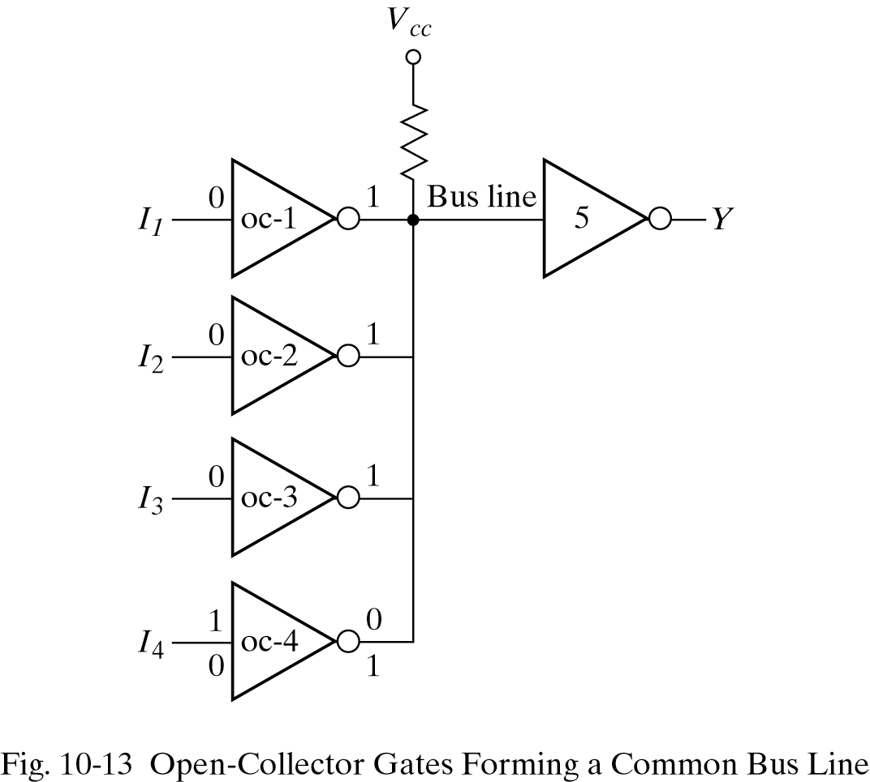
OC gates forming a ‘bus’ line
A bus acts like a common highway where multiple can send or receive information — but only one device drives it at a time to avoid conflicts.

Slide 17
Pull-up delays
Output impedance of a gate is resistive plus capacitive load (typical ‘C’ = 15 pF)
For output low to high transition C charges exponentially through RC
R is R_{L} (external) in open collector
With active pull-up delay can be reduced

Slide 18
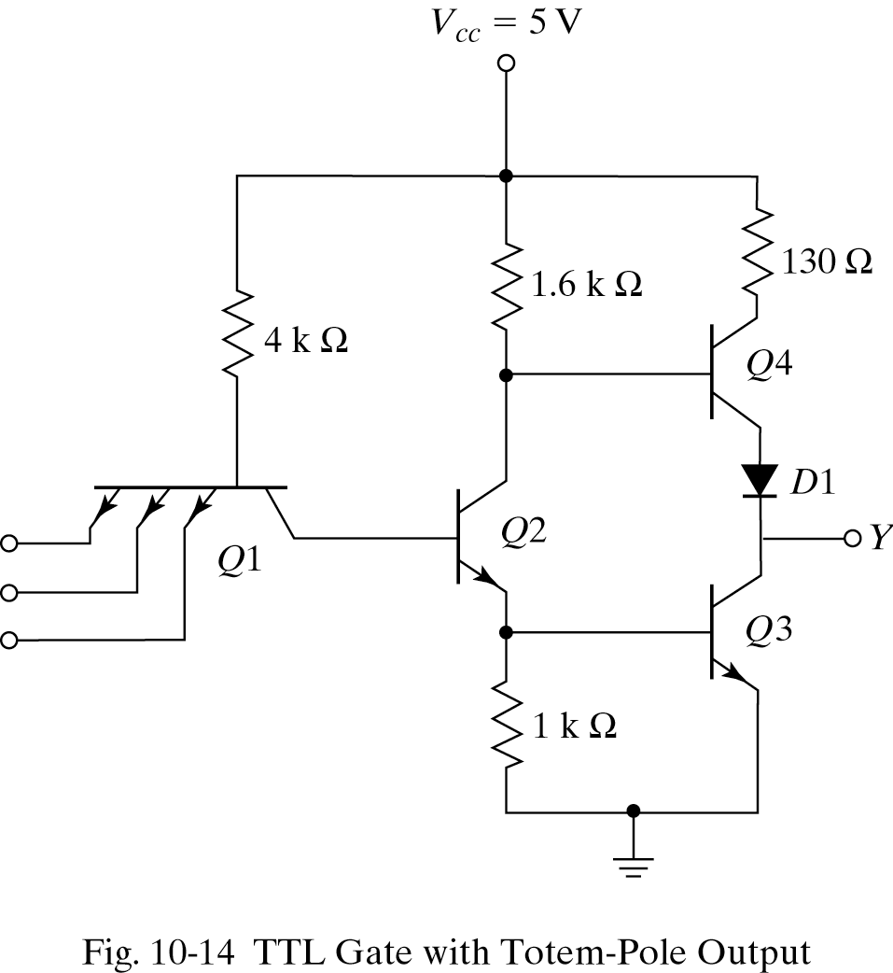
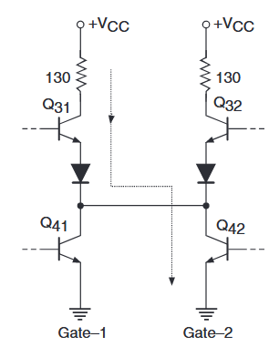
Totem pole output
Advantage: Faster switching time
Disadvantage: Outputs cannot be connected (can lead to excessive current!)

Slide 19
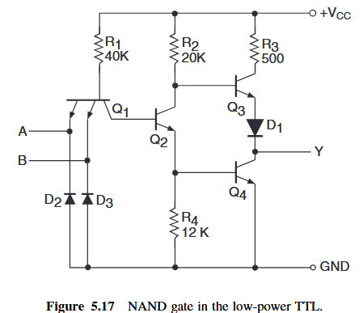
Reducing the power consumption

Slide 20
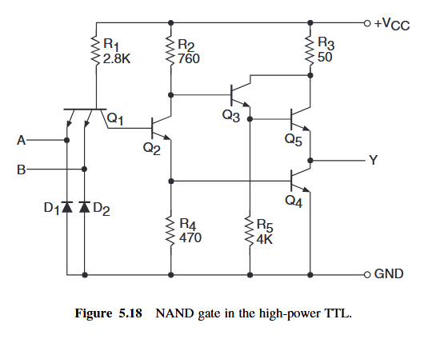
Higher speed + current capacity

Slide 21
Schottky transistors
Schottky diode: metal – semiconductor junction acts as a diode
Schottky transistor: Schottky diode between base and collector
Why bother?
When a normal BJT saturates (used as a switch):
The base–emitter (BE) junction is forward biased (≈ +0.7 V).
The base–collector (BC) junction also becomes forward biased (≈ +0.2 V).
This forward bias injects extra charge carriers into the base region.
That stored charge must be removed before the transistor can turn off again.
This causes a storage time delay, typically several nanoseconds in TTL.
Schottky transistor never enters saturation – no recharge – faster!

Slide 22
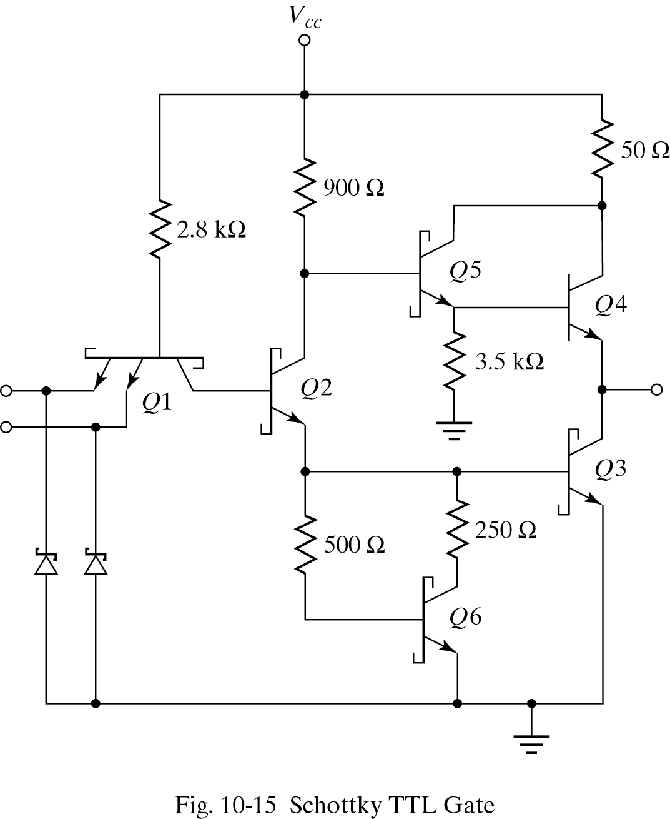
Schottky TTL NAND gate

Slide 23
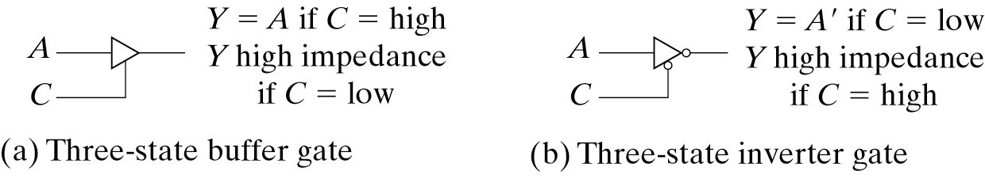
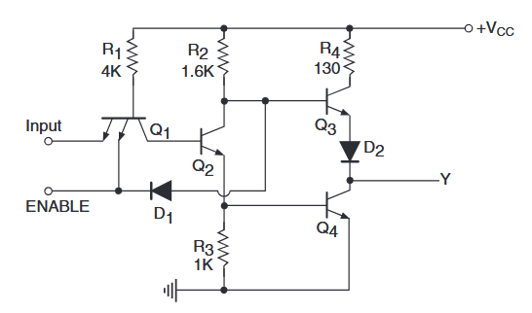
Three-state outputs
Output can be LOW / HIGH / High Impedance (ie ‘disconnected’)

Slide 24

Attendance!
Will be opened only during the attendance window.
Enable location on your device.
Grant any location permissions requested by the website.
Refresh the page.
Try submitting again.

Slide 25
