Slide 1
BITS Pilani Digital Design
Prof. GSS Chalapathi, Prof. Saurabh Gandhi (EEE department)

Slide 2
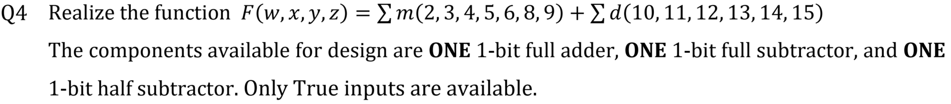
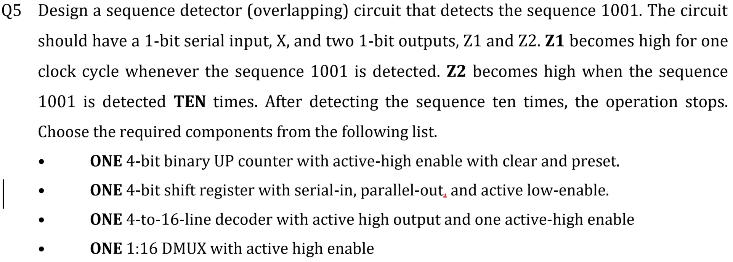
2004
Notes:
4: Is there any method to solve such questions? Not being able to solve even with the vague solution
5: How to solve systematically? Problem in designing as there are many complex components, and don't know where to store Z1 and Z2

Slide 3
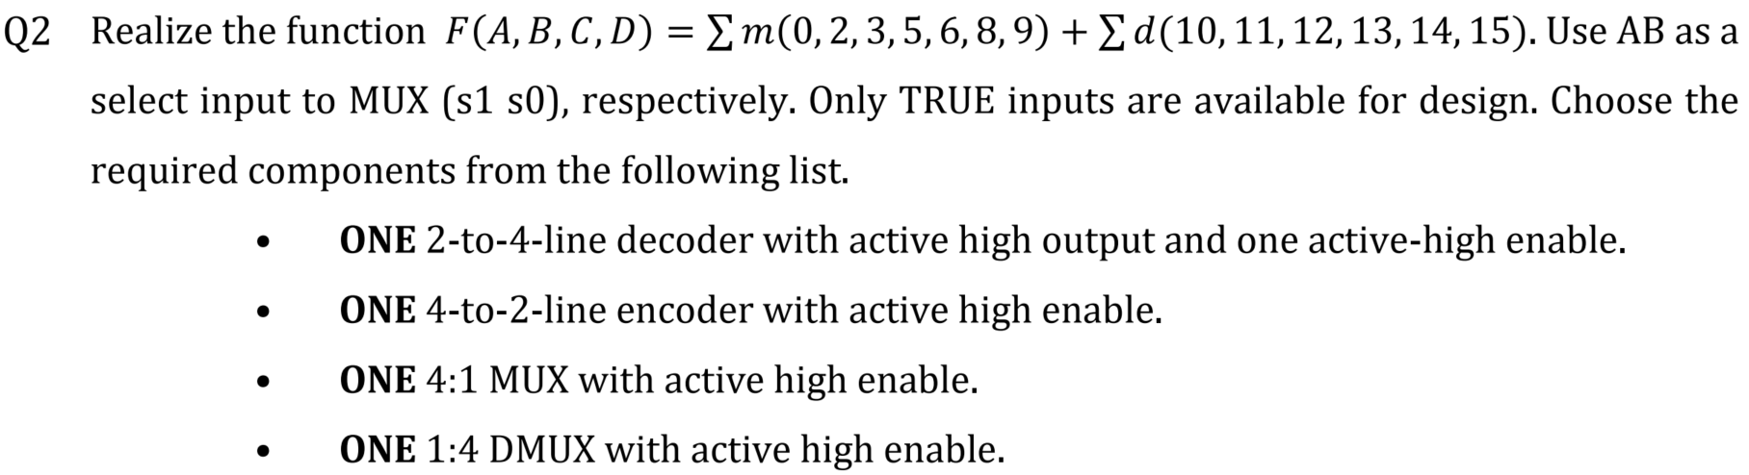
2004

Slide 4
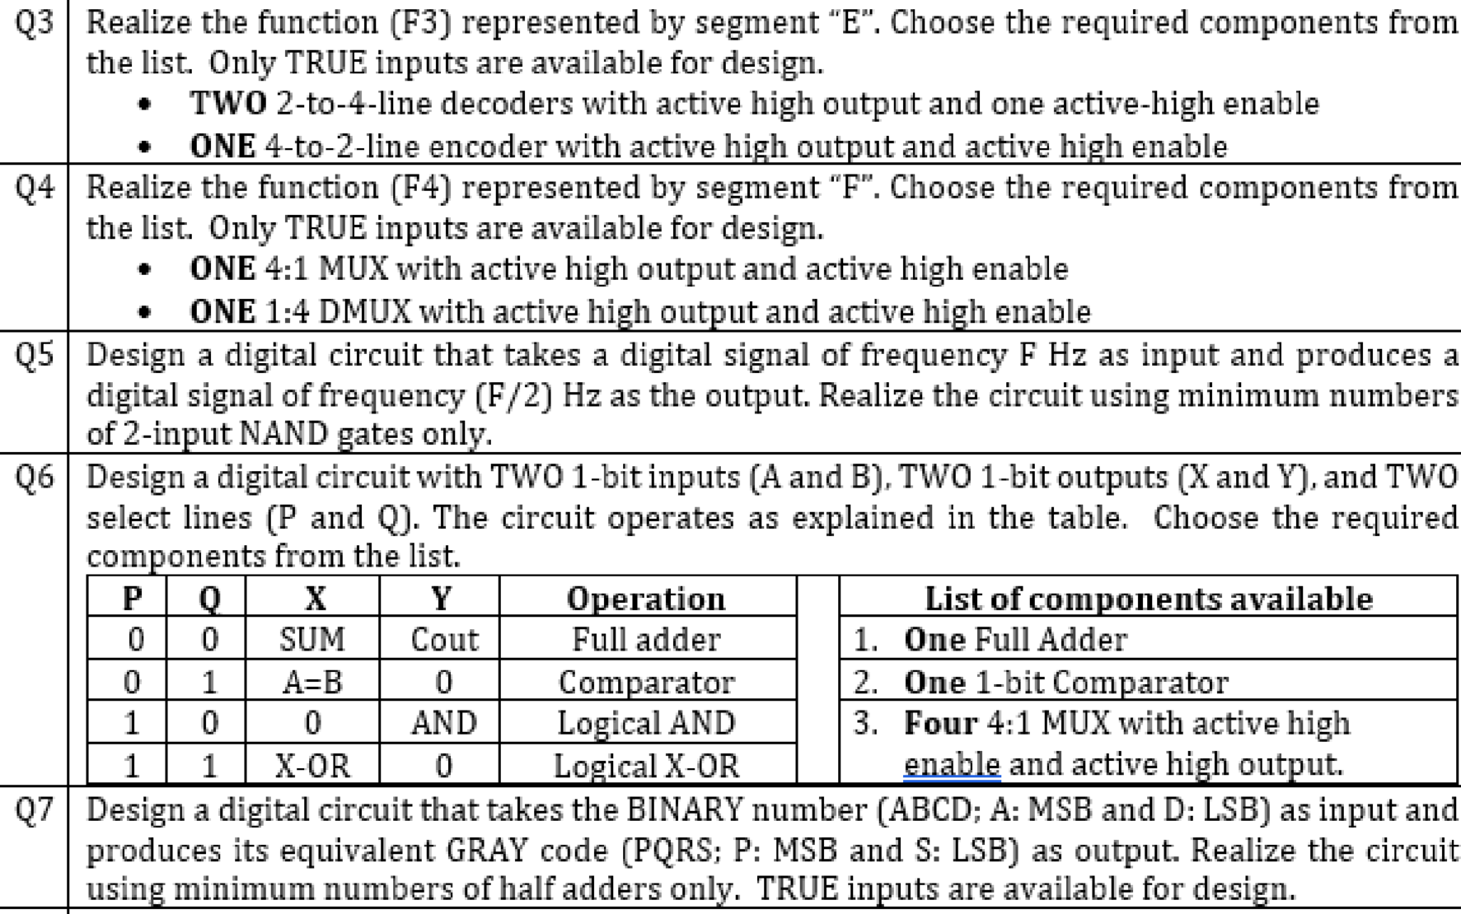
2003

