Slide 1
BITS Pilani Digital Design
Prof. GSS Chalapathi, Prof. Saurabh Gandhi (EEE department)

Slide 2
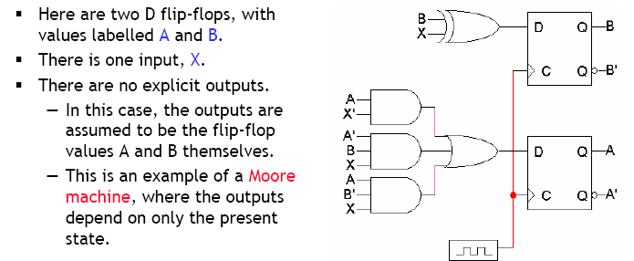
Example

Slide 3
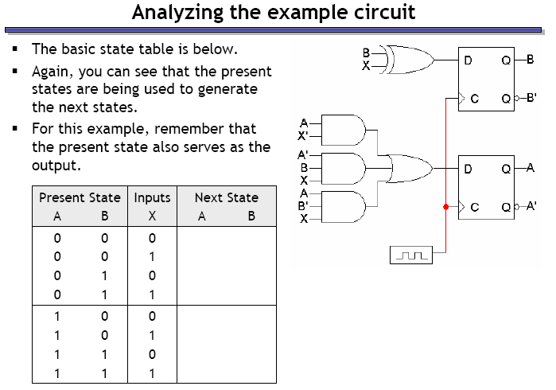
Example – circuit analysis

Slide 4
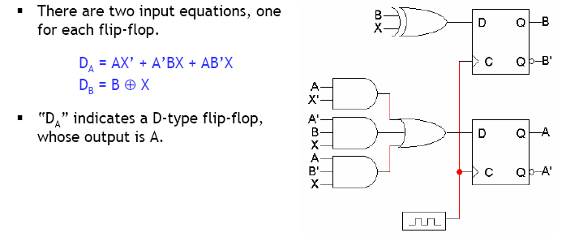
Step 1: Flip flop input equations

Slide 5
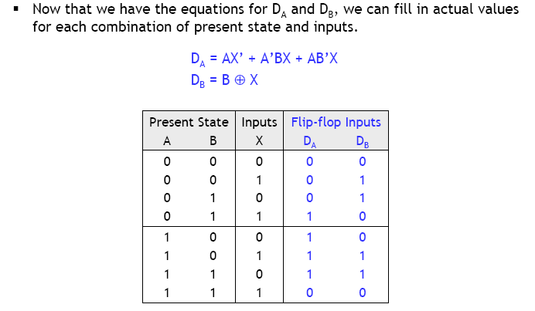
Step 2: Flip flop input values

Slide 6
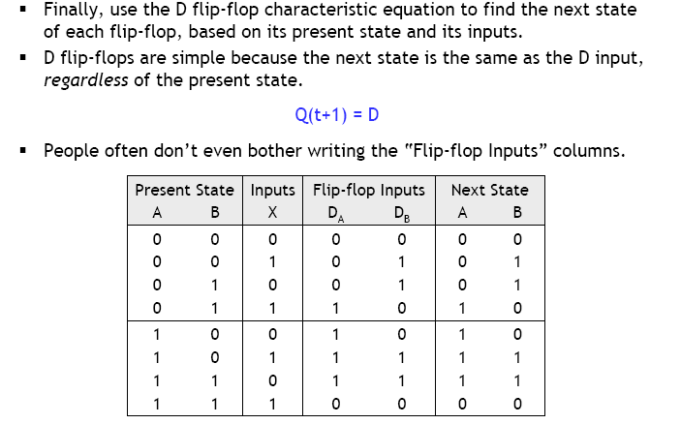
Step 3: finding next states

Slide 7
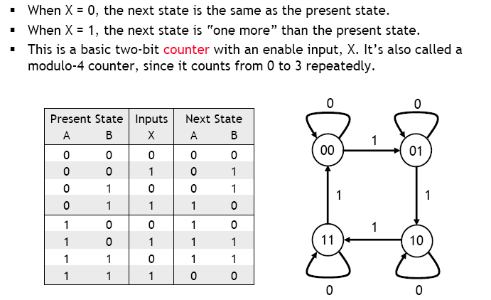
What does this circuit do?

Slide 8
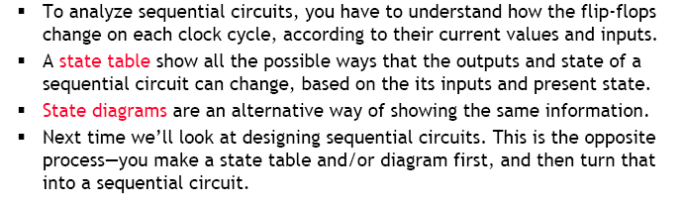
Summary

Slide 9
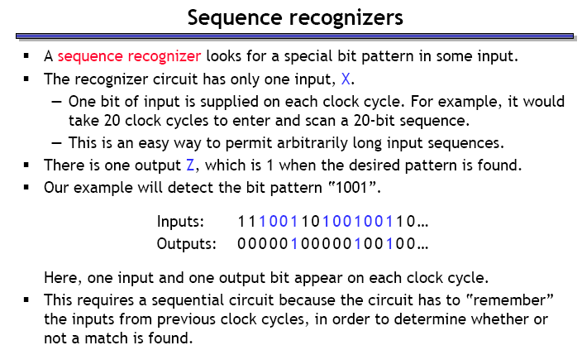
Design of sequential circuits

Slide 10
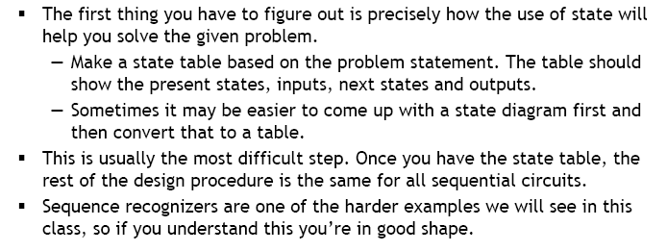
Step 1.1: Make the state diagram

Slide 11
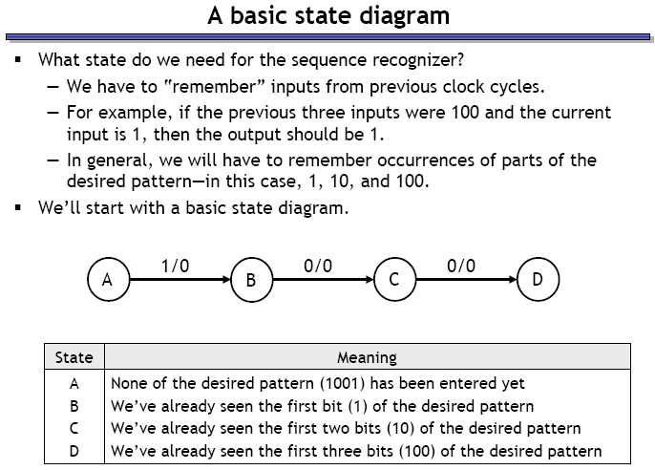
Sequence recognizer state diagram

Slide 12
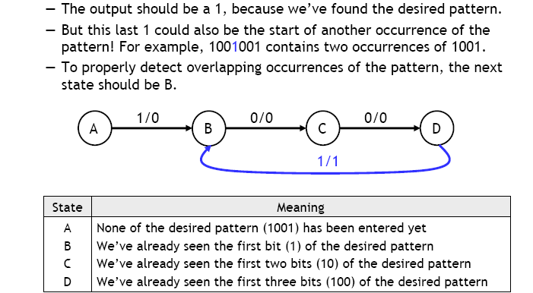
Where should the system go from D?

Slide 13
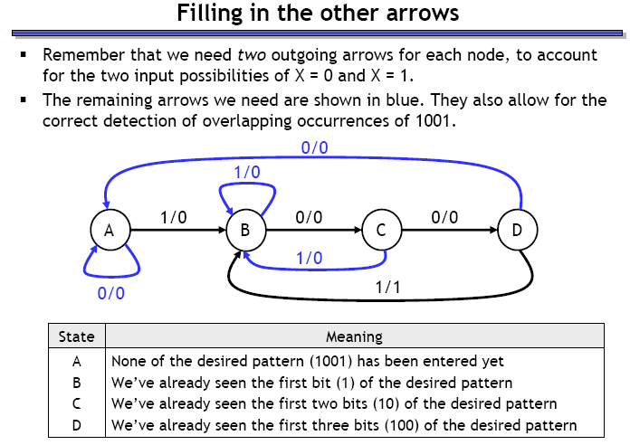
What about other state transitions?

Slide 14
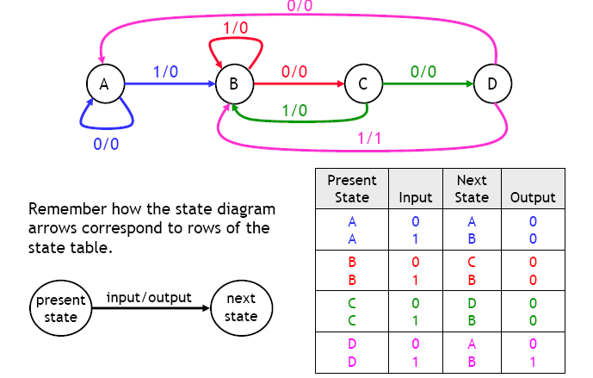
Step 1.2: make the state table

Slide 15
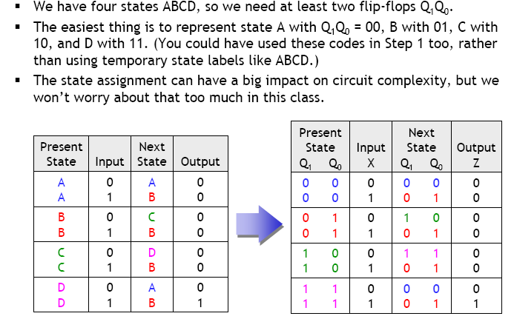
Step 2: Assign binary codes to states (to store them in flip-flops)

Slide 16
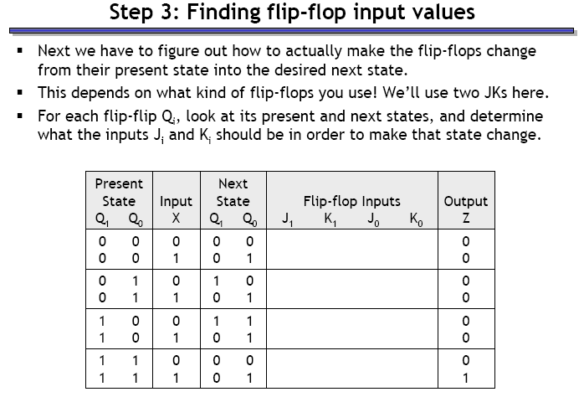
Step 3: Find flip-flop input values

Slide 17
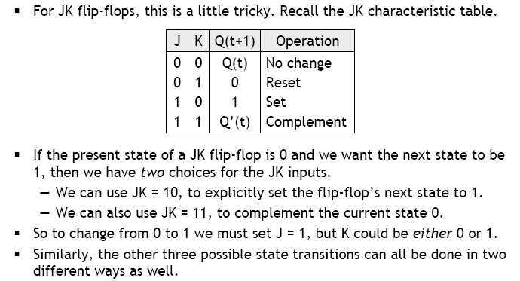
JK flip-flop input values

Slide 18
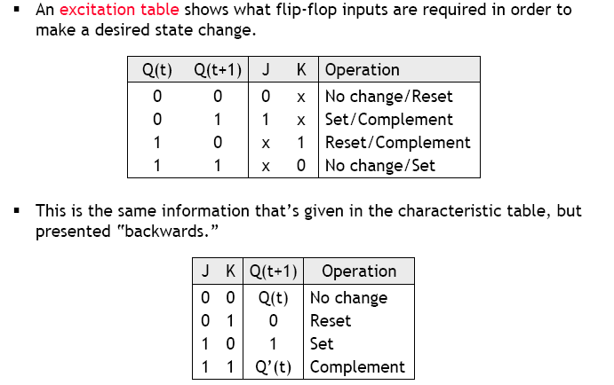
JK flip-flop excitation table

Slide 19
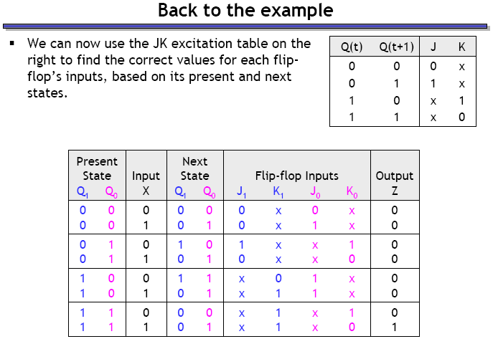
Use excitation table to complete the expanded state table

Slide 20
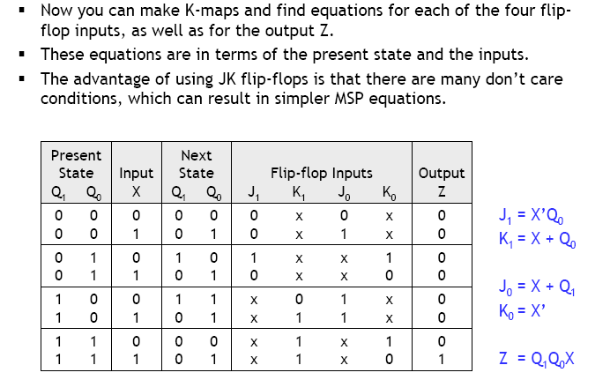
Step 4: Find equations for flip-flop input and output

Slide 21
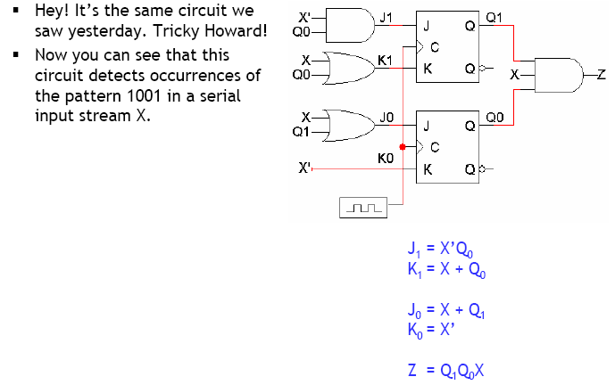
Step 5: Build the circuit!

Slide 22
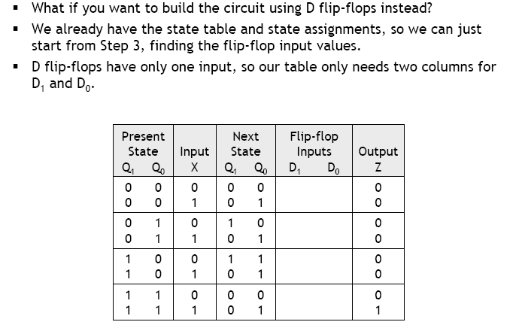
Example: same circuit with D FFs

Slide 23
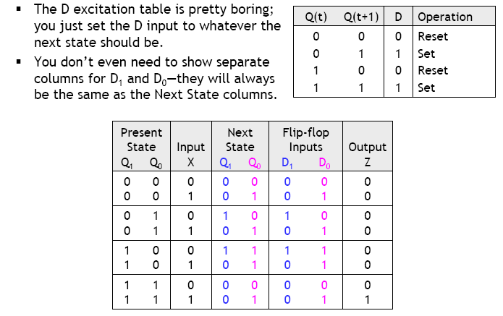
Back to step 3 with D FFs

Slide 24
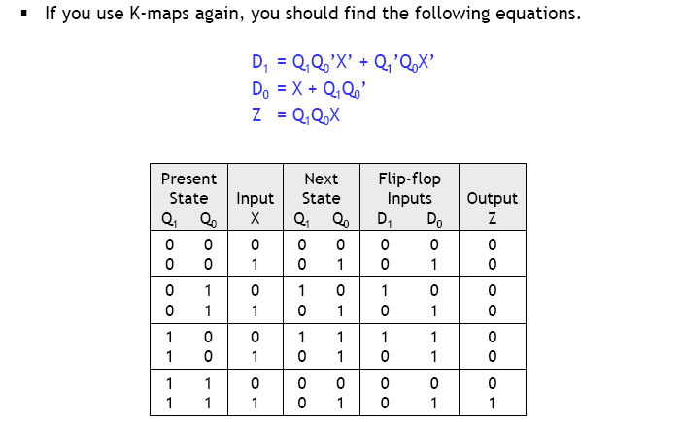
Step 4: Finding equations

Slide 25
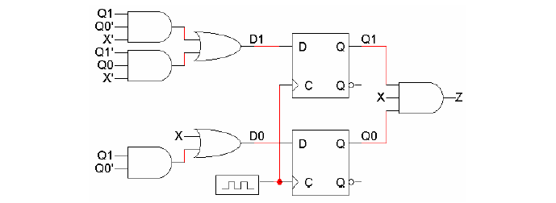
Step 5: Building the circuit

Slide 26
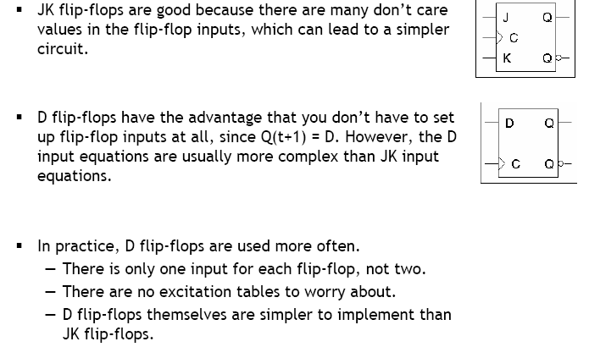
D vs JK flip flops

Slide 27
Counters
A counter is a register that goes through a predetermined sequence of states upon the application of clock pulses.
Categorized as:
Ripple counters The FF output transition serves as a source for triggering other FFs. NO COMMON CLOCK.
Synchronous counters All FFs receive the common clock pulse, and the change of state is determined based on the present state

Slide 28
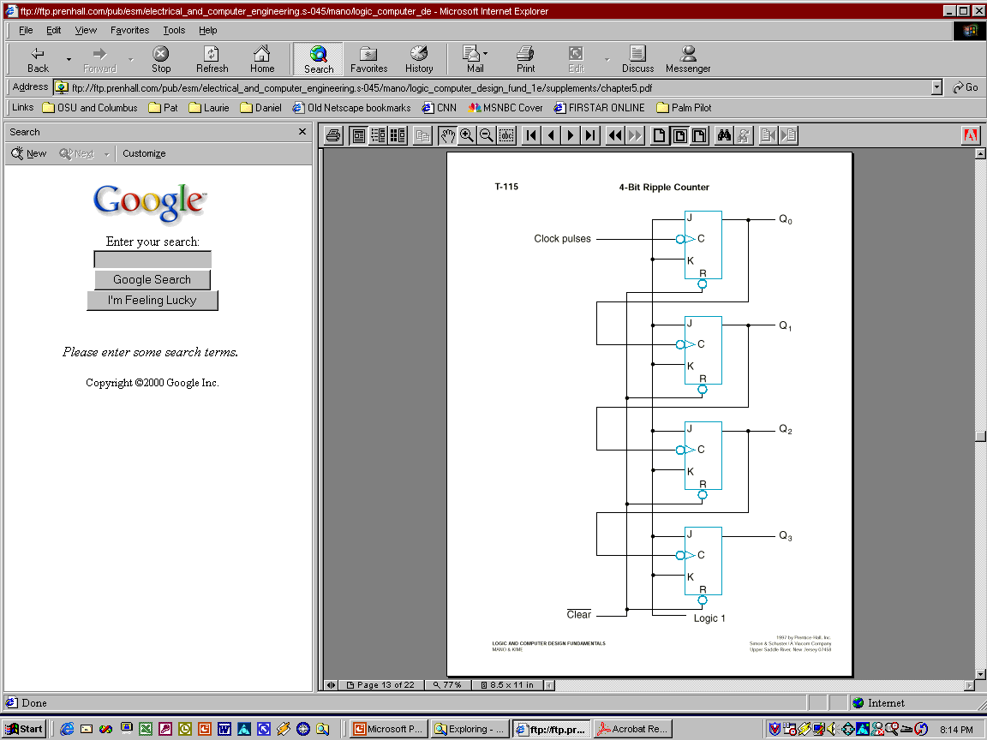
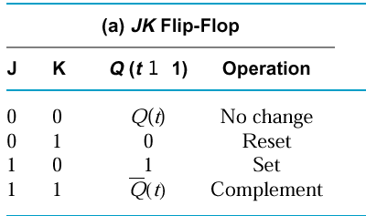
4-bit binary up counter
Less significant bit serves as the clock for the next significant bit (negative edge clock)

Slide 29
4-bit binary up counter
The output of each FF is connected to the C input of the next FF in sequence.
The FF holding the least significant bit receives the incoming clock pulses.
The J and K inputs of all FFs are connected to a permanent logic 1.
The bubble next to the C label indicates that the FFs respond to the negative-going transition of the input.

Slide 30
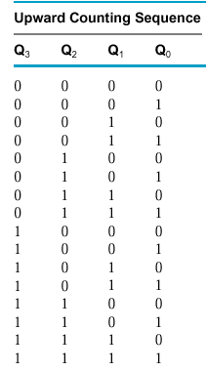
4-bit binary up counter

Slide 31
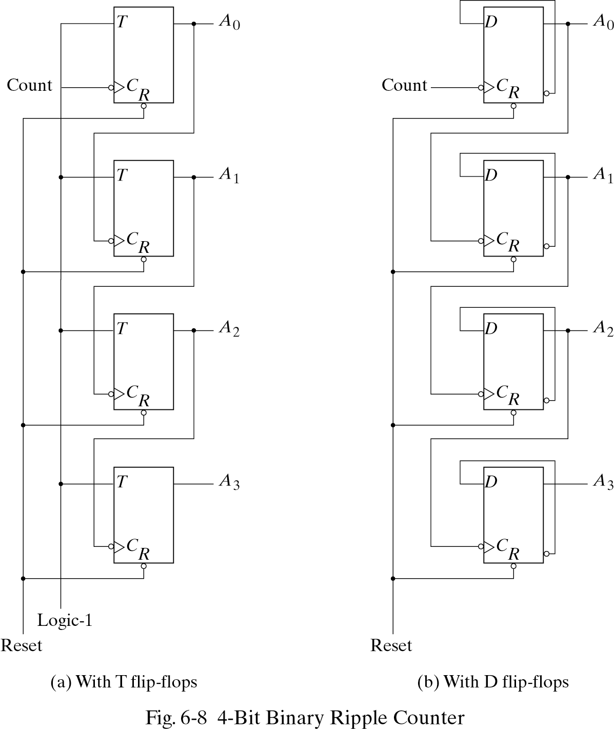
4-bit ripple counters (other designs)

Slide 32
4-bit binary down counter
Use direct set (S) instead of direct reset (R) to start at 1111 instead of 0000
Design the rest on your own…

Slide 33
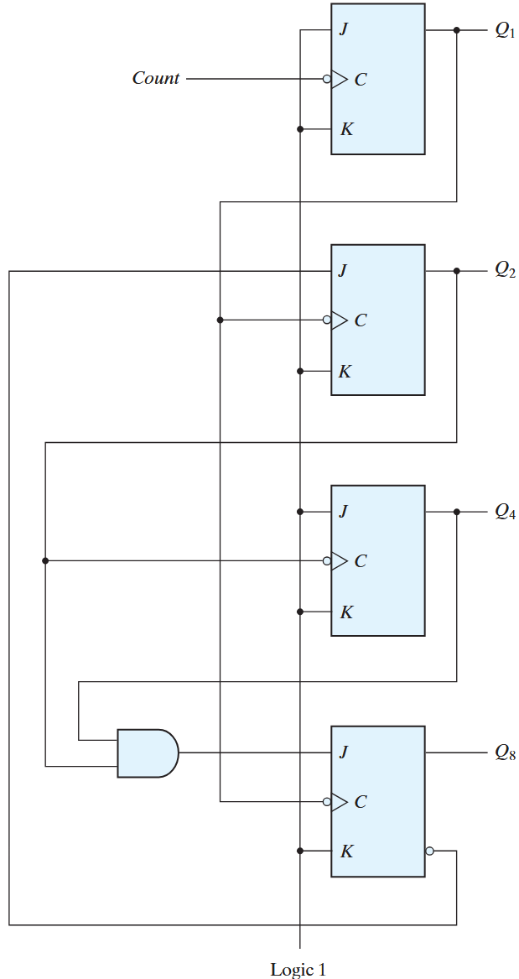
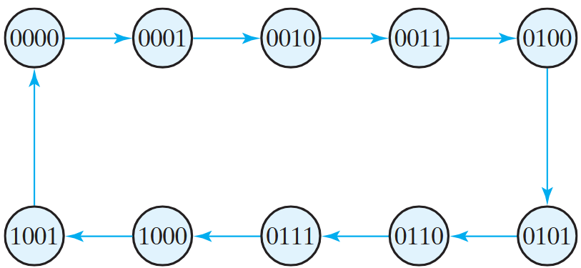
BCD ripple counter
Q1 complemented on every clock edge
Q2 complemented if Q8 = 0, Q1 goes from 1 to 0.
Q2 cleared if Q8 = 1 and Q1 goes from 1 to 0
Q4 complemented when Q2 goes from 1 to 0
Q8 complemented when Q4Q2 = 11, Q1 goes from 1 to 0.
Q8 cleared if either Q4 or Q2 is 0 and Q1 goes from 1 to 0

Slide 34
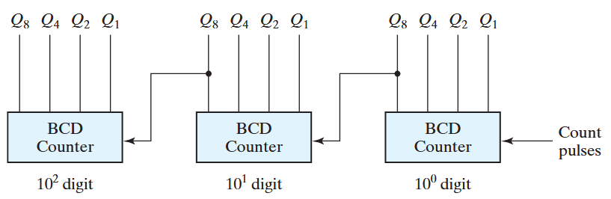
The ‘ripple’ in BCD ripple counters

Slide 35

Attendance!
Will be opened only during the attendance window.
Enable location on your device.
Grant any location permissions requested by the website.
Refresh the page.
Try submitting again.

Slide 36
Synchronous binary counters
Same design procedure as other sequential circuits
Inputs: clock and control signals (EN, Load etc)
Outputs: FF states
Most efficient implementations use T or JK FFs

Slide 37
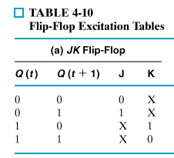
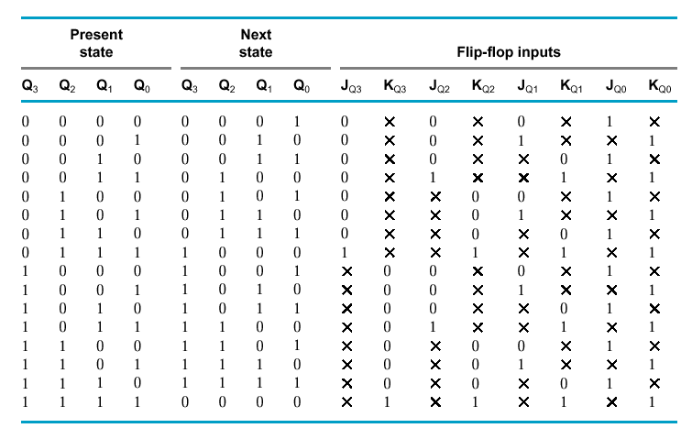

JK synchronous binary counter

Slide 38
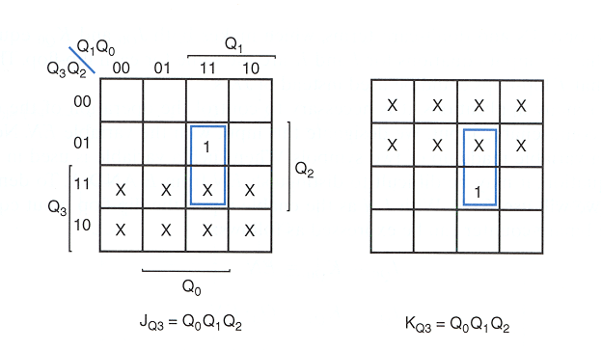
JK synchronous binary counter

Slide 39
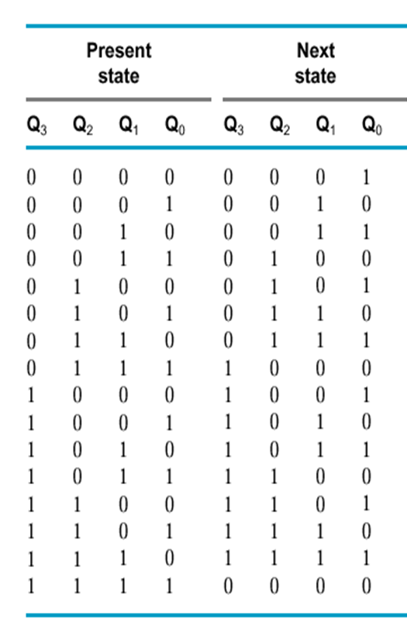
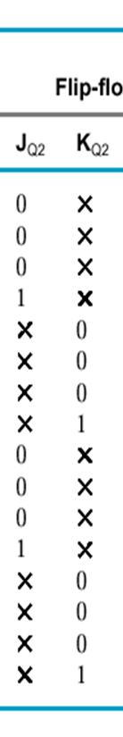
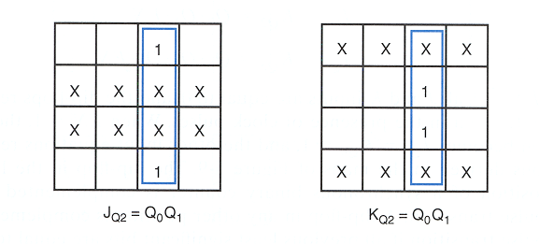
JK synchronous binary counter

Slide 40
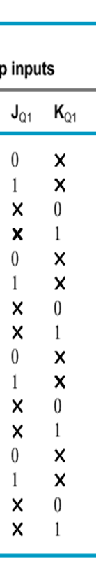
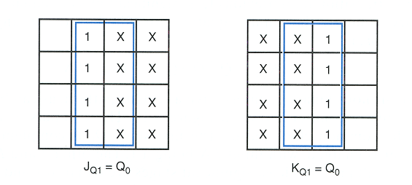
JK synchronous binary counter

Slide 41
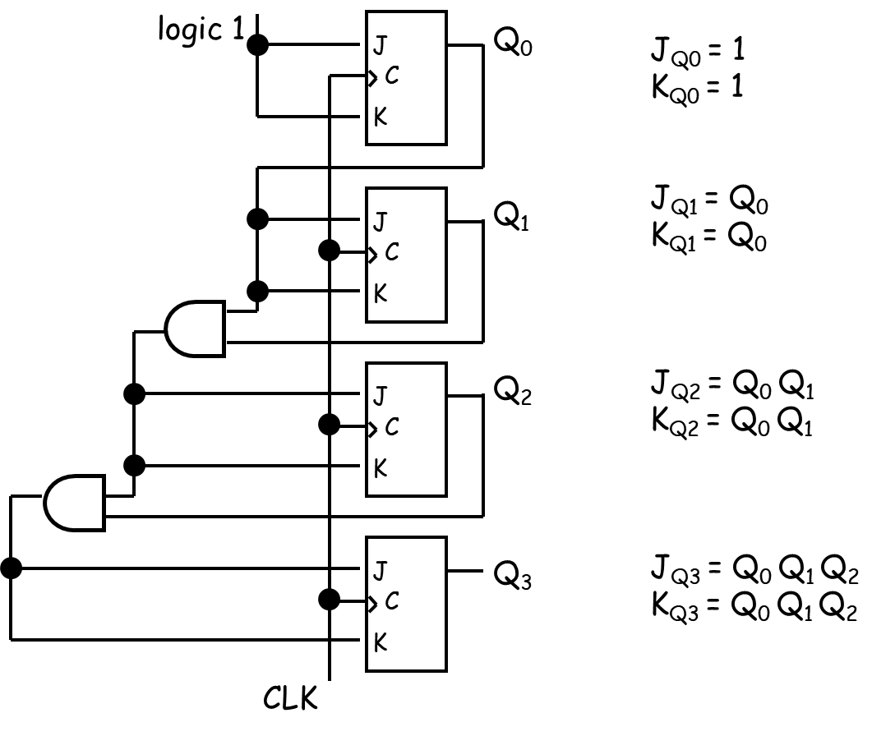
JK synchronous binary counter

Slide 42
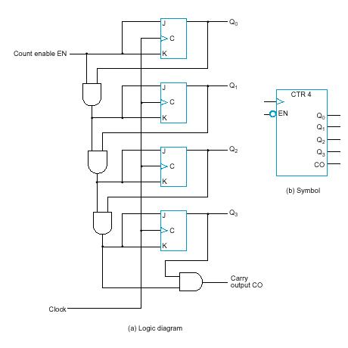
JK synchronous binary counter with EN and CO
EN = enable control signal, when 0 counter remains in the same state, when 1 it counts
J_{Q0} = 1 · EN
K_{Q0} = 1 · EN
J_{Q1} = Q₀ · EN
K_{Q1} = Q₀ · EN
J_{Q2} = Q₀ Q₁ · EN
K_{Q2} = Q₀ Q₁ · EN
J_{Q3} = Q₀ Q₁ Q₂ · EN
K_{Q3} = Q₀ Q₁ Q₂ · EN
C0 = Q₀ Q₁ Q₂ Q₃ · EN
CO = carry output signal:
used to extend the counter to more stages
…how?

Slide 43
Serial vs parallel counters
If serial gating (chain of gates, info ripples through) is used → serial counter
If serial gating is replaced with parallel gating (this is analogous with ripple-logic replaced with carry-lookeahead logic in our adder designs) → parallel counter
Advantage of parallel over serial counter: faster in certain occasions (1111 → 0000)

Slide 44
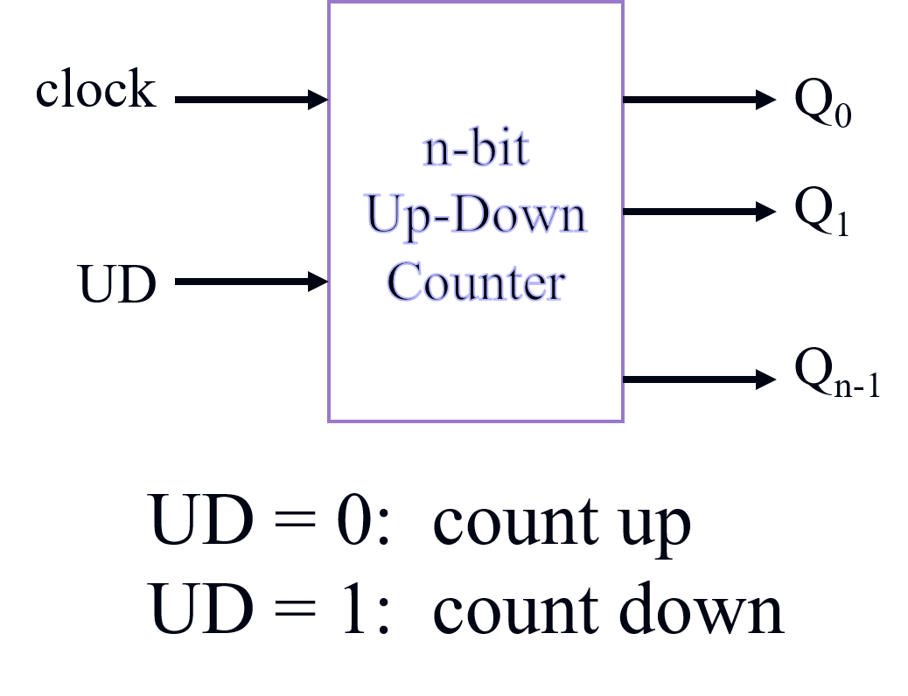
Up – Down binary counters

Slide 45
Up – Down binary counters
UD Q2 Q1 Q0 Q2.D Q1.D Q0.D
UD Q2 Q1 Q0 Q2.D Q1.D Q0.D
0 0 0 0 0 0 1
0 0 0 1 0 1 0
0 0 1 0 0 1 1
0 0 1 1 1 0 0
0 1 0 0 1 0 1
0 1 0 1 1 1 0
0 1 1 0 1 1 1
0 1 1 1 0 0 0
1 0 0 0 1 1 1
1 0 0 1 0 0 0
1 0 1 0 0 0 1
1 0 1 1 0 1 0
1 1 0 0 0 1 1
1 1 0 1 1 0 0
1 1 1 0 1 0 1
1 1 1 1 1 1 0
Up-Counter
Down-Counter

Slide 46
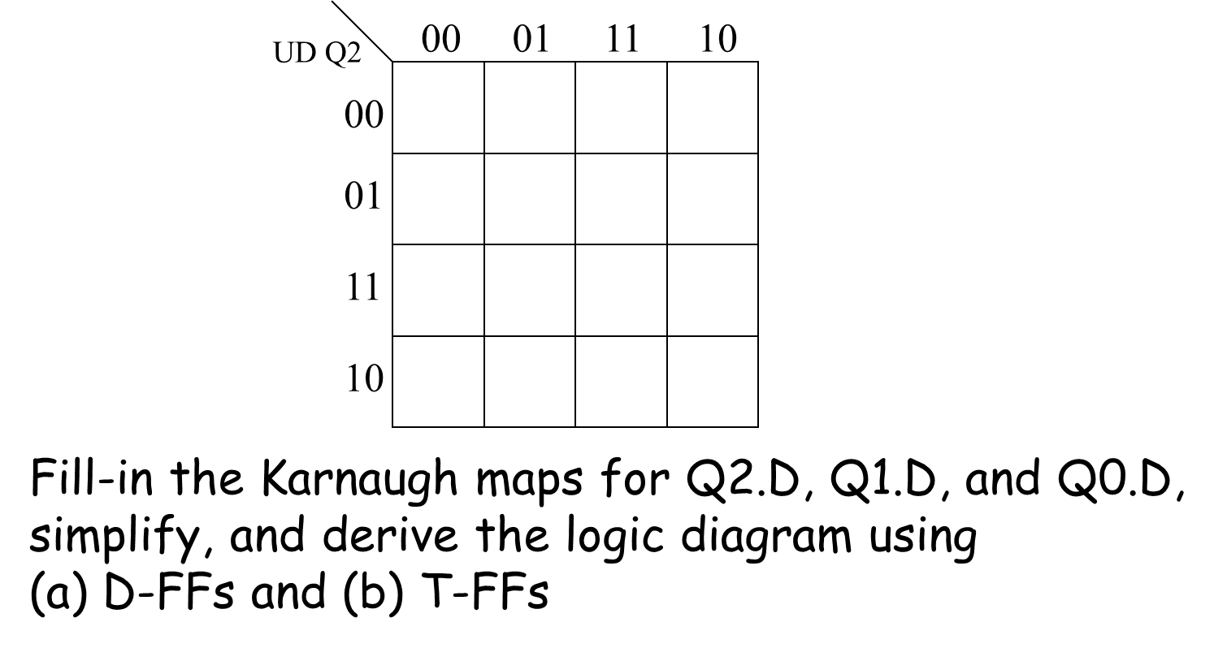
Up – Down binary counters

Slide 47
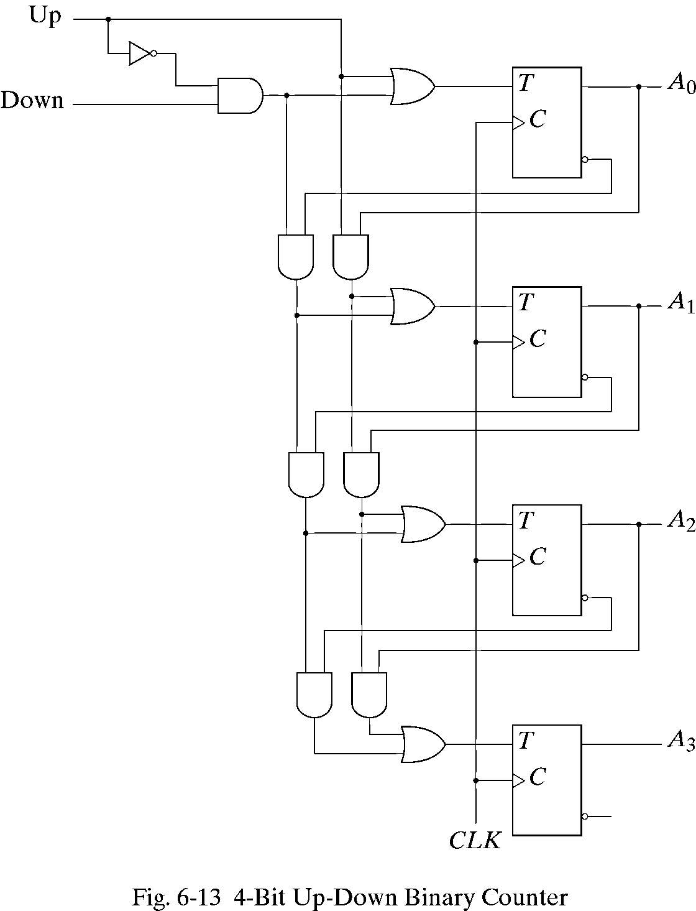
Up – Down binary counters

Slide 48
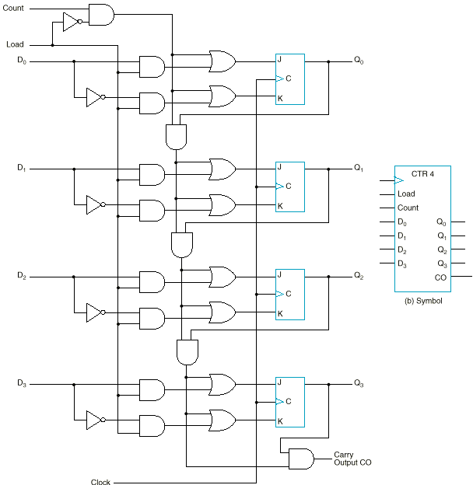
Binary counter with parallel load
Ability to set the counter to an arbitrary value to begin counting
Load | Count | Operation
0 | 0 | Nothing
0 | 1 | Count
1 | x | Load

Slide 49
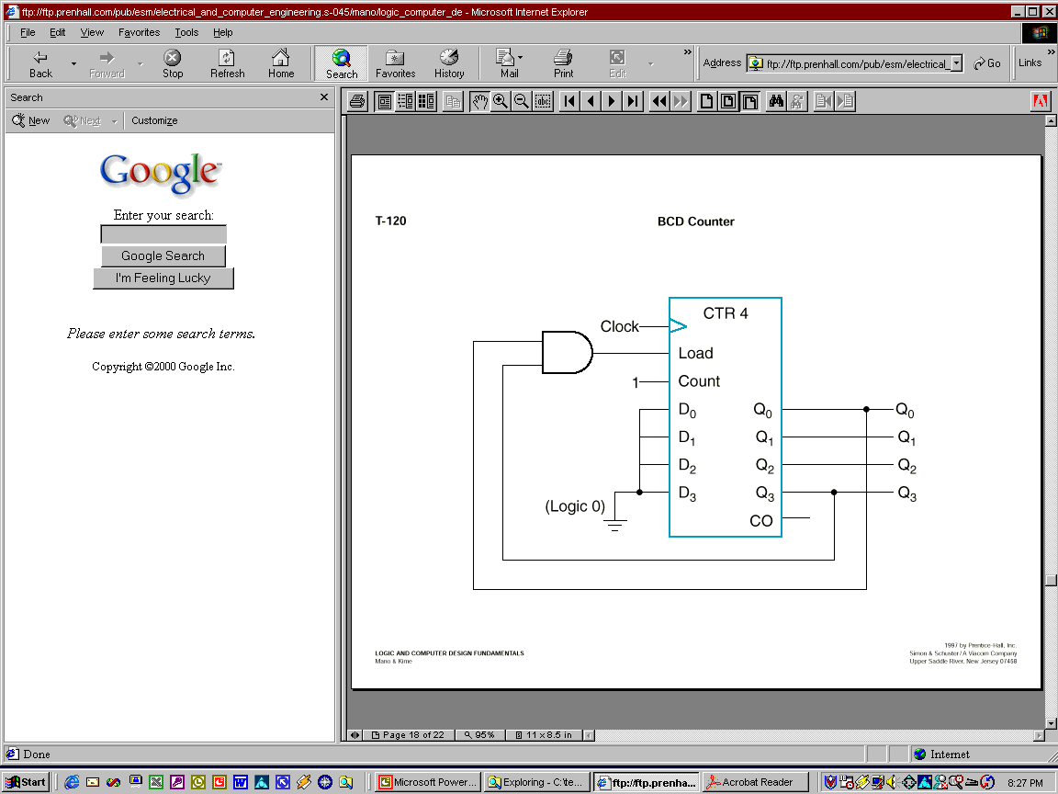
BCD counter using parallel load counter
The counter starts with an all-zero output.
As long as the output of the AND gate is 0, each positive clock pulse transition increments the counter by one.
When the output reaches the count of 1001, both Q₀ and Q₃ become 1, making the output of the AND gate equal to 1. This condition makes Load active, so on the next clock transition, the counter does not count, but is loaded from its four inputs.
The value loaded then is 0000.

Slide 50
Arbitrary sequence counter
Given an arbitrary sequence, design a counter that will generate the sequence
Procedure:
Derive state table / diagram based on the sequence
Simplify
Build the circuit
Example: Use D-FFs to design a sequence generator for the sequence: 0 → 7 → 6 → 1 → 0 (000 → 111 → 110 → 001 → 000)

Slide 51
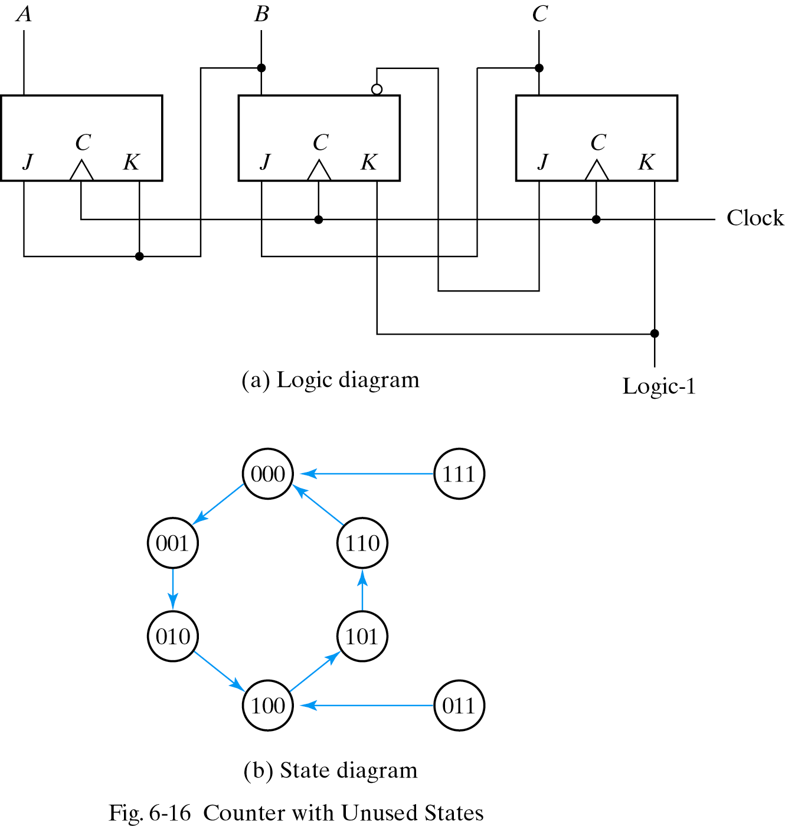
Counters with unused states

Slide 52
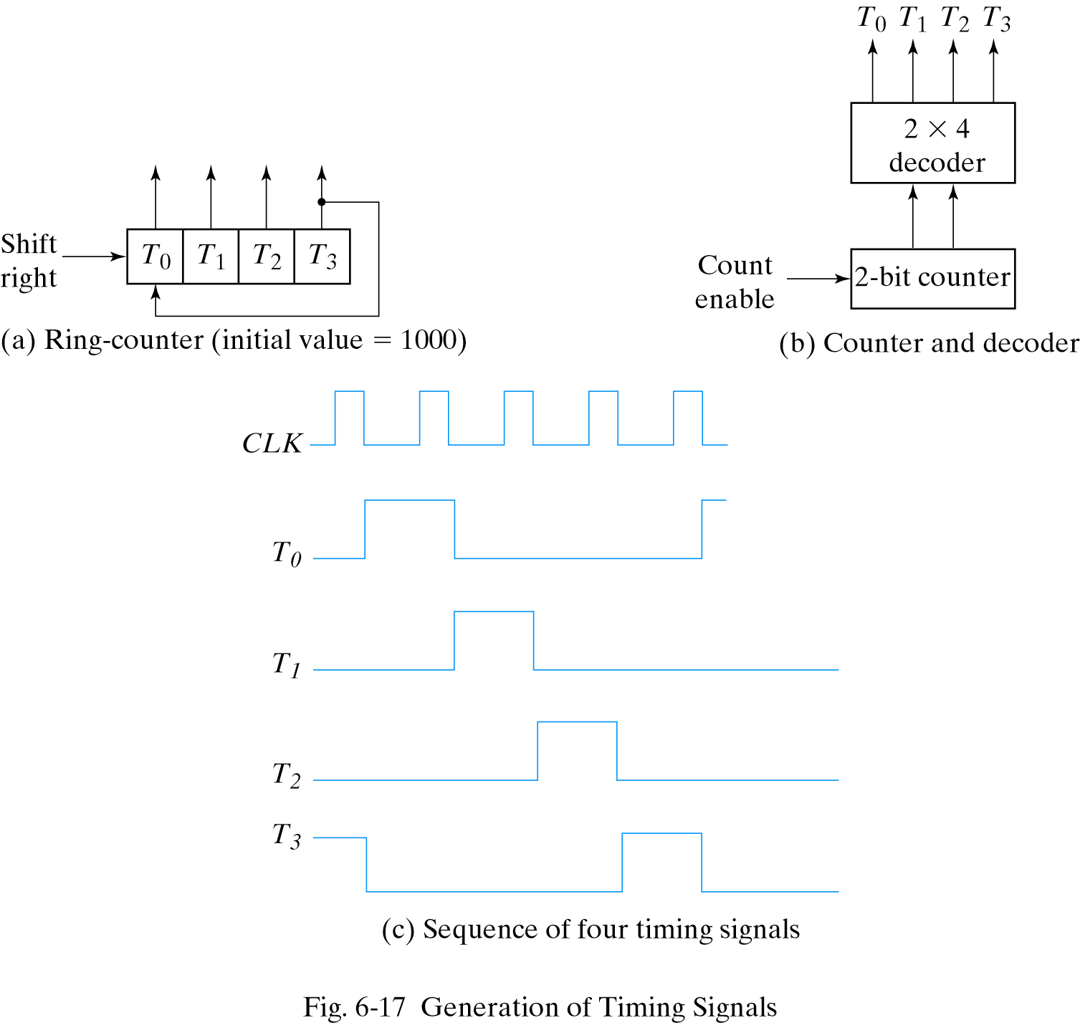
Ring counter

Slide 53
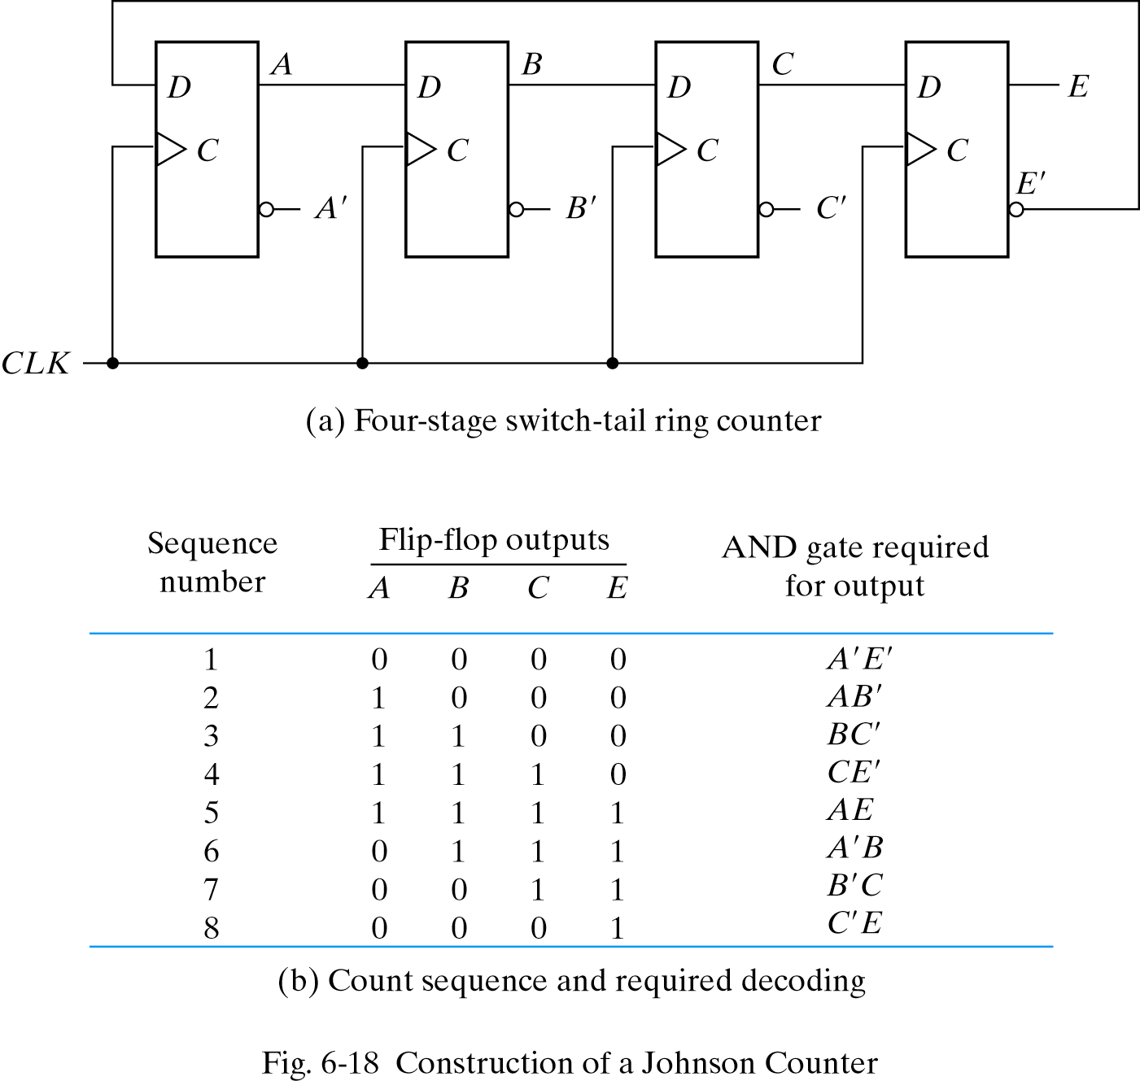
Johnson counter

