Slide 1
BITS Pilani Digital Design
Prof. GSS Chalapathi, Prof. Saurabh Gandhi (EEE department)

Slide 2
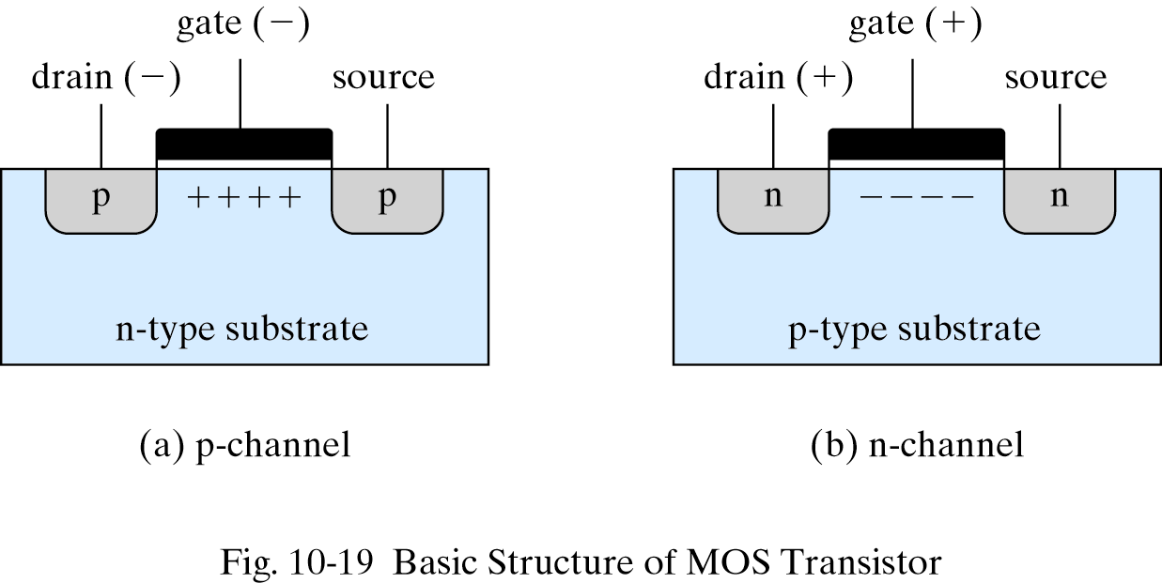
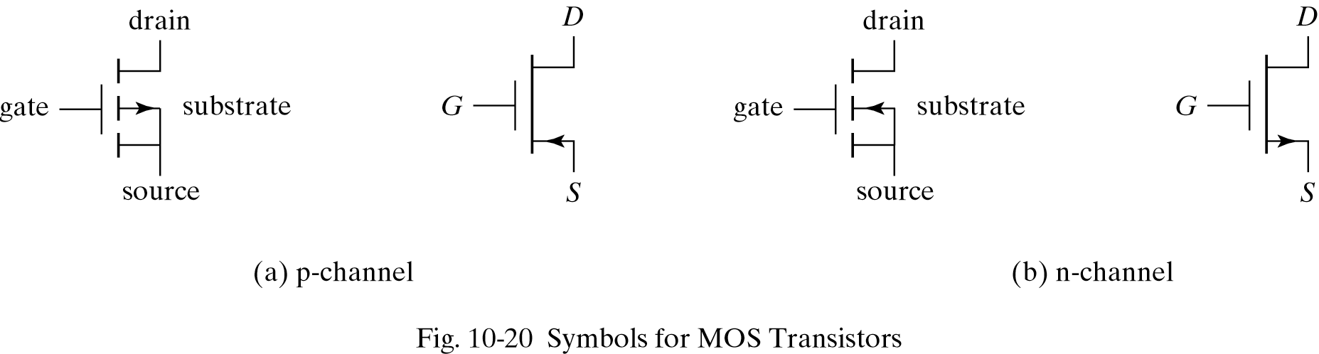
Metal Oxide Semiconductors

Slide 3
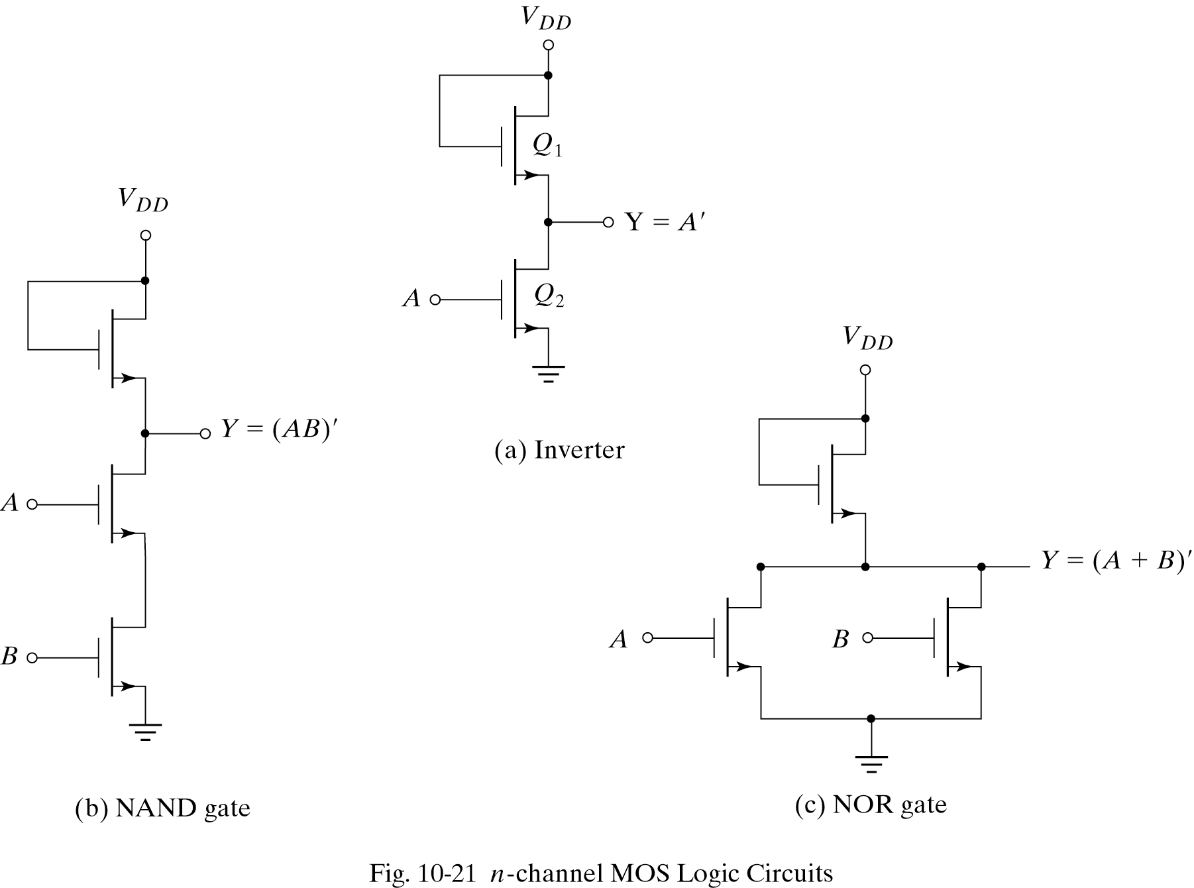
MOS Gates

Slide 4
Current controlled vs voltage controlled devices
Bipolar transistors control a current (I_{C}) by changing another current (I_{B})
Complex design involving multiple transistors, resistors and diodes
High power consumption since continuous current flows …
Lower density on chips since each gate requires more components and thus more space
More susceptible to electrical noise …
Very tight voltage requirements
MOSFETs control a current by changing the applied voltage …
Very simple structure …
Very low, since one transistor is always off, so no current path from V_{cc} to ground
Each device is small, so can accommodate more devices in the same space
More tolerant to electrical noise due to a sharp switching threshold
Large operating voltages

Slide 5

Attendance!
Will be opened only during the attendance window.
Enable location on your device.
Grant any location permissions requested by the website.
Refresh the page.
Try submitting again.

Slide 6
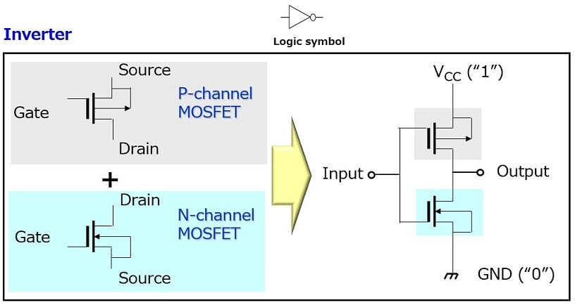
Complementary MOS (CMOS)

Slide 7
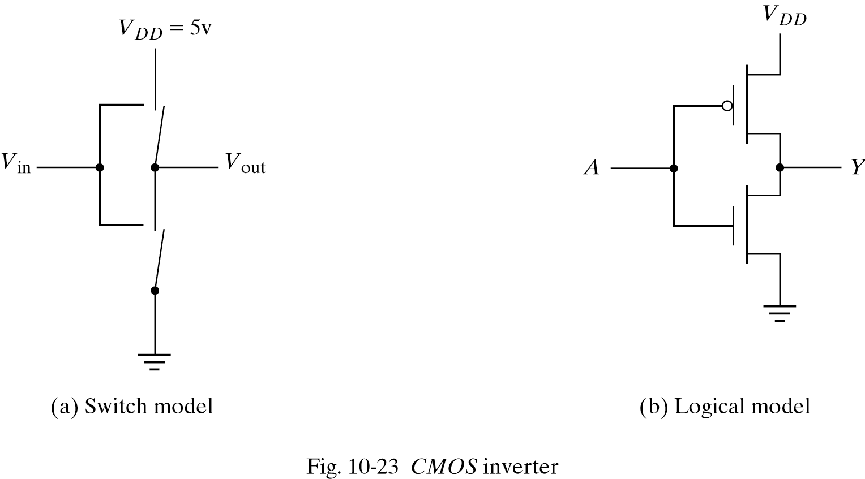
CMOS schematics

Slide 8
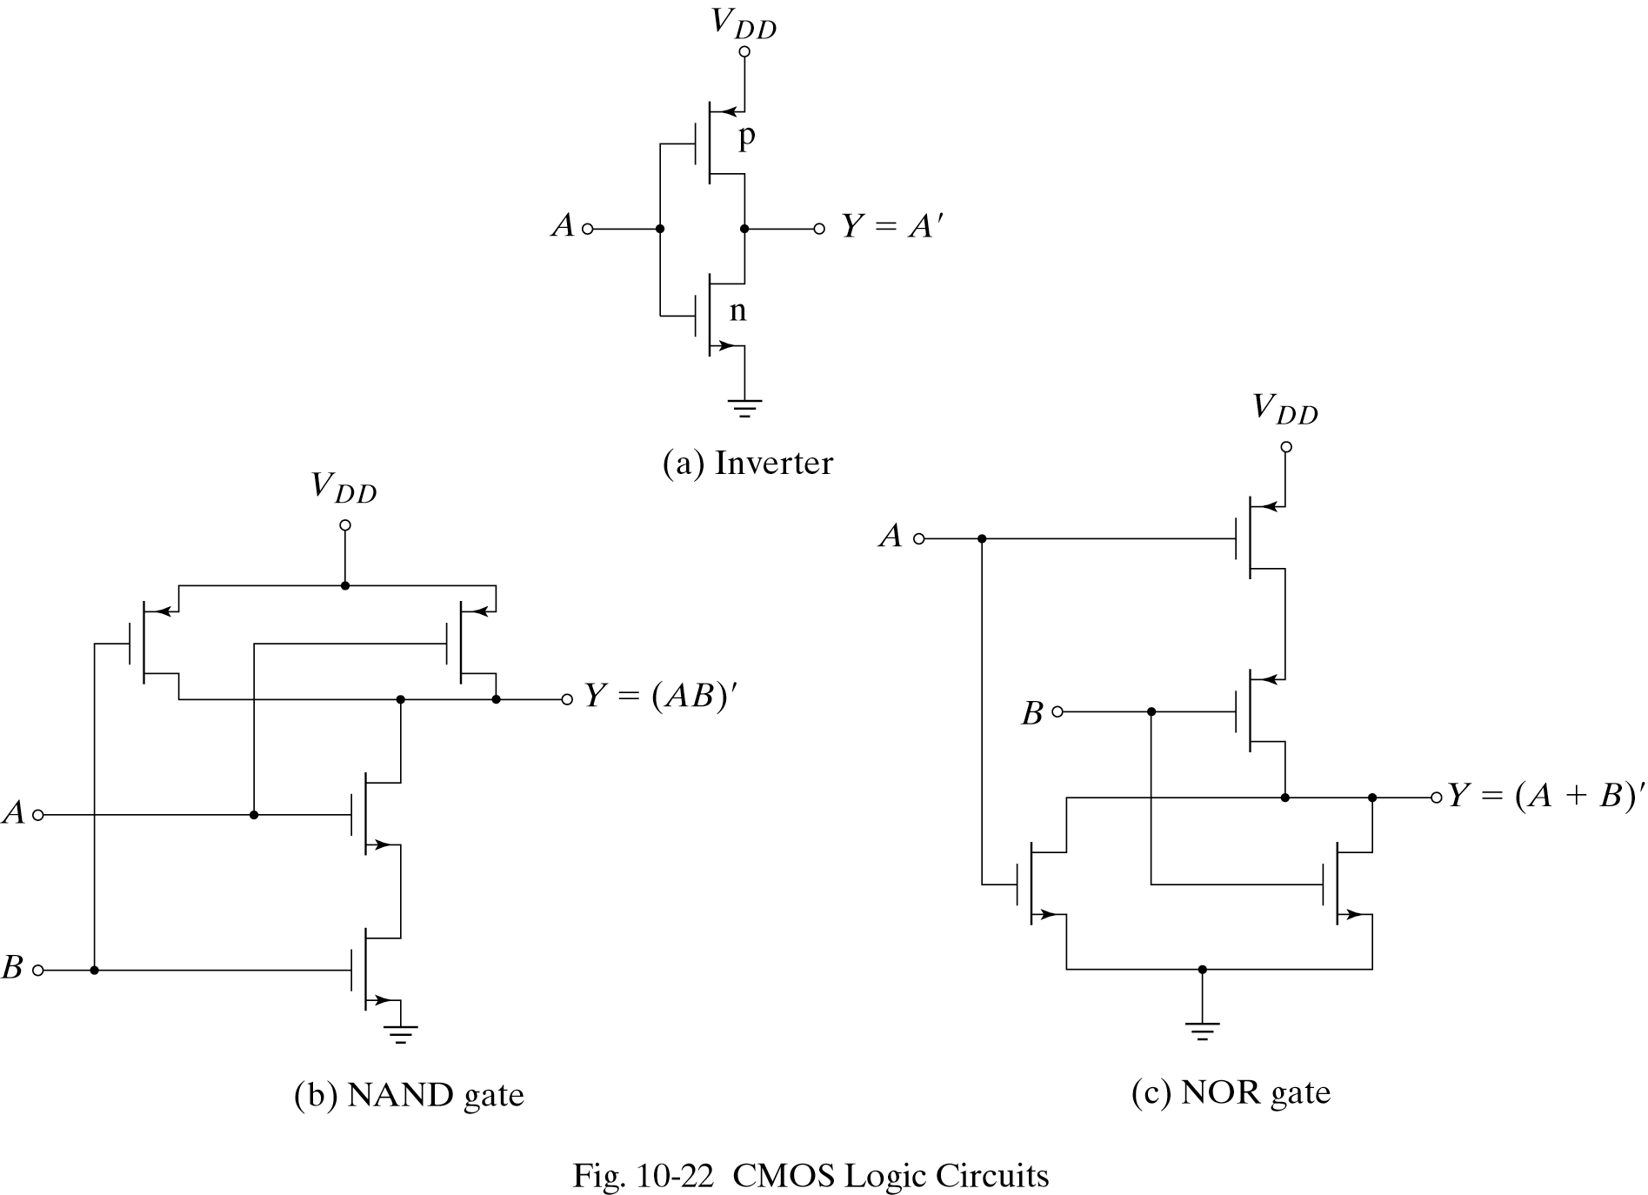
CMOS gates

Slide 9
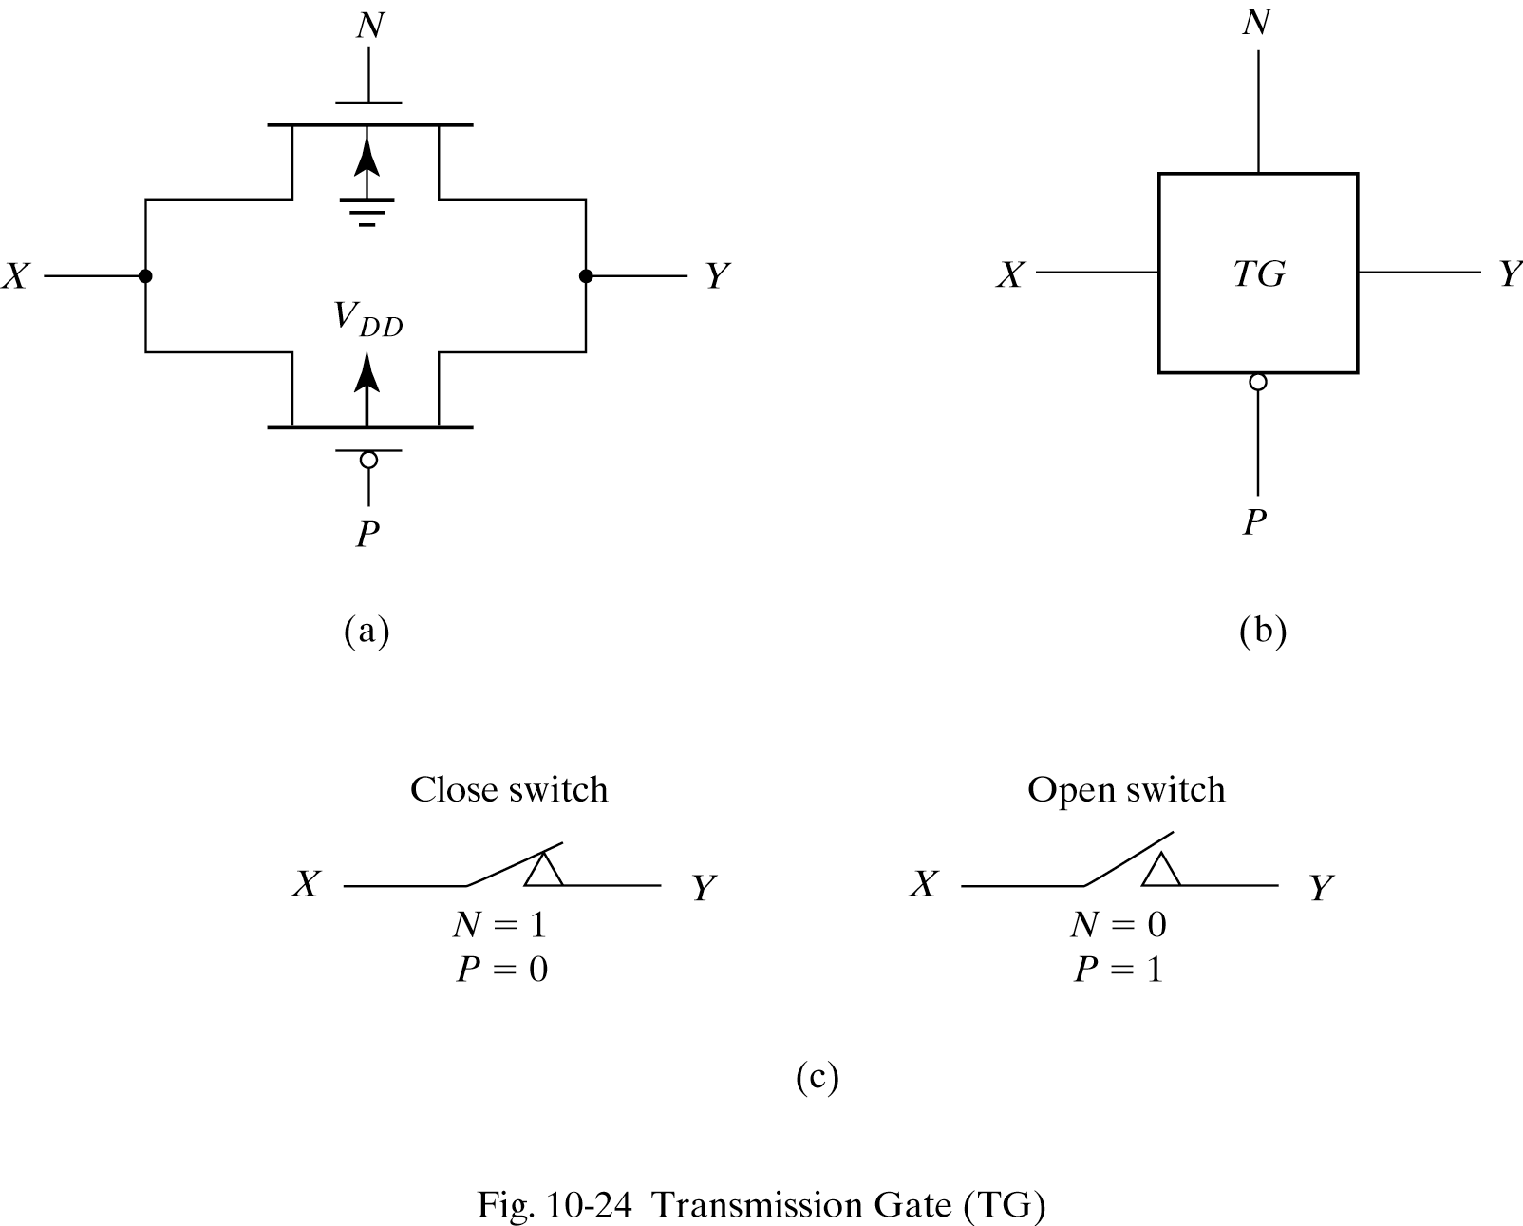
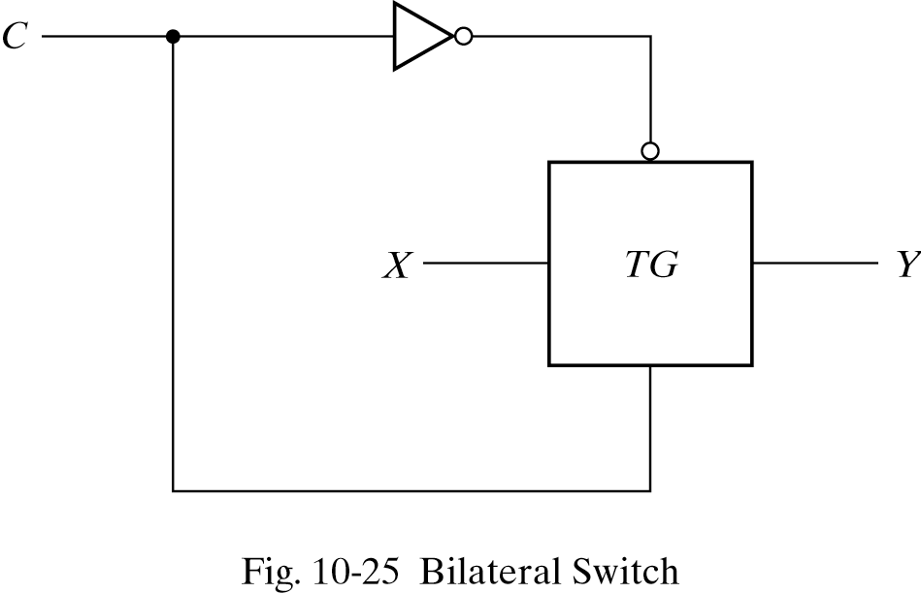
Transmission gates

Slide 10
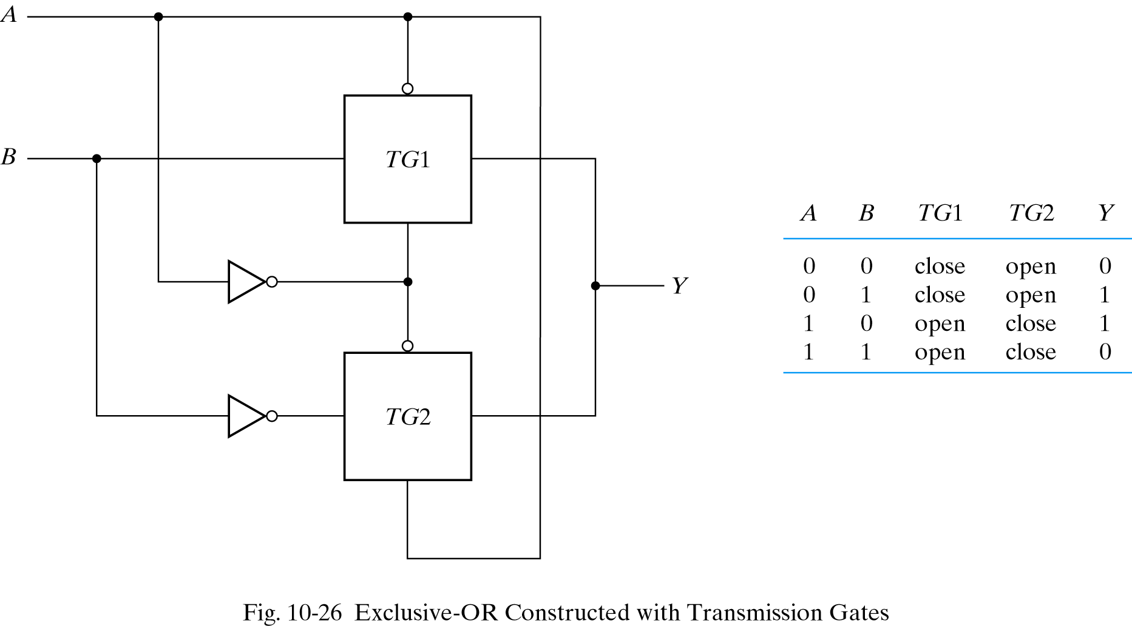
What does this circuit do?
EX-OR!

Slide 11
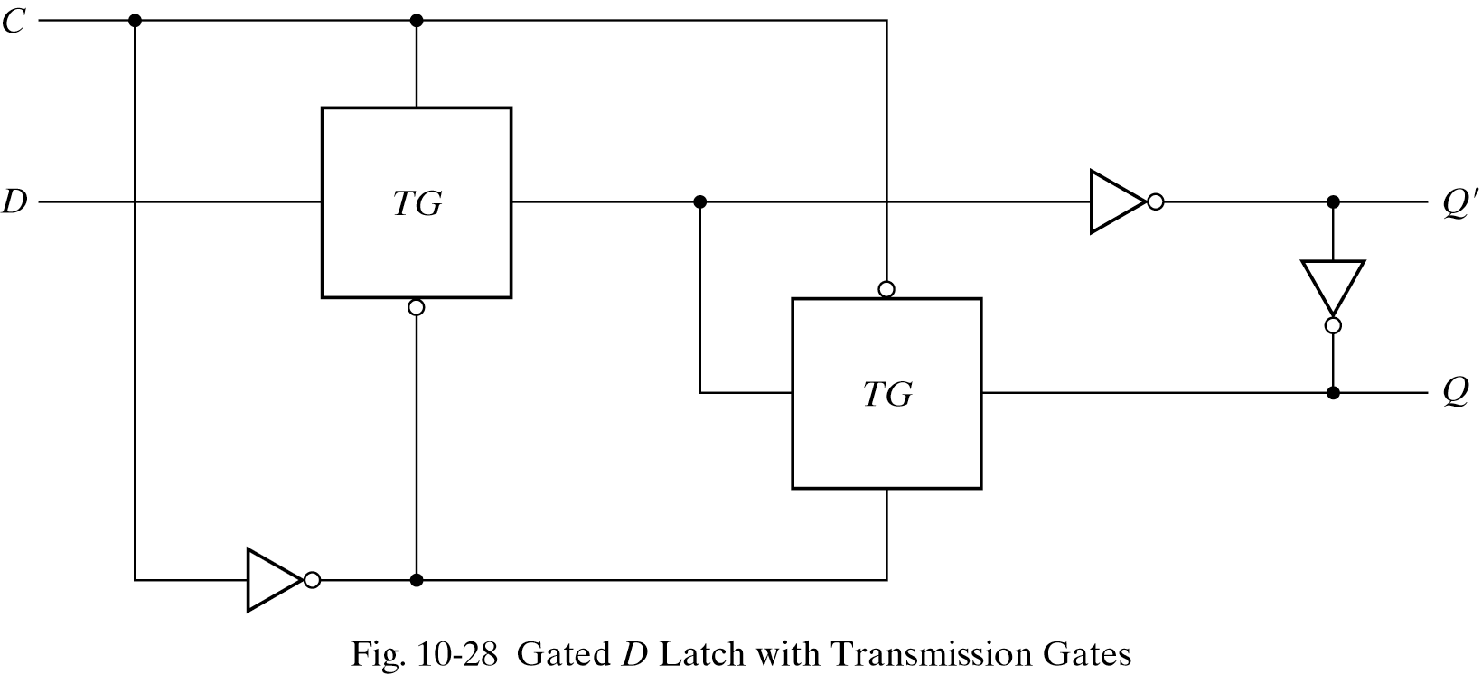
What about this one?
Gated D-latch!

Slide 12
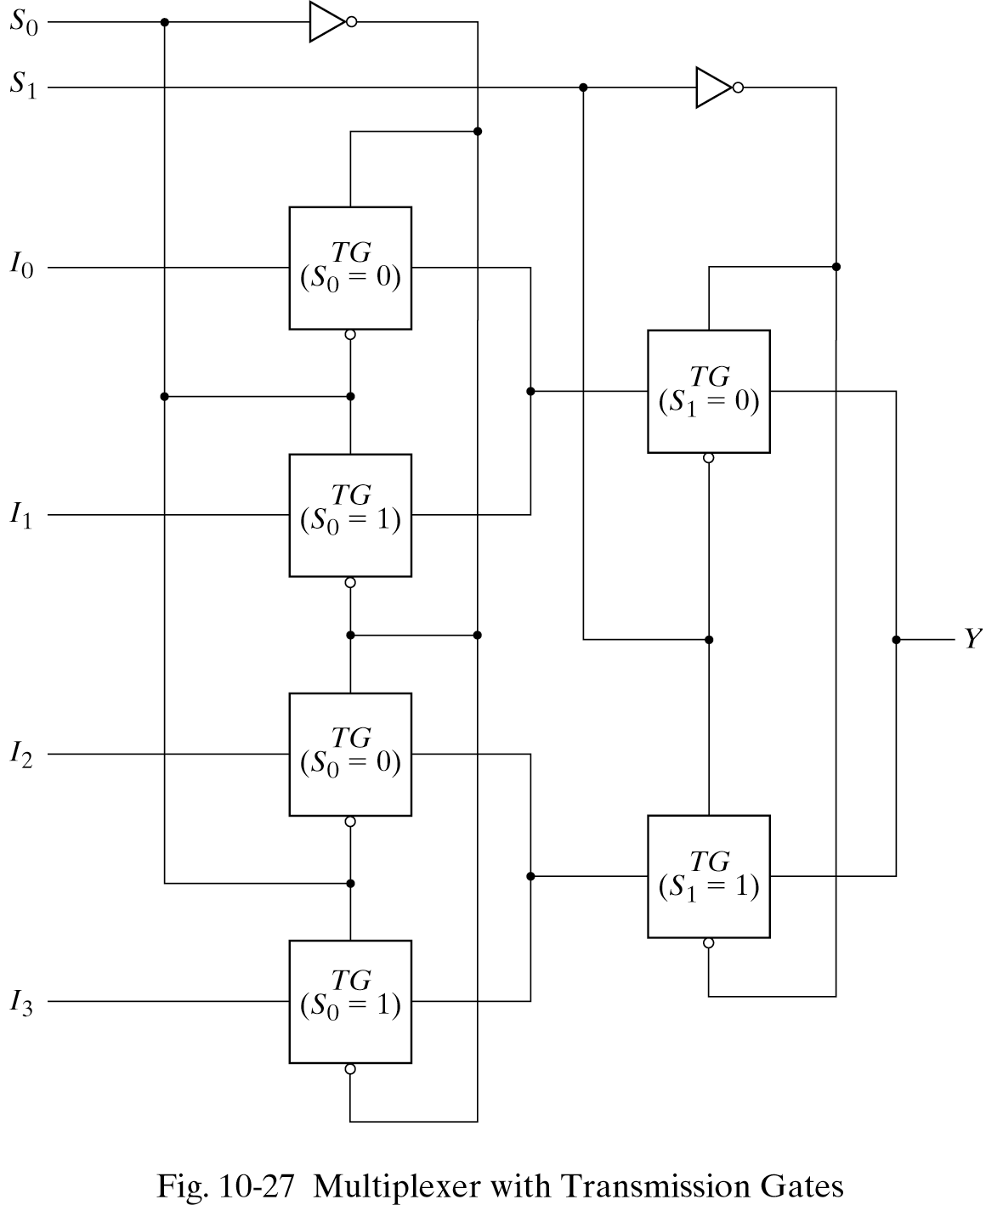
Build a mux with TGs (2-to-1 and 4-to-1)

