Slide 1
BITS Pilani Digital Design
Prof. GSS Chalapathi, Prof. Saurabh Gandhi (EEE department)

Slide 2
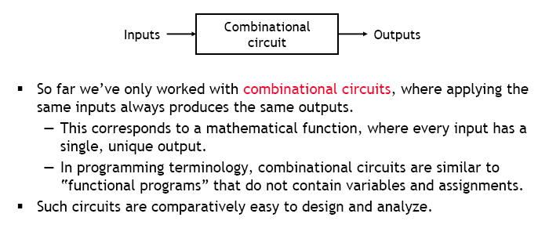
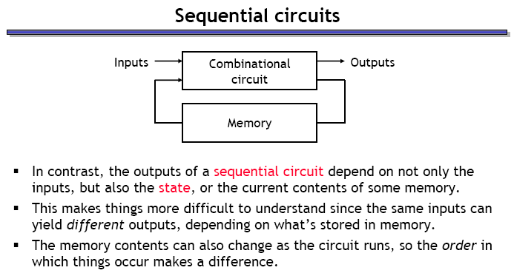
Sequential circuits

Slide 3
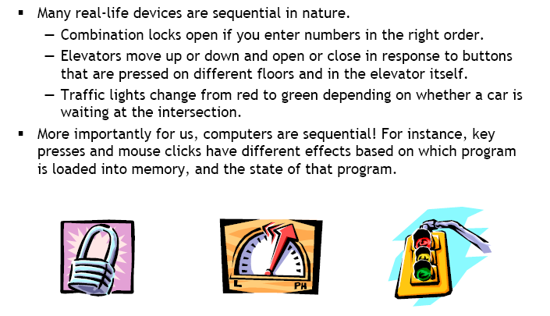
Examples of sequential devices

Slide 4
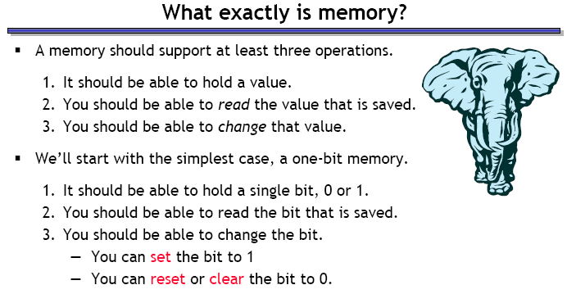
What is memory?

Slide 5
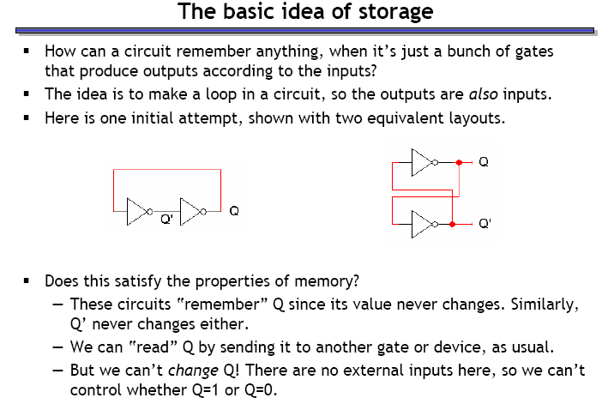
Storing a bit in a digital device

Slide 6
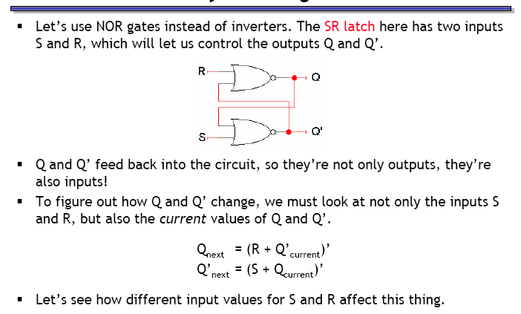
Storing a changeable bit in a device

Slide 7
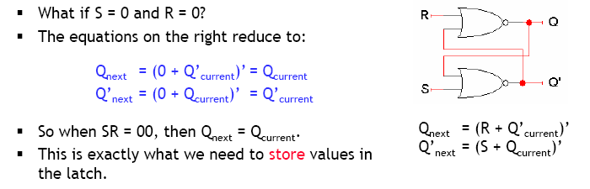
Storing a value (SR = 00)

Slide 8
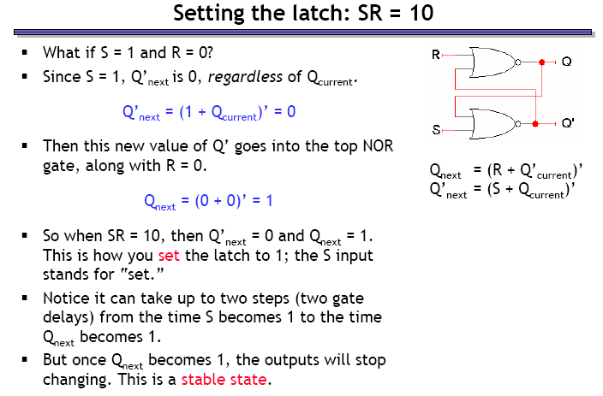
Setting the latch (SR = 10)

Slide 9
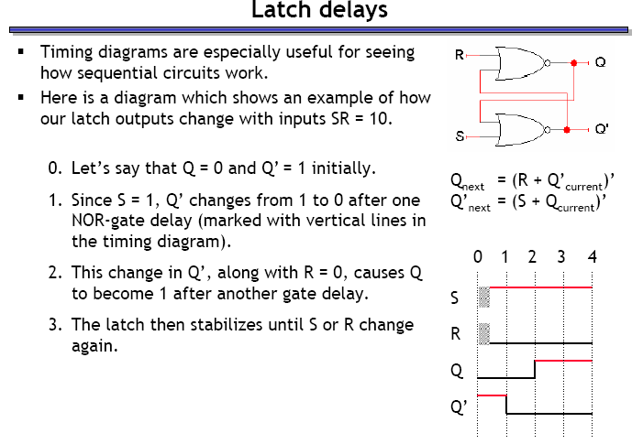
Latch delays

Slide 10
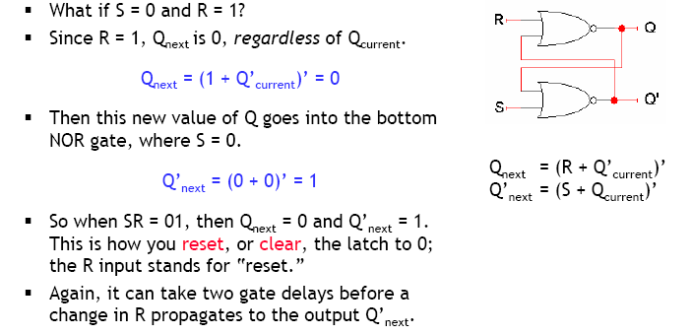
Resetting the latch (SR = 01)

Slide 11
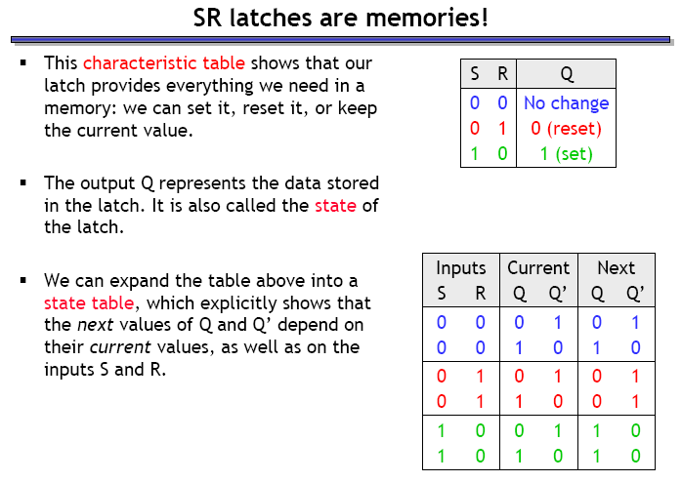
SR latch forms a memory unit

Slide 12
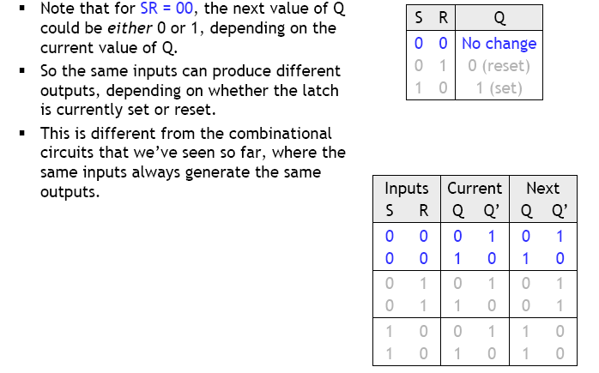
SR latches are sequential

Slide 13
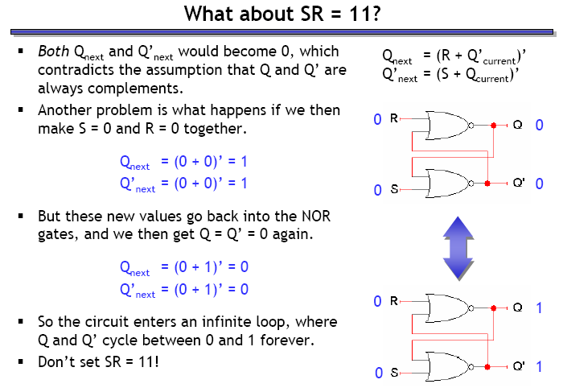
What happens when SR = 11?
The
Really?
This is the real purpose of your lab, go try it out!

