Slide 1


CoinBank - Digital Wallet Application
PG-DAC February 2025
Group 27
250241220188 Sneha Chunchuwar
25024122165 Samruddhi Pawar
Guide: Mrs. Monika Sindhikar

Slide 2
Abstract
Web-based digital wallet for secure currency transactions
Features: load funds, transfer money, withdraw funds
Front-end: React + Redux; Back-end: Spring Boot
Security via Spring Security & encrypted data storage
Modeled after services like Paytm; supports wallet top-up, P2P transfers, withdrawals

Slide 3
Introduction
Dynamic platform for secure digital financial operations
User Wallet Subsystem: for end-users
Admin Subsystem: for monitoring and account management
Tech Stack: React, Redux, Spring Boot, Spring Security
Payment Gateway: Razorpay integration

Slide 4
Purpose
Provide secure and user-friendly digital banking
Support for customers and admins
Features: registration, transactions, dashboards
Safe access with JWT-based authentication
Automate core banking functions

Slide 5
Scope
Platform for secure financial transactions
Peer-to-peer money transfers
Merchant payments
Recommendation models and transaction histories
Enhance customer satisfaction and trust

Slide 6
Objectives
Secure Digital Transactions
Real-Time Account Management
Enhanced User Experience
Robust Security & Access Control
Scalable Architecture
Comprehensive Reporting
Cost Optimization
Customer Engagement
Regulatory Compliance
Support for Future Growth

Slide 7
Key Functionalities
Separate login for admin & customer
Admin: add/update/delete customer details
Customer: online transactions, bill payments
Admin: monitor customer accounts
View transaction history
Profile management
Apply for FDs or loans
JWT authentication

Slide 8
Functional Requirements
User Management: registration, authentication, role-based access
Wallet Management: creation, linking, balance management
Transaction Processing: transfers, bill payments, receipts
Customer Management: profiles, rewards, support
Reporting & Analytics
Security: encryption, OTP, role-based access

Slide 9
Non-Functional Requirements
Performance: < 2 sec response, 50k+ concurrent users
Reliability: 99.9% uptime
Usability: clean, responsive UI
Maintainability: modular design
Testing: unit, integration, security, UAT

Slide 10
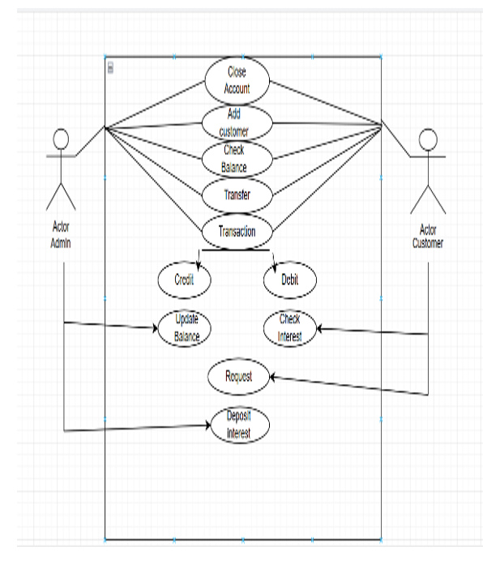
Use Case Diagram

Slide 11
Conclusion
Secure, efficient, user-centric wallet ecosystem
Empowers users with seamless financial interactions
Tech stack improved practical skills
Positioned for future growth & innovation

Slide 12
Future Scope
Cross-border payments
IoT & wearable integration
Contactless & NFC payments
Personal finance management features

