Slide 1


2023
Orlando FL, USA
Roar: A Router Microarchitecture for
In-network Allreduce
Ruiqi Wang, Dezun Dong, Fei Lei, Ke Wu, Junchao Ma, Kai Lu
NUDT, ChangSha, China
HiNA Lab: High Performance Networking and Architecture
Notes:
Good afternoon everyone.
I’m going to represent the authors to present their work about a router microarchitecture for in-network allreduce.
But don’t worry, I’m from the same research group as them, HiNA.

Slide 2
About us
High-performance Networking Architecture Research Group focuses on the design and optimization of interconnect communication system architecture.
High-performance computing (HPC)
Network on Chips, Inter-chip networks
Topology, routing and congestion control
RDMA network protocol stack
Cache optimization and instruction set extension
In-network computing
Large-scale system performance evaluation
MPI application performance optimization
NVMeoF, PM
SPMV, SPMM, HPCG optimization for CPU and accelerator
Data Center Network (DCN)
Congestion control (TCP and new proactive schemes)
Reconfigurable Network
Hardware offloading
Intelligent computing systems
Large-scale DL communication measurement
DL framework communication optimization
In-network intelligent computing
Compiler optimization, kernel fusion
Notes:
HiNA stands for High performance Networking Architecture.
Our research group focus on design and optimization of interconnect communication system architecture, including high-performance computing, data center network, and intelligent computing.
I know part of the details of this work, so I can answer some basic question.
As for some difficult question, maybe you have to mail the authors.

Slide 3
HiNA in ICS2023
Optimizing Multi-grid Computation and Parallelization on Multi-cores
Roar: A Router Microarchitecture for In-network Allreduce
GRAP: Group-level Resource Allocation Policy for Reconfigurable Dragonfly Network in HPC
Notes:
A total of three papers from HiNA are accepted by ICS.
The next report in this section is from our group.
And I’m its first author.

Slide 4
Talk Outline
Overview of In-network Allreduce
Roar’s Architecture Odyssey
Evaluations
Notes:
This presentation is divided into three parts.

Slide 5
Talk Outline
Overview of In-network Allreduce
Roar’s Architecture Odyssey
Evaluations
Notes:
I will start from an overview of the allreduce operation,
and the in-network computing to accelerate this operation.

Slide 6
The Allreduce Operation
Vectors
0
3
5
0
20
23
1
7
8
1
20
23
Rank
allreduce
2
6
1
2
20
23
summation
3
4
9
3
20
23
The most significant operation in collective communication [1].
[1] Characterization of MPI usage on a production supercomputer (SC’18).
Notes:
Allreduce is the most significant operation in collective communication, in terms of usage and time.
Allreduce is widely used in scientific applications and Distributed Machine Learning.
It collects data from all hosts, aggregates the data, and broadcasts the results back to the hosts.
The available aggregation functions include calculating the summation of elements, finding the maximum or minimum value.

Slide 7
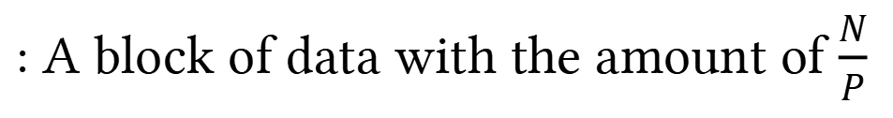
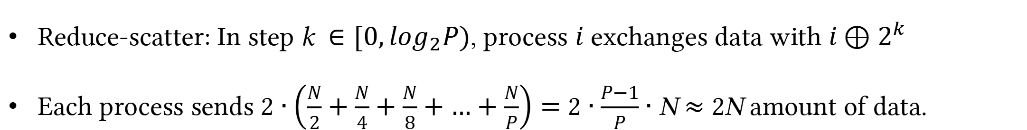
Rabenseifner Algorithm for Allreduce
Reduce-scatter
Allgather
Process 0
0
1
2
3
0
1
0
0
1
0
1
2
3
Process 1
0
1
2
3
2
3
2
2
3
0
1
2
3
P
Process 2
0
1
2
3
0
1
1
0
1
0
1
2
3
Process 3
0
1
2
3
2
3
3
2
3
0
1
2
3
Initial data
Interim results
Fully aggregated results
N
: A block of data with the amount of $\frac{N}{P}$
i
Reduce-scatter: In step k$∈[0,\log_{2}P)$, process $i$ exchanges data with ${i⊕2}^{k}$
Each process sends 2 $∙\left(\frac{N}{2}+\frac{N}{4}+\frac{N}{8}+…+\frac{N}{P}\right)=$ 2 $∙\frac{P−1}{P}∙$ N $≈$ 2N amount of data.
Notes:
Rabenseifner algorithm is one of the bandwidth-optimal algorithms for allreduce.
This algorithm breaks allreduce into two phases, that is reduce-scatter and allgather.
For reduce-scatter, in step “K”, process “i” exchange data with the process of i xor the k-th power of two.
And allgather is the reversed procedure of reduce-scatter.
Therefore, as shown in this formula above, each process totally sends two_”N” amount of data.

Slide 8


In-network Computing
Reduction Tree
Rt.
Rt.
Rt.
Rt.
Rt.
Rt.
Rt.
Rt.
Host
Host
Host
Host
Host
Host
Host
Host
N
N
N
N
N
N
N
N
Routers and hosts are organized into a reduction tree.
Allreduce is offloaded from hosts to routers.
Notes:
Allreduce can be accelerated by in-network computing.
To achieve this, a network manager organizes routers and hosts into a logical reduction tree.
The routers will be intermediate nodes,
and the hosts will be leaves.
Then, the allreduce operation is offloaded from hosts to the routers.

Slide 9


In-network Computing
N
Fully
aggregated
Interim result
Interim result
Rt.
Rt.
Rt.
Rt.
Rt.
Rt.
N
Rt.
Rt.
N
Rt.
Rt.
Rt.
Rt.
Host
Host
Host
Host
Host
Host
Host
Host
Host
Host
Host
Host
Host
Host
Host
Host
N
N
N
N
N
N
N
N
Initial data
In-network allreduce
The amount of data sent by each process is only N (half of that of Rabenseifner).
Notes:
The routers on the reduction tree collect data from their children and then aggregate the results.
And the interim results will be forward to their parents.
This procedure continues until the full aggregation is complete at the root.
After that, the fully aggregated data is broadcasted down the tree level by level.
Finally, all hosts will receive the fully aggregated results.
It is worth noting that each process only sends N amount of data, which is only half of the previous Rabenseifner.

Slide 10
Advantages in In-network Computing
N
Fully
aggregated
Interim result
Interim result
Rt.
Rt.
Rt.
Rt.
Rt.
Rt.
N
Rt.
Rt.
N
Rt.
Rt.
Rt.
Rt.
Host
Host
Host
Host
Host
Host
Host
Host
Host
Host
Host
Host
Host
Host
Host
Host
N
N
N
N
N
N
N
N
Initial data
In-network allreduce
2x improvement in bandwidth.
Congestion alleviation.
More computation-communication overlap.
Notes:
There are three advantages if we use in-network computing.
The first advantage is bandwidth improvement.
Host-based allreduce requires each host to send two_”N” amount of data.
However, in-network allreduce requires each host to send only N amount of data, which achieves a 2 times improvement in bandwidth.
The second advantage is congestion alleviation.
In-network allreduce reduces the number of packets traveling through the network, thus alleviate the load of network.
The third advantage is more computation and communication overlap.
Hosts are relieved of allreduce operation.
It allows hosts to perform other useful tasks.

Slide 11
Existing In-network Allreduce Solutions
In NIC
In-network allreduce
Programmable
In switch
Fixed-function
Roar
Host
Host
Host
Host
Notes:
Existing in-network solutions offload allreduce into NICs or switches.
Solutions offloading allreduce into switches fall into two main categories.
The first type is based on programmable switches which prioritize flexibility.
The second type relies on fixed-function switches, which prioritize high performance.
Our solution belongs to fixed-function switches.

Slide 12
Challenges
Challenge 1: High throughput.
Challenge 2: Large message aggregation.
Challenge 3: Repeatable results.
Notes:
There are several common challenges when designing an in-network allreduce solution, including high throughput, large message aggregation and repeatable results.
To produce repeatable results, it is necessary that the computed results remain unchanged across different runs.
In the following sections, I will provide a detailed explanation of how we address these challenges in our architecture.

Slide 13
Talk Outline
Overview of In-network Allreduce
Roar’s Architecture Odyssey
Evaluations
Notes:
In this section, I will present a comprehensive overview of our proposed architecture for in-network allreduce.

Slide 14
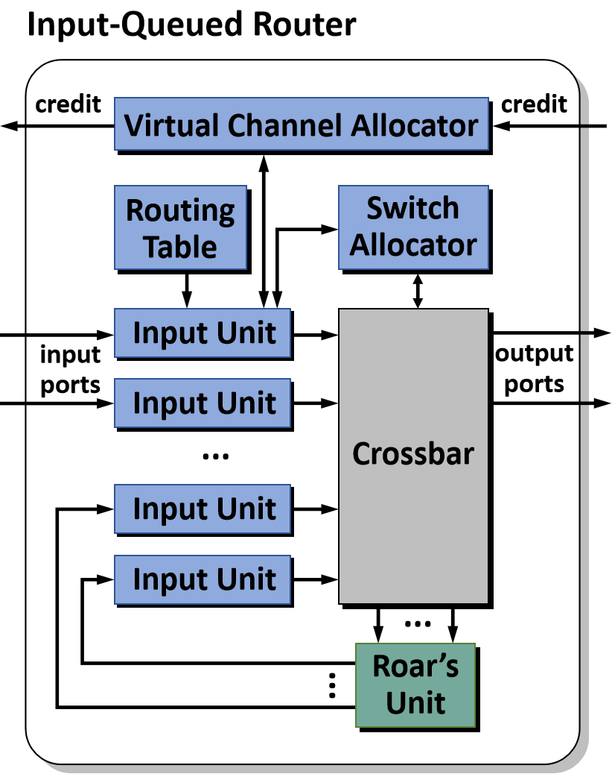
Roar’s Architecture Odyssey
Rt.
Rt.
Rt.
Host
Host
Host
Host
N
N
N
N
An enhancement to a standard router.
Regular network functions of the router are NOT affected by Roar.
Notes:
In this work, we design a router microarchitecture, named Roar, to accelerate allreduce.
The added Roar’s unit, the green one in the right corner, is an enhancement to a standard Input-Queued router and does not affect any other regular network functions of the router.

Slide 15
Roar’s Architecture Odyssey
Rt.
Rt.
Rt.
Host
Host
Host
Host
N
N
N
N
Roar’s unit: Developed on the foundation of the RDMA NIC (RNIC), can establish reliable connections and transmit data with end hosts.
Roar add bit fields to the current RDMA protocol.
Notes:
The Roar's unit is developed on the foundation of the RDMA NIC, it can establish reliable connections and transmit data with end hosts.
It is similar to how RNICs works.
At the network protocol level, we add bit fields to the current RDMA protocol.

Slide 16
Roar’s Architecture Odyssey
credit
credit
Normal data: Routed to an output port.
Data for aggregation: Routed into Roar’s unit. Aggregated result goes back to input units and is forwarded to the next hop.
Virtual Channel Allocator
Routing
Table
Switch
Allocator
data
Input Unit
input
ports
output
ports
data
Input Unit
...
Crossbar
Input Unit
Input Unit
...
...
Roar’s
Unit
Notes:
Data is routed to output ports directly or to Roar’s unit depending on whether it needs to be aggregated or not.
Normal data is directly routed to an output port.
And data requiring aggregation is routed to Roar’s unit.
The aggregated result goes back to the router input units and is then forwarded to next hop.
In the router, incoming packet obtain their destination ports from the routing table.
The destination of the aggregation data is the router itself.
Through this process, the router can distinguish between normal data and data for aggregation by checking the destination identifier.

Slide 17
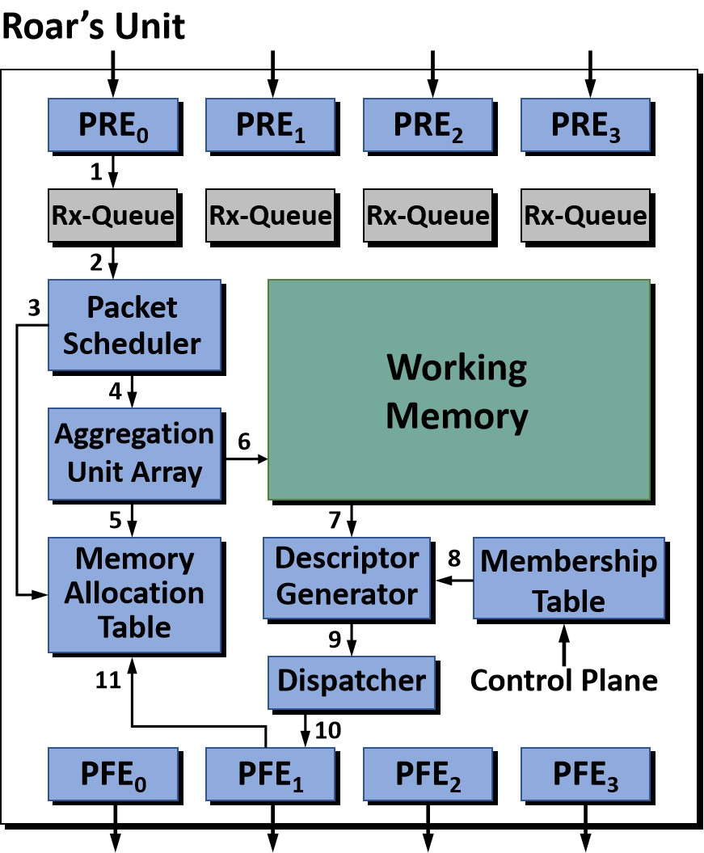
Roar’s Architecture Odyssey
Roar integrates multiple Packet Receiving Engines (PREs), each connected to the crossbar.
Notes:
Roar integrates multiple Packet Receiving Engines, they are the “PRE”s in the right figure, connected to the crossbar output port.
These Packet Receiving Engines are responsible for assembling flits into packets.
Then, the assembled packets are stored in the Rx-Queues before aggregation.
A credit based flow control implemented by the network can achieve high efficiency with limited buffer resources.

Slide 18
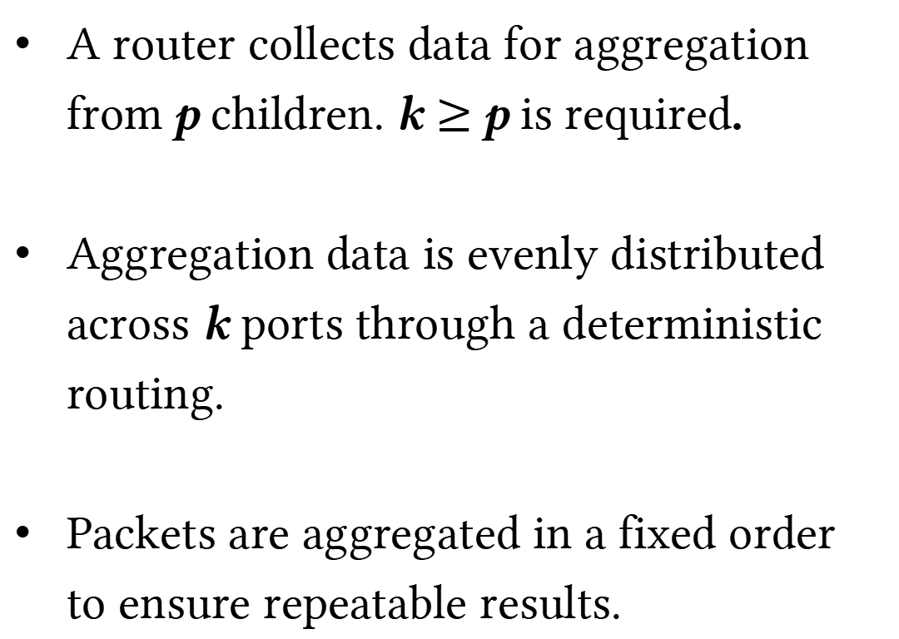
Roar’s Architecture Odyssey
credit
credit
Virtual Channel Allocator
A router collects data for aggregation from p children. k $≥$ p is required.
Aggregation data is evenly distributed across k ports through a deterministic routing.
Packets are aggregated in a fixed order to ensure repeatable results.
Routing
Table
Switch
Allocator
Input Unit
p ports
output
ports
Input Unit
...
Crossbar
Input Unit
k ports
Input Unit
...
...
Roar’s
Unit
Notes:
When a router is collecting aggregation data from “P” children,
and connecting Roar‘s unit by “K” ports,
then “K” should be no less than “P”.
The data is routed to the fixed receive buffers using deterministic routing,
and Roar can then aggregate the packets in a fixed order to ensure repeatable results.

Slide 19
Roar’s Architecture Odyssey
credit
credit
Virtual Channel Allocator
Routing
Table
Switch
Allocator
Otherwise, collecting data from different children would CONGEST a port between the crossbar unit and Roar’s unit.
Such architecture might only be efficient for small message allreduce.
Input Unit
input
ports
output
ports
Input Unit
...
Crossbar
Input Unit
Congestion occurs!
Roar’s
Unit
Notes:
Otherwise, if Roar’s unit is connected to crossbar by a few ports,
collecting data from different children will congest between the crossbar unit and and Roar`s unit,
which will decrease the performance.
In such situation, the architecture would only be efficient for small message allreduce.

Slide 20
Roar’s RDMA Protocol
RDMA-put descriptor
destId
destEvt
srcEvt
rdmaw
collFlag
reduce
resv
20 bits
1 bit
1 bit
1 bit
1 bit
1 bit
39 bits
dataLen
dataBit
opCode
jobId
resv
27 bits
1 bits
4 bits
20 bits
12 bits
srcAddr (64 bits)
destAddr (64 bits)
src_evt_cookie_0 (64 bits)
srt_evt_cookie_1 (64 bits)
dest_evt_cookie_0 (64 bits)
dest_evt_cookie_1 (64 bits)
Each descriptor is a Working Queue Element, which is used to issue an RDMA operation.
Notes:
Roar is designed for RDMA networks.
It uses an RDMA protocol to improve the throughput.
Each descriptor is a Working Queue Element, which is used to issue an RDMA operation.
The descriptor records information of the data, for example the destination node and the remote memory address to write data.
Roar uses RDMA-put for in-network allreduce.
The sender and the receiver use Queue Pair to connect endpoints.

Slide 21
Roar’s RDMA Protocol
destId
head
tail
crcErr
pktType
collFlag
pktLen
pktId
resv
20 bits
1 bit
1 bit
1 bit
4 bits
1 bit
9 bits
19 bits
8 bits
destAddr (64 bits)
srcId
rdmaw
reduce
jobId
dataBit
opCode
resv
flitCnt
20 bits
1 bit
1 bit
20 bits
1 bit
4 bits
13 bits
4 bits
Header’s Format
（24 bytes）
Packet header
256 bytes payload
RDMA packets are generated in Packet Forwarding Engines (PFEs).
Notes:
Upon receiving a descriptor, RDMA packets are generated in Packet Forwarding Engines.
The destination identifier and remote memory address for writing data are specified as fields in the packet header.

Slide 22
Roar’s RDMA Protocol
Packet header
256 bytes payload
10 body flits
head flit
body flit
body flit
...
body flit
tail flit
Payload data
Control
Message
An RDMA packet is divided into flits before sent back to router.
Notes:
Before being sent to the router, an RDMA packet is divided into flits.
The control message is included in the head flit, while the payload data is carried in the body flits and tail flit.

Slide 23
Roar’s Data Aggregation
data out
data
Working
Memory
Block 0
Block 1
...
Block k
data in
Concat
4KB
4KB
4KB
512 bits
Address
Generator
FP64/32
FP64/32
FP64/32
FP ALU
ALU
fun.
FP ALU
ALU
fun.
...
FP ALU
ALU
fun.
ALU A
ALU B
ALU A
ALU B
ALU A
ALU B
Split
Split
512 bits
512 bits
jobId
pktId
opCode
reduce
Mux
0
Header
Payload (256 bytes)
Payload data and temporary results are aggregated through parallel FP ALUs.
Notes:
To aggregate data, the packet payload and temporary results offered by the working memory are aggregated through parallel FP ALUs.

Slide 24
Roar’s Data Aggregation
data out
data
Working
Memory
Block 0
Block 1
...
Block k
data in
Concat
4KB
4KB
4KB
512 bits
Address
Generator
FP64/32
FP64/32
FP64/32
FP ALU
ALU
fun.
FP ALU
ALU
fun.
...
FP ALU
ALU
fun.
ALU A
ALU B
ALU A
ALU B
ALU A
ALU B
Split
Split
512 bits
512 bits
jobId
pktId
opCode
reduce
Mux
0
Header
Payload (256 bytes)
opCode serves as the ALU function specifier to support different reduction operations.
Notes:
The “Operation Code” serves as the ALU function specifier to support different reduction operations.
INT 8/16
精度转换

Slide 25
Roar’s Memory Management
Memory
Allocation
Table
grpId 0
grpId 1
...
grpId k
...
T
Cnt 0
Cnt 1
Cnt k
Working
Memory
Block 0
Block 1
...
Block k
4KB
4KB
4KB
Aggregated results are forwarded in the granularities of 4KB blocks.
Memory Allocation table monitors the aggregation status for each block.
Notes:
To fully utilize the bandwidth, aggregated results are forwarded in granularities of 4 Kilo Bytes blocks, rather than packet-level RDMA operations.
To monitor the aggregation status, the Memory Allocation Table assigns an aggregation counter for each block.
The counter increments upon the aggregation of a packet until reaching the specified threshold.
Roar allows each router to participate in simultaneous allreduce jobs, with each job assigned a unique identifier.
Different memory partitions are accessed based on the job identifier and each allreduce job occupies a fixed size of memory.

Slide 26
Straight-forward Approach
Packets receiving
20 KB
Results forwarding
20 KB
Time
Forwards results only after all packets have been received.
Notes:
This figure shows a straight-forward approach of packet receiving and results forwarding.
The aggregated results are forwarded only after all packets have been received and calculated.

Slide 27
Roar’s Memory Management
Packets receiving
4 KB
4 KB
4 KB
4 KB
4 KB
Results forwarding
4 KB
4 KB
4 KB
4 KB
4 KB
Time
The data is divided into multiple blocks.
Notes:
To improve the throughput, an entire data flow can be divided into multiple blocks and be pipelined.

Slide 28
Roar’s Memory Management
Packets receiving
4 KB
4 KB
4 KB
4 KB
4 KB
Results forwarding
4 KB
4 KB
4 KB
4 KB
4 KB
Time
These two steps can be overlapped, leading to a 2x improvement in throughput.
Notes:
The pipelining approach can achieves a two times improvement in throughput by overlapping packet receiving and result forwarding.
Additionally, this approach can also reduce memory occupancy because it eliminates the need to store all results before forwarding them.
The memory management and a credit-based flow control implemented in our architecture enable efficient large message aggregation with limited memory resources.

Slide 29
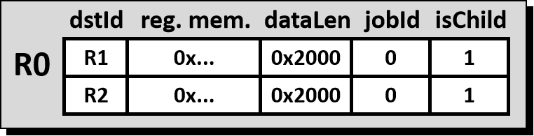
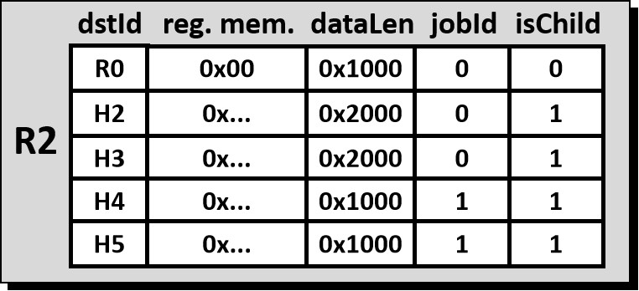
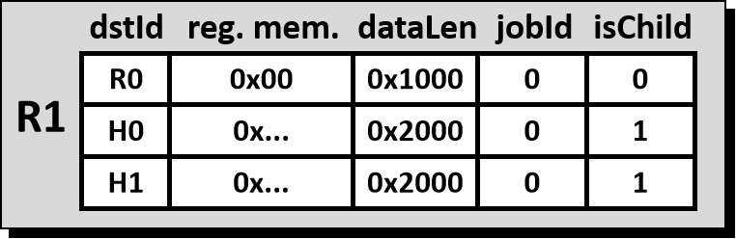
Supporting Reduction Trees in Roar
R0
R1
R2
H0
H1
H2
H3
H4
H5
The Membership Tables determine where the results should be forwarded to, providing the logical view of reduction trees.
Notes:
In-network allreduce relies on reduction trees for data aggregation.
The Membership Tables determine where the results should be forwarded to, providing the logical view of reduction trees.
Roar allows each router to participate in multiple allreduce jobs simultaneously, with each job occupying a fixed amount of memory.
As the memory resources are limited, if a router on the reduction tree is already managing the maximum number of allreduce jobs, it will reject any new requests.
To provide a clear illustration, I will present an example with only one reduction tree.

Slide 30
Supporting Reduction Trees in Roar
R0
dstId
reg. mem.
dataLen
jobId
isChild
R0
0x00
0x1000
0
0
R1
R2
R1
H0
0x...
0x2000
0
1
H1
0x...
0x2000
0
1
H0
H1
H2
H3
H4
H5
dstId: The destination of the forwarding block;
registered memory : The memory location to write data;
dataLen: Remaining size of the data to be forwarded;
jobID: Distinguish different allreduce tasks;
isChild: Upward or broadcast
Notes:
The first field, “dstID”, is the destination identifier of the forwarding block.
The second field, “registered memory” records the memory location to write data.
The third field, “dataLen” stands for the remaining size of the data to be forwarded.
The forth field, “jobID”, is used to distinguish different allreduce tasks.
The last field, “isChild”, represents the data that use this entry needs to be routed upward of broadcast downward.

Slide 31
Supporting Reduction Trees in Roar
R0
dstId
reg. mem.
dataLen
jobId
isChild
R0
0x00
0x1000
0
0
R1
R2
R1
H0
0x...
0x2000
0
1
H1
0x...
0x2000
0
1
H0
H1
H2
H3
H4
H5
R0
0x00
0x0000
0
0
R1 forwards a block of interim results to its parent R0.
dataLen: 0x1000 → 0x0000 (decreased by a block size).
Notes:
For example, “R”_one forwards a block of interim results to its parent R zero.
“dataLen” is decreased by a block size.

Slide 32
Supporting Reduction Trees in Roar
R0
dstId
reg. mem.
dataLen
jobId
isChild
R0
0x00
0x0000
0
0
R1
R2
R1
H0
0x...
0x2000
0
1
H1
0x...
0x2000
0
1
H0
H1
H2
H3
H4
H5
R1 removes the entry with dataLen == 0.
Notes:
And then the “dataLen” field is equal to zero, thus this entry is removed from the table.

Slide 33
Supporting Reduction Trees in Roar
R0
dstId
reg. mem.
dataLen
jobId
isChild
R0
0x00
0x1000
0
0
R1
R2
R1
H0
0x...
0x2000
0
1
H1
0x...
0x2000
0
1
H0
H1
H2
H3
H4
H5
H0
0x...
0x1000
0
1
H1
0x...
0x1000
0
1
R1 concurrently broadcasts a fully aggregated block to its children H0 and H1
Notes:
“R”_one can concurrently broadcast a fully aggregated block to its children “H”_zero and “H”_one.
And the “dataLen” is decreased similarly.

Slide 34
Supporting Reduction Trees in Roar
dstId
reg. mem.
dataLen
jobId
isChild
R0
R1
0x00
0x2000
0
1
R0
R2
0x00
0x2000
0
1
R1
R2
R0
0x00
0x1000
0
1
H0
H1
H2
H3
H4
H5
R1
0x00
0x1000
0
1
The root node of the job only broadcasts results to children.
Notes:
For the root node of each job, it only broadcasts results to its children.

Slide 35
An Example of Stream Aggregation
Initial data
dstId
reg. mem.
dataLen
jobId
isChild
R1
0x00
0x5000
0
1
Temporary result
R0
R2
0x00
0x5000
0
1
Fully aggregated
R0
dstId
reg. mem.
dataLen
jobId
isChild
R0
0x00
0x5000
0
0
R1
R2
R1
H0
0x...
0x5000
0
1
H1
0x...
0x5000
0
1
H0
H1
H2
H3
H4
H5
Notes:
To show the whole procedure of stream aggregation, these slides shows a detailed example to illustrate how data flows in the reduction tree.
A router can forward temporary results to its parent while broadcasting fully aggregated blocks to its children at the same time.
This procedure continues until all hosts receive the fully aggregated data.
By achieving pipelined aggregation, our architecture is capable of large message aggregation.
检查动画里的数据！

Slide 36
An Example of Stream Aggregation
Initial data
dstId
reg. mem.
dataLen
jobId
isChild
R1
0x00
0x5000
0
1
Temporary result
R0
R2
0x00
0x5000
0
1
Fully aggregated
R0
dstId
reg. mem.
dataLen
jobId
isChild
R0
0x00
0x4000
0
0
R1
R2
R1
H0
0x...
0x5000
0
1
H1
0x...
0x5000
0
1
H0
H1
H2
H3
H4
H5
Notes:
To show the whole procedure of stream aggregation, these slides shows a detailed example to illustrate how data flows in the reduction tree.
A router can forward temporary results to its parent while broadcasting fully aggregated blocks to its children at the same time.
This procedure continues until all hosts receive the fully aggregated data.
By achieving pipelined aggregation, our architecture is capable of large message aggregation.

Slide 37
An Example of Stream Aggregation
Initial data
dstId
reg. mem.
dataLen
jobId
isChild
R1
0x00
0x4000
0
1
Temporary result
R0
R2
0x00
0x4000
0
1
Fully aggregated
R0
dstId
reg. mem.
dataLen
jobId
isChild
R0
0x00
0x3000
0
0
R1
R2
R1
H0
0x...
0x5000
0
1
H1
0x...
0x5000
0
1
H0
H1
H2
H3
H4
H5
Notes:
To show the whole procedure of stream aggregation, these slides shows a detailed example to illustrate how data flows in the reduction tree.
A router can forward temporary results to its parent while broadcasting fully aggregated blocks to its children at the same time.
This procedure continues until all hosts receive the fully aggregated data.
By achieving pipelined aggregation, our architecture is capable of large message aggregation.

Slide 38
An Example of Stream Aggregation
Initial data
dstId
reg. mem.
dataLen
jobId
isChild
R1
0x00
0x3000
0
1
Temporary result
R0
R2
0x00
0x3000
0
1
Fully aggregated
R0
dstId
reg. mem.
dataLen
jobId
isChild
R0
0x00
0x2000
0
0
R1
R2
R1
H0
0x...
0x4000
0
1
H1
0x...
0x4000
0
1
H0
H1
H2
H3
H4
H5
Notes:
To show the whole procedure of stream aggregation, these slides shows a detailed example to illustrate how data flows in the reduction tree.
A router can forward temporary results to its parent while broadcasting fully aggregated blocks to its children at the same time.
This procedure continues until all hosts receive the fully aggregated data.
By achieving pipelined aggregation, our architecture is capable of large message aggregation.

Slide 39
An Example of Stream Aggregation
Initial data
dstId
reg. mem.
dataLen
jobId
isChild
R1
0x00
0x2000
0
1
Temporary result
R0
R2
0x00
0x2000
0
1
Fully aggregated
R0
dstId
reg. mem.
dataLen
jobId
isChild
R0
0x00
0x1000
0
0
R1
R2
R1
H0
0x...
0x3000
0
1
H1
0x...
0x3000
0
1
H0
H1
H2
H3
H4
H5
Notes:
To show the whole procedure of stream aggregation, these slides shows a detailed example to illustrate how data flows in the reduction tree.
A router can forward temporary results to its parent while broadcasting fully aggregated blocks to its children at the same time.
This procedure continues until all hosts receive the fully aggregated data.
By achieving pipelined aggregation, our architecture is capable of large message aggregation.

Slide 40
An Example of Stream Aggregation
Initial data
dstId
reg. mem.
dataLen
jobId
isChild
R1
0x00
0x1000
0
1
Temporary result
R0
R2
0x00
0x1000
0
1
Fully aggregated
R0
dstId
reg. mem.
dataLen
jobId
isChild
R0
0x00
0x0000
0
0
R1
R2
R1
H0
0x...
0x2000
0
1
H1
0x...
0x2000
0
1
H0
H1
H2
H3
H4
H5
Notes:
To show the whole procedure of stream aggregation, these slides shows a detailed example to illustrate how data flows in the reduction tree.
A router can forward temporary results to its parent while broadcasting fully aggregated blocks to its children at the same time.
This procedure continues until all hosts receive the fully aggregated data.
By achieving pipelined aggregation, our architecture is capable of large message aggregation.

Slide 41
An Example of Stream Aggregation
Initial data
dstId
reg. mem.
dataLen
jobId
isChild
R1
0x00
0x0000
0
1
Temporary result
R0
R2
0x00
0x0000
0
1
Fully aggregated
R0
dstId
reg. mem.
dataLen
jobId
isChild
R1
R1
R2
H0
0x...
0x1000
0
1
H1
0x...
0x1000
0
1
H0
H1
H2
H3
H4
H5
Notes:
To show the whole procedure of stream aggregation, these slides shows a detailed example to illustrate how data flows in the reduction tree.
A router can forward temporary results to its parent while broadcasting fully aggregated blocks to its children at the same time.
This procedure continues until all hosts receive the fully aggregated data.
By achieving pipelined aggregation, our architecture is capable of large message aggregation.

Slide 42
An Example of Stream Aggregation
Initial data
dstId
reg. mem.
dataLen
jobId
isChild
Temporary result
R0
Fully aggregated
R0
dstId
reg. mem.
dataLen
jobId
isChild
R1
R1
R2
H0
0x...
0x0000
0
1
H1
0x...
0x0000
0
1
H0
H1
H2
H3
H4
H5
An allreduce job is finished.
Notes:
To show the whole procedure of stream aggregation, these slides shows a detailed example to illustrate how data flows in the reduction tree.
A router can forward temporary results to its parent while broadcasting fully aggregated blocks to its children at the same time.
This procedure continues until all hosts receive the fully aggregated data.
By achieving pipelined aggregation, our architecture is capable of large message aggregation.

Slide 43
Supporting Reduction Trees in Roar
Two-level pipeline:
Rt.
Step 1
Step 2
Packets receiving
4 KB
4 KB
4 KB
4 KB
4 KB
Rt.
Results forwarding
4 KB
4 KB
4 KB
4 KB
4 KB
Host
Host
8 KB
Time
Step 1 requires 2 blocks (8 KB), with one block for aggregation and an already-aggregated block waited to be forwarded.
Step 2 also requires 8 KB, resulting in a memory occupancy of 16 KB per job.
Notes:
As packet reception and result forwarding are overlapped procedures, forming a two-level pipeline, thus Step one requires 2 blocks, with one block for aggregation and an already-aggregated block waited to be forwarded. Step 2 also requires 8 Kilo Bytes, resulting in a memory occupancy of 16 Kilo Bytes per job.

Slide 44
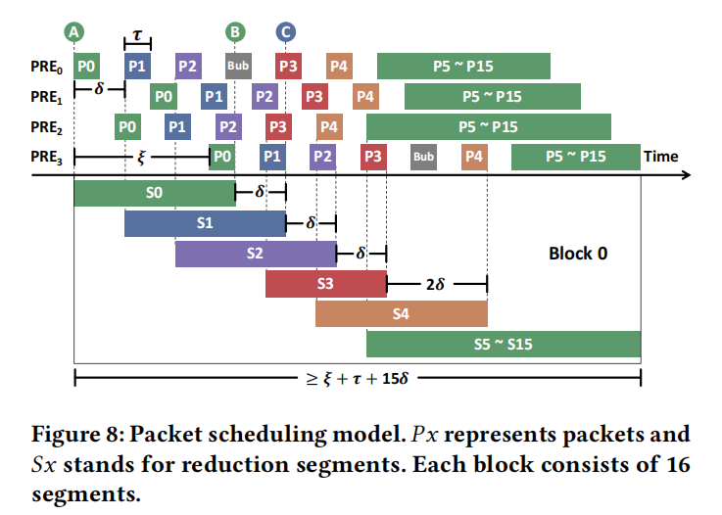
Architecture Optimization
Optimization model: Little’s law.
Reduce memory occupancy: Adjust packet aggregation order and set the block size to 4 KB.
Notes:
Because the system is stable and non-preemptive, we can use little`s law to estimate the memory occupancy for each allreduce job.
Using this model, we can reduce memory occupancy by adjusting packet aggregation order and setting the block size to 4 Kilo Bytes.
This block size strikes an optimal balance between performance and costs.
For a more comprehensive analysis, please refer to the paper.

Slide 45
Talk Outline
Overview of In-network Allreduce
Roar’s Architecture Odyssey
Evaluations
Notes:
Followed by the introduction of our method is evaluations.

Slide 46
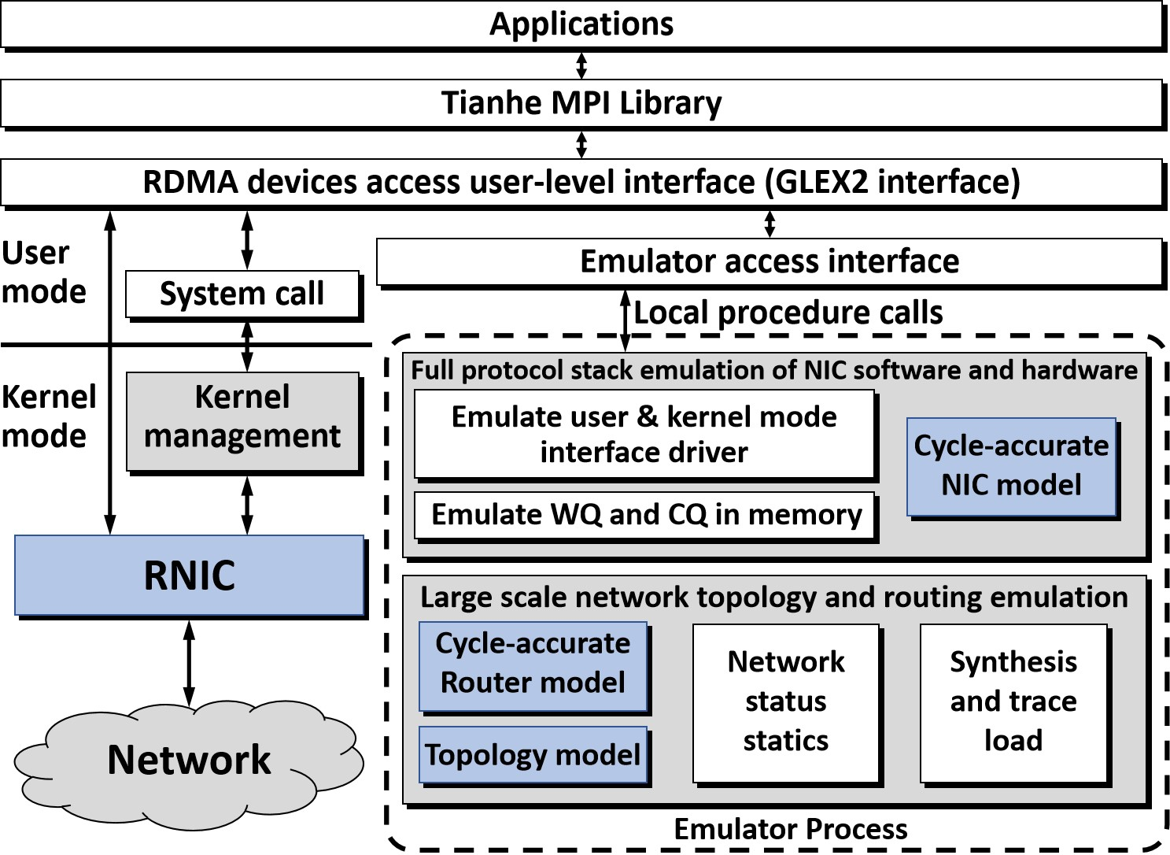
Evaluation Platform
Our self-developed in-house emulator.
Notes:
We use our self-developed in-house emulator to implement and evaluate our approach.

Slide 47
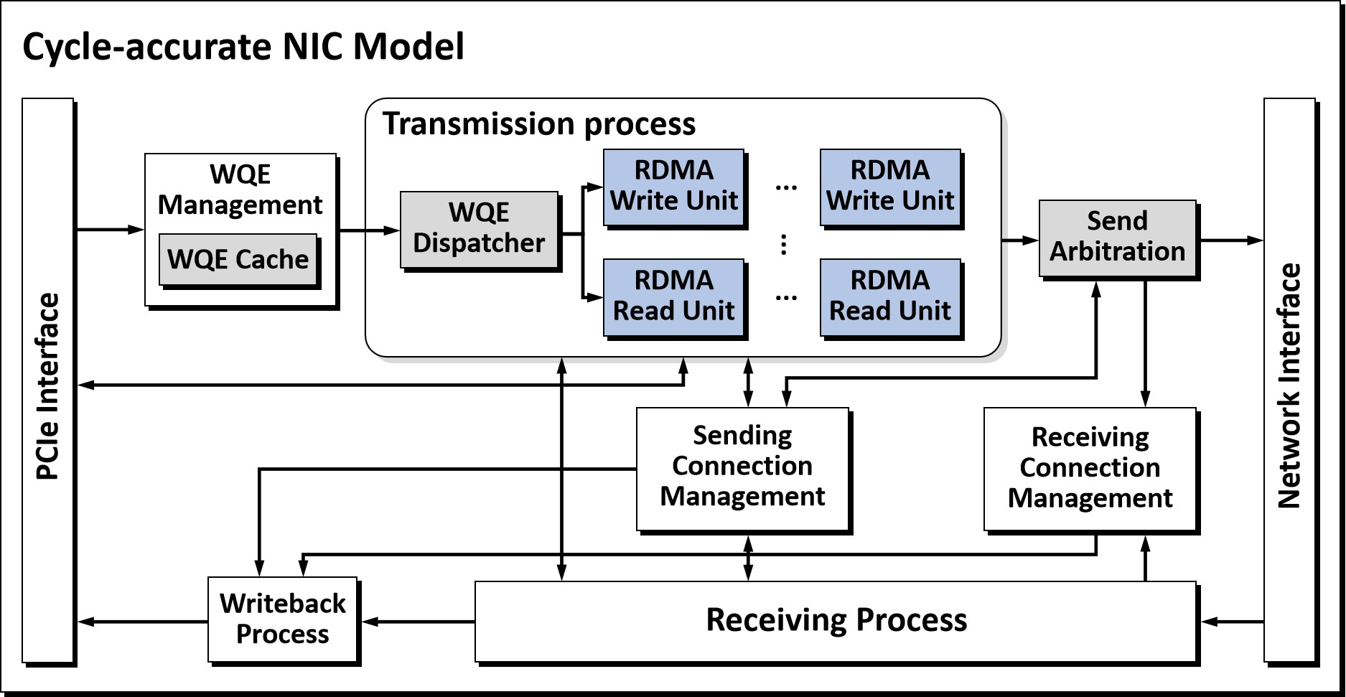
Evaluation Platform: RNIC Model
Roar’s behavior can be faithfully emulated by the RNIC and the router model.
Notes:
Our emulator includes a cycle-accurate RNIC model and several cycle-accurate router models.
The emulator places significant emphasis on implementing routers and RNICs in a hardware-realistic manner.
Therefore, Roar's behavior can be faithfully emulated by the RNIC and router model.

Slide 48
Evaluation Platform: RNIC Model
Baseline: Ring and Rabenseifner
Link delay: 100ns
Port bandwidth: 100Gbps
Notes:
To make comparisons, Ring and Rabenseifner algorithms are set as the baseline.
The link delay is set to 100 nanoseconds, and the port bandwidth is set to 100 Giga bits per second.

Slide 49
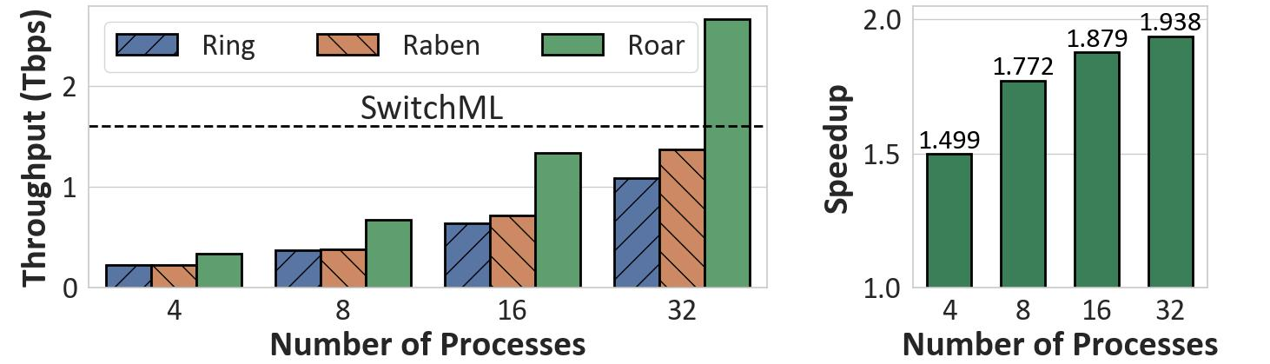
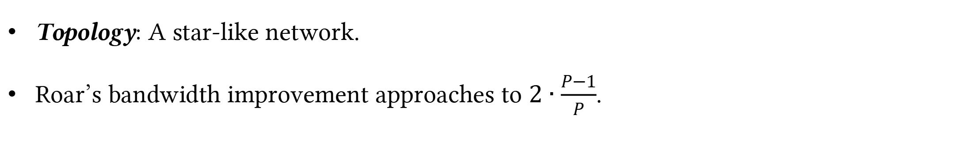
Evaluation: Throughput
R0
H0
H1
H2
H3
Topology
Topology: A star-like network.
Roar’s bandwidth improvement approaches to $2∙\frac{P−1}{P}$.
Notes:
First, we use a star-like network, where different hosts are connected to a single router.
We set the number of processes to a power of two.
And the message size is large enough to evaluate the throughput.
Roar achieves an improvement in throughput compared to host-based allreduce approaches.
The right figure shows Roar's achieved throughput improvement compared to Rabenseifner, and the speedup closely matches this ideal value.
As the number of processes increases, the throughput is approximately double of Rabenseifner.

Slide 50
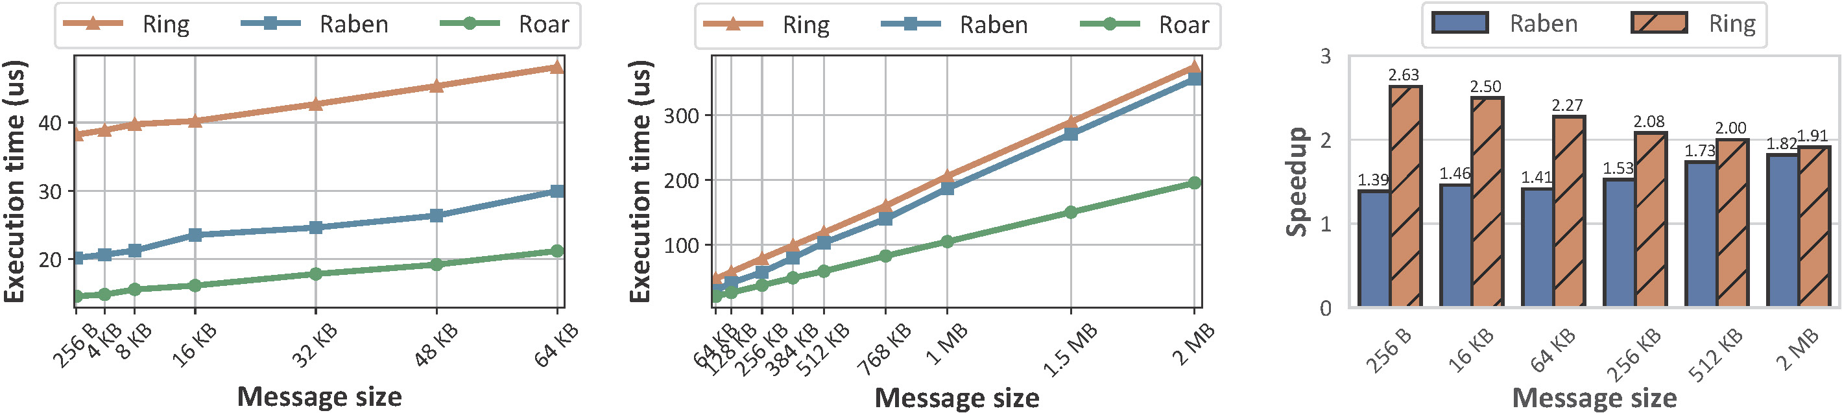
Evaluation: Performance on Fat-tree
Topology: 2-level fat-tree.
Strength: Roar’s can achieve a 2x improvement in bandwidth.
Weakness: Building the reduction trees takes extra time.
Notes:
Next, we emulate our approach on a two-level fat-tree.
As shown in the figure, the horizontal axis represents message size.
And the vertical axis represents the execution time of different solutions.
As the message size increases, Roar's execution time tendency is nearly half that of host-based allreduce.
The third figure shows Roar's speedup compared to these baselines.
The strength of our method is that it achieves a two-times improvement in bandwidth.
However, building reduction trees to determine the routers takes extra time.
As shown in the short messages in the third figure, the Roar is not much faster than Rabenseifner algorithm.
To build a reduction tree, all hosts send their requests to a network manager, who sets the entries for the membership tables for routers.

Slide 51
Conclusion
Roar : A new router microarchitecture for in-network allreduce, and tailored for RDMA network. It does not affect regular network functions of the router.
A series of strategies to address several challenges, including high throughput, large message aggregation, repeatable results.
Please email wrq2021@nudt.edu.cn for more information
Notes:
In conclusion, we have designed Roar, a router microarchitecture specifically for in-network allreduce.
As an extension to the router, Roar does not affect its regular functions.
Roar is desiged for RDMA networks. It can achieve a two times improvement in bandwidth compared with host-based allreduce.
Additionally, a series of strategies are used to overcome several challenges, including high throughput, large message aggregation, result repeatability.
That’s all of this presentation,
For more information, you can email to the address below.
Reproducible

