Slide 1
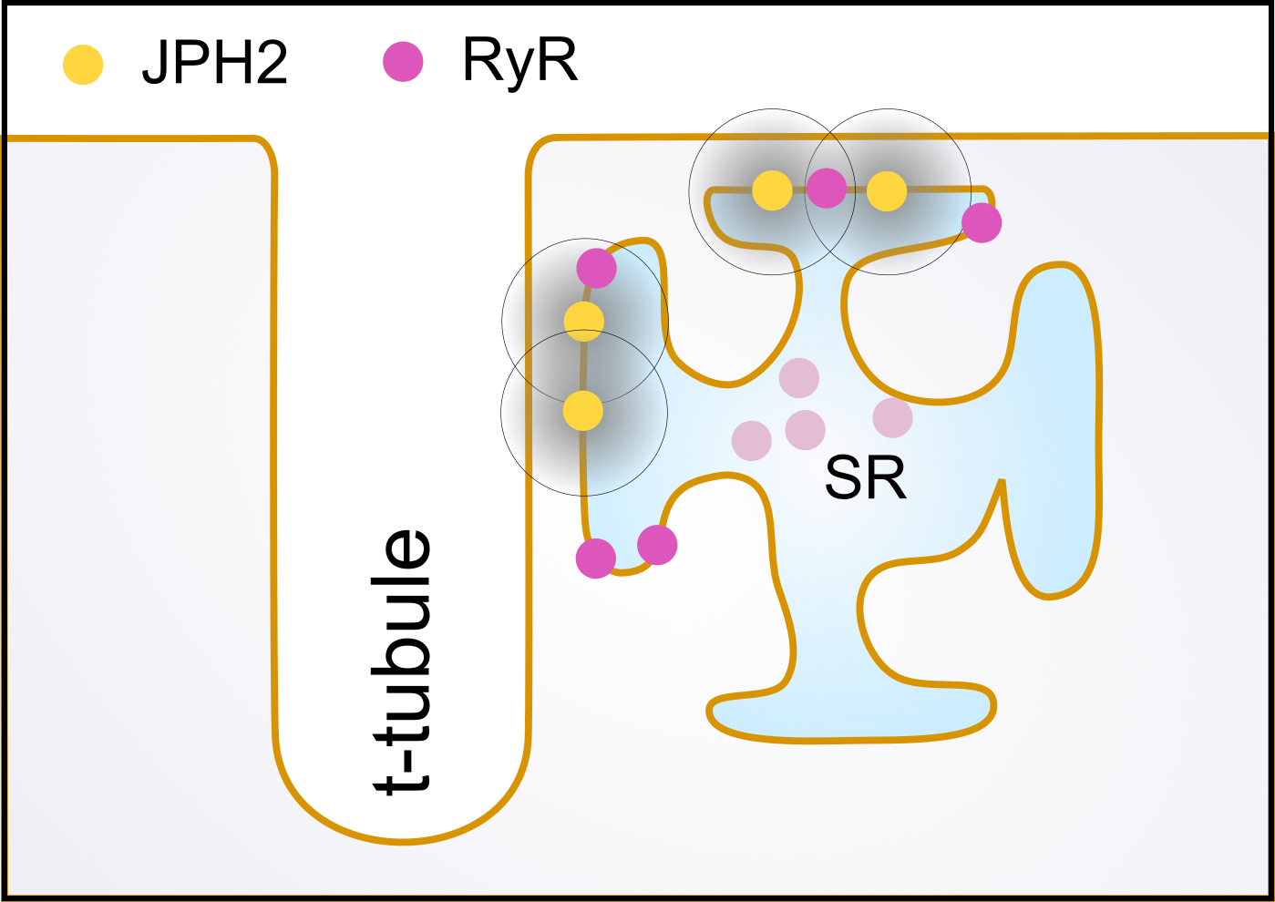
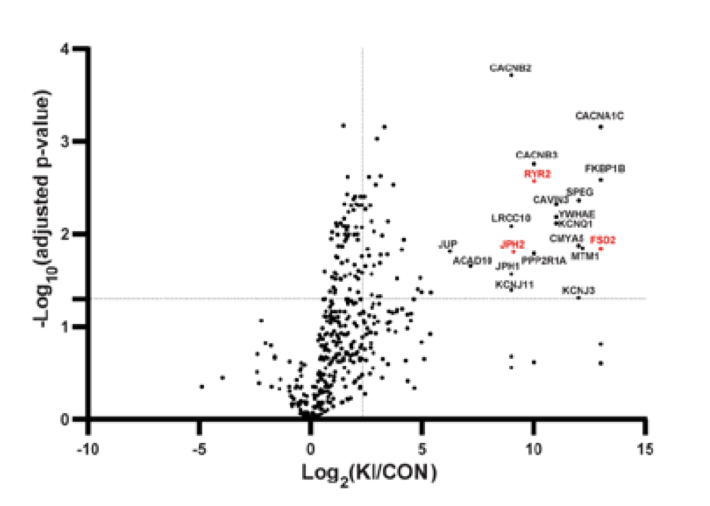
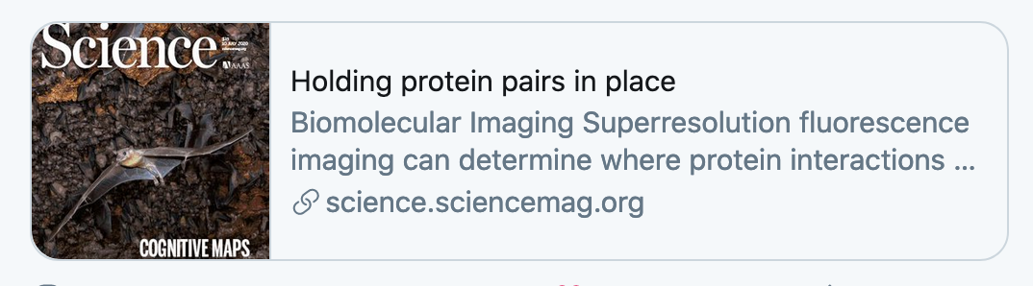
Dyad
The dyad proteome
Dyad
Szuromi, P. Science 369, 155–156 (2020)
Wei et al. Identifying the Cardiac Dyad Proteome ... Circulation 141, 940–942 (2020).

Slide 2
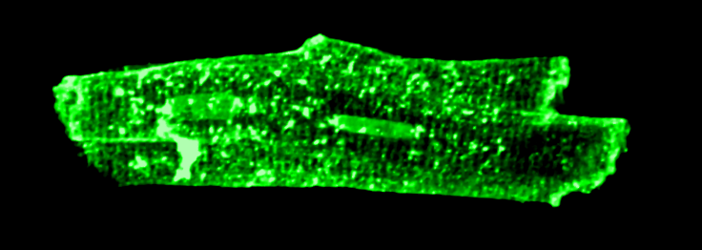
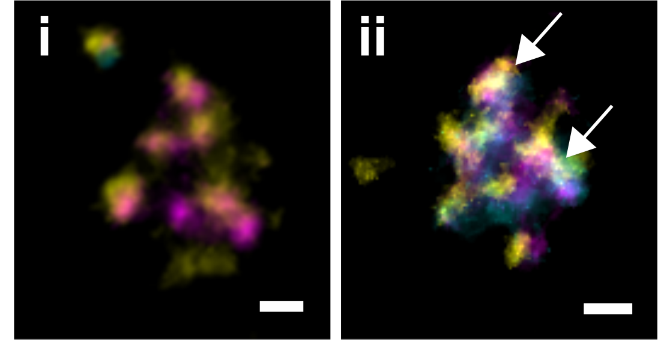
Szuromi, P. Science 369, 155–156 (2020)
100 nm
Clowsley, A. et al. J. Am. Chem. Soc. (2020) doi:10.1021/jacs.9b03418.

Slide 3
