Slide 1
Microwave Signal Loss Prediction
One-Step Ahead Forecasting with Multiple Linear Regression (MLR)
Prepared by: Cem Sondur
Data: Hourly Simulation | Duration: 1 Year (8760 hours) | Features: 5 | Language: R
Machine Learning Project

Slide 2
Project Flow
1
Data Generation
8760-hour ARIMA-based simulation: Rain, Temperature, Wind, and a realistic signal loss model
2
Feature Engineering
Lag features: Loss_Lag1 and Rain_Lag1 → time series structure for one-step ahead prediction
3
Model Setup
MLR: lm() function, 5 independent variables, 80%/20% train/test split
4
Model Validation
Visual validation with 5 plots: Actual vs Predicted, Residual analysis, Q-Q, Time, Coefficients
5
Performance Metrics
R²=72.83%, MAE=0.2947 dB, RMSE=0.3695 dB, MAPE=1.41% → Operational success

Slide 3
Theoretical Background: Multiple Linear Regression (MLR)
ŷ = β₀ + β₁·Rain + β₂·Temp + β₃·Wind + β₄·Rain_Lag1 + β₅·Loss_Lag1 + ε
What Are the β Coefficients?
One-Step Ahead Forecasting
MLR Assumptions
β₀: Constant term (intercept) — the expected loss value when all variables equal 0
Goal: Predict the Next_Loss value at time t+1 using information available at time t
Linearity: There is a linear relationship between the dependent and independent variables
β₁...β₅: The independent effect of each feature — how many dB the loss changes for a 1-unit increase while other variables are held constant
Loss_Lag1 = Loss(t-1), Rain_Lag1 = Rain(t-1) → carries past information into the model
Normality: Residuals (ε) should be normally distributed → tested with Q-Q plot
With the OLS (Ordinary Least Squares) method, β values are estimated so as to minimize the sum of squared residuals
This structure turns classic MLR into a time series forecaster — the past instant is used to predict the future instant
Homoscedasticity: Variance of residuals should be constant → verified with Residuals over time

Slide 4
Dataset: Simulation Design and Physical Model
Feature
Generation Method
Unit / Range
# Signal loss physical model (ITU-R based)
Rain
ARIMA(ar=0.98) × season
mm/h, ≥0
signal_loss <- 20 +
(0.00454*(rain^1.353)*10) +
(0.0003*temp) + (0.05*wind)
+ rnorm(N, 0, 0.3)
Temp
Sine (annual+daily) + noise
°C, ~17–33
Wind
ARIMA(ar=0.95) + constant
m/s, ≥0
Why the ITU-R formula?
The International Telecommunication Union's rain attenuation model — the rain^1.353 exponential effect represents real physical behavior.
Loss_Lag1
Previous hour's Loss value
dB
Data Splitting Strategy
Rain_Lag1
Previous hour's Rain value
mm/h
TRAIN 80% → 7007 hours
TEST 20% → 1751 hours
Chronological order preserved — no random shuffling (time series integrity)

Slide 5
R Code — Step 1: Data Generation
set.seed(42) # Reproducibility N <- 8760 # 365 days × 24 hours # Rain: autocorrelated + seasonal rain_rate <- abs(arima.sim(list(ar=0.98), n=N))*2 *
(
1 + 0.4*sin(2*pi*day_of_year/365 - pi/2)) # Temperature: annual + daily sine + noise temp <- 25 + 8*sin(...) + 2*sin(...) + rnorm(N,0,0.5) # Signal loss (ITU-R model) signal_loss <- 20 +
(
0.00454*(rain_rate^1.353)*10) +
(
0.0003*temp) + (0.05*wind) +
rnorm(N,
0, 0.3) # ±0.3 dB measurement noise
set.seed(42)
Fixes the random number generator. The same data is produced on every run — results are reproducible.
arima.sim(ar=0.98)
AR coefficient 0.98 → rain shows 'persistence'. Mimics the autocorrelation in real weather data.
sin(2π × day/365)
Annual seasonality: low rain in winter, high in summer. Temperature is modeled with a sine wave in the same way.
rain^1.353 exponential effect
ITU-R P.838 standard. As rain intensity rises, signal loss increases exponentially, not linearly.
rnorm(N, 0, 0.3)
±0.3 dB measurement noise added. Represents sensor uncertainty in real systems.

Slide 6
R Code — Steps 2 & 3: Model Setup and Metric Computation
# Lag features (one-step ahead) mw_data$Loss_Lag1 <- c(NA, mw_data$Loss[-N]) mw_data$Rain_Lag1 <- c(NA, mw_data$Rain[-N]) mw_data$Next_Loss <- c(mw_data$Loss[-1], NA) mw_data <- na.omit(mw_data) # Train / Test split (80%-20%) split_idx <- floor(0.8 * nrow(mw_data)) train_data <- mw_data[1:split_idx, ] test_data <- mw_data[(split_idx+1):nrow(mw_data), ] # MLR model — 5 features model <- lm(Next_Loss ~ Rain + Temp + Wind + Rain_Lag1 + Loss_Lag1, data = train_data) # Error metrics Residuals <- Predicted - Actual R2 <- 1 - sum(Residuals^2) / sum((Actual - mean(Actual))^2) MAE <- mean(abs(Residuals)) MAPE <- mean(abs(Residuals / Actual)) * 100
c(NA, Loss[-N])
Shifts the vector one step to the left. Writes the value at time t into row t-1 → lag feature.
Next_Loss target
c(Loss[-1], NA): a one-step forward shift. Stores t+1's loss as the target in the row at time t.
na.omit()
Loss_Lag1=NA in the first row, Next_Loss=NA in the last. Removes these two rows from the dataset.
lm() function
R's core OLS (Ordinary Least Squares) regression function. Computes coefficients analytically — no iteration needed.
R² formula
1 − (SS_res / SS_tot). Close to 1 means the model explains variance well; close to 0 means it's no better than the mean.

Slide 7
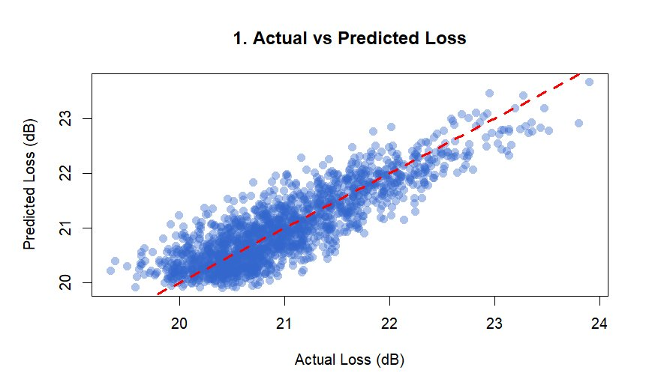
Plot 1: Actual vs Predicted Loss
45° Reference Line
The red dashed line marks a perfect prediction. Points above this line mean the model is underestimating.
Tight Point Band
Predictions cluster within ±0.5 dB of the actual values. Low scatter → the model is consistent.
Underestimation (23–24 dB)
During heavy rain spikes the model lags behind. Because Loss_Lag1 uses the previous instant, it cannot capture sudden changes.
Overall Comment
The linear relationship is strong and monotonic. R²=72.83% is fully consistent with this visual distribution.

Slide 8
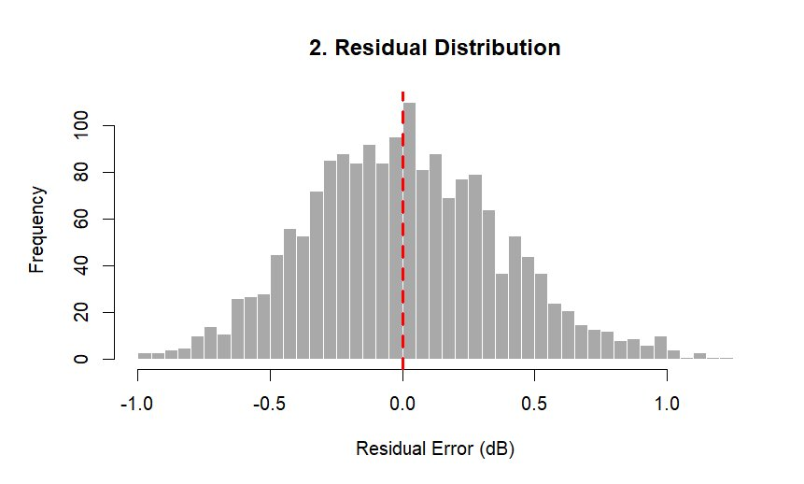
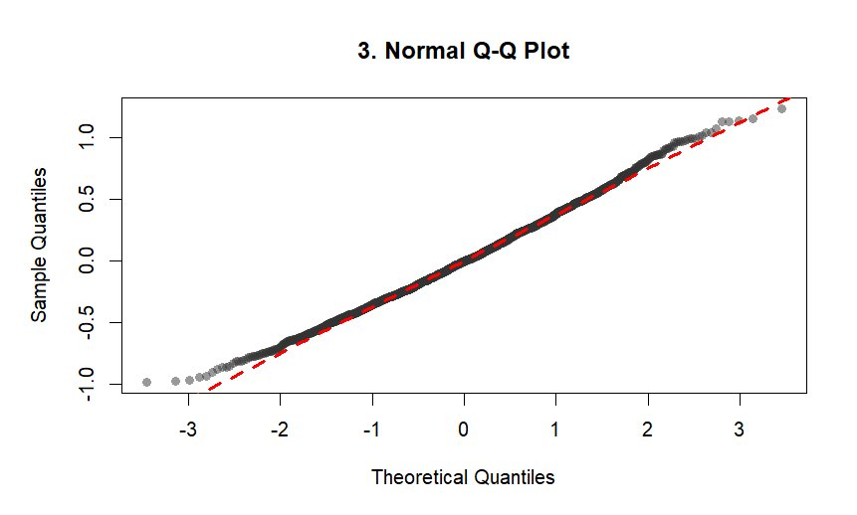
Plots 2 & 3: Residual Distribution and Normality Test (Q-Q)
Histogram Interpretation
Q-Q Plot Interpretation
Residuals are centered around 0 with a bell-curve-like shape. There is slight right skew (positive rain spikes). MLR's normality assumption is largely met. The red line shows the median is close to 0.
Points hug the reference line almost perfectly → residuals are normally distributed. In the left tail (around −3) 4–5 points fall below the line: a slight heavy-tail in extreme negative residuals. Conclusion: the normality assumption is VALID.

Slide 9
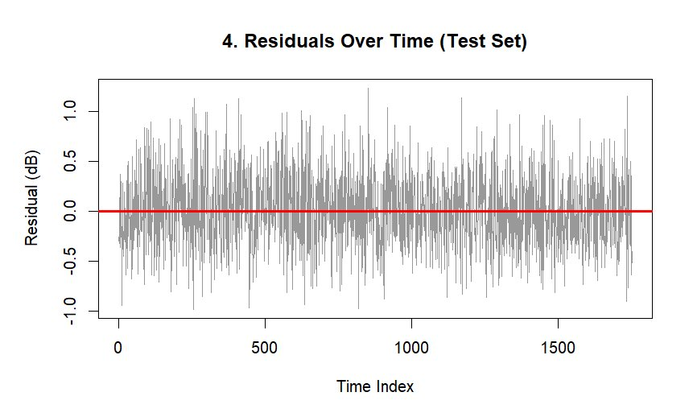
Plot 4: Residuals Over Time — MLR Assumption Check
✅ Around Zero
Residuals fluctuate around the 0 line with no systematic direction. The model is unbiased.
✅ Homoscedasticity
Variance is constant over time. Start and end have similar spread → MLR assumption satisfied.
✅ No Autocorrelation
No clear periodic pattern is visible. Residuals are independent → the model isn't missing any structural feature.
⚠️ ±1 dB Overshoot Points
Errors grow on sudden rain spikes. Due to the lag structure, the model can fall behind.
This plot visually confirms MLR's 3 core assumptions (normality, independence, constant variance).

Slide 10
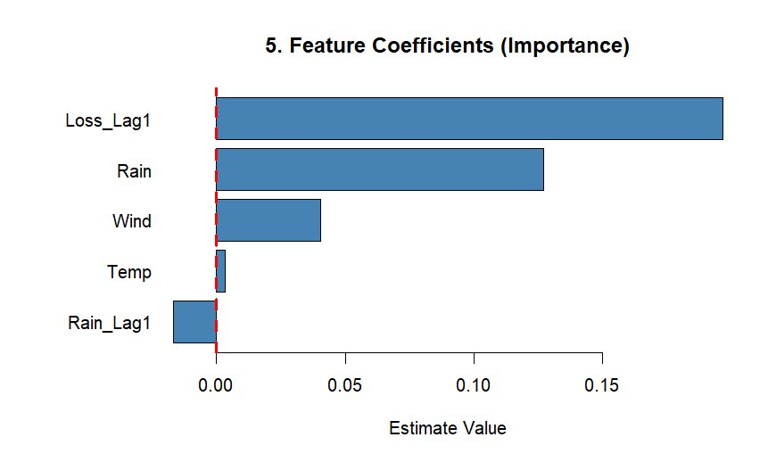
Plot 5: Feature Coefficients and Multicollinearity Analysis
1. Loss_Lag1 → β ≈ +0.17 (Dominant)
Signal loss changes very slowly. The loss one hour earlier is the strongest predictor of the current loss. Principle of physical continuity.
2. Rain → β ≈ +0.13 (Second Most Important)
Instantaneous rain directly affects the microwave signal. Because the data was generated via the ITU-R model, the coefficient is significant and positive.
⚠️ Rain_Lag1 → Negative Coefficient — Why?
Multicollinearity: Rain and Rain_Lag1 are highly correlated (r≈0.98). OLS "goes astray" when distributing coefficients. Information Overlap: Loss_Lag1 already contains the effect of past rain. To avoid double-counting, the model balances by pulling Rain_Lag1 negative.

Slide 11
Performance Metrics
R²
MAE
RMSE
MAPE
72.83%
0.2947 dB
0.3695 dB
1.41%
Explained Variance
Mean Absolute Error
Root Mean Squared Error
Mean Absolute Percentage Error
Explains ~¾ of the variability
Mean error < 0.3 dB
Close to MAE → few outliers
Strongest metric — excellent
Metric Formulas and Interpretations
MAE = (1/n)Σ|yᵢ−ŷᵢ| → Mean absolute error; treats large and small errors with equal weight. RMSE = √[(1/n)Σ(yᵢ−ŷᵢ)²] → Penalizes large errors more heavily. RMSE≈MAE implies no significant outliers. MAPE = (100/n)Σ|yᵢ−ŷᵢ|/|yᵢ| → Percentage error; a value of 1.41% is considered operationally excellent.

Slide 12
Overall Summary
Project Summary — What Did We Do?
MLR Assumption Check
Problem
Predicting hourly microwave signal loss 1 hour ahead
✅ Normality
Q-Q Plot — satisfied
✅ Homoscedasticity
Residuals over time — satisfied
Method
Multiple Linear Regression (MLR) — lm() — with OLS
✅ Independence
Time plot — satisfied
Data
8760-hour simulation; ARIMA-based rain, sinusoidal temperature, ITU-R loss model
⚠️ Multicollinearity
Rain / Rain_Lag1 — detected
Features
Rain, Temp, Wind + time series lags: Rain_Lag1, Loss_Lag1 (5 total)
Limitations and Improvement Suggestions
Train/Test
80% chronological training (7007 hours) / 20% test (1751 hours)
• Simulated data: Results may differ with real measurement data • Multicollinearity: Can be quantified numerically with VIF analysis • Better model: R² could be improved with ARIMA, Random Forest, or LSTM • R² = 72%: Natural ceiling imposed by stochastic rain noise
Findings
R²=72.83%, MAE=0.29 dB, RMSE=0.37 dB, MAPE=1.41% — Operational success
Model Strength
Loss_Lag1 is the dominant feature; Rain, Wind, and Temp provide meaningful contribution
Key Finding
Rain_Lag1 has a negative coefficient: multicollinearity + information overlap detected

Slide 13
Thank You
Cem Sondur
Machine Learning Project • Microwave Signal Loss Prediction with MLR
R²
MAE
RMSE
MAPE
72.83%
0.29 dB
0.37 dB
1.41%
I'm ready for your questions.

