Slide 1
Exploiting Unintended Feature Leakage in Collaborative Learning
Luca Melis Congzheng Song Emiliano De Cristofaro Vitaly Shmatikov
UCL Cornell Cornell Tech

Slide 2



Overview
Collaborative learning
new attack surface
Predict gender
Not correlated to learning task
model updates leak info about training data
Example: users' identities

Slide 3



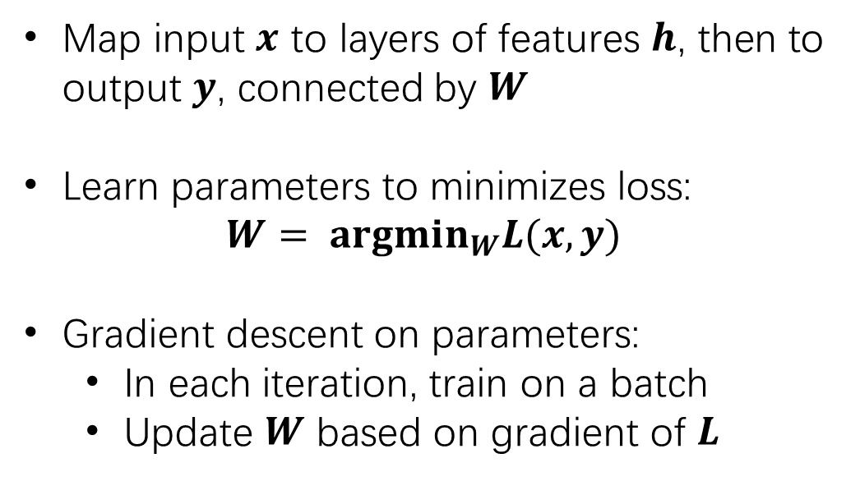





Deep Learning Background
$y=$ Female
Map input $x$ to layers of features $h$, then to output $y$, connected by $W$
Learn parameters to minimizes loss:
$$W= argmin_{W}L(x, y)$$
Gradient descent on parameters:
In each iteration, train on a batch
Update $W$ based on gradient of $L$
$$h_{3}$$
$$W_{2}$$
$$h_{2}$$
$$W_{1}$$
$$h_{1}$$
$$x=$$
Gradients reveal information about the data

Slide 4





Distributed / Federated Learning
Multiple clients want to collaboratively train a model
Server
Gboard
Tensorflow Federated

Slide 5
Distributed / Federated Learning
In each iteration
Multiple clients want to collaboratively train a model
Server
Download global model from server

Slide 6
Distributed / Federated Learning
In each iteration
Multiple clients want to collaboratively train a model
Server
Share model updates
Sharing updates rather than data...
how much
privacy gained?
Train on a batch

Slide 7





Threat Model
Malicious participant or server has WHITE-BOX access to model updates!
What information do updates leak?
Server
$$−$$
$$= Σ$$
iter $T+1$
iter $T$
Gradients based on a batch of data

Slide 8
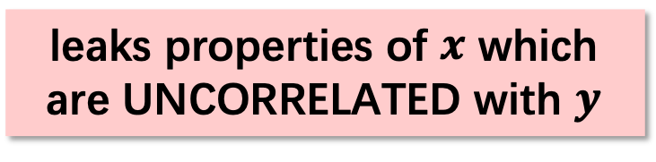
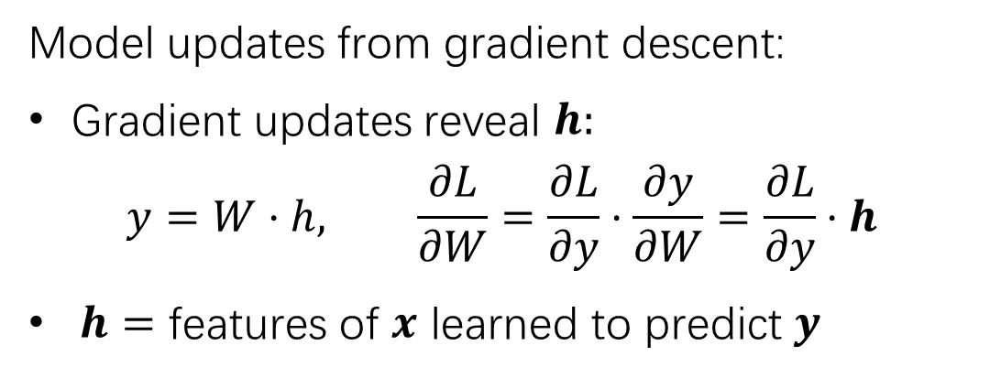
Leakage from model updates
Model updates from gradient descent:
Gradient updates reveal $h:$
$$y=W⋅h, \frac{∂L}{∂W}=\frac{∂L}{∂y}⋅\frac{∂y}{∂W}=\frac{∂L}{∂y}⋅h$$
$h=$ features of $x$ learned to predict $y$
How to infer properties from observed updates?
if adversary has examples of data with these properties
Use supervised learning!
leaks properties of $x$ which are UNCORRELATED with $y$
e.g. gender and facial IDs

Slide 9






Property Inference Attacks
Inferring properties from observation = learning problem
Labeled with property
Server
…
$$−$$
iter $i+1$
iter $i$
iter $1$
iter $2$
iter $T$
Infer
…
Train
Labeled
updates
Labeled
updates
Labeled
updates
Property Classifier

Slide 10
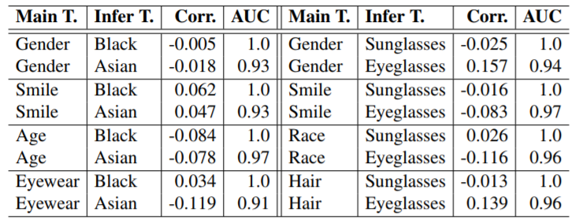
Infer Property (Two-Party Experiment)
Labeled Faces in the Wild:
Participant trains on facial images with certain attributes
Target label
Property
Correlation
Attack AUC
Main task and property are not correlated!

Slide 11
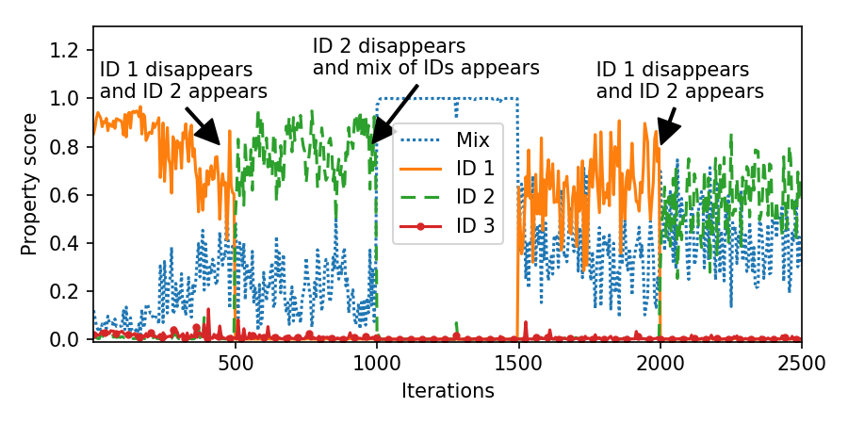
Infer Occurrence (Two-Party Experiment)
FaceScrub: target=gender, property=facial IDs
Participant trains on faces of different people in different iterations
Probability
of predicting a facial ID
Infer when images of a certain person appear and disappear in training data
Notes:
We show the score of predicting different identities in each round of training as shown by the color. Yellow curves show the score of predicting id 1 in each round.
Changes in curves correctly corresponds to when different ids appear and disappear

Slide 12
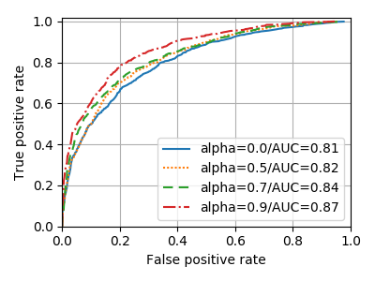
Active Attack Works Even Better
FaceScrub: target=gender, property=facial IDs
Adversary uses multi-task learning to create a model that
Predicts task label
Predicts property
Strength of active attack
Adversary can actively bias the model to leak property by sending crafted updates!

Slide 13
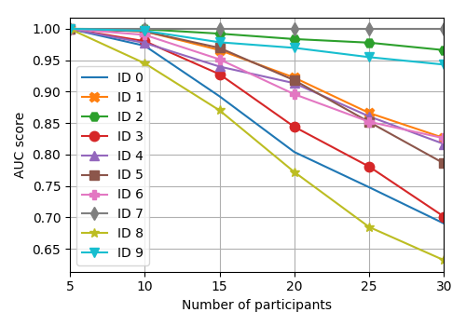
Multi-Party Experiments
Observe aggregated updates
Accurate inference for some properties!
Yelp Review: target=review score
property=authorship
Unique properties are not affected
For Yelp, unique word combinations identify authorship
Performance drops as number of participants increases
Notes:
Inference is accurate for some property. The properties are so unique that aggregation does not cancel their effects in their updates.

Slide 14
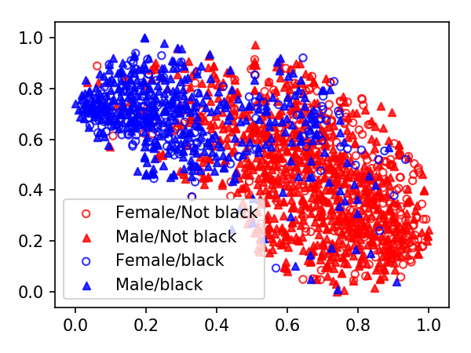
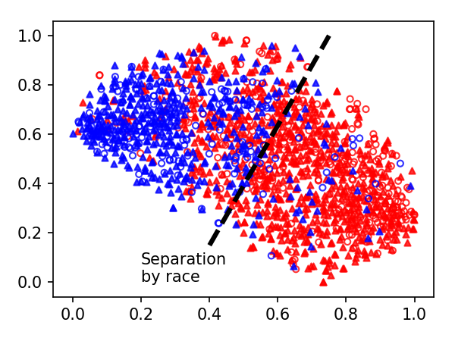
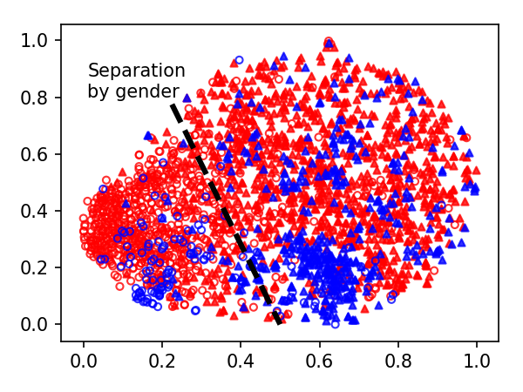
Visualize Leakage in Feature Space
Main task
Circle points = Female
Triangle points = Male
Inferred property
Blue points = Black
Red points = Not black
Pool1 Layer
Pool2 Layer
Final Layer

Slide 15
Takeaways
Models unintentionally learn all sorts of features
Collaborative training reveals white-box model updates
As a result, model updates leak information about training data
Thank you!
Code available at: https://github.com/csong27/property-inference-collaborative-ml

