Slide 1

Overlearning Reveals Sensitive Attributes
Congzheng Song Vitaly Shmatikov

Slide 2

Overlearning
Models trained for simple objectives learn features that are useful for much more complicated sensitive and uncorrelated tasks
Binary classifier
Gender: Male
Transfer learning
Identity: Brad Pitt

Slide 3

Overlearning Breaks Purpose Limitation
GDPR Principle (b): Purpose Limitation
Requires data processors to disclose every purpose of data collection and obtain consent from the users whose data was collected
Mentions "purpose”
261 times
Adversary can easily
re-purpose a trained model
Transfer learning
Identities
Authorship of text
Sensitive demographics

Slide 4









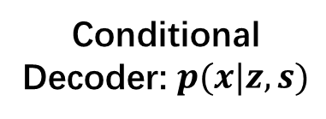




Censoring Attributes in Representations
Adversarial training
Information-theoretic
Encoder: $E$
Encoder: $q(z|x)$
Conditional
Decoder: $p(x|z, s)$
Adversary:$D$
$$z$$
$$z$$
$$s$$
$$x$$
$$x$$
$$\hat{x}$$
$$y$$
Classifier: $C$
$$s$$
$$\min_{E,C}{\max_{D}{ γ⋅logP\left(s\right|z) − logP(y|z)}}$$
$$\max_{q,p}{I\left(z, y\right)−β⋅I\left(z, x\right)−λ}⋅I(z,s)$$
$z$ is the representation, $s$ is the sensitive attribute, $I$ denotes mutual information

Slide 5




Censoring Cannot Prevent Overlearning
Need a blacklist of all sensitive attributes and corresponding labels on training data
We show that representations can leak attributes that do not occur in training data
Can only censor a single layer
Layers below can still reveal sensitive attributes
If censoring all layers, model is not learning at all
Censored representations can be de-censored
De-censor objective
De-censor
model $T$
$$min_{T}{\left|\left|z_{aux}−T\left(z\right)\right|\right|}_{2}^{2}$$
$$z= E(x)$$
$$z_{aux}= E_{aux}(x)$$

Slide 6
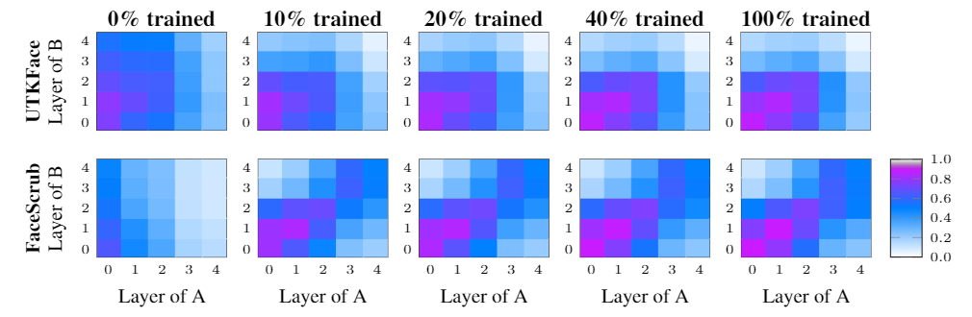
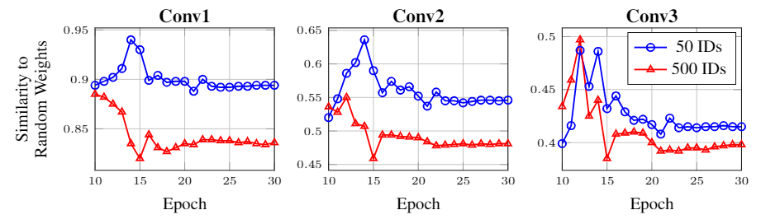
Overlearning Is Intrinsic
Lower layers learn similar representations across different tasks
Hypothesis: less structured data leads to more complex solution

Slide 7
Overlearning Is Intrinsic
Lower layers learn similar representations across different tasks

Slide 8
Takeaways
Representations learned for simple tasks help infer much more complicated sensitive and uncorrelated attributes.
Censoring sensitive attributes is either ineffective, or completely destroys the utility of the model.
Overlearning might be intrinsic. This is a challenge for GDPR, which aims to control the purposes of machine learning.

