Slide 1
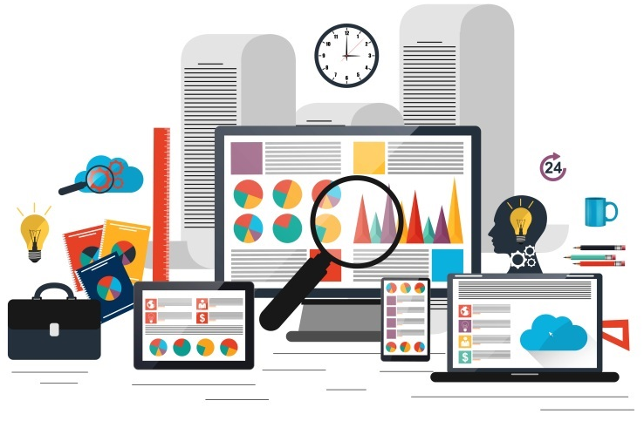
Web Scraping Project: Start Up Data Analytics Opportunities
By
Charoenpong (Paul) Songdechakraiwut
NYC Data Science Academy - Cohort ‘September 2019’

Slide 2
Content
Project Overview: Web Scraping
Website Reference
Project Workflow
Web Scrapping/ Data Mining
Exploratory Data Analysis
Findings
Prime location to grow a business analytics company!
Does the size matter to expand the analytics companies?
Summary
Future Work

Slide 3
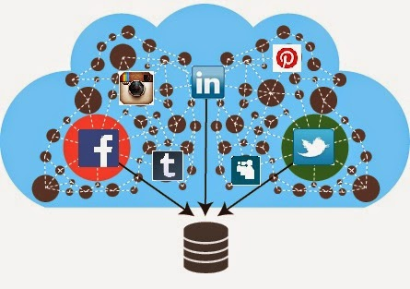
Project Overview - Web Scrapping Project
Web Scrapping
Data Cleaning
Exploration Data Analysis
Summary and Future Work Suggestion
Use “Scrapy” to scrape targeted information from the website
Scrapped data is not cleaned. Uncompleted data occurred.
Thus, cleaning processes needed to be applied before analysis.
Extracting insights out of scrapped dataset.
Summarize and provide future work suggestion.

Slide 4
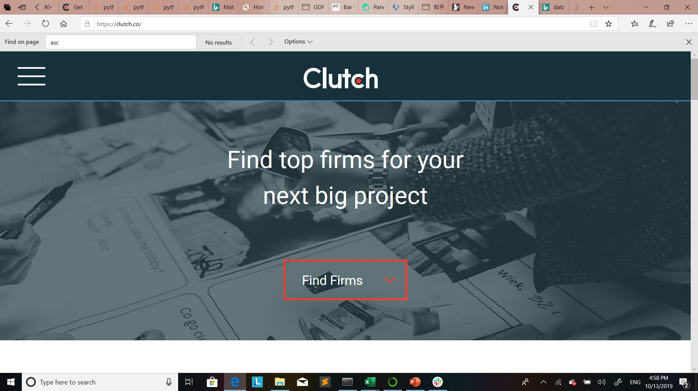
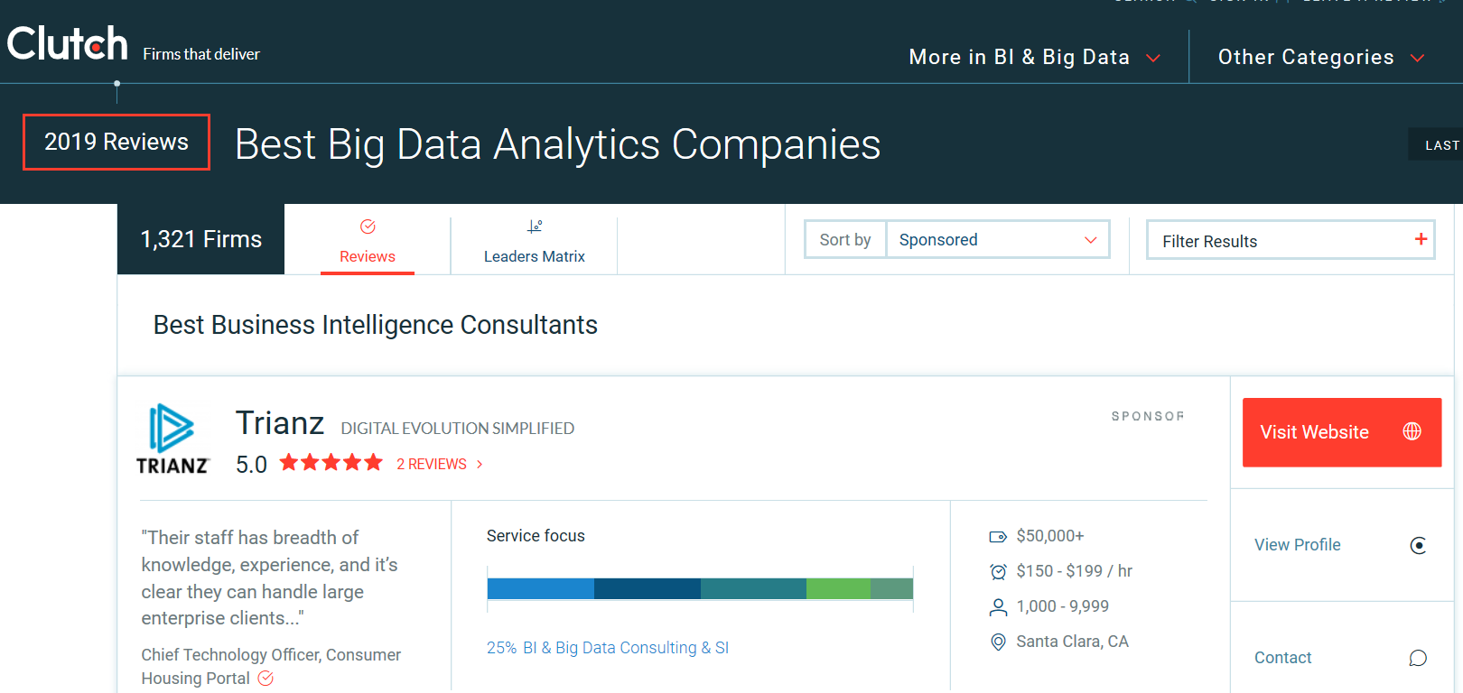
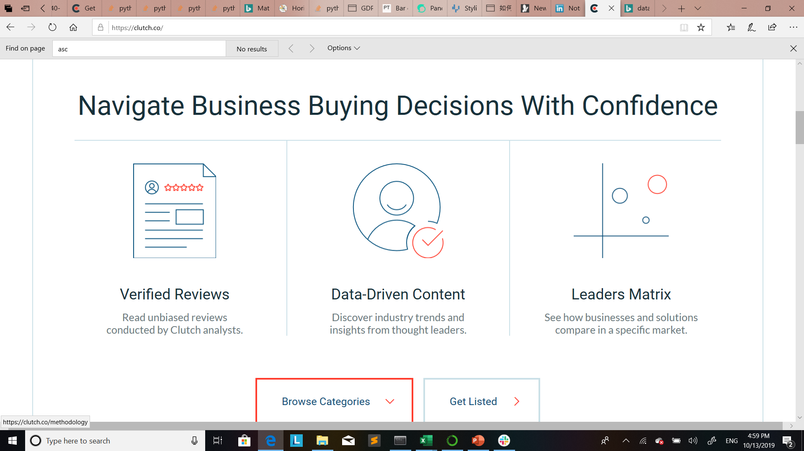
Web Scrapping
Scrapped data
Scraping Information:
The data had scraped from clutch.co.
Clutch.co is a data driven one-stop service website gathering lists of the professional services for service searchers.
Company name
Minimum project size
Hourly rate
Location
Employee
Hourly rate

Slide 5
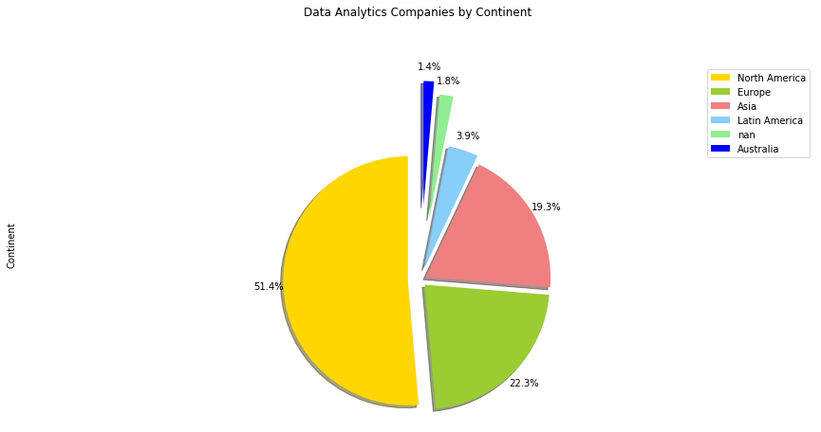
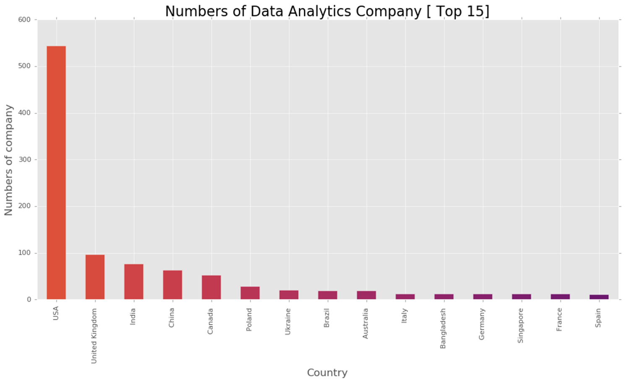
Data Analytics Company around the world

Slide 6
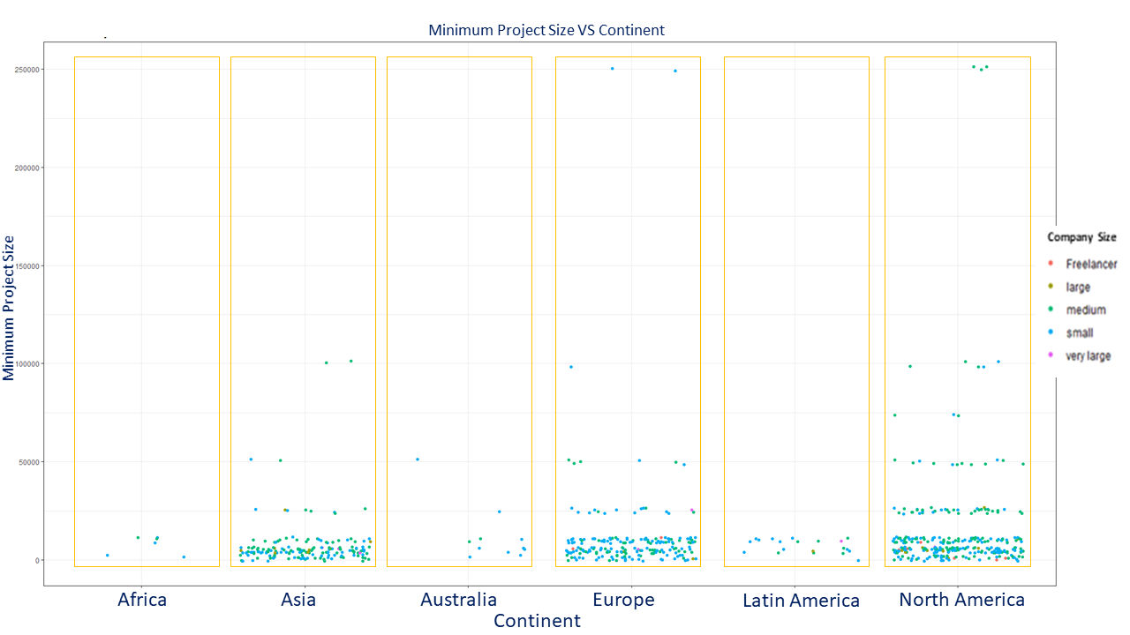
Data Analytics Company around the world
High minimum project size

Slide 7
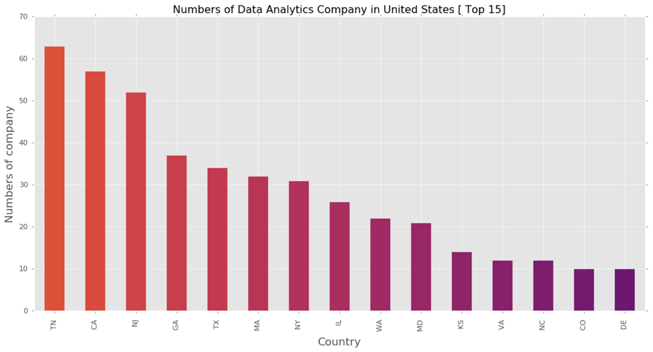
Top 15 State: Data Analytics Company in USA

Slide 8
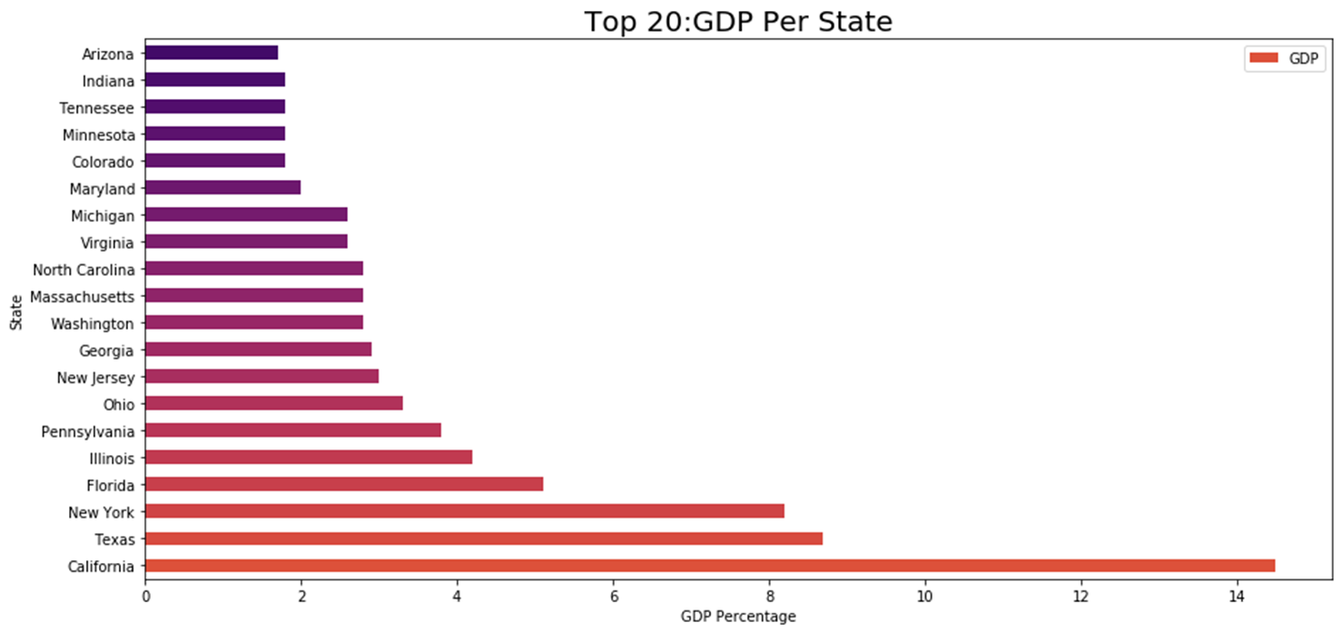
Top 20: GDP per State – United States.
GDP ranking #18
Reference: worldpopulationreview.com [1]

Slide 9
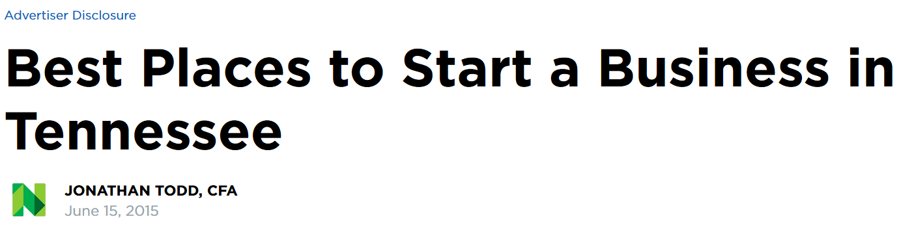
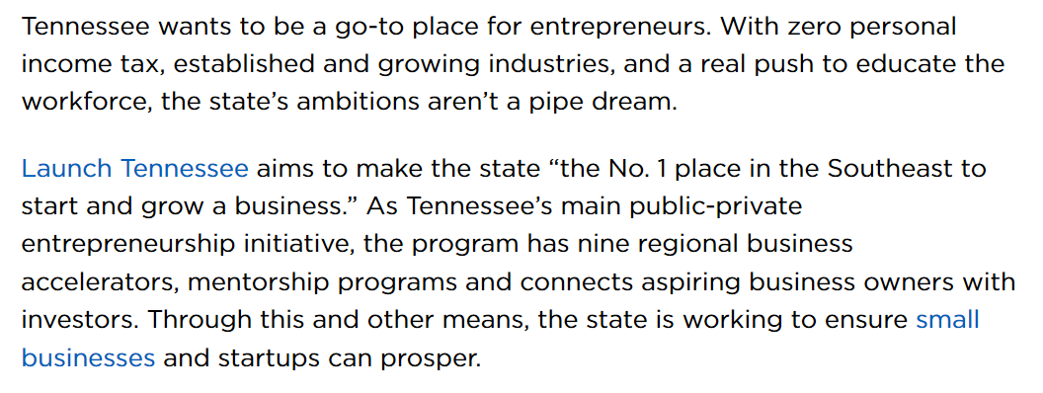
Research on Tennessee Growth Strategies
Reference: www.nerdwallet.com

Slide 10
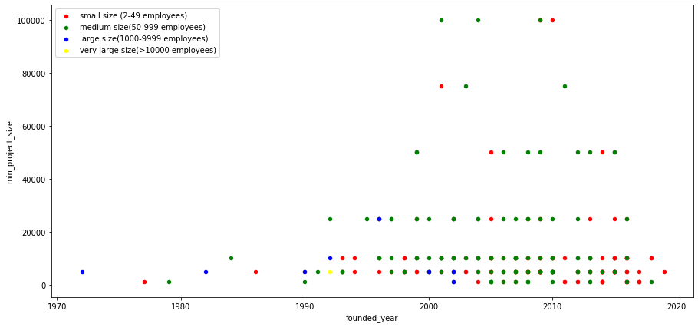
Does the size matter for ?
High minimum project size
New companies
Minimum Project Size
Founded Year

Slide 11
Conclusion
The US is still the hottest location where data analytics companies are forming to earn business.
TN provides tax incentives to boost up the state economy which benefits for new entrepreneurs to grow businesses including data analytics.
By using minimum project size, medium size companies have higher success rates to get high valued projects.
Future Recommendation
Project scope could expand to understand trends of analytics companies.
For example:
Type of hottest services line
Industry focuses.
Big data focuses
https://nycdatascience.com/blog/student-works/start-up-data-analytics-opportunities/

Slide 12

Contact:
LinkedIn : https://www.linkedin.com/in/csongdechakraiwut/
Github : https://github.com/csongdechakraiwut

Slide 13
Reference
Dataset Reference [Scrapped with “Scrapy” on October 8,2019]:
[1] Top Business Intelligence and Analytics Software - 2019 Reviews | Clutch.co. (2019). Retrieved October 8, 2019, from Clutch.co website: https://clutch.co/analytics
State Gross Domestic Product (GDP) Reference:
[2] GDP by State Population. (2019-11-05). Retrieved October 9, 2019, from http://worldpopulationreview.com/states/gdp-by-state/
Supporting Articles Reference:
[3] Todd, J. (2017, July 26). Best Places to Start a Business in Tennessee. Retrieved from https://www.nerdwallet.com/blog/small-business/best-places-start-business-tennessee/.

