Slide 1
More Divide and Conquer: Quicksort and Closest Pair of Points
CS 4102: Algorithms
Fall 2021
Mark Floryan and Tom Horton

Slide 2
Trominoes

Slide 3
Next Example: Trominos
Tiling problems
For us, a game: Trominos
In “real” life: serious tiling problems regarding component layout on VLSI chips
Definitions
Tromino
A deficient board
n x n where n = 2^{k}
exactly one square missing
Problem statement:
Given a deficient board, tile it with trominos
Exact covering, no overlap

Slide 4
Trominos: Playing the Game, Strategy
Java app for Trominos: http://www3.amherst.edu/~nstarr/puzzle.html
How can we approach this problem using Divide and Conquer?
Small solutions: Can we solve them directly?
Yes: 2 x 2 board
Next larger problem: 4 x 4 board
Hmm, need to divide it
Four 2 x 2 boards
Only one of these four has the missing square
Solve it directly!
What about the other three?

Slide 5
Trominos: Key to the Solution
Place one tromino where three 2 x 2 boards connect
You now have three 2 x 2 deficient boards
Solve directly!
General solution for deficient board of size n
Divide into four boards
Identify the smaller board that has the removed tile
Place one tromino that covers the corner of the other three
Now recursively process all four deficient boards
Don’t forget! First, check for n==2

Slide 6
Input Parameters: n, a power of 2 (the board size);
the location L of the missing square
Output Parameters: None
tile(n,L) {
if (n == 2) {
// the board is a right tromino T
tile with T
return
}
divide the board into four n/2 × n/2 subboards
place one tromino as in Figure 5.1.4(b)
// each of the 1 × 1 squares in this tromino
// is considered as missing
let m₁,m₂,m₃,m₄ be the locations of the missing squares
tile(n/2,m₁)
tile(n/2,m₂)
tile(n/2,m₃)
tile(n/2,m₄)
}

Slide 7
Trominos: Analysis
What do we count? What’s the basic operation?
Note we place a tromino and it stays put
No loops or conditionals other than placing a tile
Assume placing or drawing a tromino is constant
Assume that finding which subproblem has the missing tile is constant
Conclusion: we can just count how many trominos are placed
How many fit on a n x n board?
(n² – 1) / 3
Do you think this optimal?

Slide 8
Trominos: Analysis
Runtime?
If ‘n’ is the size of one board dimension (nxn board)
4 subproblems of size n/2 x n/2
O(1) to place one tromino “across the cuts” and “combine”
T(n) = 4T(n/2) + 1 = ??
Also, think intuitively. There are n^2 board spaces and each “round” you are placing one tromino (3 spaces)
So at least n^2 / 3 JUST to place the Trominos

Slide 9
Closest Pair of Points
Readings: CLRS 33.4

Slide 10
Closest Pair of Points in 2D Space
Given:
A list of points
Return:
Distance of the pair of points that are closest together (or possibly the pair too)
2
1
5
4
6
7
3
8

Slide 11


Closest Pair of Points: Naïve
Given:
A list of points
Return:
Distance of the closest pair of points
2
1
5
4
6
Naive Algorithm:
Test every pair of points, return the closest.
$$O(n^{2})$$
7
3
We can do better!
8
$$Θ(n\log{n)}$$

Slide 12
Closest Pair of Points: D&C
Divide:
How?
2
At median x coordinate
1
Conquer:
5
4
6
Combine:
7
3
8
12

Slide 13
Closest Pair of Points: D&C
Divide:
2
At median x coordinate
1
Conquer:
5
4
Recursively find closest pairs from Left and Right
6
Combine:
7
3
8
LeftPoints
RightPoints
13

Slide 14
Closest Pair of Points: D&C
Divide:
2
At median x coordinate
1
Conquer:
5
4
Recursively find closest pairs from Left and Right
6
Combine:
7
Return min of Left and Right pairs
?
Problem?
3
8
LeftPoints
RightPoints
14

Slide 15
Closest Pair of Points: D&C
Combine:
2 Cases:
1
2
1. Closest Pair is completely in Left or Right
5
4
6
2. Closest Pair Spans our “Cut”
7
Need to test points across the cut
?
3
8
LeftPoints
RightPoints
15

Slide 16



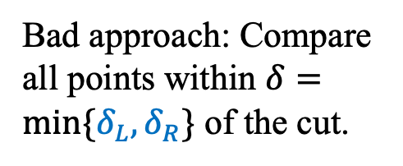
Spanning the Cut
Define “runway” or “strip” along the cut.
Combine:
2. Closest Pair Spanned our “Cut”
1
2
$$δ_{L}$$
Need to test points across the cut.
5
$$δ_{R}$$
4
6
Bad approach: Compare all points within $δ=min⁡\{δ_{L}, δ_{R}\}$ of the cut.
7
How many are there?
3
$$2δ$$
8
LeftPoints
RightPoints
16

Slide 17



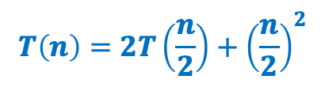
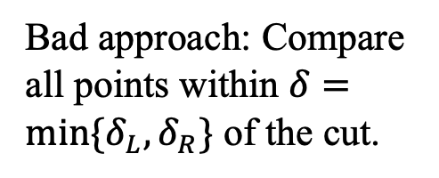
Spanning the Cut
Define “runway” or “strip” along the cut.
Combine:
2. Closest Pair Spanned our “Cut”
1
2
$$δ_{L}$$
Need to test points across the cut
4
5
$$δ_{R}$$
Bad approach: Compare all points within $δ=min⁡\{δ_{L}, δ_{R}\}$ of the cut.
6
7
How many are there?
$$T\left(n\right)=2T\left(\frac{n}{2}\right)+{\left(\frac{n}{2}\right)}^{2}$$
3
$$2δ$$
8
$$=Θ\left(n^{2}\right)$$
LeftPoints
RightPoints
17

Slide 18
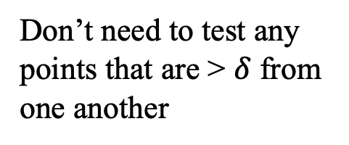
Spanning the Cut
Combine:
2. Closest Pair Spanned our “Cut”
1
2
$$δ_{L}$$
Need to test points across the cut
4
5
$$δ_{R}$$
We don’t need to test all pairs!
6
7
Don’t need to test any points that are > $δ$ from one another
3
$$2δ$$
8
LeftPoints
RightPoints
18

Slide 19
Reducing Search Space
Combine:
Need to test points across the cut
$$2⋅δ$$
Claim #1: if two points are the closest pair that cross the cut, then you can surround them in a box that’s $2⋅δ$ wide by $δ$ tall.
$$δ$$
Let’s draw some examples.
19

Slide 20
Reducing Search Space
Claim #1: if two points are the closest pair that cross the cut, then you can surround them in a box that’s $2⋅δ$ wide by $δ$ tall.
Assume you’re checking in increasing y-order, and you’ve reached the first point of the closest pair.
Do you have to look at all points above it to be guaranteed to find the other point and the minimum distance?
$$2⋅δ$$
$$δ$$
No!
Imagine you drew a box with its bottom at point’s y-coordinate.
See Claim #1.
Claim #2: only 8 points can be in the box.
20

Slide 21
Reducing Search Space
Claim #1: if two points are the closest pair that cross the cut, then you can surround them in a box that’s $2⋅δ$ wide by $δ$ tall.
Assume you’re checking in increasing y-order, and you’ve reached the first point of the closest pair.
Do you have to look at all points above it to be guaranteed to find the other point and the minimum distance?
$$2⋅δ$$
$$δ$$
No!
Imagine you drew a box with its bottom at point’s y-coordinate.
See Claim #1.
Claim #2: only 8 points can be in the box.
21

Slide 22
Spanning the Cut
Combine:
1
2
2. Closest Pair Spanned our “Cut”
$$δ_{L}$$
Consider points in strip in increasing y-order.
For a given point p, we can prove the 8th point and beyond is more than $δ$ from p.
(pp. 1041-2 in CLRS)
So for each point in strip, check next 7 points in y-order.
4
5
$$δ_{R}$$
Only check next 7
6
7
3
$$2δ$$
8
LeftPoints
RightPoints
$$Θ\left(n\right) Better!$$
22

Slide 23
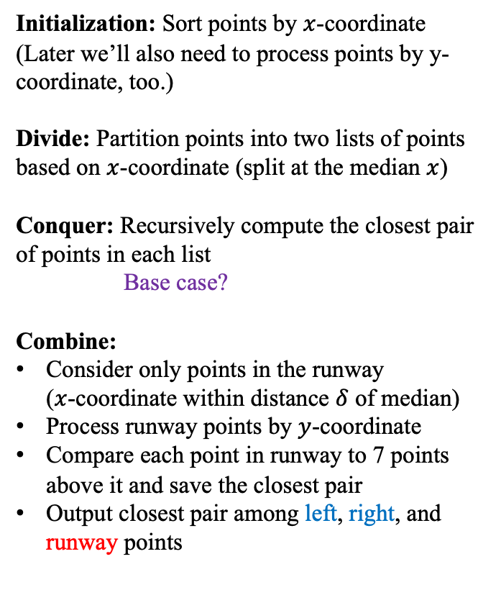
Closest Pair of Points: Divide and Conquer
Initialization: Sort points by $x$-coordinate
(Later we’ll also need to process points by y-coordinate, too.)
Divide: Partition points into two lists of points based on $x$-coordinate (split at the median $x$)
Conquer: Recursively compute the closest pair of points in each list
Base case?
Combine:
Consider only points in the runway ($x$-coordinate within distance $δ$ of median)
Process runway points by $y$-coordinate
Compare each point in runway to 7 points above it and save the closest pair
Output closest pair among left, right, and runway points
1
2
5
4
6
7
?
3
8
LeftPoints
RightPoints

Slide 24



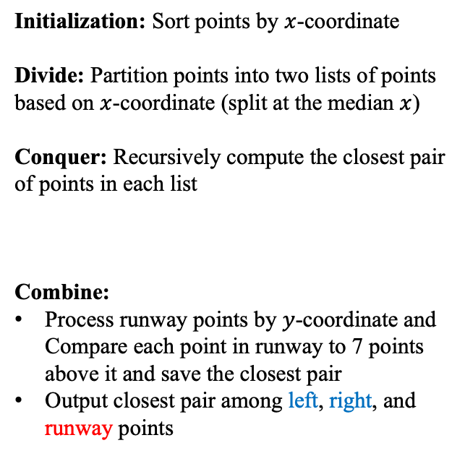

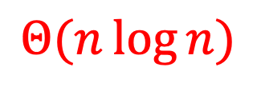

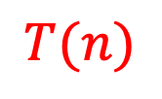

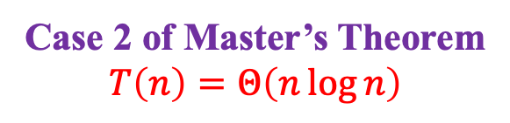
Closest Pair of Points: Divide and Conquer
What is the running time?
$$Θ\left(n\log{n}\right)$$
Initialization: Sort points by $x$-coordinate
Divide: Partition points into two lists of points based on $x$-coordinate (split at the median $x$)
Conquer: Recursively compute the closest pair of points in each list
Combine:
Process runway points by $y$-coordinate and Compare each point in runway to 7 points above it and save the closest pair
Output closest pair among left, right, and runway points
$$Θ(n\log{n})$$
$$Θ\left(1\right)$$
$$2T(n/2)$$
$$T(n)$$
$$T(n)=2T(n/2)+Θ(n)$$
$$Θ\left(n\right)$$
Case 2 of Master’s Theorem
$$T\left(n\right)=Θ\left(n\log{n}\right)$$
$$Θ\left(1\right)$$

Slide 25
Summary for Closest Pair of Points
Comparing all pairs is a brute-force fail
Except for small inputs
Divide and conquer a big improvement
Needed to find an efficient way for part of the combine step
Geometry came through for us here!
Only needed to look at constant number of points for each point in the strip
Implementation subtleties
Don’t want to sort the strip by y-coordinate in each recursive call
In initialization, create an “index” that lets you process all points in order by y-coordinate
(There are other ways to address this.)

