Slide 1
Max-flow variations

Slide 2
Finding a Circulation
Real world applications don’t have just one source and sink
Instead there are multiple ones: power production / consumption, etc.
We designate a set S to be all the nodes that are sources
We can also view them has having negative demand
Likewise, we designate a set T to be all the nodes that are sinks
They have positive demand
Networks with multiple sources and sinks (modeled using demand) are called circulation networks

Slide 3
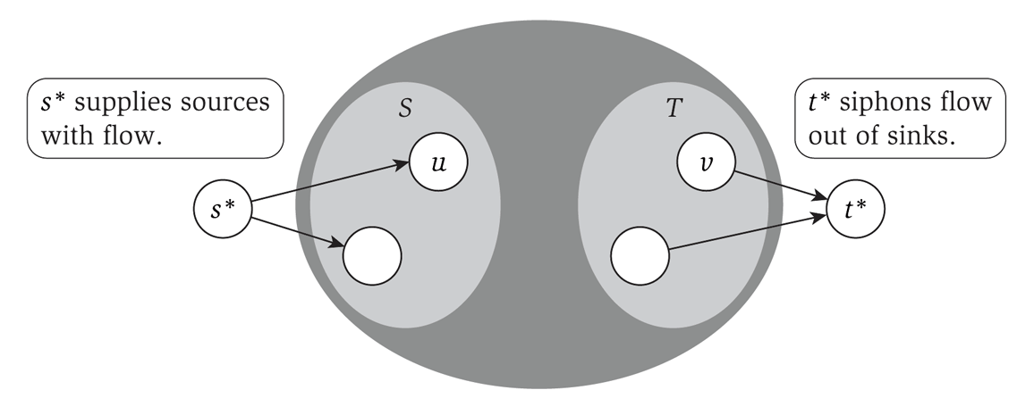
Reduction to max-flow
With a few modifications, we can make this a max-flow problem:
Create a ‘super source’ s* with edges to each node in S
The capacity of that edge is the size of the source of the node in S
Likewise with the set T

Slide 4
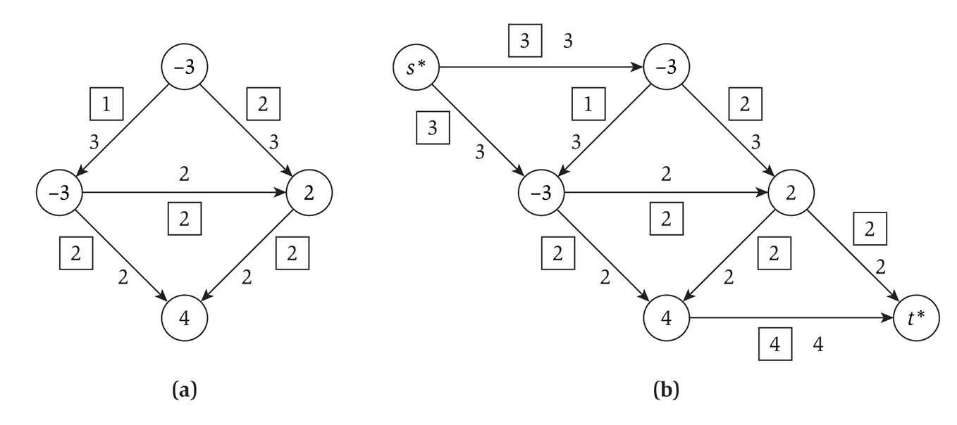
Conversion example
Converting a graph with multiple sources and sinks to a single-source-single-sink max-flow problem:

Slide 5
Circulation notes
A circulation problem is aiming for feasibility, not max flow
But we use max flow to solve it
We set each edge from the super-source to each individual source to be the absolute value as the individual source’s demand
Max-flow is then run
If the total amount leaving the single-source is the SAME as the capacity of each outgoing edge, then the circulation is feasible

Slide 6
Edge lower bounds
So far, we have considered only the capacity of an edge: the upper bound on the flow
We also want to consider a lower bound on the flow on an edge
i.e. forcing a certain amount of flow through an edge
We will reduce this to a circulation problem
Which can then be reduced to a max-flow problem

Slide 7
Handling lower bounds
A lower bound forces flow across an edge
Which increases demand at the start of the edge (to compensate for the flow across the edge)
And decreases demand at the terminus of the edge (as some flow is fulfilling the demand)

Slide 8
Solving a flow with lower bounds
Given a circulation network G, construct a new graph G’ such that for each edge e from u to v with a lower bound l_{e}:
We decrease the capacity on that edge by l_{e}
As that is the flow that is moving through the edge
We increase the demand at u by l_{e}
We decrease the demand at v by l_{e}
Then solve G’ as a circulation problem
i.e. add a super-sink and super-terminus, and solve as a max-flow problem

Slide 9
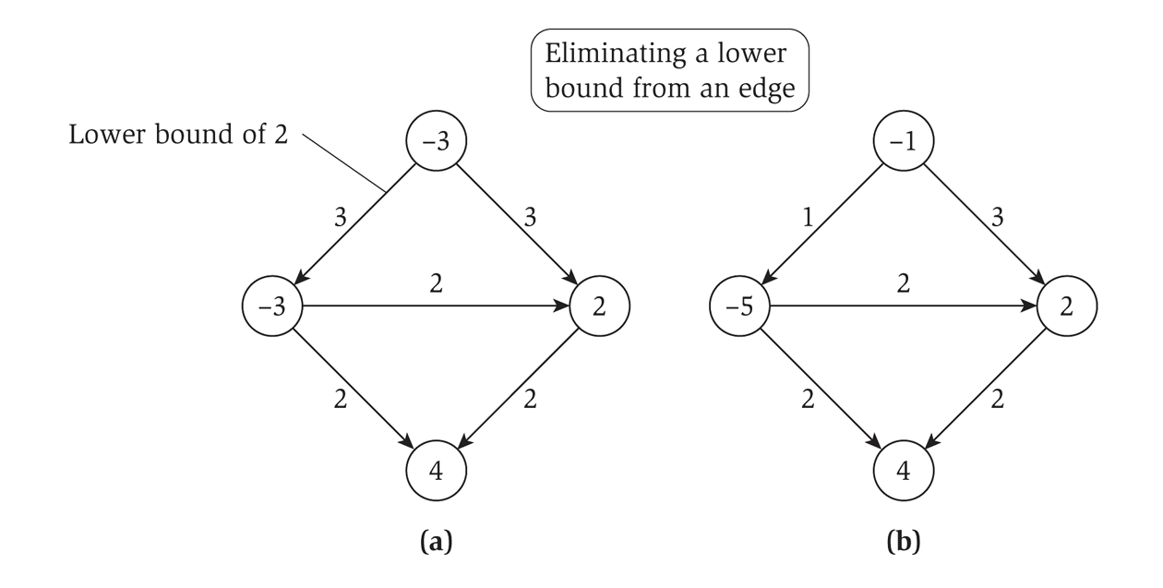
Eliminating a lower bound
Diagrammatically…
Is this feasible? Can this work if we enforce the lower bound?
No!
How to find out? Convert to NW Flow, solve, check amount leaving the single source.

Slide 10
Final Words
Circulation problems
Like max-flow but slightly different. Check if feasible (not max)
Variation: put a lower-bound on some connections
Note all this is really just more reductions!
Solving variations of max-flow by converting the problem into an instance of “normal” max-flow.

