Slide 1
CS4102 Algorithms Spring 2021 – Floryan and Horton
Module 4, Day 1: Horton’s Live Session
Network Flow, Ford-Fulkerson

Slide 2
Announcements, Mon., April 19
Quiz 3 (1st attempt) and Quiz 2 (2nd attempt) will be end of this week
Same as before: GradeScope, Friday noon – Sat. 6pm
Module 3 soft deadline grading is underway, should be done before quiz (that’s our goal)
Recommended schedule for HWs
Working on one Module 3 Advanced HW this week.
Start Module 4 HWs next week
Module 4 starts today. Hooray! (?)
End of semester makes it a bit condensed. We’ll do our best to make it easier on you.
Today: flow networks, Ford-Fulkerson. Do you understand? Example!

Slide 3
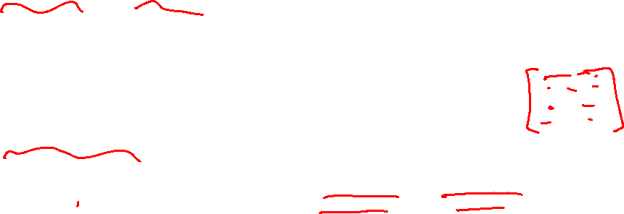
In your textbook
CLRS 26.1 and 26.2
Includes simple solutions to the following “complications”
What if (u,v) and (v,u) are in the flow graph?
What if we need >1 source? >1 sink?
Note:
Recorded lecture emphasized adjacency matrix for storing residual network G_{f} for a given flow-graph G
Matrix stores both capacities and back-flow values for (u,v)
Today we’ll just draw graphs
We won’t draw edges in G_{f} with value 0 (either capacity or back-flow)

Slide 4

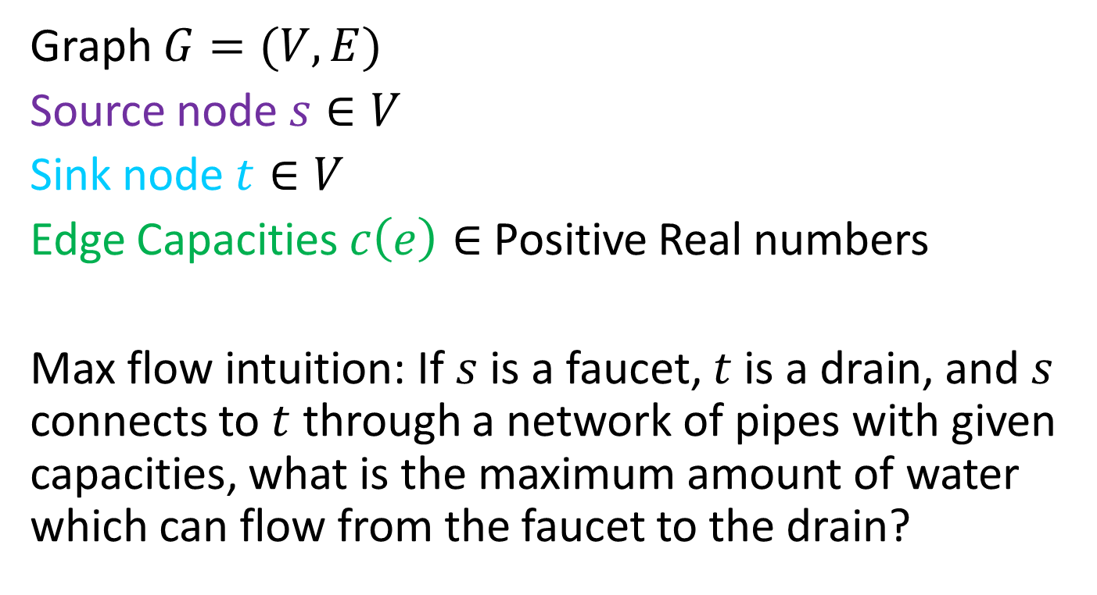

Flow Network
3
2
3
Graph $G=(V,E)$
Source node $s∈V$
Sink node $t∈V$
Edge Capacities $c\left(e\right)∈$ Positive Real numbers
Max flow intuition: If $s$ is a faucet, $t$ is a drain, and $s$ connects to $t$ through a network of pipes with given capacities, what is the maximum amount of water which can flow from the faucet to the drain?
$$s$$
3
2
$$t$$
2
1
3
2
3

Slide 5
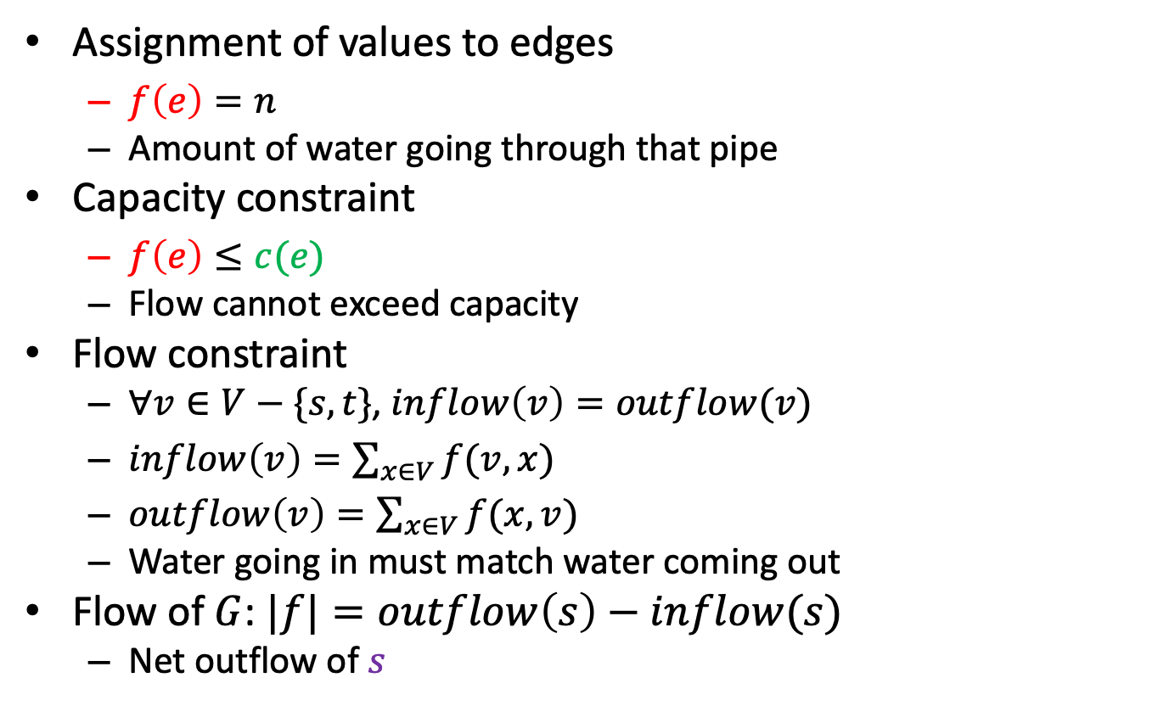
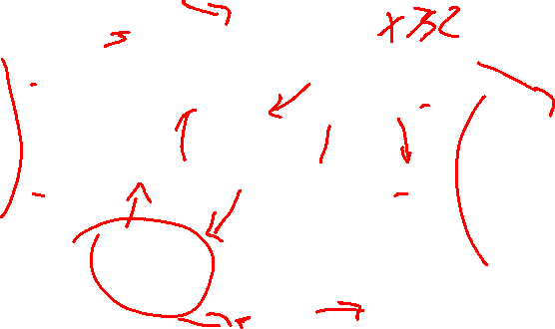


Flow
2/2
1/3
2/3
$$s$$
Assignment of values to edges
$f\left(e\right)=n$
Amount of water going through that pipe
Capacity constraint
$f\left(e\right)≤c(e)$
Flow cannot exceed capacity
Flow constraint
$∀v∈V−\{s,t\}$, $inflow\left(v\right)=outflow(v)$
$inflow\left(v\right)=\sum_{x∈V}{f(v,x)}$
$outflow\left(v\right)=\sum_{x∈V}{f(x,v)}$
Water going in must match water coming out
Flow of $G$: $|f|=outflow\left(s\right)−inflow(s)$
Net outflow of $s$
1/1
1/3
$$t$$
2/2
1/2
2/3
1/2
2/3
Flow/Capacity
3 in example above

Slide 6
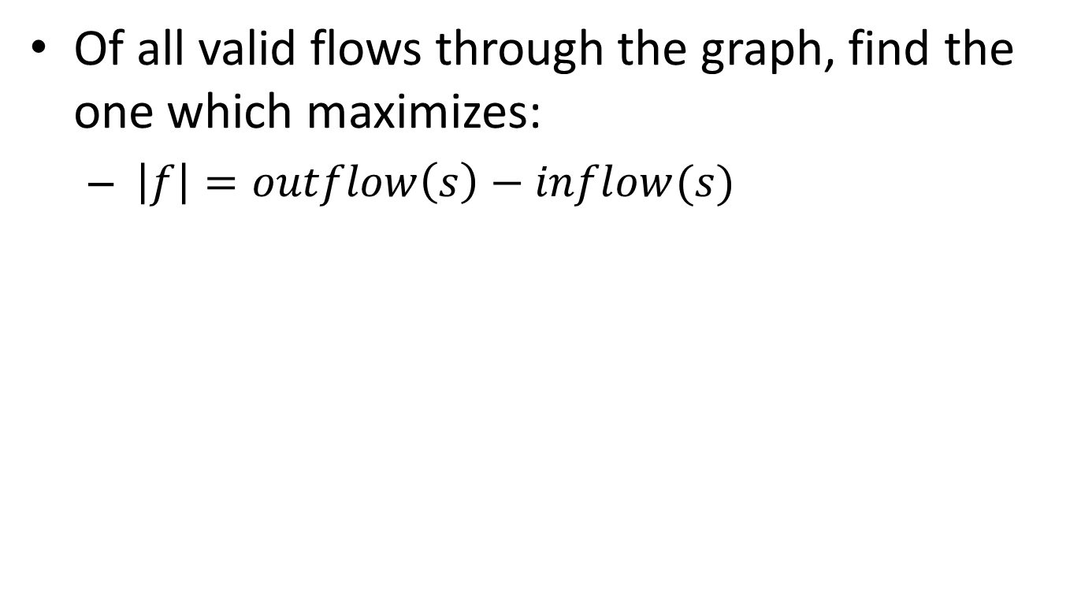
Max Flow
Of all valid flows through the graph, find the one which maximizes:
$\left|f\right|=outflow\left(s\right)−inflow(s)$

Slide 7


Greedy doesn’t work
Saturate Highest Capacity Path First
20
10
$$s$$
30
$$t$$
20
10

Slide 8
Greedy doesn’t work
Saturate Highest Capacity Path First
20
10
$$s$$
30
$$t$$
20
10

Slide 9
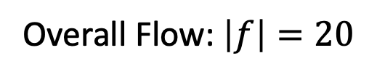
Greedy doesn’t work
Saturate Highest Capacity Path First
20/20
0/10
$$s$$
20/30
$$t$$
0/10
20/20
Overall Flow: $\left|f\right|=20$

Slide 10
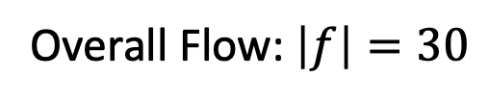
Greedy doesn’t work
Better Solution
20/20
10/10
$$s$$
10/30
$$t$$
10/10
20/20
Overall Flow: $\left|f\right|=30$

Slide 11

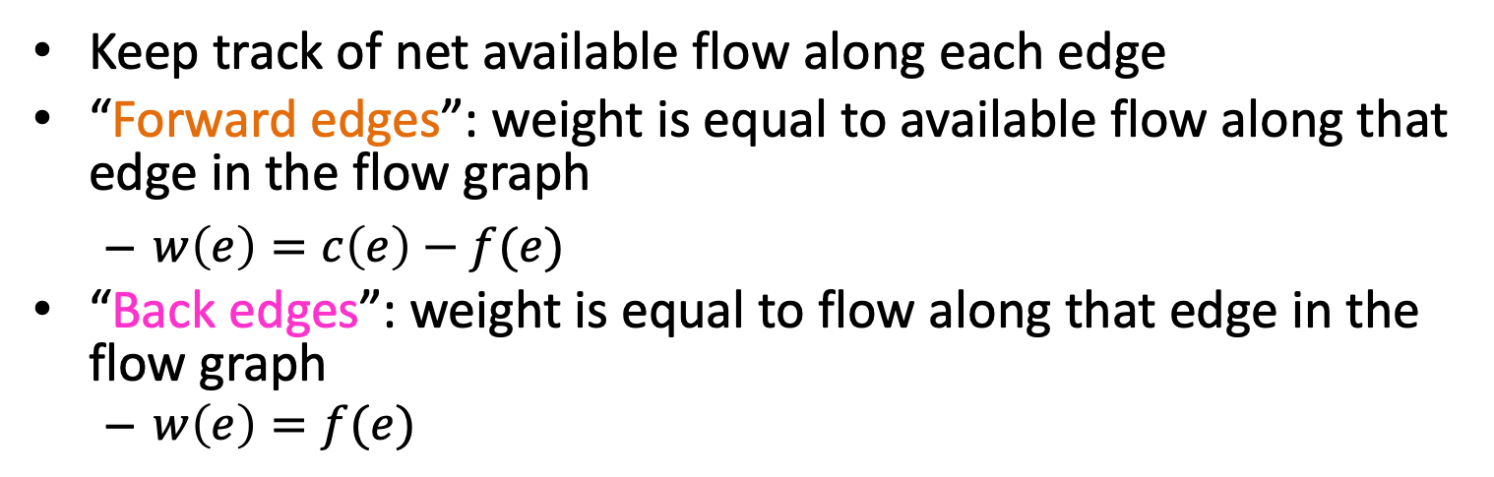



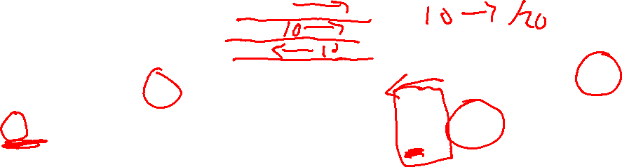



Residual Graph $G_{f}$
Keep track of net available flow along each edge
“Forward edges”: weight is equal to available flow along that edge in the flow graph
$w\left(e\right)=c\left(e\right)−f(e)$
“Back edges”: weight is equal to flow along that edge in the flow graph
$w\left(e\right)=f(e)$
Flow I could add
Flow I could remove
Residual Graph $G_{f}$
Flow Graph $G$
2
1
1/3
a
2/2
a
0
2
2
2/3
1
1
$$s$$
1/3
1/1
$$s$$
1
1/2
$$t$$
2
0
3
$$t$$
2/2
2/3
0
2
2
1
1
b
1/2
b
1
2/3
2

Slide 12





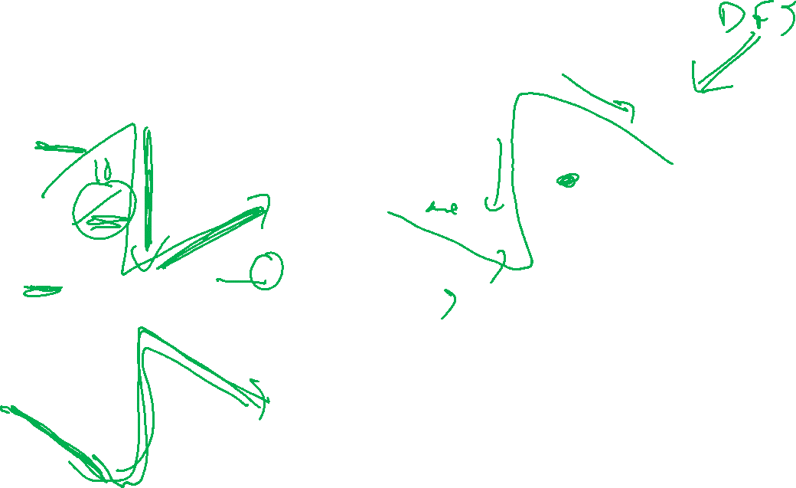



Residual Graphs Example
Flow Graph
Residual Graph
20
0
10
0
20/20
0/10
$$s$$
20
$$t$$
$$s$$
20/30
$$t$$
10
10
0
20/20
0
20
0/10
20
20/20
10
10/10
0
0
$$s$$
10/30
$$t$$
$$s$$
20
10
$$t$$
0
0
10/10
20/20
10
20

Slide 13
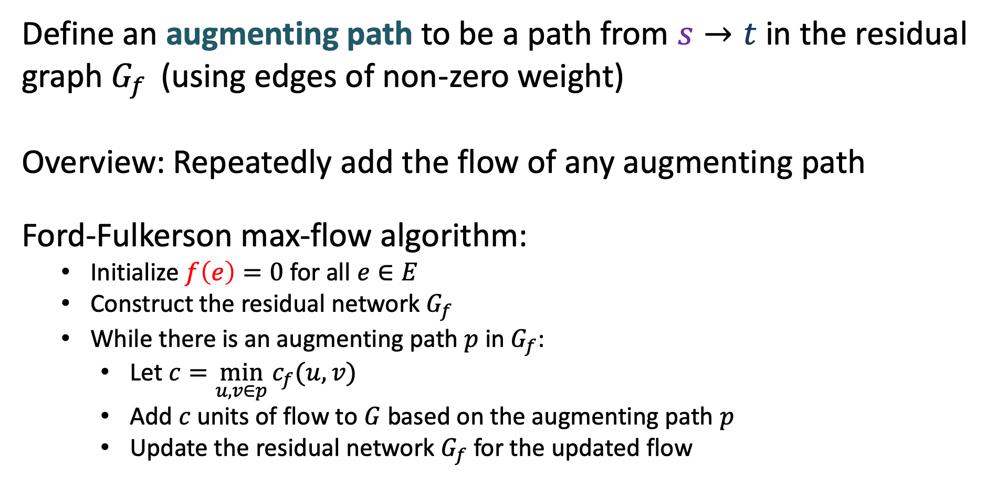
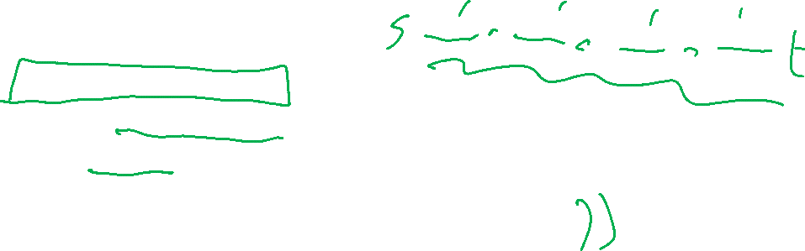
Ford-Fulkerson Algorithm
Define an augmenting path to be a path from $s→t$ in the residual graph $G_{f }$ (using edges of non-zero weight)
Overview: Repeatedly add the flow of any augmenting path
Ford-Fulkerson max-flow algorithm:
Initialize $f\left(e\right)=0$ for all $e∈E$
Construct the residual network $G_{f}$
While there is an augmenting path $p$ in $G_{f}$:
Let $c=\min_{u,v∈p}{c_{f}(u,v)}$
Add $c$ units of flow to $G$ based on the augmenting path $p$
Update the residual network $G_{f}$ for the updated flow

Slide 14
Ford-Fulkerson Algorithm
Define an augmenting path to be a path from $s→t$ in the residual graph $G_{f }$ (using edges of non-zero weight)
Overview: Repeatedly add the flow of any augmenting path
Ford-Fulkerson max-flow algorithm:
Initialize $f\left(e\right)=0$ for all $e∈E$
Construct the residual network $G_{f}$
While there is an augmenting path $p$ in $G_{f}$:
Let $c=\min_{u,v∈p}{c_{f}(u,v)}$
Add $c$ units of flow to $G$ based on the augmenting path $p$
Update the residual network $G_{f}$ for the updated flow
Ford-Fulkerson approach: take any augmenting path
(will revisit this later)

Slide 15
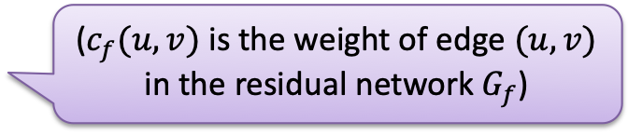
Ford-Fulkerson Algorithm
Define an augmenting path to be a path from $s→t$ in the residual graph $G_{f }$ (using edges of non-zero weight)
Overview: Repeatedly add the flow of any augmenting path
Ford-Fulkerson max-flow algorithm:
Initialize $f\left(e\right)=0$ for all $e∈E$
Construct the residual network $G_{f}$
While there is an augmenting path $p$ in $G_{f}$:
Let $c=\min_{u,v∈p}{c_{f}(u,v)}$
Add $c$ units of flow to $G$ based on the augmenting path $p$
Update the residual network $G_{f}$ for the updated flow
Ford-Fulkerson approach: take any augmenting path
(will revisit this later)
($c_{f}(u,v)$ is the weight of edge $(u,v)$ in the residual network $G_{f}$)

Slide 16

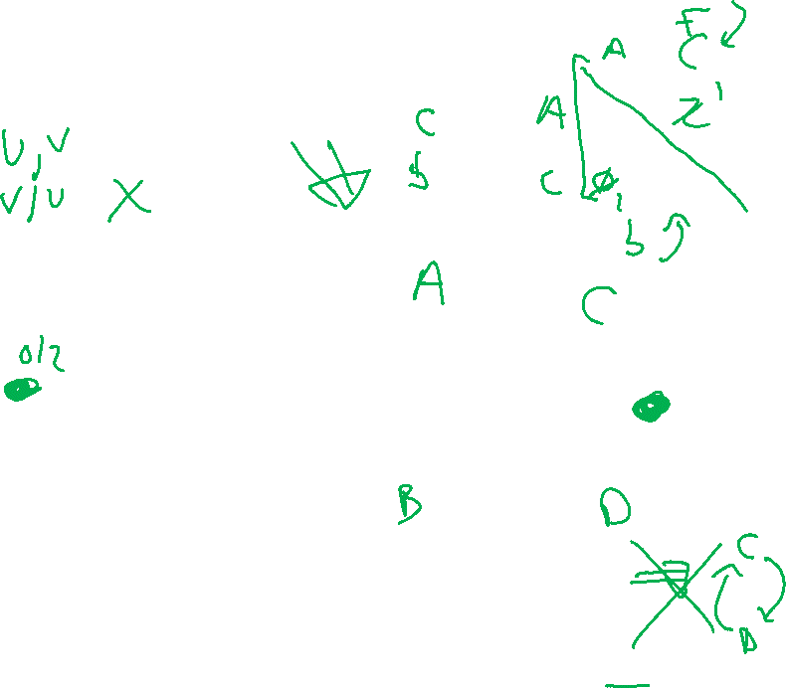

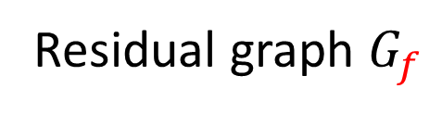

Ford-Fulkerson Example
0/2
2
0/3
3
0/3
$$s$$
0/3
$$s$$
3
3
0/1
1
0/2
$$t$$
2
$$t$$
0/2
3
0/3
2
0/2
2
0/3
3
Initially: $f\left(e\right)=0$ for all $e∈E$
Residual graph $G_{f}$

Slide 17
Ford-Fulkerson Example
Increase flow by 1 unit
0/2
2
0/3
3
0/3
$$s$$
0/3
$$s$$
3
3
0/1
1
0/2
$$t$$
2
$$t$$
0/2
3
0/3
2
0/2
2
0/3
3
Residual graph $G_{f}$

Slide 18
Ford-Fulkerson Example
Increase flow by 1 unit
1/2
2
1/3
3
0/3
$$s$$
0/3
$$s$$
3
3
1/1
1
0/2
$$t$$
2
$$t$$
0/2
3
0/3
2
1/2
2
1/3
3
Residual graph $G_{f}$

Slide 19
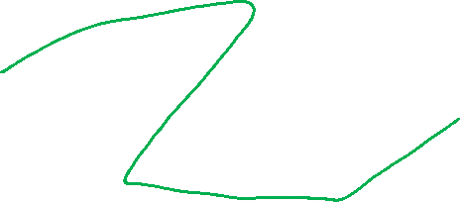
Ford-Fulkerson Example
1/2
1
1/3
2
0/3
1
$$s$$
0/3
$$s$$
1
3
3
1/1
1
0/2
$$t$$
2
1
$$t$$
0/2
3
0/3
2
1
1/2
1
1/3
2
Residual graph $G_{f}$

Slide 20
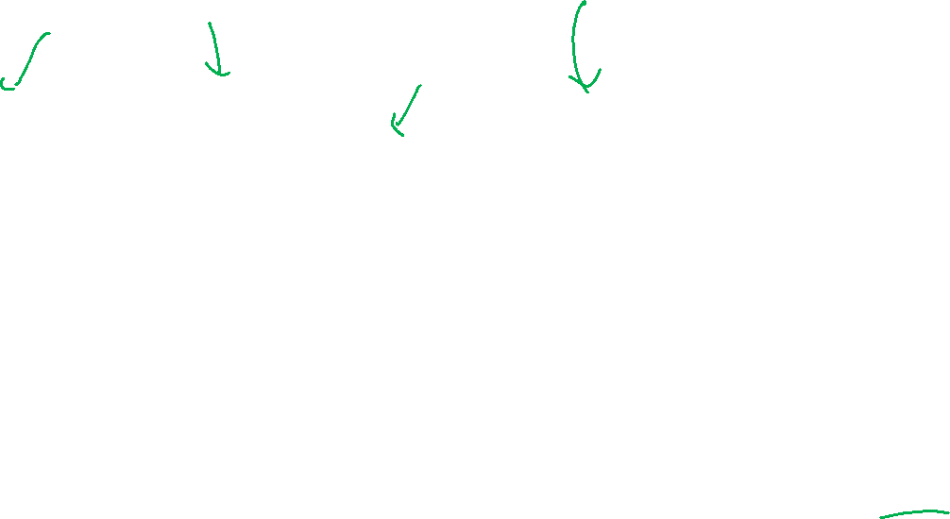
Ford-Fulkerson Example
Increase flow by 1 unit
1/2
1
1/3
2
0/3
1
$$s$$
0/3
$$s$$
1
3
3
1/1
1
0/2
$$t$$
2
1
$$t$$
0/2
3
0/3
2
1
1/2
1
1/3
2
Residual graph $G_{f}$

Slide 21

Ford-Fulkerson Example
Increase flow by 1 unit
2/2
1
2/3
2
1/3
1
$$s$$
0/3
$$s$$
1
3
3
1/1
1
0/2
$$t$$
2
1
$$t$$
0/2
3
0/3
2
1
1/2
1
1/3
2
Residual graph $G_{f}$

Slide 22
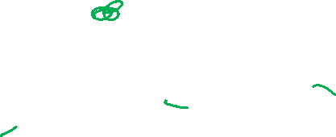
Ford-Fulkerson Example
Increase flow by 1 unit
2/2
2/3
1
1/3
2
1
$$s$$
0/3
$$s$$
2
3
2
1/1
1
0/2
$$t$$
2
1
$$t$$
0/2
3
0/3
2
1
1/2
1
1/3
2
Residual graph $G_{f}$

Slide 23
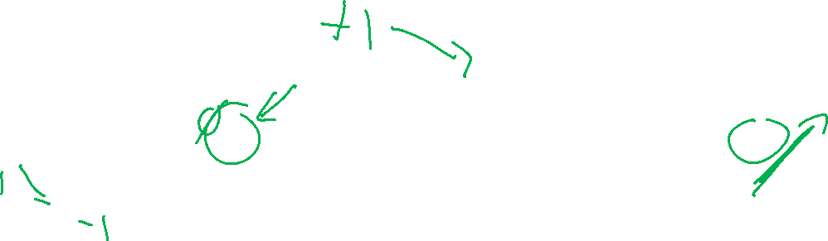


Ford-Fulkerson Example
2/2
2/3
1
1/3
2
1
$$s$$
0/3
$$s$$
2
3
2
1/1
1
0/2
$$t$$
2
1
$$t$$
0/2
3
0/3
2
1
1/2
1
1/3
2
Residual graph $G_{f}$

Slide 24

Ford-Fulkerson Example
Increase flow by 1 unit
2/2
2/3
1
2/3
2
1
$$s$$
0/3
$$s$$
2
3
2
0/1
1
0/2
$$t$$
2
1
$$t$$
1/2
3
0/3
2
1
1/2
1
1/3
2
Residual graph $G_{f}$

Slide 25

Ford-Fulkerson Example
Increase flow by 1 unit
2/2
2/3
1
2/3
2
2
$$s$$
0/3
$$s$$
2
3
1
0/1
1
0/2
$$t$$
2
1
$$t$$
1/2
1
3
0/3
1
1
1/2
1
1/3
2
Residual graph $G_{f}$

Slide 26

Ford-Fulkerson Example
2/2
2/3
1
2/3
2
2
$$s$$
0/3
$$s$$
2
3
1
0/1
1
0/2
$$t$$
2
1
$$t$$
1/2
1
3
0/3
1
1
1/2
1
1/3
2
Residual graph $G_{f}$

Slide 27
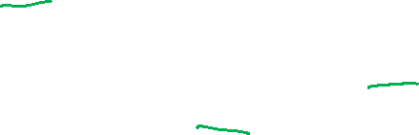
Ford-Fulkerson Example
Increase flow by 1 unit
2/2
2/3
1
2/3
2
2
$$s$$
0/3
$$s$$
2
3
1
0/1
1
0/2
$$t$$
2
1
$$t$$
2/2
1
3
0/3
1
1
2/2
1
2/3
2
Residual graph $G_{f}$

Slide 28

Ford-Fulkerson Example
2/2
2/3
1
2/3
2
2
$$s$$
0/3
$$s$$
2
3
1
0/1
1
0/2
$$t$$
2
2
$$t$$
2/2
2
3
0/3
2
2/2
2/3
1
Residual graph $G_{f}$

Slide 29
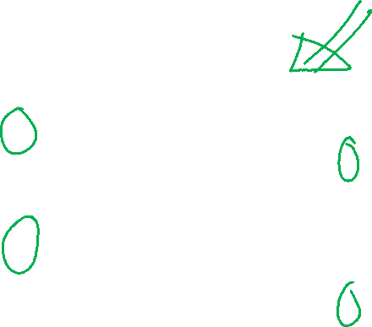
Ford-Fulkerson Example
No more augmenting paths
2/2
2/3
1
2/3
2
2
$$s$$
0/3
$$s$$
2
3
1
0/1
1
0/2
$$t$$
2
2
$$t$$
2/2
2
3
0/3
2
2/2
2/3
1
Residual graph $G_{f}$
Maximum flow: 4

Slide 30
Ford-Fulkerson Algorithm - Runtime
Define an augmenting path to be a path from $s→t$ in the residual graph $G_{f }$ (using edges of non-zero weight)
Overview: Repeatedly add the flow of any augmenting path
Ford-Fulkerson max-flow algorithm:
Initialize $f\left(e\right)=0$ for all $e∈E$
Construct the residual network $G_{f}$
While there is an augmenting path $p$ in $G_{f}$:
Let $c=\min_{u,v∈p}{c_{f}(u,v)}$
Add $c$ units of flow to $G$ based on the augmenting path $p$
Update the residual network $G_{f}$ for the updated flow
Time to find an augmenting path:
Number of iterations of While loop:

Slide 31

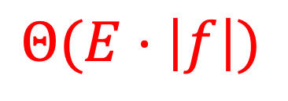

Ford-Fulkerson Algorithm - Runtime
Define an augmenting path to be a path from $s→t$ in the residual graph $G_{f }$ (using edges of non-zero weight)
Overview: Repeatedly add the flow of any augmenting path
Ford-Fulkerson max-flow algorithm:
Initialize $f\left(e\right)=0$ for all $e∈E$
Construct the residual network $G_{f}$
While there is an augmenting path $p$ in $G_{f}$:
Let $c=\min_{u,v∈p}{c_{f}(u,v)}$
Add $c$ units of flow to $G$ based on the augmenting path $p$
Update the residual network $G_{f}$ for the updated flow
Time to find an augmenting path:
$$BFS: Θ(V+E)$$
Number of iterations of While loop:
$$|f|$$
$$Θ(E⋅\left|f\right|)$$

Slide 32
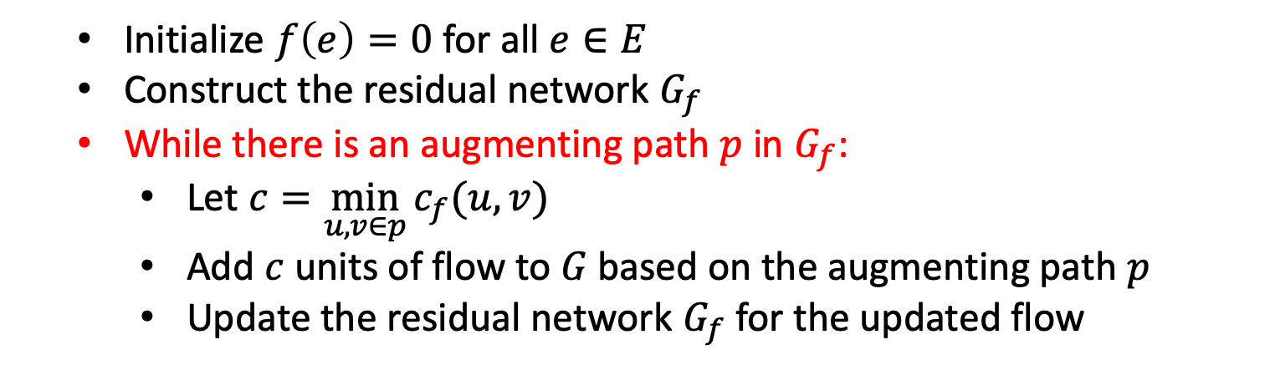


Why might we loop $|f|$ times?
Initialize $f\left(e\right)=0$ for all $e∈E$
Construct the residual network $G_{f}$
While there is an augmenting path $p$ in $G_{f}$:
Let $c=\min_{u,v∈p}{c_{f}(u,v)}$
Add $c$ units of flow to $G$ based on the augmenting path $p$
Update the residual network $G_{f}$ for the updated flow
0
0/100
0
0/100
100
100
$$s$$
0/1
$$t$$
$$s$$
0
$$t$$
1
100
100
0/100
0/100
0
0

Slide 33
Why might we loop $|f|$ times?
Initialize $f\left(e\right)=0$ for all $e∈E$
Construct the residual network $G_{f}$
While there is an augmenting path $p$ in $G_{f}$:
Let $c=\min_{u,v∈p}{c_{f}(u,v)}$
Add $c$ units of flow to $G$ based on the augmenting path $p$
Update the residual network $G_{f}$ for the updated flow
1
1/100
0
0/100
99
100
$$s$$
1/1
$$t$$
$$s$$
1
$$t$$
0
100
99
0/100
1/100
0
1

Slide 34
Why might we loop $|f|$ times?
Initialize $f\left(e\right)=0$ for all $e∈E$
Construct the residual network $G_{f}$
While there is an augmenting path $p$ in $G_{f}$:
Let $c=\min_{u,v∈p}{c_{f}(u,v)}$
Add $c$ units of flow to $G$ based on the augmenting path $p$
Update the residual network $G_{f}$ for the updated flow
1
1/100
1
1/100
99
99
$$s$$
0/1
$$t$$
$$s$$
0
$$t$$
1
99
99
1/100
1/100
1
1

Slide 35
Why might we loop $|f|$ times?
Initialize $f\left(e\right)=0$ for all $e∈E$
Construct the residual network $G_{f}$
While there is an augmenting path $p$ in $G_{f}$:
Let $c=\min_{u,v∈p}{c_{f}(u,v)}$
Add $c$ units of flow to $G$ based on the augmenting path $p$
Update the residual network $G_{f}$ for the updated flow
Each time we increase flow by 1
Loop runs 200 times
2
2/100
1
1/100
98
99
$$s$$
1/1
$$t$$
$$s$$
0
$$t$$
1
99
98
1/100
2/100
1
2

Slide 36
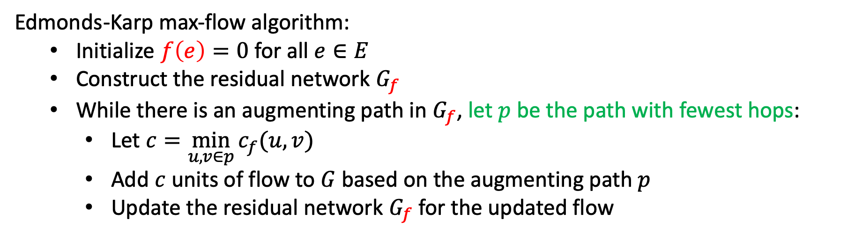

Can We Avoid this?
Edmonds-Karp Algorithm: choose augmenting path with fewest hops
Running time: $Θ\left(\min\left(\left|E\right|\left|f^{∗}\right|, \left|V\right|{\left|E\right|}^{2}\right)\right)=O\left(\left|V\right|{\left|E\right|}^{2}\right)$
Edmonds-Karp max-flow algorithm:
Initialize $f\left(e\right)=0$ for all $e∈E$
Construct the residual network $G_{f}$
While there is an augmenting path in $G_{f}$, let $p$ be the path with fewest hops:
Let $c=\min_{u,v∈p}{c_{f}(u,v)}$
Add $c$ units of flow to $G$ based on the augmenting path $p$
Update the residual network $G_{f}$ for the updated flow
Proof: See CLRS (Chapter 26.2)

Slide 37

Can We Avoid this?
Edmonds-Karp Algorithm: choose augmenting path with fewest hops
Running time: $Θ\left(\min\left(\left|E\right|\left|f^{∗}\right|, \left|V\right|{\left|E\right|}^{2}\right)\right)=O\left(\left|V\right|{\left|E\right|}^{2}\right)$
How to find this?
Use breadth-first search (BFS)!
Edmonds-Karp = Ford-Fulkerson using BFS to find augmenting path
Edmonds-Karp max-flow algorithm:
Initialize $f\left(e\right)=0$ for all $e∈E$
Construct the residual network $G_{f}$
While there is an augmenting path in $G_{f}$, let $p$ be the path with fewest hops:
Let $c=\min_{u,v∈p}{c_{f}(u,v)}$
Add $c$ units of flow to $G$ based on the augmenting path $p$
Update the residual network $G_{f}$ for the updated flow
Proof: See CLRS (Chapter 26.2)

