Slide 1
CS4102 – Algorithms
Tom Horton
horton@cs.virginia.edu
Mark Floryan
mfloryan@cs.virginia.edu
Course Mechanics
Course content
Topics from earlier classes
Course learning objectives
What’s the course all about? A quick tour

Slide 2
Course introduction

Slide 3
General Info
See syllabus on course website for general information
Pre-requisites:
CS2150 (with C- or better)
Math topics: proof by induction, proof by contradiction, exponents, logarithms, limits, simple differentiations (covered in APMA 1090 or MATH 1210 or MATH 1310)
Teaching Assistants
Graduates (1):
Austin Engle (ae3xd)
Undergraduates (~20)
We should have enough undergraduate support!
Both will hold office hours, which will start next week
Locations and hours mostly set on course website
Also, we’ll use Piazza for questions and Discord for office hours
Post all questions about HW, topics, etc. to Piazza NOT email to instructors!

Slide 4
Discord
Much of our course communication will happen on Discord.
Class announcements
Office Hours
General Q&A with TAs, etc. (We will use Piazza too)
If you want instructors to see it, use Piazza
If someone else might search for this later, use Piazza
Please join ASAP!
https://discord.gg/GqqakWbs (expires end of first week or so)

Slide 5
Piazza
We will use Piazza
Link to course site available in Collab tools
Please use Piazza for:
Content related questions
Working through example homework problems
Helping each other with test cases / edge cases on programming
Discussing old exam questions
etc….

Slide 6
Expectations
Of you:
When asked, prepare for things in advance
Participate in class activities when asked
Act mature, professional.
Plan ahead.
Don’t take advantage. Follow the Honor Code. (See the BOCM.)
Of me:
Be fair, open, and considerate.
Seek and listen to your feedback.
Not to waste your time.
Be effective in letting you know how you’re doing

Slide 7
General Info
Textbook:
Introduction to Algorithms, 3rd edition, by Cormen, et. al.
Other references:
Your CS2150 material (will be VERY useful here)
Discrete Math textbook / references
Other readings may be assigned
We’ll see…

Slide 8
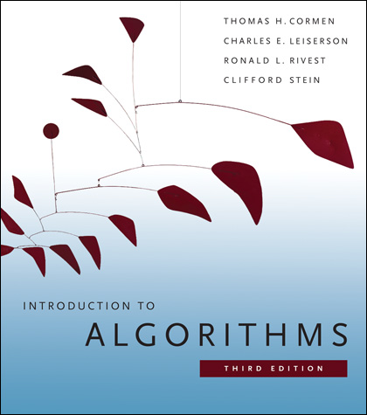
Textbook
You really need to read and study material other than the slides.
There are options, but a textbook is the easiest option.
We’ll post readings from CLRS, urge you to read them or get that info from another source.
We may also post additional resources.
Introduction to Algorithms by Cormen, et. al. (CLRS)
3rd edition!
UVA Library has a digital version of CLRS available online for free at https://search.lib.virginia.edu/catalog/u6757775

Slide 9
Lectures
Back to traditional, in-person lectures.
12:30 - 1:45 pm @ Olsson Hall 120 (Floryan)
2:00 - 3:15 pm @ Gilmer Hall 390 (Horton)
At least one of the two lectures (maybe both) will be recorded and posted on Collab -> Lecture Recordings
Using Panopto, so no live broadcast
Lectures will cover course topics, example problems, proofs, etc.

Slide 10
Modules
The course is divided into 10 modules
Divide & Conquer: Insertion Sort, Mergesort, Quicksort
Divide & Conquer: Recurrence Relations
Divide & Conquer: Advanced Topics
Graphs: Breadth-first Search (BFS) & Depth Search (DFS)
Graphs: Kruskal’s and Find-Union
Graphs: Prim’s & Dijkstra’s
Greedy Algorithms
Dynamic Programming
Network Flow and Ford-Fulkerson
Bi-Partite Matching & Reductions

Slide 11
Modules (Cont’d)
Most modules are 2 lectures worth of content, some are 3 or 4 lectures.
Each module involves:
2-4 lectures worth of content
1 homework assignment
1 quiz (assessment)

Slide 12
Quizzes
Short assessments of your knowledge in each module
Meant to ensure you have knowledge of the individual topics from lecture to a sufficient degree.
There are five different dates to take quizzes (in lecture)
Tue, Sep. 21 Mod 1-3 (first attempts)
Thu, Oct. 7 Mod 1-3 (second attempt), 4-5 (first attempt)
Tue, Nov. 16 Mod 4-5 (second attempt), 6-8 (first attempt)
Thu, Dec. 2 Mod 6-8 (second attempt), 9-10 (first attempt)
Final Exam Mod 1-10 (final attempts)
Note: it’s naturally harder to do a lot of quizzes in a 75-minute class period, so don’t get yourself into a bad situation!

Slide 13
Quizzes
Three possible grade outcomes for each module:
Incomplete: Knowledge not shown
Pass: You clearly demonstrate competence for this module
High-Pass: You did VERY well on this quiz
You always receive the highest grade over all attempts
Your quiz grade for a module can never decrease
You can take module quizzes multiple times
You never need to retake a quiz once you get a high-pass
Though you may decide that “pass” is good enough for you and choose not to retake a particular quiz

Slide 14
Quizzes (quick example)
Quiz Day 1:
Floryan takes quizzes 1-3
Floryan receives a high-pass, pass, and incomplete (fail) on them respectively. **Note that the score is PER MODULE
Quiz Day 2:
Floryan DOES NOT need to retake module 1
Floryan MIGHT choose to retry module 2 (get pass to high pass)
Floryan SHOULD retry module 3 (to pass it)
Floryan will attempt modules 4-5 for the first time also if he has time
In general: always attempt quizzes you haven’t passed FIRST, then try to retake old quizzes you’ve passed to get high-pass second.

Slide 15
Final Exam
Our final exam time will be used to:
Provide you with one more attempt at every quiz
You will ONLY attempt quizzes for which you haven’t passed or wish to increase your grade further (to high-pass)
This means if you’ve already passed every quiz, you do not need to do anything during the final exam period
Likewise, some of you will come in to take 1 or 2 quizzes only, and that is fine.
We DO NOT RECOMMEND attempting all 10 quizzes once during the final.

Slide 16
Homeworks
Each of the 10 modules has one homework associated
Programming HW:
Can be written in Java, C++, or Python (your choice)
Homework will specify the problem, input, and output specs.
Some will be graded solely on passing test-cases and/or meeting a target runtime.
Some will require you to measure run-times and answer questions.
Written HW
Solving small problems, analyzing runtimes, etc.
Sometimes proofs of correctness, etc.
Written in Latex (tutorial on course webpage)

Slide 17
Homework Grades
Homeworks are pass / fail and meant to be fairly low-stress (compared to other classes):
Incomplete: The student has not submitted evidence that they have engaged with the material and with the assignment.
Pass: The student has shown evidence that they have attempted the ENTIRE assignment and made a serious, thoughtful attempt at it.
You may submit homework assignments as many times as you’d like until you pass.

Slide 18
Homework Grades (Cont’d)
A Pass does NOT mean that your homework is perfect. Simply means you clearly have put in the effort we expect.
On a programming HW, a pass might mean:
You are passing simple and moderate test cases but your code is still a little too slow. You “pass” the assignment, but are encouraged to continue investigating how you can more cleanly solve the problem.
On a written homework:
You have made a serious, well-written attempt at every problem even if the solutions have some issues.

Slide 19
Homework Grade Philosophy
Wait, so homework is all effort-based?
Well…not quite. The purpose of the homework is:
To practice in an environment that is lower-stress
To push yourself to solve algorithms problems to prepare you for the quizzes, NOT just to get a grade.
To tinker and experiment with your code (e.g., what happens if I slightly change the base case on this algorithm)
To focus on attempting to solve problems yourself before asking others for assistance.
To show us that you engaged with the homework by showing that work is “mostly” there.

Slide 20
Quiz and Homework Deadlines
Quiz Deadlines:
Are in-person during the set lecture dates (see previous slides)
No makeups provided unless you have extreme extenuating circumstances (e.g., Covid-19 Quarantine, etc.)
Remember: you get 3 attempts at Quizzes 1-8 and 2 attempts for Quizzes 9-10
Homework Deadlines:
Each homework will have a recommended deadline (about 1 per week)
If you want to succeed, you need to try to hit these recommended deadlines
Deadlines are all soft deadlines (i.e., everyone gets an automatic extension until the end of the semester.
All homework is due Fri., Dec. 3 (except perhaps the last HW)

Slide 21
Grading Overview
Let’s look at how grades work on course website →
Your goal is to pass modules
You pass a module by:
Passing the homework for that module AND
Passing the quiz (you DO NOT need a high-pass)
Your final letter grade is determined by how many modules you pass
High-passing the quiz in a module can raise your grade a bit more.

Slide 22
Grading Scheme Philosophy
For grades F-B, passing new modules is more important than high-passing old ones
We care about breadth over depth until you reach 9 modules passed to earn a B
High-pass can be used to raise your grade slightly at each grade level.
After B obtained, high-passes are needed to earn, B+, A-, etc.
We are treating the course as having 9 modules (for B) instead of 10, effectively allowing you to “skip one module”

Slide 23
Why this Approach to Grades?
It’s a good match of CS department policy on course letter grades: http://ugrads.cs.virginia.edu/grading-guidelines.html
We Think These Are Benefits:
It values competence in a breadth of modules
Lower stress from HWs: practice, explore, tinker,…
Lower stress because you can repeat quizzes
Many quizzes, more chances to take
“Visible:” You know what you’ve earned so far, can predict scores on future modules to see where you might end up
Small grading changes have correspondingly small impacts on final grade

Slide 24
Office Hours
Let’s discuss office hours by looking at the course website.

Slide 25
Homework: Programming Hints
Understand the problem!
Consider all boundary cases
Use pre-existing library code
Number formatting: NumberFormat in Java, printf() in C/C++
Input: Scanner in Java, scanf() in C, cin in C++
Know how to handle floating point numbers
Understand float/double precision issues
Rounding, floating-point mod
Make sure it works for the provided test cases
Then write some of your own
Make sure you read the language specific details for submission!!!

Slide 26
Homework: Programming FAQ
Do I need to write my own sorting methods.
No, unless the point of that assignment is to write sorting methods, you can use libraries for this.
Can I get the test cases from submission server?
No, part of the point is to work on brainstorming cases your code is missing without being told. Submission server will give limited feedback on purpose!
Will you help me debug my code?
No, we won’t. You need to learn how to do this on your own. I’m happy to give you advice on how to approach your debugging problems, but I will not sit down and debug code with you.

Slide 27
Homework: Written
These assignments must be typeset in LaTeX
I will provide a couple tutorials, guides, and templates when the first assignment is given out
You may not embed images of text or formulas!

Slide 28
Use of Online Code Etc.
Studying code online is permitted but only for getting ideas
Copying or reusing code from an online source violates the pledge
You must cite sources of any online code you use in this way in a comment in your source file(s)
Remember: the purpose of the homework is
To practice in an environment that is lower-stress
To push yourself to solve algorithms problems to prepare you for the quizzes, NOT just to get a grade.
To tinker and experiment with your code (e.g., what happens if I slightly change the base case on this algorithm)
To focus on attempting to solve problems yourself before asking others for assistance.

Slide 29
Working in groups
For the homeworks, you may work together in groups of 5 or less to discuss the algorithmic aspects ONLY
State who you worked with (in code comments)
Do not look at or copy another student’s code!
For the written homeworks, you may work together in groups of 5 or less, but you MUST:
State who you worked with
Type up your own assignment!

Slide 30
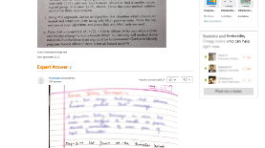
Academic Integrity
Collaboration allowed and encouraged!
But only within your groups of up to 5 per assignment (you + 4 more)
Write-ups/code written independently
DO NOT share written solutions / code
DO NOT share documents (ex: Overleaf)
DO NOT share debugging of code
DO NOT seek published solutions online
Be able to explain any solution you submit!
We will find those who don’t do the right thing.

Slide 31
What you know already from CS2150
Definition of an algorithm
Definition of algorithm “complexity”
Measuring worst-case complexity
Cost as a function of input size
Asymptotic rate of growth: Big-Oh, Big-Theta
Relative ordering of rates of growth
Analyzing an algorithm's cost:
sequences, loops, if/else, functions, recursion
Focus on counting one particular statement or operation; don’t count all statements

Slide 32
What you know already from CS2150
Problems and their solutions:
Linear data structures vs. tree data structures
Searching: linear/sequential search, binary search (?), hashing
Sorting: quicksort, mergesort in CS2110 (?)
Priority Queue ADT and Heap Implementation

Slide 33
What you know already from all your courses
Examples of Algorithm design methods:
Divide and Conquer (quicksort, mergesort)
Greedy (though you didn’t call it this)
Dynamic programming (fibonacci numbers, Floyd-Warshall)
NP-complete (traveling salesperson. Have you seen this?)

Slide 34
What you know already from Discrete Math and Theory of Computation…
From CS2102:
Proofs: induction, contradiction
If you are uncomfortable with these two, review them NOW!
Counting, probability, combinatorics, permutations
From some earlier math class:
Exponents, logarithms, limits, differentiation on polynomials and other simple functions
From CS3102 (if you have taken it)
Maturity in mathematics and computing theory
Ability to do proofs
Abstract models of computation, such as Turing machines

Slide 35
Questions? Concerns? Wrath to vent?

Slide 36
A first algorithm: making change

Slide 37
OK… But What’s It Really All About?
Let’s illustrate some ideas you’ll see throughout the course
Using one example
Concepts:
Describing an algorithm
Measuring algorithm efficiency
Families or types of problems
Algorithm design strategies
Alternative strategies
Lower bounds and optimal algorithms
Problems that seem very hard

Slide 38
Everyone Already Knows Many Algorithms!
Worked retail? You know how to make change!
Example:
My item costs $4.37. I give you a five dollar bill. What do you give me in change?
Answer: two quarters, a dime, three pennies
Why? How do we figure that out?

Slide 39
Making Change
The problem:
Give back the right amount of change, and…
Return the fewest number of coins!
Inputs: the dollar-amount to return
Also, the set of possible coins. (Do we have half-dollars? That affects the answer we give.)
Output: a set of coins
Note this problem statement is simply a transformation
Given input, generate output with certain properties
No statement about how to do it.
Can you describe the algorithm you use?

Slide 40
A Change Algorithm
Consider the largest coin
How many go into the amount left?
Add that many of that coin to the output
Subtract the amount for those coins from the amount left to return
If the amount left is zero, done!
If not, consider next largest coin, and go back to Step 2
Notes:
Will this always finish? Yes, because we have pennies!

Slide 41
Is this a “good” algorithm?
What makes an algorithm “good”?
Good time complexity. (Maybe space complexity.)
Better than any other algorithm
Easy to understand
How could we measure how much work an algorithm does?
Code it and time it. Issues?
Count how many “instructions” it does before implementing it
Computer scientists count basic operations, and use a rough measure of this: order class, e.g. O(n lg n)

Slide 42
Evaluating Our Greedy Algorithm
How much work does it do?
Say C is the amount of change, and N is the number of coins in our coin-set
Loop at most N times, and inside the loop we do:
A division
Add something to the output list
A subtraction, and a test
We say this is O(N), or linear in terms of the size of the coin-set
Could we do better?
Is this an optimal algorithm?
We need to do a proof somehow to show this

Slide 43
You’re Being Greedy!
This algorithm is an example of a family of algorithms called greedy algorithms
Suitable for optimization problems
There are many feasible answers that add up to the right amount, but one is optimal or best (fewest coins)
Immediately greedy: at each step, choose what looks best now. No “look-ahead” into the future!
What’s an optimization problem?
Some subset or combination of values satisfies problem constraints (feasible solutions)
But, a way of comparing these. One is best: the optimal solution

Slide 44
Does Greed Pay Off?
Greedy algorithms are often efficient.
Are they always right? Always find the optimal answer?
For some problems.
Not for checkers or chess!
Always for coin-changing problem? Depends on coin values
Say we had a 11-cent coin
What happens if we need to return 15 cents?
So how do we know?
In the real world:
Many optimization problems
Many good greedy solutions to some of these
Notes:
Use a funny name for the 11-cent coin. Name it after yourself, or call it a “Kardashian” or a Floryan or something.
If our set of coins contains a “Kardashian” plus the usual, then our algorithm will return first a Kardashian, then four pennies. Five coins. The best answer is a dime and a nickel, or two coins.

Slide 45
Formal algorithmic description
All algorithms in this course must have the following components:
Problem description (1 line max)
Inputs
Outputs
Assumptions
Strategy overview
1 or 2 sentences outlining the basic strategy, including the name of the method you are going to use for the algorithm
Algorithm description
If listed in English (as opposed to pseudo-code), then it should be listed in steps

Slide 46
Change solution (greedy)
Problem description: providing coin change of a given amount in the fewest number of coins
Inputs: the dollar-amount to return. Perhaps the possible set of coins, if it is non-obvious.
Output: a set of coins that obtains the desired amount of change in the fewest number of coins
Assumptions: If the coins are not stated, then they are the standard quarter, dime, nickel, and penny. All inputs are non-negative, and dollar amounts are ignored.
Strategy: a greedy algorithm that uses the largest coins first
Description: Issue the largest coin (quarters) until the amount left is less than the amount of a quarter ($0.25). Repeat with decreasing coin sizes (dimes, nickels, pennies).

Slide 47
Another Change Algorithm
Give me another way to do this?
Brute force:
Generate all possible combinations of coins that add up to the required amount
From these, choose the one with smallest number
What would you say about this approach?
There are other ways to solve this problem
Dynamic programming: build a table of solutions to small subproblems, work your way up

Slide 48
Change solution (brute-force)
Problem description: providing coin change of a given amount in the fewest number of coins
Inputs: the dollar-amount to return. Perhaps the possible set of coins, if it is non-obvious.
Output: a set of coins that obtains the desired amount of change in the fewest number of coins
Assumptions: If the coins are not stated, then they are the standard quarter, dime, nickel, and penny. All inputs are non-negative, and dollar amounts are ignored.
Strategy: a brute-force algorithm that considers every possibility and picks the one with the fewest number of coins
Description: Consider every possible combination of coins that add to the given amount (done via a depth-first search). Return the one with the fewest number of coins.

Slide 49
Motivating problems

Slide 50
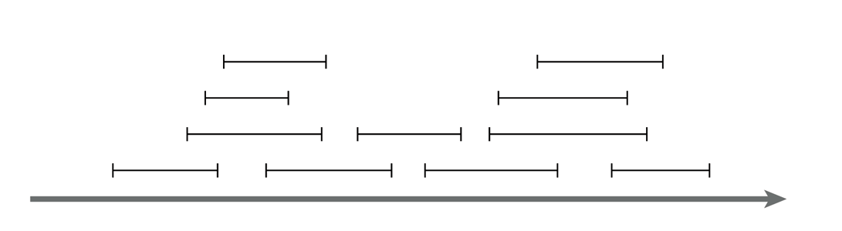
Motivating problem: Interval scheduling
Interval scheduling
Given a series of requests, each with a start time and end time, maximize the number of requests scheduled
This is solved by a greedy algorithm
Most of the CS 2150 algorithms you’ve seen are greedy algorithms: Dijkstra’s shortest path, both MST algorithms, etc.

Slide 51
Motivating problem: Weighted interval scheduling
Weighted interval scheduling
Same as the regular interval scheduling, but in addition each request has a cost associated with it
The goal is to maximize the cost from scheduling the items
This is solved by dynamic programming

Slide 52
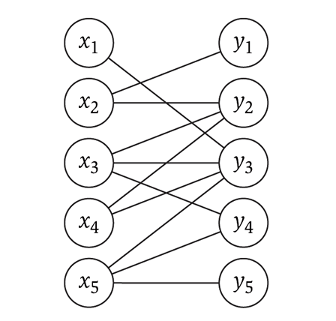
Motivating problem: Bipartite matching
Bipartite matching
Given a graph G, find the maximum sub-graph of G that partitions G into sets X and Y such that no node from X is connected to a node in Y, and vise-versa
Example: given a series of requests, and entities that can handle each request (such people, computers, etc.), find the optimal matching of requests to entities
This is a network flow problem

Slide 53
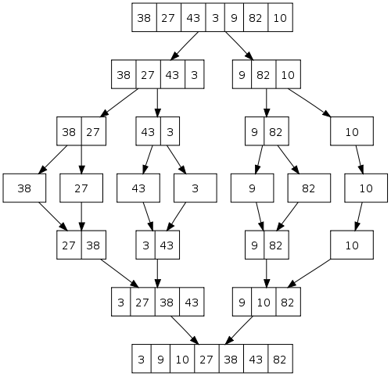
Motivating problem: Sorting
How do you implement a general-purpose sort that is as efficient as possible in both space and time, and is stable?
One solution is merge-sort
We’ll see later why quicksort, heapsort, and radix sort are not sufficient
This is an application of both sorting and divide and conquer

Slide 54
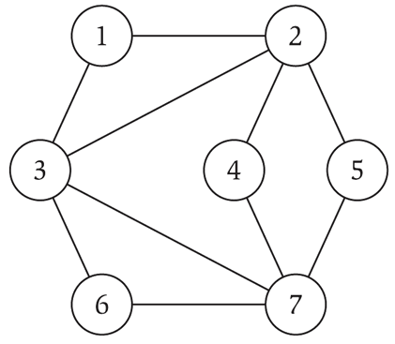
Motivating problem: Independent set
Independent set
Given a graph G, find the maximum size subset X of G such that no two nodes in X are connected to each other
This is a NP-complete problem
You’ve seen TSP (travelling salesperson problem) in CS 2150, which is a NP-complete problem

Slide 55
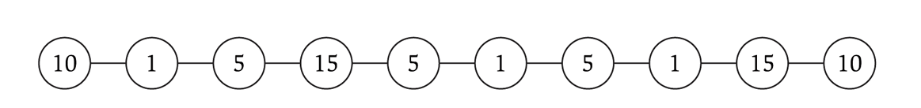
Motivating problem: Competitive facility location
Competitive facility location
Consider a graph G, where two ‘players’ choose nodes in alternating order. No two nodes can be chosen (by either side) if a connecting node is already chosen. Choose the winning strategy for your player.
This is a PSPACE problem, which are harder than NP-complete problems

