Slide 1
Announcements: Monday, May 3
Last week of classes!!!!
Quiz 3 (attempt 2) and Quiz 4 (attempt 1) are end of this week
See Piazza note about quiz-window
Yes, things are rushed…. ☹
Module 4 hard deadline is May 10
Yes, this is during exams. See Piazza note. You can think of this as you being meant to be done by Thursday night, but you can have extra time.
No Module 4 soft deadline really
Recommended: do whatever Module 4 HWs you need to meet your goal
Today: another reduction!

Slide 2
Lecture Planning
There are n total guest lectures that can be given
There are l guest lectures to be given (one per week) during the first “half” of the course
For each week, a different set of lectures are available
There may be more guest lectures than the l slots
During the second “half” of the course, there are p projects to be completed, one each week
Each project requires one of a set of guest lectures
Can you schedule l guest lecturers (one per week) such that all p the projects can be completed?

Slide 3
Lecture planning Inputs
l (the number of weeks of lectures)
p (the number of projects)
n (the number of possible guest lecturers)
Availability of lecturers for each week, L_{i}
L₁ = {A, B, C}, L₂ = {A, D}, …
Which lectures/lecturers are needed for each of the projects, P_{i}
P₁ = {B, C}, P₂ = {A, B, D}, P₃ = {C, D}, …
Remember: reduction means transforming one input to another…

Slide 4
Lecture planning example
l (the number of weeks of lectures) = 2
p (the number of projects) = 3
n (the number of possible guest lecturers) = 4
L_{i}, the availability for the two weeks:
L₁ = {A, B, C}, L₂ = {A, D}
P_{i}, which lectures/lecturers are needed for each of the 3 projects:
P₁ = {B, C}, P₂ = {A, B, D}, P₃ = {C, D}
Of the 4 lecturers, can we schedule 2 of them such that all 3 of the projects can be completed?
Yes, we can schedule B in the first week and D in the second week
Solution for search-problem: { (i,j), … } where lecturer i scheduled for week j for all l weeks.

Slide 7

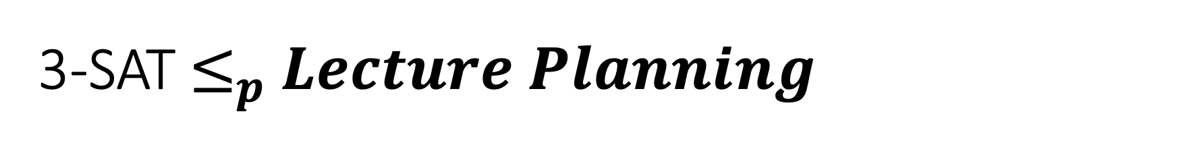
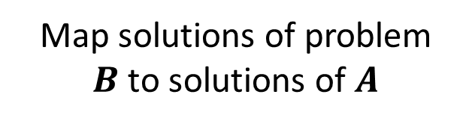
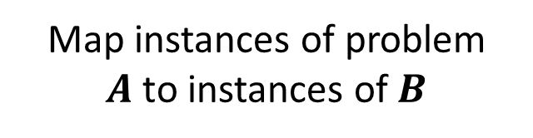
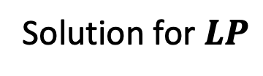
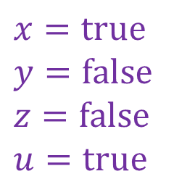
3-SAT $≤_{p}$ $Lecture Planning$
3-SAT
$$LecturePlanning$$
Map instances of problem $A$to instances of $B$
polynomial time
l, p, n, L_{i}, P_{i}
Map solutions of problem $B$to solutions of $A$
$$x=true$$
$$y=false$$
$$z=false$$
$$u=true$$
Solution for $LP$
polynomial time
Mapping of lecturers to weeks
polynomial-time reduction

Slide 8
Prove that Lecture Planning is NP-complete
Can reduce from 3-SAT
Can you do it?
Will you see this later on a quiz?
Maybe ;)
Actually…no you won’t
Is he lying?
I’m confused!
Seriously though…this is a really good example of how to approach a reduction
Notes:
Pages 502-505

