Slide 1
Quicksort Lower Bounds for Comparison Sorts
CS 4102, Algorithms
Prof. Floryan and Prof. Horton
Spring 2021

Slide 2
Quicksort and Partition
Readings: CLRS Chapter 7 (not 7.4.2)

Slide 3
Quicksort: Introduction
Developed by C.A.R. (Tony) Hoare (a Turing Award winner) http://www.wikipedia.org/wiki/C._A._R._Hoare
Published in 1962
Classic divide and conquer, but…
Mergesort does no comparisons to divide, but a lot to combine results (i.e. the merge) at each step
Quicksort does a lot of work to divide, but has nothing to do after the recursive calls. No work to combine.
If we’re using arrays. Linked lists? Interesting to think about this!
Dividing done with algorithm often called partition
Sometimes called split. Several variations.

Slide 4
Quicksort’s Strategy
Called on subsection of array from first to last
Like mergesort
First, choose some element in the array to be the pivot element
Any element! Doesn't matter for correctness.
Often the first item. For us, the last. Or, we often move some element into the last position (to get better efficiency)
Second, call partition, which does two things:
Puts the pivot in its proper place, i.e. where it will be in the correctly sorted sequence
All elements below the pivot are less-than the pivot, and all elements above the pivot are greater-than
Third, use quicksort recursively on both sub-lists

Slide 5
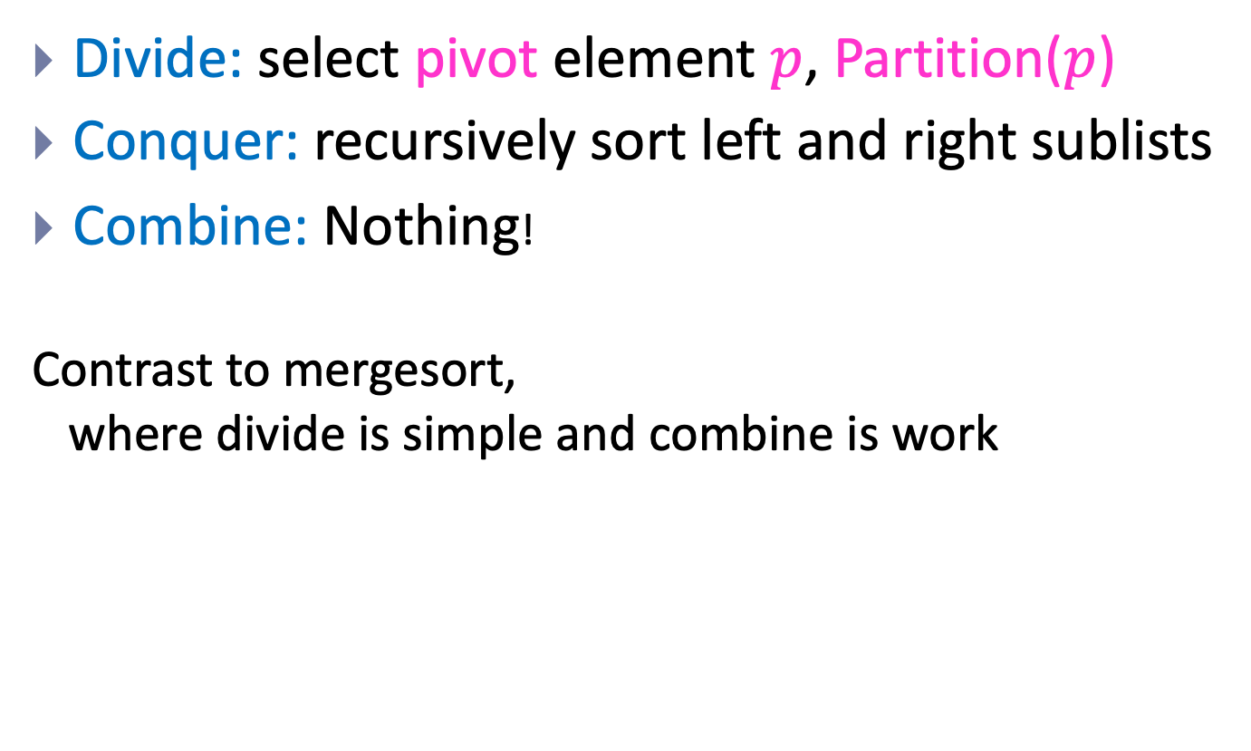
Quicksort is Divide and Conquer
Divide: select pivot element $p$, Partition($p$)
Conquer: recursively sort left and right sublists
Combine: Nothing!
Contrast to mergesort, where divide is simple and combine is work

Slide 6
Quicksort’s Strategy (a picture)
Use last element as pivot (or pick one and move it there)
After call to partition…
Now sort two parts recursively and we’re done!
Note that splitPoint may be anywhere in first..last
Note our assumption that all keys are distinct
pivot
first
last
<= pivot (unsorted)
pivot
> pivot (unsorted)
first
split point
last
<= pivot (sorted)
pivot
> pivot (sorted)
first
split point
last

Slide 7
Quicksort Code
Input Parameters: list, first, last
Output Parameters: list
def quicksort(list, first, last):
if first < last:
q = partition(list, first, last)
quicksort(list, first, q-1)
quicksort(list, q+1, last)
return

Slide 8
Partition Does the Dirty Work
Partition rearranges elements
How? How many comparisons? How many swaps?
How? Two well-known algorithms
In this chapter of CLRS, Lomuto’s algorithm
In the exercises, the original: Hoare’s algorithm. (Page 185. Look at on your own.)
Important:
Both are in-place!
Both are linear.

Slide 9

Strategy for Lomuto’s Partition
Invariant: At any point:
i indexes the right-most element <= pivot
j-1 indexes the right-most element > pivot
Note: book uses p and r for what we called first and last in earlier slides
Strategy:
Look at next item a[j]
If that item > pivot, all is well!
If that item < pivot, increment i and then swap items at positions i and j
When done, swap pivot with item at position i+1
Number of comparisons: n-1

Slide 10
Efficiency of Quicksort
Partition divides into two sub-lists, perhaps unequal size
Depends on value of pivot element
Recurrence for Quicksort T(n) = partition-cost + T(size of 1st section) + T(size of 2nd section)
If divides equally, T(n) = 2 T(n/2) + n-1
Just like mergesort
Solve by substitution or master theorem T(n) ∈ Θ(n lg n )
This is the best-case. But…

Slide 11
Worst Case of Quicksort
What if divides in most unequal fashion possible?
One subsection has size 0, other has size n-1
T(n) = T(0) + T(n-1) + n-1
What if this happens every time we call partition recursively?
Uh oh. Same as insertion sort.
“Sorry Prof. Hoare – we have to take back that Turing Award now!”

Slide 12
Quicksort’s Average Case
Good if it divides equally, bad if most unequal.
Remember: when subproblems size 0 and n-1
Can worst-case happen? Sure! Many cases. One is when elements already sorted. Last element is max, pivot around that. Next pivot is 2nd max…
What’s the average?
Much closer to the best case
A bad-split then a good-split is closer to best-case (pp. 176-178)
To prove A(n), fun with recurrences!
The result: If all permutations are equal, then A(n) ≅ 1.386 n lg n (for large n)
So very fast on average.
And, we can take simple steps to avoid the worst case!

Slide 13
Avoiding Quicksort’s Worst Case
Make sure we don’t pivot around max or min
Find a better choice and swap it with last element
Then partition as before
Recall we get best case if divides equally
Could find median. But this costs Θ(n). Instead…
Choose a random element between first and last and swap it with the last element
Or, estimate the median by using the “median-of-three” method
Pick 3 elements (say, first, middle and last)
Choose median of these and swap with last. (Cost?)
If sorted, then this chooses real median. Best case!

Slide 14
Tuning Quicksort’s Performance
In practice quicksort runs fast
A(n) is log-linear, and the “constants” are smaller than mergesort and heapsort
Often used in software libraries
So worth tuning it to squeeze the most out of it
Always do something to avoid worst-case
Sort small sub-lists with (say) insertion sort
For small inputs, insertion sort is fine
No recursion, function calls
Variation: don’t sort small sections at all. After quicksort is done, sort entire array with insertion sort
It’s efficient on almost-sorted arrays!

Slide 15
Quicksort’s Space Complexity
Looks like it’s in-place, but there’s a recursion stack
Depends on your definition: some people define in-place to not include stack space used by recursion
E.g. our CLRS algorithms textbook
Other books and people do “count” this
How much goes on the stack?
If most uneven splits, then Θ(n).
If splits evenly every time, then Θ(lg n).
Ways to reduce stack-space used due to recursion
Various books cover the details (not ours, though)
First, remove 2nd recursive call (tail-recursion)
Second, always do recursive call on smaller section

Slide 16
Summary: Quicksort
Divide and conquer where divide does the heavy-lifting
In worst-case, efficiency is Θ(n²)
But it’s practical to avoid the worst-case
On average, efficiency is Θ(n lg n)
Better space-complexity than mergesort.
In practice, runs fast and widely used
Many ways to tune its performance
Various strategies for Partition
Some work better if duplicate keys
More details? See Sedgewick’s algorithms textbook
He’s the expert! PhD on this under Donald Knuth

Slide 17
Lower Bounds Proof for Comparison Sorts
Readings: CLRS Section 8.1

Slide 18
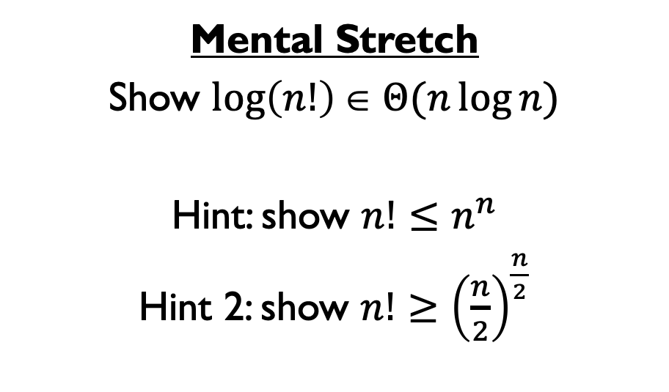
Mental Stretch
Show $\log\left(n!\right)\text{∈} Θ(n\log{n})$
Hint: show $n!≤n^{n}$
Hint 2: show $n!≥{\left(\frac{n}{2}\right)}^{\frac{n}{2}}$

Slide 19
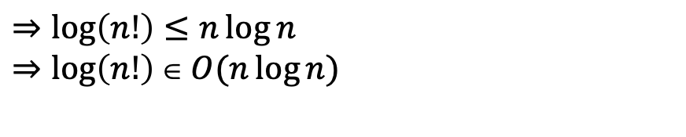
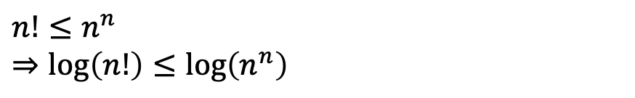



$$\log{n!}\text{∈} O\left(n\log{n}\right)$$
$$n!=n⋅\left(n−1\right)⋅\left(n−2\right)⋅…⋅2⋅1$$
$$=$$
$$<$$
$$<$$
$$<$$
$$<$$
$$n^{n}=n⋅ n ⋅ n ⋅…⋅n⋅n$$
$$n!≤n^{n}$$
$$⇒\log\left(n!\right)≤\log\left(n^{n}\right)$$
$$⇒\log\left(n!\right)≤n\log{n}$$
$$⇒\log\left(n!\right)\text{∈} O(n\log{n})$$

Slide 20

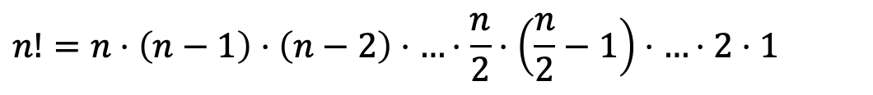






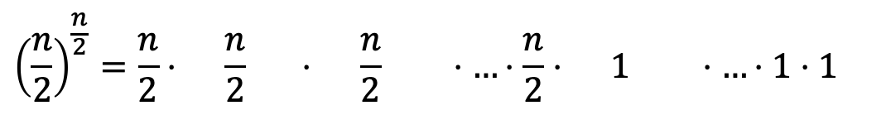
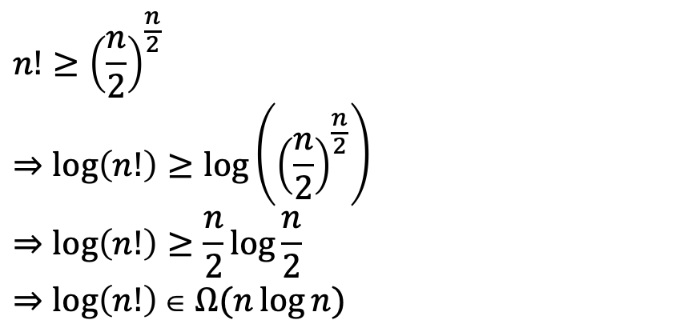
$$\log{n!}\text{∈} Ω\left(n\log{n}\right)$$
$$n!=n⋅\left(n−1\right)⋅\left(n−2\right)⋅…⋅\frac{n}{2}⋅\left(\frac{n}{2}−1\right)⋅…⋅2⋅1$$
$$>$$
$$>$$
$$>$$
$$=$$
$$>$$
$$>$$
$$=$$
$${\left(\frac{n}{2}\right)}^{\frac{n}{2}}=\frac{n}{2}⋅ \frac{n}{2} ⋅ \frac{n}{2} ⋅…⋅\frac{n}{2}⋅ 1 ⋅…⋅1⋅1$$
$$n!≥{\left(\frac{n}{2}\right)}^{\frac{n}{2}}$$
$$⇒\log\left(n!\right)≥\log\left({\left(\frac{n}{2}\right)}^{\frac{n}{2}}\right)$$
$$⇒\log\left(n!\right)≥\frac{n}{2}\log{\frac{n}{2}}$$
$$⇒\log\left(n!\right)\text{∈} Ω(n\log{n})$$

Slide 21

Worst Case Lower Bounds
Prove that there is no algorithm which can sort faster than $O(n\log{n})$
Non-existence proof!
Seems like maybe it would be very hard to do… (?)

Slide 22
Strategy: Decision Tree
Sorting algorithms use comparisons to determine the order of input elements
Conceptually possible to draw a tree to illustrate all possible execution paths
One comparison
Possible execution path
Result of comparison
<
>or<?
>
<
>or<?
>
<
>or<?
>
>or<?
>or<?
>or<?
>or<?
>or<?
>or<?
>or<?
>or<?
>or<?
>or<?
>or<?
>or<?
…
…
…
…
…
…
Permutation of sorted list
[1,2,3,4,5]
[2,1,3,4,5]
[5,2,4,1,3]
[5,4,3,2,1]

Slide 23
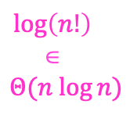

Strategy: Decision Tree
Worst case run time is the longest execution path
i.e., “height” of the decision tree
One comparison
Possible execution path
Result of comparison
<
>or<?
>
$\log\left(n!\right)$ $\text{}$ $$Θ(n log{n})$$
<
>or<?
>
<
>or<?
>
>or<?
>or<?
>or<?
>or<?
>or<?
>or<?
>or<?
>or<?
>or<?
>or<?
>or<?
>or<?
…
…
…
…
…
…
Permutation of sorted list
[1,2,3,4,5]
[2,1,3,4,5]
[5,2,4,1,3]
[5,4,3,2,1]
$n!p$ossible permutations

Slide 24
Lower Bound for Worst Case
Binary tree property: At level d in a binary tree, there are at most 2^{d} nodes (where level of root is 0)
Also, let’s say a tree’s height is number of levels minus one
Height of our decision tree is the W(n) number of comparisons
Theorem 8.1 (p. 193):
Let L be the number of leaves in a binary tree and let h be its height. (Book uses lower-case l, not L like we do here.)
Then . (Number of leaves is no more than 2^{h}.)
Therefore (Height is not less than…)
For a correct sorting algorithm, L >= n!
Therefore
Thus, for any algorithm that sorts by comparison of keys W(n) is at least

Slide 25
Formula for the Lower Bound
Earlier we showed this was Θ(n lg n)
Or, we can we lose that factorial in other ways
Stirling’s formula: (n/e)^{n} sqrt(2πn)
Take the log of this approximation of n! and you’ll see that it’s Θ(n lg n)
Better to re-write, use integrals, and…
See a textbook for details (but not ours)
If you were to do all this, you’d see:
which is of course Θ(n lg n)
FYI Mergesort is very close to optimal
But not for all values of n

Slide 26
Summary
Our lower-bound proof shows any algorithm must be Ω(n lg n) in the worst-case if it works by comparing keys
Algorithms that only do key-comparisons can sort any data type
Algorithms that can calculate on their keys can do better
E.g. counting sort and radix sort for numbers (Ch. 8 of CLRS)
In the same way that binary search is optimal, but hashing can be faster
Mergesort and Quicksort are in this order-class
Mergesort is very close to the L.B. (but not in-place)
But quicksort will run faster generally
Why? Constants and lower-order terms are smaller. In other words, the overhead per comparison is less.
But Quicksort really could be Θ(n²) at its worst

