Slide 1
CS4102 Algorithms Spring 2021 – Floryan and Horton
Module 3, Day 4
Proof of correctness for greedy coin change
(Solution not in textbook, is exercise in textbook)
DP Solution to the Coin Change Problem
(Also given as an exercise in the textbook)

Slide 2
Making Change

Slide 3
Everyone Already Knows Many Algorithms!
Worked retail? You know how to make change!
Example:
My item costs $4.37. I give you a five dollar bill. What do you give me in change?
Answer: two quarters, a dime, three pennies
Why? How do we figure that out?

Slide 4
Making Change
The problem:
Give back the right amount of change, and…
Return the fewest number of coins!
Inputs: the dollar-amount to return
Also, the set of possible coins. (Do we have half-dollars? That affects the answer we give.)
Output: a set of coins
Note this problem statement is simply a transformation
Given input, generate output with certain properties
No statement about how to do it.
Can you describe the algorithm you use?

Slide 5
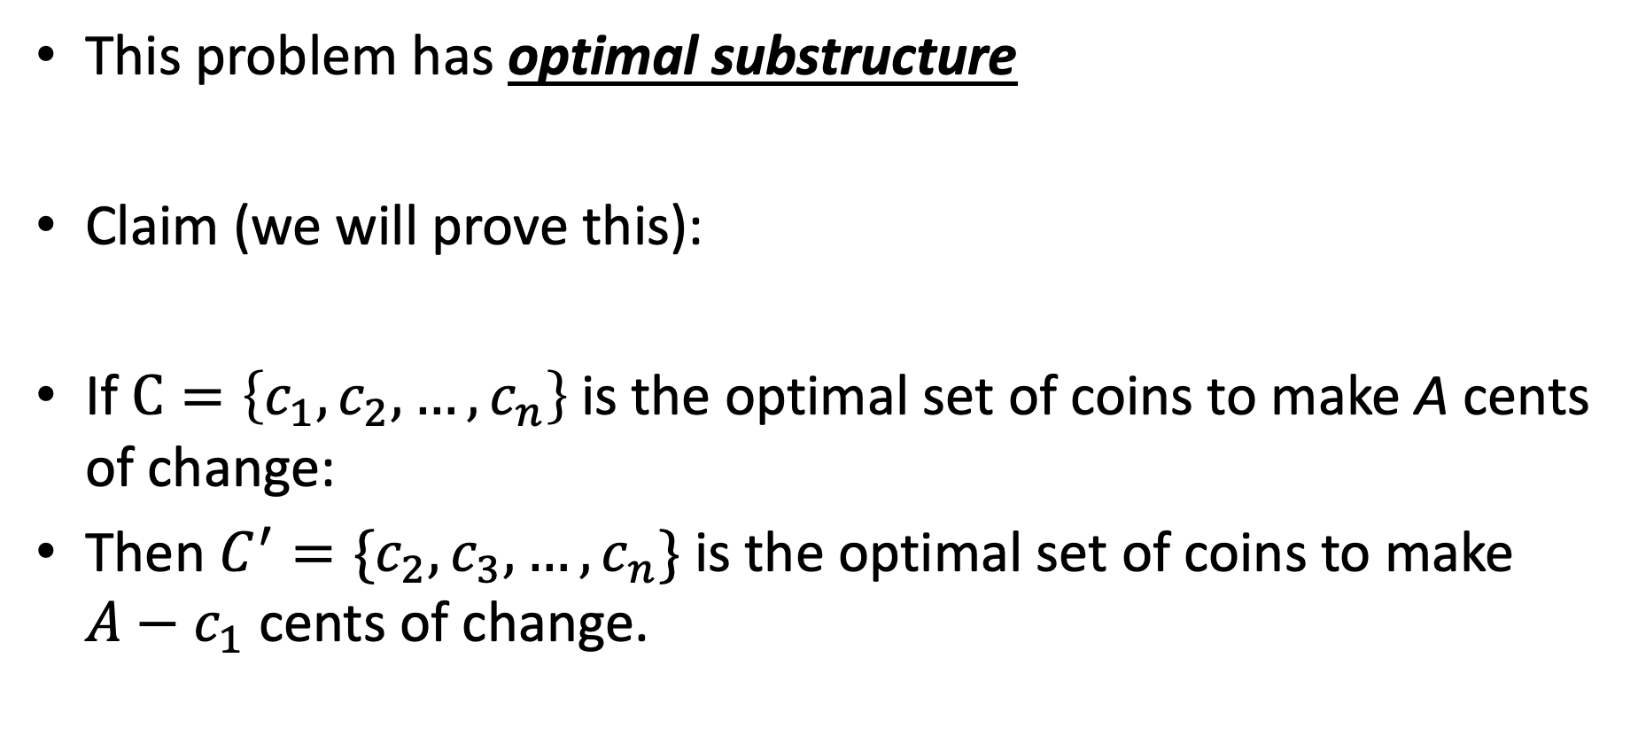
Optimal Substructure
This problem has optimal substructure
Claim (we will prove this):
If $C=\left\{c_{1},c_{2},…,c_{n}\right\}$is the optimal set of coins to make A cents of change:
Then $C^{′}=\{c_{2},c_{3},…,c_{n}\}$ is the optimal set of coins to make $A−c_{1}$ cents of change.

Slide 6
A Change Algorithm
Consider the largest coin
How many go into the amount left?
Add that many of that coin to the output
Subtract the amount for those coins from the amount left to return
If the amount left is zero, done!
If not, consider next largest coin, and go back to Step 2
Notes:
Will this always finish? Yes, because we have pennies!

Slide 7
Evaluating Our Greedy Algorithm
How much work does it do?
Say C is the amount of change, and N is the number of coins in our coin-set
Loop at most N times, and inside the loop we do:
A division
Add something to the output list
A subtraction, and a test
We say this is O(N), or linear in terms of the size of the coin-set
Could we do better?
Is this an optimal algorithm?
We need to do a proof somehow to show this

Slide 8
Another Change Algorithm
Give me another way to do this?
Brute force:
Generate all possible combinations of coins that add up to the required amount
From these, choose the one with smallest number
What would you say about this approach?
There are other ways to solve this problem
Dynamic programming: build a table of solutions to small subproblems, work your way up

Slide 9
Algorithm for making change
This algorithm makes change for an amount A using coins of denominations
denom[1] > denom[2] > ··· > denom[n] = 1.
Input Parameters: denom, A
Output Parameters: None
greedy_coin_change(denom, A) {
i = 1
while (A > 0) {
c = A / denom[i]
println(“use ” + c + “ coins of denomination ” + denom[i])
A = A - c * denom[i]
i = i + 1
}
}

Slide 10
Making change proof
Another methodology for proving correctness of greedy algorithms:
A greedy algorithm is correct if the following hold:
The problem has optimal substructure
The algorithm has the greedy choice property (see next slide)

Slide 11
Making change proof
What is the greedy choice property?
Your algorithm makes some greedy choice and then continues
e.g., choose largest coin, then continue
Prove that the one thing the greedy algorithm selects MUST be in some optimal solution to the problem.

Slide 12
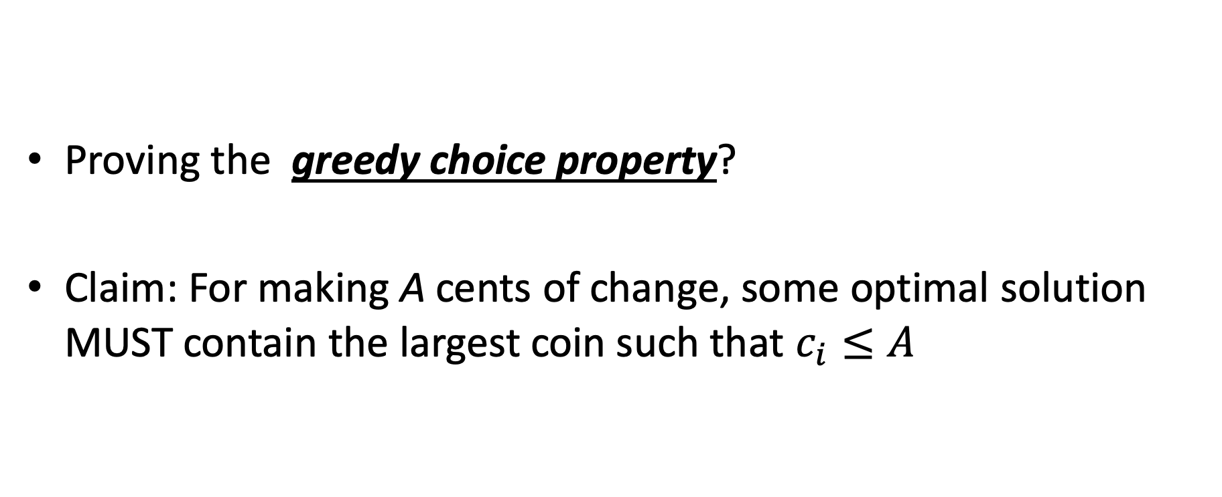
Making change proof
Proving the greedy choice property?
Claim: For making A cents of change, some optimal solution MUST contain the largest coin such that $c_{i}≤A$

Slide 13
Proof
Overview of proof:
Assume largest coin NOT in some optimal solution
Ok, some other coins must be in there instead.
4 Cases:
Largest coin that fits is penny (1 cent) //this one is trivial though!
Largest coin that fits is nickel (5 cent)
Largest coin that fits is dime (10 cent)
Largest coin that fits is quarter (25 cent)

Slide 14
Proof
Largest coin that fits is penny (1 cent) //this one is trivial though!
means A < 5
Only penny fits, so penny must be in some optimal solution!
Largest coin that fits is nickel (5 cent)
Assume nickel not in optimal solution. Note A >= 5
Pennies are only other option, so 5 or more pennies in optimal solution
But I can swap out 5 of those pennies with a nickel
Solution decreases by 4 coins!! Contradiction!!

Slide 15
Proof
Largest coin that fits is Dime (10 cent)
Assume dime not in optimal solution. Note A >= 10 and A < 25
So the optimal solution contains:
>= 2 nickels, some number of pennies (might be 0)
1 nickel, some pennies (at least 5)
all pennies (more than 10)
In each case above, I can swap a dime in for some combination of nickels or pennies
Solution decreases by 1, 5, or 9 coins respectively. Contradiction!
Largest coin that fits is quarter (25 cent)
Assume quarter not in optimal solution. Note A >= 25
So the optimal solution contains:

Slide 16
Proof
Largest coin that fits is quarter (25 cent)
Assume quarter not in optimal solution. Note A >= 25
So the optimal solution contains:
2 dimes, 1 nickel, some pennies maybe
2 dimes, 0 nickels, 5 or more pennies
1 dime, 3 nickels, 0 or more pennies
1 dime, 2 nickels, 5 or more pennies
1 dime, 1 nickel, 10 or more pennies
1 dime, 0 nickel, 15 or more pennies
0 dime, 5 nickels, 0 or more pennies
…
For each case above, a quarter can be swapped back in for more than 1 coin to make the solution better!! Contradiction!

Slide 17
How would a failed proof work?
Prove greedy choice property for denominations 1, 6, and 10
This is going to fail because the algorithm doesn’t work. Let’s see it!
For A = 12, greedy outputs 10,1,1
Best answer is 6,6

Slide 18
How would a failed proof work?
Largest coin that fits is Dime (10 cent)
Assume dime not in optimal solution. Note A >= 10
So the optimal solution contains:
2 or more six-cent coins, pennies maybe (could be 0)
1 six-cent coin, at least 4 pennies
0 six-cent coins, at least 10 pennies
For the second two, we can do the exchange, but NOT for the first one. The proof doesn’t work!!

Slide 19
Dynamic Programming: Making Change

Slide 20
Recall coin change
Given an amount A, pick the minimum amount of coins that yield A
Recall the greedy algorithm:
Use the biggest coin possible, and use as many of those as possible
Repeat with successively smaller denominations
This algorithm won’t work with non-standard denominations

Slide 21
Greedy algorithm
Given coin cent amounts of 10, 6, 5, and 1
Compute the coins needed for 12 cents
The greedy algorithm picks {10, 1, 1}
But {6, 6} is more optimal (fewer coins)

Slide 22
Definitions
We define an array denom which holds the denominations of the coins such that:
denom[1] > denom[2] > … > denom[n] = 1
In other words, we sort the coin denominations in decreasing order, ending with a penny
We are obtaining change for an amount A
Consider the i,j problem:
The available denominations are denom[i] through denom[n], where i ≥ 1 (i.e. the smaller n-i+1 coins)
Note: when i is large, you’re working with fewer types of coins, and when i=1 you’re working with your complete set
The amount we are looking for is j, where j ≤ A (i.e. the remaining amount of money)

Slide 23
The i,j problem
Consider the i,j problem: (Remember, i is which coins, and j is the amount)
The available denominations are denom[i] through denom[n], where i ≥ 1 (i.e. the smaller n-i+1 coins)
The amount we are looking for is j, where j ≤ A (i.e. the remaining amount of money)
Given coins of denominations 10, 6, and 1, here’s the table showing how to create change up to 12 cents:
Our answer!
j (the amount)
 | 0 | 1 | 2 | 3 | 4 | 5 | 6 | 7 | 8 | 9 | 10 | 11 | 12
1 | 0 | 1 | 2 | 3 | 4 | 5 | 1 | 2 | 3 | 4 | 1 | 2 | 2
2 | 0 | 1 | 2 | 3 | 4 | 5 | 1 | 2 | 3 | 4 | 5 | 6 | 2
3 | 0 | 1 | 2 | 3 | 4 | 5 | 6 | 7 | 8 | 9 | 10 | 11 | 12
Can use 1, 6 & 10
Can use 1 & 6
Can use 1
i

Slide 24
Solving the problem
How to solve the i,j problem (Remember, i is which coins, and j is the amount)
If denom[i] > j, then not possible to include this coin
Then the solution is the same as the (i+1),j problem (same amount, but with one fewer of the coin-options)
In the table, that’s the cell right below the current cell.
Is this making the problem simpler?
Maybe the best answer does use a coin of denomination i
Then the solution is 1 more than the i,(j-denom[i]) problem
j changes to j-denom[i] because we subtract off the value of the coin used
i doesn’t change because there could be multiple coins of denomination i used in the solution
Maybe the best answer does NOT use a coin of denomination i
Then the solution is the same as the (i+1),j problem
In the table, that’s the cell right below the current cell

Slide 25
The formulaic solution
The solution becomes:
Where C[i][0] = 0 for all values of i
If we have a penny, then C[n][j] = j
This is required to get all amounts, so we assume a penny is the smallest denomination

Slide 26
Recursive solution
The solution:
Note that a given problem (C[i][j]) is expressed in terms of sub-problems
We can write a solution now using memorization with a top-down solution (recursive calls), or a bottom-up approach (build a table)

Slide 27
The bottom-up algorithm
dynamic_coin_change1 (denom, A, C) {
n = denom.last
for j = 0 to A
C[n][j] = j
for i = n-1 down to 1
for j = 0 to A
if ( denom[j] > j ||
C[i+1][j] < 1 + C[i][j-denom[i]] )
C[i][j] = C[i+1][j]
else
C[i][j] = 1 + C[i][j-denom[i]]
}
Time complexity?
Constant time to file each cell in the table. So Θ(n ・ A) where n is the number of coins and A is the amount

Slide 28
But how to get the coins chosen?
It’s easy to trace back through the values
Or, we could keep a used Boolean array
If used[i][j] is true, then the solution for i,j does use a coin of denom[i] for amount j
If false, it does not
j
 | 0 | 1 | 2 | 3 | 4 | 5 | 6 | 7 | 8 | 9 | 10 | 11 | 12
1 | F | F | F | F | F | F | F | F | F | F | T | T | F
2 | F | F | F | F | F | F | T | T | T | T | T | T | T
3 | F | T | T | T | T | T | T | T | T | T | T | T | T
Can use 1, 6 & 10
Can use 1 & 6
Can use 1
i

Slide 29
Recording the answers
dynamic_coin_change2 (denom, A, C, used) {
n = denom.last
for j = 0 to A
C[n][j] = j
used[n][j] = true
for i = n-1 downto 1
for j = 0 to A
if ( denom[j] > j ||
C[i+1][j] < 1+C[i][j-denom[i]] )
C[i][j] = C[i+1][j]
used[i][j] = false
else
C[i][j] = 1 + C[i][j-denom[i]]
used[i][j] = true
}

Slide 30
Obtaining the coin set
optimal_coins_set (i, j, denom, used) {
if ( j == 0 )
return
if ( used[i][j] )
println (“Use coin of denomination “ + denom[i])
optimal_coins_set (i, j-denom[i], denom, used)
else
optimal_coins_set (i+1, j, denom, used)
}

