Slide 1
CS4102 Algorithms Fall 2021 – Floryan and Horton
Greedy Algorithms

Slide 2
CLRS Readings
Chapter 16, Greedy Algorithms
Intro, page 414
Section 16.2, Elements of the Greedy Strategy, Knapsack problem
Later Section 16.1, Activity Selection problem

Slide 3
Topics
Greedy Algorithms: Our next algorithmic technique
How to analyze problems with greedy solutions:
Optimal substructure property
Greedy choice property
Proving correctness of greedy algorithms
Three example problems
Coin Change
Activity Selection
Knapsack (fractional version)

Slide 4
Optimization Problems
Greedy algorithms can (sometimes) solve optimization problems:
Find the best solution among all feasible solutions
An example you know: Find the shortest path in a weighted graph G from s to v
Form of the solution: a path (and sum of its edge-weights)
Feasible solutions must meet problem constraints
Example: All edges in solution are in graph G and form a simple path from s to v
We can get a score for each feasible solution on some criteria:
We call this the objective function
Example: the sum of the edge weights in path
One (or more) feasible solutions that scores highest (by the objective function) is the optimal solution(s)

Slide 5
Coin Change, Optimal Substructure, and the Greedy Choice Property

Slide 6
Goals!
First problem with a greedy algorithm solution (Coin Change!)
What is optimal substructure? Why is it useful?
Making a greedy choice to solve the problem
What is the greedy choice property?

Slide 7
Everyone Already Knows Many Algorithms!
Worked retail? You know how to make change!
Example:
My item costs $4.37. I give you a five dollar bill. What do you give me in change?
Answer: two quarters, a dime, three pennies
Why? How do we figure that out?

Slide 8
Making Change
The problem:
Give back the right amount of change, and…
Return the fewest number of coins!
Inputs: the dollar-amount to return
Also, the set of possible coins. (Do we have half-dollars? That affects the answer we give.)
Output: a set of coins
Note this problem statement is simply a transformation
Given input, generate output with certain properties
No statement about how to do it.
Can you describe the algorithm you use?

Slide 9
Optimal Substructure
This problem has optimal substructure
Optimal Substructure: If given a solution to the larger problem, it can be seen to be made up of solutions to smaller versions of the same problem.
e.g., Optimal solution for giving 15 cents of change contains within it the optimal set of coins to make 5 cents of change

Slide 10
Optimal Substructure
This problem has optimal substructure
LEMMA 1: If a problem has optimal substructure, then a greedy algorithm MIGHT solve it (but not necessarily).
Lemma 2: If a greedy algorithm solves the problem, then it has optimal substructure.
Lesson: Check for optimal substructure to see if a greedy algorithm MIGHT be applicable. Also gives hints as to what the algorithm might be!!

Slide 11
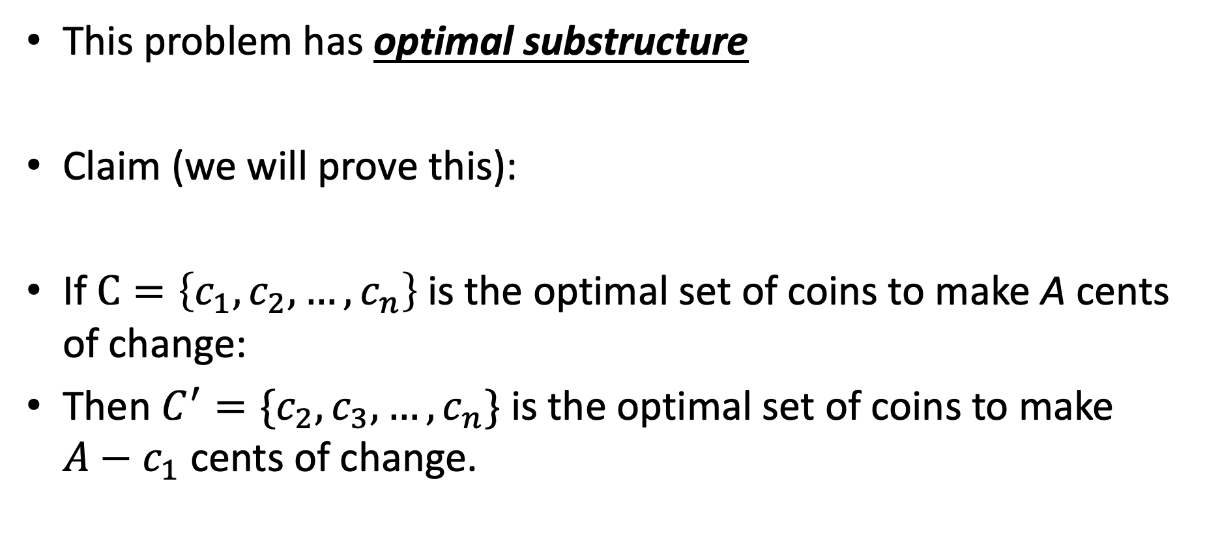
Optimal Substructure
This problem has optimal substructure
Claim (we will prove this):
If $C=\left\{c_{1},c_{2},…,c_{n}\right\}$is the optimal set of coins to make A cents of change:
Then $C^{′}=\{c_{2},c_{3},…,c_{n}\}$ is the optimal set of coins to make $A−c_{1}$ cents of change.

Slide 12
A Change Algorithm
Consider the largest coin
How many go into the amount left?
Add that many of that coin to the output
Subtract the amount for those coins from the amount left to return
If the amount left is zero, done!
If not, consider next largest coin, and go back to Step 2
Notes:
Will this always finish? Yes, because we have pennies!

Slide 13
Evaluating Our Greedy Algorithm
How much work does it do?
Say C is the amount of change, and N is the number of coins in our coin-set
Loop at most N times, and inside the loop we do:
A division
Add something to the output list
A subtraction, and a test
We say this is O(N), or linear in terms of the size of the coin-set
Could we do better?
Is this an optimal algorithm?
We need to do a proof somehow to show this

Slide 14
Another Change Algorithm
Give me another way to do this?
Brute force:
Generate all possible combinations of coins that add up to the required amount
From these, choose the one with smallest number
What would you say about this approach?
There are other ways to solve this problem
Dynamic programming: build a table of solutions to small subproblems, work your way up

Slide 15
Algorithm for making change
This algorithm makes change for an amount A using coins of denominations
denom[1] > denom[2] > ··· > denom[n] = 1.
Input Parameters: denom, A
Output Parameters: None
greedy_coin_change(denom, A) {
i = 1
while (A > 0) {
c = A / denom[i]
println(“use ” + c + “ coins of denomination ” + denom[i])
A = A - c * denom[i]
i = i + 1
}
}

Slide 16
Making change proof
One methodology for proving correctness of greedy algorithms:
A greedy algorithm is correct if the following hold:
The problem has optimal substructure
The algorithm has the greedy choice property (see next slide)

Slide 17
Making change proof
What is the greedy choice property?
Your algorithm makes some greedy choice and then continues
e.g., choose largest coin, then continue
Prove that the one thing the greedy algorithm selects MUST be in some optimal solution to the problem.

Slide 18
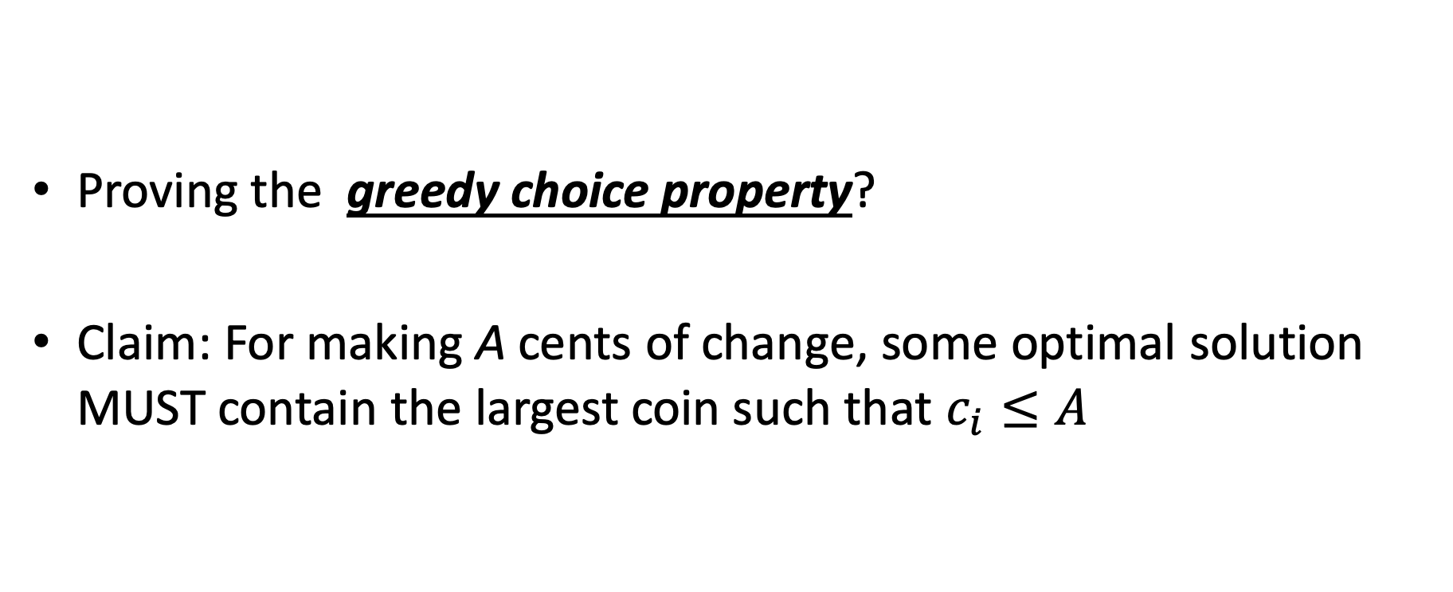
Making change proof
Proving the greedy choice property?
Claim: For making A cents of change, some optimal solution MUST contain the largest coin such that $c_{i}≤A$

Slide 19
Proof
Overview of proof:
Assume largest coin NOT in some optimal solution
Ok, some other coins must be in there instead.
4 Cases:
Largest coin that fits is penny (1 cent) //this one is trivial though!
Largest coin that fits is nickel (5 cent)
Largest coin that fits is dime (10 cent)
Largest coin that fits is quarter (25 cent)

Slide 20
Proof
Largest coin that fits is penny (1 cent) //this one is trivial though!
means A < 5
Only penny fits, so penny must be in some optimal solution!
Largest coin that fits is nickel (5 cent)
Assume nickel not in optimal solution. Note A >= 5
Pennies are only other option, so 5 or more pennies in optimal solution
But I can swap out 5 of those pennies with a nickel
Solution decreases by 4 coins!! Contradiction!!

Slide 21
Proof
Largest coin that fits is Dime (10 cent)
Assume dime not in optimal solution. Note A >= 10 and A < 25
So the optimal solution contains:
>= 2 nickels, some number of pennies (might be 0)
1 nickel, some pennies (at least 5)
all pennies (more than 10)
In each case above, I can swap a dime in for some combination of nickels or pennies
Solution decreases by 1, 5, or 9 coins respectively. Contradiction!
Largest coin that fits is quarter (25 cent)
Assume quarter not in optimal solution. Note A >= 25
So the optimal solution contains:

Slide 22
Proof
Largest coin that fits is quarter (25 cent)
Assume quarter not in optimal solution. Note A >= 25
So the optimal solution contains:
2 dimes, 1 nickel, some pennies maybe
2 dimes, 0 nickels, 5 or more pennies
1 dime, 3 nickels, 0 or more pennies
1 dime, 2 nickels, 5 or more pennies
1 dime, 1 nickel, 10 or more pennies
1 dime, 0 nickel, 15 or more pennies
0 dime, 5 nickels, 0 or more pennies
…
For each case above, a quarter can be swapped back in for more than 1 coin to make the solution better!! Contradiction!

Slide 23
How would a failed proof work?
Prove greedy choice property for denominations 1, 6, and 10
This is going to fail because the algorithm doesn’t work. Let’s see it!
For A = 12, greedy outputs 10,1,1
Best answer is 6,6

Slide 24
How would a failed proof work?
Largest coin that fits is Dime (10 cent)
Assume dime not in optimal solution. Note A >= 10
So the optimal solution contains:
2 or more six-cent coins, pennies maybe (could be 0)
1 six-cent coin, at least 4 pennies
0 six-cent coins, at least 10 pennies
For the second two, we can do the exchange, but NOT for the first one. The proof doesn’t work!!

Slide 25
Knapsack Problems

Slide 26


Knapsack Problems
Pages 425-427 in textbook
Description: Thief robbing a store finds n items, each with a profit amount p_{i} and a weight w_{i}
Wants to steal as valuable a load as possible
But can only carry total weight C in their knapsack
Which items should they take to maximize profit?
Form of the solution: an x_{i} value for each item, showing if (or how much) of that item is taken
Inputs are: C, n, the p_{i} and w_{i} values
26

Slide 27
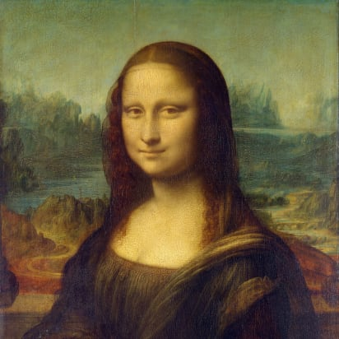

Two Types of Knapsack Problem
0/1 knapsack problem
Each item is discrete: must choose all of it or none of it. So each x_{i} is 0 or 1
Greedy approach does not produce optimal solutions
But dynamic programming does
Fractional knapsack problem (AKA continuous knapsack)
Can pick up fractions of each item. So each x_{i} is a value between 0 or 1
A greedy algorithm finds the optimal solution
27

Slide 28
Formal Statement of Fractional Knapsack Problem
Given n objects and a knapsack of capacity C, where object i has weight w_{i} and earns profit p_{i}, find values x_{i} that maximize the total profit subject to the constraints

Slide 29
Greedy Approach
Let’s use a greedy strategy to solve the fractional knapsack
Build solution by stages, adding one item to partial solution found so far
At each stage, make locally optimal choice based on the greedy choice (sometimes called the greedy rule or the selection function)
Locally optimal, i.e. best choice given what info available now
Irrevocable: a choice can’t be un-done
Sequence of locally optimal choices leads to globally optimal solution (hopefully)
Must prove this for a given problem!
Approximation algorithms, heuristic algorithms

Slide 30
A Bit More Terminology
Problems solvable by both Dynamic Programming and the Greedy approach have the optimal substructure property:
An optimal solution to a problem contains within it optimal solutions to subproblems
This allows us to build a solution one step at a time, because we can solve increasingly smaller problems with confidence

Slide 31
Greedy Approach for Fractional Knapsack?
Build up a partial solutions:
Determine which of the remaining items to add
How much can you add (its x_{i})
Repeat until knapsack is full (or no more items)
Which item to choose next? What’s a good greedy choice (AKA greedy selection)?
Let’s try several obvious options on this example:
n = 3, C = 20
Item | Value | Weight
1 | 25 | 18
2 | 24 | 15
3 | 15 | 10

Slide 32
Possible Greedy Choices for Knapsack
Greedy choice #1: by highest profit value
n = 3, C = 20
Item 1 first. Can take all of it, so x₁ is 1. Capacity used is 18 of 20. Profit so far is 25.
Item 2 next. Room for only 2 units, so x₂ is 2/15 = 0.133. Capacity used is 20 of 20. Profit so far is 25 + (24 x 0.133) = 28.2.
Item 3 would be next, but knapsack full! x₃ is 0. Total profit is 28.2. x_{i} = (1, .133, 0)
Item | Value | Weight
1 | 25 | 18
2 | 24 | 15
3 | 15 | 10
Select item 1 first, then item 2, then item 3. Take as much of each as fits!

Slide 33
Possible Greedy Choices for Knapsack
Greedy choice #2: by lowest weight
n = 3, C = 20
Item 3 first. Can take all of it, so x₃ is 1. Capacity used is 10 of 20. Profit so far is 15.
Item 2 next. Room for only 10 units, so x₂ is 10/15 = 0.667. Capacity used is 20 of 20. Profit so far is 15 + (24 x 0.667) = 31.
Item 1 would be next, but knapsack full! x₁ is 0. Total profit is 31.0. x_{i} = (0, .667, 1)
Note it’s better than previous greedy choice.
Best possible?
Item | Value | Weight
1 | 25 | 18
2 | 24 | 15
3 | 15 | 10
Select item 3 first, then item 2, then item 1. Take as much of each as fits!

Slide 34
Possible Greedy Choices for Knapsack
Greedy choice #3: highest value-to-weight ratio
n = 3, C = 20
Item 2 first. Can take all of it, so x₂ is 1. Capacity used is 15 of 20. Profit so far is 24.
Item 3 next. Room for only 5 units, so x₁ is 5/10 = 0.5. Capacity used is 20 of 20. Profit so far is 24 + (15 x 0.5) = 31.5.
Item 1 would be next, but knapsack full! x₁ is 0. Total profit is 31.5. x_{i} = (0, 1, 0.5)
This greedy choice produces optimal solution!
Must prove this (but we won’t today).
Item | Value | Weight | Ratio
1 | 25 | 18 | 1.4
2 | 24 | 15 | 1.6
3 | 15 | 10 | 1.5
Select item 2 first, then item 3, then item 1. Take as much of each as fits!

Slide 35
Fractional Knapsack Algorithm
FRACTIONAL_KNAPSACK(a, C)
1 n = a.last
2 for i = 1 to n
3 ratio[i] = a[i].p / a[i].w
4 sort(a, ratio)
5 weight = 0
6 i = 1
7 while (i ≤ n and weight < C)
8 if (weight + a[i].w ≤ C)
9 println “select all of object “ + a[i].id
10 weight = weight + a[i].w
11 else
12 r = (C – weight) / a[i].w
13 println “select “ + r + “ of object “ + a[i].id
14 weight = C
15 i = i+1
Worst-case runtime: for loop and while loop take θ(n) time,
sorting takes θ(nlgn) time, so algorithm takes θ(nlgn) time

Slide 36
Another Knapsack Example to Try
Assume for this problem that:
Ratios of profit to weight:
What order do we examine items?
What are the x_{i} values that result?
What’s the total profit?
p₁/w₁ = 5/120 = .0417
p₂/w₂ = 5/150 = .0333
p₃/w₃ = 4/200 = .0200
p₄/w₄ = 8/150 = .0533
p₅/w₅ = 3/140 = .0214

Slide 37
Proving a Greedy Algorithm Correct
For fractional knapsack, we can prove greedy choice of p_{i}/w_{i} leads to optimal solution
In general, given a greedy algorithm, how do approach such a proof?
Recall we’ve done this for Dijkstra’s SP and Prim’s MST
We can compare the solution our algorithm finds with an optimal solution
Show they’re the same
Or, assume they’re not and show a contradiction
Remember exchange argument for Dijkstra’s or for Prim’s?

Slide 38
0/1 knapsack
n = 3, C = 4
Let’s try this same greedy solution with the 0/1 version
New example inputs →
Item 1 first. So x₁ is 1. Capacity used is 1 of 4. Profit so far is 3.
Item 2 next. There’s room for it! So x₂ is 1. Capacity used is 3 of 4. Profit so far is 3 + 5 = 8.
Item 3 would be next, but its weight is 3 and knapsack only has 1 unit left! So x₃ is 0. Total profit is 8. x_{i} = (1, 1, 0)
But picking items 1 and 3 will fit in knapsack, with total value of 9
Thus, the greedy solution does not produce an optimal solution to the 0/1 knapsack algorithm
Greedy choice left unused room, but we can’t take a fraction of an item
The 0/1 knapsack problem doesn’t have the greedy choice property
Item | Value | Weight | Ratio
1 | 3 | 1 | 3
2 | 5 | 2 | 2.5
3 | 6 | 3 | 2

Slide 39
Activity Selection

Slide 40
Activity-Selection
Formally:
Given a set S of n activities
s_{i} = start time of activity i
f_{i} = finish time of activity i
Find max-size subset A of compatible activities
3
4
6
2
1
5
Assume (wlog) that f₁ ≤ f₂ ≤ … ≤ f_{n}

Slide 41
Activity Selection: A Greedy Algorithm
So algorithm using the best greedy choice is simple:
Sort the activities by finish time
Schedule the first activity
Then schedule the next activity in sorted list which starts after previous activity finishes
Repeat until no more activities
Or in simpler terms:
Always pick the compatible activity that finishes earliest

Slide 42
Non-recursive algorithm
greedy-interval (s, f)
n = s.length
A = {a₁}
k = 1 # last added
for m = 2 to n
if s[m] ≥ f[k]
A = A U {a_{m}}
k = m
return A
s is an array of the intervals’ start times
f is an array of the intervals’ finish times
A is the array of the intervals to schedule
How long does this take?

Slide 43
Does Greedy Always Find Optimal Solution?
Yes, we can prove that the greedy algorithm always “stays ahead”!

Slide 44
Does Greedy Always Find Optimal Solution?
Yes, we can prove that the greedy algorithm always “stays ahead”!
How?
Overall idea: Show the i’th interval algorithm chooses always ends earlier than optimal solution

Slide 45
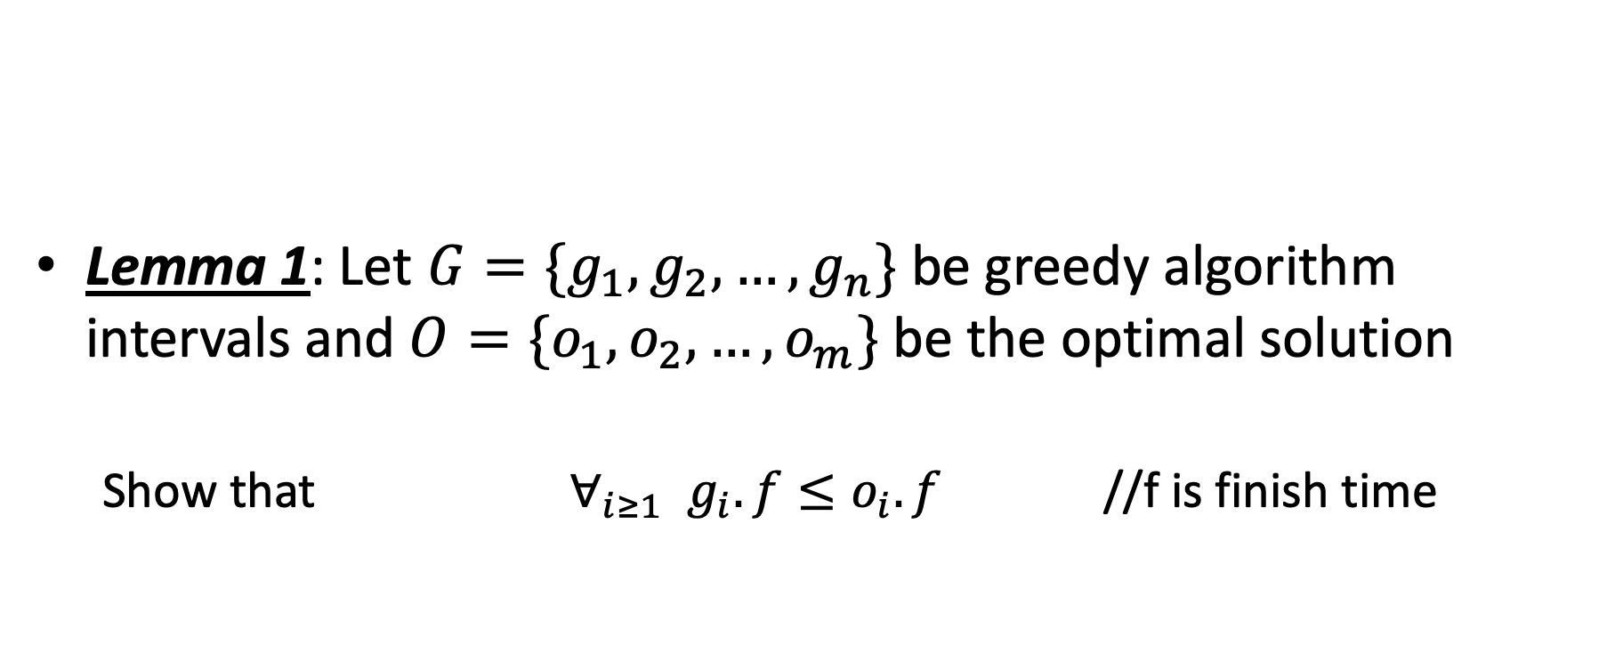
Does Greedy Always Find Optimal Solution?
Lemma 1: Let $G=\{g_{1},g_{2},…,g_{n}\}$ be greedy algorithm intervals and $O=\{o_{1},o_{2},…, o_{m}\}$ be the optimal solution
Show that $∀_{i≥1}{ g}_{i}.f≤o_{i}.f$ //f is finish time

Slide 46
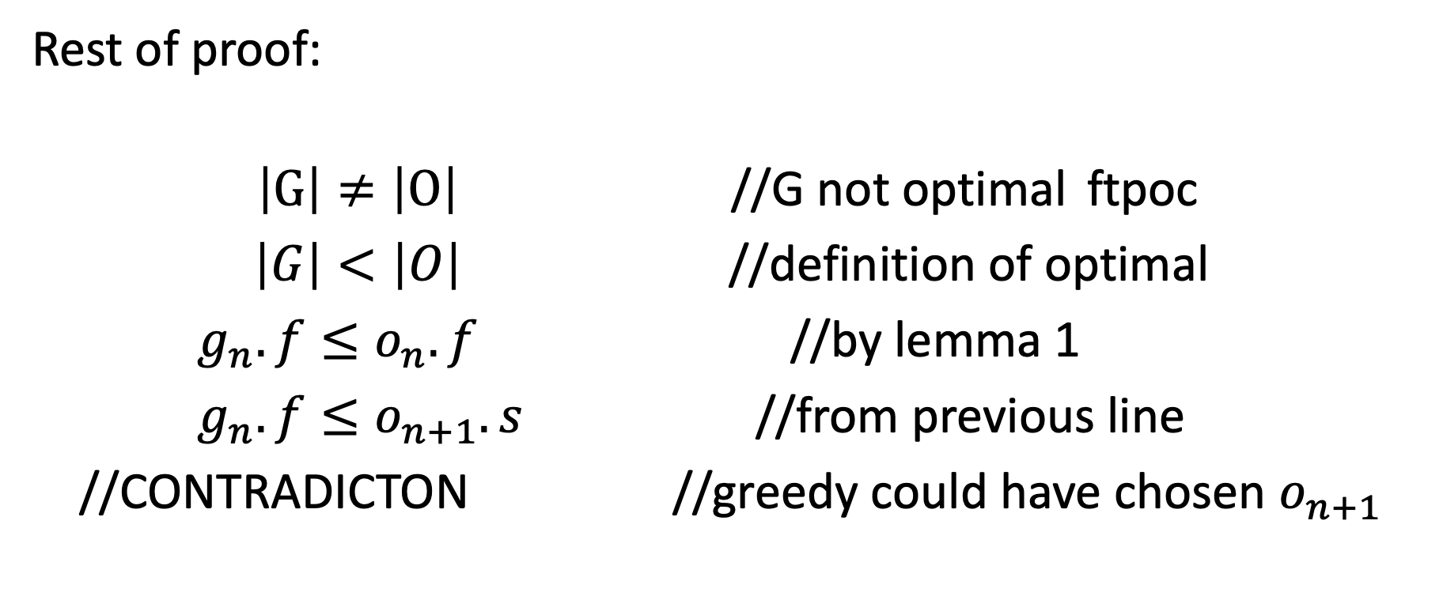
Does Greedy Always Find Optimal Solution?
Rest of proof:
$\left|G\right|≠\left|O\right|$ //G not optimal ftpoc
$\left|G\right|<\left|O\right|$ //definition of optimal
$g_{n}.f≤o_{n}.f$ //by lemma 1
$g_{n}.f≤o_{n+1}.s$ //from previous line
//CONTRADICTON //greedy could have chosen $o_{n+1}$

