Slide 1
CS4102 Algorithms Spring 2021 – Floryan and Horton
Module 3, Day 3
DP solution to weighted activity selection
(Solution not in textbook)
Proof of greedy solution to Activity Selection problem
(CLRS Section 16.1)

Slide 2
Activity-Selection
Formally:
Given a set S of n activities
s_{i} = start time of activity i
f_{i} = finish time of activity i
Find max-size subset A of compatible activities
3
4
6
2
1
5
Assume (wlog) that f₁ ≤ f₂ ≤ … ≤ f_{n}

Slide 3
Activity Selection: A Greedy Algorithm
So algorithm using the best greedy choice is simple:
Sort the activities by finish time
Schedule the first activity
Then schedule the next activity in sorted list which starts after previous activity finishes
Repeat until no more activities
Or in simpler terms:
Always pick the compatible activity that finishes earliest

Slide 4
Non-recursive algorithm
greedy-interval (s, f)
n = s.length
A = {a₁}
k = 1 # last added
for m = 2 to n
if s[m] ≥ f[k]
A = A U {a_{m}}
k = m
return A
s is an array of the intervals’ start times
f is an array of the intervals’ finish times
A is the array of the intervals to schedule
How long does this take?

Slide 5
Does Greedy Always Find Optimal Solution?
Yes, we can prove that the greedy algorithm always “stays ahead”!

Slide 6
Does Greedy Always Find Optimal Solution?
Yes, we can prove that the greedy algorithm always “stays ahead”!
How?
Overall idea: Show the i’th interval algorithm chooses always ends earlier than optimal solution

Slide 7
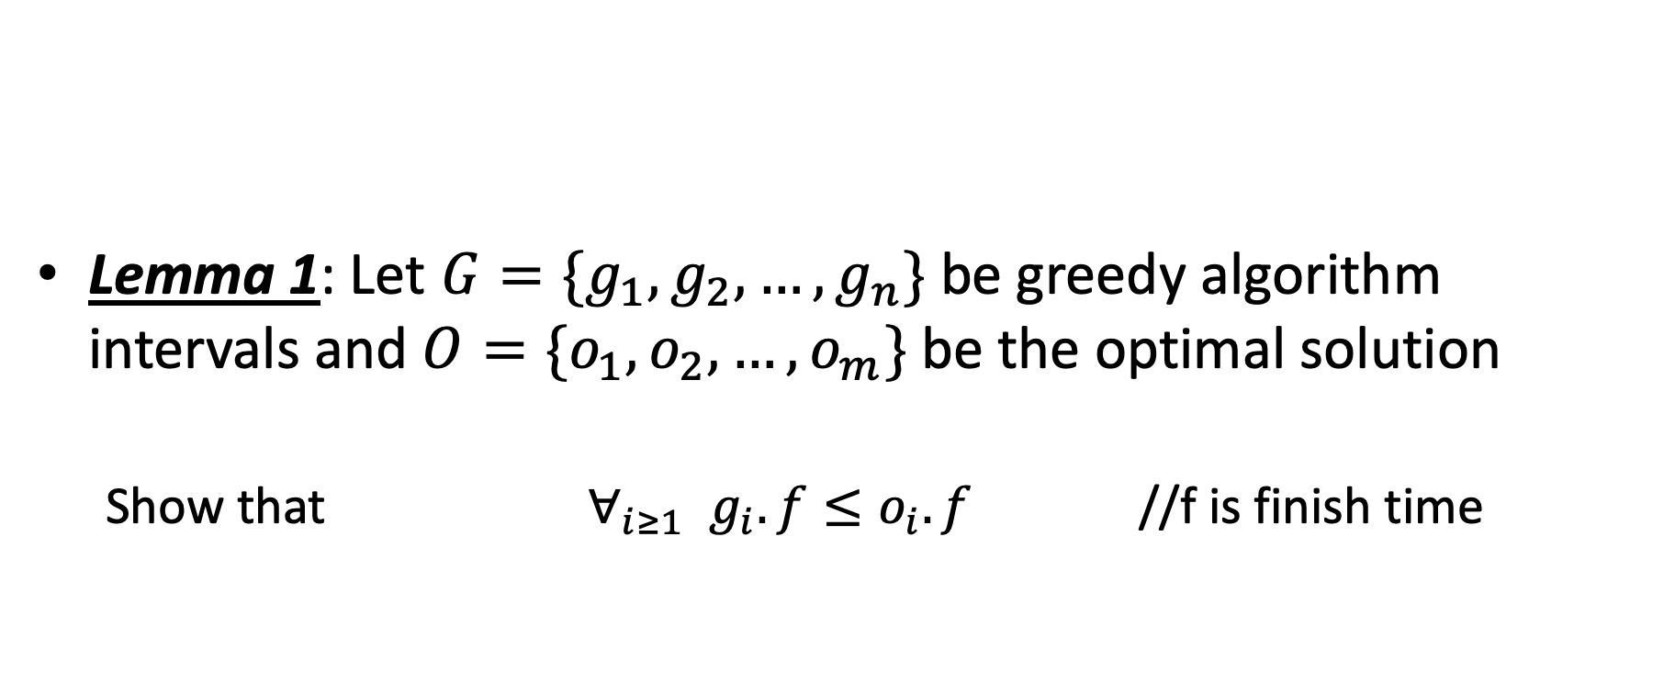
Does Greedy Always Find Optimal Solution?
Lemma 1: Let $G=\{g_{1},g_{2},…,g_{n}\}$ be greedy algorithm intervals and $O=\{o_{1},o_{2},…, o_{m}\}$ be the optimal solution
Show that $∀_{i≥1}{ g}_{i}.f≤o_{i}.f$ //f is finish time

Slide 8
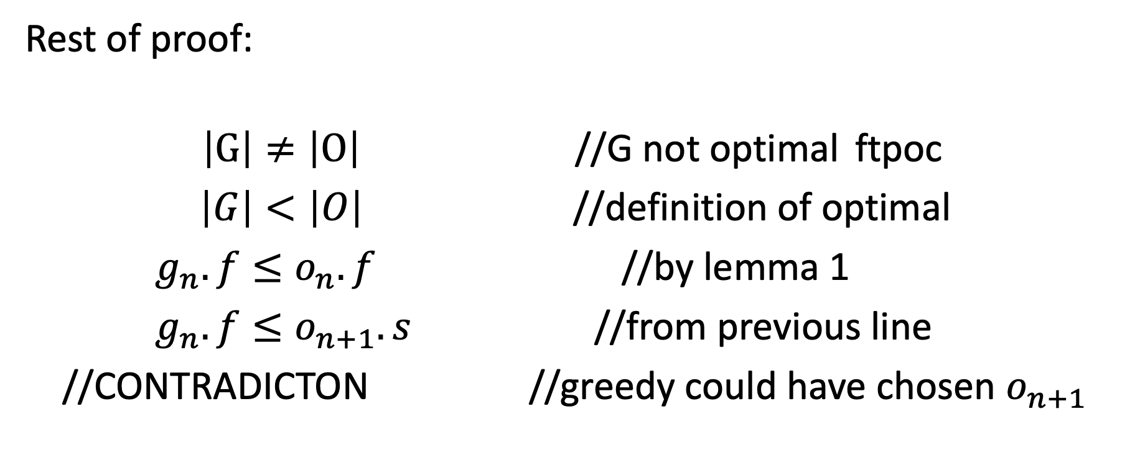
Does Greedy Always Find Optimal Solution?
Rest of proof:
$\left|G\right|≠\left|O\right|$ //G not optimal ftpoc
$\left|G\right|<\left|O\right|$ //definition of optimal
$g_{n}.f≤o_{n}.f$ //by lemma 1
$g_{n}.f≤o_{n+1}.s$ //from previous line
//CONTRADICTON //greedy could have chosen $o_{n+1}$

Slide 9
Weighted Interval Scheduling
Live Section (Apr. 5, 2021)

Slide 10
Weighted Interval Scheduling
Recall Interval Scheduling:
Given a list of intervals pick a schedule of non-overlapping intervals that maximizes the number chosen
i.e. each one has the same value
Weighted interval scheduling is similar, but…
Each interval has a different value

Slide 11
Greedy solution to interval scheduling
The algorithm:
Sort the activities by finish time
Schedule the first activity
Then schedule the next activity in sorted list which starts after previous activity finishes
Repeat until no more activities
Intuition is even more simple:
Always pick next activity that finishes earliest

Slide 12
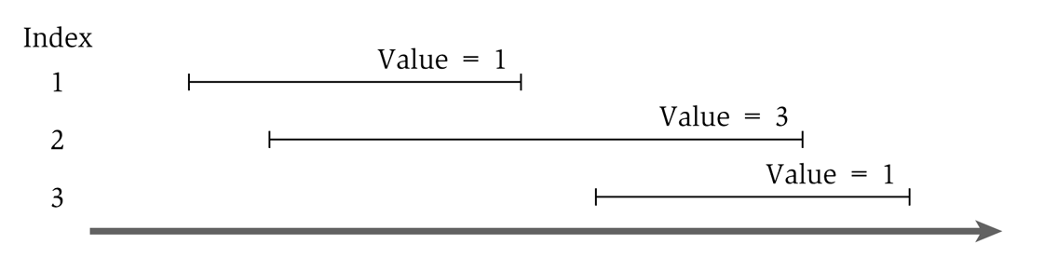
Greedy solution to the weighted version
What would the greedy algorithm pick for this example?
And is that answer optimal?
We can see that the greedy algorithm does not work for the weighted version

Slide 13
Step 1
Define the sub-problem
This problem has optimal substructure, so let’s only consider intervals up to a certain point.
Let Opt(j) be the solution to this problem when only considering intervals 1 through j
How should we order the intervals? Does it matter? We will see soon that it does.
Note that Opt(0) = 0

Slide 14
Step 2
Define solution to problem in terms of sub-problems
Base Case:
Opt(0) = 0
Opt(j) = ?

Slide 15
Step 2
Opt(j) = ?
Two cases:
Interval j is not in the optimal solution
Opt(j) = Opt(j-1) //same solution, because j interval doesn’t matter
Interval j is in the optimal solution
Opt(j) = Vj + Opt(intervals compatible with j)
Intervals compatible with j? Yikes? How do we calculate that?

Slide 16
Calculating Opt(j)
Sort all intervals by their finish time
And number them sequentially
We define interval i is less than interval j if i finishes before j (i.e. is before it in the sort)
Define p(j) to be the highest numbered interval i<j such that i and j are disjoint
Define OPT(j) to be the value of an optimal solution for intervals 1 through j only

Slide 17
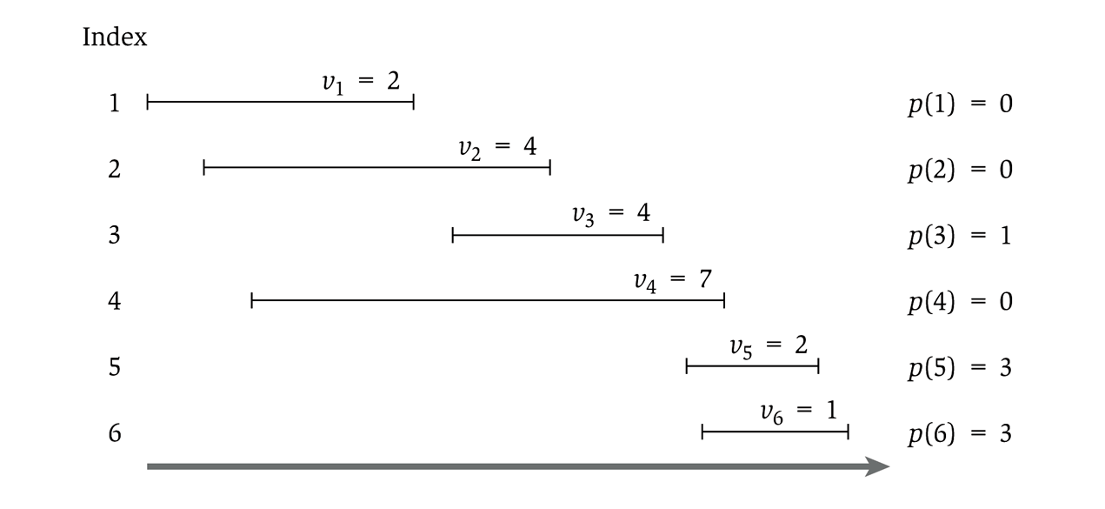
Showing p(j)

Slide 18
Step 2
Opt(j) = ?
Two cases:
Interval j is not in the optimal solution
Opt(j) = Opt(j-1) //same solution, because j interval doesn’t matter
Interval j is in the optimal solution
Opt(j) = Vj + Opt(p(j))
So…we have
Opt(j) = Max( Opt(j-1), Vj + Opt(p(j)) )

Slide 19
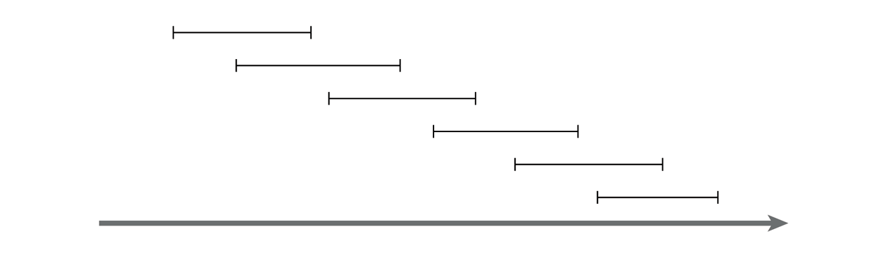
Recursive solution
OPT(j) = max(v_{j} + OPT(p(j)), OPT(j-1))
And OPT(0) = 0
This is similar in running time to the Fibonacci sequence
And similarly exponential
Consider a simple example:
Notes:
For any j, will generate recursive calls on inputs of size j-1 and j-2.
Just like Fibonacci!

Slide 20
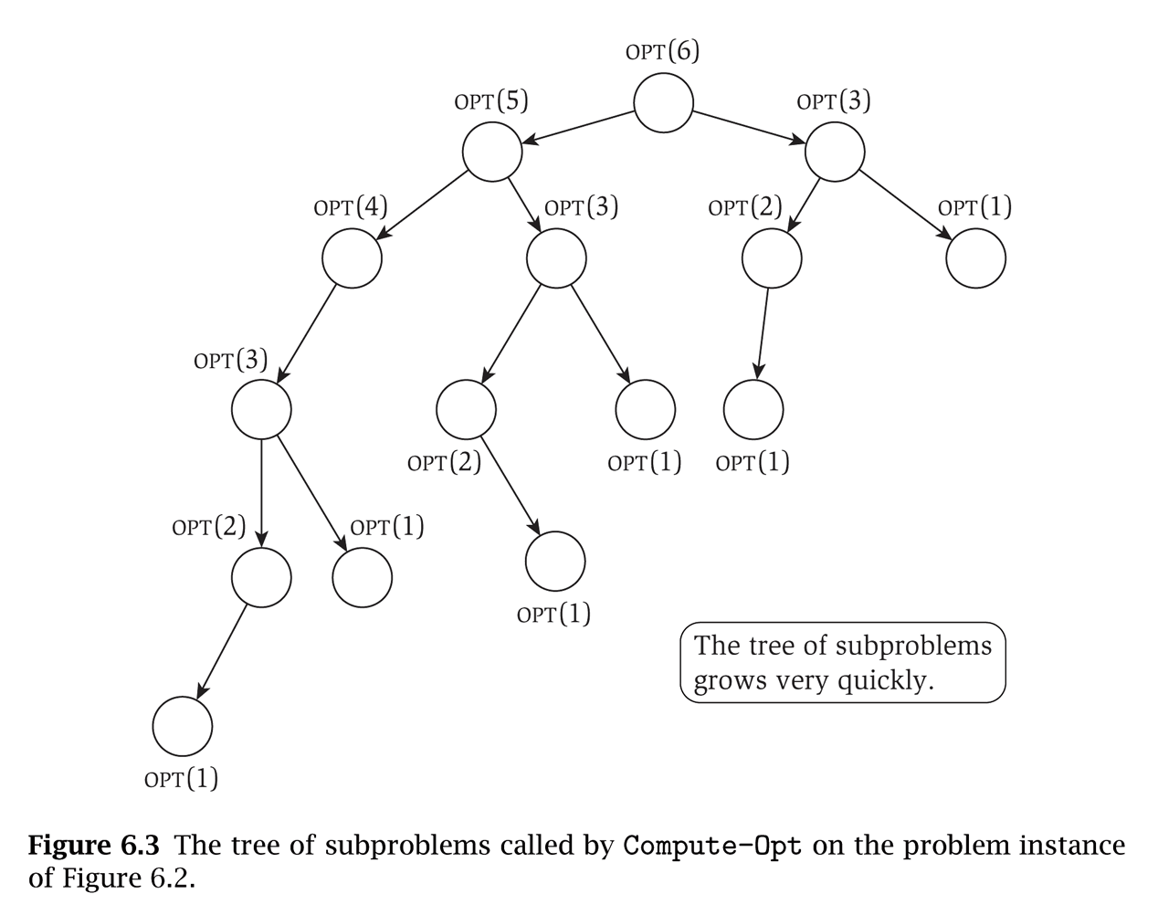
That example will take exponential time
Notice that the sub-problems are being re-computed each time

Slide 21
Step 3!
Formulate the data structure to look up subproblems.
Pretty simple, define M[n]
M[j] stores the solution to Opt(j)

Slide 22
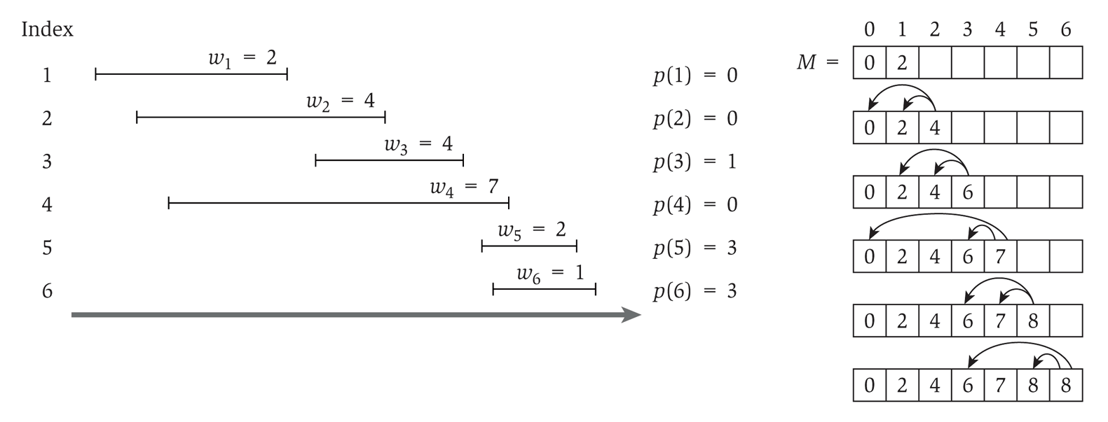
So we add memoization…
This runs in linear time

Slide 23
Computing the intervals
The solution only gives us the final value
Computing a sub-array each step would make it quadratic running time
To determine the intervals:
If v_{j} + M[p(j)] ≥ M[j-1]
Then j is part of the solution, and consider p(j)
Else
Then j is NOT part of the solution, and consider j-1

