Slide 1
Sorting and Some Algorithm Principles
CS 4102, Algorithms
Prof. Floryan and Prof. Horton
Spring 2021

Slide 2
Topics

Slide 3
Topics in first part of this slide-deck:
Readings: CLRS, Chapter 2
Goals for this lecture:
Review the sorting problem and some “basic” algorithms, while using this to review (or introduce) some principles of algorithm analysis
Topics:
The sorting problem
Insertion Sort
Including a lower-bounds proof
Mergesort
Including an overview of Divide and Conquer
Second part of this slide-deck: Quicksort

Slide 4
Sorting Introduction

Slide 5
Sorting a Sequence: Defining the Problem
The problem:
Given a sequence of items a₀ … a_{n} reorder it into a permutation a’₀ … a’_{n} such that a’_{i} <= a’_{i+1} for all pairs
Specifically, this is sorting in non-descending order…
We’ll mostly focus on a restricted form of this problem: “Sorting using comparison of keys”
The basic operation we’ll count in our analysis will be a comparison of two items’ key-values. Why?
General: can sort anything
Controls decisions, so total operations often proportional
Can be an expensive operation (e.g. when keys are large strings)

Slide 6
Some Observations
We assume non-descending order for simplicity
Our analysis results apply for other orderings
You know a comparison-function can be used in practice (e.g. Java’s Comparable interface)
In analyzing a problem and algorithms that solve it, sometimes it’s important to define constraints like the basic operation
Example: binary search is an optimal algorithm for searching using key comparisons, but hashing can be faster in practice.
Swapping items is often expensive
We can apply same techniques to count swapping, as a separate analysis

Slide 7
Sorting: More Terminology
Comparison Sorts: only compare keys and move items
Adjacent Sort: Algorithms that sort by only swapping adjacent elements
e.g., bubble sort and insertion sort
...these are a subset of comparison sorts.
Stable Sort: A sorting algorithm is stable
when two items x and y occur in the relative order x,y in the original list AND x==y, then x and y appear in the same relative order x,y in the final sorted list.
Why would we want this?
In-Place Sort: the algorithm uses at most Θ(1) extra space
e.g., allocating another array of size Θ(n) is NOT allowed.

Slide 8
Why Do We Study Sorting?
An important problem, often needed
Often users want items in some order
Required to make many other algorithms work well.
Example: To use binary search, sequence must be sorted first. The search algorithm is optimal and requires θ(log n) comparisons.
And, for the study of algorithms…
A history of solutions
Illustrates various design strategies and data structures
Illustrates analysis methods
Illustrates how we prove something about optimality for this problem

Slide 9
Insertion Sort

Slide 10
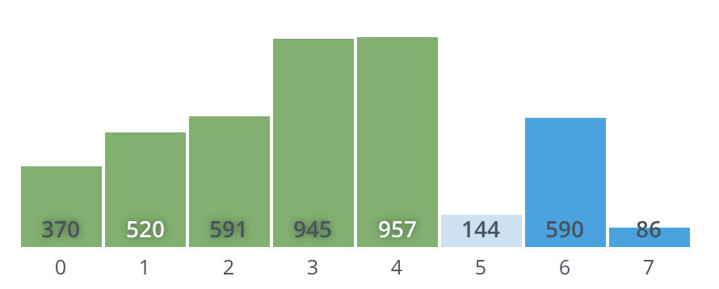
Insertion Sort
The strategy:
First section of list is sorted (say i-1 items)
Increase this partial solution by…
Shifting down next item beyond sorted section (i.e. the i^{th} item) down to its proper place in sorted section. (Must shift items up to make room.)
Since one item alone is already sorted, we can put steps 1-3 in a loop going from the 2nd to the last item.
Note: Example of general strategy: Extend a partial solution by increasing its size by one. Some call this: decrease and conquer

Slide 11
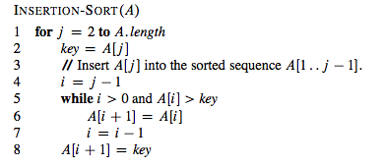
Insertion Sort: Pseudocode

Slide 12
An Aside: Proving it right with Loop Invariants
An important technique to prove algorithm correctness. (See CLRS or even Wikipedia.)
Properties that hold true at these points:
Prior to first iteration (initialization)
If true before an iteration, then true after that iteration (maintenance)
When loop ends, properties still hold and tell us something useful about correctness (termination)
Loop invariant for Insertion Sort:
For the for-loop governed by index j, the values A[0..j-1] are the elements originally stored in the sub-list but in sorted order

Slide 13
Properties of Insertion Sort
We could have talked about bubble sort, selection sort,…
Why Insertion Sort here?
Easy to code
In-place
What’s it like if the list is sorted?
Or almost sorted?
Fine for small inputs. Why?
Is it stable? Why?

Slide 14
Insertion Sort: Analysis
Worst-Case:
Average Behavior
Average number of comparisons in inner-loop?
So for the j^{th} element, we do roughly j/2 comparisons
To calculate A(n), we note j goes from 2 to n
Best-case behavior? One comparison each time

Slide 15
Lower Bounds Proof for Adjacent Sorts

Slide 16
Insertion Sort: Best of a breed?
We know that I.S. is one of many quadratic sort algorithms, and that log-linear sorts (i.e. Θ(n lg n )) do exist
But, can we learn something about I.S. that tells us what it is about I.S. that “keeps it” in the slower class?
Yes, by a lower-bounds argument for adjacent sort algorithms
This is our first example about you how to make lower-bounds arguments about a problem
E.g. “it’s impossible for any algorithm to solve this problem in better than….”
We’ll show that sorting a list by only swapping adjacent elements is Ω(n²) and can never be o(n²)
We’ll do this proof “live” session” in lecture!

Slide 17
Removing Inversions
Define an inversion in a sequence: A pair of elements that are out of order
E.g. [ 2, 4, 1, 5, 3 ] not sorted and has 4 inversions: pairs (2,1) (4,1) (4,3) (5,3)
To sort, we must fix each of these
What’s the maximum possible number of inversions? n(n-1)/2 all possible pairs This really can occur, e.g. [ 5, 4, 3, 2, 1 ]
Insertion sort only swaps adjacent elements
This can only remove at most one inversion!
Therefore insertion sort only removes at most one inversion for each key comparison

Slide 18
Lower-bounds and Insertion Sort
Theorem
Any algorithm that sorts by comparison of keys and removes at most one inversion after each comparison must do at least n(n-1)/2 comparisons in the worst case.
Important: we just proved a time-complexity result about the problem that applies to any algorithm that solves it!
Lower bounds proofs are about the problem, and can be used to show an algorithm is optimal (or close to optimal)
Conclusion: Insertion Sort is optimal for the set of algorithms that only swap adjacent elements.
I.e. adjacent sorts
And, for any algorithm to be o(n²), it must swap elements that are not adjacent!

Slide 19
Mergesort and Divide and Conquer

Slide 20
Mergesort Overview
General and practical sorting algorithm
Good example of a divide-and-conquer algorithm
More on what that means next
Recursion leads to a more efficient solution in the worst-case than adjacent sorts
It’s o(n²) or Θ(n lg n) to be more precise

Slide 21
Divide and Conquer Strategy
A divide-and conquer algorithm usually has the following structure:
solveProblem(input) if input is small, then solve directly (brute-force?) else if input is big divide problem into n smaller problems recursively invoke solveProblem on smaller problems combine solutions to small problems into bigger solution return bigger solution
Note: maybe solve all the smaller problem, or maybe just some of them.
Runtime is sum of the times to divide, recursively solve, and combine

Slide 22
Mergesort and Divide and Conquer
Base case:
Sublist is size 1. Already sorted!
Divide:
Divide list into two sublists of equal size.
Conquer:
Call mergesort recursively on each sublist.
Gives us a sorted left and right sublist.
Combine:
Merge the sorted left and right sublists to get one larger sorted list.

Slide 23
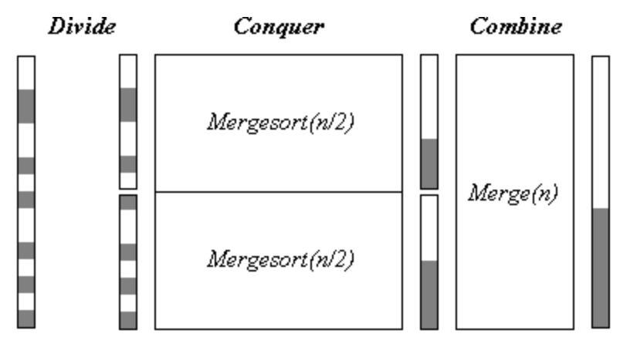
Picture
Note: in this diagram, think of the colored regions being small values that should get sorted to the front.

Slide 24
Mergesort code
Specification:
Input: List lst and indexes first, and last, such that all elements lst[i] are defined for first <= i <= last.
Output: lst[first], …, lst[last] is sorted rearrangement of the same elements
def mergesort(lst, first, last):
if first < last:
mid = (first+last) // 2
mergesort(lst, first, mid)
mergesort(lst, mid+1, last)
merge(lst, first, mid, last)
return
Wait, where’s the actual work happening?
Why do we need the 2nd and 3rd parameters? Wait for live session!

Slide 25
Merge: Pseudocode
Most of the work done in merge
Comparisons, moves
Most implementations use a "scratch array”
An extra array of size n which is then copied back into
The Problem:
Given two sorted sequences A and B, merge them to create one sorted sequence C
Strategy:
C is initially empty.
Look at the first (current) items in A and B.
The smallest of these should become the first (next) item in C
Move that item to the end of C.
You need to now compare the next item in that list to the current item in the other. Essentially, go to Step 2.
When you’ve moved all items in one list, move the items in the other to the end.
Time complexity of merge is linear, Θ(n)

Slide 26
Mergesort Analysis
What is the runtime T(n)? Add up the costs!
Divide the list: constant, Θ(1)
Two recursive sorts: each costs T(n/2)
Merge: linear, n or close to it, so Θ(n)
Overall it’s better than adjacent sorts! T(n) = 2T(n/2) + n = Θ(n log(n))
Uhhhhh...why?
Next lecture and Chapter 4 of CLRS is all about “solving” recurrence relations
Getting a closed-form solution to a recursive formula

Slide 27
Summary

Slide 28
Where we are: We’ve used sorting to…
See again how to apply ideas of counting operations
Including: worst, average, best case
See two different strategies for the same problem
Insertion sort: “decrease and conquer”
Mergesort: divide and conquer
Introduced some new concepts: in-place, stable
Prove a lower-bound that shows (well, in the live session)
One class of algorithms has a lower bound of Ω(n²)
To do better, must remove >1 inversion for each comparison
Reason about algorithms and problems
Cost measures for an algorithm
Correctness: loop invariants
Lower-bound proof for a problem and class of algorithms

Slide 29
Quicksort and Partition
Readings: CLRS Chapter 7 (not 7.4.2)

Slide 30
Quicksort: Introduction
Developed by C.A.R. (Tony) Hoare (a Turing Award winner) http://www.wikipedia.org/wiki/C._A._R._Hoare
Published in 1962
Classic divide and conquer, but…
Mergesort does no comparisons to divide, but a lot to combine results (i.e. the merge) at each step
Quicksort does a lot of work to divide, but has nothing to do after the recursive calls. No work to combine.
If we’re using arrays. Linked lists? Interesting to think about this!
Dividing done with algorithm often called partition
Sometimes called split. Several variations.

Slide 31
Quicksort’s Strategy
Called on subsection of array from first to last
Like mergesort
First, choose some element in the array to be the pivot element
Any element! Doesn't matter for correctness.
Often the first item. For us, the last. Or, we often move some element into the last position (to get better efficiency)
Second, call partition, which does two things:
Puts the pivot in its proper place, i.e. where it will be in the correctly sorted sequence
All elements below the pivot are less-than the pivot, and all elements above the pivot are greater-than
Third, use quicksort recursively on both sub-lists

Slide 32
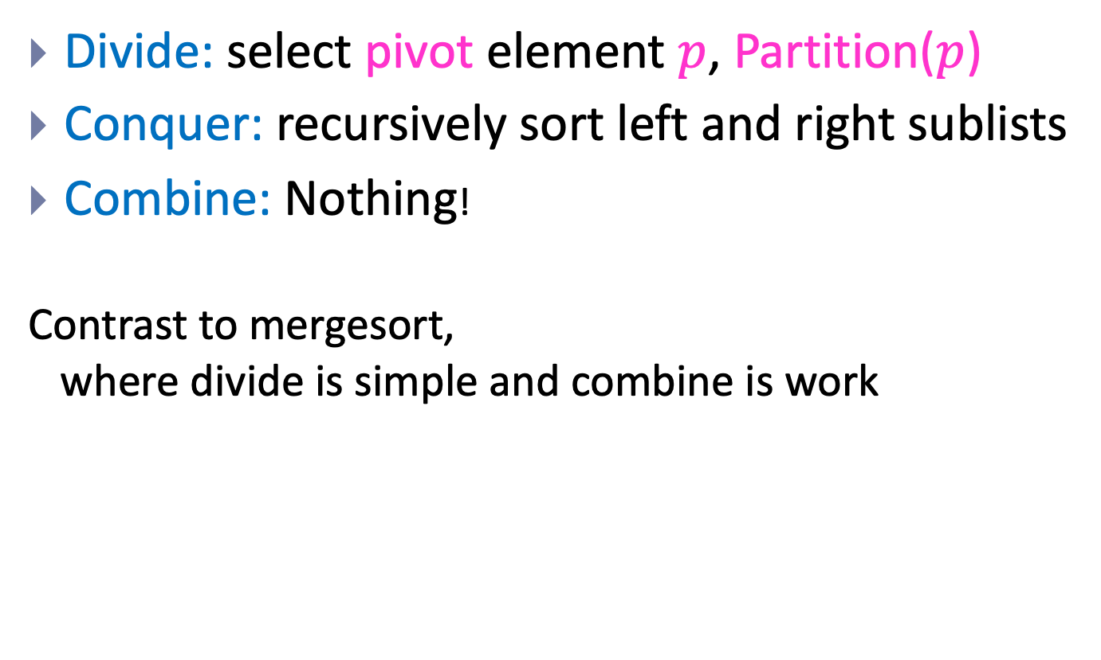
Quicksort is Divide and Conquer
Divide: select pivot element $p$, Partition($p$)
Conquer: recursively sort left and right sublists
Combine: Nothing!
Contrast to mergesort, where divide is simple and combine is work

Slide 33
Quicksort’s Strategy (a picture)
Use last element as pivot (or pick one and move it there)
After call to partition…
Now sort two parts recursively and we’re done!
Note that splitPoint may be anywhere in first..last
Note our assumption that all keys are distinct
pivot
first
last
<= pivot (unsorted)
pivot
> pivot (unsorted)
first
split point
last
<= pivot (sorted)
pivot
> pivot (sorted)
first
split point
last

Slide 34
Quicksort Code
Input Parameters: list, first, last
Output Parameters: list
def quicksort(list, first, last):
if first < last:
q = partition(list, first, last)
quicksort(list, first, q-1)
quicksort(list, q+1, last)
return

Slide 35
Partition Does the Dirty Work
Partition rearranges elements
How? How many comparisons? How many swaps?
How? Two well-known algorithms
In this chapter of CLRS, Lomuto’s algorithm
In the exercises, the original: Hoare’s algorithm. (Page 185. Look at on your own.)
Important:
Both are in-place!
Both are linear.

Slide 36

Strategy for Lomuto’s Partition
Invariant: At any point:
i indexes the right-most element <= pivot
j-1 indexes the right-most element > pivot
Note: book uses p and r for what we called first and last in earlier slides
Strategy:
Look at next item a[j]
If that item > pivot, all is well!
If that item < pivot, increment i and then swap items at positions i and j
When done, swap pivot with item at position i+1
Number of comparisons: n-1

Slide 37
Efficiency of Quicksort
Partition divides into two sub-lists, perhaps unequal size
Depends on value of pivot element
Recurrence for Quicksort T(n) = partition-cost + T(size of 1st section) + T(size of 2nd section)
If divides equally, T(n) = 2 T(n/2) + n-1
Just like mergesort
Solve by substitution or master theorem T(n) ∈ Θ(n lg n )
This is the best-case. But…

Slide 38
Worst Case of Quicksort
What if divides in most unequal fashion possible?
One subsection has size 0, other has size n-1
T(n) = T(0) + T(n-1) + n-1
What if this happens every time we call partition recursively?
Uh oh. Same as insertion sort.
“Sorry Prof. Hoare – we have to take back that Turing Award now!”

Slide 39
Quicksort’s Average Case
Good if it divides equally, bad if most unequal.
Remember: when subproblems size 0 and n-1
Can worst-case happen? Sure! Many cases. One is when elements already sorted. Last element is max, pivot around that. Next pivot is 2nd max…
What’s the average?
Much closer to the best case
A bad-split then a good-split is closer to best-case (pp. 176-178)
To prove A(n), fun with recurrences!
The result: If all permutations are equal, then A(n) ≅ 1.386 n lg n (for large n)
So very fast on average.
And, we can take simple steps to avoid the worst case!

Slide 40
Avoiding Quicksort’s Worst Case
Make sure we don’t pivot around max or min
Find a better choice and swap it with last element
Then partition as before
Recall we get best case if divides equally
Could find median. But this costs Θ(n). Instead…
Choose a random element between first and last and swap it with the last element
Or, estimate the median by using the “median-of-three” method
Pick 3 elements (say, first, middle and last)
Choose median of these and swap with last. (Cost?)
If sorted, then this chooses real median. Best case!

Slide 41
Tuning Quicksort’s Performance
In practice quicksort runs fast
A(n) is log-linear, and the “constants” are smaller than mergesort and heapsort
Often used in software libraries
So worth tuning it to squeeze the most out of it
Always do something to avoid worst-case
Sort small sub-lists with (say) insertion sort
For small inputs, insertion sort is fine
No recursion, function calls
Variation: don’t sort small sections at all. After quicksort is done, sort entire array with insertion sort
It’s efficient on almost-sorted arrays!

Slide 42
Quicksort’s Space Complexity
Looks like it’s in-place, but there’s a recursion stack
Depends on your definition: some people define in-place to not include stack space used by recursion
E.g. our CLRS algorithms textbook
Other books and people do “count” this
How much goes on the stack?
If most uneven splits, then Θ(n).
If splits evenly every time, then Θ(lg n).
Ways to reduce stack-space used due to recursion
Various books cover the details (not ours, though)
First, remove 2nd recursive call (tail-recursion)
Second, always do recursive call on smaller section

Slide 43
Summary: Quicksort
Divide and conquer where divide does the heavy-lifting
In worst-case, efficiency is Θ(n²)
But it’s practical to avoid the worst-case
On average, efficiency is Θ(n lg n)
Better space-complexity than mergesort.
In practice, runs fast and widely used
Many ways to tune its performance
Various strategies for Partition
Some work better if duplicate keys
More details? See Sedgewick’s algorithms textbook
He’s the expert! PhD on this under Donald Knuth

