Slide 1
CS4102 Algorithms Spring 2021 – Floryan and Horton
Module 3, Day 3
DP solution to weighted activity selection
(Solution not in textbook)
Proof of greedy solution to Activity Selection problem
(CLRS Section 16.1)

Slide 2
Activity-Selection
Formally:
Given a set S of n activities
s_{i} = start time of activity i
f_{i} = finish time of activity i
Find max-size subset A of compatible activities
3
4
6
2
1
5
Assume (wlog) that f₁ ≤ f₂ ≤ … ≤ f_{n}

Slide 3
Activity Selection: A Greedy Algorithm
So algorithm using the best greedy choice is simple:
Sort the activities by finish time
Schedule the first activity
Then schedule the next activity in sorted list which starts after previous activity finishes
Repeat until no more activities
Or in simpler terms:
Always pick the compatible activity that finishes earliest

Slide 4
Non-recursive algorithm
greedy-interval (s, f)
n = s.length
A = {a₁}
k = 1 # last added
for m = 2 to n
if s[m] ≥ f[k]
A = A U {a_{m}}
k = m
return A
s is an array of the intervals’ start times
f is an array of the intervals’ finish times
A is the array of the intervals to schedule
How long does this take?

Slide 5
Does Greedy Always Find Optimal Solution?
Yes, we can prove that the greedy algorithm always “stays ahead”!

Slide 6
Does Greedy Always Find Optimal Solution?
Yes, we can prove that the greedy algorithm always “stays ahead”!
How?
Overall idea: Show the i’th interval algorithm chooses always ends earlier than optimal solution

Slide 7
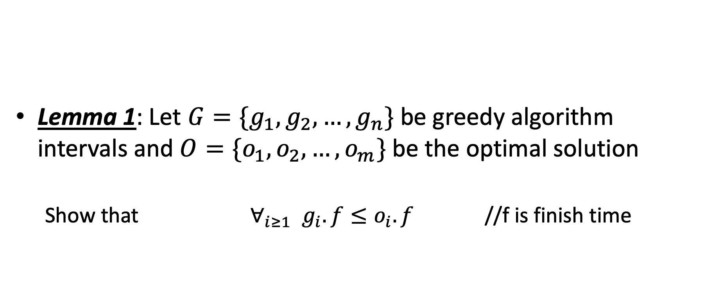
Does Greedy Always Find Optimal Solution?
Lemma 1: Let $G=\{g_{1},g_{2},…,g_{n}\}$ be greedy algorithm intervals and $O=\{o_{1},o_{2},…, o_{m}\}$ be the optimal solution
Show that $∀_{i≥1}{ g}_{i}.f≤o_{i}.f$ //f is finish time

Slide 8
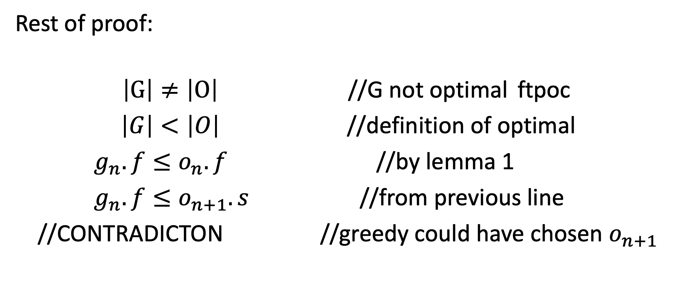
Does Greedy Always Find Optimal Solution?
Rest of proof:
$\left|G\right|≠\left|O\right|$ //G not optimal ftpoc
$\left|G\right|<\left|O\right|$ //definition of optimal
$g_{n}.f≤o_{n}.f$ //by lemma 1
$g_{n}.f≤o_{n+1}.s$ //from previous line
//CONTRADICTON //greedy could have chosen $o_{n+1}$

