Slide 1
Reductions: 3-Coloring

Slide 2
3-Coloring

Slide 3
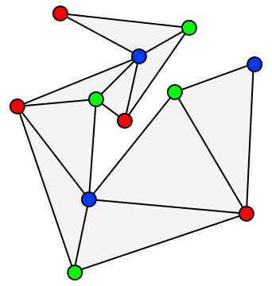
3-Coloring
Given graph G, and three colors c1,c2,c3 (not really given as input)
Can we color the graph with these colors such that no adjacent nodes have the same color.
Turns out that 3-Coloring is NP-Complete

Slide 4
3-Coloring
First show:
3-Coloring ∈ NP
How?
Given a coloring of the graph, is it valid?
Must do this in polynomial time!

Slide 5
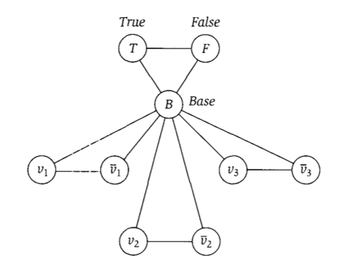
Reducing 3-SAT to 3-coloring

Slide 6
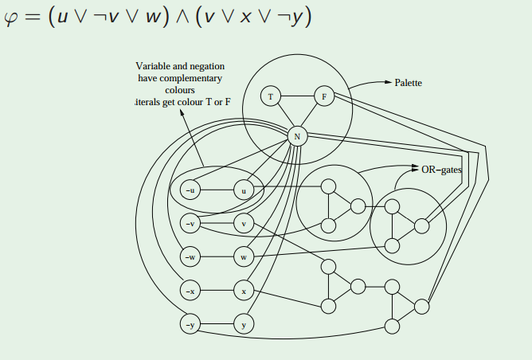
Reducing 3-SAT to 3-coloring

Slide 7
(VERY informal) proof of reduction
Sat(Φ) → G is 3-Colorable
Assume Φ is satisfiable
3 colors (true, false, base)
Color B,T,F with these colors
Color variable nodes with T and F depending on their satisfying values for Φ
Or gates always colorable so that they represent correct OR (output is true iff one or more inputs true)
Thus G is 3-Colorable
G is 3-Colorable → Sat(Φ)
Assume G is 3-Colorable
Color the graph
Let the colors of the B,T,F nodes represent base, true, and false respectively.
Re-arrange OR gate colors slightly if necessary so output is always T or F
Let variable assignments be the color they were given
These assignments satisfy Φ

