Slide 1
NP
CS 4102: Algorithms
Spring 2021
Mark Floryan and Tom Horton

Slide 2
Topics
Reviewing our complexity classes
How did we find the first NP-Complete Problem?
Cook-Levin Theorem
One more reduction
SAT to 3-SAT

Slide 3
Quick Review: Complexity Classes

Slide 4
Remember our complexity classes
P
NP
NP-Hard
NP-Complete
What does this all mean!!

Slide 5
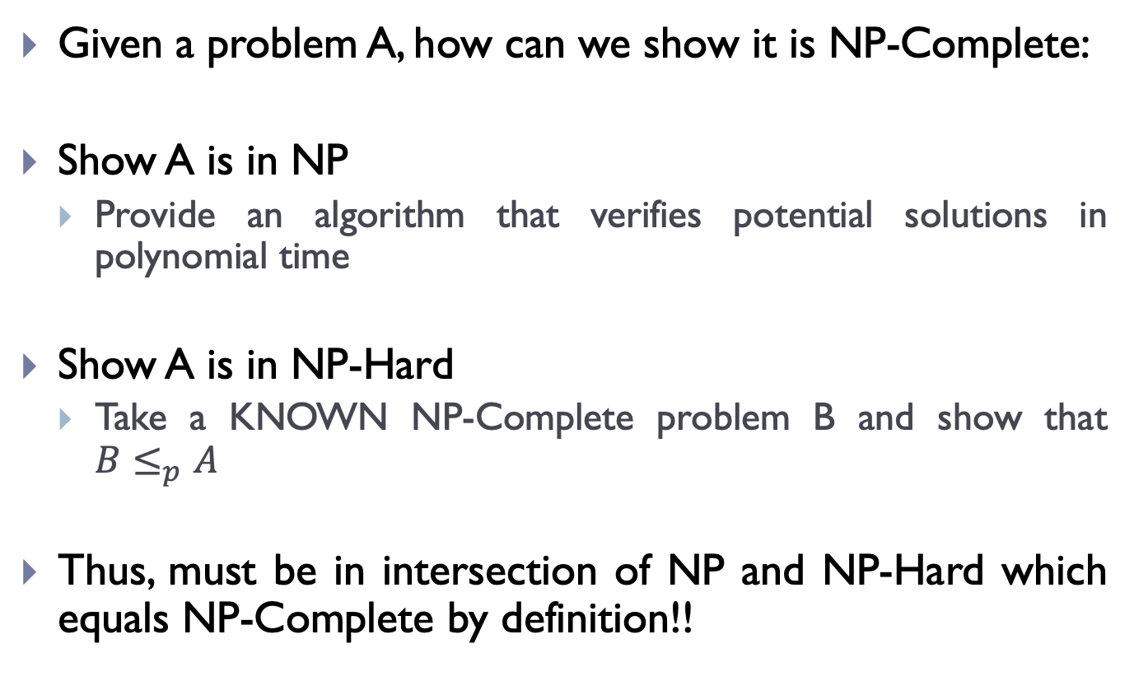
Remember our complexity classes
Given a problem A, how can we show it is NP-Complete:
Show A is in NP
Provide an algorithm that verifies potential solutions in polynomial time
Show A is in NP-Hard
Take a KNOWN NP-Complete problem B and show that $B≤_{p}A$
Thus, must be in intersection of NP and NP-Hard which equals NP-Complete by definition!!

Slide 6
Proving something is NP-complete
This is done by a reduction with only one of the thousands of existing NP-complete problems
But how did we figure out the first NP-complete problem?
And what was that problem?

Slide 7
Satisfiability

Slide 8
Satisfiability
Consider a Boolean expression that uses only and, or, & not
Label the variables x₁ … x_{n}
Can we find truth assignments to x₁ … x_{n} such that the overall result is true?

Slide 9
Satisfiability variants
Originally, the formula had to be in conjunctive normal form
A long and-ing of clauses
Each clause was an or-ing of literals (or negated literals)
In other words, a conjunction of disjunctions
This was called circuit satisfiability
Now, any Boolean expression is valid
And it is usually just called satisfiability

Slide 10
Satisfiability
The only known solutions take exponential time
The decision problem: given an equation E (or a circuit E), is it satisfiable?
Only known solutions are non-deterministic polynomial time
Or deterministic exponential time
The function problem: given an equation E, what is/are the satisfiable solution(s)?
Same running time as the decision problem
The verification problem: given an equation E, and a solution S, does S satisfy E?
Polynomial time to verify

Slide 11
The Cook-Levin Theorem

Slide 12
The Cook-Levin Theorem
Sometimes just called the Cook Theorem
Developed independently by Stephen Cook (US) and Leonid Levin (USSR) in 1971 & 1973
It states, simply, that Circuit Satisfiability (SAT) is NP-complete (NPC)

Slide 13
Cook-Levin Theorem Proof
To show that SAT is NPC, we must show:
SAT ∈NP
That every other NP problem can be reduced to SAT in polynomial time
This proof generally follows the Wikipedia article for the Cook-Levin theorem
As I thought it explained it fairly well

Slide 14
SAT ∈ NP
This is easy:
Any solution to a NP problem can be verified in polynomial time by a DTM
Equivalent statement: solvable in polynomial time by a NTM
Given a solution to SAT, we can easily check this in polynomial time on a DTM
How?
Plug in the values for the solution, run through the terms of the equation and compute their truth value.

Slide 15
∀_{X∈NP} X≤_{p}SAT
Every problem in NP can be reduced to SAT
Consider an NTM that accepts a generic problem X in NP
M = (Q, Σ, s, F, δ)
We will see how to reduce this general problem X to an instance of SAT

Slide 16
Variables
Variables used in our conversion:
n is the input size
p(n) is the (polynomial) time the NTM takes
q ∈ Q
-p(n) ≤ i ≤ p(n)
j ∈Σ
0 ≤ k ≤ p(n)
Variable | Meaning | How many
T_{ijk} | True if tape cell i contains symbol j at step k of the computation | O(p(n)²)
H_{ik} | True if the M’s read/write head is at tape cell i at step k of the computation | O(p(n)²)
Q_{qk} | True if M is in state q at step k of the computation | O(p(n))

Slide 17
Create a conjunction ‘B’ of…
Expression | Conditions | Interpretation | How many
T_{ij0} | Tape cell i initially contains symbol j | Initial tape state; blank symbols below 0 and above n | O(p(n))
Q_{s0} |  | Initial state of the NTM | 1
H₀₀ |  | Initial position of the read/write head | 1
T_{ijk} → ¬T_{ij’k} | j != j’ | One symbol per tape cell | O(p(n)²)
T_{ijk} = T_{ij(k+1)} ∨ H_{ik} |  | Tape remains unchanged unless written | O(p(n)²)
Q_{qk} → ¬Q_{q’k} | q ≠ q’ | Only one state at a time | O(p(n))
H_{ik} → ¬H_{i’k} | i ≠ i’ | Only one head position at a time | O(p(n)²)
(H_{ik} ∧ Q_{qk} ∧ T_{iσk}) → (H_{(i+d)(k+1)} ∧ Q_{q’(k+1)} ∧ T_{iσ(k+1)}) | (q, σ, q’, σ’, d) ∈ δ | Possible transitions at computation step k when head position is at position I | O(p(n)²)
∨_{f∈F} Qfp(n) |  | Must finish in an accepting state | 1

Slide 18
Final part of the proof
If there is an accepting computation for the NTM on input I, then B is satisfiable by assigning T_{ijk}, H_{jk}, and Q_{jk} their intended interpretations
The number of sub-expressions is 2p(n) + 4p(n)² + 3 = O(p(n)²)
Which means the reduction is polynomial
B is called the tableau of the NTM

Slide 19
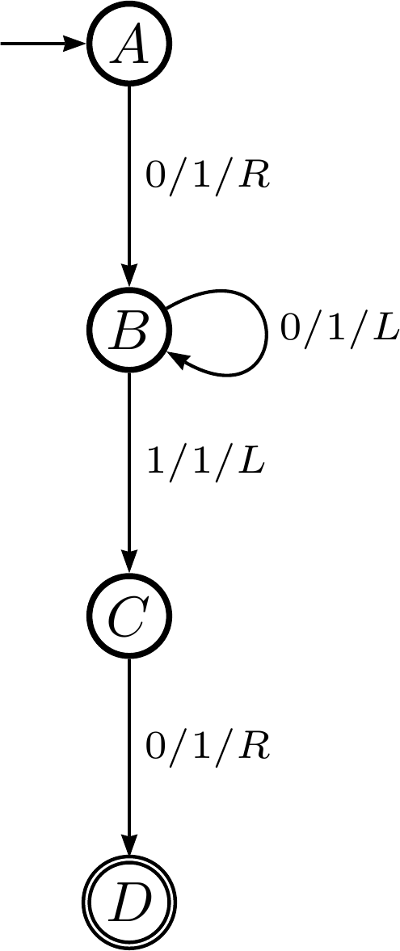
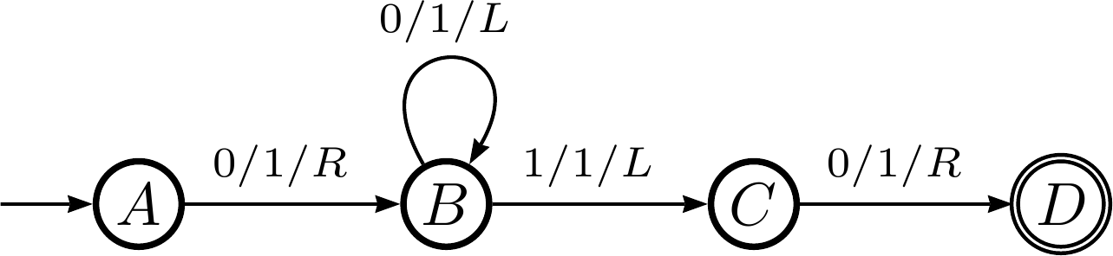
Cook-Levin proof example
Consider the following DTM:

Slide 20
Cook-Levin proof example
Step 0: in state A
Step 1: in state B
Step 2: in state B
Step 3: in state C
Step 4: in state D
…
0
0
0
0
0
0
0
…
…
0
0
0
1
0
0
0
…
…
0
0
0
1
1
0
0
…
…
0
0
0
1
1
0
0
…
…
0
0
1
1
1
0
0
…

Slide 21
The state of the TM, part 1
The tape is all zeros for the 7 cells we care about (cells 0-6)
T_{ijk} is true if the tape cell i contains symbol j at step k
T₀₀₀ ∧ T₁₀₀ ∧ T₂₀₀ ∧ T₃₀₀ ∧ T₄₀₀ ∧ T₅₀₀ ∧ T₆₀₀
The initial state of the TM is state A
Q_{qk} is true if the TM is in state q at step k
Q_{A0}
The head is in the center (cell 3)
H_{ik} is true if the TM is in cell i at step k
H₃₀

Slide 22
The state of the TM, part 2
The tape is all zeros for the 7 cells we care about (cells 0-6)
We’ll only focus on cells 2-4 for brevity
T_{ijk} is true if the tape cell i contains symbol j at step k
T_{ijk} → T_{ij’k} where j!=j’
(T₂₀₀ → ¬T₂₁₀) ∧ (T₃₀₀ → ¬T₃₁₀) ∧ (T₄₀₀ → ¬T₄₁₀)
Likewise for all the other steps (0 ≤ k ≤ 4)
Convert that to an or clause: p→q ≡ ¬p∨q
(¬T₂₀₀ ∨ ¬T₂₁₀) ∧ (¬T₃₀₀ ∨ ¬T₃₁₀) ∧ (¬T₄₀₀ ∨ ¬T₄₁₀)

Slide 23
Create a conjunction ‘B’ of…
Expression | Conditions | Interpretation | How many
T_{ij0} | Tape cell i initially contains symbol j | Initial tape state; blank symbols below 0 and above n | O(p(n))
Q_{s0} |  | Initial state of the NTM | 1
H₀₀ |  | Initial position of the read/write head | 1
T_{ijk} → ¬T_{ij’k} | j != j’ | One symbol per tape cell | O(p(n)²)
T_{ijk} = T_{ij(k+1)} ∨ H_{jk} |  | Tape remains unchanged unless written | O(p(n)²)
Q_{qk} → ¬Q_{q’k} | q ≠ q’ | Only one state at a time | O(p(n))
H_{jk} → ¬H_{j’k} | i ≠ i’ | Only one head position at a time | O(p(n)²)
(H_{ij} ∧ Q_{qk} ∧ T_{iσk}) → (H_{(i+d)(k+1)} ∧ Q_{q’(k+1)} ∧ T_{iσ(k+1)}) | (q, σ, q’, σ’, d) ∈ δ | Possible transitions at computation step k when head position is at position I | O(p(n)²)
∨_{f∈F} Qfp(n) |  | Must finish in an accepting state | 1

Slide 24
End conjunction
B = T₀₀₀ ∧ T₁₀₀ ∧ T₂₀₀ ∧ T₃₀₀ ∧ T₄₀₀ ∧ T₅₀₀ ∧ T₆₀₀ ∧ Q_{A0} ∧ H₃₀ ∧ (¬T₂₀₀ ∨ ¬T₂₁₀) ∧ (¬T₃₀₀ ∨ ¬T₃₁₀) ∧ (¬T₄₀₀ ∨ ¬T₄₁₀) ∧ …
If the TM successfully completes the computation, then B will be true

Slide 25
How to prove problem X is NP-complete
Show it is in NP
Any solution to a NP problem can be verified in polynomial time by a DTM
Equivalent statement: solvable in polynomial time by a NTM
Show it is in NP-hard
You can convert any NP problem into L in polynomial time
Done via a reduction: SAT ≤_{p} X

Slide 26
3-SAT

Slide 27
Circuit-SAT versus SAT
Circuit-SAT is a translation of a Boolean circuit
Only and, or, and not
Each operator only operates on 2 literals (or their negations)
SAT can be any Boolean expression
Including conditionals and bi-conditionals
Sometimes called Formula SAT to differentiate it
They were known to be equivalent in expressive power long before NP-completeness came around
And are thus used rather interchangeably

Slide 28
3-SAT
Satisfiability (SAT) takes pretty much any Boolean expression
And, or, conditional, bi-conditional, etc.
In 3-SAT, we claim that the Boolean expression must be a conjunction of disjunctions
Each clause is a disjunction (OR’ing) of literals (or their negations)
The overall expression is a conjunction (AND’ing) of the clauses
Each clause can have exactly 3 literals
It’s called 3-CNF-SAT because it must be in conjunctive normal form (a conjunction of disjunctions)

Slide 29
Showing 3-SAT is NP-complete
First, we must show it’s in NP
A NTM can decide it in polynomial time
Rephrased: it can be verified by a DTM in polynomial time
The equivalence of those two statements is on slide 30
This second one is easy to show
A formal proof would require showing how, which I’ll do verbally
Next we must show that 3-SAT is NP-hard: that we can reduce an NP-complete problem to 3-SAT
Not surprisingly, we choose SAT
We’ll consider the following formula:
φ = ((x₁ → x₂) ∨ ¬((¬x₁ ↔ x₃) ∨ x₄)) ∧ ¬x₂

Slide 30
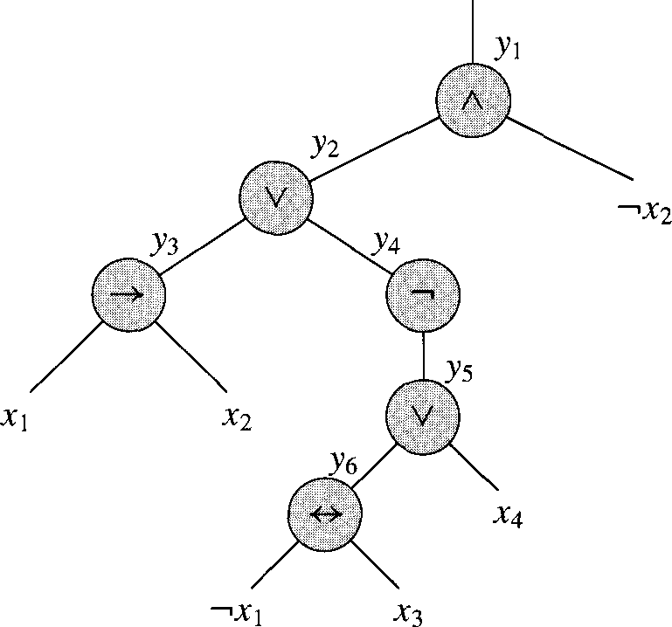
Converting SAT to 3-SAT, step 1
φ = ((x₁ → x₂) ∨ ¬((¬x₁ ↔ x₃) ∨ x₄)) ∧ ¬x₂
We parse the expression into an expression tree
You did this in 2150 lab 5 with arithmetic operators; same principle applies
Since each operator (other than ¬) is binary, it will be a binary tree

Slide 31
Converting SAT to 3-SAT, step 2
We introduce a variable y_{i} for each internal node
We can then re-write our expression:
φ’ = y₁ ∧ (y₁ ↔ (y₂ ∧ ¬x₂)
∧ (y₂ ↔ (y₃ ∨ y₄))
∧ (y₃ ↔ (x₁ → x₂))
∧ (y₄ ↔ ¬y₅)
∧ (y₅ ↔ (y₆ ∨ x₄))
∧ (y₆ ↔ (¬x₁ ↔ x₃))

Slide 32
Converting SAT to 3-SAT, step 3
So we build a truth table for each clause φ’_{i}:
φ’ = y₁ ∧ (y₁ ↔ (y₂ ∧ ¬x₂)
∧ (y₂ ↔ (y₃ ∨ y₄))
∧ (y₃ ↔ (x₁ → x₂))
∧ (y₄ ↔ ¬y₅)
∧ (y₅ ↔ (y₆ ∨ x₄))
∧ (y₆ ↔ (¬x₁ ↔ x₃))
We have an equation with at most 3 literals each
But it’s not in CNF!
y₁ | y₂ | _{X2} | (y₁ ↔ (y₂ ∧ ¬x₂))
1 | 1 | 1 | 0
1 | 1 | 0 | 1
1 | 0 | 1 | 0
1 | 0 | 0 | 0
0 | 1 | 1 | 1
0 | 1 | 0 | 0
0 | 0 | 1 | 1
0 | 0 | 0 | 1

Slide 33
Converting SAT to 3-SAT, step 4
So we build a truth table for each clause φ’_{i}:
For each clause φ’_{i}, we create new DNF (disjunctive normal form) clauses for when it’s false:
¬φ’_{i} = (y₁∧y₂∧x₂) ∨ (y₁∧¬y₂∧x₂) ∨ (y₁∧¬y₂∧¬x₂) ∨ (¬y₁∧y₂∧¬x₂)
We then negate that to get when it’s true
y₁ | y₂ | x₂ | (y₁ ↔ (y₂ ∧ ¬x₂))
1 | 1 | 1 | 0
1 | 1 | 0 | 1
1 | 0 | 1 | 0
1 | 0 | 0 | 0
0 | 1 | 1 | 1
0 | 1 | 0 | 0
0 | 0 | 1 | 1
0 | 0 | 0 | 1

Slide 34
Converting SAT to 3-SAT, step 5
So we build a truth table for each clause φ’_{i}:
¬φ’_{i} = (y₁∧y₂∧x₂) ∨ (y₁∧¬y₂∧x₂) ∨ (y₁∧¬y₂∧¬x₂) ∨ (¬y₁∧y₂∧¬x₂)
Then the negation (DeMorgan’s law!) is:
φ’_{i} = (¬y₁∨¬y₂∨¬x₂) ∧ (¬y₁∨y₂∨¬x₂) ∧ (¬y₁∨y₂∨x₂) ∧ (y₁∨¬y₂∨x₂)
y₁ | y₂ | x₂ | (y₁ ↔ (y₂ ∧ ¬x₂))
1 | 1 | 1 | 0
1 | 1 | 0 | 1
1 | 0 | 1 | 0
1 | 0 | 0 | 0
0 | 1 | 1 | 1
0 | 1 | 0 | 0
0 | 0 | 1 | 1
0 | 0 | 0 | 1

Slide 35
Converting SAT to 3-SAT, step 6
Three cases can occur for all the CNF clauses C_{i}:
C_{i} has 3 literals: then we include it in the final formula
C_{i} has 2 literals (l₁ and l₂): we include (l₁ ∨ l₂ ∨ p) ∧ (l₁ ∨ l₂ ∨ ¬p)
It doesn’t matter whether p is true or false; one clause will evaluate to true, the other to l₁ ∨ l₂
C_{i} has just one literal (l): we include the following:
(l ∨ p ∨ q) ∧ (l ∨ ¬p ∨ q) ∧ (l ∨ p ∨ ¬q) ∧ (l ∨ ¬p ∨ ¬q)
Regardless of what p and q are, 3 clauses will evaluate to true, and the other one to l

Slide 36
We’re done!
Whew!
Note that each step of converting SAT to 3-SAT was in polynomial time
And thus the entire thing in polynomial time

