Slide 1
Network Flow
Mark Floryan and Tom Horton CS4102 – Spring 2021

Slide 2
Topics

Slide 3
Topics in this slide-deck:
Flow-Networks
Max-flow problem
Ford-Fulkerson Algorithm
Related Graph Problems
Bi-partite Matching
Minimum Cut
A Short introduction to reductions
…but many more reductions coming at end of course

Slide 4
Maximal Flow

Slide 5
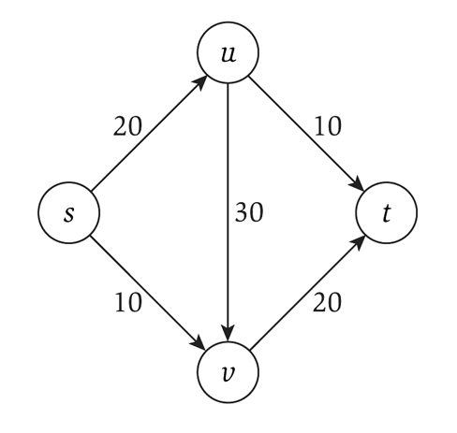
Flow networks
Consider a flow network, which is a specialized directed graph with:
A single source node s
A single terminus node t
Capacities on each edge
That must be integer!
What is the maximum flow you can send from s to t?

Slide 6
Applications
Transportation networks
How many people can be routed?
Computer networks
Electrical distribution
Water distribution
Note that all these applications have multiple sources and multiple sinks!
Whereas the flow networks we study do not, yet

Slide 7
Some rules
Source node has NO incoming flow
Terminal (sink) node has NO outgoing flow
Internal nodes has net zero flow
all units of flow going in must be going out as well
No edge is over capacity
GOAL: Find the maximum flow that can be “pushed” through the network

Slide 8
Algorithm notation
Graph G has vertices V and edges E
s ∈V is the source
t ∈V is the sink (terminus)
f(u,v): the flow on the edge from u to v
f(v,u): the backflow on the edge from v to u
c(u,v): the capacity on the edge from u to v
c_{f}(u,v): the residual capacity on the edge from u to v
G_{f} is the graph where the edges weights are the residual capacities
THIS is usually the graph we actually use when running the algorithm we are about to see.

Slide 9
Ford-Fulkerson: Algorithm overview
Consider the residual capacities
Meaning how much capacity is left after taking into account how much flow is going through that edge
Find a path from s to t such that the minimum residual capacity is greater than zero
Since everything is integer, it must be 1 or more
Update the residual capacities after taking into account this new flow
Repeat until no more such paths are found

Slide 10
Backflow
Each edge has forward flow and backflow
The two must always be inverses of each other!
This allows for modeling of flow “returning” along a given edge

Slide 11
Ford-Fulkerson Algorithm
f(u,v) = 0 for all edges (u,v)
While there is an “augmenting” path p from s to t in G_{f} such that c_{f}(u,v) > 0 for all edges (u,v) ∈ p
Find c_{f}(p) = min{c_{f}(u,v) | (u,v) ∈ p}
For each edge (u,v) ∈ p
f(u,v) = f(u,v) + c_{f}(p) send flow along the path
f(v,u) = f(v,u) - c_{f}(p) send backflow the other way

Slide 12
Running time
Is O(E*f)
E is the number of edges
Maximum time to find an augmenting path via depth-first search
Can also use breadth-first search!
f is the maximum flow of the final graph
Minimum flow on an augmenting path is 1, so the maximum number of steps is thus f

Slide 13
What type of search?
“While there is a path p from s to t in G_{f}”
A depth-first search is the Ford-Fulkerson algorithm
Each augmenting path can be found in O(m) time
And there can be f paths
So the running time is O(mf)
Will not terminate with irrational edge values
A breadth-first search is the Edmonds-Karp algorithm
Runs in O(nm²)
Total number of augmentations is O(nm)
And finding each augmentation takes O(m)
Guaranteed termination with irrational edge values
Run-time is independent of the maximum flow of the graph

Slide 14
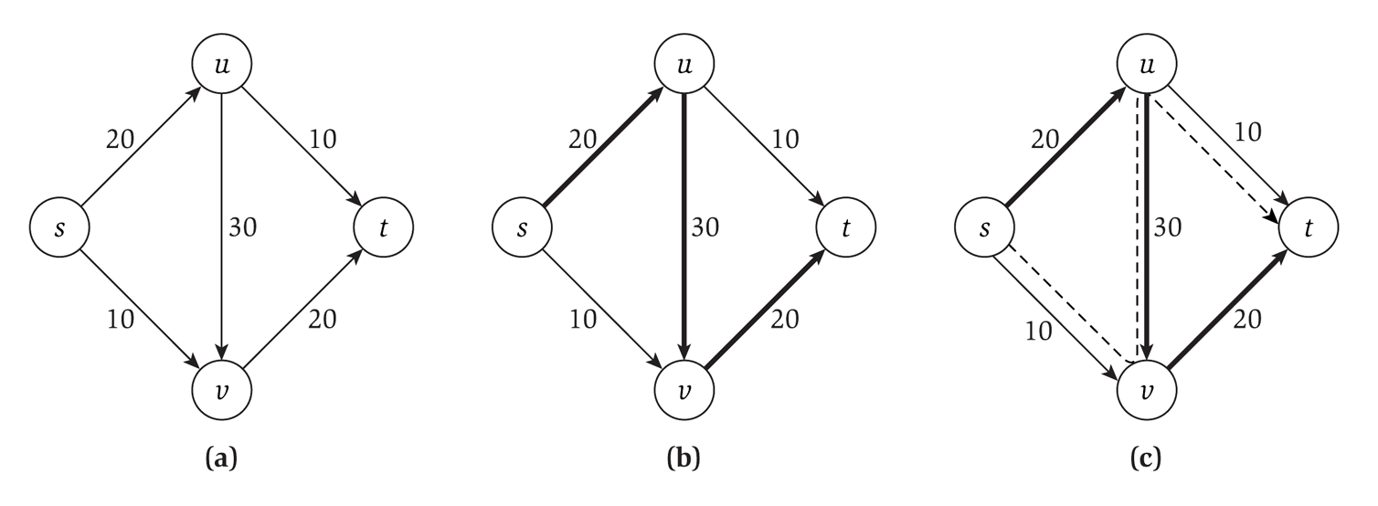
Our example

Slide 15
Minimum Cut

Slide 16
Definition: Cut
Given a flow network, we want to cut edges…
A cut C = (A, B) where:
A is a set of vertices (A is a subset of V)
B is a set of vertices (B also a subset of V)
A intersect B = null set (no shared vertices)
A union B = V (all vertices in either A or B)
s in A, t in B
What do we care about?
Well, we care about the edges that go across this cut.
Either from node in A to a node in B or vice versa.

Slide 17
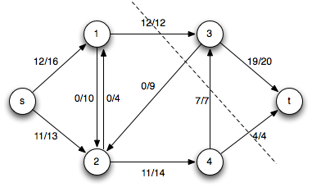
Definition: Net Flow across Cut
Given a cut C = (A, B)
The net flow across the cut C = (A, B) is the sum of the flows on its edges from A to B minus the sum of the flow on its edges from B to A

Slide 18
Definition: Flow-value lemma
Let f be any flow and C = (A, B) be any cut
The net flow across (A, B) equals the value of the flow f

Slide 19
Proof: Flow-value lemma
Let f be any flow and C = (A, B) be any cut
The net flow across (A, B) equals the value of the flow f
Proof by induction on the size of B
B.C. B = {t} (B is only the sink)
Clearly this is true as the flow across the cut is everyone sinking into t, which is the definition of the flow f
I.H. Assume true for some cut C = (A, B)
I.S. Move one node from A to B
Choose an a’ to move that has at least one edge to a node in B
We know the flow f never changes
How does the value of the new cut C’ = (A’, B’) change?
It doesn’t! Why? See next slide…

Slide 20
Proof: Flow-value lemma cont.
Let f be any flow and C = (A, B) be any cut
The net flow across (A, B) equals the value of the flow f
Why does C’ = (A’, B’) have the same net flow?
Local equilibrium: net flow coming into a’ from nodes in A only must equal the flow going out across the cut to nodes in B
After a’ is moved:
everything going across the cut now goes to something in B from B, everything going to or from a node in A now goes across the cut.
Thus, by local equilibrium the value of the cut C’ is equivalent to the value of the cut C
Induction done!

Slide 21
Max-flow min-cut theorem
The max-flow min-cut theorem states that the maximum value of an s-t flow is equal to the minimum capacity of an s-t cut
In other words, if you look at all the possible cuts in the graph, and find the smallest capacity of those cuts, then that value is the value of the maximum flow for that network.

Slide 22
Another definition: Weak Duality
Let f be any flow and C = (A, B) be any cut
Then:
Value of f <= capacity of C
Note: We are talking about the CAPACITY of C, not the value of the flow across C

Slide 23
Another version of MaxFlow-MinCut
The following three statements are equivalent:
For some flow f
1) There exists a cut whose capacity equals the value of f
2) f is a maximum flow
3) There is no augmenting path with respect to f
Let’s prove this!
1 → 2
2 → 3
3 → 1

Slide 24
How to determine the min cut?
Use the Ford-Fulkerson algorithm to determine max flow
Time is O(mf)
Worst case is each edge needs a cut
So we can determine the min cut in O(m) additional time
O(mf) + O(m) = O(mf)

Slide 25
Reductions

Slide 26
Algorithm for min-cut
Imagine that I presented you with a new algorithm to determine min-cut
Everybody uses max-flow to determine min-cut, but imagine it anyway
What could you tell me about that algorithm?
About it’s running time?

Slide 27
Max-flow vs. min-cut
These two problems are “equivalent”
Specifically, if you can solve one, you can solve the other
Alternatively, we can say that one problem reduces to the other
The problem of finding min-cut reduces to the problem of finding max-flow (plus a polynomial time conversion)

Slide 28
Reduction
A reduction is a transformation of one problem into another problem
Min-cut is reducible to max-flow because we can use max-flow to solve min-cut
Formally, problem A is reducible to problem B if we can use a solution to B to solve A
We note that the reduction happens in polynomial time
And signify it with a ≤_{p}

Slide 29
Reducing both ways
We know that:
Min-cut ≤_{p} max-flow
Max-flow ≤_{p} min-cut
Because they reduce both ways, they are polynomial-time equivalent
Often times you can’t directly compare algorithms
So you show that they reduce both ways

Slide 30
Bipartite Graphs

Slide 31
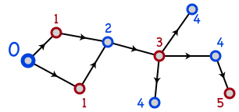
Bipartite Graphs
A graph is bipartite if node set V can be split into sets X and Y such that every edge has one end in X and one end in Y
X and Y are typically colored red and blue
Or Boolean true/false

Slide 32
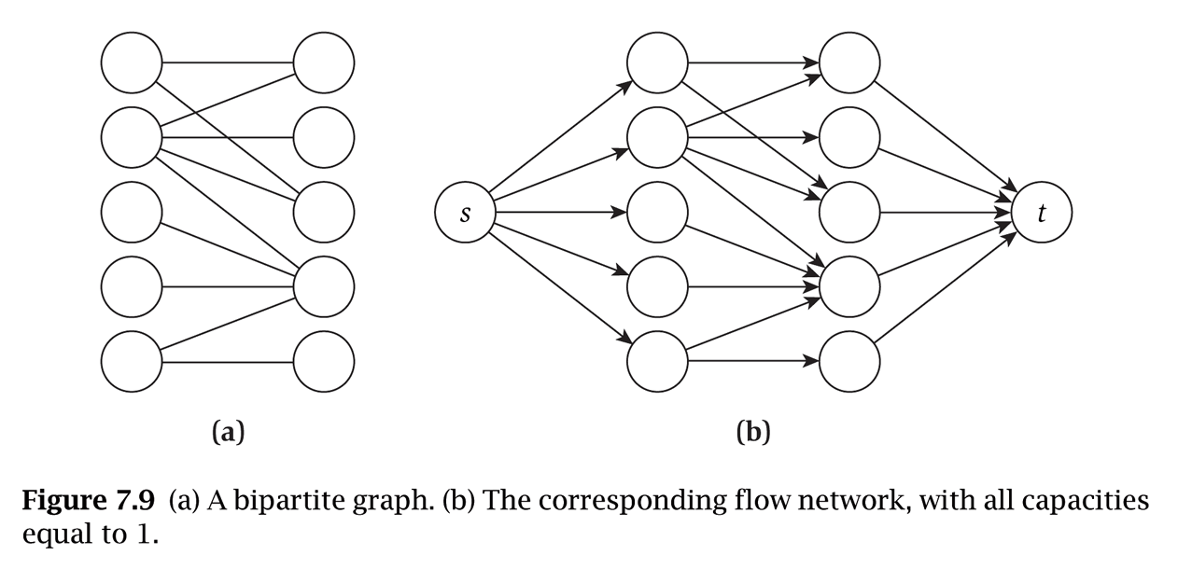
Notes and assumptions
We assume the graph is connected
Otherwise we will only look at each connected component individually
A triangle cannot be bipartite
In fact, any graph with an odd length cycle cannot be bipartite

Slide 33
Bipartite Determination Algorithm
Pick a starting vertex, color it red
Color all adjacent nodes blue
And all nodes adjacent to that red
Etc.
If you ever try coloring a red node blue, or a blue node red, then the graph is not bipartite
Does this algorithm sound familiar?

Slide 34
Bipartite Matching

Slide 35
Bipartite Matching
Given a bipartite graph G, can we find a matching M in G such that M ⊆ E and each node appears on exactly one of M
In other words, find a subset of edges that connect every node on the left to one (and only one!) node on the right
Since the graph is bipartite, all edges connect one on the left with one on the right

Slide 36
Reduction!
To solve this, we reduce it to a maximal flow problem by creating a graph G’:
Direct all edges from the left to the right
Add a source node, with edges to every node on the left side
Add a terminus node, with edges to every node on the right side
Compute maximal flow!
The maximal flow in G’ is the maximum matching in G

Slide 37
Reduction, diagrammatically

Slide 38
Why does this work?
Each node on the left can be in at most one matching
This is enforced by the edge of capacity one leading into it
Likewise for each node on the right
The bottleneck will be how it flows across the bipartite “barrier”

Slide 39
Reduction details
We have transformed (in polynomial time) a bipartite matching problem into a maximal flow problem
Specifically, bipartite-matching ≤_{p} max-flow
Because we can transform bipartite matching to max-flow in polynomial time
But is it the case that max-flow ≤_{p} bipartite-matching?
Not so much: a solution to bipartite matching does not help us with a non-bipartite graph

Slide 40
Running time
Max flow runs in O(E*f)
But the max flow is (at most) n/2
If every node in the graph has flow through it, then there are n/2 units of flow moving through the graph
So the running time is equivalent to O(E*n)

Slide 41
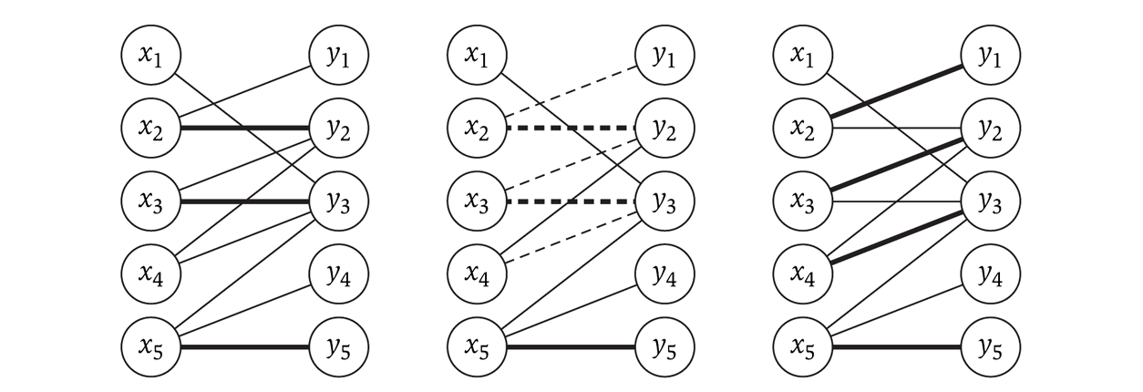
Imperfect bipartite matchings
These exist, and the algorithm may produce them, depending on the graph
The following shows an augmenting path (in the middle) used to achieve the maximal flow on the right

Slide 42
Max-flow variations

Slide 43
Finding a Circulation
Real world applications don’t have just one source and sink
Instead there are multiple ones: power production / consumption, etc.
We designate a set S to be all the nodes that are sources
We can also view them has having negative demand
Likewise, we designate a set T to be all the nodes that are sinks
They have positive demand
Networks with multiple sources and sinks (modeled using demand) are called circulation networks

Slide 44
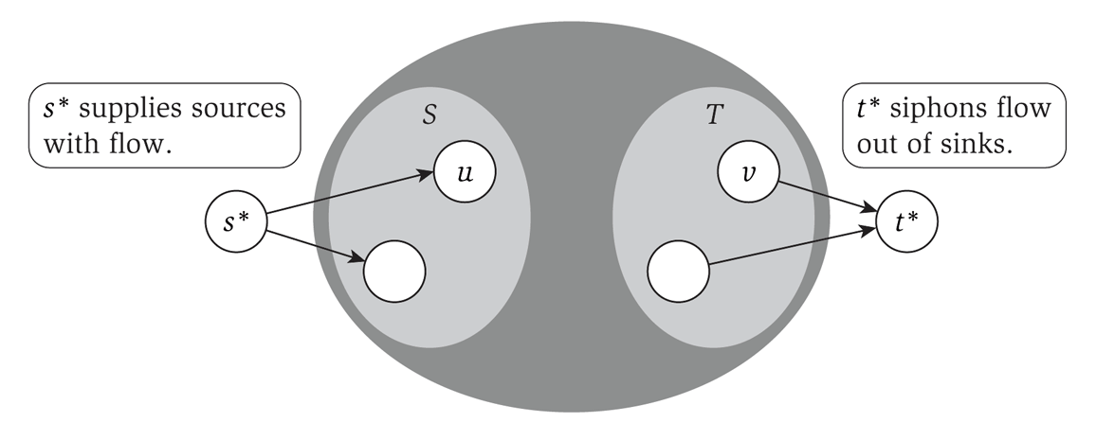
Reduction to max-flow
With a few modifications, we can make this a max-flow problem:
Create a ‘super source’ s* with edges to each node in S
The capacity of that edge is the size of the source of the node in S
Likewise with the set T

Slide 45
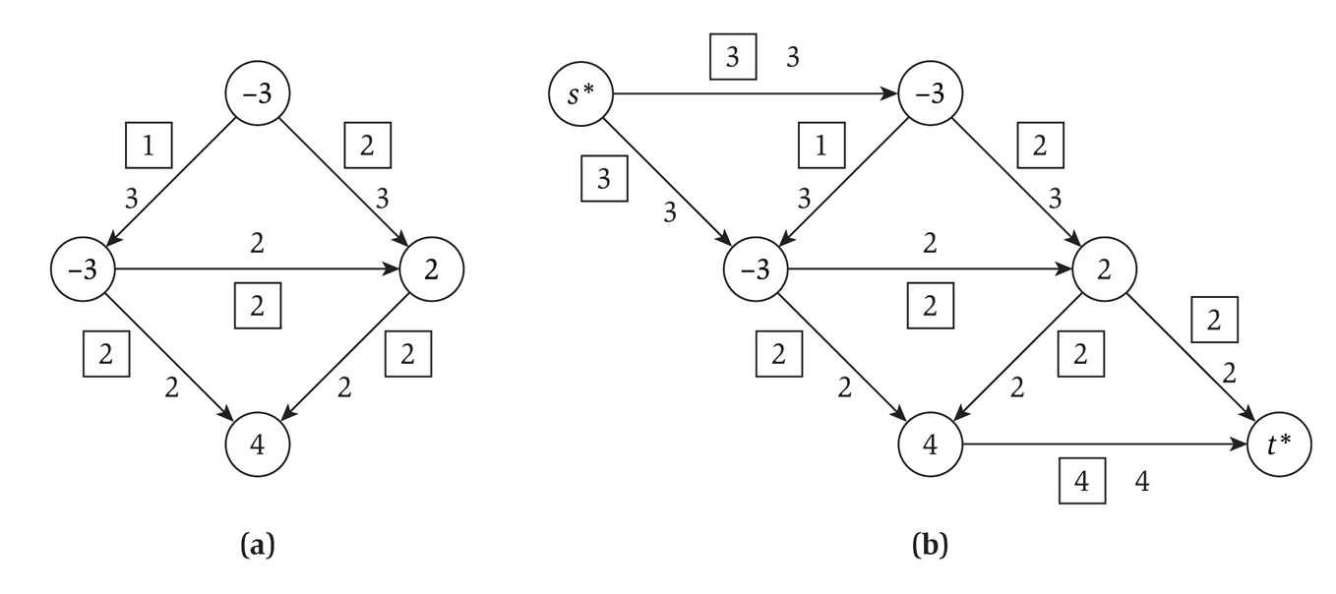
Conversion example
Converting a graph with multiple sources and sinks to a single-source-single-sink max-flow problem:

Slide 46
Circulation notes
A circulation problem is aiming for feasibility, not max flow
But we use max flow to solve it
We set each edge from the super-source to each individual source to be the absolute value as the individual source’s demand
Max-flow is then run
If the total amount leaving the single-source is the SAME as the capacity of each outgoing edge, then the circulation is feasible

Slide 47
Edge lower bounds
So far, we have considered only the capacity of an edge: the upper bound on the flow
We also want to consider a lower bound on the flow on an edge
i.e. forcing a certain amount of flow through an edge
We will reduce this to a circulation problem
Which can then be reduced to a max-flow problem

Slide 48
Handling lower bounds
A lower bound forces flow across an edge
Which increases demand at the start of the edge (to compensate for the flow across the edge)
And decreases demand at the terminus of the edge (as some flow is fulfilling the demand)

Slide 49
Solving a flow with lower bounds
Given a circulation network G, construct a new graph G’ such that for each edge e from u to v with a lower bound l_{e}:
We decrease the capacity on that edge by l_{e}
As that is the flow that is moving through the edge
We increase the demand at u by l_{e}
We decrease the demand at v by l_{e}
Then solve G’ as a circulation problem
i.e. add a super-sink and super-terminus, and solve as a max-flow problem

Slide 50
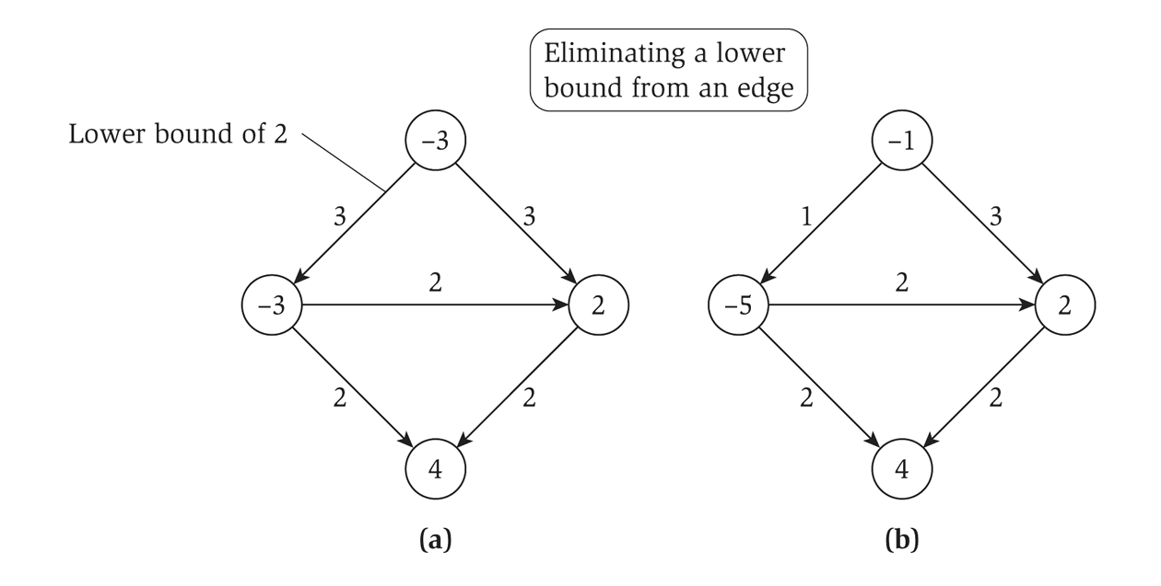
Eliminating a lower bound
Diagrammatically…

Slide 51
Summary

Slide 52
What did we learn?
Max-flow / min-cut
The problems, relationship between them, etc.
Ford-Fulkerson algorithm and related proofs that this approach is optimal
Bi-partite matching
First example of a reduction. Use the algorithm from one problem to solve another problem.
More reductions
Solving variations of max-flow by converting the problem into an instance of “normal” max-flow.

