Slide 1

MICHIGAN DEVFEST 2026 / NEXT-GEN MOBILITY
Carpool
Shared trips for Commuters
A driver already going to DTW.
An open seat for someone working there.
Michigan DevFest 2026
Chayanon “Mac” Sontidpanya
Carl Scozzari
CARPOOL / MICHIGAN DEVFEST
01
Notes:
0:00-0:20 / PROBLEM
Imagine a Detroit airport worker planning an early shift without a dependable car. A ride needs to fit both the schedule and the budget. Carpool explores whether an empty seat on a trip already going to DTW can help.
Delivery: This is a target scenario, not a verified customer story. Keep the research numbers for questions. References: supplied keynote pages 20-22 and workbook pages 6-9.

Slide 2
One commuter, one dependable trip
Our target user
Why do we care?
Anyone who needs to commute and carpool without dependable transportation
We are building around access to work and the empty seats on trips already happening.
The question to test
Will riders and drivers agree on a pickup, time and fair trip share?
CARPOOL / MICHIGAN DEVFEST
02
Notes:
0:20-0:40 / WHY US
We are Venture313. We care about connecting Detroit residents with opportunity. We chose one concrete situation: getting to an airport shift. Our question is whether a driver already taking that route can share a seat on terms both people understand.
Delivery: Confirm this motivation with the presenter before using it. No personal lived experience or user interview has been supplied. Replace it with a true first-person experience only if you have one.

Slide 3
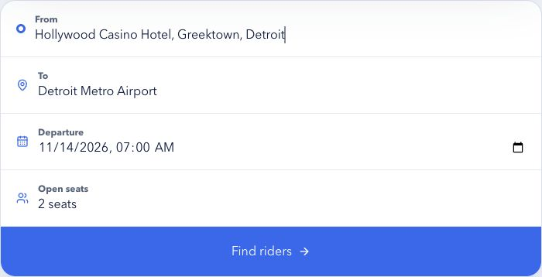
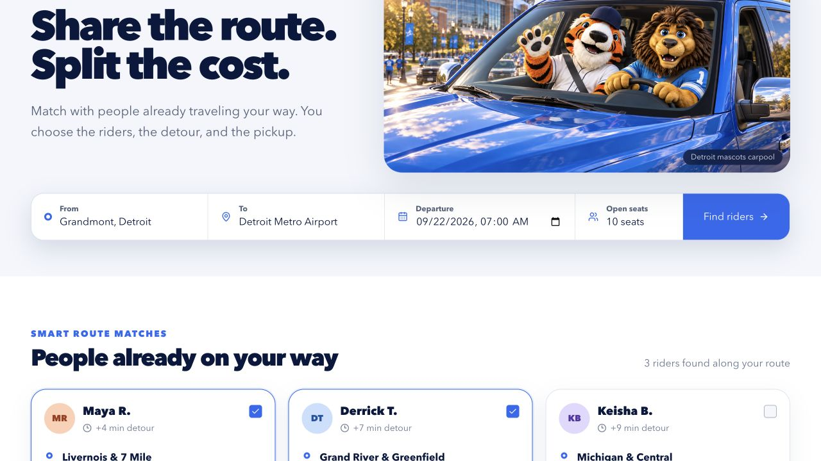
Live demo: a draft carpool in three clicks
1 Find riders
Hollywood Casino Greektown, Detroit
Tomorrow at 7:00 a.m.
2 Remove Derrick
2 riders / $26 becomes
1 rider / $12
3 Add Keisha
2 riders / $23
Fictional fixtures. Trip shares and detours are sample values. No booking or payment.
CARPOOL / MICHIGAN DEVFEST
03
Notes:
0:40-2:10 / LIVE DEMO
Use the browser. Keep this slide only as a fallback. The screenshot comes from the existing project and may differ from the current view.
0:40-0:55: Here is the driver's starting point in Grandmont, the destination at Detroit Metro Airport and tomorrow's seven a.m. departure. This screen lets us set the trip context. It does not calculate a live route.
0:55-1:10: Click 1: Find riders. We get three fictional examples. Their detours and contributions are sample values, not live availability, verified profiles or prices.
1:10-1:30: Maya and Derrick start selected. The draft shows two riders and twenty-six dollars in suggested contributions. Pickup areas, destinations and notes make the decision visible.
1:30-1:50: Click 2: uncheck Derrick. The total changes to one rider and twelve dollars. The driver controls the selection.
1:50-2:05: Click 3: check Keisha. Now two riders contribute twenty-three dollars. We can compare the sample detours before deciding what to confirm with each person.
2:05-2:10: This produces a draft to discuss. It creates no booking and takes no payment.
Setup: reset with Maya and Derrick selected, Keisha unselected. Inputs can be prepared before timing. The example is an airport-shift commuting scenario, but the fixture cards include luggage notes and are not verified worker personas. Do not claim the Find riders button performs matching. Source: rideshare-app/app/page.tsx.
Additional local proof: run python3 ibm/evaluate_trip.py < ibm/demo_request.json. Two seats and a sample added-minutes limit of 12 produce Maya + Derrick, sample detour sum 11, and sample contributions $26. This is locally tested deterministic logic, not a live Orchestrate execution. Do not describe it as live route optimization.

Slide 4
IBM products and implementation status
IBM Bob IDE (required)
watsonx Orchestrate (prepared)
Core development role required
Project usage still needs to be tested and improved
Agent + Python wrapper prepared
Collect constraints, explain results
Working implementation
React UI and local Python tool
10 tests pass
Video narration: macOS speech
CARPOOL / MICHIGAN DEVFEST
04
Notes:
2:10-2:40 / HOW IT WORKS
The interface uses React and fixed demo riders. Our new deterministic tool checks seat capacity, a supplied sample-detour limit and contribution totals. Ten local tests pass. We prepared an Orchestrate agent to collect constraints and explain the tool result. Its IBM deployment still needs verification, along with authentic Bob usage evidence.
IBM Bob is the required development tool under the guide, not an app inference service. Codex produced the current revisions. No Bob contribution is claimed. Orchestrate import files are in ibm/. Local tests validate the pure logic, not IBM integration. Source: ibm/evaluate_trip.py, ibm/test_evaluate_trip.py, ibm/orchestrate_tool.py, ibm/agent.template.yaml.
The older Flue/OpenAI agent remains separately in src/agents/along313.ts. Its existence does not satisfy the IBM requirements.
IBM tool docs: https://developer.watson-orchestrate.ibm.com/tools/create_tool
IBM agent docs: https://developer.watson-orchestrate.ibm.com/agents/build_agent

Slide 5
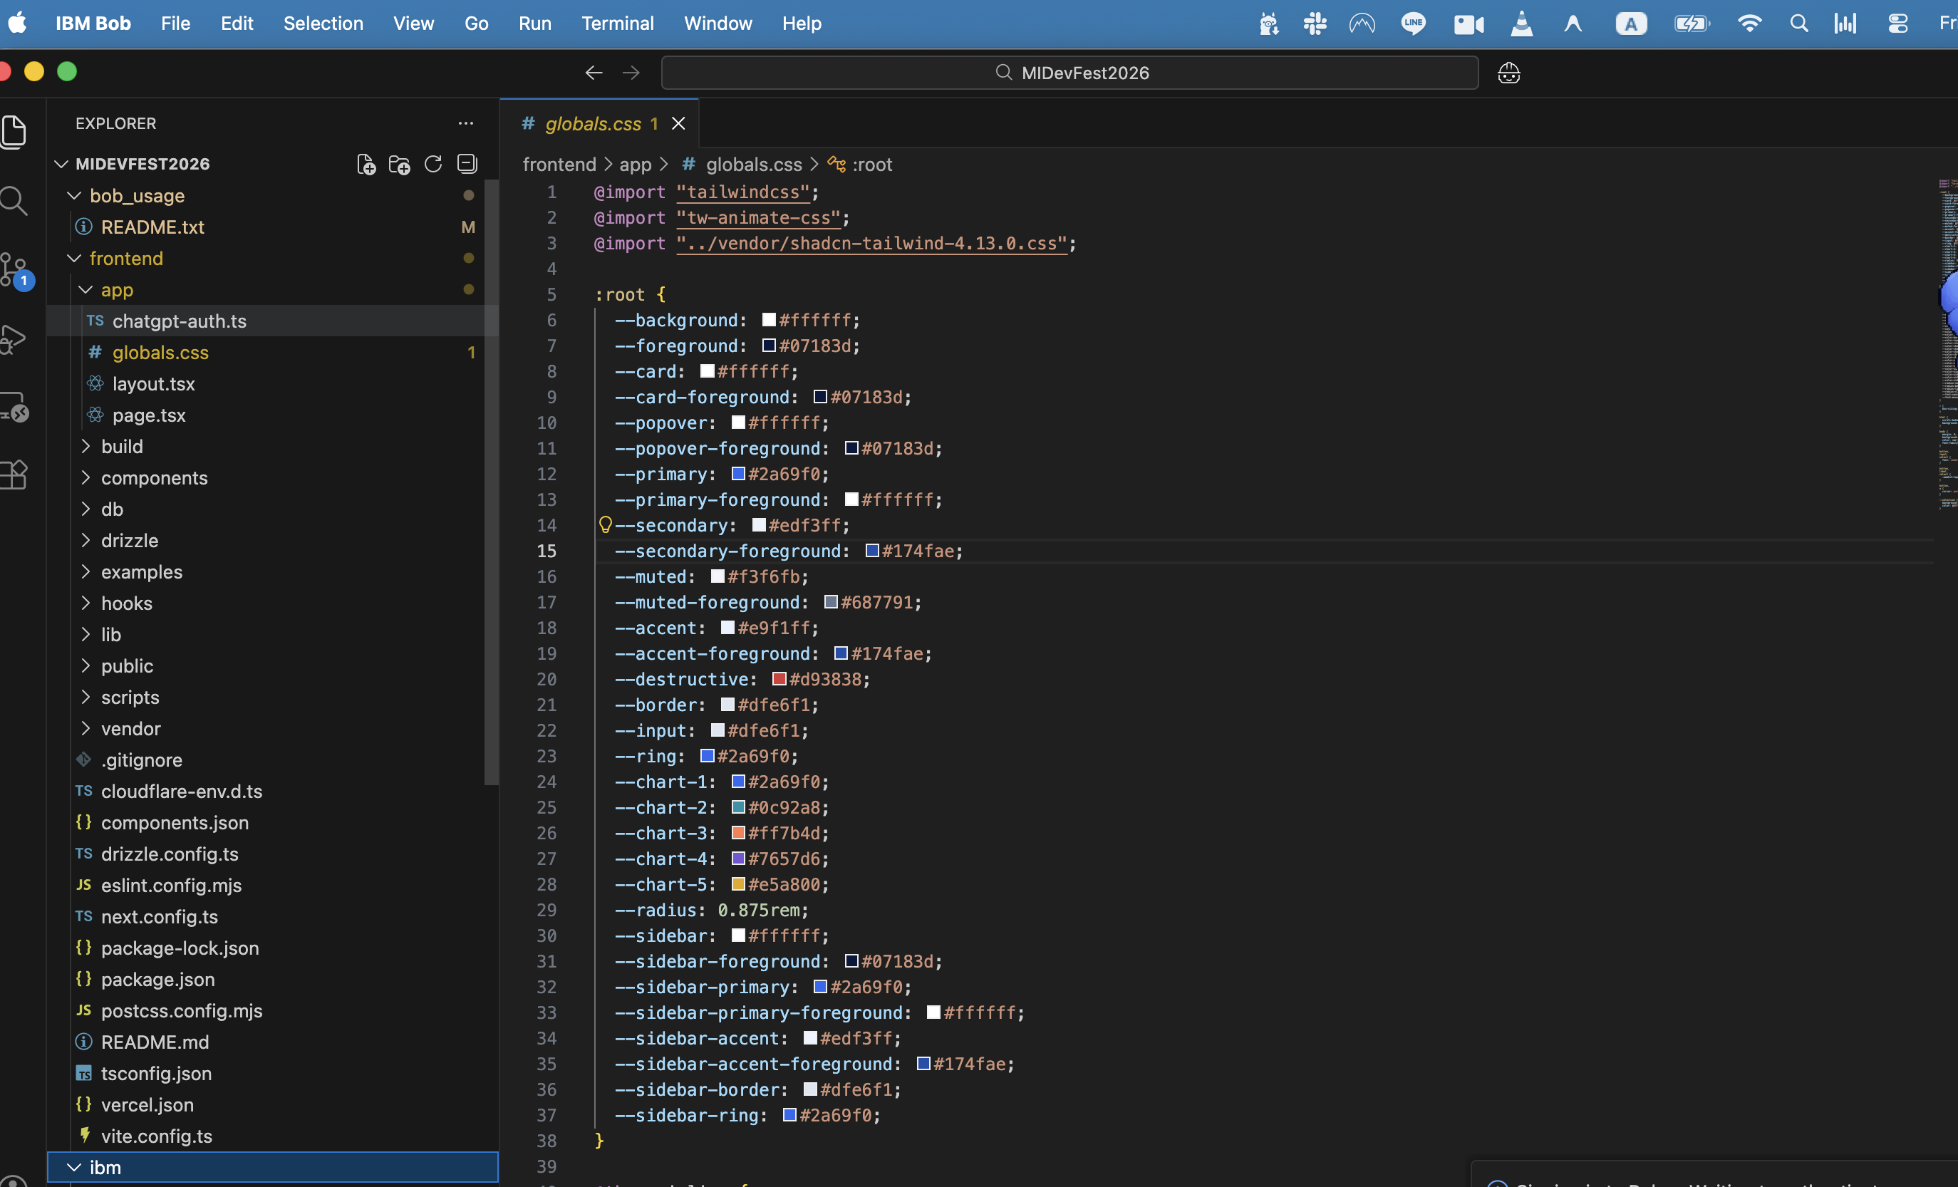
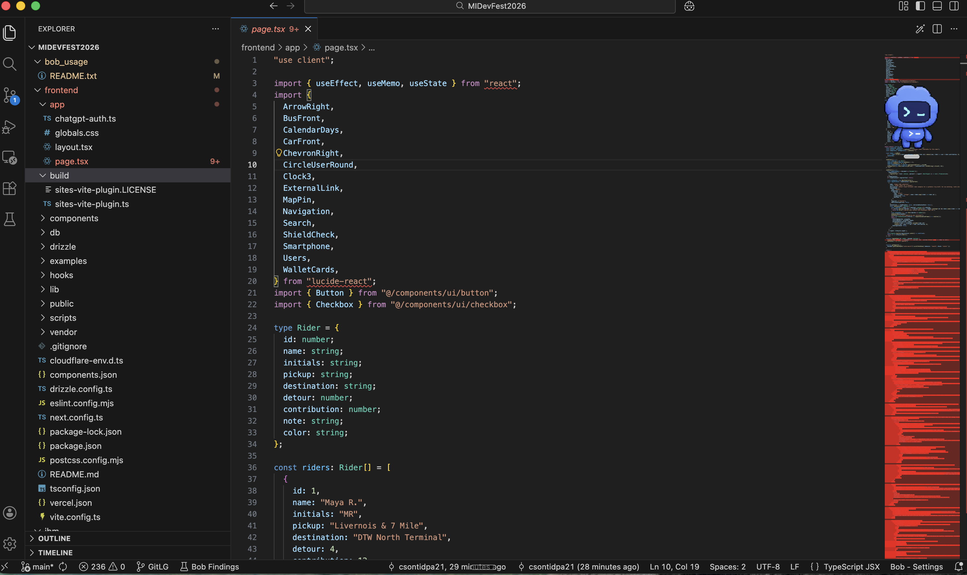
Project workspace in IBM Bob
MIDevFest2026 frontend files open in IBM Bob
Frontend styling
Commuter application source
CARPOOL / MICHIGAN DEVFEST
05
Notes:
User-supplied screenshots, November 13, 2026. Project workspace in IBM Bob only. No Budget usage badge or completed AI task is visible. Originals preserved; published copies omit metadata and retain identical pixels.

Slide 6
Michigan value and the next pilot
01
Interview 5 commuters
and 3 potential drivers
Proposed research targets. No interviews or commitments claimed.
02
Test access to Michigan jobs
Measure pickup agreement, added travel time and repeat interest.
Check driver verification, consent and operating requirements first.
Our ask: one employer or community partner to help test the need
CARPOOL / MICHIGAN DEVFEST
06
Notes:
2:40-3:00 / MICHIGAN VALUE AND NEXT STEP
Our aim is dependable access to Michigan jobs using seats on existing trips. We would test one corridor with an employer, measure pickup agreement, added time and repeat use, and compare actual travel options. Next we need user interviews and verified IBM runs. We are asking for one partner to test the need.
Proposed research targets remain five commuters and three drivers. No pilot, partner, savings, emissions reduction or job retention outcome is claimed. Business hypotheses: employer-supported pilot or access contract, subject to interviews and operating requirements. Scale only after one route and trusted cohort work.

Slide 7
Research and alternatives
About 76,000
More than 23%
households in the DDOT service area
lacked access to a vehicle
of surveyed DDOT riders said they
could not make the trip without transit
Historical context from a 2022 RTA report,
using SEMCOG 2020 data. Not a current count.
SEMCOG 2019 rider survey, cited by RTA.
Evidence of dependence, not Carpool demand.
Transit remains a strong option
SMART lists a $2 full fare and free fixed-route student rides with valid ID.
Our hypothesis is a schedule or connection gap, not a lower fare than transit.
CARPOOL / MICHIGAN DEVFEST
07
Notes:
APPENDIX / RESEARCH AND ALTERNATIVES
RTA, Detroit Workforce Mobility Equity Analysis: Gap Analysis Report, dated May 5, 2022, page 4. Nearly 76,000 households (21%) in the DDOT service area lacked a vehicle, citing SEMCOG 2020. More than 23% of SEMCOG 2019 survey respondents could not make their trip without transit. These are different populations and historical sources. They support a transport-access need, not Carpool adoption or current market size.
https://www.rtamichigan.org/app/uploads/2025/06/RTA-Detroit-Workforce-Mobility-Equity-Report-F-1.pdf
SMART fares, checked November 13, 2026: full fixed-route adult fare $2. Valid student IDs qualify K-12, college and university students for free fixed-route rides effective May 4, 2026. https://www.smartbus.org/Fares
Alternatives: fixed-route transit provides a low-cost baseline. On-demand rides offer individual trips, with actual availability and quotes to check per journey. Informal carpools already coordinate shared trips, with coordination varying by group. Proposed differentiation is explicit trip context, candidate comparison and shared-cost visibility. No superiority claim has been validated.

Slide 8
Official judging rubric: 25 points
Completeness and feasibility
5
Working proof, clear IBM roles and a feasible plan
Creativity and innovation
5
Useful AI and a distinct approach to the problem
Design and usability
5
Clear decisions and a flow target users can adopt
Effectiveness and efficiency
5
A relevant need, measurable results and room to scale
Michigan impact
5
Practical value for Michigan jobs and opportunity
Submission readiness
IBM Bob IDE: required development tool. watsonx Orchestrate: agent + tool prepared.
Optional, not used: watsonx.ai, Code Engine, Cloudant, Speech to Text,
Text to Speech and Bob Shell.
Notes:
APPENDIX / OFFICIAL 25-POINT RUBRIC AND READINESS
Five categories, 5 points each. Final score averages judges' scores.
Completeness and feasibility: tested local evaluation tool and explicit missing IBM evidence.
Creativity and innovation: proposed combination of natural-language constraints, transparent deterministic checks and human choice. Differentiation remains a hypothesis.
Design and usability: visible draft selection and totals, plus a no-fit response in the tool.
Effectiveness and efficiency: measure agreement, arrival reliability, added minutes and repeat use in a pilot. No measured field impact yet.
Michigan impact: focus on access to Michigan jobs, local employers and a reusable mobility workflow. No jobs-retained claim.
Source, read signed in November 13, 2026: https://compete.112601.watsonx-challenge.ibm.com/competitions/midevfest#judging
Portal requirements: https://compete.112601.watsonx-challenge.ibm.com/competitions/midevfest/complete-the-hackathon
Portal deadline: November 15, 2026, 2 p.m. Eastern. Team-building closes noon that day. PDFs supplied earlier say November 13, 6 p.m. Confirm this discrepancy with organizers and meet the earlier cutoff if relevant to onsite judging.
Video: maximum 3 minutes, at least 90 seconds on-screen demonstration, narration, real Bob and Orchestrate proof per portal. Problem/solution text: 500 words or fewer. Technology statement: describe actual Bob and Orchestrate use. Public repo must contain per-member Bob usage screenshots.
The downloadable guide pp.4 and 7 makes Bob IDE mandatory and calls Orchestrate optional. The portal requests both. Prepare for the stricter portal wording until organizers clarify.
Back up IBM assets before November 24 at 11 a.m. Eastern. No submission has been made. Existing source predates the event, so disclose prior work and confirm eligibility.

