Slide 1

ID-10-T
Christopher Silva
Anthony Enem
Nathon Durst
Da Dong
Shujing Zhang

Slide 2
Overview
Introduction and Overview
Description of problem / user's work context
System Design(UML Arch Diagram) Test Report–known problems; deviations from reqs
Deployment issues
Process you used, team organization –how well you followed it
What you’d do if you had more time, or what you’d do if you had to do over; and what you learned
Organization of presentation
Demo system
ID-10-T
Software Metrics Calculation System

Slide 3
Overview
Description of Problem
Software Requirements
System Design
Test Report
Deployment
Process Used
Lessons Learned
Demo
ID-10-T
Software Metrics Calculation System

Slide 4
Description of Problem
Customer: Dr. Stringfellow
Needs:
Software to display metrics for 1st & 2nd year CS student’s source code
Requirements:
Run on student environments: Windows XP or later
Support C++ and/or Java
Metrics: LOC, LOD, Blank Lines, Cyclomatic Complexity
ID-10-T
Software Metrics Calculation System

Slide 5
Software Requirements
Minimum Operating System: Windows XP, OS X 10.7, Linux 2.6.23
Browser: Chrome, Firefox, Edge, Safari
Hardware: Anything that can run the above
ID-10-T
Software Metrics Calculation System

Slide 6
System Design
Written in Go
Web server for GUI
Flex used to create C parser for C, C++, & Java
Lexer tokenizes source code
Analyzer runs metrics on tokens
Results are displayed on webpage
ID-10-T
Software Metrics Calculation System

Slide 7
Lex Files
%{
#include "scanner.h"
%}
%%
\/\/.* return LINE_COMMENT;
\/\*(?:[^\*]*|[^\/])*\*\/ return BLOCK_COMMENT;
[0-9]+ return INT;
[0-9]+.[0-9]+ return FLOAT;
[_a-zA-Z][_a-zA-Z0-9]* return VAR_NAME;
[ \t] ;
. ;
%%
int yywrap(void) {
return 1;
}
Import token definitions
Section separator
Create regex for tokens
ID-10-T
Software Metrics Calculation System

Slide 8
Lexer
func Tokenize(language, source string) []Token {
var next NextToken
var tokens []Token
var closeCall Close
switch language {
case "c":
c.Parse(source)
next = c.NextToken
closeCall = c.Close
...
}
ntoken, vtoken := next()
for ntoken != "NULL" {
tokens = append(tokens, Token{Type: ntoken, Value: vtoken})
ntoken, vtoken = next()
}
closeCall()
return tokens
}
ID-10-T
Software Metrics Calculation System

Slide 9
Metrics
func LinesOfDocumentation(tokens []Token) (Result, error) {
lines := 0
for _, token := range tokens {
if token.Type == "LINE_COMMENT" {
lines++
} else if token.Type == "BLOCK_COMMENT" {
lines += strings.Count(token.Value, "\n") + 1
}
}
...
}
ID-10-T
Software Metrics Calculation System

Slide 10
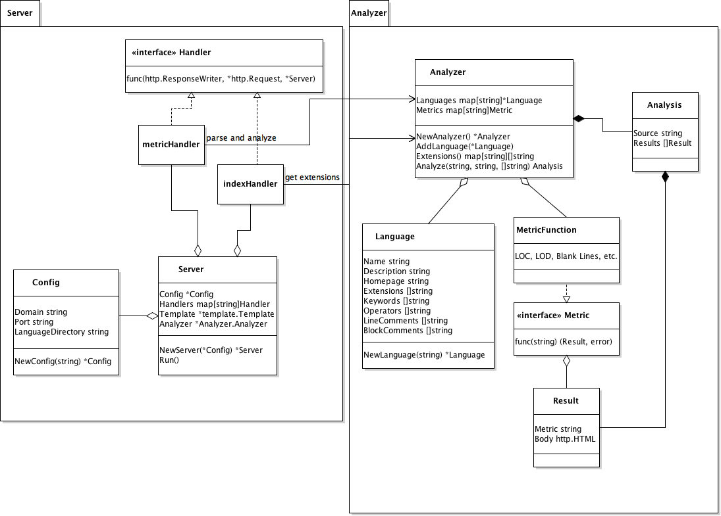
Original System Design
ID-10-T
Software Metrics Calculation System

Slide 11
Test Report
test | Input | Expected Output | Actual Output | Result
1 | + | ADD | ADD | true
2 | - | SUB | SUB | true
3 | int main() | FUNCTION | FUNCTION | true
4 | #include <iostream >(.cpp) | IMPORT | IMPORT | true
5 | import java.util.Date (.java) | IMPORT | IMPORT | true
6 | //comment | LINECOMMENT | LINECOMMENT | true
7 | /*comment*/ | BLOCKCOMMENT | BLOCKCOMMENT | true
Unit Test
Validation Test
test | Input | Expected Output | Actual Output | Result
1 | empty file | 0 LOC, 0 LOD | 0 LOC, 0 LOD | true
2 | 15 lines without comments | 15 LOC, 0 LOD | 15 LOC, 0 LOD | true
3 | 21 lines of just comments | 0 LOC, 21 LOD | 0 LOC, 21 LOD | true
4 | 7 lines of comments 8 lines of code | 8 LOC, 7 LOD | 8 LOC, 7 LOD | true
5 | 2 lines of code 12 lines of comments 53 lines of code | 55 LOC, 12 LOD | 55 LOC, 12 LOD | true
ID-10-T
Software Metrics Calculation System

Slide 12


Deployment
Binaries and Source:
github.com/csos95/CMPS-4113-Spring-2017
Docker image:
hub.docker.com/u/csos95/
ID-10-T
Software Metrics Calculation System

Slide 13



Process Used
Group meeting every week
Whole group working on one problem or split up to work on multiple
Combine work at end of meeting
Make plan for upcoming weeks work
Tools
Communication: Slack
Version Control: Github
IDE: Gogland
Programming Language
Go
ID-10-T
Software Metrics Calculation System

Slide 14
Lessons Learned
What was good
Good division of labor
What to change
Meeting frequency – not enough group work time due to schedules
Test earlier – Allow for more time to fix issues
More metrics/better UI
More time working with flex
What was learned
Don’t reinvent the wheel – Use existing tools/libraries
Learned about development/project lifecycle
ID-10-T
Software Metrics Calculation System

Slide 15
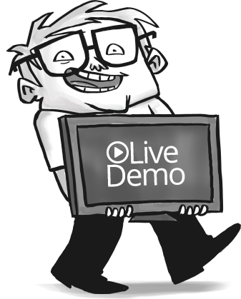
Demo
ID-10-T
Software Metrics Calculation System

Slide 16
References
Go: golang.org
Lex: aquamentus.com/tut_lexyacc.html
Regex: regex101.com
LaTeX: latex-project.org
ID-10-T
Software Metrics Calculation System

