Slide 1
3DOF Manipulator
Jae Hyeong Park
Combined Course School of Mechanical Engineering, Sungkyunkwan University

Slide 2
Chapter
Forward Kinematics
Inverse Kinematics
Jacobian and Singularities
Dynamics
Control
Trajectory and Motion Planning

Slide 3
Forward kinematics

Slide 4



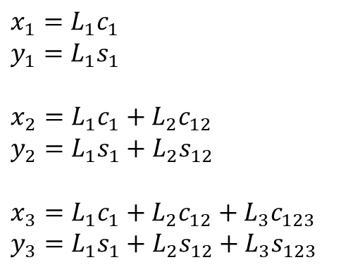






3-DOF Manipulator Forward kinematics (1)
$$(x_{3},y_{3})$$
$$x_{1}=L_{1}c_{1}$$
$$y_{1}=L_{1}s_{1}$$
$$x_{2}=L_{1}c_{1}+L_{2}c_{12}$$
$$y_{2}=L_{1}s_{1}+L_{2}s_{12}$$
$$x_{3}=L_{1}c_{1}+L_{2}c_{12}+L_{3}c_{123}$$
$$y_{3}=L_{1}s_{1}+L_{2}s_{12}+L_{3}s_{123}$$
$$L_{3}$$
$$θ_{3}$$
$$(x_{2},y_{2})$$
$$L_{2}$$
$$θ_{2}$$
$$L_{1}$$
$$(x_{1},y_{1})$$
$$θ_{1}$$

Slide 5
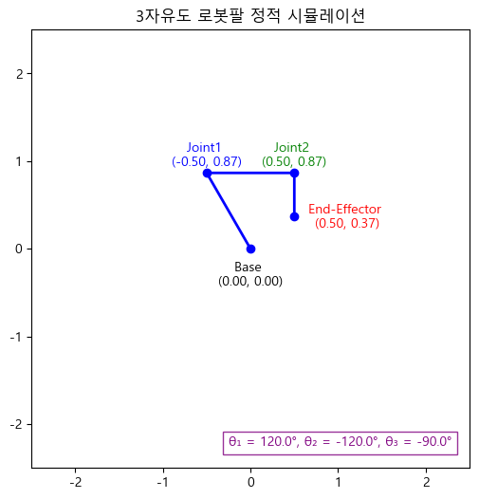
3-DOF Manipulator Forward kinematics (2)
$$(x_{3},y_{3})$$
$$L_{3}$$
$$θ_{3}$$
$$(x_{2},y_{2})$$
$$L_{2}$$
$$θ_{2}$$
$$L_{1}$$
$$(x_{1},y_{1})$$
$$θ_{1}$$

Slide 6
Inverse kinematics

Slide 7
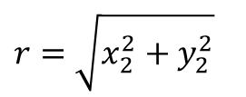

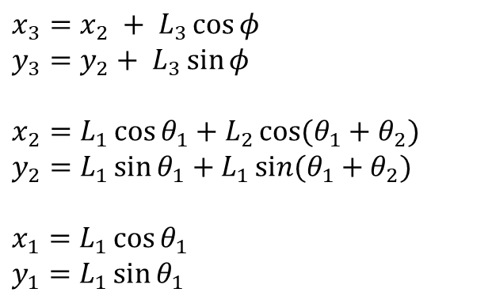


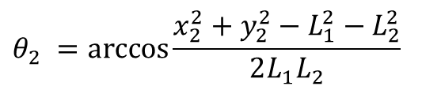
3-DOF Manipulator Inverse kinematics (1)
$$(x_{3},y_{3})$$
$$L_{3}$$
$$θ_{3}$$
$$x_{3}=x_{2} + L_{3}\cos{φ}$$
$$y_{3}=y_{2}+ L_{3}\sin{φ}$$
$$x_{2}=L_{1}\cos{θ_{1}}+L_{2}\cos{(θ_{1}+θ_{2})}$$
$$y_{2}=L_{1}\sin{θ_{1}}+L_{1}\sin{(θ_{1}+θ_{2})}$$
$$x_{1}=L_{1}\cos{θ_{1}}$$
$$y_{1}=L_{1}\sin{θ_{1}}$$
$$(x_{2},y_{2})$$
$$r$$
$$L_{2}$$
$$θ_{2}$$
$$L_{1}$$
$$(x_{1},y_{1})$$
$$θ_{1}$$
$$r=\sqrt{x_{2}^{2}+y_{2}^{2}}$$
$$θ_{2} =\arccos{\frac{x_{2}^{2}+y_{2}^{2}−L_{1}^{2}−L_{2}^{2}}{2L_{1}L_{2}}}$$

Slide 8
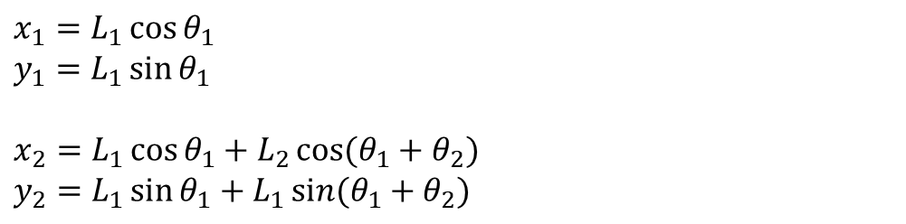

2-DOF Manipulator Inverse kinematics (2)
$$(x_{3},y_{3})$$
$$L_{3}$$
$$θ_{3}$$
$$(x_{2},y_{2})$$
$$x_{1}=L_{1}\cos{θ_{1}}$$
$$y_{1}=L_{1}\sin{θ_{1}}$$
$$x_{2}=L_{1}\cos{θ_{1}}+L_{2}\cos{(θ_{1}+θ_{2})}$$
$$y_{2}=L_{1}\sin{θ_{1}}+L_{1}\sin{(θ_{1}+θ_{2})}$$
$$r$$
$$L_{2}$$
$$θ_{2}$$
$$L_{1}$$
$$(x_{1},y_{1})$$
$$θ_{1}$$
$$α=arctan2\left(y,x\right)$$
$$β=arctan2\left(L_{2}\sin{θ_{2}},L_{1}+L_{2}\cos{θ_{2}}\right)$$
$$θ_{1}=α−β=arctan2\left(y,x\right)−{arctan2\left(L_{2}\sin{θ_{2}},L_{1}+L_{2}\cos{θ_{2}}\right)}$$
$$θ_{3}=φ−θ_{1}−θ_{2}$$

Slide 9



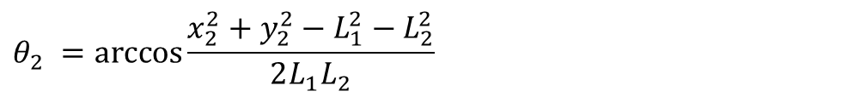

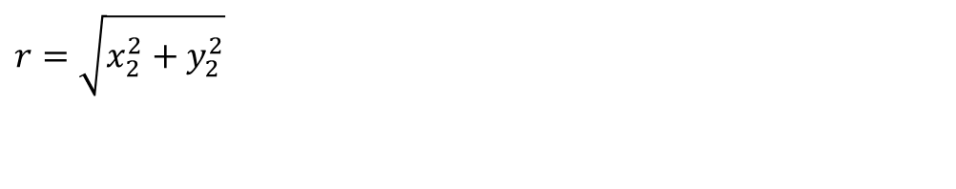



3-DOF Manipulator Inverse kinematics (2)
$$(x_{2},y_{2})$$
$$L_{2}$$
$$x_{1}=L_{1}\cos{θ_{1}}$$
$$y_{1}=L_{1}\sin{θ_{1}}$$
$$x_{2}=L_{1}\cos{θ_{1}}+L_{2}\cos{(θ_{1}+θ_{2})}$$
$$y_{2}=L_{1}\sin{θ_{1}}+L_{1}\sin{(θ_{1}+θ_{2})}$$
$$θ_{2}$$
$$L_{1}$$
$$(x_{1},y_{1})$$
$$θ_{1}$$
$$r=\sqrt{x_{2}^{2}+y_{2}^{2}}$$
$$\left|L_{1}−L_{2}\right|≤r≤\left|L_{1}−L_{2}\right|$$
$$L_{1}^{2}+L_{2}^{2}−2L_{1}L_{2}\cos\left(π−θ_{2}\right)=r^{2}$$
$$θ_{2} =\arccos{\frac{x_{2}^{2}+y_{2}^{2}−L_{1}^{2}−L_{2}^{2}}{2L_{1}L_{2}}}$$

Slide 10
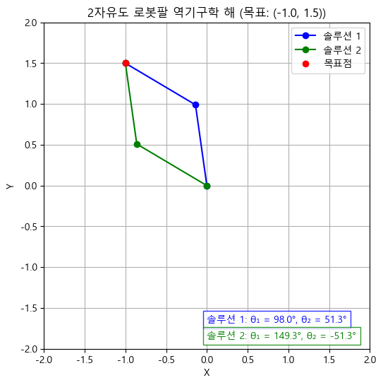







2-DOF Manipulator Inverse kinematics (3)
$$(x_{2},y_{2})$$
$$L_{2}$$
$$θ_{2}$$
$$(x_{1},y_{1})$$
$$L_{1}$$
$$φ$$
$$θ_{1}$$

Slide 11
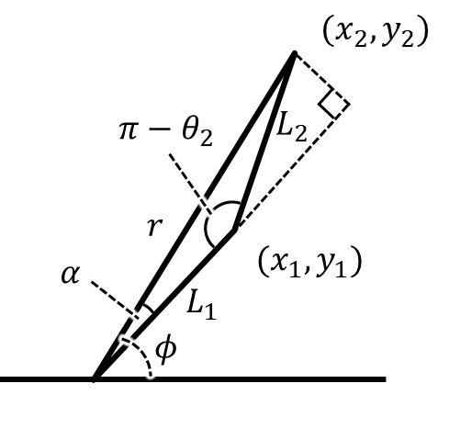
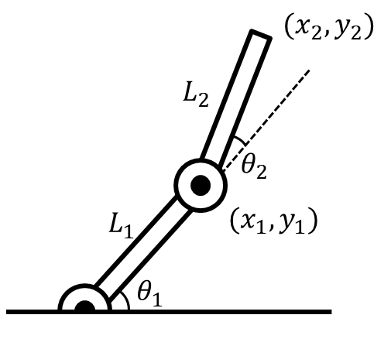












2-DOF Manipulator Inverse kinematics (3)
$$(x_{2},y_{2})$$
$$(x_{2},y_{2})$$
$$L_{2}$$
$$π−θ_{2}$$
$$L_{2}$$
$$θ_{2}$$
$$r$$
$$L_{1}$$
$$(x_{1},y_{1})$$
$$α$$
$$(x_{1},y_{1})$$
$$L_{1}$$
$$θ_{1}$$
$$φ$$

Slide 12
Jacobian & Singularity

Slide 13

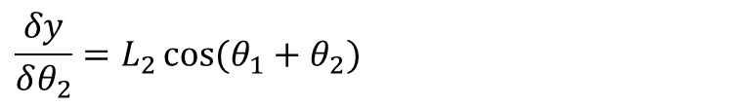

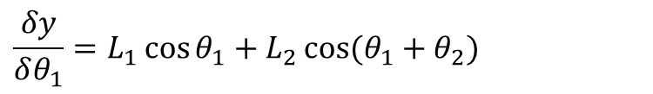
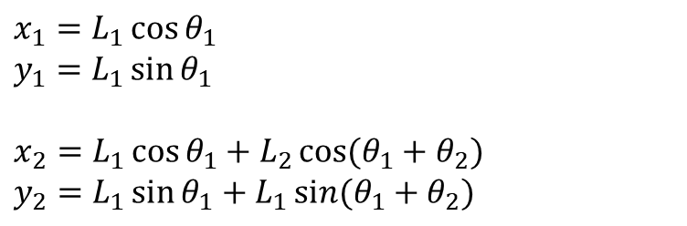
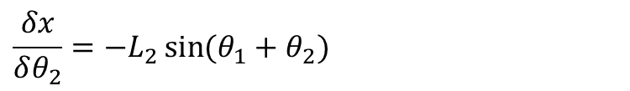
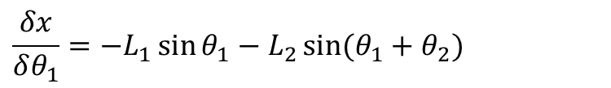

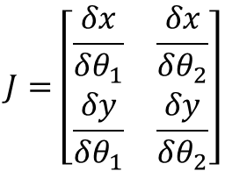
2-DOF Manipulator Jacobian (1)
$$(x_{2},y_{2})$$
$$L_{2}$$
$$x_{1}=L_{1}\cos{θ_{1}}$$
$$y_{1}=L_{1}\sin{θ_{1}}$$
$$x_{2}=L_{1}\cos{θ_{1}}+L_{2}\cos{(θ_{1}+θ_{2})}$$
$$y_{2}=L_{1}\sin{θ_{1}}+L_{1}\sin{(θ_{1}+θ_{2})}$$
$$θ_{2}$$
$$L_{1}$$
$$(x_{1},y_{1})$$
$$θ_{1}$$
$$J=\left[\begin{matrix}\frac{δx}{δθ_{1}} & \frac{δx}{δθ_{2}} \\ \frac{δy}{δθ_{1}} & \frac{δy}{δθ_{2}}\end{matrix}\right]$$
$$\frac{δx}{δθ_{1}}=−L_{1}\sin{θ_{1}}−L_{2}\sin{(θ_{1}+θ_{2})}$$
$$\frac{δx}{δθ_{2}}=−L_{2}\sin{(θ_{1}+θ_{2})}$$
$$\frac{δy}{δθ_{1}}=L_{1}\cos{θ_{1}}+L_{2}\cos{(θ_{1}+θ_{2})}$$
$$\frac{δy}{δθ_{2}}=L_{2}\cos{(θ_{1}+θ_{2})}$$

Slide 14
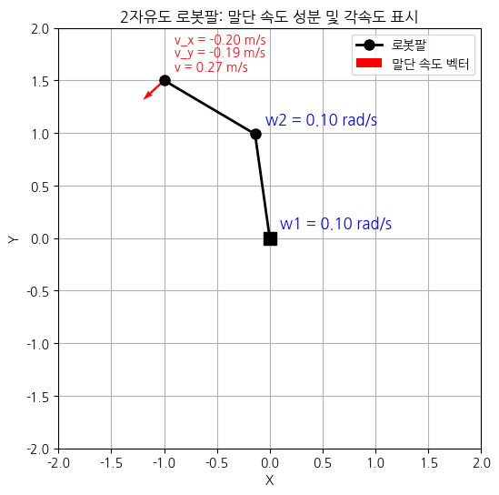


2-DOF Manipulator Jacobian (2)
$$(x_{2},y_{2})$$
$$J=\left[\begin{matrix}−L_{1}\sin{θ_{1}}−L_{2}\sin{(θ_{1}+θ_{2})} & −L_{2}\sin{(θ_{1}+θ_{2})} \\ L_{1}\cos{θ_{1}}+L_{2}\cos{(θ_{1}+θ_{2})} & L_{2}\cos{(θ_{1}+θ_{2})}\end{matrix}\right]$$
$$L_{2}$$
$$v=J\dot{θ}$$
$$θ_{2}$$
$$L_{1}$$
$$(x_{1},y_{1})$$
$$θ_{1}$$

Slide 15




2-DOF Manipulator Inverse Jacobian (1)
$$(x_{2},y_{2})$$
$$\dot{θ}=J^{−1}v$$
$$L_{2}$$
$$θ_{2}$$
$$L_{1}$$
$$(x_{1},y_{1})$$
$$θ_{1}$$
$$J=\left[\begin{matrix}−L_{1}\sin{θ_{1}}−L_{2}\sin{(θ_{1}+θ_{2})} & L_{2}\sin{(θ_{1}+θ_{2})} \\ L_{1}\cos{θ_{1}}+L_{2}\cos{(θ_{1}+θ_{2})} & L_{2}\cos{(θ_{1}+θ_{2})}\end{matrix}\right]$$
$$J^{−1}=\frac{1}{det⁡(J)}\left[\begin{matrix}J_{11} & {−J}_{12} \\ {−J}_{21} & J_{22}\end{matrix}\right]$$
$$\det\left(J\right)=L_{1}L_{2}\sin{θ_{2}}$$
$$J^{−1}=\frac{1}{L_{1}L_{2}\sin{θ_{2}}}\left[\begin{matrix}L_{2}\cos{(θ_{1}+θ_{2})} & L_{2}\sin{(θ_{1}+θ_{2})} \\ −L_{1}\cos{θ_{1}}−L_{2}\cos{(θ_{1}+θ_{2})} & −L_{1}\sin{θ_{1}}−L_{2}\sin{(θ_{1}+θ_{2})}\end{matrix}\right]$$

Slide 16

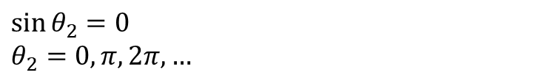
2-DOF Manipulator Singularity (1)
$$(x_{2},y_{2})$$
$$L_{2}$$
$$θ_{2}$$
$$L_{1}$$
$$(x_{1},y_{1})$$
$$θ_{1}$$
$$\det\left(J\right)=L_{1}L_{2}\sin{θ_{2}}=0$$
$$\sin{θ_{2}}=0$$
$$θ_{2}=0,π,2π,…$$

Slide 17
Dynamics

Slide 18



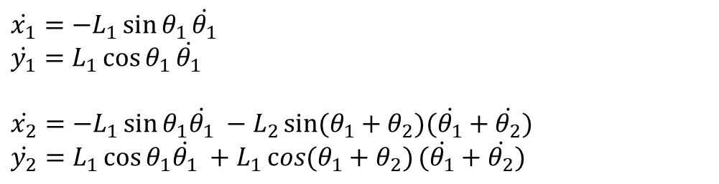
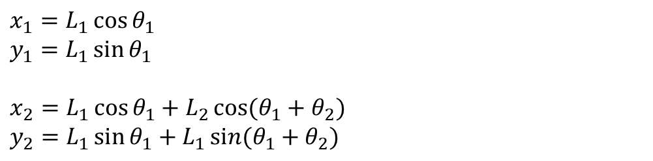
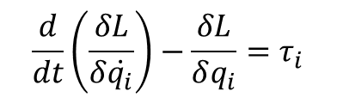
2-DOF Manipulator Dynamics (1)
$$(x_{2},y_{2})$$
$$L=T−V$$
$$L_{2},m_{2},I_{2}$$
$$\frac{d}{dt}\left(\frac{δL}{δ\dot{q_{i}}}\right)−\frac{δL}{δq_{i}}=τ_{i}$$
$$θ_{2}$$
$$L_{1},m_{1},I_{1}$$
$$(x_{1},y_{1})$$
$$θ_{1}$$
$$x_{1}=L_{1}\cos{θ_{1}}$$
$$y_{1}=L_{1}\sin{θ_{1}}$$
$$x_{2}=L_{1}\cos{θ_{1}}+L_{2}\cos{(θ_{1}+θ_{2})}$$
$$y_{2}=L_{1}\sin{θ_{1}}+L_{1}\sin{(θ_{1}+θ_{2})}$$
$$\dot{x_{1}}=−L_{1}\sin{θ_{1}}\dot{θ_{1}}$$
$$\dot{y_{1}}=L_{1}\cos{θ_{1}}\dot{θ_{1}}$$
$$\dot{x_{2}}=−L_{1}\sin{θ_{1}\dot{θ_{1}} }−L_{2}\sin{(θ_{1}+θ_{2})(\dot{θ_{1}}+\dot{θ_{2}})}$$
$$\dot{y_{2}}=L_{1}\cos{θ_{1}\dot{θ_{1}} }+L_{1}\cos{(θ_{1}+θ_{2})}(\dot{θ_{1}}+\dot{θ_{2}})$$
$$v_{1}^{2}=x_{1}^{2}+y_{1}^{2}= {L_{1}}^{2}{{\dot{θ}}_{1}}^{2}$$
$$v_{2}^{2}=x_{2}^{2}+y_{2}^{2}={L_{1}}^{2}{{\dot{θ}}_{1}}^{2}+{L_{2}}^{2}{({\dot{θ}}_{1}+{\dot{θ}}_{2})}^{2}+2L_{1}L_{2}\cos{θ_{2}}\dot{θ_{1}}(\dot{θ_{1}}+\dot{θ_{2}})$$

Slide 19
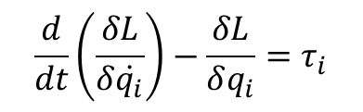

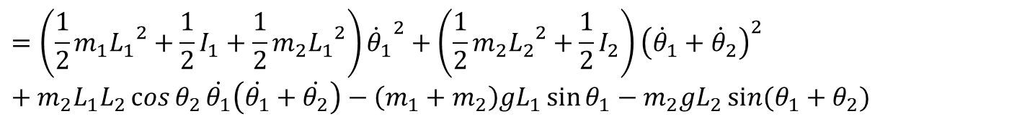

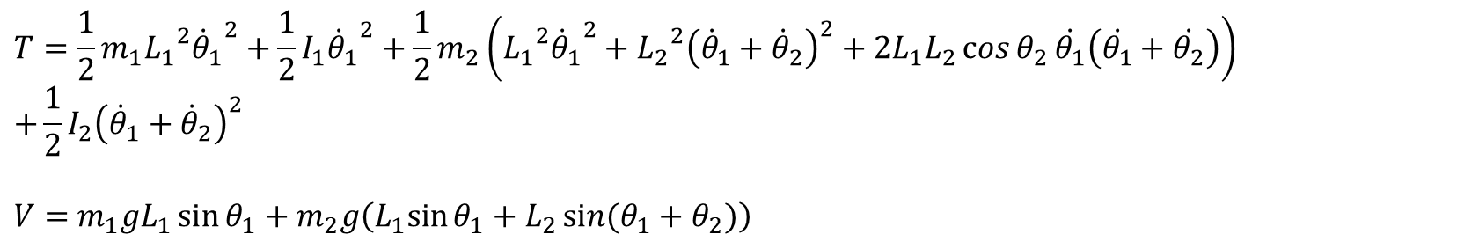
2-DOF Manipulator Dynamics (2)
$$\frac{d}{dt}\left(\frac{δL}{δ\dot{q_{i}}}\right)−\frac{δL}{δq_{i}}=τ_{i}$$
$$L=T−V$$
$$T=\frac{1}{2}m_{1}{L_{1}}^{2}{{\dot{θ}}_{1}}^{2}+\frac{1}{2}I_{1}{{\dot{θ}}_{1}}^{2}+\frac{1}{2}m_{2}\left({L_{1}}^{2}{{\dot{θ}}_{1}}^{2}+{L_{2}}^{2}{\left({\dot{θ}}_{1}+{\dot{θ}}_{2}\right)}^{2}+2L_{1}L_{2}\cos{θ_{2}}\dot{θ_{1}}\left(\dot{θ_{1}}+\dot{θ_{2}}\right)\right) \\ +\frac{1}{2}I_{2}{\left({\dot{θ}}_{1}+{\dot{θ}}_{2}\right)}^{2}$$
$V=$ $m_{1}gL_{1}\sin{θ_{1}}+m_{2}g\left(L_{1}sin{θ_{1}}+L_{2}\sin{(θ_{1}+θ_{2})}\right)$
$$L=T−V$$
$$=\left(\frac{1}{2}m_{1}{L_{1}}^{2}+\frac{1}{2}I_{1}+\frac{1}{2}m_{2}{L_{1}}^{2}\right){{\dot{θ}}_{1}}^{2}+\left(\frac{1}{2}m_{2}{L_{2}}^{2}+\frac{1}{2}I_{2}\right){\left({\dot{θ}}_{1}+{\dot{θ}}_{2}\right)}^{2}+m_{2}L_{1}L_{2}\cos{θ_{2}}\dot{θ_{1}}\left(\dot{θ_{1}}+\dot{θ_{2}}\right)−\left(m_{1}+m_{2}\right)gL_{1}\sin{θ_{1}}−m_{2}gL_{2}\sin{(θ_{1}+θ_{2})}$$

Slide 20
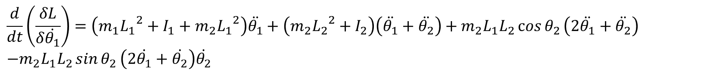



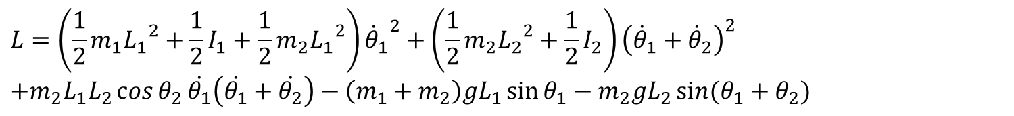
2-DOF Manipulator Dynamics (3)
$$\frac{d}{dt}\left(\frac{δL}{δ\dot{q_{i}}}\right)−\frac{δL}{δq_{i}}=τ_{i}$$
$$L=T−V$$
$$L=\left(\frac{1}{2}m_{1}{L_{1}}^{2}+\frac{1}{2}I_{1}+\frac{1}{2}m_{2}{L_{1}}^{2}\right){{\dot{θ}}_{1}}^{2}+\left(\frac{1}{2}m_{2}{L_{2}}^{2}+\frac{1}{2}I_{2}\right){\left({\dot{θ}}_{1}+{\dot{θ}}_{2}\right)}^{2} \\ +m_{2}L_{1}L_{2}\cos{θ_{2}}\dot{θ_{1}}\left(\dot{θ_{1}}+\dot{θ_{2}}\right)−\left(m_{1}+m_{2}\right)gL_{1}\sin{θ_{1}}−m_{2}gL_{2}\sin{(θ_{1}+θ_{2})}$$
$$\frac{δL}{δ\dot{θ_{1}}}=\left(m_{1}{L_{1}}^{2}+I_{1}+m_{2}{L_{1}}^{2}\right){\dot{θ}}_{1}+\left(m_{2}{L_{2}}^{2}+I_{2}\right)\left({\dot{θ}}_{1}+{\dot{θ}}_{2}\right)+m_{2}L_{1}L_{2}\cos{θ_{2}}\left(2\dot{θ_{1}}+\dot{θ_{2}}\right)$$
$$\frac{d}{dt}\left(\frac{δL}{δ\dot{θ_{1}}}\right)=\left(m_{1}{L_{1}}^{2}+I_{1}+m_{2}{L_{1}}^{2}\right)\ddot{θ_{1}}+\left(m_{2}{L_{2}}^{2}+I_{2}\right)\left(\ddot{θ_{1}}+\ddot{θ_{2}}\right)+m_{2}L_{1}L_{2}\cos{θ_{2}}\left(2\ddot{θ_{1}}+\ddot{θ_{2}}\right) \\ −m_{2}L_{1}L_{2}\sin{θ_{2}}\left(2\dot{θ_{1}}+\dot{θ_{2}}\right)\dot{θ_{2}}$$
$$\frac{d}{dt}\left(\frac{δL}{δ\dot{θ_{1}}}\right)=A\ddot{θ_{1}}+B\left(\ddot{θ_{1}}+\ddot{θ_{2}}\right)+C\cos{θ_{2}}\left(2\ddot{θ_{1}}+\ddot{θ_{2}}\right)−C\sin{θ_{2}}\left(2\dot{θ_{1}}+\dot{θ_{2}}\right)\dot{θ_{2}}$$
$$A=m_{1}{L_{1}}^{2}+I_{1}+m_{2}{L_{1}}^{2}$$
$$B=m_{2}{L_{2}}^{2}+I_{2}$$
$$C=m_{2}L_{1}L_{2}$$

Slide 21
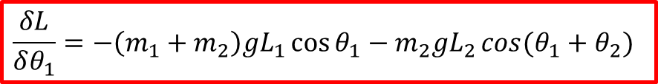
2-DOF Manipulator Dynamics (4)
$$\frac{d}{dt}\left(\frac{δL}{δ\dot{q_{i}}}\right)−\frac{δL}{δq_{i}}=τ_{i}$$
$$L=T−V$$
$$L=\left(\frac{1}{2}m_{1}{L_{1}}^{2}+\frac{1}{2}I_{1}+\frac{1}{2}m_{2}{L_{1}}^{2}\right){{\dot{θ}}_{1}}^{2}+\left(\frac{1}{2}m_{2}{L_{2}}^{2}+\frac{1}{2}I_{2}\right){\left({\dot{θ}}_{1}+{\dot{θ}}_{2}\right)}^{2} \\ +m_{2}L_{1}L_{2}\cos{θ_{2}}\dot{θ_{1}}\left(\dot{θ_{1}}+\dot{θ_{2}}\right)−\left(m_{1}+m_{2}\right)gL_{1}\sin{θ_{1}}−m_{2}gL_{2}\sin{(θ_{1}+θ_{2})}$$
$$\frac{δL}{δθ_{1}}=−\left(m_{1}+m_{2}\right)gL_{1}\cos{θ_{1}}−m_{2}gL_{2}\cos{(θ_{1}+θ_{2})}$$
$$A\ddot{θ_{1}}+B\left(\ddot{θ_{1}}+\ddot{θ_{2}}\right)+C\cos{θ_{2}}\left(2\ddot{θ_{1}}+\ddot{θ_{2}}\right)−C\sin{θ_{2}}\left(2\dot{θ_{1}}+\dot{θ_{2}}\right)\dot{θ_{2}}+\left(m_{1}+m_{2}\right)gL_{1}\cos{θ_{1}}+m_{2}gL_{2}\cos\left(θ_{1}+θ_{2}\right)=τ_{1}$$

Slide 22
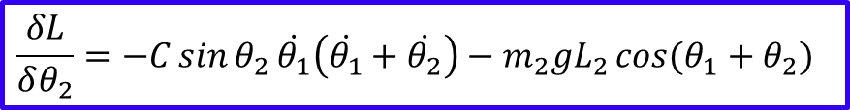
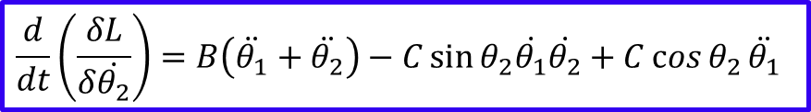
2-DOF Manipulator Dynamics (5)
$$\frac{d}{dt}\left(\frac{δL}{δ\dot{q_{i}}}\right)−\frac{δL}{δq_{i}}=τ_{i}$$
$$L=T−V$$
$$L=\left(\frac{1}{2}m_{1}{L_{1}}^{2}+\frac{1}{2}I_{1}+\frac{1}{2}m_{2}{L_{1}}^{2}\right){{\dot{θ}}_{1}}^{2}+\left(\frac{1}{2}m_{2}{L_{2}}^{2}+\frac{1}{2}I_{2}\right){\left({\dot{θ}}_{1}+{\dot{θ}}_{2}\right)}^{2} \\ +m_{2}L_{1}L_{2}\cos{θ_{2}}\dot{θ_{1}}\left(\dot{θ_{1}}+\dot{θ_{2}}\right)−\left(m_{1}+m_{2}\right)gL_{1}\sin{θ_{1}}−m_{2}gL_{2}\sin{(θ_{1}+θ_{2})}$$
$$\frac{δL}{δ\dot{θ_{2}}}=B\left({\dot{θ}}_{1}+{\dot{θ}}_{2}\right)+m_{2}L_{1}L_{2}\cos{θ_{2}}\dot{θ_{1}}$$
$$\frac{d}{dt}\left(\frac{δL}{δ\dot{θ_{2}}}\right)=B\left(\ddot{θ_{1}}+\ddot{θ_{2}}\right)−C\sin{θ_{2}\dot{θ_{1}}\dot{θ_{2}}}+C\cos{θ_{2}}\ddot{θ_{1}}$$
$$\frac{δL}{δθ_{2}}=−C\sin{θ_{2}}\dot{θ_{1}}\left(\dot{θ_{1}}+\dot{θ_{2}}\right)−m_{2}gL_{2}\cos{(θ_{1}+θ_{2})}$$
$$B\left(\ddot{θ_{1}}+\ddot{θ_{2}}\right)+C\cos{θ_{2}}\ddot{θ_{1}}+C\sin{θ_{2}}{{\dot{θ}}_{1}}^{2}+m_{2}gL_{2}\cos\left(θ_{1}+θ_{2}\right)=τ_{2}$$

Slide 23
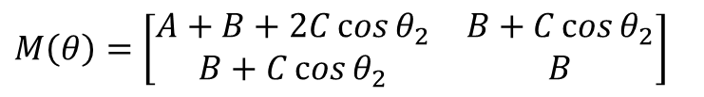
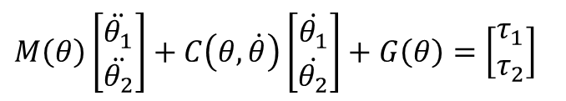
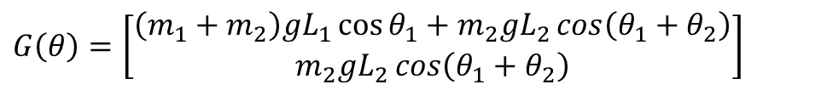
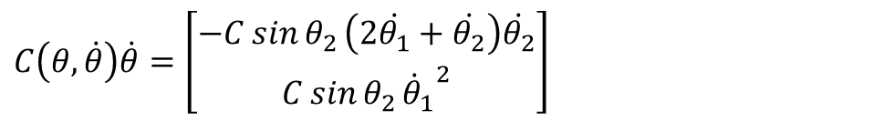
2-DOF Manipulator Dynamics (6)
$$A\ddot{θ_{1}}+B\left(\ddot{θ_{1}}+\ddot{θ_{2}}\right)+C\cos{θ_{2}}\left(2\ddot{θ_{1}}+\ddot{θ_{2}}\right)−C\sin{θ_{2}}\left(2\dot{θ_{1}}+\dot{θ_{2}}\right)\dot{θ_{2}}+\left(m_{1}+m_{2}\right)gL_{1}\cos{θ_{1}}+m_{2}gL_{2}\cos\left(θ_{1}+θ_{2}\right)=τ_{1}$$
$$B\left(\ddot{θ_{1}}+\ddot{θ_{2}}\right)+C\cos{θ_{2}}\ddot{θ_{1}}+C\sin{θ_{2}}{{\dot{θ}}_{1}}^{2}+m_{2}gL_{2}\cos\left(θ_{1}+θ_{2}\right)=τ_{2}$$
$$M\left(θ\right)\left[\begin{matrix}\ddot{θ_{1}} \\ \ddot{θ_{2}}\end{matrix}\right]+C\left(θ,\dot{θ}\right)\left[\begin{matrix}\dot{θ_{1}} \\ \dot{θ_{2}}\end{matrix}\right]+G\left(θ\right)=\left[\begin{matrix}τ_{1} \\ τ_{2}\end{matrix}\right]$$
$$M\left(θ\right)=\left[\begin{matrix}A+B+2C\cos{θ_{2}} & B+C\cos{θ_{2}} \\ B+C\cos{θ_{2}} & B\end{matrix}\right]$$
$$C\left(θ,\dot{θ}\right)\dot{θ}=\left[\begin{matrix}−C\sin{θ_{2}}\left(2\dot{θ_{1}}+\dot{θ_{2}}\right)\dot{θ_{2}} \\ C\sin{θ_{2}}{{\dot{θ}}_{1}}^{2}\end{matrix}\right]$$
$$G\left(θ\right)=\left[\begin{matrix}\left(m_{1}+m_{2}\right)gL_{1}\cos{θ_{1}}+m_{2}gL_{2}\cos\left(θ_{1}+θ_{2}\right) \\ m_{2}gL_{2}\cos\left(θ_{1}+θ_{2}\right)\end{matrix}\right]$$

Slide 24
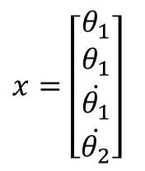
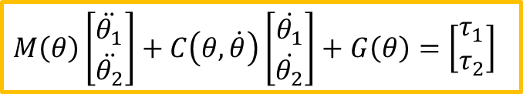
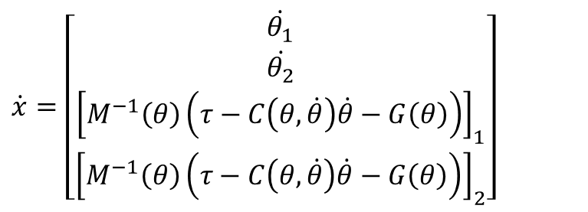
2-DOF Manipulator Simulation (1)
$$M\left(θ\right)\left[\begin{matrix}\ddot{θ_{1}} \\ \ddot{θ_{2}}\end{matrix}\right]+C\left(θ,\dot{θ}\right)\left[\begin{matrix}\dot{θ_{1}} \\ \dot{θ_{2}}\end{matrix}\right]+G\left(θ\right)=\left[\begin{matrix}τ_{1} \\ τ_{2}\end{matrix}\right]$$
$$x=\left[\begin{matrix}θ_{1} \\ θ_{1} \\ \dot{θ_{1}} \\ \dot{θ_{2}}\end{matrix}\right]$$
$$\ddot{θ}= M^{−1}\left(θ\right)\left(τ−C\left(θ,\dot{θ}\right)\dot{θ}−G\left(θ\right)\right)$$
$$\dot{x}=\left[\begin{matrix}\dot{θ_{1}} \\ \dot{θ_{2}} \\ {\left[M^{−1}\left(θ\right)\left(τ−C\left(θ,\dot{θ}\right)\dot{θ}−G\left(θ\right)\right)\right]}_{1} \\ {\left[M^{−1}\left(θ\right)\left(τ−C\left(θ,\dot{θ}\right)\dot{θ}−G\left(θ\right)\right)\right]}_{2}\end{matrix}\right]$$

Slide 25
Control

Slide 26
Control
PID Control
PD Control + Gravity Compensation
Computed Torque Control
Sliding Mode Control
Adaptive Control
Trajectory and Motion Planning

Slide 27
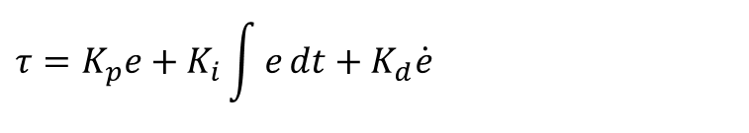
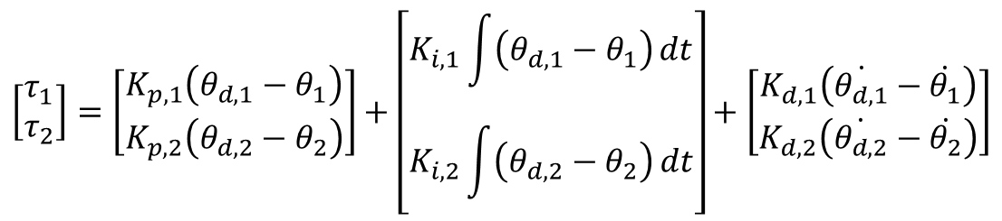
2-DOF Manipulator PID Control (1)
PID Control
$$τ=K_{p}e+K_{i}\int{e}dt+K_{d}\dot{e}$$
$$τ_{i}=K_{p,i}\left(θ_{d,i}−θ_{i}\right)e+K_{i,i}\int{\left(θ_{d,i}−θ_{i}\right)}dt+K_{d}\left(\dot{θ_{d,i}}−\dot{θ_{i}}\right), (i=1,2)$$
$$τ_{i}=K_{p,i}\left(θ_{d,i}−θ_{i}\right)+K_{i,i}\int{\left(θ_{d,i}−θ_{i}\right)}dt+K_{d}\left(\dot{θ_{d,i}}−\dot{θ_{i}}\right), (i=1,2)$$
$$\left[\begin{matrix}τ_{1} \\ τ_{2}\end{matrix}\right]=\left[\begin{matrix}K_{p,1}\left(θ_{d,1}−θ_{1}\right) \\ K_{p,2}\left(θ_{d,2}−θ_{2}\right)\end{matrix}\right]+\left[\begin{matrix}K_{i,1}\int{\left(θ_{d,1}−θ_{1}\right)}dt \\ K_{i,2}\int{\left(θ_{d,2}−θ_{2}\right)}dt\end{matrix}\right]+\left[\begin{matrix}K_{d,1}\left(\dot{θ_{d,1}}−\dot{θ_{1}}\right) \\ K_{d,2}\left(\dot{θ_{d,2}}−\dot{θ_{2}}\right)\end{matrix}\right]$$

Slide 28
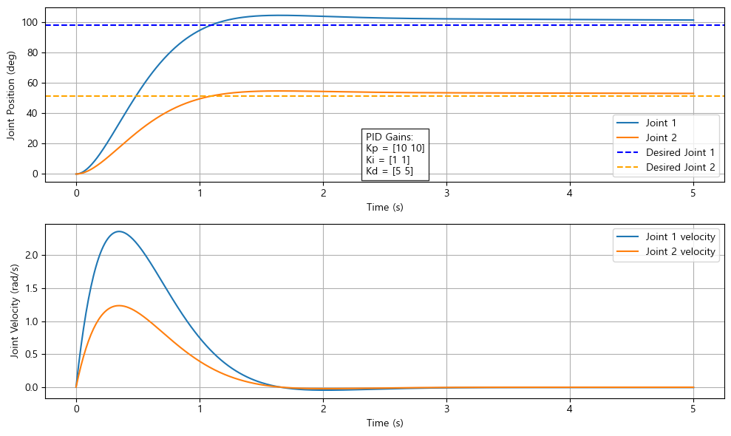
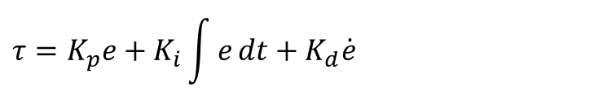
2-DOF Manipulator PID Control (2)
$$τ=K_{p}e+K_{i}\int{e}dt+K_{d}\dot{e}$$

Slide 29
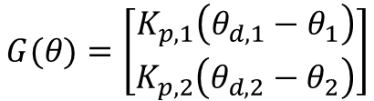

2-DOF Manipulator PD Control + GC(1)
$$(x_{2},y_{2})$$
PD Control + GC
$$L_{2}$$
$$τ_{PD}=K_{p}\left(θ_{d}−θ\right)+K_{d}\left(\dot{θ_{d}}−\dot{θ}\right)$$
$$θ_{2}$$
$$τ=G(θ)+K_{p}\left(θ_{d}−θ\right)+K_{d}\left(\dot{θ_{d}}−\dot{θ}\right)$$
$$L_{1}$$
$$(x_{1},y_{1})$$
$$θ_{1}$$
$$G(θ)=\left[\begin{matrix}K_{p,1}\left(θ_{d,1}−θ_{1}\right) \\ K_{p,2}\left(θ_{d,2}−θ_{2}\right)\end{matrix}\right]$$

Slide 30
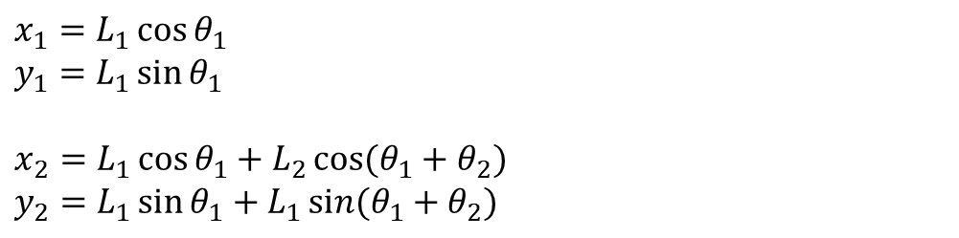




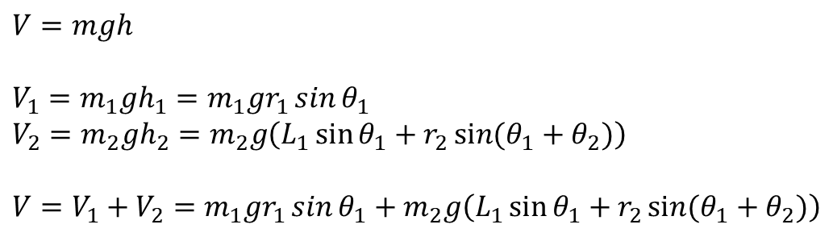



2-DOF Manipulator Inverse kinematics (1)
$$x_{1}=L_{1}\cos{θ_{1}}$$
$$y_{1}=L_{1}\sin{θ_{1}}$$
$$x_{2}=L_{1}\cos{θ_{1}}+L_{2}\cos{(θ_{1}+θ_{2})}$$
$$y_{2}=L_{1}\sin{θ_{1}}+L_{1}\sin{(θ_{1}+θ_{2})}$$
$$(x_{2},y_{2})$$
$$L_{2}$$
$$θ_{2}$$
PD Control + GC
$$L_{1}$$
$$(x_{1},y_{1})$$
$$τ_{PD}=K_{p}\left(θ_{d}−θ\right)+K_{d}\left(\dot{θ_{d}}−\dot{θ}\right)$$
$$θ_{1}$$
$$τ=G(θ)+K_{p}\left(θ_{d}−θ\right)+K_{d}\left(\dot{θ_{d}}−\dot{θ}\right)$$
$$V=mgh$$
$$V_{1}=m_{1}gh_{1}=m_{1}gr_{1}\sin{θ_{1}}$$
$$V_{2}=m_{2}gh_{2}=m_{2}g\left(L_{1}\sin{θ_{1}}+r_{2}\sin{(θ_{1}+θ_{2})}\right)$$
$$V=V_{1}+V_{2}=m_{1}gr_{1}\sin{θ_{1}}+m_{2}g\left(L_{1}\sin{θ_{1}}+r_{2}\sin{(θ_{1}+θ_{2})}\right)$$

Slide 31
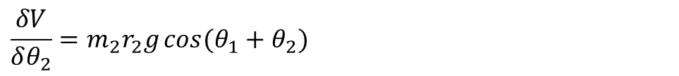
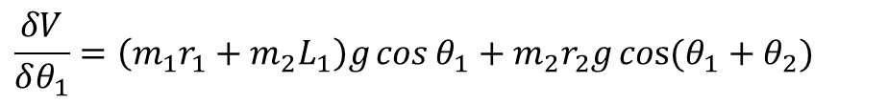
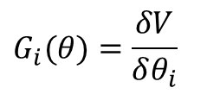
2-DOF Manipulator PD Control + GC (1)
$$V=V_{1}+V_{2}=m_{1}gr_{1}\sin{θ_{1}}+m_{2}g\left(L_{1}\sin{θ_{1}}+r_{2}\sin{(θ_{1}+θ_{2})}\right)$$
$$G_{i}(θ)=\frac{δV}{δθ_{i}}$$
$$\frac{δV}{δθ_{1}}=\left(m_{1}r_{1}+m_{2}L_{1}\right)g\cos{θ_{1}}+m_{2}r_{2}g\cos{(θ_{1}+θ_{2})}$$
$$\frac{δV}{δθ_{2}}=m_{2}r_{2}g\cos{(θ_{1}+θ_{2})}$$
$$G(θ)=\left[\begin{matrix}G_{1}\left(θ\right) \\ G_{2}\left(θ\right)\end{matrix}\right]=\left[\begin{matrix}\left(m_{1}r_{1}+m_{2}L_{1}\right)g\cos{θ_{1}}+m_{2}r_{2}g\cos{(θ_{1}+θ_{2})} \\ m_{2}r_{2}g\cos{(θ_{1}+θ_{2})}\end{matrix}\right]$$

Slide 32
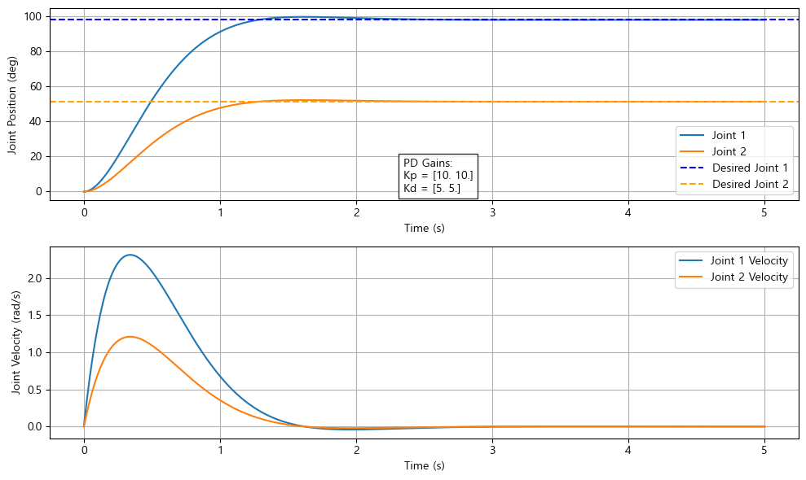

2-DOF Manipulator PD Control + GC (2)
$$τ=G(θ)+K_{p}\left(θ_{d}−θ\right)+K_{d}\left(\dot{θ_{d}}−\dot{θ}\right)$$

Slide 33



2-DOF Manipulator Computed Torque Control (1)
Error Dynamics
$$e=θ_{d}−θ$$
$$\ddot{e}+K_{d}\dot{e}+K_{p}e=0$$
$$\ddot{e}=\ddot{θ_{d}}−\ddot{θ}$$
$$\ddot{θ} =\ddot{θ_{d}}+K_{d}(\dot{θ_{d}}−\dot{θ}) +K_{p}(θ_{d}−θ)$$
Computed Torque Control
$$M\left(θ\right)\ddot{θ}+C\left(θ,\dot{θ}\right)\dot{θ}+G\left(θ\right)=τ$$
$$M\left(θ\right)\left[\ddot{θ_{d}}+K_{d}(\dot{θ_{d}}−\dot{θ}) +K_{p}(θ_{d}−θ)\right]+C\left(θ,\dot{θ}\right)\dot{θ}+G\left(θ\right)=τ$$

Slide 34
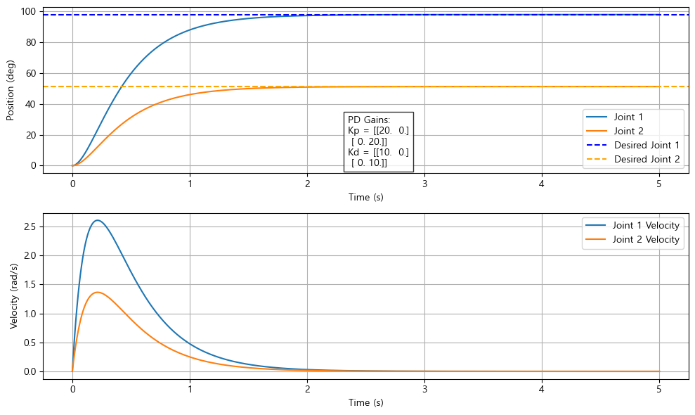
2-DOF Manipulator Computed Torque Control (2)
$$M\left(θ\right)\left[\ddot{θ_{d}}+K_{d}(\dot{θ_{d}}−\dot{θ}) +K_{p}(θ_{d}−θ)\right]+C\left(θ,\dot{θ}\right)\dot{θ}+G\left(θ\right)=τ$$

Slide 35





2-DOF Manipulator Sliding Mode Control (1)
Error Dynamics
$$e=θ_{d}−θ$$
$$s=\dot{e}+λe=−\dot{θ}+λ(θ_{d}−θ)$$
$$\ddot{e}+λ\dot{e}=0$$
$$\dot{e}=−λe$$
$$e(t)=e(0)e^{−λt}$$
Reaching Law
$$\dot{s}=−k\operatorname{sgn}{(s)}$$
$${\ddot{θ}}_{des}=−λ\dot{θ}+k\operatorname{sgn}{(s)}$$
$$M\left(θ\right)\ddot{θ}+C\left(θ,\dot{θ}\right)\dot{θ}+G\left(θ\right)=τ$$
$$τ=M\left(θ\right){\ddot{θ}}_{des}+C\left(θ,\dot{θ}\right)\dot{θ}+G\left(θ\right)$$
$$τ=M\left(θ\right)\left[−λ\dot{θ}+k\operatorname{sgn}{(s)}\right]+C\left(θ,\dot{θ}\right)\dot{θ}+G\left(θ\right)$$
$$τ=M\left(θ\right)\left[−λ\dot{θ}+k\operatorname{sgn}{(\dot{e}+λe)}\right]+C\left(θ,\dot{θ}\right)\dot{θ}+G\left(θ\right)$$

Slide 36
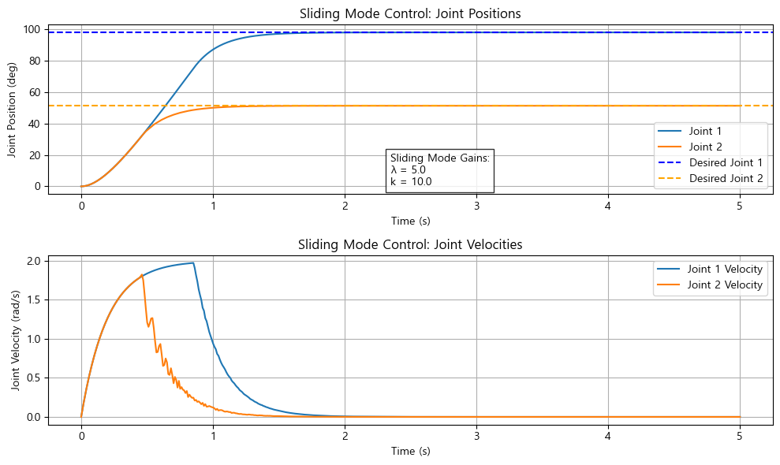
2-DOF Manipulator Sliding Mode Control (2)
$$τ=M\left(θ\right)\left[−λ\dot{θ}+k\operatorname{sgn}{(s)}\right]+C\left(θ,\dot{θ}\right)\dot{θ}+G\left(θ\right)$$

Slide 37




2-DOF Manipulator Sliding Mode Control (3)
sign function
$$\operatorname{sgn}{(s)}=\left\{\begin{matrix}1, & if s≥0 \\ −1, & else\end{matrix}\right.$$
saturation function
$$\operatorname{sgn}{(s/φ)}=\left\{\begin{matrix}1, & if s/φ>1 \\ s/φ, & if \left|s/φ\right|≤1 \\ −1, & if s/φ<−1\end{matrix}\right.$$
Hyperbolic tangent
$$tanh⁡(s/φ)$$
Sigmoid Function
$$σ\left(s\right)=\frac{2}{1+e^{−s/φ}}−1$$

Slide 38


2-DOF Manipulator Adaptive Control (1)
Dynamic Model
?
$$τ=M\left(θ\right)\ddot{θ}+C\left(θ,\dot{θ}\right)\dot{θ}+G\left(θ\right)$$
만약 실제 파라미터 $m_{1},m_{2},I_{1},I_{2},r_{1},r_{2}가$ 불확실 하다면, 모델은 추정 파라미터 $\hat{M}\left(θ\right),\hat{C}\left(θ,\dot{θ}\right),\hat{G}\left(θ\right)$를 기반으로 합니다.
Parameter estimation
$$\hat{M}\left(θ\right)\ddot{θ}+\hat{C}\left(θ,\dot{θ}\right)\dot{θ}+\hat{G}\left(θ\right)=Y(θ,\dot{θ},\ddot{θ})θ^{∗}$$
Control Law
Adaptive Law

Slide 39




2-DOF Manipulator Adaptive Control (1)
?

Slide 40



2-DOF Manipulator Model Predictive Control (1)
Dynamic Model
$$τ=M\left(θ\right)\ddot{θ}+C\left(θ,\dot{θ}\right)\dot{θ}+G\left(θ\right)$$
Predictive Model (linearization)
$$x_{k+1}=Ax_{k}+Au_{k}$$
Optimal Problem
$$J=\sum_{k=0}^{N−1}{\left[{\left(x_{k}−x_{ref,k}\right)}^{T}Q_{f}\left(x_{k}−x_{ref,k}\right)+{u_{k}}^{T}Ru_{k}\right]+{(x_{N}−x_{ref,N})}^{T}Q_{f}(x_{N}−x_{ref,N})}$$

Slide 41
Advanced Control

Slide 42

Model Predictive Control (1)

Slide 43
Trajectory & Motion Planning

Slide 44







Trajectory Planning - Trapezodial
Trapezodial
Boundary condition
$$t_{c}: 정속시간$$ $t_{a}: 가$속시간
$$ω_{max}=\frac{D}{t_{a}+t_{c}}$$
$$α=\frac{ω_{max}}{t_{a}}$$
$$D=θ_{f}−θ_{0}$$
$$t_{c}=T−2t_{a}$$
Solution
$$θ(t)\left\{\begin{matrix}θ_{0}+\frac{1}{2}αt^{2} & [0,t_{a}) \\ θ_{0}+\frac{1}{2}αt_{a}^{2}+ω_{max}(t−t_{a}) & [t_{a},t_{a},t_{c}) \\ θ_{f}−\frac{1}{2}α{(T−t)}^{2} & [t_{a}+t_{c},T]\end{matrix} \right.$$
$$ω(t)\left\{\begin{matrix}αt & [0,t_{a}) \\ ω_{max} & [t_{a},t_{a},t_{c}) \\ ω_{max}−α(t−t_{a}−t_{c}) & [t_{a}+t_{c},T]\end{matrix} \right.$$
$$α(t)\left\{\begin{matrix}α & [0,t_{a}) \\ 0 & [t_{a},t_{a},t_{c}) \\ −α & [t_{a}+t_{c},T]\end{matrix} \right.$$

Slide 45




Trajectory Planning – Cubic Polynomial
Cubic Polynomial
$$θ\left(t\right)=a_{0}+a_{1}t+a_{2}t^{2}+a_{3}t^{3}$$
Boundary condition
$$θ\left(T\right)=θ_{f}$$
$$\dot{θ}\left(T\right)=ω_{f}$$
$$θ\left(0\right)=θ_{0}$$
$$\dot{θ}\left(0\right)=ω_{0}$$
Solution
$$a_{0}=θ_{0}$$
$$a_{1}=ω_{0}$$
$$a_{2}=\frac{3\left(θ_{f}−θ_{0}\right)−\left(2ω_{0}−ω_{f}\right)T}{T^{2}}$$
$$a_{3}=\frac{−2\left(θ_{f}−θ_{0}\right)+\left(ω_{0}+ω_{f}\right)T}{T^{3}}$$

Slide 46




Trajectory Planning – Quintic polynomial
Quintic Polynomial
$θ\left(t\right)=a_{0}+a_{1}t+a_{2}t^{2}+a_{3}t^{3}+a_{4}t^{4}$ $+a_{5}t^{5}$
Boundary condition
$$θ\left(T\right)=θ_{f}$$
$$\dot{θ}\left(T\right)=ω_{f}$$
$$\ddot{θ}\left(T\right)=α_{f}$$
$$θ\left(0\right)=θ_{0}$$
$$\dot{θ}\left(0\right)=ω_{0}$$
$$\ddot{θ}\left(0\right)=α_{0}$$
Solution
$$a_{0}=θ_{0}$$
$$a_{1}=ω_{0}$$
$$a_{2}=\frac{α_{0}}{2}$$
$$a_{3}=\frac{20\left(θ_{f}−θ_{0}\right)−\left(8ω_{f}+12ω_{0}\right)T+\left(α_{f}−3α_{0}\right)T^{2}}{2T^{3}}$$
$$a_{4}=\frac{−30\left(θ_{f}−θ_{0}\right)+\left(14ω_{f}+16ω_{0}\right)T−\left(2α_{f}+3α_{0}\right)T^{2}}{2T^{4}}$$
$$a_{5}=\frac{12\left(θ_{f}−θ_{0}\right)−\left(6ω_{f}+6ω_{0}\right)T+\left(α_{f}−α_{0}\right)T^{2}}{2T^{5}}$$

Slide 47

Trajectory Planning – Bezier Curve
Bezier Curve
$θ\left(t\right)={(1−t)}^{3}P_{0}+{3(1−t)}^{2}tP_{1}+(1−t)t^{2}P_{2}+$ $t^{3}P_{3}$

Slide 48


Trajectory Planning – Bezier Curve
Bezier Curve
$θ\left(t\right)={(1−t)}^{3}P_{0}+{3(1−t)}^{2}tP_{1}+(1−t)t^{2}P_{2}+$ $t^{3}P_{3}$
$$P_{i}=\left[\begin{matrix}x_{i} \\ y_{i}\end{matrix}\right]$$
https://ko.javascript.info/bezier-curve

Slide 49




Trajectory Planning – B Spline
B-Spline
$$θ\left(t\right)=\sum_{i=0}^{n}{P_{i}∙B_{i,3}(t)}$$
https://stella47.tistory.com/138

Slide 50



Trajectory Planning – TOPP
Time Optimal Path Parameterization
$$\begin{matrix}maximize & −T_{f} \\ subject to & \begin{matrix}|\dot{q}(t)|≤{\dot{q}}_{max} \\ |\ddot{q}(t)|≤{\ddot{q}}_{max} \\ |τ(q,\dot{q},\ddot{q})|≤τ_{max}\end{matrix}\end{matrix}$$

Slide 51
Trajectory Planning – TOPP-RA
Time Optimal Path Parameterization via Reachability Analysis

Slide 52


Trajectory Planning – TOPP-RA
Time Optimal Path Parameterization via Reachability Analysis

Slide 53

Trajectory Planning – TOPP-RA
Time Optimal Path Parameterization via Reachability Analysis

Slide 54
Trajectory & Motion Planning

Slide 55


Slide 56
Thank you

