Slide 1

LEAF Robotics
Jae Hyeong Park
Ph.D. in Mechanical Engineering
(Robotics)

Slide 2
Product

Slide 3







LEAF Hierarchy
LEAF Robotics
LEAF Server
LEAF Handy
LEAF Core
LEAF Feel
LEAF Eyes
LEAF bot

Slide 4
Thank you

Slide 5
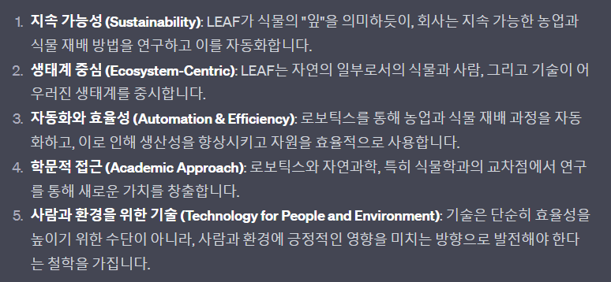
LEAF Robotics
LEAF Robotics
Light, Environment, Air, Food Robotics
경영철학

Slide 6
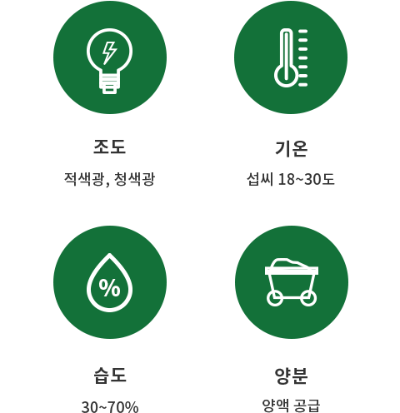


Plant²
Plant²
Plant
Plant

