Slide 1
Greedy Algorithm

Slide 2
Hyperparameter
Layer num
Node num
Activation function
Loss function
Learning rate
Hyperparameter
Start from 32/32

Slide 3
Layer Num

Slide 4
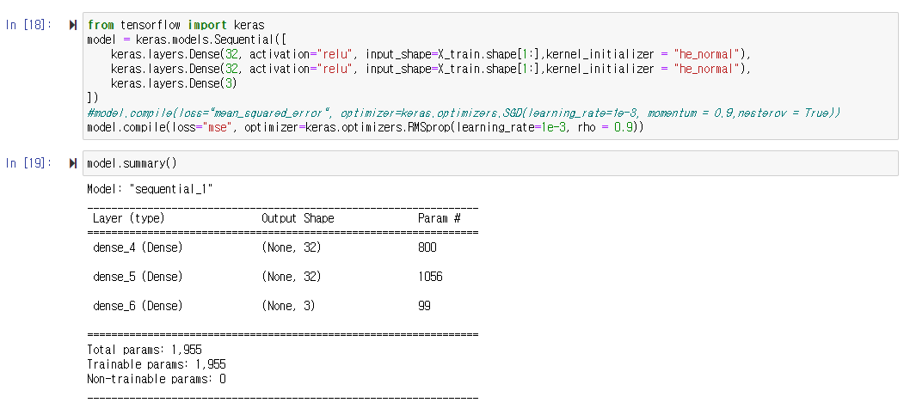
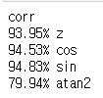

Slide 5
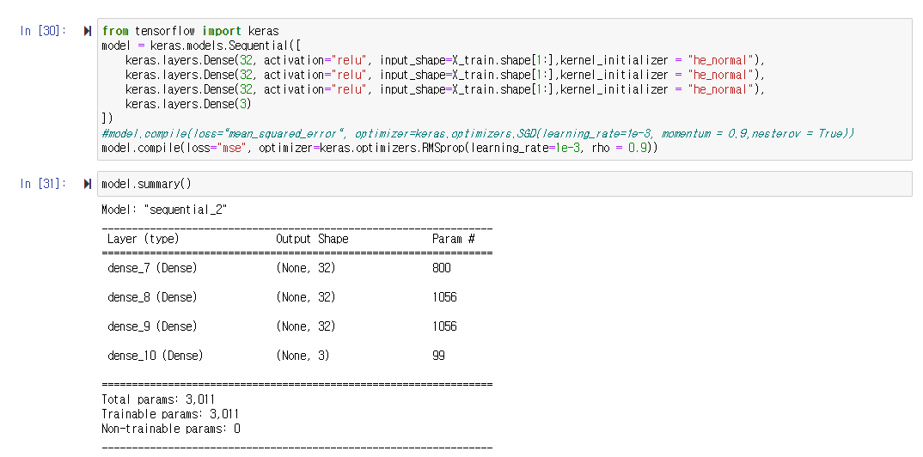


Slide 6
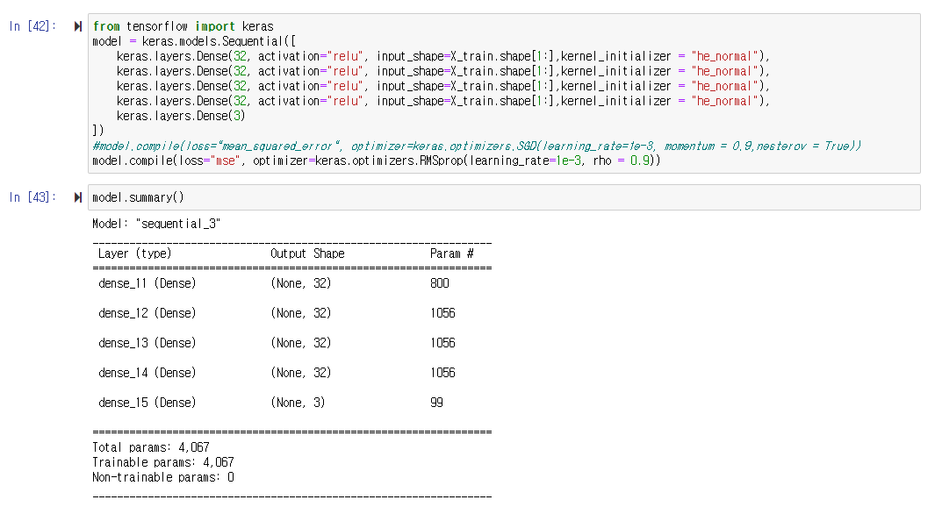


Slide 7
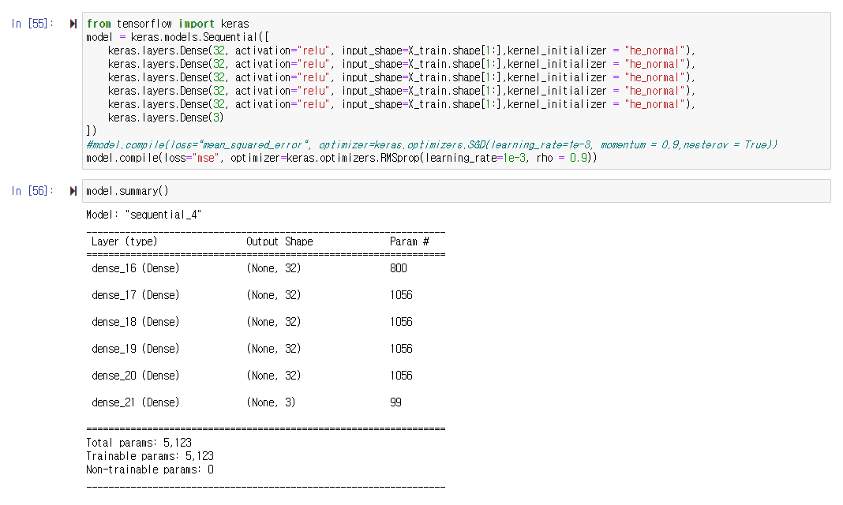


Slide 8
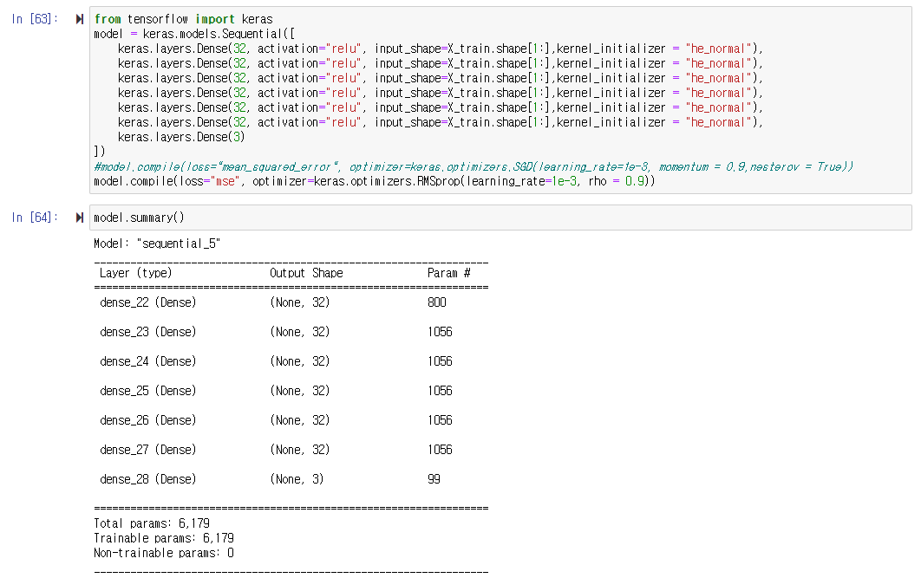


Slide 9
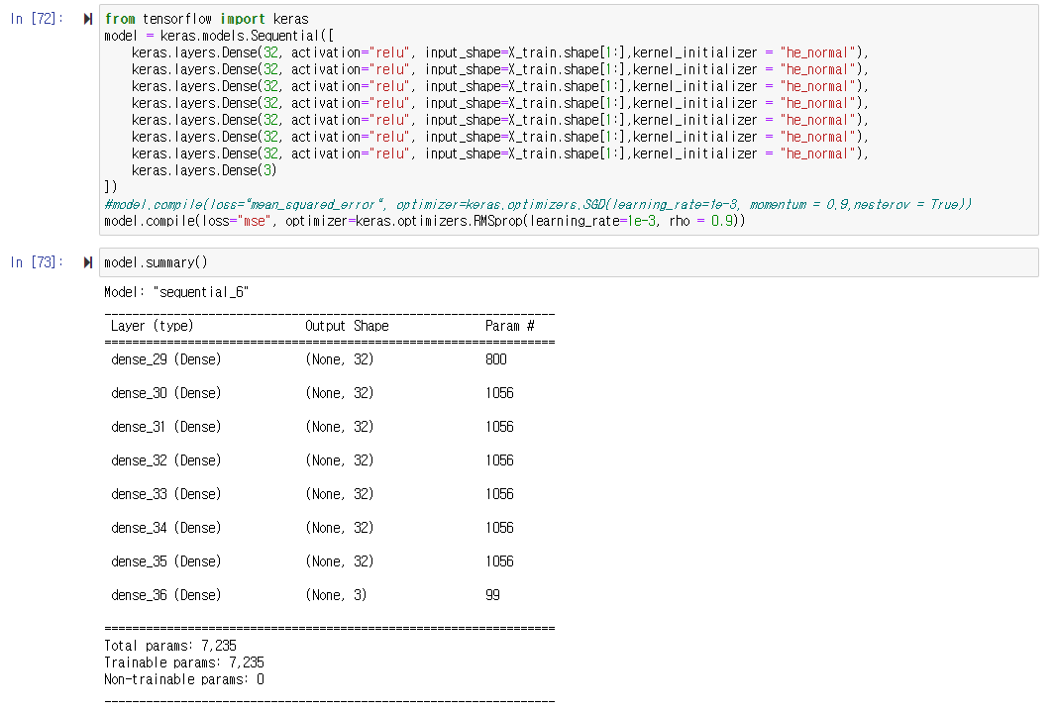


Slide 10
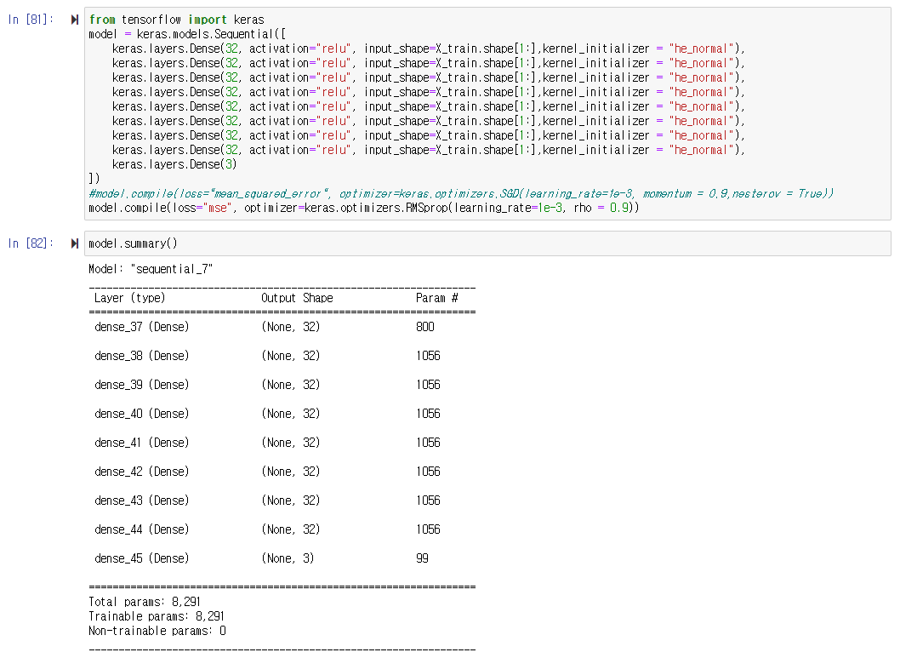


Slide 11
32 32 32 32

Slide 12
Node Num

Slide 13
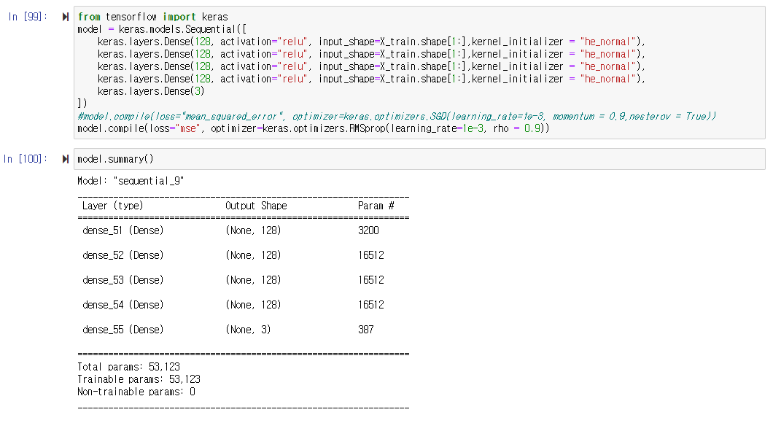


Slide 14



Slide 16
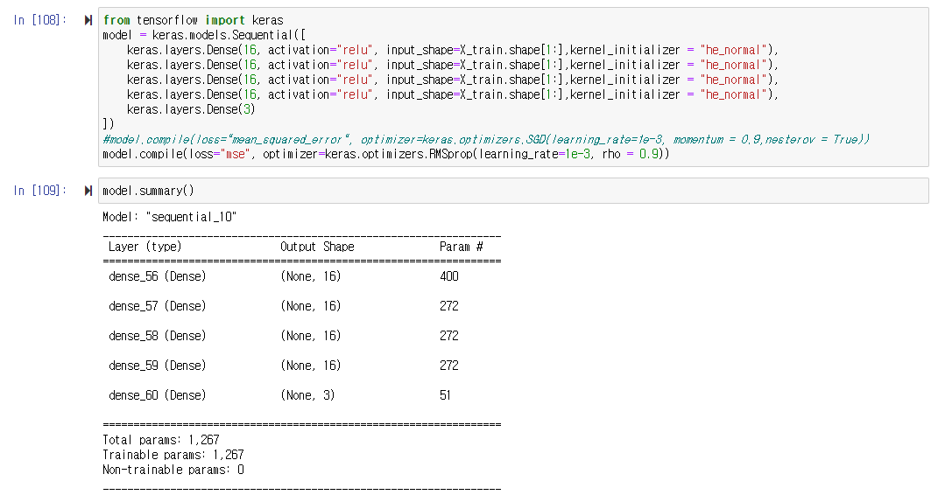


Slide 17
64 64 64 64
~
32 32 32 32

Slide 18
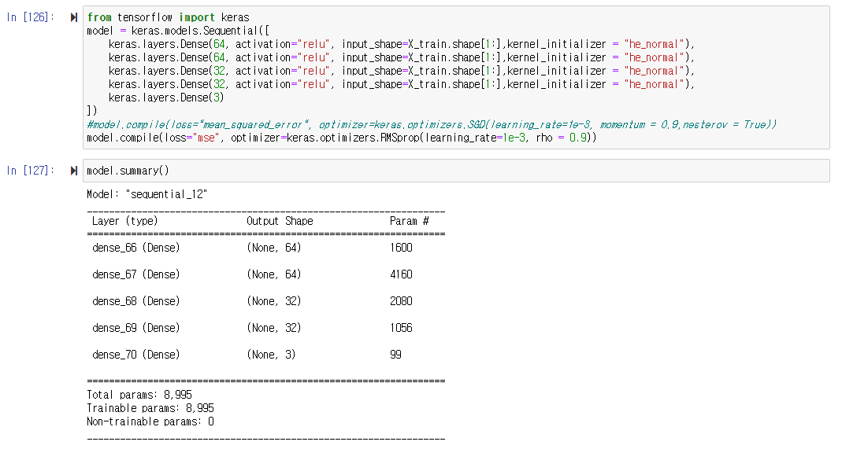


Slide 19
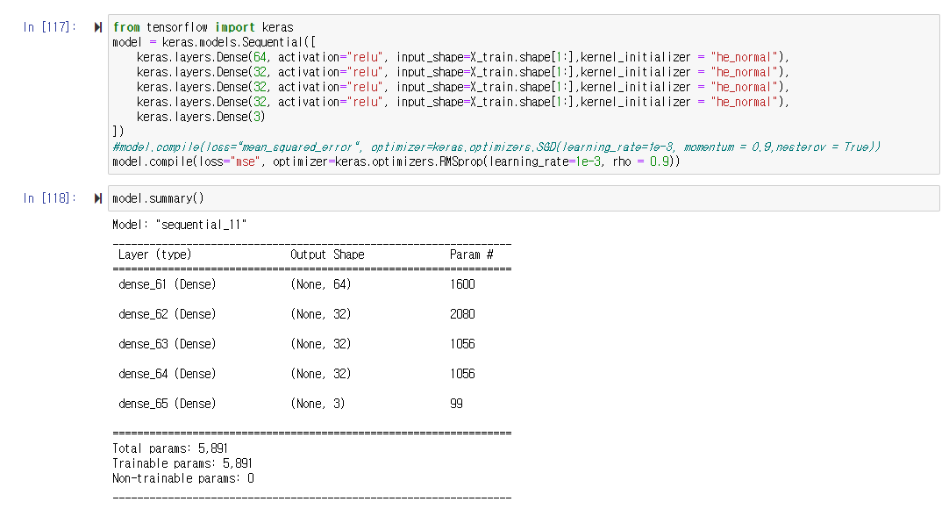


Slide 20
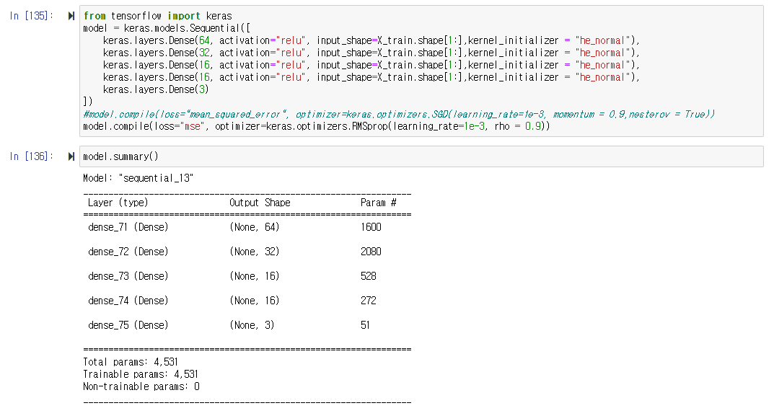


Slide 21



Slide 22
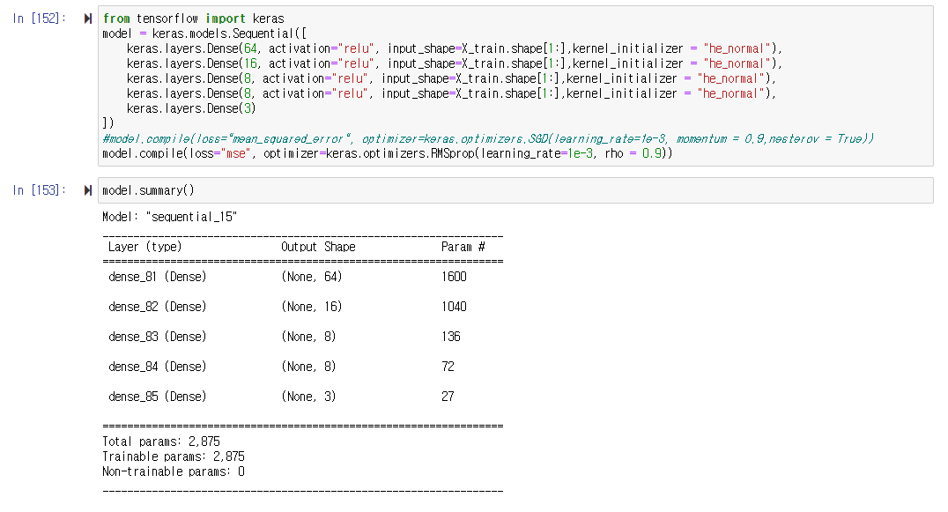


Slide 23
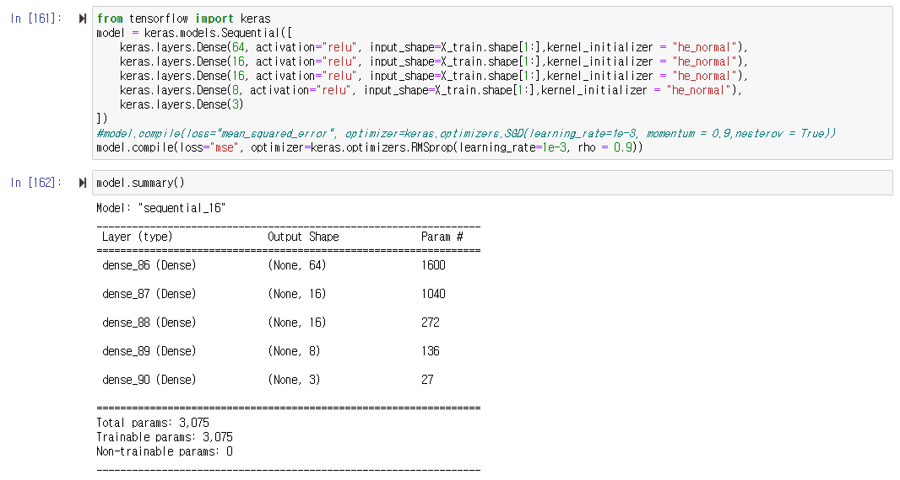


Slide 24
64 16 16 16

