Slide 1

AI APPLICATIONS IN ACCELERATORS TUTORIAL & MINI-HACKATHON | KOMAC / KAERI
Lecture 1: AI/ML Foundations and Closed-Loop Control
for Particle Accelerators
Physics Foundations, Neural Surrogates, Reinforcement Learning, and Bayesian Optimization
Chong Shik Park, Ph.D.
• Department of Accelerator Science, Korea University, Sejong 30019, Republic of Korea
• Center for Accelerator Research, Korea University, Sejong 30019, Republic of Korea
Date: November 3, 2026 | Target: Accelerator Physicists, Postdocs, Engineers & Graduate Students
November 3, 2026
Chong Shik Park, Ph.D. | Korea University, Sejong | AI Applications in Accelerators
1

Slide 2
WORKSHOP CURRICULUM | Integrated Morning Lectures & Afternoon Hackathon
Bridging theoretical foundations directly with closed-loop simulation and live W&B tracking
Lecture 1 (09:10 - 10:30)
Lecture 2 (10:40 - 12:00)
Mini-Hackathon (13:30 - 17:00)
Instructor: Chong Shik Park, Ph.D.
• Physics Foundations & Hill's Equation
• Orbit Response Matrix (ORM) Coupling
• Magnetic Core Cubic Saturation
• Neural Surrogate Digital Twins (MLP)
• SVD Pseudo-Inverse vs Bounded Inversion
• Physics-Informed RL & Dynamic Damping
• Gaussian Process Bayesian Optimization
Target: Sub-micron closed-loop control under non-linear actuator constraints.
Instructor: Thorsten Hellert, Ph.D.
• Agentic AI Frameworks in Accelerators
• Large Language Model (LLM) Agents
• Osprey Autonomous Control System
• Automated Scientific Workflows
• Python API Tool Calling Architecture
• Operational Guardrails & Safety Bounds
• Human-in-the-Loop Supervision
Target: Autonomous tuning agents and scientific workflow orchestration.
Hands-On Orbit Alignment Challenge
• 15-meter Transport Lattice (12 BPMs, 6 Steerers)
• 3 Parallel Tracks (MLP, RL, BO)
• Standardized 30-Seed Evaluation Suite
• Sub-30 μm Convergence Target
• Real-time Weights & Biases (W&B) Logging
• Live Global Leaderboard Tracking
• Final Awards & Recognition
Target: > 1,000 points on standardized evaluation suite.
November 3, 2026
Chong Shik Park, Ph.D. | Korea University, Sejong | AI Applications in Accelerators
2

Slide 3
DOMAIN OVERVIEW | Five Foundational Pillars of AI in Modern Accelerators
How artificial intelligence transforms design, commissioning, and autonomous operations
1. Neural Surrogate Digital Twins
• Replaces slow tracking codes (ELEGANT, MAD-X) with sub-ms deep neural surrogates.
• Enables real-time model-predictive control, online orbit feedback, and virtual parametric sensitivity analysis.
2. Multi-Objective Bayesian Optimization
• Balances trade-offs: beam transmission vs photon brightness vs transverse emittance.
• Gaussian Processes with acquisition functions find Pareto-optimal set in dozens of shots instead of thousands.
3. Virtual Diagnostics & Phase Space
• Reconstructs destructive beam metrics (6D phase space, bunch slice emittance) non-invasively.
• Neural networks predict shot-by-shot profiles from upstream RF cavities and BPM telemetry.
4. Anomaly Detection & Machine Protection
• Unsupervised models monitor sensor drift to prevent multi-megawatt beam downtime.
• Deep sequence models predict RF breakdown and cavity quenches milliseconds before catastrophic trips.
5. Agentic AI & Autonomous Operations
• Integrates LLM reasoning engines with accelerator APIs and diagnostic archives (e.g. Osprey).
• Executes high-level operational commands safely within strict hardware interlock boundaries.
November 3, 2026
Chong Shik Park, Ph.D. | Korea University, Sejong | AI Applications in Accelerators
3

Slide 4
PHYSICS FOUNDATIONS | Transverse Beam Dynamics & Hill's Equation
Theoretical governing equation shaping betatron oscillations in linear magnetic lattices
Hill's Equation Formulation
The Operational Challenge: Hadron Linacs & Rings
Transverse motion along coordinate s in uncoupled lattice:
d²x(s)/ds² + K(s) x(s) = 0
• K(s) = (e/p) · (∂By/∂x) represents alternating quadrupole focusing strength (K > 0 for QF, K < 0 for QD).
• General solution is a pseudo-harmonic betatron oscillation:
x(s) = √[ε · β(s)] · cos(ψ(s) + φ₀)
• β(s): Courant-Snyder beta function (beam envelope)
• ψ(s) = ∫ ds / β(s): Betatron phase advance
• ν = (1/2π) ∮ ds / β(s): Betatron tune (total phase advance)
Sub-Micron Stability Tolerances:
• Modern light sources require orbit stabilization to < 10% of beam size (sub-micron RMS tolerances).
• In multi-megawatt hadron linacs (e.g. KOMAC, SNS, ESS):
- Offsets in quadrupoles/cavities induce non-linear space charge forces and halo.
- Losses exceeding 1 W/m (10⁻⁵ of total current) cause severe structural radioactivation.
- Hands-on maintenance is prohibited if orbit deviations remain uncorrected.
• Physical Disturbance Mechanisms:
- Ground motion and mechanical vibrations (pumps, cryocoolers)
- Thermal girder expansion and diurnal temperature cycles
- Power supply current ripple and magnet hysteresis
November 3, 2026
Chong Shik Park, Ph.D. | Korea University, Sejong | AI Applications in Accelerators
4

Slide 5
ANALYTICAL OPTICS | Derivation of the Orbit Response Matrix (ORM)
Mathematical link connecting steerer deflections to downstream diagnostic readings
Theoretical ORM Derivation
Why Pure Linear Inversion Breaks Down
Localized angular deflection (kick) θj applied by steerer j:
R_ij = Δx(s_i) / θ_j
= [√(β_i β_j) / (2 sin(π ν))] · cos(|ψ_i - ψ_j| - π ν)
Linear Response Formulation:
Y_linear = I · R
• I ∈ ℝ⁶: Vector of 6 corrector currents (Amperes)
• R ∈ ℝ⁶ˣ¹²: Linear Orbit Response Matrix
• Y ∈ ℝ¹²: Transverse displacements measured at 12 BPMs
Coupling Mechanism:
Deflecting a single steerer perturbs the entire downstream trajectory through betatron phase advance.
Classical Singular Value Decomposition (SVD):
ΔI = - α · (Rᵀ)⁺ · Y
Key Vulnerabilities in Real Operations:
1. Magnetic Core Saturation:
High coil currents drive yoke iron into non-linear saturation. The true response departs significantly from R.
2. Limit Cycles & Overshoot:
High static feedback gains (α > 0.5) cause severe overshoot and persistent oscillatory limit cycles.
3. Diagnostic Sensor Noise:
Sensor jitter (σ = 10 μm) is inverted as false physical errors, commanding unnecessary actuator kicks.
November 3, 2026
Chong Shik Park, Ph.D. | Korea University, Sejong | AI Applications in Accelerators
5

Slide 6
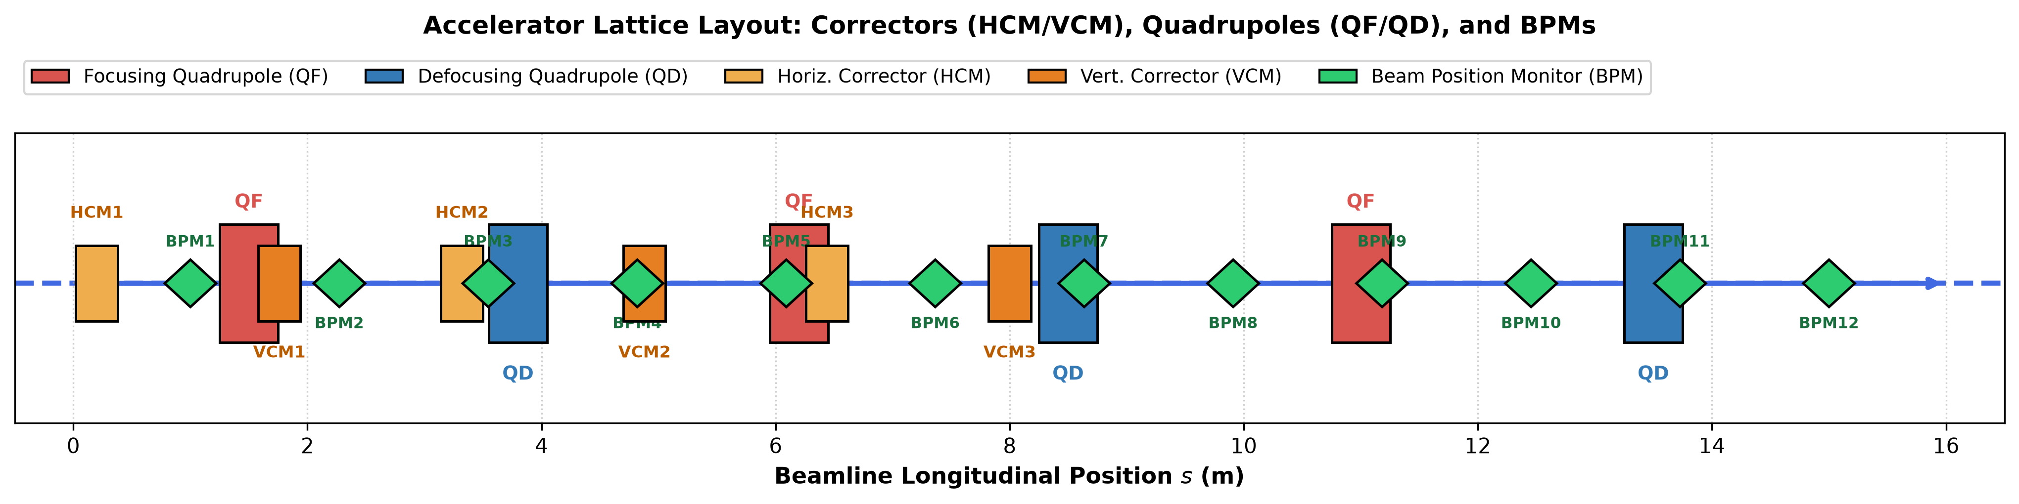
HACKATHON BENCHMARK | The 15-Meter Transport Lattice Architecture
Layout of quadrupole doublets, dipole steering magnets, and beam position monitors
Diagnostics & Actuators
Hardware Constraints
• 12 Diagnostic BPMs: Evenly spaced from s = 1.0 m to s = 15.0 m
• 6 Dipole Steering Magnets: 3 Horizontal (HCM1-3) & 3 Vertical (VCM1-3)
• Quadrupole Doublets: Alternating QF & QD magnets shaping transverse beta
• Cumulative Current Bounds: I ∈ [-5.0 A, +5.0 A] (Power supply thermal limit)
• Single-Step Delta Bounds: ΔI ∈ [-0.8 A, +0.8 A] (Rate of change limit)
• Sensor Noise Floor: Gaussian jitter ε ~ 𝒩(0, 0.010² mm) (10 μm RMS)
November 3, 2026
Chong Shik Park, Ph.D. | Korea University, Sejong | AI Applications in Accelerators
6

Slide 7
PHYSICAL REALISM | Non-Linear Magnetic Saturation & Misalignments
Modeling realistic iron-core saturation and random quadrupole alignment errors
Mathematical Response Formulation
Initial Distortion & Noise Profiles
Physical Beam Position Monitor Reading Y:
Y = I · R - 0.015 · (I³ · R) + Y₀ + ε
Components Breakdown:
1. I · R: Pure linear betatron response
2. -0.015 · (I³ · R): Non-linear iron core soft saturation
- At I = 2.0 A: 6% drop in effective steerer authority
- At I = 4.0 A: 24% authority loss (linear model severely overshoots)
3. Y₀: Initial orbit distortion from misaligned quadrupoles
4. ε ~ 𝒩(0, 0.010² mm): BPM Gaussian sensor noise (10 μm)
Initial Distortion Generation (Y₀):
Quadrupole misalignments induce harmonic betatron waves:
Y₀,k = A₁ sin(2π s_k / λ₁ + φ₁) + A₂ cos(2π s_k / λ₂ + φ₂)
• Produces realistic initial RMS orbit errors between 0.40 mm and 1.10 mm across seeds.
The Benchmark Convergence Target:
Target RMS: < 0.030 mm (30 μm)
To achieve success, policies must reduce initial orbit distortion by 93% to 97% within a strict budget of 20 control steps.
November 3, 2026
Chong Shik Park, Ph.D. | Korea University, Sejong | AI Applications in Accelerators
7

Slide 8
ML CORE THEORY | Deep Neural Networks & Supervised Learning Foundations
Architectural principles of artificial neurons, non-linear activations, and loss optimization
Anatomy of an Artificial Neural Network
Loss Formulation & Adam Optimizer
Artificial Neuron Transformation:
z = ∑ w_j x_j + b = wᵀ x + b
a = σ(z)
Multi-Layer Perceptron (MLP):
Chaining L affine transformations with element-wise non-linear activations:
h⁽ˡ⁾ = σ(W⁽ˡ⁾ h⁽ˡ⁻¹⁾ + b⁽ˡ⁾)
Activation Function: Rectified Linear Unit (ReLU)
σ(z) = max(0, z)
• Constant gradient = 1 for z > 0 (prevents vanishing gradients)
• Computationally efficient; introduces piecewise linearity
Objective Function (Mean Squared Error + L2 Penalty):
ℒ(θ) = (1/N) ∑ ||y_true - f_θ(I)||² + λ ||θ||²
Adam (Adaptive Moment Estimation):
• Tracks exponentially decaying first moment m_t (mean gradient) and second moment v_t (uncentered variance):
m_t = β₁ m_{t-1} + (1 - β₁) g_t
v_t = β₂ v_{t-1} + (1 - β₂) g_t²
• Parameter update:
θ_{t+1} = θ_t - [η / (√(v̂_t) + ε)] · m̂_t
• Enables robust convergence without manual per-parameter learning rate tuning.
November 3, 2026
Chong Shik Park, Ph.D. | Korea University, Sejong | AI Applications in Accelerators
8

Slide 9
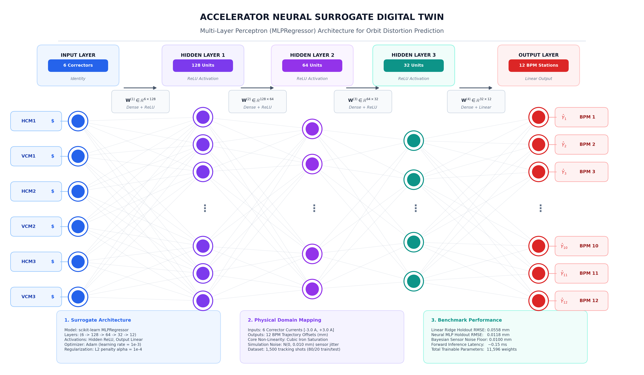
SURROGATE MODELING | Designing the Neural Surrogate Digital Twin
Capturing non-linear cubic saturation with MLPRegressor for sub-millisecond execution
Surrogate Architecture & Training
Dataset Generation:
• 2,000 synthetic tracking runs sampling steerer currents uniformly across I ∈ [-3.0, 3.0]⁶ A.
• Captures both linear coupling and cubic core saturation.
MLPRegressor Hyperparameters:
• Input: 6 Corrector currents [HCM1-3, VCM1-3]
• Hidden Layers: (128, 64, 32) neurons
• Activation: ReLU; Solver: Adam
• Regularization: α_L2 = 10⁻⁴, max_iter = 500
• Output: 12 predicted BPM readings [BPM1-12]
Performance Verification:
• Holdout Test MSE: < 2.5 × 10⁻⁴ mm²
• Inference Execution Latency: < 0.2 ms per call
November 3, 2026
Chong Shik Park, Ph.D. | Korea University, Sejong | AI Applications in Accelerators
9

Slide 10
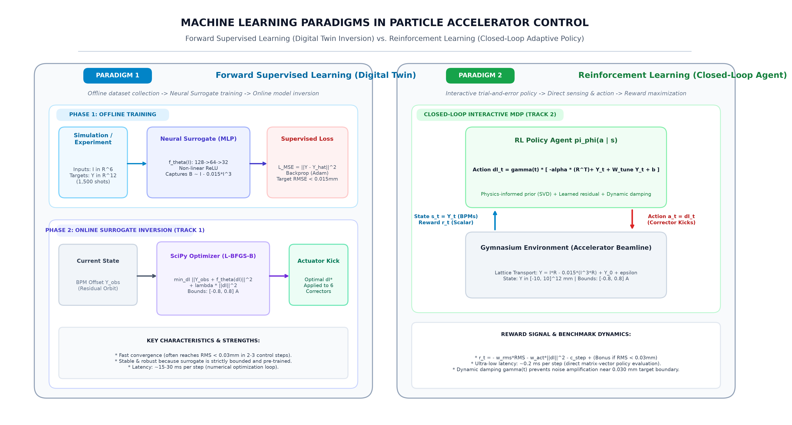
CLOSED-LOOP CONTROL | Forward Prediction vs Closed-Loop Orbit Control
Transitioning from predictive surrogate twins to continuous closed-loop feedback policies
Closed-Loop Control Dynamics
The Closed-Loop Feedback Cycle:
1. Beam Position Monitors measure current transverse displacement Y_t ∈ ℝ¹².
2. Orbit Controller computes corrective kick vector ΔI_t ∈ [-0.8, 0.8]⁶ A.
3. Power supplies update cumulative magnet currents:
I_{t+1} = clip(I_t + ΔI_t, -5.0, 5.0) A
4. Updated magnetic fields deflect beam; new orbit Y_{t+1} is established.
5. Terminate when RMS < 0.030 mm or step count reaches 20.
November 3, 2026
Chong Shik Park, Ph.D. | Korea University, Sejong | AI Applications in Accelerators
10

Slide 11
BENCHMARK BASELINES | Baseline 0 (Linear SVD) vs Baseline 1 (Neural Inversion)
Comparing classical pseudo-inverse control with model-based bounded optimization
Baseline 0: Classical Linear SVD
Baseline 1: Supervised Neural Inversion
Mathematical Form:
ΔI = - α · (Rᵀ)⁺ · Y
Characteristics:
• Gain: α ≈ 0.45, hard clipped to [-0.8, 0.8] A
• Latency: < 0.1 ms (instantaneous)
Strengths & Weaknesses:
✓ Mathematically exact in purely linear regimes
✗ Completely blind to cubic core saturation
✗ High current demands cause magnetic saturation
✗ Sluggish convergence (Mean steps: 5.6)
Official Score: 1,013.1 points (Rank #3)
Mathematical Optimization:
min_{ΔI} ||Y_obs + f_θ(ΔI)||² + λ ||ΔI||²
subject to ΔI ∈ [-5.0, 5.0]⁶
Characteristics:
• Solver: SciPy L-BFGS-B on trained MLP twin
• Latency: ~15 - 25 ms per step
Why It Outperforms Classical SVD:
✓ Accurately anticipates non-linear core saturation
✓ Computes optimal kicks in non-linear regimes
✓ Reaches convergence in just 2.3 steps average
Official Score: 1,016.8 points (Rank #2)
November 3, 2026
Chong Shik Park, Ph.D. | Korea University, Sejong | AI Applications in Accelerators
11

Slide 12
TRACK 2 CHALLENGE | Closed-Loop RL with Physics-Informed Priors
Continuous policy networks combining analytical optics priors with dynamic step damping
Physics-Informed Residual Architecture
Dynamic Harmonic Step Damping
Residual Policy Formulation:
ΔI(t) = γ(t) · [ - α (Rᵀ)⁺ Y + W_learned Y + b ]
Two Core Components:
1. Analytical Physics Prior (- α (Rᵀ)⁺ Y):
- Guarantees immediate coarse stabilization.
- Prevents unguided random exploratory actions.
2. Learned Residual Offset (W_learned Y + b):
- Compensates for non-linear saturation deficit.
- Learns asymmetric corrections across HCM/VCM.
The Sensor Noise Amplification Problem:
Near the 0.030 mm target boundary, sensor noise ε ~ 10 μm creates spurious apparent gradients, causing limit cycles.
Harmonic Damping Schedule:
γ(t) = 1.0 / (1.0 + κ · t), κ ≈ 0.03
• Step 1 (t = 0, γ = 1.0): Full kick authority rapidly eliminates millimeter-scale orbit error.
• Step 5+ (t ≥ 4, γ < 0.88): Attenuated feedback prevents sensor noise amplification and locks RMS below 0.030 mm.
November 3, 2026
Chong Shik Park, Ph.D. | Korea University, Sejong | AI Applications in Accelerators
12

Slide 13
TRACK 3 CHALLENGE | Closed-Loop Bayesian Optimization with Gaussian Processes
Sample-efficient probabilistic modeling with Lower Confidence Bound (LCB) acquisition
Probabilistic Gaussian Process Modeling
Lower Confidence Bound (LCB) Acquisition
GP Mapping: ΔI ↦ Transverse Orbit Deviation Y:
Ŷ(ΔI) ~ 𝒢𝒫( m(ΔI), K(ΔI, ΔI') )
Composite Kernel Architecture:
k(x, x') = k_Matérn-5/2(x, x') + σ_noise² δ(x, x')
• Matérn-5/2 Kernel: Captures smooth, non-linear iron core saturation dynamics without unrealistic infinite differentiability.
• White Noise Kernel: Explicitly models the 10 μm BPM diagnostic jitter floor.
LCB Acquisition Function:
α_LCB(ΔI) = RMS( Y_obs + μ_GP(ΔI) ) - κ · σ̄_GP(ΔI) + λ ||ΔI||²
Exploration vs Exploitation Trade-off:
• μ_GP(ΔI): Posterior mean predicted orbit
• σ̄_GP(ΔI): Posterior epistemic uncertainty across BPMs
• κ ≥ 0: Exploration coefficient
Benchmark Outcome:
When calibrated, Track 3 achieves optimal convergence in just 1.5 steps average, with highest current economy.
November 3, 2026
Chong Shik Park, Ph.D. | Korea University, Sejong | AI Applications in Accelerators
13

Slide 14
COMPETITION RULES | Gymnasium Contract & Official Scoring Formula
Standardized Farama Gymnasium environment interface and multi-objective performance metric
Gymnasium Contract (AcceleratorOrbitGymEnv)
Official Hackathon Scoring Formula
Environment Interface:
obs, info = env.reset(seed=s)
obs, reward, terminated, truncated, info = env.step(action)
• obs: np.ndarray shape (12,) in [-10, 10] mm
• action: np.ndarray shape (6,) clipped to [-0.8, 0.8] A
• Step reward:
r_t = - RMS_{t+1} - 0.01 ||action||₂ + (50.0 if success)
• Termination: RMS < 0.030 mm (success!)
• Truncation: step >= 20 (failed to converge)
Score Formula (Across 30 Standardized Seeds):
Score = (Success% × 10.0) - (2.0 × Mean_Steps)
+ [0.03 / max(Mean_RMS, 0.005)] × 20.0
- (2.0 × Mean_||I||)
Four Scoring Components:
1. Success Rate: Up to +1,000 pts (100% convergence)
2. Speed Penalty: -2 pts per step taken
3. Sub-Micron Precision Bonus: Up to +120 pts for ultra-low residual RMS
4. Current Economy Penalty: -2 pts per Ampere of cumulative current norm
November 3, 2026
Chong Shik Park, Ph.D. | Korea University, Sejong | AI Applications in Accelerators
14

Slide 15
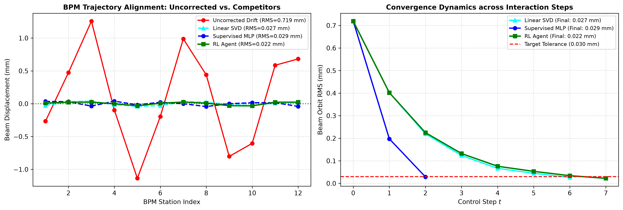
EVALUATION RESULTS | 30-Seed Benchmark Leaderboard & Trajectories
Comparison of Classical SVD, Supervised MLP, Closed-Loop RL, and Bayesian Optimization
Official Benchmark Leaderboard
🥇 Rank #1: Bayesian Opt (Track 3)
• Success: 100.0% | Steps: 1.5 steps
• Final RMS: 0.0149 mm | Current Norm: 0.93 A
• Challenge Score: 1,035.4 pts
🥈 Rank #2: Supervised MLP (Baseline 1)
• Success: 100.0% | Steps: 2.3 steps
• Final RMS: 0.0257 mm | Current Norm: 1.21 A
• Challenge Score: 1,016.8 pts
🥉 Rank #3: Classical SVD (Baseline 0)
• Success: 100.0% | Steps: 5.6 steps
• Final RMS: 0.0230 mm | Current Norm: 1.16 A
• Challenge Score: 1,013.1 pts
4️⃣ Rank #4: Closed-Loop RL (Track 2)
• Success: 100.0% | Steps: 6.1 steps
• Final RMS: 0.0239 mm | Current Norm: 1.18 A
• Challenge Score: 1,011.1 pts
November 3, 2026
Chong Shik Park, Ph.D. | Korea University, Sejong | AI Applications in Accelerators
15

Slide 16
CONCLUSION & ROADMAP | Key Takeaways, Practical Advice & Next Steps
Strategic advice for afternoon hackathon competitors and transition to Lecture 2
Key Takeaways from Lecture 1
Practical Hackathon Advice & Next Session
1. Physics Guides the AI:
Never train from scratch when the analytical ORM is known. Using pseudo-inverse priors guarantees early stability.
2. Surrogates Capture Non-Linearities:
When iron yokes saturate, compact MLPs accurately represent cubic falloff and enable 2-step bounded inversions.
3. Probabilistic Uncertainty Wins:
Gaussian Process BO balances exploration against exploitation, leading the 30-seed leaderboard in 1.5 steps.
4. Adaptive Damping Locks Stability:
Attenuating feedback near the 10 μm noise floor prevents sensor-induced limit cycles.
Practical Competitor Advice:
• If your policy oscillates: Check feedback gain α. Introduce harmonic damping γ(t) = 1 / (1 + 0.03t).
• If surrogate error is high: Ensure training data covers [-3.0, 3.0] A with cubic non-linearities.
• Log Telemetry to W&B: Compare your run curves against the official benchmark on the live leaderboard.
Next Session (10:40 - 12:00):
Lecture 2: Agentic AI for Accelerator Research (Osprey Applications)
Speaker: Thorsten Hellert, Ph.D. (LBNL)
November 3, 2026
Chong Shik Park, Ph.D. | Korea University, Sejong | AI Applications in Accelerators
16

